Slide 1
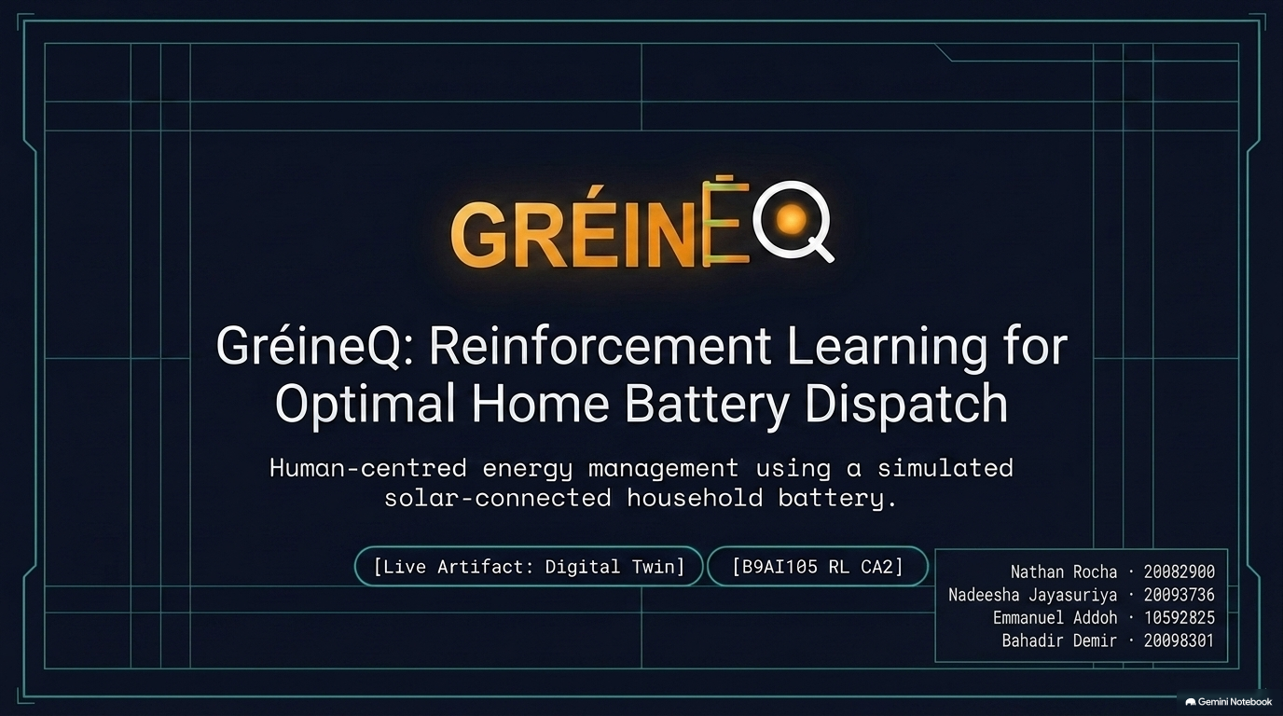
Notes:
Speaker: Emmanuel Time: 35 seconds
Good morning. We are presenting GréineQ, our Reinforcement Learning system for home battery dispatch.
The project investigates how an intelligent controller can manage a household battery connected to solar panels and the electricity grid.
We developed both the Reinforcement Learning environment and an interactive Digital Twin. During this presentation, we will explain our experimental design, report our evaluation results and demonstrate the working system.
Our team members are Emmanuel, Nathan, Nadeesha and Bahadir.
Handover:
I will begin by introducing the battery-management problem.

Slide 2
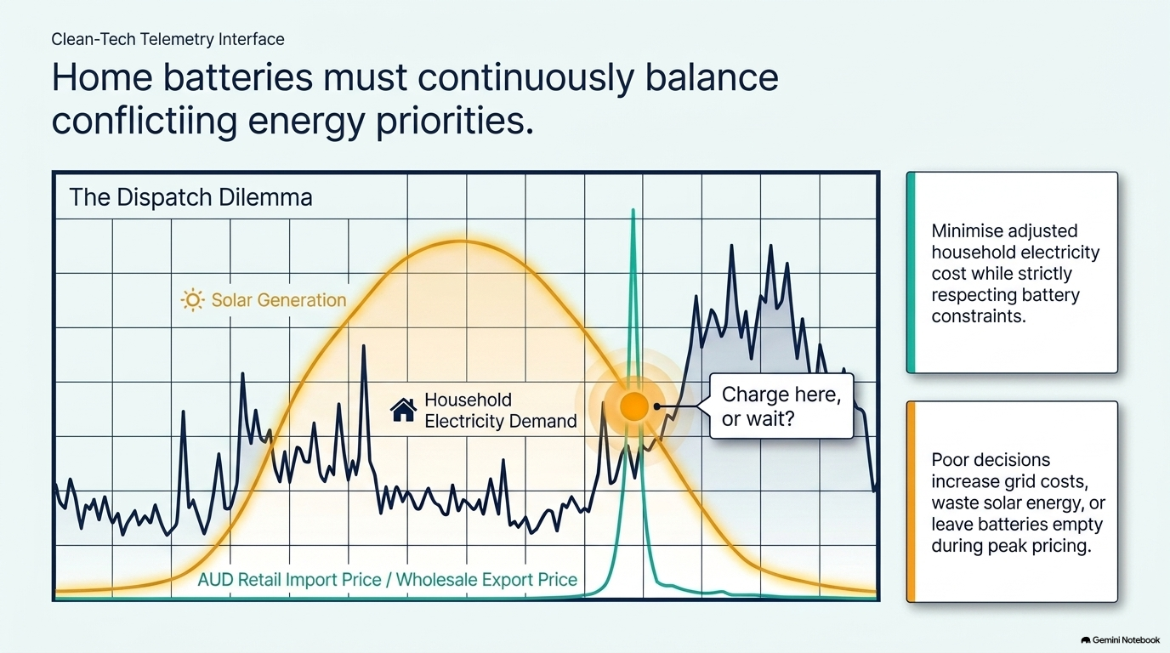
Notes:
Speaker: Emmanuel Time: 1 minute 10 seconds
A solar-connected household must continuously decide what to do with available electricity.
Solar energy can be used immediately, stored in the battery or exported to the grid. When solar generation is insufficient, the household can import electricity or discharge the battery.
These decisions are affected by changing household demand, solar generation, electricity prices and the battery’s current state of charge.
A poor decision can increase electricity cost. For example, exporting energy at a low price may be less valuable than storing it to avoid an expensive grid import later.
Our objective was therefore to minimise adjusted household electricity cost while respecting the battery’s physical operating constraints.
Reinforcement Learning is suitable for this sequential problem because every action changes both the immediate cost and the battery energy available for future timesteps.
Handover:
Nathan will now explain how we represented this problem as a Reinforcement Learning environment.

Slide 3
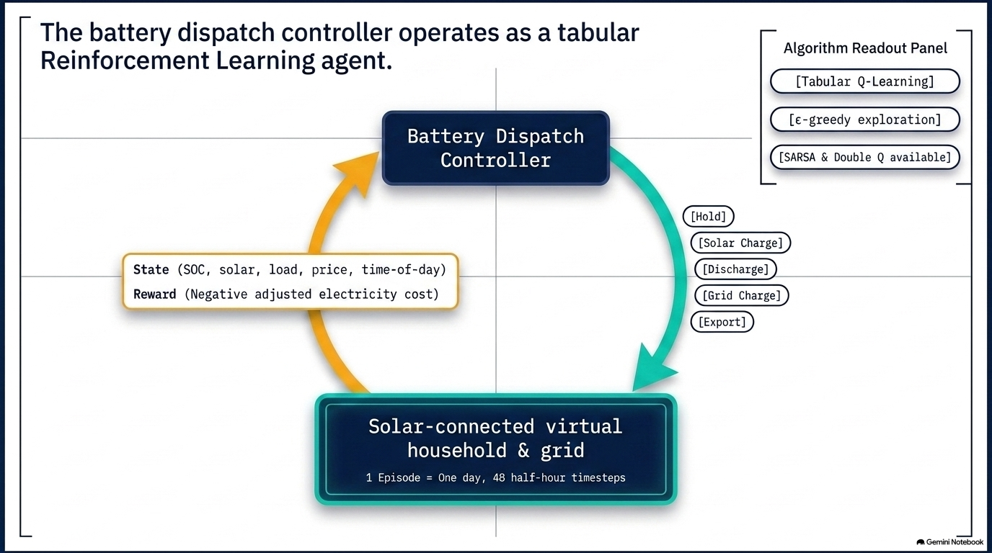
Notes:
Speaker: Nathan Time: 1 minute 15 seconds
In our system, the battery dispatch controller is the Reinforcement Learning agent.
The environment represents a solar-connected virtual household and the electricity grid. One episode represents one day, divided into 48 half-hour timesteps.
The state includes battery state of charge, solar generation, household demand, electricity price and time of day.
The controller can choose from five actions: hold, charge from solar, discharge, charge from the grid or export stored electricity.
The reward is based on negative adjusted electricity cost. It accounts for electricity purchases and export revenue, together with battery cycling cost and terminal state-of-charge value.
Our main algorithm is tabular Q-Learning. It estimates the expected long-term value of performing each action in each state.
During training, epsilon-greedy exploration allows the controller to test alternative actions. During evaluation, exploration is disabled and the highest-value valid action is selected.
SARSA and Double Q-Learning are also implemented for comparison, but the headline results focus on the Q-Learning controllers.

Slide 4
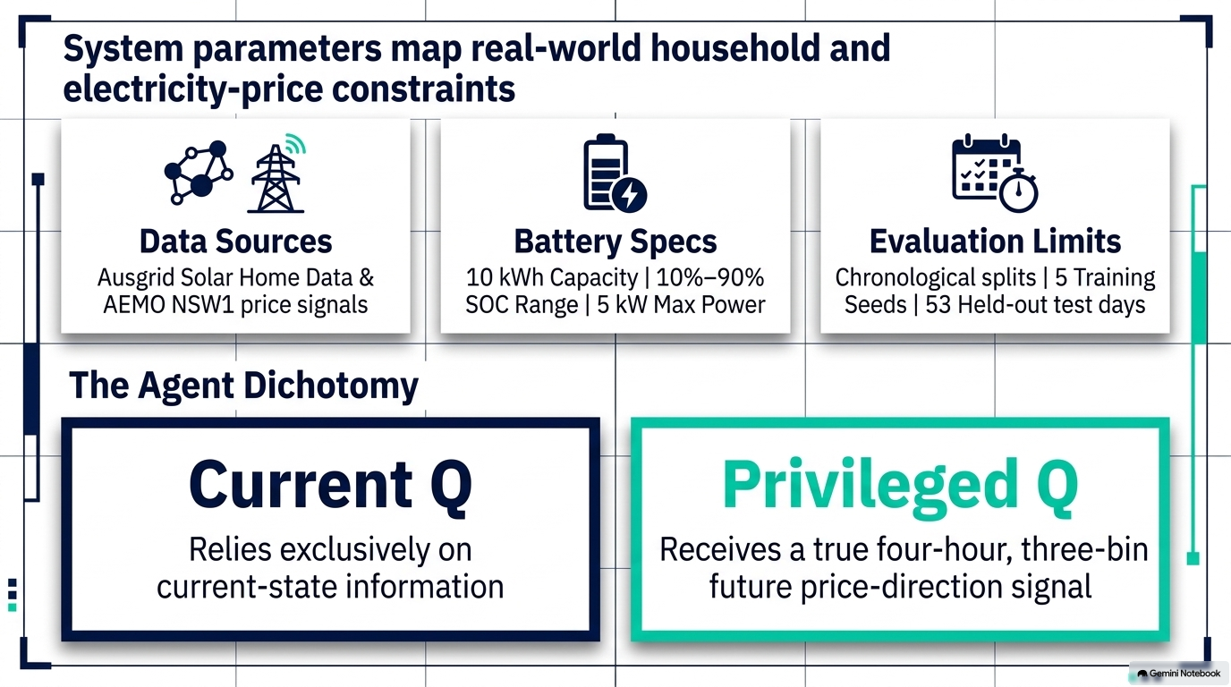
Notes:
Speaker: Nathan Time: 1 minute 15 seconds
We combined household demand and solar-generation data from the Ausgrid Solar Home Electricity dataset with NSW1 electricity-price data from AEMO.
The simulated battery has a capacity of 10 kilowatt-hours. Its state of charge is constrained between 10 and 90 per cent, and its maximum charging or discharging power is 5 kilowatts.
We used chronological training, validation and held-out test splits to prevent future observations from leaking into training. Final evaluation used 53 held-out days and five training seeds.
We compared two Q-Learning information setups.
Current Q uses current-state information only. Privileged Q additionally receives the true price direction over the following four hours, represented by three categories.
This privileged signal was used only in the controlled experiment. The realistic forecast shown later in Agent Play is an interface feature and was not used to calculate the headline experimental results.
Handover:
Nadeesha will present the results produced by this evaluation.

Slide 5
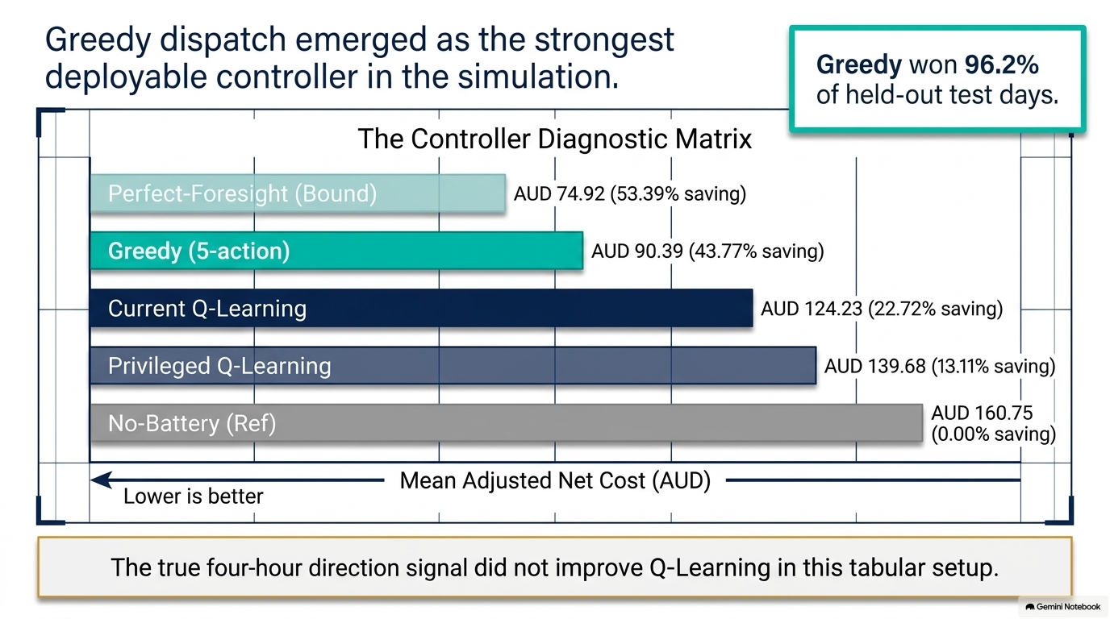
Notes:
Lower adjusted net cost is better.
The main result is that Greedy was the strongest deployable controller, achieving a cost of 90.39 Australian dollars, compared with 160.75 dollars for no battery.
Current Q reached 124.23 dollars, while Privileged Q performed worse at 139.68 dollars.
So, under this setup, the additional coarse foresight information did not improve the RL policy.

Slide 6
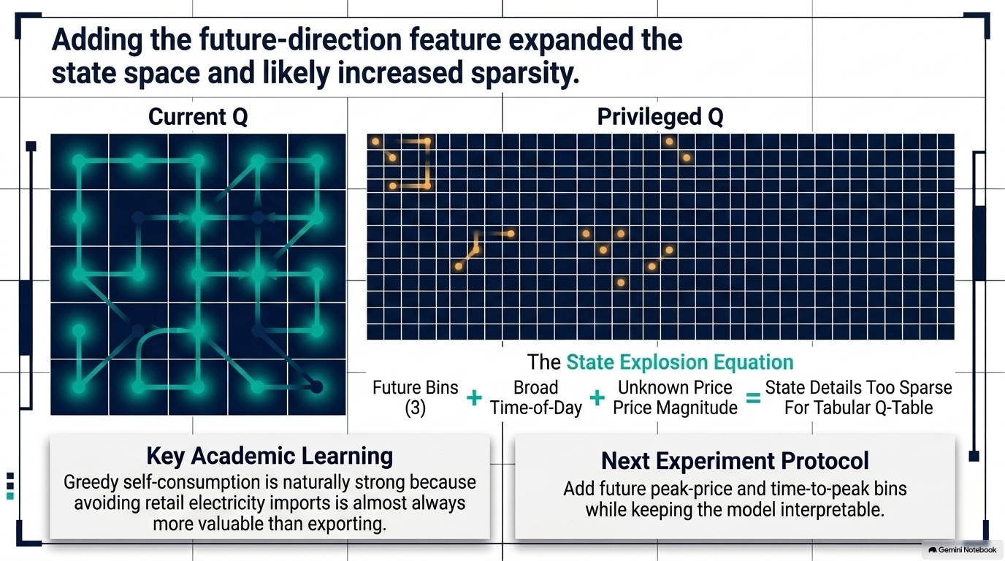
Notes:
These results were evaluated across 53 held-out days and five training seeds, rather than only the single Digital Twin example.
I’ll now show the aggregate evidence and experimental setup directly in the Results page.

Slide 7
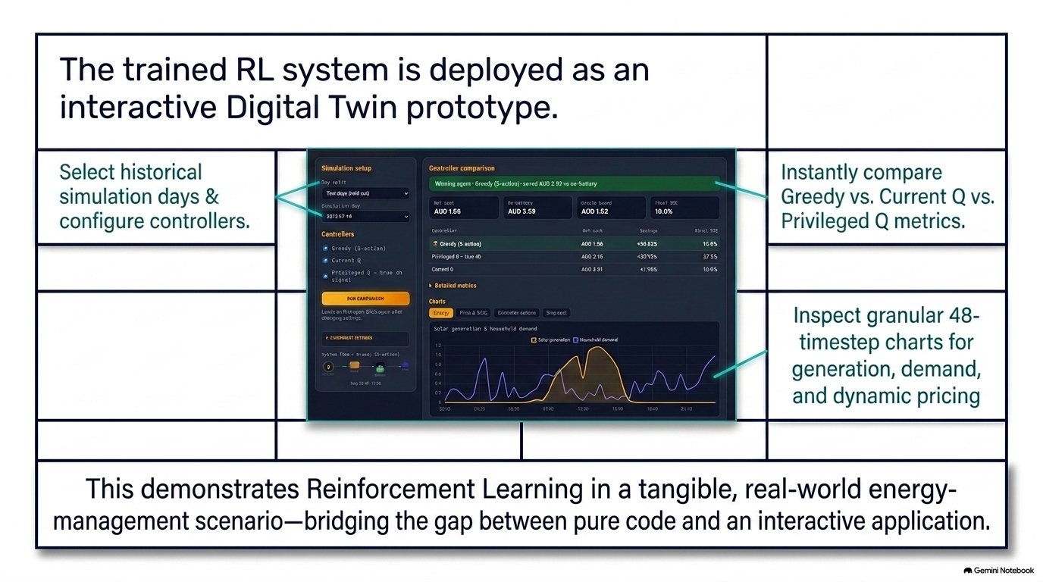
Notes:
Speaker: Bahadir Time on slide: 35 seconds
We deployed the controllers through an interactive Digital Twin prototype.
Users can select a historical test day, compare multiple controllers and inspect costs, energy flows, actions and battery state of charge.
This moves the project beyond theory and code by making the controller’s behaviour visible at both daily and individual-timestep levels.
We will now switch to the application and demonstrate these features.
Live demonstration: Digital Twin setup
Operator: Nathan Speaker: Emmanuel Time: 50 seconds
Nathan’s actions:
Switch to the Digital Twin.
Select the verified held-out test day.
Select Greedy, Current Q and Privileged Q.
Click Run comparison.
Emmanuel says:
This is the GréineQ Digital Twin. It replays a historical household day using demand, solar-generation and electricity-price observations.
We have selected a day from the held-out test period and three controllers: Greedy, Current Q and Privileged Q.
All three operate with the same initial battery state, tariff, battery capacity and physical constraints. Therefore, differences in their outcomes result from their dispatch decisions rather than different simulation conditions.
Live demonstration: energy and controller behaviour
Operator and speaker: Nathan Time: 1 minute
Actions:
Show the summary cards.
Open the energy and state-of-charge chart.
Select one informative timestep.
Open the timestep details.
Nathan says:
The summary cards show each controller’s adjusted net cost, savings and final battery state for this selected day.
This chart combines household demand, solar generation and battery state of charge across the 48 half-hour timesteps.
At an individual timestep, we can inspect the controller’s action, state of charge before and after the action and the resulting step cost.
For example, at this point, the controller selected [name the visible action]. Its state of charge changed from [visible value] to [visible value], producing a step cost of [visible value].
The interface also makes it possible to identify whether a controller is charging during solar surplus, discharging to meet demand or exporting energy.
Live demonstration: aggregate results
Operator and speaker: Nadeesha Time: 1 minute 10 seconds
Actions:
Briefly indicate the selected-day comparison.
Open Experiment Results.
Show the controller cost chart and detailed results.
Nadeesha says:
The Digital Twin view illustrates controller behaviour on one selected day. However, one day is not sufficient to evaluate overall performance.
This Experiment Results page shows the aggregate evaluation across 53 held-out test days and five training seeds.
The values correspond to those presented on Slide 5. Greedy produced the strongest deployable result at 90.39 Australian dollars. Current Q produced 124.23 dollars, while Privileged Q produced 139.68 dollars.
The perfect-foresight result is shown as an ideal benchmark, and the no-battery result provides the comparison baseline.
Separating the selected-day simulation from the aggregate evaluation prevents us from drawing a general conclusion from one favourable or unfavourable day.
Transition:
Return to the presentation and move to Slide 8.

Slide 8
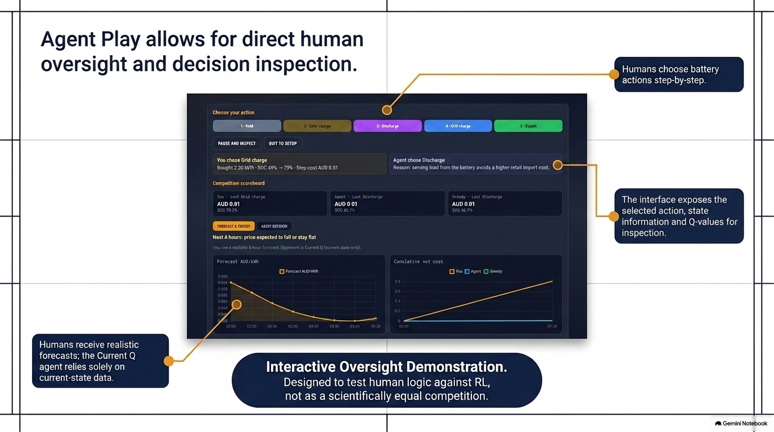
Notes:
Speaker: Bahadir Time: 1 minute 10 seconds
A battery controller must be safe, inspectable and transparent about its limitations.
Within the simulation, state-of-charge and power constraints prevent invalid battery actions. The interface exposes the controller’s selected actions, observed states, costs and Q-values for inspection.
Greedy also provides a simple and understandable fallback if a learned policy behaves unexpectedly.
However, this is a software Digital Twin and not a physical battery controller. It should not be presented as ready for autonomous household deployment.
A real system using smart-meter data would require informed consent, secure storage, access control and privacy protection.
There are also fairness and accessibility concerns. Households do not have equal access to solar panels, batteries or flexible electricity tariffs.
Finally, the study uses data from one Ausgrid household and NSW1 price information. Consequently, the results should not be generalised to every household, tariff or electricity market without further evaluation.

Slide 9
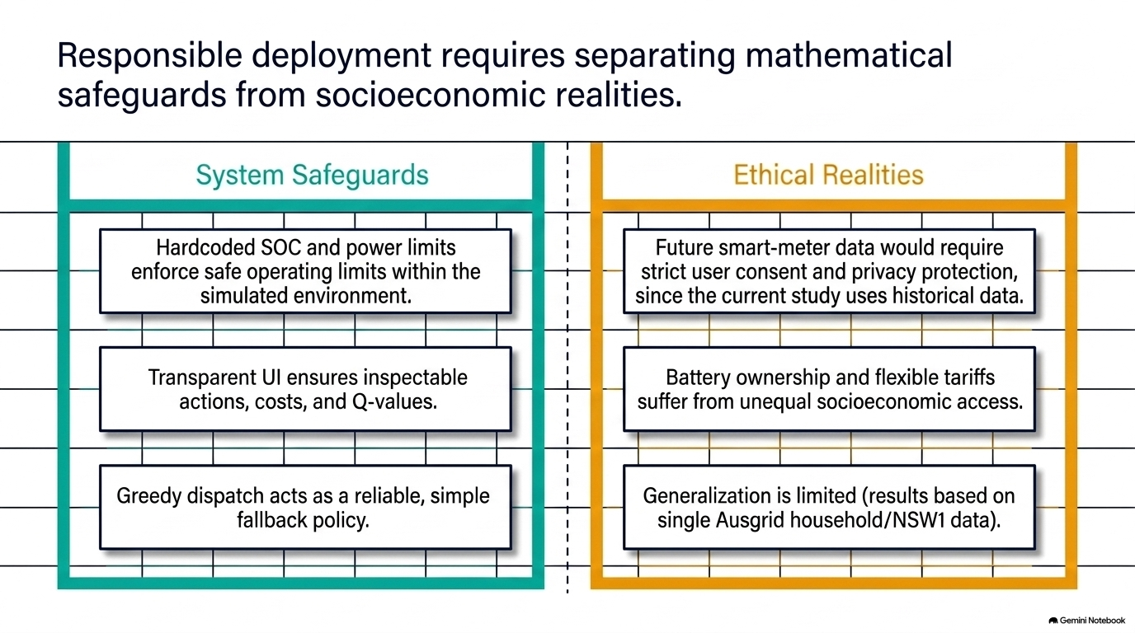
Notes:
Speaker: Bahadir Time on slide: 30 seconds
Agent Play allows a user to make battery decisions and compare them with Current Q and Greedy.
The user can inspect the current battery state, energy demand, solar generation, prices and a realistic short-term forecast before choosing an action.
We will demonstrate one decision to show how the interface supports human oversight.
Live demonstration: Agent Play
Operator and speaker: Bahadir Time: 1 minute 20 seconds
Actions:
Switch to Play vs Agent.
Confirm that Current Q is the selected opponent.
Show the current state, forecast and available actions.
Choose one sensible action.
Show the updated SOC, step cost and scoreboard.
Briefly show the Current Q action and Q-value information.
Bahadir says:
At this timestep, the interface shows the current state of charge, household demand, solar generation and import and export prices.
The human also receives a realistic short-term price forecast. Current Q, however, observes current-state information only. Therefore, this is an interactive oversight demonstration rather than a scientifically equal competition.
At this step, I will choose [action] because [brief reason using the visible SOC, solar, demand and price].
After the action, we can see its effect on the battery state and step cost. The scoreboard compares the cumulative performance of the human, Current Q and Greedy.
The interface also exposes Current Q’s selected action and Q-values. These values provide inspectable decision evidence, but they should not be described as human-like reasoning.
Together, Digital Twin, Experiment Results and Agent Play demonstrate historical simulation, aggregate evaluation and human inspection of individual decisions.
Transition:
Return to Slide 10.

Slide 10
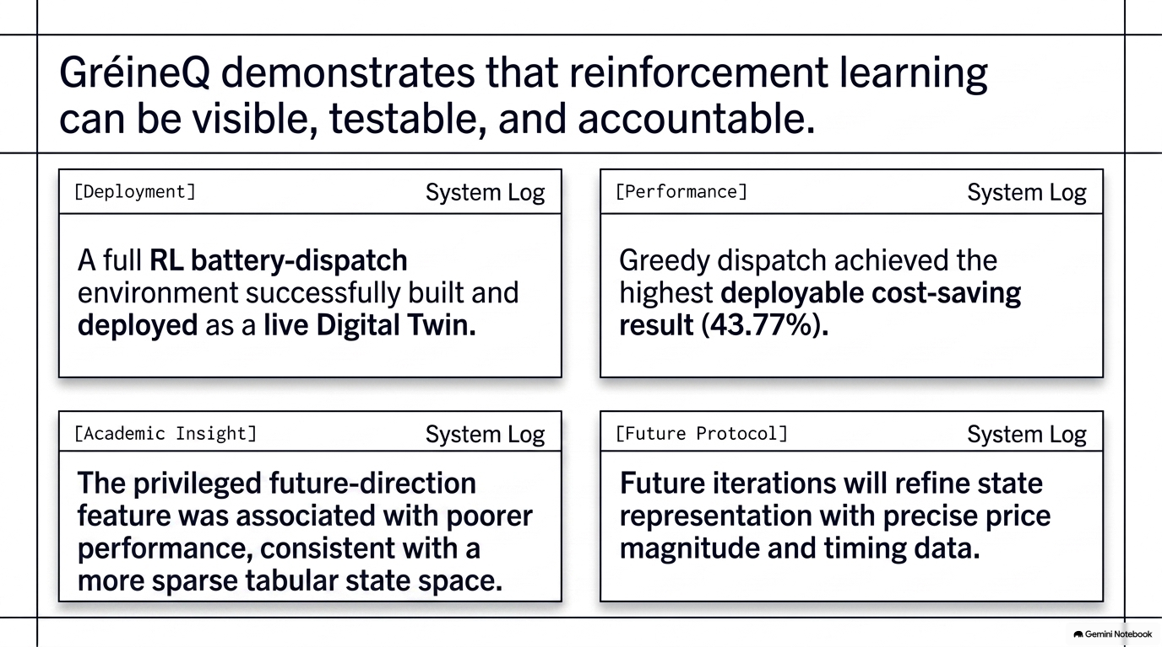
Notes:
Speaker: Emmanuel Time: 55 seconds
To conclude, GréineQ demonstrates a complete Reinforcement Learning workflow for home battery dispatch.
We designed the environment, trained and evaluated multiple controllers and deployed the results through an interactive Digital Twin.
Greedy achieved the strongest deployable result in our experiment, saving 43.77 per cent against the no-battery reference.
The privileged future-direction feature was associated with poorer Q-Learning performance, consistent with a more sparse tabular state space and an information signal that lacked price magnitude and timing.
The interface makes controller actions, battery behaviour, costs and Q-values available for inspection. However, it remains an experimental software prototype rather than a production battery controller.
Future work will improve the state representation, evaluate additional households and tariffs and investigate methods that generalise better than a tabular Q-table.
Thank you.

