Slide 1
B9AI105 · REINFORCEMENT LEARNING · CA1 DEFENCE
GréineGrid Qagent
Tabular reinforcement learning for home battery dispatch
on a solar-connected microgrid
[Member 1 Name] · [Member 2 Name] · [Member 3 Name]
Dublin Business School · MSc Artificial Intelligence
Live demo greineq-agent.sudocod.com
Notes:
SPEAKER: Member 1 | 0:15 | Say: "We're GreineQ - reinforcement learning for home battery dispatch on a solar microgrid. We built tabular Q-Learning and SARSA from scratch in NumPy, on real Ausgrid and AEMO data. Live demo at greineq-agent.sudocod.com." Don't read the subtitle. Handoff: none yet - go straight to slide 2.

Slide 2
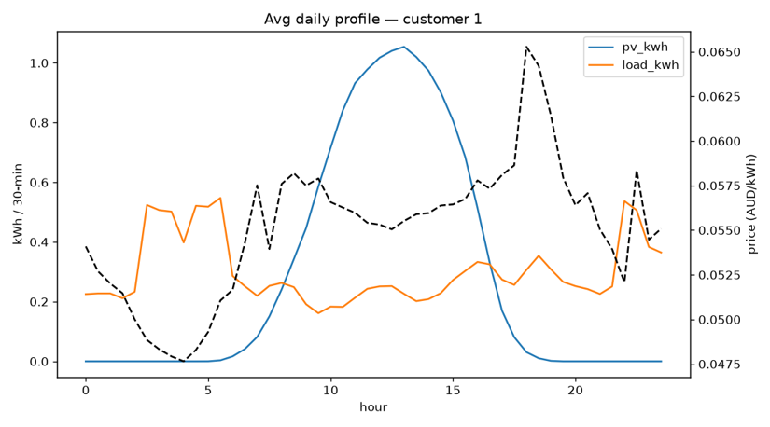
Solar peaks at noon. Demand peaks at night.
Without storage, surplus midday solar is exported at a low feed-in rate while the evening peak is bought at retail prices.
A home battery can shift energy in time — but every 30 minutes it must decide: hold, charge, or discharge.
48 decisions per day. No labelled “correct” action exists.
Avg daily profile — Ausgrid Customer 1 (load, PV, NSW1 price)
Real data: Ausgrid half-hourly household load + rooftop PV (2012–13) · AEMO NSW1 wholesale spot prices, merged per 30-min interval
GréineGrid Qagent · B9AI105 CA1
2
Notes:
SPEAKER: Member 1 | 0:35 | Say: "Solar peaks at midday; demand peaks morning and evening - point at the chart. Without a battery, surplus is exported cheap and the evening is bought dear. The controller decides every 30 minutes: hold, charge, or discharge - 48 steps a day. It's sequential decision-making, not prediction: today's action changes tomorrow's battery state." Q&A you own: why not price forecasting -> one action affects future SOC, not a one-shot problem.

Slide 3
Method, in three numbers
324
2
4
discretised states
agents from scratch
baselines
SOC × PV × load × price × time-of-day (tertile bins, fitted on train only)
Q-Learning (off-policy) & SARSA (on-policy) — NumPy only, no RL libraries
no-battery floor · tertile rule · greedy self-consumption · perfect-foresight oracle
MDP: 48-step daily episodes · 3 actions (hold / charge from surplus / discharge to deficit) · 10 kWh, 5 kW battery · γ = 0.95 · 10,000 episodes · greedy test evaluation (ε = 0) on 53 held-out days
GréineGrid Qagent · B9AI105 CA1
3
Notes:
SPEAKER: Member 1 | 0:35 | Say: "We model one day as a 48-step MDP: 324 discretised states - state of charge, solar, load, price, time of day - and three actions. Physics: 10 kWh battery, 5 kW limits, SOC clamped 10-90%. We implemented Q-Learning and SARSA from scratch in NumPy and compare against four baselines, from a no-battery floor to a perfect-foresight oracle." Handoff: "[Member 2] will take reward design and results." Q&A you own: why 324 states, why tabular not deep -> exact table, interpretable, no NN instability at this scale.

Slide 4
Reward design decided what the agent learned
v1 — wholesale proxy
v2 — monetised AUD cost
Penalised spot price only — no retail margin, no feed-in
Agent beat the rule baseline on reward…
…while losing on the actual bill (23.02 vs 18.80 AUD)
r = −(import × retail) − (waste × feed-in) − degradation
Training objective = evaluation metric (household bill)
Reward ranking now matches bill ranking
→
“The training reward diverged from the evaluation metric — the agent could look better on paper while doing worse on the bill.”
GréineGrid Qagent · B9AI105 CA1
4
Notes:
SPEAKER: Member 2 | 0:40 | This is the project's strongest argument - treat it as such. Say: "Our first reward was a wholesale-price proxy. The agent looked good in training and lost on the real bill - reward-metric misalignment. v2 monetises everything in AUD: retail margin on imports, feed-in value of wasted solar, optional degradation. Now reward ranking matches bill ranking - verified in an ablation." Q&A you own: how do you know v2 is right -> reward-redesign ablation, Section 4.5, Table VI.

Slide 5
Total test-split cost, 53 days — lower is better
Q-Learning −32.9% and SARSA −31.0% vs the tertile rule — but both sit 19–22% above greedy self-consumption.
GréineGrid Qagent · B9AI105 CA1
5
Notes:
SPEAKER: Member 2 | 0:40 | Say: "No battery: 160.75 AUD over 53 days. A perfect-foresight oracle: 49.19 - the theoretical floor. Q-Learning 62.02 and SARSA 63.75 beat the tertile rule by 31-33%. But greedy self-consumption reaches 52.15. RL beats the weak rule, not the strong heuristic - and we report that honestly; it's the next slide, not a weakness to hide." Do NOT rush the numbers; point at the bars.

Slide 6
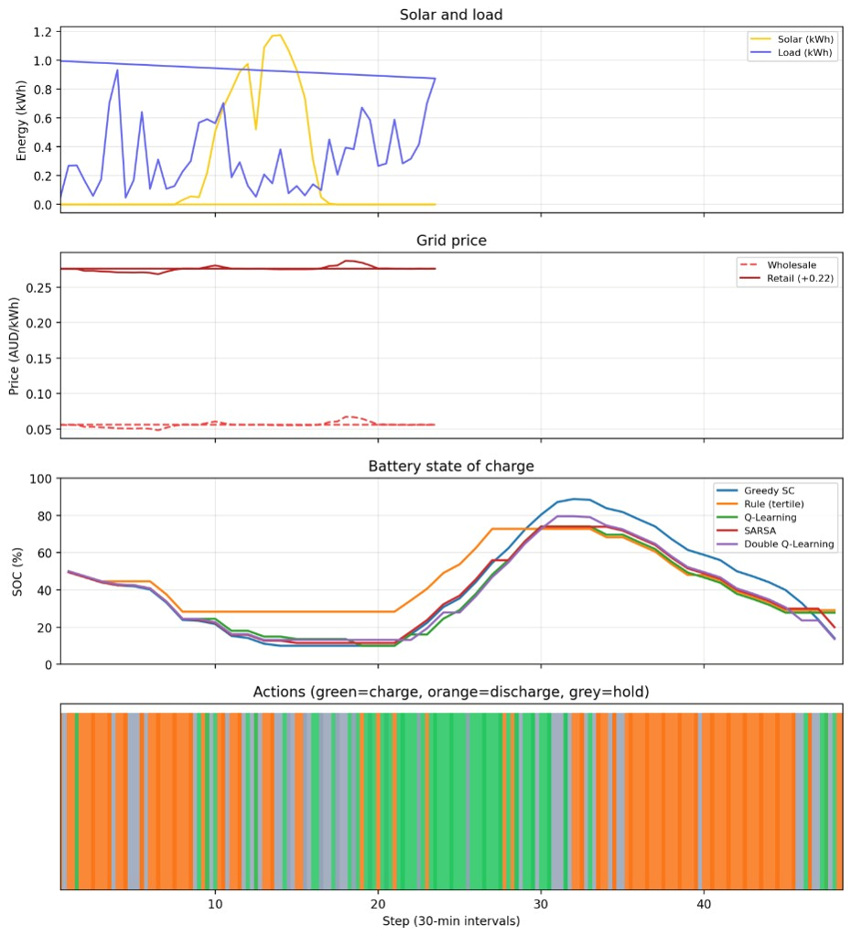
The headline finding
97.4%
of the oracle's achievable saving is already captured by simple greedy self-consumption
Self-consumption rate: 0.76 greedy vs 0.60 rule
Self-sufficiency: 0.80 greedy vs 0.58 rule
Evening peak import: 0.77 vs 1.74 kWh/step
Bottleneck = problem structure + state coarseness, not the TD algorithm
Digital twin — multi-policy replay of one test day
GréineGrid Qagent · B9AI105 CA1
6
Notes:
SPEAKER: Member 3 | 0:35 | Say: "The most important result is not that RL beats every baseline - it's that a simple heuristic already captures 97.4% of what's achievable. With solar-only charging and coarse states, charging every surplus and covering every deficit is near-optimal." Use the dashboard live only if the panel asks. Q&A you own: 'so why use RL?' -> next slide: grid charging, arbitrage, fleet coordination.

Slide 7
What we're not claiming
Known limitations
Where RL earns its place
Single customer; 2012–13 tariffs
Solar-only dispatch — no grid charging or export arbitrage
Time-of-day bins break strict Markov property
5 seeds × 10k: Q-Learning 61.75 ± 2.14 AUD, SARSA 61.62 ± 0.86 AUD (paired t-test p = 0.90)
Correct wiring + a simple controller already delivers most of the benefit here.
RL's value rises with grid charging, price arbitrage, and fleet-level coordination — scoped as CA2 extensions on this same MDP and codebase.
Not because RL failed here — because the problem hasn't needed it yet.
GréineGrid Qagent · B9AI105 CA1
7
Notes:
SPEAKER: Member 3 | 0:35 | Active defence against the hardest question: 'if the heuristic wins, why RL?' All three must be able to say from memory: "RL value increases with grid charging, export tariffs, or fleet-level aggregation - scoped for CA2, not because RL failed here." Multi-seed: Q-Learning 61.75 ± 2.14, SARSA 61.62 ± 0.86, p = 0.90. Also own: the Double Q-Learning terminal-update bug - know how it was found and fixed.

Slide 8
Conclusion
Reward design determines what the agent learns — v1→v2 fixed a real training/evaluation misalignment
Q-Learning & SARSA beat weak rules (−31–33%), not strong heuristics (+19–22% vs greedy SC)
Greedy self-consumption sets a high, realistic ceiling — 97.4% of achievable savings
Next (CA2): grid charging, tariff arbitrage, cross-household transfer
Questions? · greineq-agent.sudocod.com
Notes:
SPEAKER: Member 1 closes (who opened, closes) | 0:25 | Speak to the panel, not the slide. Four takeaways, then: "Questions?" - and stop talking. Let the silence work. Total target: 4:45 with a 15-second buffer before the hard 5:00 cut.

