Slide 1
Lidar Semantic Global Localization (LSGLOC) Demo
Date: 22 April 2026, 1500hrs
By: Adiel Firqin

Slide 2
Problem Statement
Robots currently cannot autonomously determine their initial pose or continuously localise themselves within the 2D map coordinate frame without manual assistance or prior environment mapping.

Slide 3
Problems
Global Localization: No manual initial pose is given to the robot during deployment.
No Prior Mapping: The robot must make use of a CAD floor plan that describes the geometry of the environment.
Long-Term Localization: A robot must continuously localize within an environment to allow waypoint navigation.

Slide 4
Solution
Based on a paper by Nicky Zimmerman (1), it does the following:
Use of CAD floor plans for lidar scan of the environment’s geometry
Uses Monte-Carlo Localization (MCL) Framework to stochastically determine robot’s pose on the map
Uses a motion model that incorporates the omnidirectional odometry
Combines YOLO semantic observation model with a lidar beam observation model to attenuate particles' weights across a map
Uses a “semantic map," which indicates to the robot of where the semantic landmarks are on the map

Slide 5
Difference in Solution
ZImmerman uses room segmentation to optimize particle distribution across the map during initialization. I have removed this step as the current operational environment is corridor, although future plans might include corridor segmentation
Zimmerman uses the YOLO model for the semantic observation model, whereas I use the VLM Llava3 model for the semantic observation model.

Slide 6
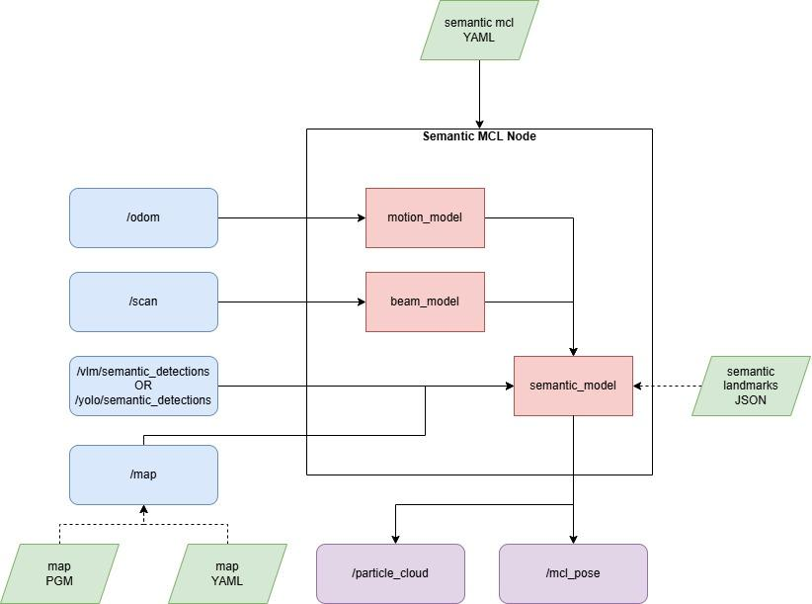
System Architecture

Slide 7
Global Localization Process
Particles are first uniformly distributed across the map with equal weights, i.e., equal likelihood that the robot is everywhere on the map
During initialization, the robot first inputs lidar and semantic observations to get the best pose estimate of where it is at.
As the robot moves, it takes in more lidar and semantic observations to get a better estimate of where it is at. It also takes into account its odometry and samples a new pose for each time step.
The more unique the semantic detections are, the better the candidate pose is at corresponding to the ground truth location.
The particles are resampled everytime a semantic detection occurs or when the weight values of the particles are similar to one another, i.e., uncertainty

Slide 8
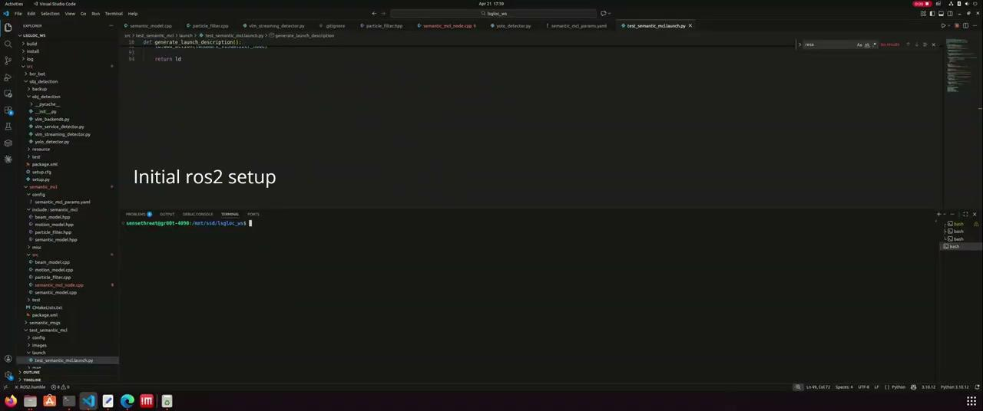
Video Demo of LSGLOC

Slide 9
Limitations & Challenges
Map Format Requirement: The robot must be given a map in PGM (only black and white pixels) and YAML format in order to do Monte Carlo Localization (MCL).
Map Scaling: The lidar distances to nearest obstacles must correctly match in RViz2 or other software description applications.
Semantic Map Requirement: The robot must be given a “semantic map” that lists down the locations of semantic landmarks on the map.

Slide 10
Limitations & Challenges
Global Localization Efficiency: Given an environment with a limited number of semantic landmarks the robot can recognize, the robot will take a longer time to converge to the right location on the map.
VLM Hallucinations: If we use VLM as our primary object detection model, the VLM “might” inaccurately describe objects in the scene.
VLM Latency: If we use VLM as our primary object detection model, the VLM will take time to process the input payload and produce semantic detections.

Slide 11
Limitations & Challenges
Dynamic Object Interaction: Currently, the semantic landmarks are assumed to be statically placed with respect to the semantic landmark file.
Object Instances & Uniqueness: LSGLOC works well when there are many objects in the scene, and they are unique and different from one another.

Slide 12
Future Project Implementation
Global Localization → Pose Tracking: After the robot’s pose has been correctly identified, the robot should be able to maintain a unimodal probability distribution over a long period of time.
Localization Confidence Tracking: The robot should indicate and quantify to the user how well it localizes with respect to the map and sensor observations without manual intervention.
Path-Planning Integration: The robot will be integrated with the Nav2 stack to perform waypoint navigation.

Slide 13
Possible Future Challenges during Deployment
VLM Processing: If the VLM is used as the primary object detection model, it might use a lot of power and computation, thus affecting the rest of the system.
Sim2Real Gap: Since the simulated robot model is different from the ones we have in real life, the odometry will be different and “might” be challenging to the localization. Dynamics has been filtered out of the simulation which affects the localization process even more.

Slide 14
Reference(s)
Zimmerman, N., Guadagnino, T., Chen, X., Behley, J., & Stachniss, C. (2022). Long-Term Localization using Semantic Cues in Floor Plan Maps. ArXiv.org. https://arxiv.org/abs/2210.01456

