Slide 1
Ranger - an AI Quiz game FYP 2025 Nathan McCormack Supervisor – Dr Fergus Downey

Slide 2
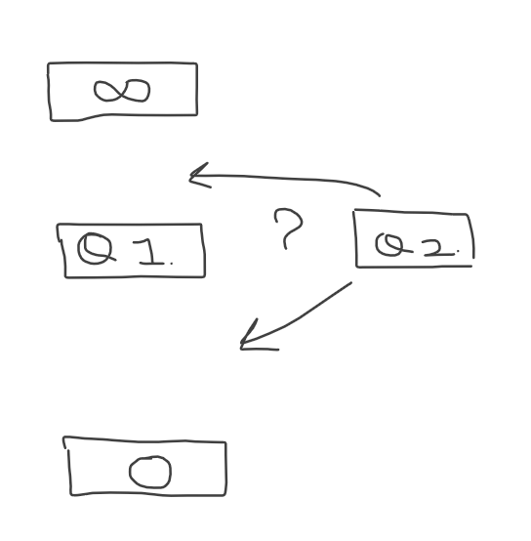
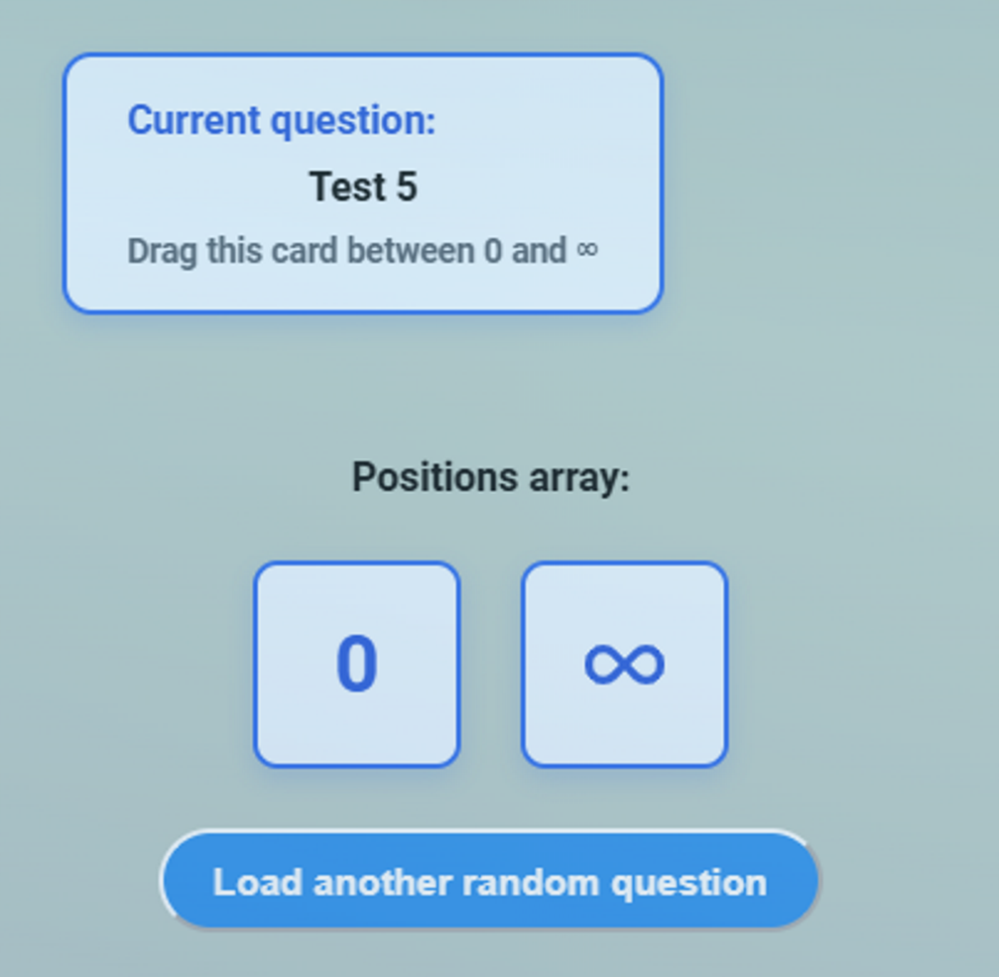
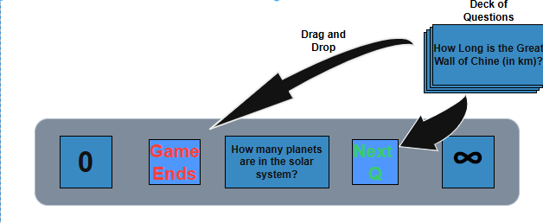
RECAP
Week 1
XMAS Demo
Week 9
Final Design
Notes:
Interactive and fun game, where users can test their general knowledge by drawing a card and placing it between two boundaries – “0” and “∞”.
The answers to each question will be numerical only, and placing the question in an incorrect position on the number line will result in the game ending.

Slide 3
Sem 2 goals
Goals
Highest Priority:
Game logic
Unit Testing
AI Implementation
Medium Priority:
User Login/Account Creation
Containerise services
Data Storage for user (high scores, avg score etc.)
LCOV (Linux Coverage Reports)
Lower Priority:
Multiplayer
Accessibility Features (colour schemes, sounds etc.)

Slide 4
Game logic
Goals
Left Card Answer
Placed Card Answer
Right Card Answer
0
≤
≤
…
…
When User Places Card:
3 question id’s are gotten: placed card & both neighbour cards
Question id’s get sent to backend
Answers are fetched from DB using the id’s
Game logic is applied
Returns Boolean - “correct”

Slide 5
AI implementation
Goals
Category
}
Clicks
“Start Game”
1.
Difficulty
Question Schema
System Prompt (Rules)
User Prompt (Category, Difficulty, count)
2.
Validation
Sends Response
Saved in DB
3.
Notes:
Interactive and fun game, where users can test their general knowledge by drawing a card and placing it between two boundaries – “0” and “∞”.
The answers to each question will be numerical only, and placing the question in an incorrect position on the number line will result in the game ending.

Slide 6
Automated Daily Pipeline
Runs at 12am UTC
Installs Dependencies
Selects Random Category
{
Runs Unit Tests
AI Question Generation
Selects Random Difficulty
Calls Backend Generation
Notifies Admin if Failure

Slide 7
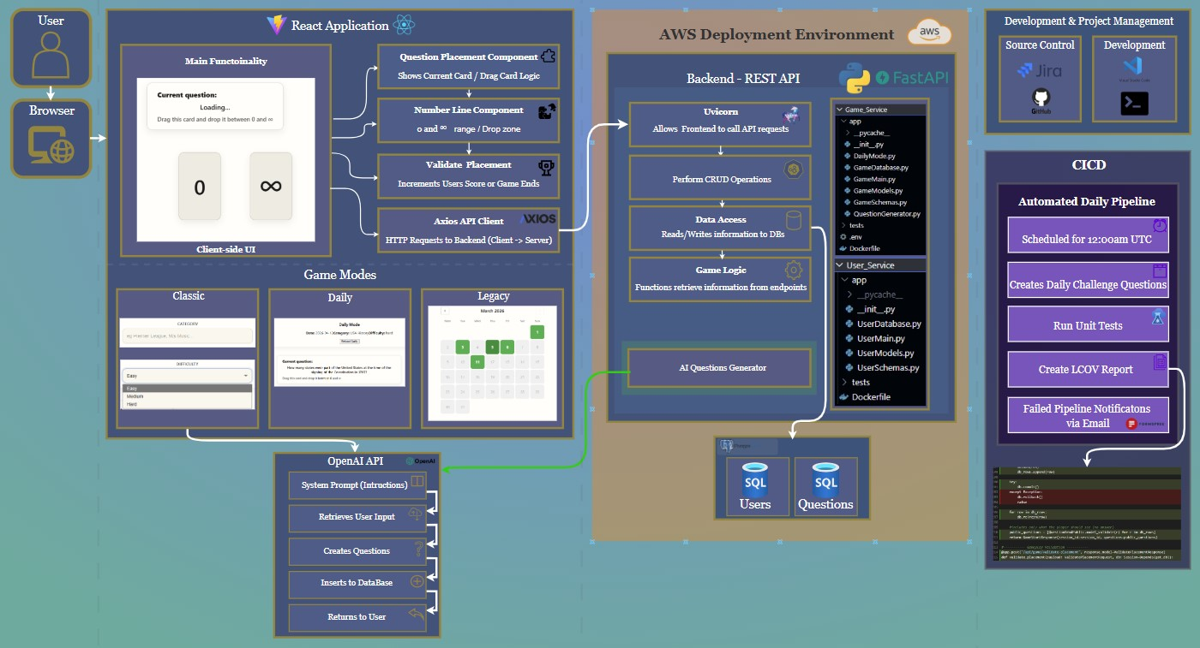
Architecture & Tech
Notes:
Linking back to Research:
Node.js – powers JS tooling for the frontend, React/Vite are built around Node.js, manages dependencies to run React/Vite environments,
React – ideal for my Drag and Drop style game, easily extendable – allows to test small bits at a time and continuously build upon,
Vite – implemented into industry within the last couple years, replacing create-react, much faster than competitors – trial/error testing,
Axios: fetches API on the frontend to call REST endpoints, handles JSON responses between the React app and FastAPI backend,
DnD-kit: provides accessible, react-friendly D&D components and zones, much more flexible and actively maintained than other dnd libraries,
Python: clean syntax, lots of libraries, integrates well with FastAPI
FastAPI: Allows to build REST API in Python with data validation and automatically generates the Swagger UI, > Compared with something heavier like Django, FastAPI is lean, fast, and better suited to a small, API-focused backend like mine.
Uvicorn: highly recommended ASGI to run FastAPI, designed for python (handles incoming HTTP requests),
SQL: easy to query data (random/by id), very comfortable using through past experience. SQLite for simple db file, later – SQL Postgres once docker is implemented and proper server is running,

Slide 8
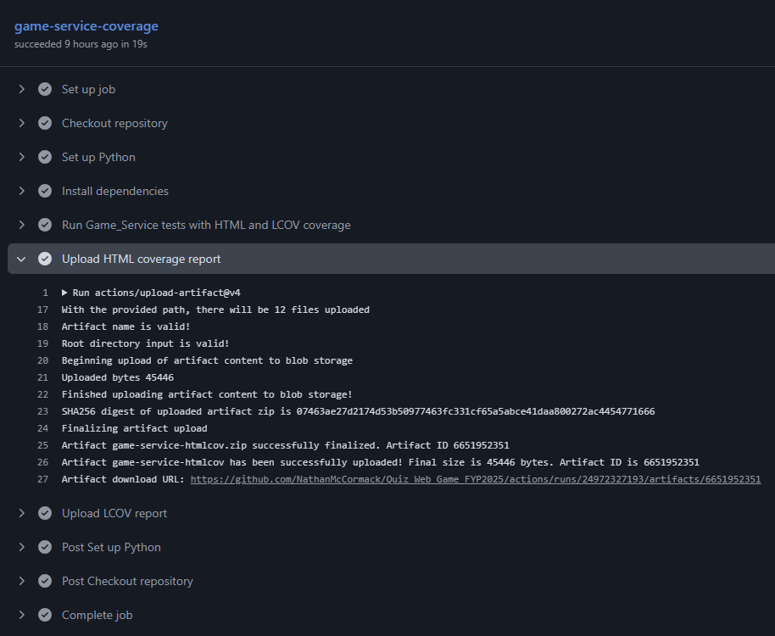
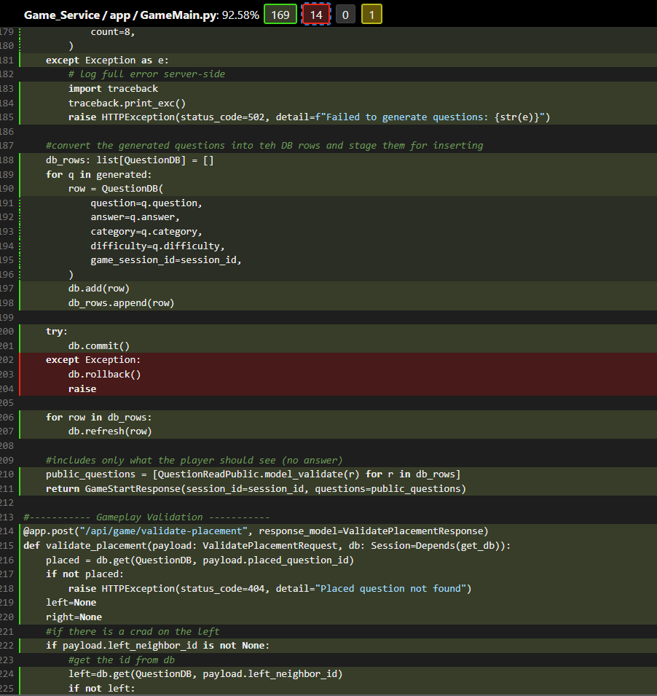
testing
Manual Testing:
CRUD endpoints – Swagger UI
End to End playtesting
Trial & Error - Styling
Friends/Family/Classmates – Unguided playtesting
Post play survey
Automated Testing:
Run CRUD Unit Tests Daily/Every Code Push.
LCOV Reports

Slide 9
Problem Solving
Goals
Inconsistent responses from OpenAI’s API
Moving from SQLite -> PostgreSQL
Backend Unit Tests affecting real DB
Moving Validation Logic to Backend.
Notes:
Interactive and fun game, where users can test their general knowledge by drawing a card and placing it between two boundaries – “0” and “∞”.
The answers to each question will be numerical only, and placing the question in an incorrect position on the number line will result in the game ending.

Slide 10
Future plans
Project Planning
Create user Accounts
Deploy on secure server to run 24/7
Add Mobile App Compatibility
Limitations: OpenAI API key usage.

Slide 11
Ai use
AI Usage
ChatGPT :
Bug fixes
Building off concept idea (suggestions for what tools to use)
Suggestions on how to approach tasks effectively to avoid taking a wrong path due to lack of knowledge.
Tweaking minor changes within CSS files to get my desired output (centre boxes, correct padding etc)
Understanding LCOV Implementation.
gitIgnore file.
Integration into my code:
AI responses were treated as suggestions to guide me while writing the code as apposed to finished work.
All suggestions were verified through manual testing.

Slide 12
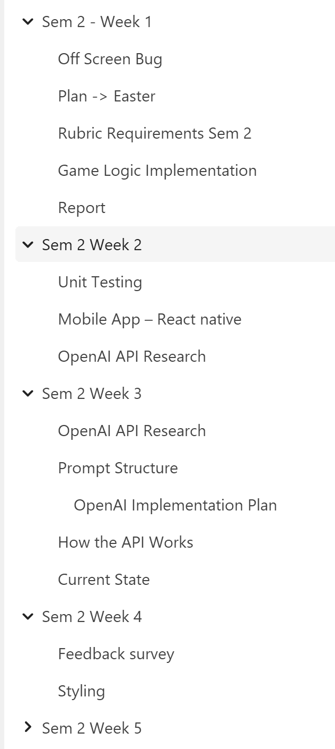
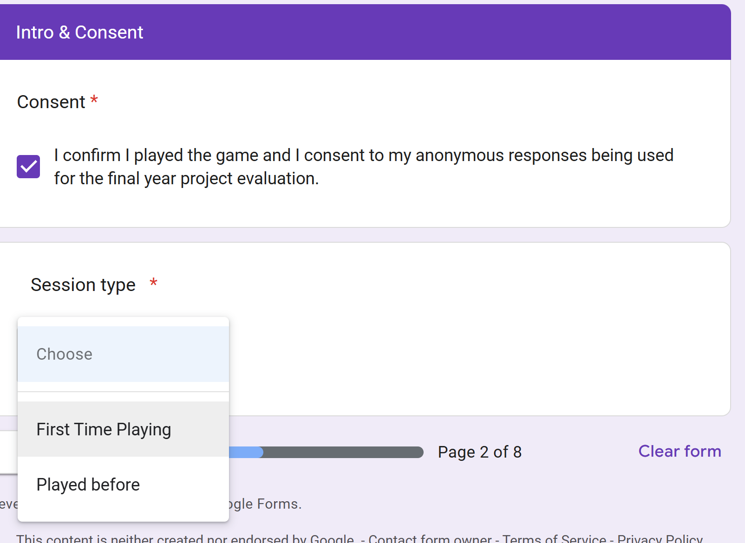
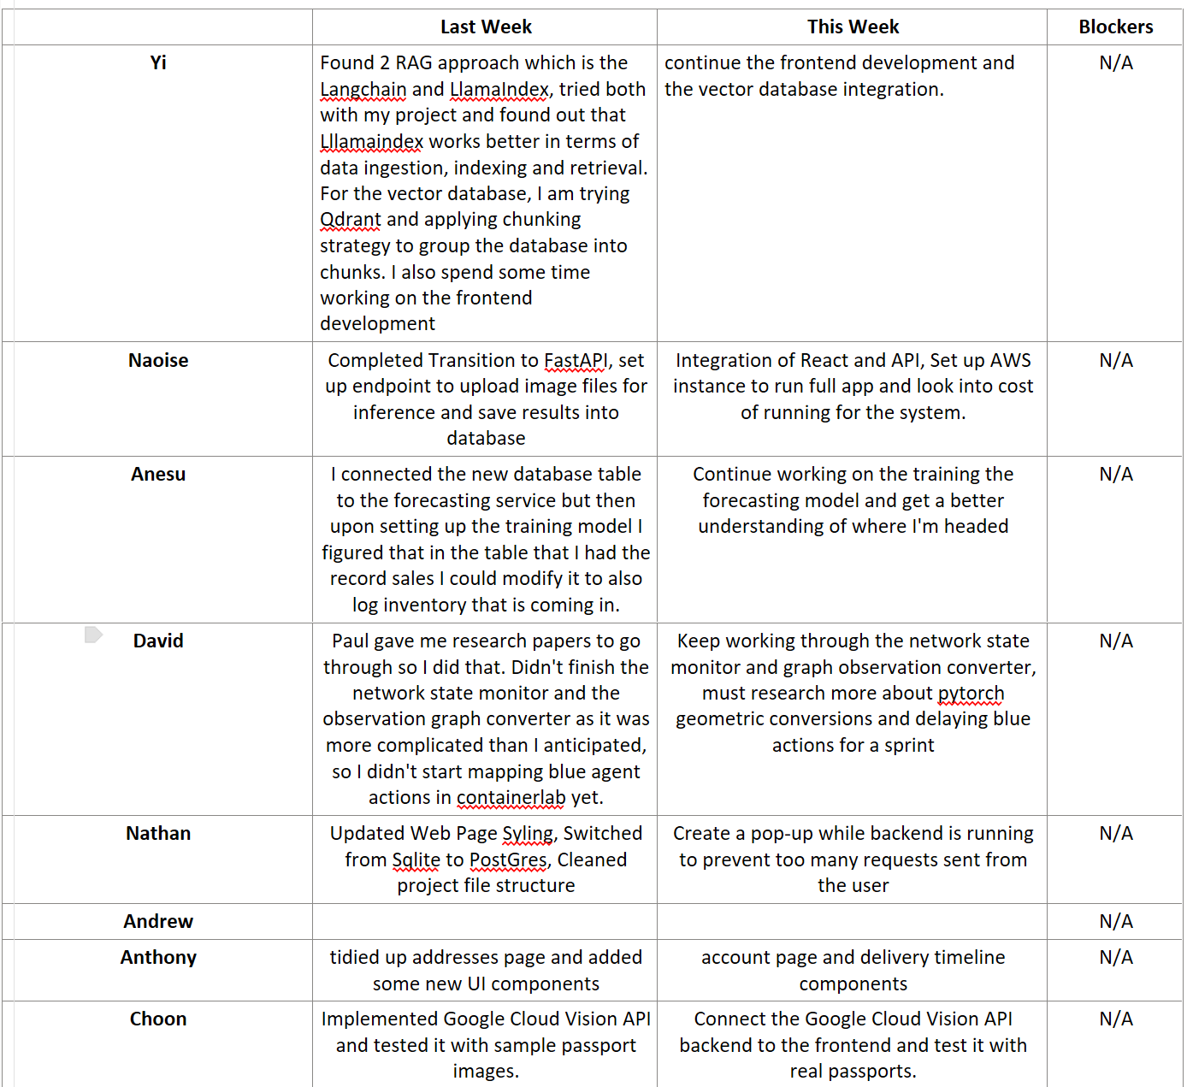
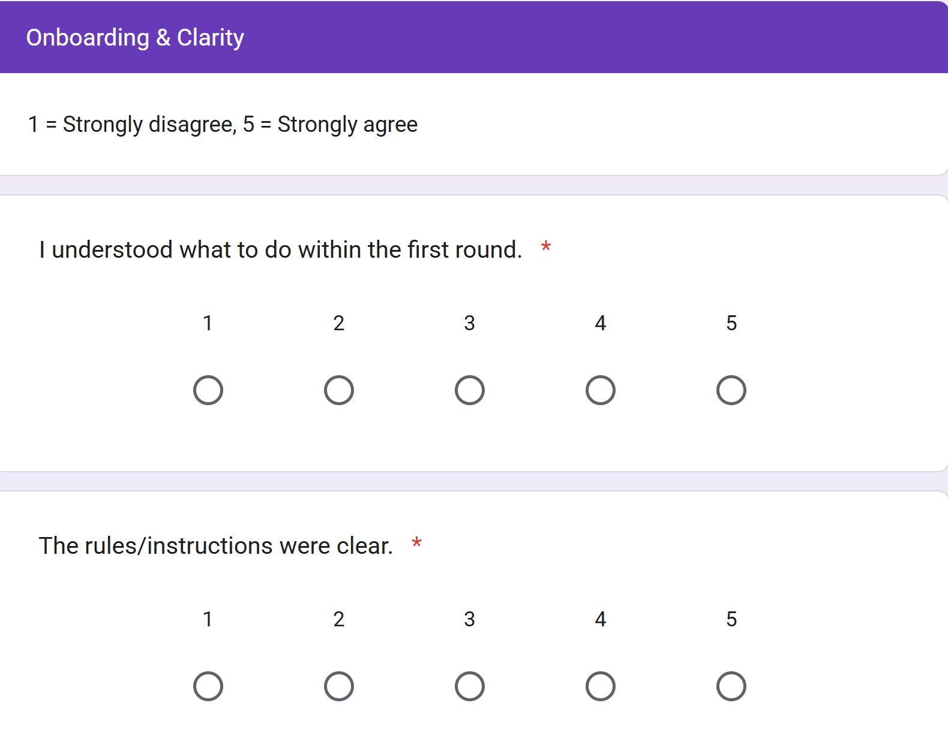
Weekly standups, logs, teamwork
Project Management & Collaboration
Software standups kept in table format
Weekly Logs covering work/research completed for that week
Post play survey given to players after a game run.

Slide 13
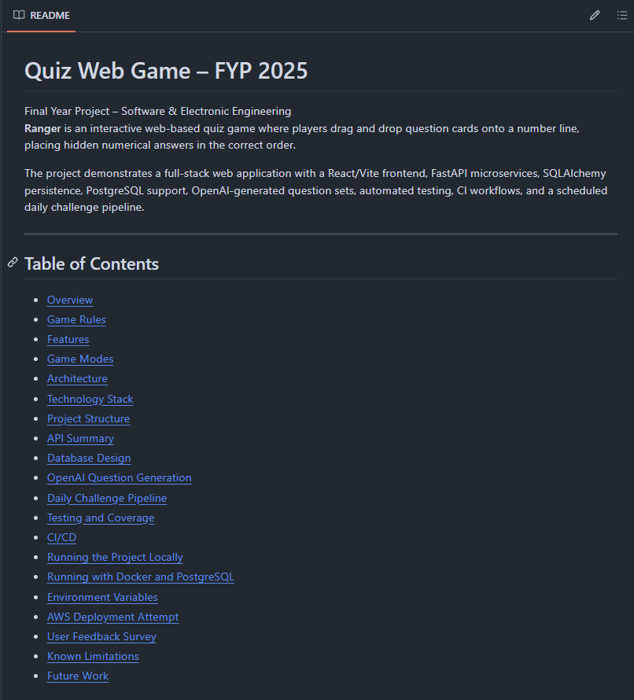
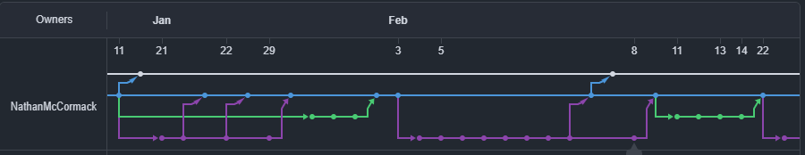
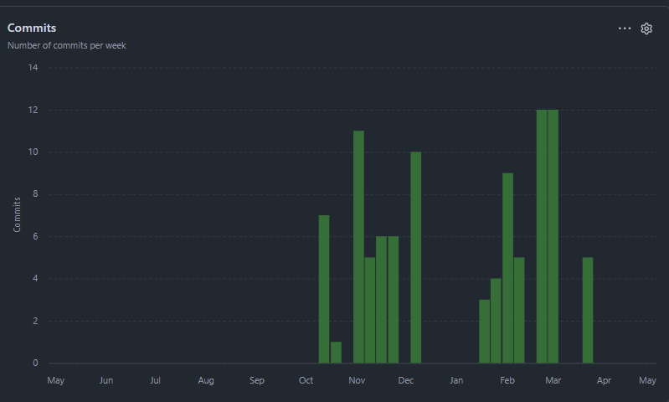
Github
Project Management & Collaboration

Slide 14
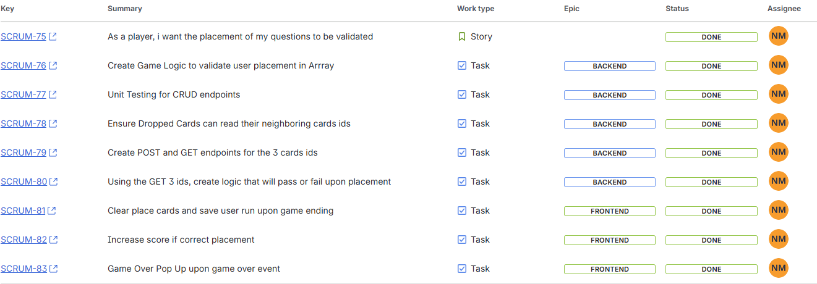
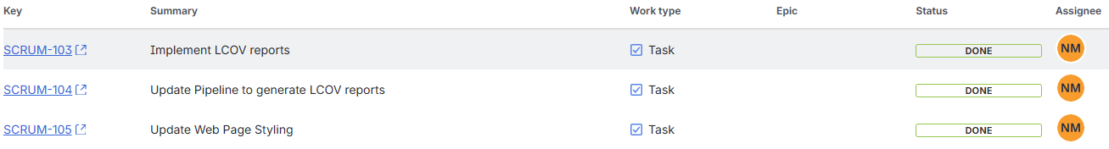
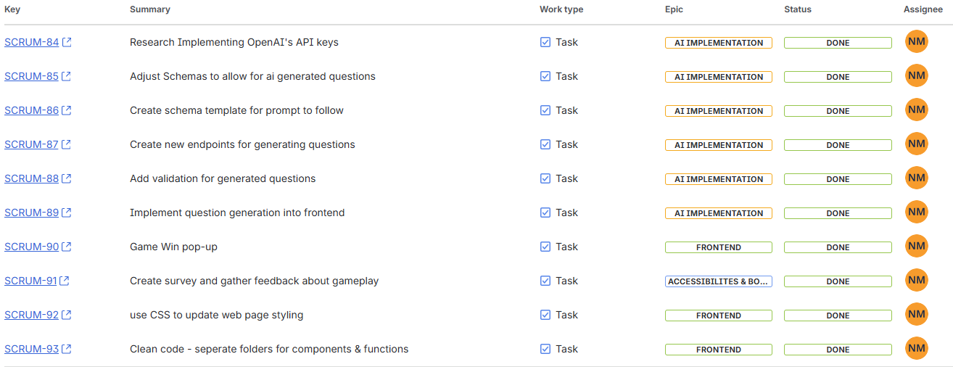
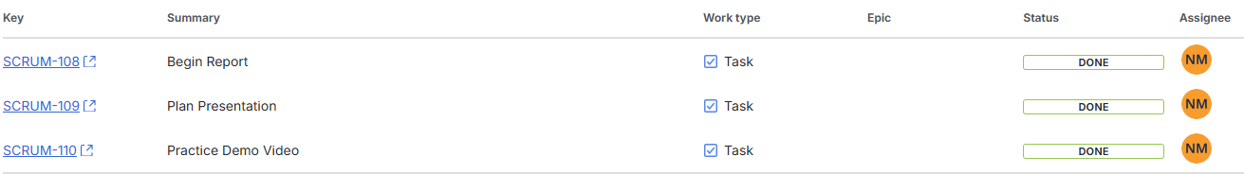
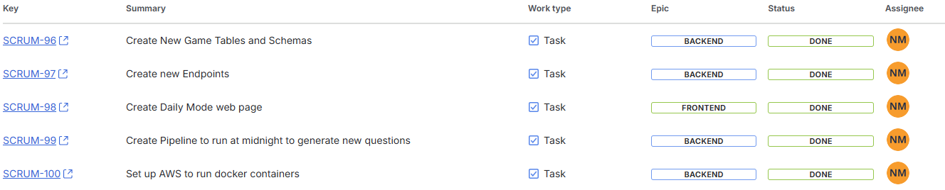
JIRA
Concept & Research

Slide 15
Code Demo
Demo_Backup_video
Notes:
Live demo:
Backend:
MakeFile - runs backend. (uvicorn - ASGI web server that handles HTTP requests and passes them to the FastAPI app.)
Quickly show models file with database tables, schemas for validations
Swagger - quickly show both swaggers for services, explain endpoints -> highlight two main endpoints I'm using as of now (random questions, question by ID), scroll down - show schema.
Quickly walk through these endpoints in main.
Show CORS - briefly explain.
Show pytest for user - unit tests. What coverage I'll be aiming for
Frontend:
Downloading Vite, files it gave, why we need these
Show api file where the endpoints are called using axios
Explain file structure - so having an App.jsx file, QuestionPlacement.jsx in a separate file and then Main.jsx
Demonstrate functionality - api requests from frontend to backend. Drag and drop (explain later there will be game logic)
Explain the process of when the card gets dropped
Explain the number line- questions get stored in an array, with a unique id "slot-XXX" based off the current question ID, if that is null or undefined I've added the current time as the unique ID to avoid bugs/errors.
Go to the function that loads a new question (calls backend)

Slide 16
Thank you

