Slide 1




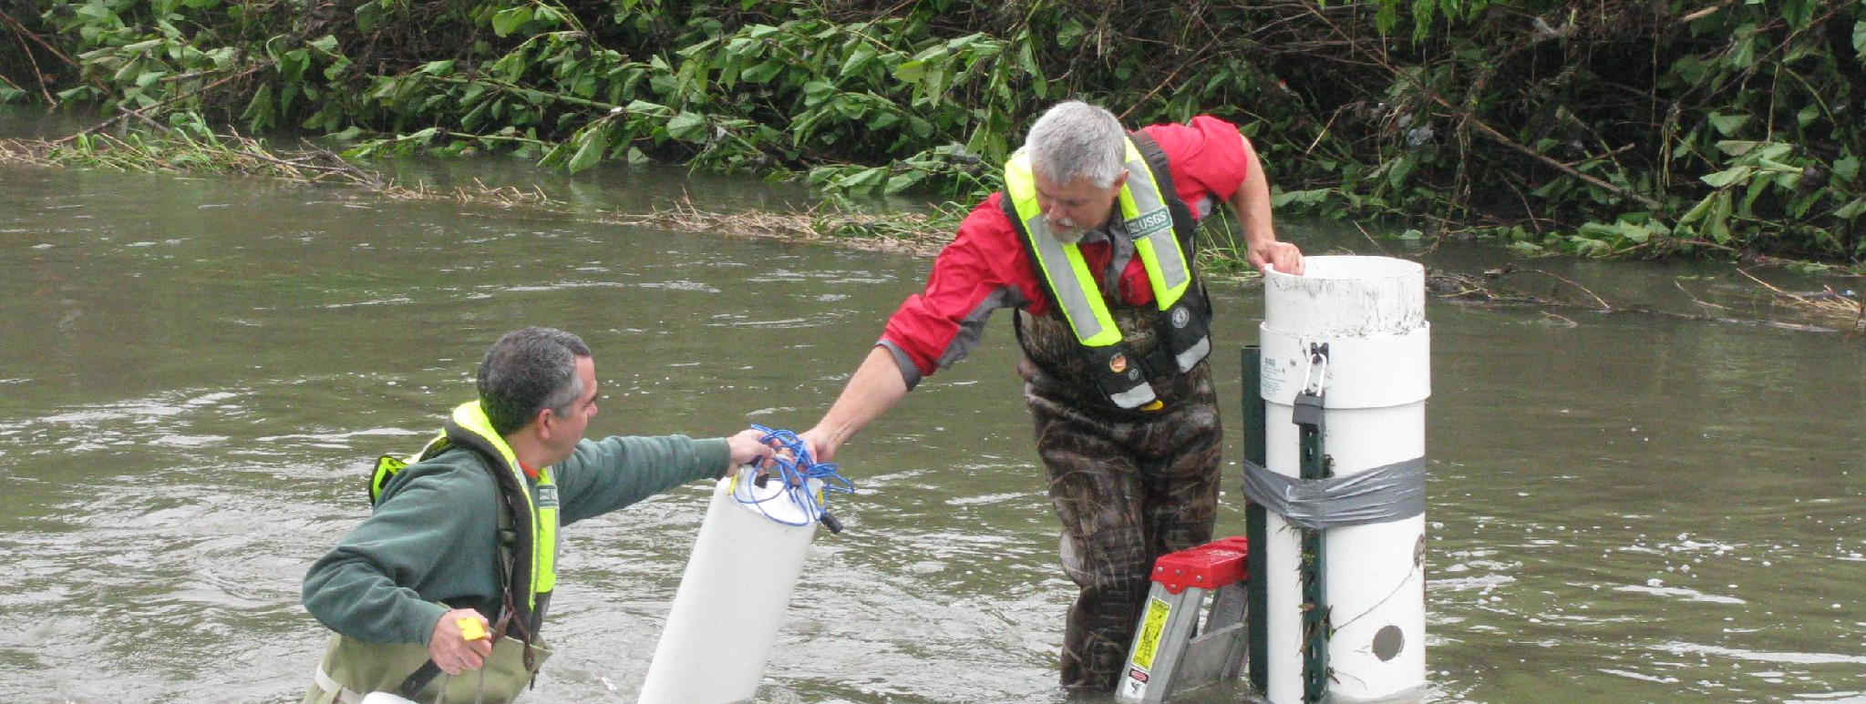
Team 7: SensorFlow | سنسورفلو
Catch salt creep before the tap
Use case: salinity alarms at water-reuse and desalination blending points
The problem
Brine carry-over or saline intrusion first appears as a tiny rise in dissolved salt. Today it is often caught at the next scheduled lab test, after the water has already moved on.
Our target
Detect a 0.15 mg/kg rise on a 500 mg/kg NaCl background (0.03 %) in a 1 s window, so the operator pulls a confirmatory grab sample immediately.
Why it matters: SDG 6
6.1 safe drinking water · 6.3 safe water reuse · 6.4 less water dumped because of late detection. Our question: does quantum sensing make that alarm better?
USGS field sampling: real-world monitoring demands
Sources: UN SDG Report 2025; US EPA Online Water Quality Monitoring. The 0.15 mg/kg target is our design choice.
Photos: Duane Lempke / CC0; Barbara Mahler / USGS, public domain
1 / 5
Notes:
Judges asked for one concrete analyte, the threshold, and the decision it improves. Analyte: dissolved salt (NaCl-equivalent), measured as a change on a 500 mg/kg background. Decision: trigger a grab sample. Impact framing: SDG 6.1/6.3/6.4. The rest of the deck answers one question honestly: is quantum light the right tool for this alarm?

Slide 2
Quantum sensing, classical decisions
End-to-end: water sample → squeezed phase sensing → classical estimator → action
Water tap
16 taps, sampled every 1 s
Phase cell
1550 nm, 10 µm path: salt shifts refractive index → optical phase
Quantum probe
one squeezed beam shared across all taps; homodyne readout
Estimator
classical weighted mean + drift model (Kalman-equivalent)
Action
alarm → grab sample → lab confirms
What is quantum
What is not
Only the sensing: distributed squeezed light lowers the shot noise on the average of all taps (Zhuang, Zhang & Shapiro 2018; Guo et al. 2020).
Everything after the detector is classical signal processing.
No quantum computing advantage is claimed.
QAOA was tested for choosing tap locations: a classical greedy algorithm is near-optimal and scales to thousands of nodes, so placement moved to backup (B1).
Measured gain is a constant factor, not √N. 1.39× lower error for the 16-tap pilot (1.36 dB loss), 1.11× across 64 regional taps. With loss η the ceiling is 1/√(1−η) = 1.93× (Demkowicz-Dobrzański et al. 2012). See B3.
2 / 5
Notes:
Answers: "what is the quantum technique" and "why QAOA". It is CV distributed quantum sensing; processing is a classical linear estimator, which is optimal for this Gaussian model (a Kalman filter gives the same answer for slow drift). QAOA is not needed: placement is a solved classical problem. The previous "classical needs N sensors, quantum needs √N" line was wrong with loss; replaced by the measured constant factor, as judge 4 asked.

Slide 3
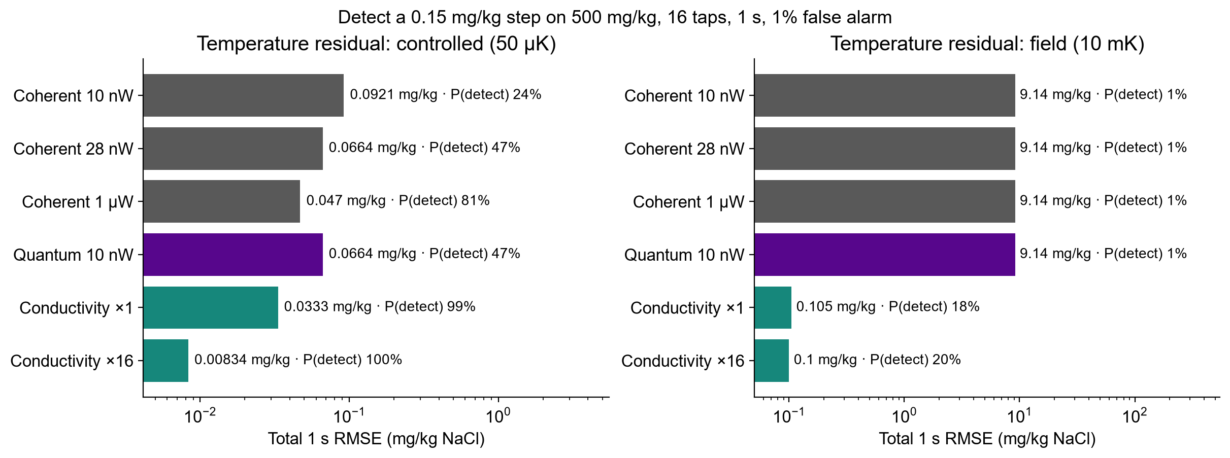
Is quantum light necessary? Not for salt
Same 500 mg/kg background, 16 taps, 1 s window, 1 % false alarm per decision
28 nW of ordinary light matches 10 nW of squeezing. A temperature-compensated conductivity probe is 2× better (controlled) and 91× better in field drift: 1 mK looks like 0.92 mg/kg of salt optically, 0.01 mg/kg to conductivity.
3 / 5
Notes:
Judges 1, 4 and 5 asked for a head-to-head with classical baselines and a commercial conductivity probe at the same background, window and false-alarm rate. Conductivity model is spec-derived (YSI EXO-class: 0.1 µS/cm resolution, ±0.01 °C temperature sensor, ~2 %/°C compensation), not a measurement. Refractive index is non-specific and very temperature sensitive; conductivity is ~90× less so. Honest result: for salinity, conductivity wins.

Slide 4
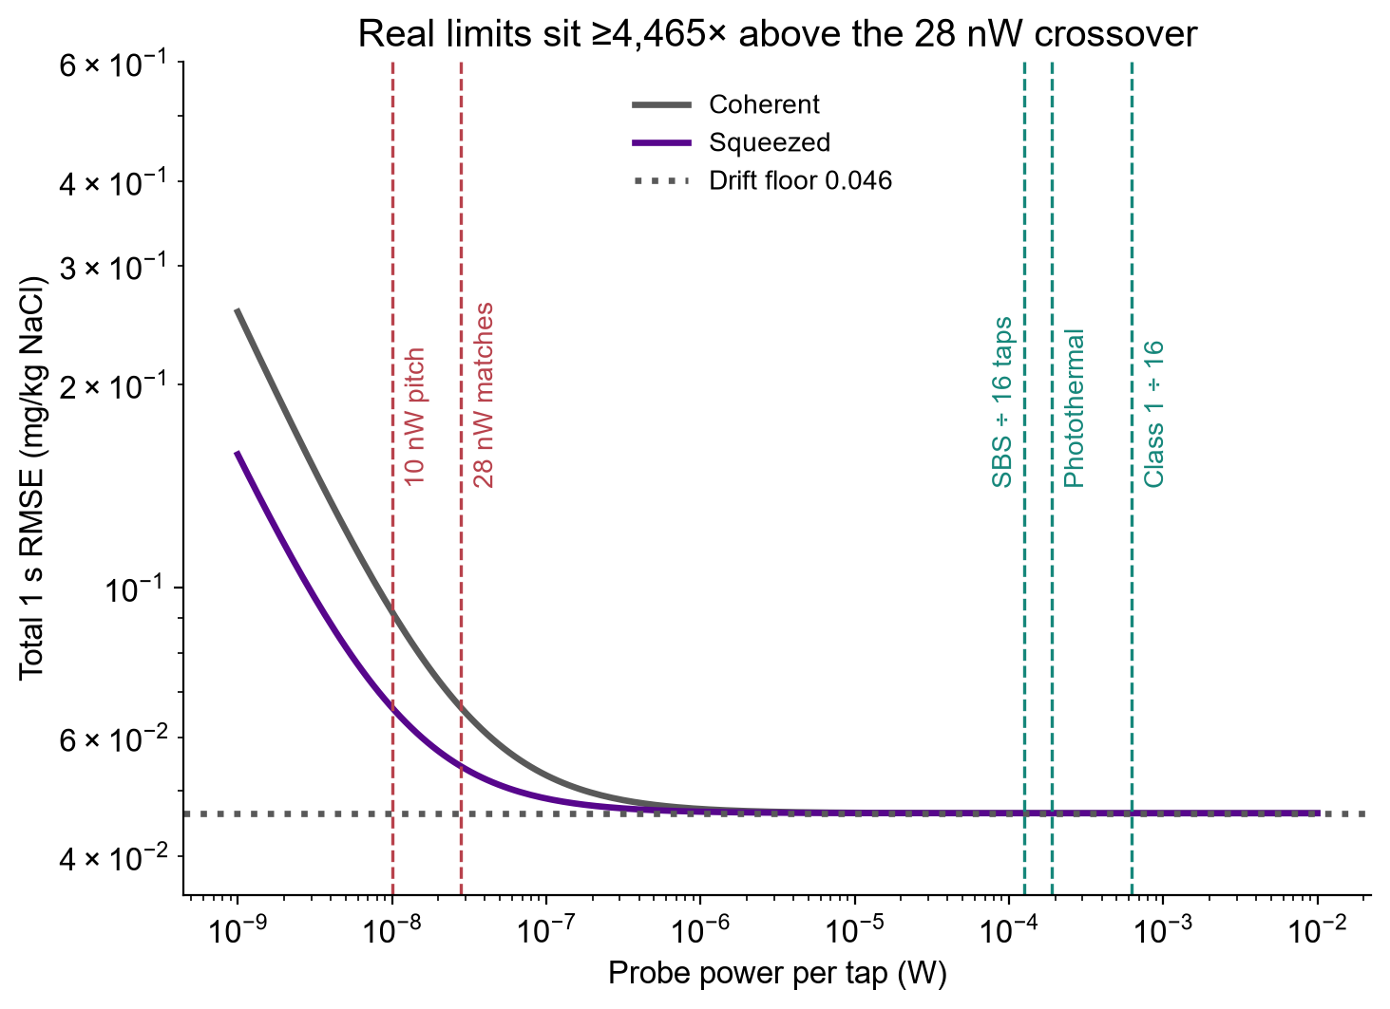
What would it take? Power cap and loss budget
Quantum only pays if probe power is genuinely capped — and the squeezing survives the network
Element (16-tap pilot) | Loss
Splitter excess (4 stages) | 0.20 dB
Fibre (100 m) | 0.02 dB
Fibre-to-cell coupling | 0.46 dB
Sample cell | 0.46 dB
Homodyne detector | 0.22 dB
Total, source → detector | 1.36 dB
Squeezing needed to keep 1.39×:
9.2 dB entering the network (4.5 dB survives to the detectors)
11.3 dB at the source if 95 % escapes the squeezer; 16.4 dB if 90 %
Gain falls below 1.1× after 5.3 dB of extra loss
No physical cap near 10 nW: fibre SBS ÷ 16 taps allows 125 µW, photothermal noise 189 µW. A real cap needs ~70,000 taps per source.
4 / 5
Notes:
Judges 4 and 5 priorities 1 and 2. Power: coherent light matching the quantum error needs only 28.0 nW; above ~1 µW both hit the same drift floor (0.046 mg/kg) and the gain vanishes (1.009× at 1 µW). Photothermal cap: water absorbs ~10/cm at 1550 nm, 1.0 % absorbed over 10 µm, 264 K/W heating, 1e-3 RIN, set equal to the 50 µK thermal budget. SBS: 2 mW per shared trunk (assumed). Eye safety: Class 1 ~10 mW at 1550 nm. Loss budget from config; squeezer escape efficiency was not in the original model and is now stated explicitly. Full squeezing sweep in B2.

Slide 5
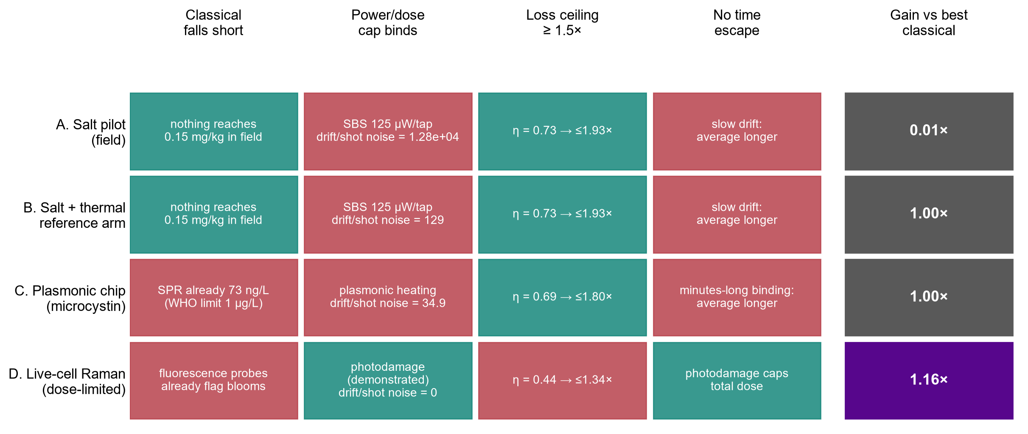
Verdict: where quantum light really wins
Squeezing must beat the best classical option at the power the sample allows
Salt fails. At the real power cap, temperature drift is 129–12,831× the shot noise, so squeezing changes nothing.
Real advantage needs a dose cap. Live cells limit light by photodamage; squeezing gave 1.16× lower error (Casacio et al. 2021), but 56% optical loss caps it at 1.34×.
Path: 1 find a water decision only a dose-limited measurement can make (e.g. toxin state of live cyanobacteria); 2 tabletop squeezed vs coherent at the photodamage limit; 3 go only if ≥1.2× (today: 1.16×) and classical misses the target.
What we deliver: a validated simulator and four-gate test that tells a utility, before it buys a squeezed-light source, whether quantum sensing can beat the sensor it already has.
5 / 5
Notes:
Four gates for a real quantum advantage: (1) the best classical sensor falls short of the target; (2) a physical power or dose cap binds while shot noise still dominates; (3) loss is low enough that 1/sqrt(1-eta) is worth it; (4) classical cannot simply average longer. Salt fails 2 and 4 (and conductivity beats it, B7). A plasmonic microcystin chip fails 1 (classical SPR already reaches 73 ng/L vs the WHO 1 ug/L limit) and 2 (Biacore-class noise is ~35x Dowran's shot-noise level; it would need a 37x quieter baseline for 1.2x). Dose-limited live-cell Raman passes 2 and 4 and has been demonstrated: Casacio reports 35 % better power SNR, which is 1.16x lower error. It fails 3: total efficiency is only 0.44, so even perfect squeezing gives at most 1.34x. No routine water decision needs it yet: that is the open research question. Cost, false alarms and stop rule in B7; loss ceiling curves in B8.

Slide 6
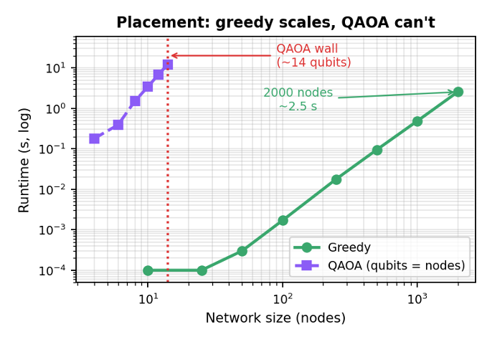
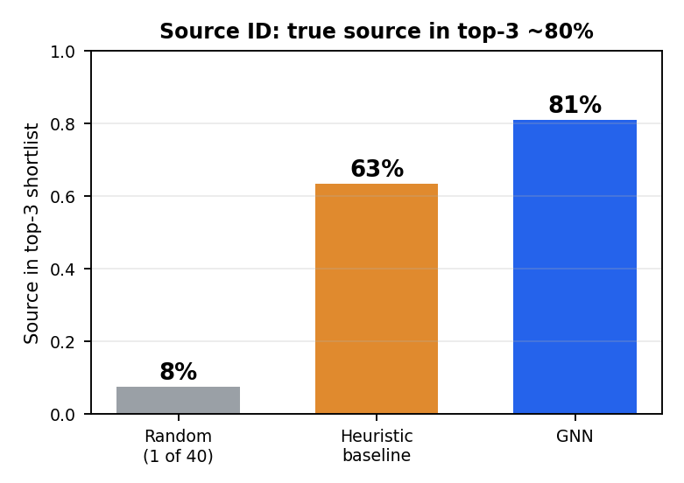
Backup B1: classical layers — placement and source ID
Decide where to sense (placement) and localize what the regional signal flags (source ID)
Greedy submodular: provable near-optimal (1−1/e ≈ 63%), scales to thousands of nodes. QAOA (1 qubit/node) matches only on tiny cases, then falls behind and stalls. Placement is a solved classical problem.
Quantum sensing flags that a region is contaminated (photonic quantum advantage). A GNN recovers likely node source from sensor trip pattern: true source in its top-3 ~80% of the time (vs 7.5% random) on random graphs, degrading gracefully under noise. Further refinement can increase accuracy
B1
Notes:
Show the two classical support layers that wrap the quantum sensing core. Each method is used only where it is strongest; we are not using quantum for its own sake.
Placement: choosing sensor locations to detect contamination is a max-coverage problem, which is monotone submodular. Greedy maximisation therefore has a provable (1 − 1/e) ≈ 63% worst-case guaranteed, and that is the best any efficient algorithm can achieve unless P = NP. In practice greedy is near-optimal and scales: 2000 nodes in about 2.5 seconds. We benchmarked QAOA (Qiskit statevector) on the same problem: it needs one qubit per node, so it only runs on tiny instances. There it matches greedy, then falls behind (it optimises a quadratic coverage surrogate at shallow depth) and its runtime explodes; about 12 seconds at just 14 qubits. Honest takeaway: placement is a solved CLASSICAL problem, so it should NOT be our quantum angle (CERN/OQI/Pasqal already pursue quantum placement). This is a deliberate, evidence-backed decision, not a limitation.
Source identification: distributed quantum sensing layer measures the GLOBAL regional signal; it tells us a region is contaminated but, by design, not which node. Recovering the source is a graph inverse problem, which a graph neural network handles well (and, unlike placement, it does not compete with a guaranteed classical method). On a 40-node network with 10 sensors, the GNN places the true source in its top-3 shortlist about 80% of the time, versus about 63% for a hand-crafted heuristic and 7.5% for random guessing. It improves with more sensors and degrades gracefully under false-trip noise. Honest caveats: with very few sensors it underperforms the baseline (too little signal to learn from); it gives a ranked SHORTLIST, not a certain identification.
Greedy decides where to sense; the entangled quantum probe detects THAT a region is contaminated below the classical shot-noise limit; the GNN infers WHERE it came from. Three jobs, each to the right tool.
Both use a synthetic random-geometric graph and hop-distance spreading as proxies for a real EPANET/WNTR network and hydraulic transport; results are simulated. WNTR on a benchmark network is the next step to ground these in real hydraulics

Slide 7
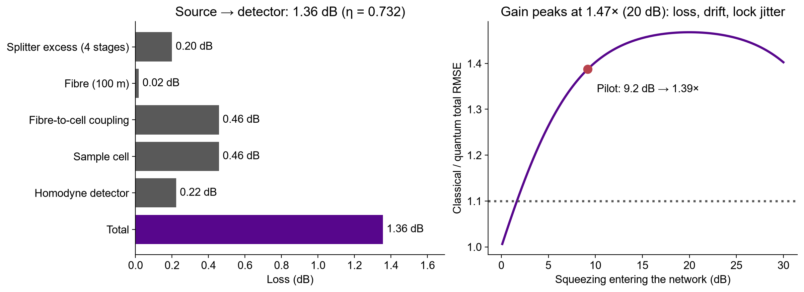
Backup B2: loss budget and squeezing sweep
Gain peaks at 1.47× near 20 dB; phase-lock jitter then mixes in anti-squeezing
B2

Slide 8
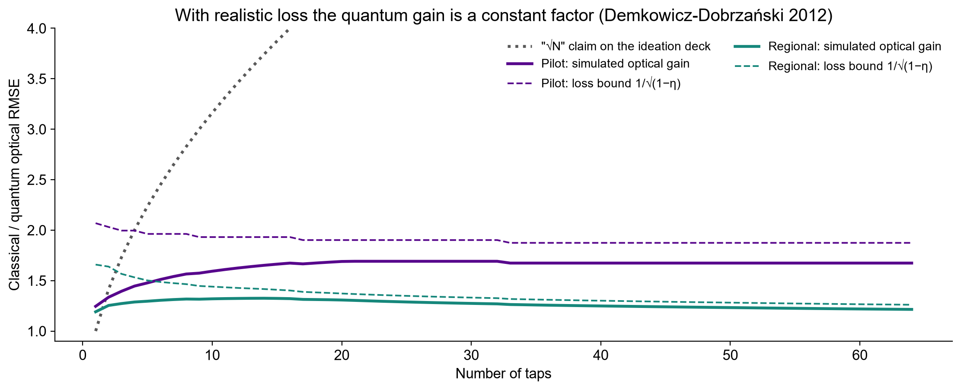
Backup B3: realised gain vs the √N claim
Loss-limited constant factor 1/√(1−η); Demkowicz-Dobrzański, Kołodyński & Guţă, Nat. Commun. 3, 1063 (2012)
B3

Slide 9
Backup B4: controlled pilot estimation and detection
16 taps • 100 m links • 10 nW/tap • 1 s • Assumed 50 µK common temperature residual
Input: optical budget, 64 locations, salt-change signals; Compute: phase sensitivity, optical covariance, mean RMSE, detection probability; Verification: 100,000 null/event draws, seeded, 13 model checks
Estimation: 28% lower total RMSE
Detection: 24% → 47% probability
0.0921 → 0.0664 mg/kg total RMSE. Distributed squeezing also beats independent squeezing by 16.6%.
A 0.15 mg/kg mean step, at 1% false alarm per decision. 100,000 null and event trials per strategy.
All results simulated. 1% at 1 Hz means 36 expected flagged windows/hr; need warning system. Analytic error curves, Monte Carlo checks and a synthetic time trace.
B4
Notes:
This is a prediction for a proposed controlled instrument. Optical RMSE .079619 vs .047583; total precision gain 1.387×. The ambitious common temperature residual is an engineering assumption. Probe photon accounting includes squeezed photons deducted from carrier power, but excludes pump and local oscillator energy. Common residual 50 microkelvin is an ambitious compensated bench target.
Results give 27.92% RMSE reduction versus coherent and16.58% versus independent squeezing. At 64 regional sites compare optimized coherent .0728867 to distributed .0655362mg/kg.10mK residual gives approximately 9.137mg/kg for either strategy. More classical power shrinks total gain (conditional predictions). Source plot uses exact model results rounded for spreadsheet portability. 16 taps is a design assumption: four binary splitter stages and Ns=1.6 below the 2.025 photons/mode cap. Not optimal or deployment-derived. Guo et al. demonstrated four nodes: https://arxiv.org/abs/1905.09408 . Start with one/four measured taps. 100 m links, 10 nW/tap and 50 microkelvin residual are assumptions. Our contribution integrates existing CV theory with a NaCl proxy, losses, technical noise and decision analysis.
Independent Monte Carlo marginal windows, not independent samples of the OU trace. Assumes Gaussian moments including squeeze-angle jitter. Decision threshold is not regulatory. Bonferroni alpha=0.05/3600 bounds hourly familywise false-alarm probability at 5% without independence.
Analytic Pdetect .2426817/.3293999/.4733113;MC .24311/.3316/.47512. Marginal Gaussian tests, not temporally independent field seconds. No regulatory or chemical safety threshold.13internal checks validate model properties; no hardware trial. Pilot optical RMSE .079619 vs .047583mg/kg gives1.673×gain;total1.387×. Technical targets are essential.

Slide 10
Backup B5: sensor and continuous readout
1550 nm light → water-induced phase shift → homodyne → mean estimate
A calibrated optical proxy
Synthetic event at 16 different taps
NaCl index slope: 1.62 × 10⁻⁷ RIU per mg/kg. A proposed 10 µm interaction converts salt changes into phase.
Why shared squeezing?
Distribute one squeezed mode across taps. Negative readout correlations reduce noise in q̂ = Σ yᵢ / M.
Arrivals: 90-135 s; response lag: 10 s. Both strategies share the same drift. Squeezing reduces noise
Classical Python simulator. Proposed quantum sensing hardware. No pollutant-specific identification
B5
Notes:
Classical matrix operations and Gaussian threshold tests. Covariance is propagated through loss and phase jitter. Objective is minimum error for an unbiased arithmetic-mean estimate under the stated resource constraints; no changing site weights to discard noisy nodes. Theory https://arxiv.org/abs/1711.10459 and https://doi.org/10.1103/PhysRevResearch.2.023030 . Classical estimator is computationally tractable. Stack: Python, NumPy, SciPy, Matplotlib. No quantum hardware.
NaCl calibration: Saunders https://doi.org/10.1364/AO.55.000947 . Around 500mg/kg, dn/dc=1.6207394e-7 RIU/(mg/kg). Effective length10µm is assumed, giving6.5699393e-6rad/(mg/kg). Local concentrations may differ. NaCl-equivalent mg/kg is a nonspecific proxy: no arsenic/nitrate selectivity or mg/L conversion. Classical simulator uses Python, NumPy and SciPy. Product concept: calibrated optical sampling module with operator software and confirmatory chemical analysis. 16 taps is a design assumption: four binary splitter stages and Ns=1.6 below the 2.025 photons/mode cap. Not optimal or deployment-derived. Guo et al. demonstrated four nodes: https://arxiv.org/abs/1905.09408 . Start with one/four measured taps. 100 m links, 10 nW/tap and 50 microkelvin residual are assumptions. Our contribution integrates existing CV theory with a NaCl proxy, losses, technical noise and decision analysis. Synthetic changes. Independent optical noise, common OU realization, seed2601006. Optical noise advantage concerns the aggregate; local contrasts do not receive the same benefit.
Source NaCl slope Saunders2016 https://doi.org/10.1364/AO.55.000947 . Mean event.35mg/kg,±25%spatial variation,25s rise,1s sampling. The stationary RMSE does not include transient lag bias. Full trace results/time_trace.csv. Scalar estimator is classical; this does not show quantum computational speedup. Source mode rate1MHz and10dB cap are assumptions.

Slide 11
Backup B6: assumptions and references
Every number is a model prediction; no hardware was measured
NaCl index slope 1.62×10⁻⁷ RIU per mg/kg (Saunders et al. 2016); dn/dT −1.49×10⁻⁴ /K.
10 nW per tap, 10 µm path, 100 m fibre, 16 taps, 1 s window, 50 µK (controlled) or 10 mK (field) common temperature residual.
Water absorption ≈10 cm⁻¹ at 1550 nm (Hale & Querry 1973); 5 µm beam radius; 1e-3 laser intensity noise.
Conductivity: 2 µS/cm per mg/kg, 2 %/°C compensation, 0.1 µS/cm resolution, ±0.01 °C sensor (YSI EXO-class specs).
Fibre SBS budget 2 mW per shared trunk; Class 1 eye-safe ~10 mW at 1550 nm.
Zhuang, Zhang & Shapiro, Phys. Rev. A 97, 032329 (2018).
Guo et al., Nat. Phys. 16, 281 (2020).
Demkowicz-Dobrzański, Kołodyński & Guţă, Nat. Commun. 3, 1063 (2012).
Oh et al., Phys. Rev. Research 2, 023030 (2020).
Saunders et al., Appl. Opt. 55, 947 (2016).
Hale & Querry, Appl. Opt. 12, 555 (1973).
YSI EXO sensor specifications; US EPA Online Water Quality Monitoring; UN SDG Report 2025.
Dowran et al., Optica 5, 628 (2018); Casacio et al., Nature 594, 201 (2021).
Code and data: src/judges_response.py, src/advantage_path.py and their results/*.json.
B6

Slide 12
Backup B7: salt verdict, impact and scale
Rigorous negative results are a deliverable: they tell operators what to buy
Verdict
Impact and scale
Next steps
For salinity, a conductivity probe beats our quantum design (2× controlled, 91× in the field).
Squeezing helps only if power per tap is capped below ~30 nW, extra loss stays under ~5 dB and temperature is held to ~0.1 mK.
At 1 false alarm per week, 16 conductivity probes catch the 0.15 mg/kg step 100% of the time in controlled conditions; the quantum array 0.8%.
Cost, calibration and maintenance favour commercial probes; squeezed sources need lab-grade stabilisation.
1 Point the optical sensor at targets conductivity cannot see (non-ionic organics), with a temperature reference arm.
2 Lab pilot: one cell, coherent vs squeezed vs conductivity side by side.
3 Stop rule: if classical meets the operator's alarm target, ship classical.
What we deliver: a validated simulator and feasibility map (power × loss × drift) that tells a utility, before it buys a squeezed-light source, whether quantum sensing will beat the probe it already has.
B7

Slide 13
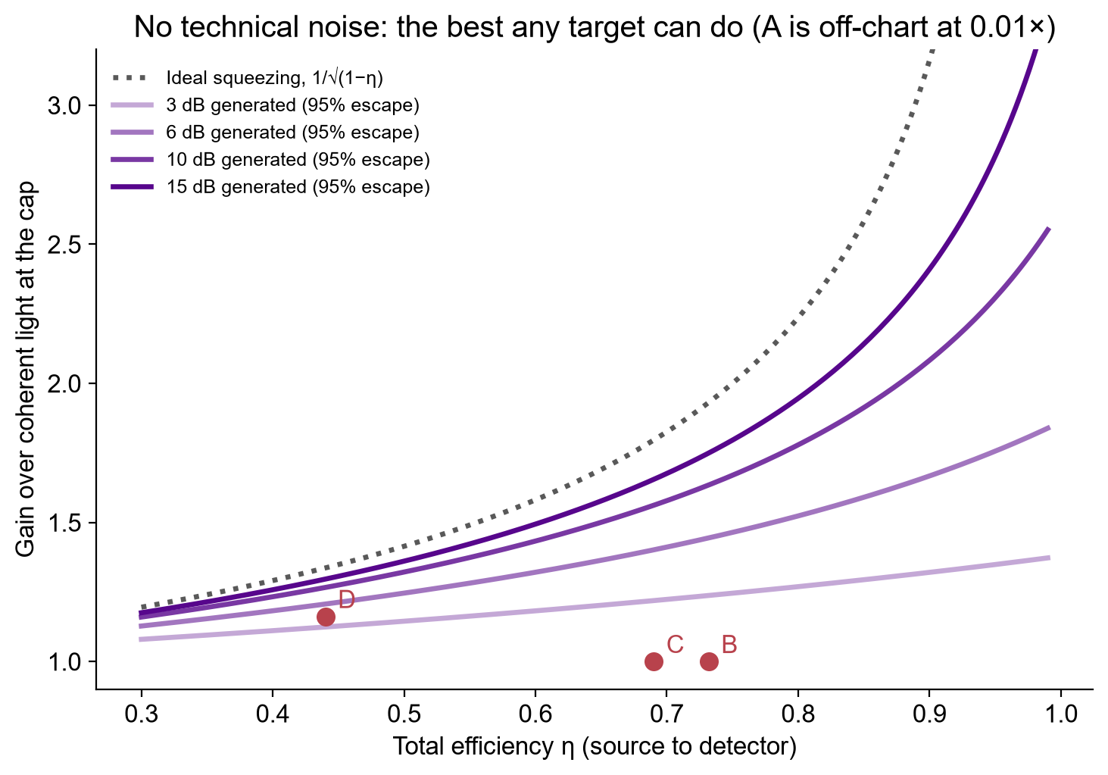
Backup B8: loss ceiling for any target
Gain over coherent light at the cap with no technical noise; points are the screened candidates
B8

