Slide 1




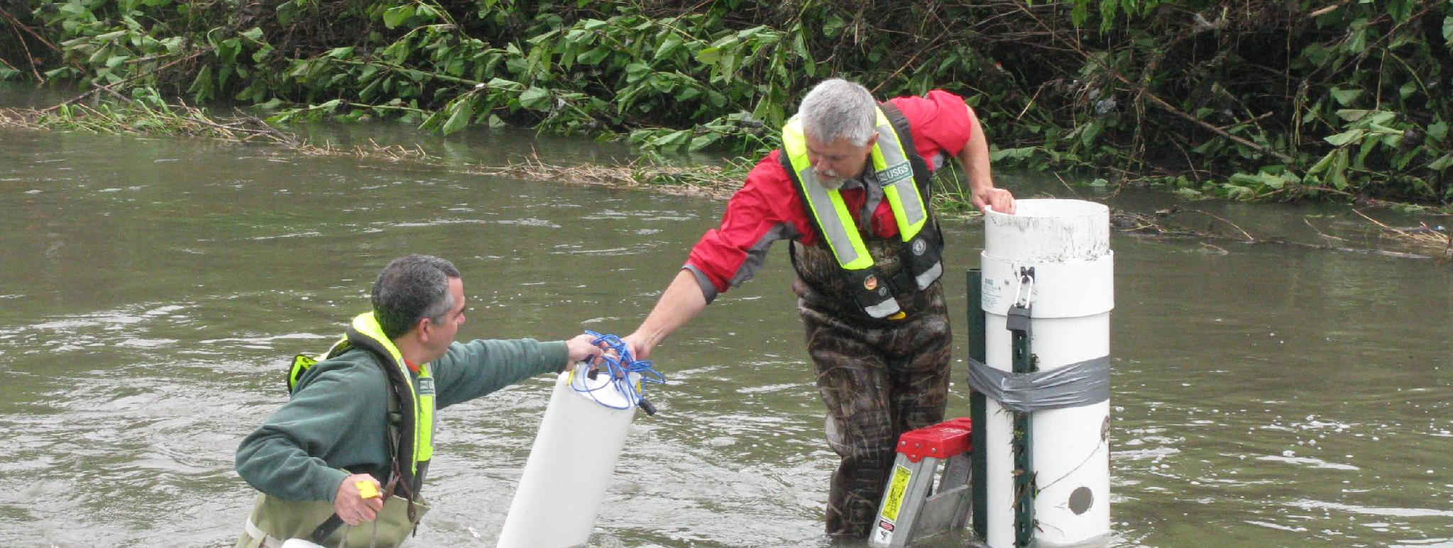
Team 7: SensorFlow | سنسورفلو
Small changes need trustworthy detection
Water-quality monitoring for treatment and reuse operators
A documented monitoring gap
UN 2025: poorest regions supplied only 60,000 of about two million water-quality reporting measurements. EPA describes online monitoring for investigation.
Our target
Test a water-proxy mean using published CV sensing, adding loss, drift and decision analysis.
Sources: UN SDG Report 2025; EPA OWQM.
Our operator use case is assumed. Water saved remains unmeasured.
USGS field sampling: real-world monitoring demands
Photos: Duane Lempke / CC0; Barbara Mahler / USGS, public domain
1 / 5
Notes:
UN SDG Report 2025, Goal 6: https://unstats.un.org/sdgs/report/2025/Goal-06/ reports approximately two million measurements used for reporting, 60,000 from poorest regions. These are monitoring data. WHO 2023 fact sheet, 2022 data: https://www.who.int/news-room/fact-sheets/detail/drinking-water . EPA online monitoring: https://www.epa.gov/waterresilience/online-water-quality-monitoring-resources . These sources establish importance and monitoring use cases, not a quantum bottleneck or salt-based pathogen detection. Operator need for this dose and sensitivity is an assumption.
PHOTO SOURCES: Blue Plains aerial by Duane Lempke,2022,CC0: https://commons.wikimedia.org/wiki/File:BluePlainsWaste-4126-022022.jpg . USGS Lincoln Creek sampling by Barbara J Mahler,2013,public domain: https://www.usgs.gov/media/images/collecting-a-water-quality-sample-usgs-regional-stream-quality . Photographs illustrate context; neither location is our pilot or a measured salt incident. They are not proof that our salt proxy detects all visible contamination. SDG definitions: https://sdgs.un.org/goals/goal6 .

Slide 2
Proposed sensor and continuous readout
1550 nm light → water-induced phase shift → homodyne → mean estimate
A calibrated optical proxy
Synthetic event at 16 different taps
NaCl index slope: 1.62 × 10⁻⁷ RIU per mg/kg. A proposed 10 µm interaction converts salt changes into phase.
Why shared squeezing?
Distribute one squeezed mode across taps. Negative readout correlations reduce noise in q̂ = Σ yᵢ / M.
Arrivals: 90-135 s; response lag: 10 s. Both strategies share the same drift. Squeezing reduces noise
Classical sensing needs N sensors for precision P; quantum needs √N
Classical Python simulator. Proposed quantum sensing hardware. No pollutant-specific identification
2 / 5
Notes:
Classical matrix operations and Gaussian threshold tests. Covariance is propagated through loss and phase jitter. Objective is minimum error for an unbiased arithmetic-mean estimate under the stated resource constraints; no changing site weights to discard noisy nodes. Theory https://arxiv.org/abs/1711.10459 and https://doi.org/10.1103/PhysRevResearch.2.023030 . Classical estimator is computationally tractable. Stack: Python, NumPy, SciPy, Matplotlib. No quantum hardware.
NaCl calibration: Saunders https://doi.org/10.1364/AO.55.000947 . Around 500mg/kg, dn/dc=1.6207394e-7 RIU/(mg/kg). Effective length10µm is assumed, giving6.5699393e-6rad/(mg/kg). Local concentrations may differ. NaCl-equivalent mg/kg is a nonspecific proxy: no arsenic/nitrate selectivity or mg/L conversion. Classical simulator uses Python, NumPy and SciPy. Product concept: calibrated optical sampling module with operator software and confirmatory chemical analysis. 16 taps is a design assumption: four binary splitter stages and Ns=1.6 below the 2.025 photons/mode cap. Not optimal or deployment-derived. Guo et al. demonstrated four nodes: https://arxiv.org/abs/1905.09408 . Start with one/four measured taps. 100 m links, 10 nW/tap and 50 microkelvin residual are assumptions. Our contribution integrates existing CV theory with a NaCl proxy, losses, technical noise and decision analysis. Synthetic changes. Independent optical noise, common OU realization, seed2601006. Optical noise advantage concerns the aggregate; local contrasts do not receive the same benefit.
Source NaCl slope Saunders2016 https://doi.org/10.1364/AO.55.000947 . Mean event.35mg/kg,±25%spatial variation,25s rise,1s sampling. The stationary RMSE does not include transient lag bias. Full trace results/time_trace.csv. Scalar estimator is classical; this does not show quantum computational speedup. Source mode rate1MHz and10dB cap are assumptions.

Slide 3
Controlled pilot: lower error, more detected changes
16 taps • 100 m links • 10 nW/tap • 1 s • Assumed 50 µK common temperature residual
Input: optical budget, 64 locations, salt-change signals; Compute: phase sensitivity, optical covariance, mean RMSE, detection probability; Verification: 100,000 null/event draws, seeded, 13 model checks
Estimation: 28% lower total RMSE
Detection: 24% → 47% probability
0.0921 → 0.0664 mg/kg total RMSE. Distributed squeezing also beats independent squeezing by 16.6%.
A 0.15 mg/kg mean step, at 1% false alarm per decision. 100,000 null and event trials per strategy.
All results simulated. 1% at 1 Hz means 36 expected flagged windows/hr; need warning system. Analytic error curves, Monte Carlo checks and a synthetic time trace.
3 / 5
Notes:
This is a prediction for a proposed controlled instrument. Optical RMSE .079619 vs .047583; total precision gain 1.387×. The ambitious common temperature residual is an engineering assumption. Probe photon accounting includes squeezed photons deducted from carrier power, but excludes pump and local oscillator energy. Common residual 50 microkelvin is an ambitious compensated bench target.
Results give 27.92% RMSE reduction versus coherent and16.58% versus independent squeezing. At 64 regional sites compare optimized coherent .0728867 to distributed .0655362mg/kg.10mK residual gives approximately 9.137mg/kg for either strategy. More classical power shrinks total gain (conditional predictions). Source plot uses exact model results rounded for spreadsheet portability. 16 taps is a design assumption: four binary splitter stages and Ns=1.6 below the 2.025 photons/mode cap. Not optimal or deployment-derived. Guo et al. demonstrated four nodes: https://arxiv.org/abs/1905.09408 . Start with one/four measured taps. 100 m links, 10 nW/tap and 50 microkelvin residual are assumptions. Our contribution integrates existing CV theory with a NaCl proxy, losses, technical noise and decision analysis.
Independent Monte Carlo marginal windows, not independent samples of the OU trace. Assumes Gaussian moments including squeeze-angle jitter. Decision threshold is not regulatory. Bonferroni alpha=0.05/3600 bounds hourly familywise false-alarm probability at 5% without independence.
Analytic Pdetect .2426817/.3293999/.4733113;MC .24311/.3316/.47512. Marginal Gaussian tests, not temporally independent field seconds. No regulatory or chemical safety threshold.13internal checks validate model properties; no hardware trial. Pilot optical RMSE .079619 vs .047583mg/kg gives1.673×gain;total1.387×. Technical targets are essential.

Slide 4
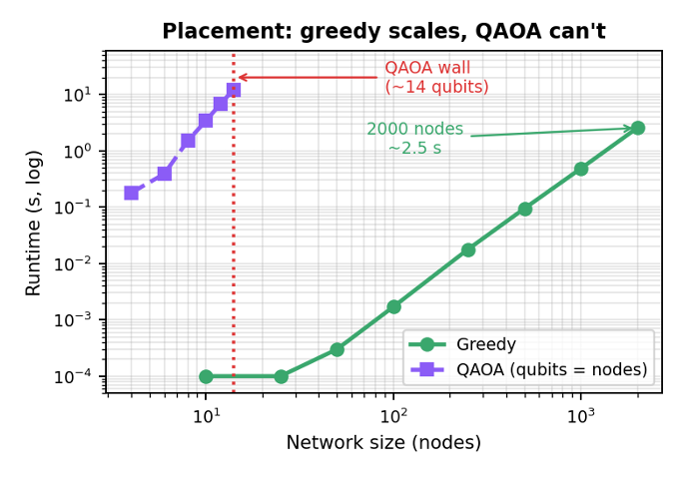
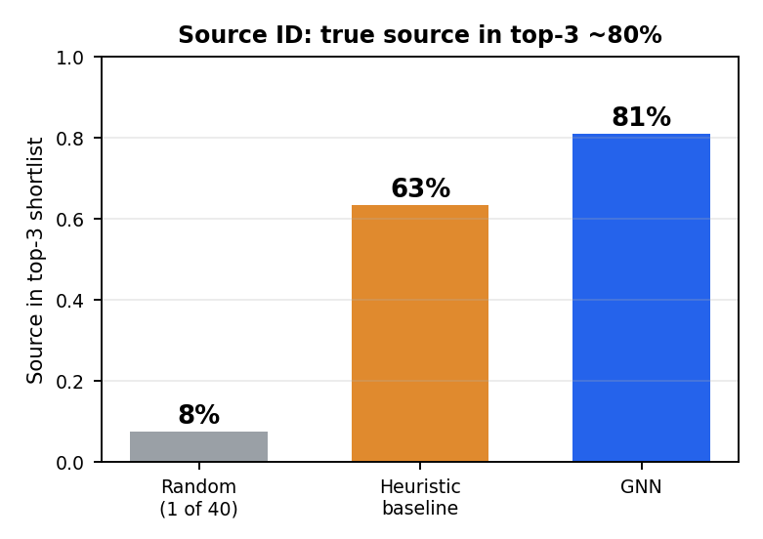
Classical layers make quantum sensing perform best
Decide where to sense (placement) and localize what the regional signal flags (source ID)
Greedy submodular: provable near-optimal (1−1/e ≈ 63%), scales to thousands of nodes. QAOA (1 qubit/node) matches only on tiny cases, then falls behind and stalls. Placement is a solved classical problem.
Quantum sensing flags that a region is contaminated (photonic quantum advantage). A GNN recovers likely node source from sensor trip pattern: true source in its top-3 ~80% of the time (vs 7.5% random) on random graphs, degrading gracefully under noise. Further refinement can increase accuracy
4 / 5
Notes:
Show the two classical support layers that wrap the quantum sensing core. Each method is used only where it is strongest; we are not using quantum for its own sake.
Placement: choosing sensor locations to detect contamination is a max-coverage problem, which is monotone submodular. Greedy maximisation therefore has a provable (1 − 1/e) ≈ 63% worst-case guaranteed, and that is the best any efficient algorithm can achieve unless P = NP. In practice greedy is near-optimal and scales: 2000 nodes in about 2.5 seconds. We benchmarked QAOA (Qiskit statevector) on the same problem: it needs one qubit per node, so it only runs on tiny instances. There it matches greedy, then falls behind (it optimises a quadratic coverage surrogate at shallow depth) and its runtime explodes; about 12 seconds at just 14 qubits. Honest takeaway: placement is a solved CLASSICAL problem, so it should NOT be our quantum angle (CERN/OQI/Pasqal already pursue quantum placement). This is a deliberate, evidence-backed decision, not a limitation.
Source identification: distributed quantum sensing layer measures the GLOBAL regional signal; it tells us a region is contaminated but, by design, not which node. Recovering the source is a graph inverse problem, which a graph neural network handles well (and, unlike placement, it does not compete with a guaranteed classical method). On a 40-node network with 10 sensors, the GNN places the true source in its top-3 shortlist about 80% of the time, versus about 63% for a hand-crafted heuristic and 7.5% for random guessing. It improves with more sensors and degrades gracefully under false-trip noise. Honest caveats: with very few sensors it underperforms the baseline (too little signal to learn from); it gives a ranked SHORTLIST, not a certain identification.
Greedy decides where to sense; the entangled quantum probe detects THAT a region is contaminated below the classical shot-noise limit; the GNN infers WHERE it came from. Three jobs, each to the right tool.
Both use a synthetic random-geometric graph and hop-distance spreading as proxies for a real EPANET/WNTR network and hydraulic transport; results are simulated. WNTR on a benchmark network is the next step to ground these in real hydraulics

Slide 5
The next test: does the gain survive real water?
Loss, temperature drift and higher classical power determine whether quantum optics is useful
Common temperature drift erases gain
A scoped laboratory pilot
1 Calibrate one water cell: salt response, transmission, temperature and bias.
2 Blind-test four taps against coherent probes and conventional conductivity.
3 Measure detection delay, false alarms and full electrical energy before scaling.
At 10 mK: both errors ≈9.137 mg/kg. At low drift, ~28 nW coherent matches 10 nW distributed performance.
Resource KPI: 160 nJ probe/window for both.
Path to impact: operator + optics-lab pilot → validated monitoring module; water saved and commercial viability remain open.
5 / 5
Notes:
All pilot claims use 16 nodes,10nW/node,1s,50µK common residual. Detection uses.15mg/kg increase and1% false alarm per decision. Optical energy160nJ is equal resources. Algorithm is estimator accuracy, not quantum computational runtime. Next KPI: total joules per validated useful detection at matched coverage, false-alarm rate and response time. Results do not prove/disprove literature: conditional model consistency only.
Detection of.15mg/kg mean increase,16nodes,1s,50µK residual.1% per-window false alarm at1Hz gives36expected flagged windows/hour; not an operational alarm policy. Need a separately validated sequential rule. First audience controlled plant lab; possible model research pilot then monitoring module, no confirmed partner or revenue. Compare conventional conductivity and higher-power coherent optics. Expansion only if useful detection beats these alternatives under an operator-relevant constraint and measured total cost/energy. Seek water operator and optical laboratory for a scoped pilot. Figures do not prove/disprove experimental literature; they show conditional consistency and failure regimes.
S10 reports dn/dT≈−1.485e−4 RIU/K at1550nm. The exact coefficient depends on temperature/composition. 0.05 mK and10 mK are assumed stochastic residuals, not manufacturer statistical specifications.
The50µK residual is a demanding target, not demonstrated water performance;10mK is a stress scenario, not statistical interpretation of YSI accuracy. CommonOUdrift tau60s.1mK≈.916mg/kg apparent NaCl change using Kim thermo-optic anchor https://opg.optica.org/abstract.cfm?uri=sensors-2012-STu1F.3 . Higher-power coherent sweep1nW–70µW in Figure10. Stop or redesign if a cheaper/lower-energy conventional alternative achieves the operational goal. Three KPIs: estimator RMSE/sl4,monitoring detection/sl4,energy accounting/sl5.

