Slide 1
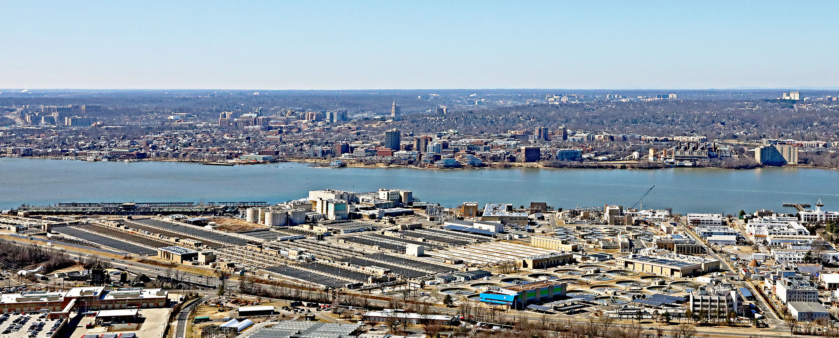
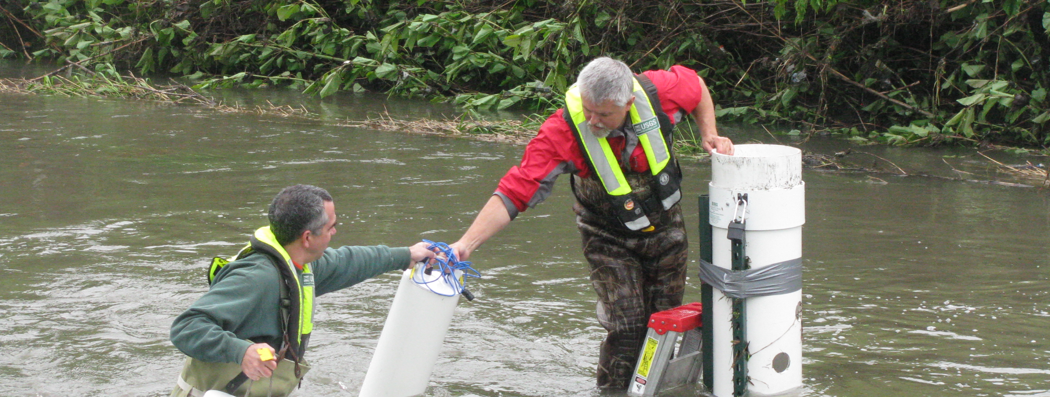
Small changes need trustworthy detection
Water-quality monitoring for treatment and reuse operators • SDG 6
A documented monitoring gap
UN 2025: poorest regions supplied only 60,000 of about two million water-quality reporting measurements. EPA describes online monitoring for investigation.
Treatment context: Blue Plains, Washington, DC
Our target
Test a water-proxy mean using published CV sensing, adding loss, drift and decision analysis.
Sources: UN SDG Report 2025; EPA OWQM.
Our operator use case is assumed. Water saved remains unmeasured.
USGS field sampling: real-world monitoring demands
Photos: Duane Lempke / CC0; Barbara Mahler / USGS, public domain
TEAM 7 • IDEATION • SIMULATED RESULTS
1 / 5
Notes:
UN SDG Report 2025, Goal 6: https://unstats.un.org/sdgs/report/2025/Goal-06/ reports approximately two million measurements used for reporting, 60,000 from poorest regions. These are monitoring data, not all worldwide measurements. WHO 2023 fact sheet, 2022 data: https://www.who.int/news-room/fact-sheets/detail/drinking-water . EPA online monitoring: https://www.epa.gov/waterresilience/online-water-quality-monitoring-resources . These sources establish importance and monitoring use cases, not a quantum bottleneck or salt-based pathogen detection. Operator need for this dose and sensitivity is an assumption.
PHOTO SOURCES: Blue Plains aerial by Duane Lempke,2022,CC0: https://commons.wikimedia.org/wiki/File:BluePlainsWaste-4126-022022.jpg . USGS Lincoln Creek sampling by Barbara J Mahler,2013,public domain: https://www.usgs.gov/media/images/collecting-a-water-quality-sample-usgs-regional-stream-quality . Photographs illustrate context; neither location is our pilot or a measured salt incident. They are not proof that our salt proxy detects all visible contamination. SDG definitions: https://sdgs.un.org/goals/goal6 .

Slide 2
Proposed sensor and continuous readout
1550 nm light → water-induced phase shift → homodyne → mean estimate
A calibrated optical proxy
Synthetic event at 16 different taps
NaCl index slope: 1.62 × 10⁻⁷ RIU per mg/kg. A proposed 10 µm interaction converts salt changes into phase.
Why shared squeezing?
Distribute one squeezed mode across taps. Negative readout correlations reduce noise in q̂ = Σ yᵢ / M.
Arrivals: 90–135 s; response lag: 10 s. Both strategies share the same drift. Squeezing reduces noise, not lag.
Classical Python simulator • Proposed quantum sensing hardware • No pollutant-specific identification
TEAM 7 • IDEATION • SIMULATED RESULTS
2 / 5
Notes:
Technical rigor: 30%. Classical matrix operations and Gaussian threshold tests; no quantum computing speedup, QAOA, VQE or QML execution. Covariance is propagated through loss and phase jitter. Objective is minimum error for an unbiased arithmetic-mean estimate under the stated resource constraints; no changing site weights to discard noisy nodes. Theory https://arxiv.org/abs/1711.10459 and https://doi.org/10.1103/PhysRevResearch.2.023030 . Classical estimator is computationally tractable. QC-specific eligibility must be confirmed with organizers. Hack stack: Python, NumPy, SciPy, Matplotlib. No quantum hardware has been built.
NaCl calibration: Saunders https://doi.org/10.1364/AO.55.000947 . Around500mg/kg, dn/dc=1.6207394e-7 RIU/(mg/kg). Effective length10µm is assumed, giving6.5699393e-6rad/(mg/kg). Local concentrations may differ. NaCl-equivalent mg/kg is a nonspecific proxy: no arsenic/nitrate selectivity or mg/L conversion. Classical simulator uses Python, NumPy and SciPy. Hardware remains proposed. Product concept: calibrated optical sampling module with operator software and confirmatory chemical analysis. Quantum-computing emphasis of rubric remains an eligibility question. 16 taps is a design assumption: four binary splitter stages and Ns=1.6 below the 2.025 photons/mode cap. Not optimal or deployment-derived. Guo et al. demonstrated four nodes: https://arxiv.org/abs/1905.09408 . Start with one/four measured taps. 100 m links, 10 nW/tap and 50 microkelvin residual are assumptions. Our contribution integrates existing CV theory with a NaCl proxy, losses, technical noise and decision analysis. No research-priority claim. docs/DESIGN_DECISIONS.md.
results/time_trace.csv. Synthetic changes, not observed water data. Independent optical noise, common OU realization, seed2601006. Optical noise advantage concerns the aggregate; local contrasts do not receive the same benefit.
Source NaCl slope Saunders2016 https://doi.org/10.1364/AO.55.000947 . Mean event.35mg/kg,±25%spatial variation,25s rise,1s sampling. The stationary RMSE does not include transient lag bias. Full trace results/time_trace.csv. Scalar estimator is classical; this does not show quantum computational speedup. Source mode rate1MHz and10dB cap are assumptions.

Slide 3
How the simulation runs
Classical Python on a CPU models a proposed quantum optical sensor
1 Inputs and assumptions
2 Scientific implementation
default.json: optical budget, loss and drift.
site_geometry.csv: 64 distinct locations.
Salt-change signals are synthetic.
Python 3.12, NumPy and SciPy compute phase sensitivity, optical covariance, mean RMSE and detection probability.
3 Outputs and reproducibility
4 Verification and limits
pandas writes CSV/JSON result tables.
Matplotlib creates ten PNG/SVG figures.
Run: bash src/reproduce.sh
13 model checks. Seed 2601006.
100,000 null/event draws per strategy.
No quantum hardware or ML training.
Analytic error curves, Monte Carlo checks and a separate synthetic time trace. Full method: docs/SIMULATION.md
TEAM 7 • IDEATION • SIMULATED RESULTS
3 / 5
Notes:
Implementation evidence: src/model.py, src/run.py, src/validate.py, src/practical_comparisons.py and requirements.txt. Local Python 3.12.14 CPU execution. NumPy 2.3.5 arrays, covariance, seeded Gaussian draws; SciPy 1.18.1 constants and normal CDF, root solve in comparison helper; pandas 2.2.3 CSV processing; Matplotlib 3.11.2 PNG/SVG figures. Python unittest runs 13 internal model checks. Inputs: config/default.json and data/site_geometry.csv. Chemical concentrations in the trace are synthetic; coordinates only from supplied USGS-labelled file. Compute phase slope, loss, covariance, w^T Sigma w, add thermal/calibration variance, then threshold tests. Most RMSE curves are analytic. Monte Carlo: 100,000 null and alternative draws per strategy. A separate synthetic OU time trace has response lag. Seed 2601006. Outputs: results/summary.json, CSV, feasibility.npz, ten figures. Run bash src/reproduce.sh in project root with prepared .venv. No quantum SDK, circuit execution, ML training or quantum hardware. JavaScript/Node artifact-tool creates PPTX; Python creates offline HTML; Playwright prints PDF. Authoring tools are separate from the scientific simulator. Details: docs/SIMULATION.md. 16 taps is a design assumption: four binary splitter stages and Ns=1.6 below the 2.025 photons/mode cap. Not optimal or deployment-derived. Guo et al. demonstrated four nodes: https://arxiv.org/abs/1905.09408 . Start with one/four measured taps. 100 m links, 10 nW/tap and 50 microkelvin residual are assumptions. Our contribution integrates existing CV theory with a NaCl proxy, losses, technical noise and decision analysis. No research-priority claim. docs/DESIGN_DECISIONS.md. Code structure: model.py implements equations; run.py sweeps assumptions; validate.py checks identities. Native PPTX uses JavaScript and artifact-tool, separate from the science. Analytic curves compute w^T Sigma w, with OU temperature and independent calibration added. Monte Carlo checks Gaussian marginal decisions. A seeded trace does not establish field reliability.

Slide 4
Controlled pilot: lower error, more detected changes
16 taps • 100 m links • 10 nW/tap • 1 s • Assumed 50 µK common temperature residual
Estimation: 28% lower total RMSE
Detection: 24% → 47% probability
0.0921 → 0.0664 mg/kg total RMSE. Distributed squeezing also beats independent squeezing by 16.6%.
A 0.15 mg/kg mean step, at 1% false alarm per decision. 100,000 null and event trials per strategy.
All results simulated. 1% at 1 Hz means 36 expected flagged windows/hour; an operational alarm rule is still needed.
TEAM 7 • IDEATION • SIMULATED RESULTS
4 / 5
Notes:
Quantum justification: 20%. This is a prediction for a proposed controlled instrument, not a measured water sensor. Optical RMSE .079619 vs .047583; total precision gain 1.387×. The ambitious common temperature residual is an engineering assumption. Probe photon accounting includes squeezed photons deducted from carrier power, but excludes pump and local oscillator energy.
results/summary.json pilot16. No measured-field accuracy claim. Common residual 50 microkelvin is an ambitious compensated bench target.
Results/summary.json gives27.92% RMSE reduction versus coherent and16.58% versus independent squeezing. At64regional sites compare optimized coherent .0728867 to distributed .0655362mg/kg.10mK residual gives approximately9.137mg/kg for either strategy. More classical power also shrinks total gain. These are conditional predictions, not measured hardware results or experimental proof of the literature. Source plot uses exact model results rounded for spreadsheet portability. 16 taps is a design assumption: four binary splitter stages and Ns=1.6 below the 2.025 photons/mode cap. Not optimal or deployment-derived. Guo et al. demonstrated four nodes: https://arxiv.org/abs/1905.09408 . Start with one/four measured taps. 100 m links, 10 nW/tap and 50 microkelvin residual are assumptions. Our contribution integrates existing CV theory with a NaCl proxy, losses, technical noise and decision analysis. No research-priority claim. docs/DESIGN_DECISIONS.md.
results/detection.csv. Independent Monte Carlo marginal windows, not independent samples of the OU trace. Assumes Gaussian moments including squeeze-angle jitter. Decision threshold is not regulatory. Bonferroni alpha=0.05/3600 bounds hourly familywise false-alarm probability at5% without independence.
Analytic Pdetect .2426817/.3293999/.4733113;MC .24311/.3316/.47512. Marginal Gaussian tests, not temporally independent field seconds. No regulatory or chemical safety threshold.13internal checks validate model properties; no hardware trial. Pilot optical RMSE .079619 vs .047583mg/kg gives1.673×gain;total1.387×. Technical targets are essential. Raw summary results/summary.json.

Slide 5
The next test: does the gain survive real water?
Loss, temperature drift and higher classical power determine whether quantum optics is useful
Common temperature drift erases gain
A scoped laboratory pilot
1 Calibrate one water cell: salt response, transmission, temperature and bias.
2 Blind-test four taps against coherent probes and conventional conductivity.
3 Measure detection delay, false alarms and full electrical energy before scaling.
At 10 mK: both errors ≈9.137 mg/kg. At low drift, ~28 nW coherent matches 10 nW distributed performance.
Resource KPI: 160 nJ probe/window for both. Pump, readout and control energy are unmeasured; no net saving claimed.
Path to impact: operator + optics-lab pilot → validated monitoring module; water saved and commercial viability remain open.
TEAM 7 • IDEATION • SIMULATED RESULTS
5 / 5
Notes:
Required closing three claims from judging guidance. All pilot claims use16nodes,10nW/node,1s,50µK common residual. Detection uses.15mg/kg increase and1% false alarm per decision. Optical energy160nJ is equal resources, not measured sustainability improvement. Algorithm is estimator accuracy, not quantum computational runtime. Next KPI: total joules per validated useful detection at matched coverage, false-alarm rate and response time. Results do not prove/disprove literature: conditional model consistency only.
Detection of.15mg/kg mean increase,16nodes,1s,50µK residual.1% per-window false alarm at1Hz gives36expected flagged windows/hour; not an operational alarm policy. Need a separately validated sequential rule. First audience controlled plant lab; possible model research pilot then monitoring module, no confirmed partner or revenue. Compare conventional conductivity and higher-power coherent optics. Expansion only if useful detection beats these alternatives under an operator-relevant constraint and measured total cost/energy. Seek water operator and optical laboratory for a scoped pilot. Figures do not prove/disprove experimental literature; they show conditional consistency and failure regimes. Sources and technical details in docs/PROJECT_REPORT.md and results/summary.json. The proposed environmental impact remains unvalidated. Derived comparison: src/practical_comparisons.py and results/practical_comparisons.json.
S10 reports dn/dT≈−1.485e−4 RIU/K at1550nm. The exact coefficient depends on temperature/composition. 0.05 mK and10 mK are assumed stochastic residuals, not manufacturer statistical specifications.
The50µK residual is a demanding target, not demonstrated water performance;10mK is a stress scenario, not statistical interpretation of YSI accuracy. CommonOUdrift tau60s.1mK≈.916mg/kg apparent NaCl change using Kim thermo-optic anchor https://opg.optica.org/abstract.cfm?uri=sensors-2012-STu1F.3 . Higher-power coherent sweep1nW–70µW in Figure10. Stop or redesign if a cheaper/lower-energy conventional alternative achieves the operational goal. Three KPIs: estimator RMSE/sl4,monitoring detection/sl4,energy accounting/sl5. Literature is conditionally consistent, not independently experimentally validated. Team7 has no confirmed partner, customer, price or installed device.

