Slide 1
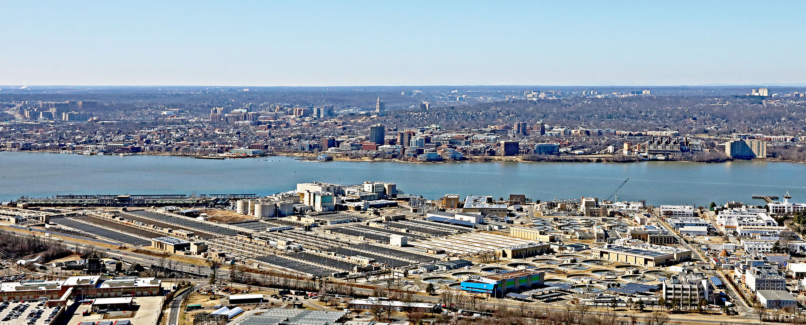
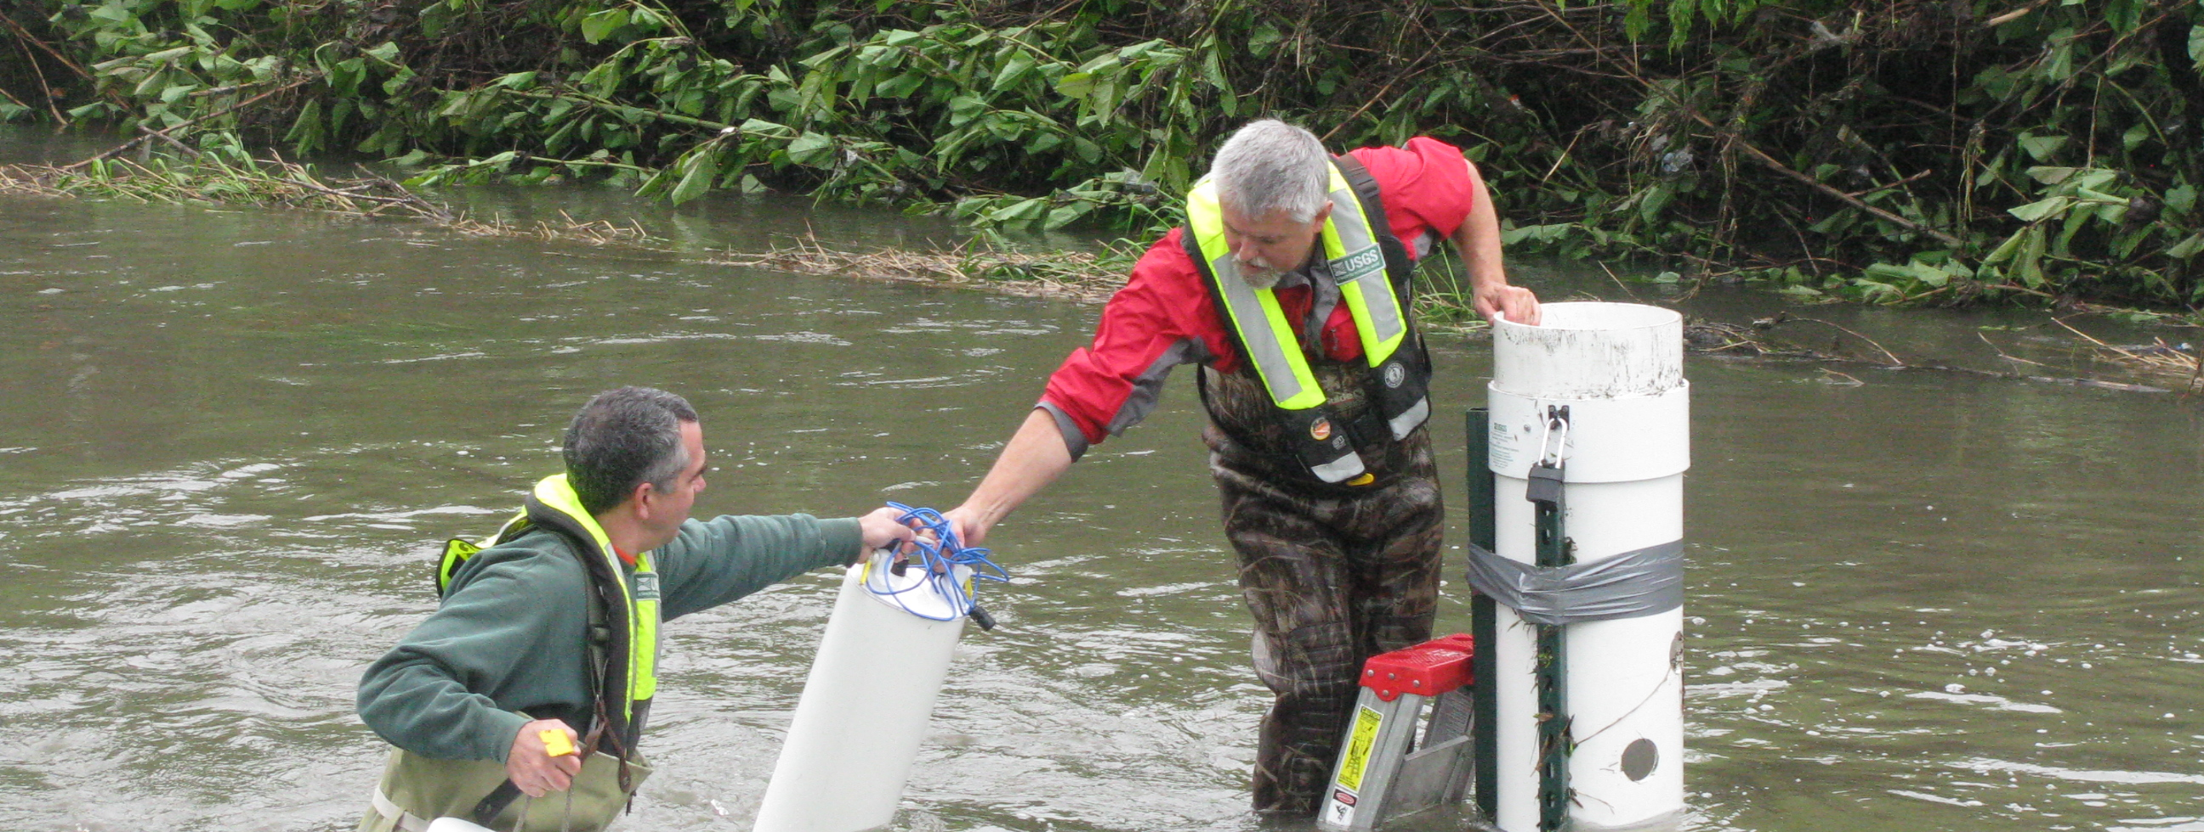
Small changes need trustworthy detection
Water-quality monitoring for treatment and reuse operators • SDG 6
The decision gap
Across multiple sampling taps, a small composition change can be hidden by measurement noise or temperature drift. Operators need to know when to investigate.
Treatment context: Blue Plains, Washington, DC
Our target
Track the mean dissolved-salt change continuously, then trigger a chemically specific follow-up test.
SDG 6.3: water quality and safer reuse.
SDG 6.4: potential efficiency benefit; water saved remains unmeasured.
USGS field sampling: real-world monitoring demands
Photos: Duane Lempke / CC0; Barbara Mahler / USGS, public domain
TEAM 7 • IDEATION • SIMULATED RESULTS
1 / 5
Notes:
Proposed use case; no verified customer or quantified missed-event prevalence. United Nations target definitions: https://sdgs.un.org/goals/goal6 and https://unstats.un.org/sdgs/metadata/?Goal=6&Target= . Target6.3 concerns water quality, pollution reduction, wastewater treatment and safe reuse; target6.4 concerns water-use efficiency and sustainable withdrawals. Our proposed contribution is monitoring, not proven delivery of either target. This is a salt-proxy change detector, not a drinking-water safety test. The supplied template explicitly distinguishes October ideation from the in-person presentation; this concise artifact is created at the user’s request. Working nameTeam7 confirmed; final name and roster remain unconfirmed.
PHOTO SOURCES: Blue Plains aerial by Duane Lempke,2022,CC0: https://commons.wikimedia.org/wiki/File:BluePlainsWaste-4126-022022.jpg . USGS Lincoln Creek sampling by Barbara J Mahler,2013,public domain: https://www.usgs.gov/media/images/collecting-a-water-quality-sample-usgs-regional-stream-quality . Photographs illustrate context; neither location is our pilot or a measured salt incident. They are not proof that our salt proxy detects all visible contamination. SDG definitions: https://sdgs.un.org/goals/goal6 .

Slide 2
Proposed sensor and continuous readout
1550 nm light → water-induced phase shift → homodyne → mean estimate
A calibrated optical proxy
Synthetic event at 16 different taps
NaCl index slope: 1.62 × 10⁻⁷ RIU per mg/kg. A proposed 10 µm interaction converts salt changes into phase.
Why shared squeezing?
Distribute one squeezed mode across taps. Negative readout correlations reduce noise in q̂ = Σ yᵢ / M.
Arrivals: 90–135 s; response lag: 10 s. Both strategies share the same drift. Squeezing reduces noise, not lag.
Classical Python simulator • Proposed quantum sensing hardware • No pollutant-specific identification
TEAM 7 • IDEATION • SIMULATED RESULTS
2 / 5
Notes:
Technical rigor: 30%. Classical matrix operations and Gaussian threshold tests; no quantum computing speedup, QAOA, VQE or QML execution. Covariance is propagated through loss and phase jitter. Objective is minimum error for an unbiased arithmetic-mean estimate under the stated resource constraints; no changing site weights to discard noisy nodes. Theory https://arxiv.org/abs/1711.10459 and https://doi.org/10.1103/PhysRevResearch.2.023030 . Classical estimator is computationally tractable. QC-specific eligibility must be confirmed with organizers. Hack stack: Python, NumPy, SciPy, Matplotlib. No quantum hardware has been built.
NaCl calibration: Saunders https://doi.org/10.1364/AO.55.000947 . Around500mg/kg, dn/dc=1.6207394e-7 RIU/(mg/kg). Effective length10µm is assumed, giving6.5699393e-6rad/(mg/kg). Local concentrations may differ. NaCl-equivalent mg/kg is a nonspecific proxy: no arsenic/nitrate selectivity or mg/L conversion. Classical simulator uses Python, NumPy and SciPy. Hardware remains proposed. Product concept: calibrated optical sampling module with operator software and confirmatory chemical analysis. Quantum-computing emphasis of rubric remains an eligibility question.
results/time_trace.csv. Synthetic changes, not observed water data. Independent optical noise, common OU realization, seed2601006. Optical noise advantage concerns the aggregate; local contrasts do not receive the same benefit.
Source NaCl slope Saunders2016 https://doi.org/10.1364/AO.55.000947 . Mean event.35mg/kg,±25%spatial variation,25s rise,1s sampling. The stationary RMSE does not include transient lag bias. Full trace results/time_trace.csv. Scalar estimator is classical; this does not show quantum computational speedup. Source mode rate1MHz and10dB cap are assumptions.

Slide 3
Scaling: the ideal gain meets real losses
Coherent vs independent squeezing vs distributed squeezing • Same launched probe photons
Ideal reference: near inverse-node RMS
Regional stress test: 64 distinct sites
Slope −0.953 vs −0.500 over M = 33–64. Requires lossless links and total squeezed energy growing with M.
Mean transmission 0.371; optimized classical 0.0729 → quantum 0.0655 mg/kg: only 1.11× gain.
Regional: assumed 1.3× geographic routes, 0.18 dB/km fiber, 10 dB squeezing cap; geometry is not surveyed fiber.
TEAM 7 • IDEATION • SIMULATED RESULTS
3 / 5
Notes:
NaCl: Saunders https://doi.org/10.1364/AO.55.000947 ; squeezing Mehmet https://arxiv.org/abs/1110.3737 ; fiber https://www.corning.com/media/worldwide/coc/documents/Fiber/application-notes/AN2008.pdf ; thermo-optic Kim https://opg.optica.org/abstract.cfm?uri=sensors-2012-STu1F.3 . Supplied Dowran https://doi.org/10.1364/OPTICA.5.000628 reports795nm199kHz air sensitivities8.6/6.8/5.5e-10RIU/sqrtHz; not transferable to1s1550nm water. Supplied Pooser/Lawrie PDF is supporting information of a separate paper. QML https://doi.org/10.3390/quantum8030060 ; matched RBF remains strong. Complete sources and each config parameter in docs/PROJECT_REPORT.md AppendixA.
Pilot eta=.731827,sourceNs1.6 photons/mode,9.18dB squeezing; source cap10dB and mode rate1MHz are engineering targets. Equal launched carrier+squeezed photons, excluding pump and LO electricity. Nearest64distinct supplied USGS-labelled coordinates; route1.3×greatcircle, not surveyed fiber. Sweep includes10mK stress case and1nW–70µW classical power. Ideal lossless uncapped fitM33–64 yields−.953 vs−.500 RMS slope only with growing total squeezing; no deployable1/M claim.13internal model tests;100000 null/alternative draws per strategy verify Gaussian ROC. No field data are generated or claimed; see docs/PROJECT_REPORT.md.
Computed by src/model.py and results/summary.json. Per-node squeezed budget 0.1 photon/mode, total Ns=0.1 M; equal launched bright-plus-squeezed photon budgets. S4 asymptotic displacement model.
data/site_geometry.csv derives coordinates only from draft. 8889 records reduce to 7704 coordinate pairs; nearest64 selected. As M changes, sampled population changes, so this is not a sensor-reduction claim for one fixed spatial target.
Ideal panel Ns=.1M, no cap/loss/jitter/technical noise; practical source Ns<=2.025. These are different reference scenarios, not a proof of deployable1/Mscaling. All carrier+squeezed photons included, pump and LO electricity excluded. The regional plot changes sampled sites as M increases. Coordinates only transferred from supplied USGS-labelled file, lacking full environmental provenance. Exact values results/summary.json and scaling.csv. Theory https://arxiv.org/abs/1711.10459 ; fiber https://www.corning.com/media/worldwide/coc/documents/Fiber/application-notes/AN2008.pdf .

Slide 4
Controlled pilot: lower error, more detected changes
16 taps • 100 m links • 10 nW/tap • 1 s • Assumed 50 µK common temperature residual
Estimation: 28% lower total RMSE
Detection: 24% → 47% probability
0.0921 → 0.0664 mg/kg total RMSE. Distributed squeezing also beats independent squeezing by 16.6%.
A 0.15 mg/kg mean step, at 1% false alarm per decision. 100,000 null and event trials per strategy.
All results simulated. 1% at 1 Hz means 36 expected flagged windows/hour; an operational alarm rule is still needed.
TEAM 7 • IDEATION • SIMULATED RESULTS
4 / 5
Notes:
Quantum justification: 20%. This is a prediction for a proposed controlled instrument, not a measured water sensor. Optical RMSE .079619 vs .047583; total precision gain 1.387×. The ambitious common temperature residual is an engineering assumption. Probe photon accounting includes squeezed photons deducted from carrier power, but excludes pump and local oscillator energy.
results/summary.json pilot16. No measured-field accuracy claim. Common residual 50 microkelvin is an ambitious compensated bench target.
Results/summary.json gives27.92% RMSE reduction versus coherent and16.58% versus independent squeezing. At64regional sites compare optimized coherent .0728867 to distributed .0655362mg/kg.10mK residual gives approximately9.137mg/kg for either strategy. More classical power also shrinks total gain. These are conditional predictions, not measured hardware results or experimental proof of the literature. Source plot uses exact model results rounded for spreadsheet portability.
results/detection.csv. Independent Monte Carlo marginal windows, not independent samples of the OU trace. Assumes Gaussian moments including squeeze-angle jitter. Decision threshold is not regulatory. Bonferroni alpha=0.05/3600 bounds hourly familywise false-alarm probability at5% without independence.
Analytic Pdetect .2426817/.3293999/.4733113;MC .24311/.3316/.47512. Marginal Gaussian tests, not temporally independent field seconds. No regulatory or chemical safety threshold.13internal checks validate model properties; no hardware trial. Pilot optical RMSE .079619 vs .047583mg/kg gives1.673×gain;total1.387×. Technical targets are essential. Raw summary results/summary.json.

Slide 5
The next test: does the gain survive real water?
Loss, temperature drift and higher classical power determine whether quantum optics is useful
Common temperature drift erases gain
A scoped laboratory pilot
1 Calibrate one water cell: salt response, transmission, temperature and bias.
2 Blind-test four taps against coherent probes and conventional conductivity.
3 Measure detection delay, false alarms and full electrical energy before scaling.
At 10 mK residual, both strategies give ≈9.137 mg/kg error. More coherent light also narrows the advantage.
Resource KPI: 160 nJ probe/window for both. Pump, readout and control energy are unmeasured; no net saving claimed.
Path to impact: operator + optics-lab pilot → validated monitoring module; water saved and commercial viability remain open.
TEAM 7 • IDEATION • SIMULATED RESULTS
5 / 5
Notes:
Required closing three claims from judging guidance. All pilot claims use16nodes,10nW/node,1s,50µK common residual. Detection uses.15mg/kg increase and1% false alarm per decision. Optical energy160nJ is equal resources, not measured sustainability improvement. Algorithm is estimator accuracy, not quantum computational runtime. Next KPI: total joules per validated useful detection at matched coverage, false-alarm rate and response time. Results do not prove/disprove literature: conditional model consistency only.
Detection of.15mg/kg mean increase,16nodes,1s,50µK residual.1% per-window false alarm at1Hz gives36expected flagged windows/hour; not an operational alarm policy. Need a separately validated sequential rule. First audience controlled plant lab; possible model research pilot then monitoring module, no confirmed partner or revenue. Compare conventional conductivity and higher-power coherent optics. Expansion only if useful detection beats these alternatives under an operator-relevant constraint and measured total cost/energy. Seek water operator and optical laboratory for a scoped pilot. Figures do not prove/disprove experimental literature; they show conditional consistency and failure regimes. Sources and technical details in docs/PROJECT_REPORT.md and results/summary.json. The proposed environmental impact remains unvalidated.
S10 reports dn/dT≈−1.485e−4 RIU/K at1550nm. The exact coefficient depends on temperature/composition. 0.05 mK and10 mK are assumed stochastic residuals, not manufacturer statistical specifications.
The50µK residual is a demanding target, not demonstrated water performance;10mK is a stress scenario, not statistical interpretation of YSI accuracy. CommonOUdrift tau60s.1mK≈.916mg/kg apparent NaCl change using Kim thermo-optic anchor https://opg.optica.org/abstract.cfm?uri=sensors-2012-STu1F.3 . Higher-power coherent sweep1nW–70µW in Figure10. Stop or redesign if a cheaper/lower-energy conventional alternative achieves the operational goal. Three KPIs: estimator RMSE/sl4,monitoring detection/sl4,energy accounting/sl5. Literature is conditionally consistent, not independently experimentally validated. Team7 has no confirmed partner, customer, price or installed device.

