Slide 1

Getting into software
An apprentice's guide for getting into the tech and software industry.

Slide 2
WHO AM I?
Hi, I’m Nathan
Software Developer Apprentice at RCS (Retail Computer Solutions)
RCS makes EPOS software for all kinds of businesses, currently building a web version of our product set for release next year.
A-level further maths, Computer science and physics
6th form at Garforth Academy, finished school in 2023
Straight to RCS on a level 4 apprenticeship

Slide 3
WHY THIS IS WORTH YOUR TIME
Coding for a job is very different to coding in school. The tools available to you are more powerful and the jobs are more creative yet still structured and much more fun
A lot of helpful info is not taught in school, so it is rushed later in your careers.
Nobody codes alone but all schoolwork is done independently e.g. coursework so it can be hard to work in a team after school.
The things I can show you will be helpful through your careers and education whether you go straight to work or go to uni.

Slide 4
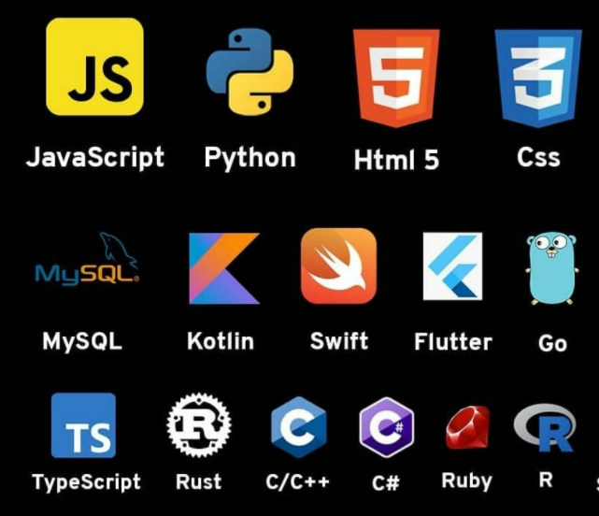

LEARNING NEW LANGUAGES

Slide 5
Learning something new
Knowing more languages gives you more variety in the sorts of work you can do
Most languages can do anything with the help of a library, but some are much more specialised at certain tasks
Same basic concepts exist in practically every language or can be added to them with libraries
But some languages are more helpful to learn then others
Some languages are more widely used. Others are so similar in nature, learning one teachers you them all. For example…

Slide 6
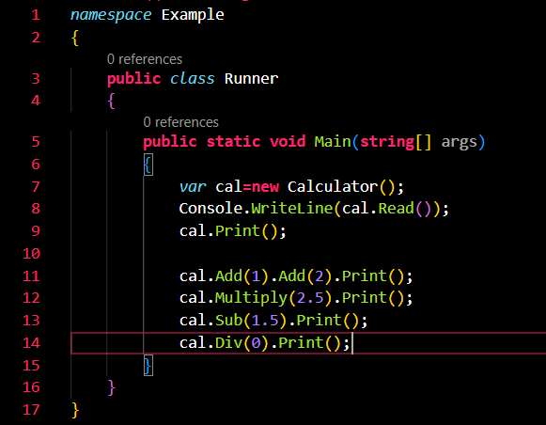
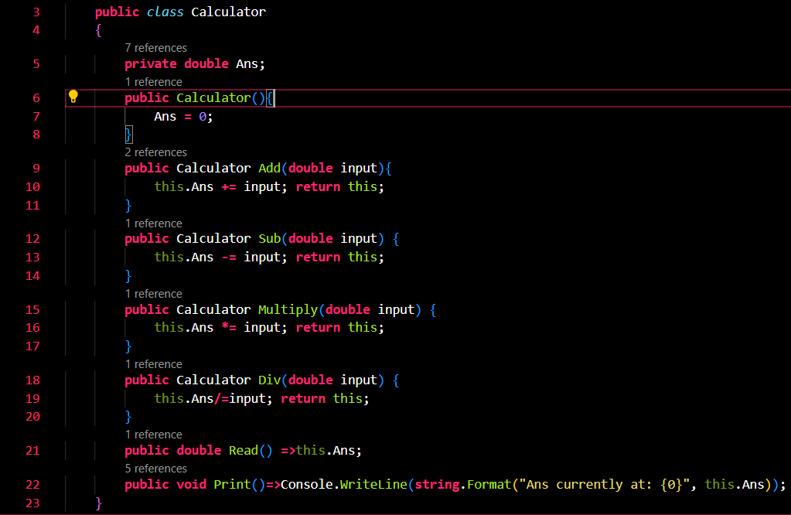
Here is some C# code
You do not need to “know” C# to for this example
Just do your best to follow along
Start by reading the Main function

Slide 7
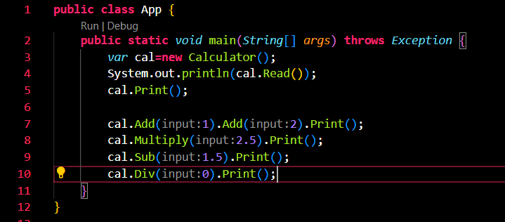
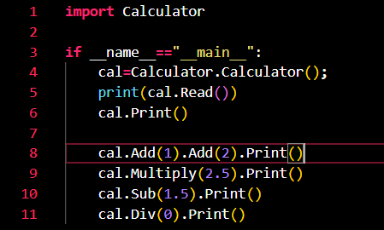
Here is that main function Now in Java and Python

Slide 8
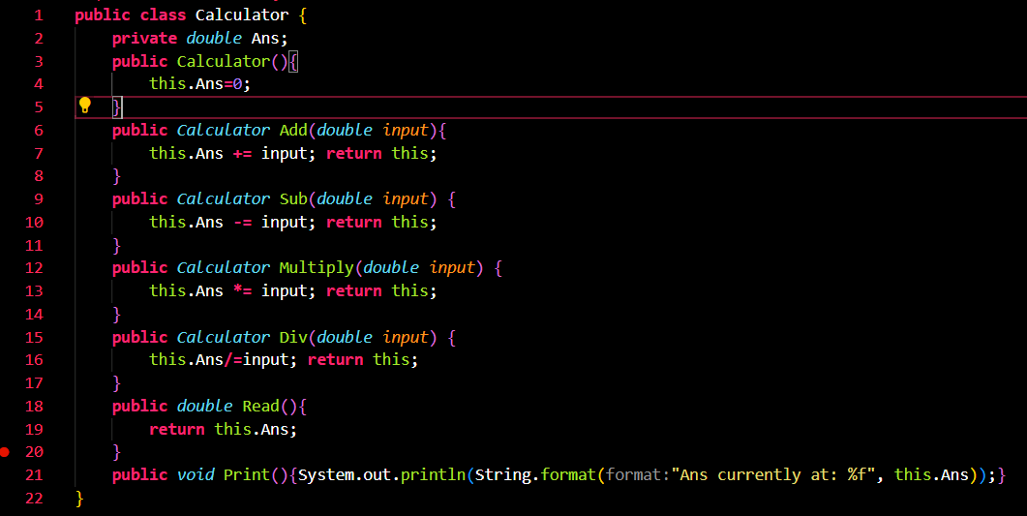
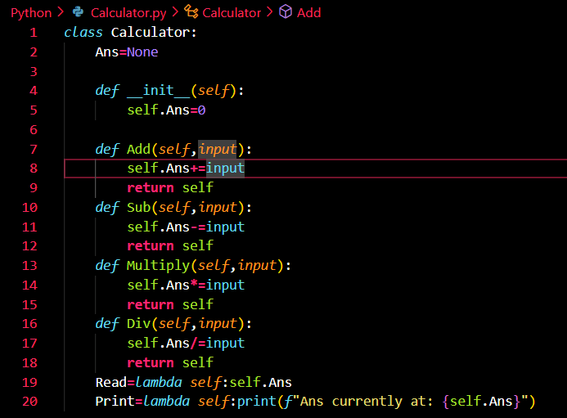
How about the calculator itself By learning C#, you would also be learning Java as they are so similar

Slide 9
My recommendation
I would suggest leaning c#. It is a highly functional language useable in lots of places. From web servers to the unity game engine
It uses a lot of common features so by learning it, you get a head start in several other languages
Supports features like method overloading which python does not, and extension methods which are exclusive to C#
Has several tools and libraries that can help. Like entity framework that can connect to Databases and write SQL for you
High level so still easy to learn and understand

Slide 10
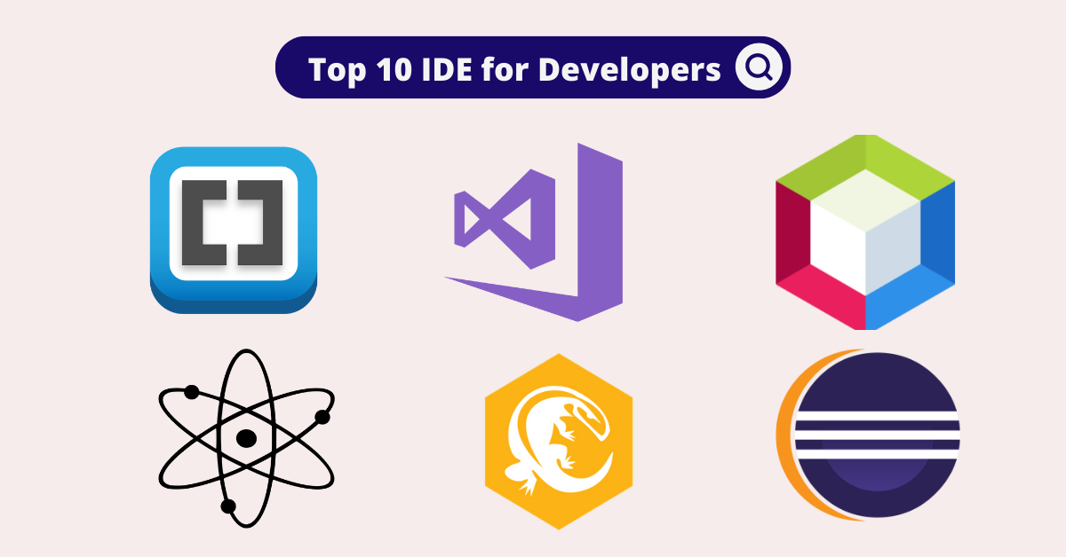
Using an IDE

Slide 11
What is an IDE really
An IDE is the industry standard way to write software
A piece of software that while not required to write code, in the modern world, it is unlikely you will not make use of one
Most IDEs will: highlight errors in your code and provide an explanation as to why, make the setting of breakpoints easy for debugging, provide ability to step through code when in debug mode, show available variable and function
Many are free to download and come with additional tools
Any decent IDE can do everything that I have mentioned, for free, no strings attached. If not, it is not a good IDE (at least not yet)
Let’s look at 2 examples

Slide 12

A good starting point
The previous examples were made using VS code
Free open-source IDE by Microsoft
Highly customisable. Supports many languages by default and can also have additional languages added to it. Also, custom tools and themes (like the one I use). All free from an in-app marketplace.
Supports everything I mentioned but still quite light.

Slide 13

A professional’s tool
Visual Studio Community Edition is another free IDE developed by Microsoft. This one being much more powerful
Same sort of customisability but expanded features for getting started and debugging
Includes C# download by default
Project templates to help you get started with a variety of tools from Websites and console apps to test projects and web forms
Lots of IDEs out there so it’s always worth looking. But there are many good (free) options

Slide 14
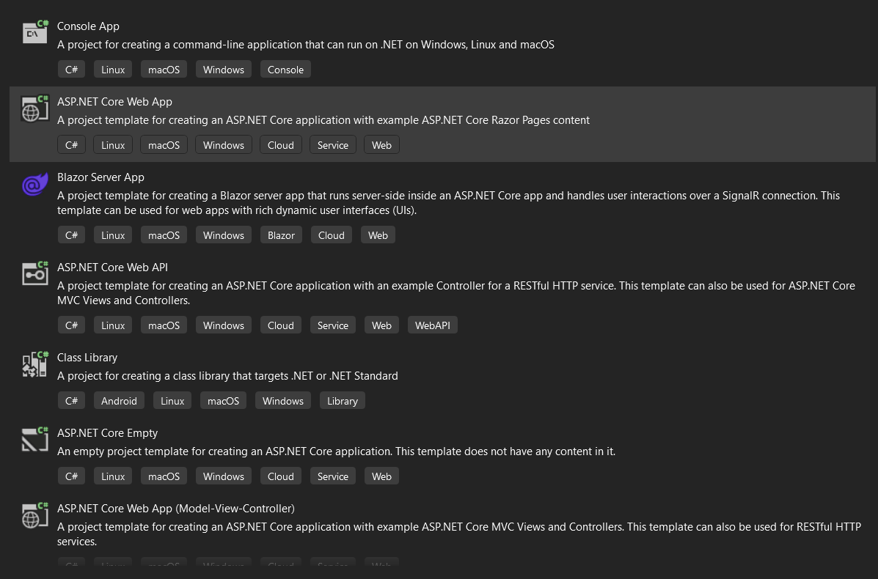
Here is just some of the templates available to use

Slide 15


SOURCE CONTROL
HOW WE WORK
AS A TEAM

Slide 16
Git and GitHub
Together, these make the backbone of most of the software industry. 90% fortune 100 companies. Around 100 million developers use these tools as a pair.
The closest competitor to GitHub is GitLab. GitLab still uses Git to work but only itself has 2 million users. GitHub easily some of the most used source control in.
A lot of statistics are based on GitHub e.g. what code languages are most popular

Slide 17
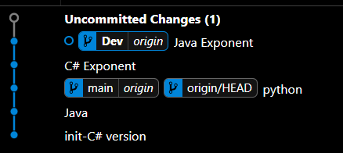
Git
Git is used to set up repositories (repos)
Repos are like folders, only they can remember what has changed.
To save the current state of a repo, you make a commit. This can be done with the command line
You can move between these commits so if something goes wrong, you can always recover progress
Also allows for branching. This allows us to isolate development and merge branches together when ready.
Typically, 2 branches minimum: a main branch that always works and a dev branch you work on.
Look at the image above, this is a commit tree:
There are 2 branches, main and dev
Dev is 2 commits ahead of dev
There are also changes waiting to be committed

Slide 18
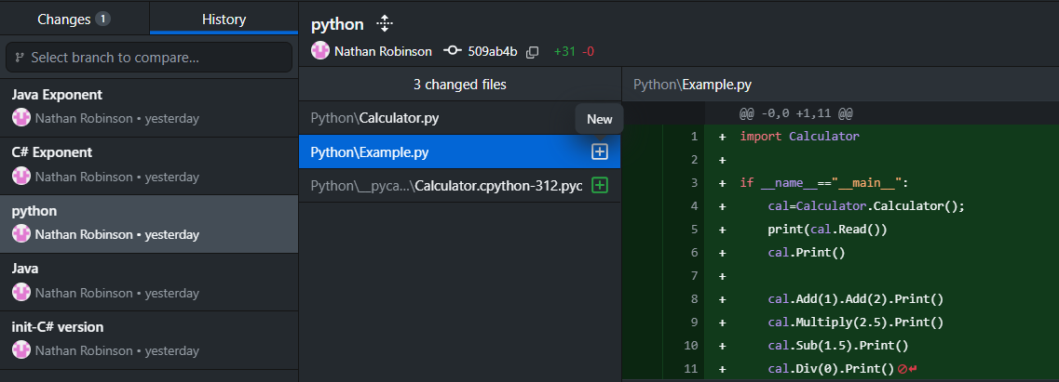
GitHub
GitHub is effectively cloud storage for repos.
This is the key to working in a team. GitHub connects all instances of the repo together.
When a user makes a commit to the repo, they push this to the GitHub
Other users then pull these changes down into their own local versions of the repo
This means that users have detailed records of what changes have been made and who made them and they are always working on the same code. Allowing for seamless collaboration. Below is a screenshot from GitHub desktop.

Slide 19
QUICK DEMO From: https://github.com/NathanRobinson3012/codeSchoolDemo

Slide 20

SQL

Slide 21
A valuable skill to remember
A large amount of software relies on external data, commonly from a database
This makes SQL an important skill in the industry to be able to check the status of databases and that the SQL you write does what you expect
Most coding languages have tools that allow you to construct SQL and execute it against a database from within the application. Sometimes this is writing the raw SQL, but some tools can do it all for you
SQL queries can be used to construct objects based on the data given
Queries are often very powerful tools. In particular: aggregate functions allow for lots of data to be transformed into something useful like a table of averages

Slide 22
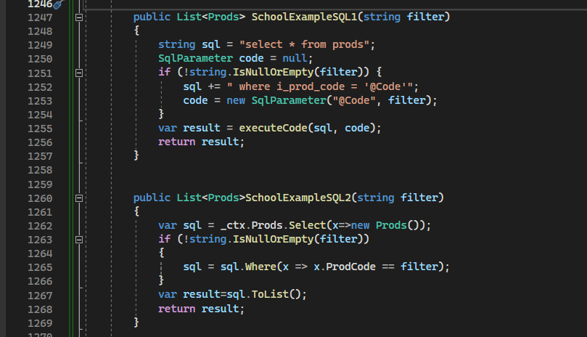
Example
The first function here writes the SQL as a string, then sends this to a new function to execute it against the server. This gives us control of the SQL.
However, we need to use something to “parameterise” the data. This guards against SQL inject attacks as writing raw SQL with user input presents a security risk.
For example, without the SQLparameter, the user could send“0 drop table prods” for the filter and this would remove the whole table from our server, breaking everything
The second function uses a Library that will compile the SQL for us based on a class Prods.
Much easier to write. Also much more likely to be safe
But as we lack control, the SQL the library makes could end up being slow and memory inefficient. Also creating the SQL from the library takes time and memory.

Slide 23
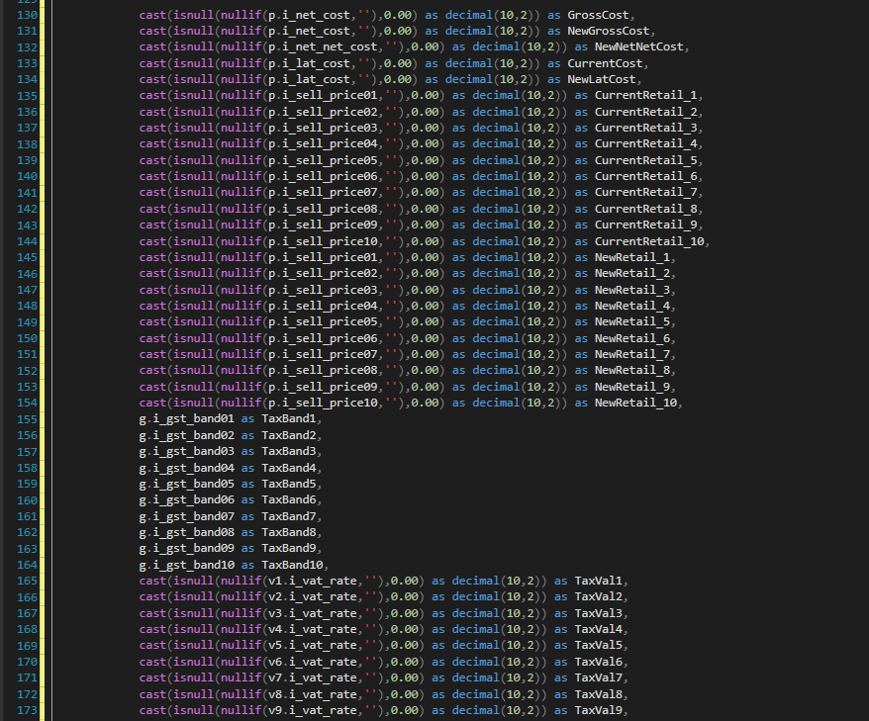
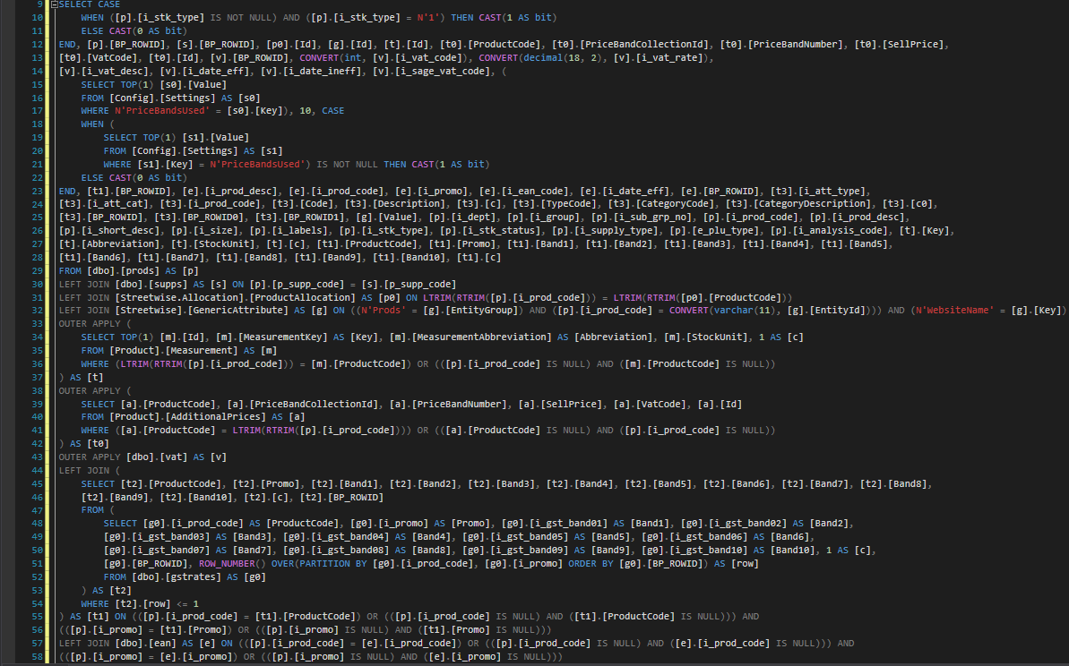
But why this skill needs upkeep
Because SQL quickly gets much more difficult. Look at these 2 example, the left one from a larger query written by a developer, the right written by a library. Both are a single select statement.
And this is a mess to me, but its ok because I understood the code that made it from a library.
This was at line 200

Slide 24
Finally, a quick note on convention
Convention is a set of “rules” that prescribe how code should be written to be maintainable.
Languages can have their own set of conventions as they are often developed as a shared understanding between the community of developers who use the language. As a result, they change e.g. Hungarian notation would say a list of ages should be called “intListAges”
Companies can also have their own internal conventions or style guides
But in general: variable names are written in camelCase, classes and function names are PascalCase. Comments should also be added on anything that would be unclear to a reasonable programmer. And regardless of language, indent like you would in python
BUT most importantly. This is a guide. Code in the clearest, cleanest way you can, however that may look

Slide 25

An opportunity at www.rcs-uk.com
If you are interested in getting into software, getting that first real experience in the industry in a paid position, we may have a place for you
NRobinson@rcs-uk.com
Email in your CV. I will get back to you with some possible improvements for someone trying to get into the industry. Also, Y13s may want to send in their coursework
I will also be sharing the CVs with my higher-ups for their input.
RCS has a long history of recruiting people from 6th form. My manager is a perfect example of this, being recruited from school and now being the person everyone goes to
Experience can be one of the most valuable things in the working world, just look at how much I have learnt in less than a year
Make sure to include your: Name, email (not schools), A-levels and expected grades, work experience, interests and anything else we should know about you!

