Slide 1
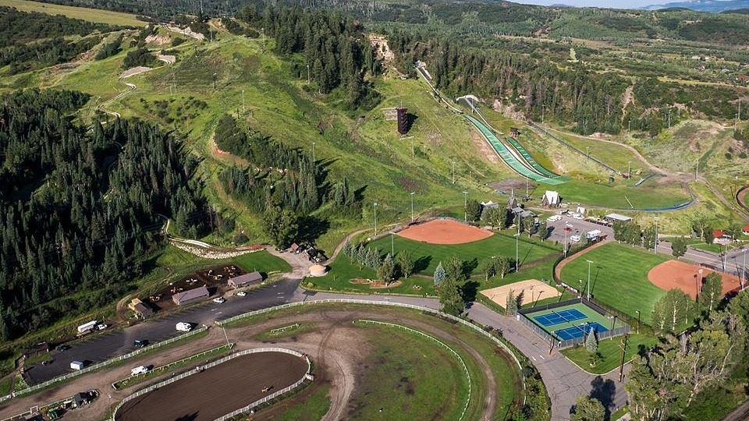
FDEM Analysis of Howelsen Hill Steamboat Springs, CO
Ian P. Hickey, Nate T. Sedmak, M. Lucas Holt
Day 1

Slide 2
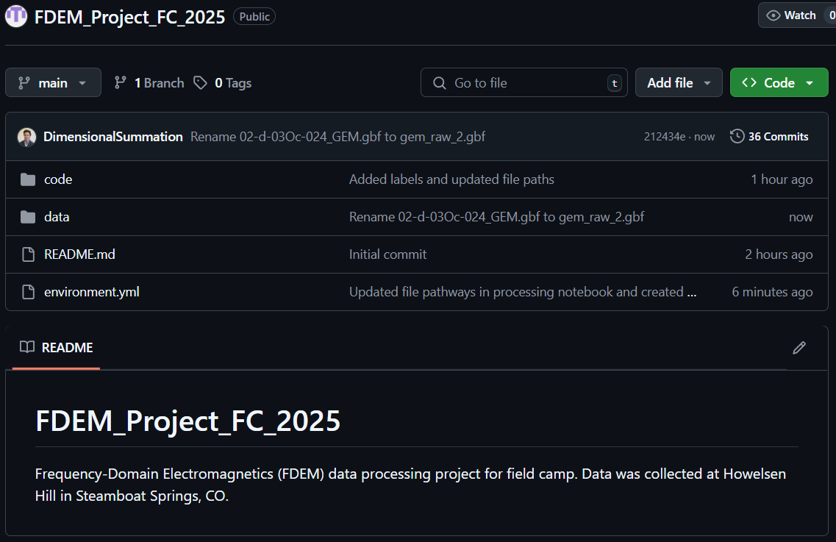
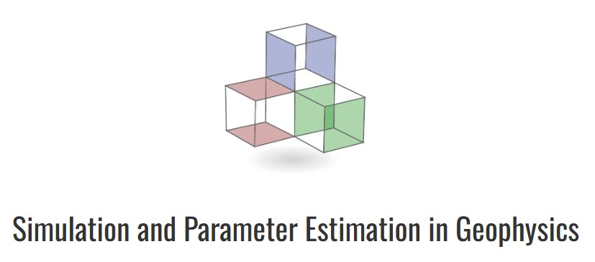
What We Accomplished
Created a GitHub repository to store our data, code, progress, and files associated with the project
Downloaded and set up SimPEG so we can perform 2D inversions and potentially a 3D inversion.
Performed early analysis of group 2's 05/14/2025 FDEM data

Slide 3
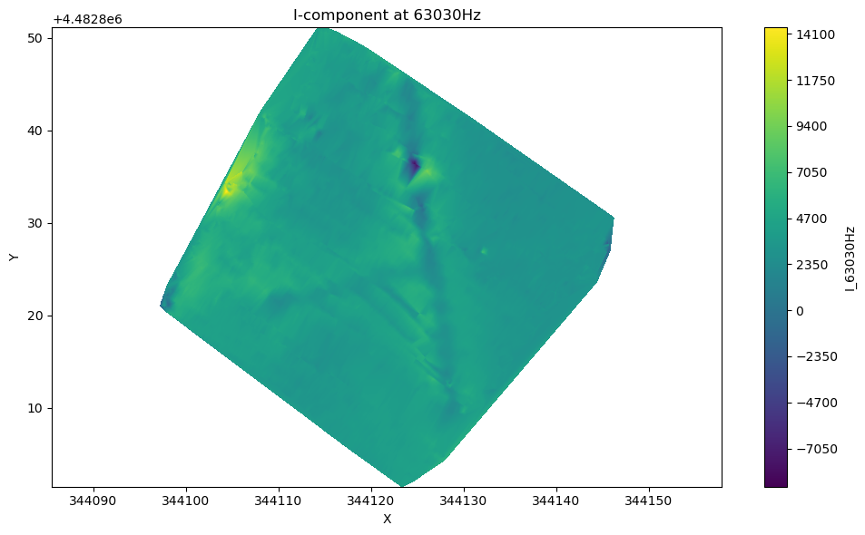
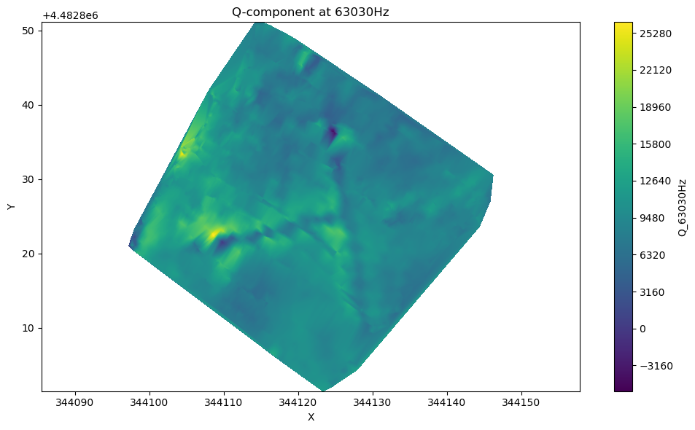
Early analysis of In-phase and Quadrature FDEM Components
At 63030Hz evidence of a T-shaped feature takes shape.
We worked with Joe to identify if features in the data are viable for future analysis of landslide slumps.

Slide 4
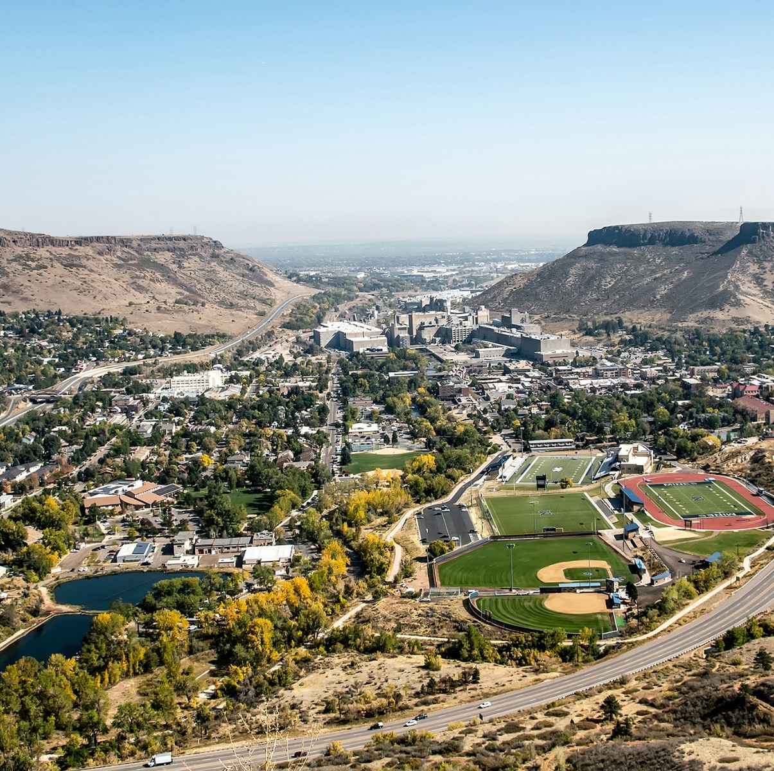
Future Plans
Completely setup all required software including SimPEG on all computers
Talk with Joe on how to implement topography into 2D/3D inversions
Perform 2D inversions
Continue gathering information about Howelsen Hill (previous slides and utilities)
Contact Dr. Gabe Walton (Mines Geology) about LiDAR data

