Slide 1
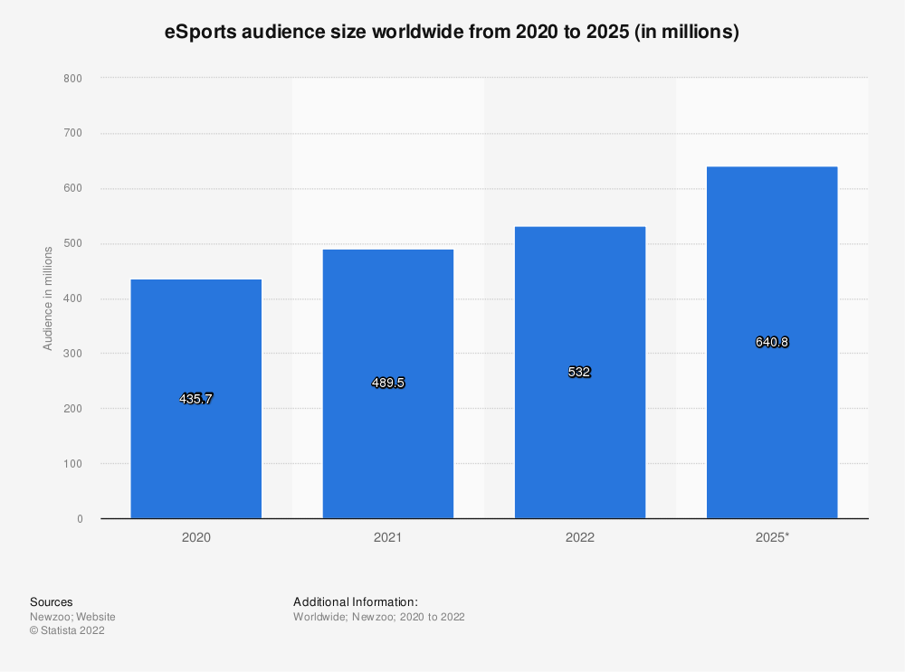
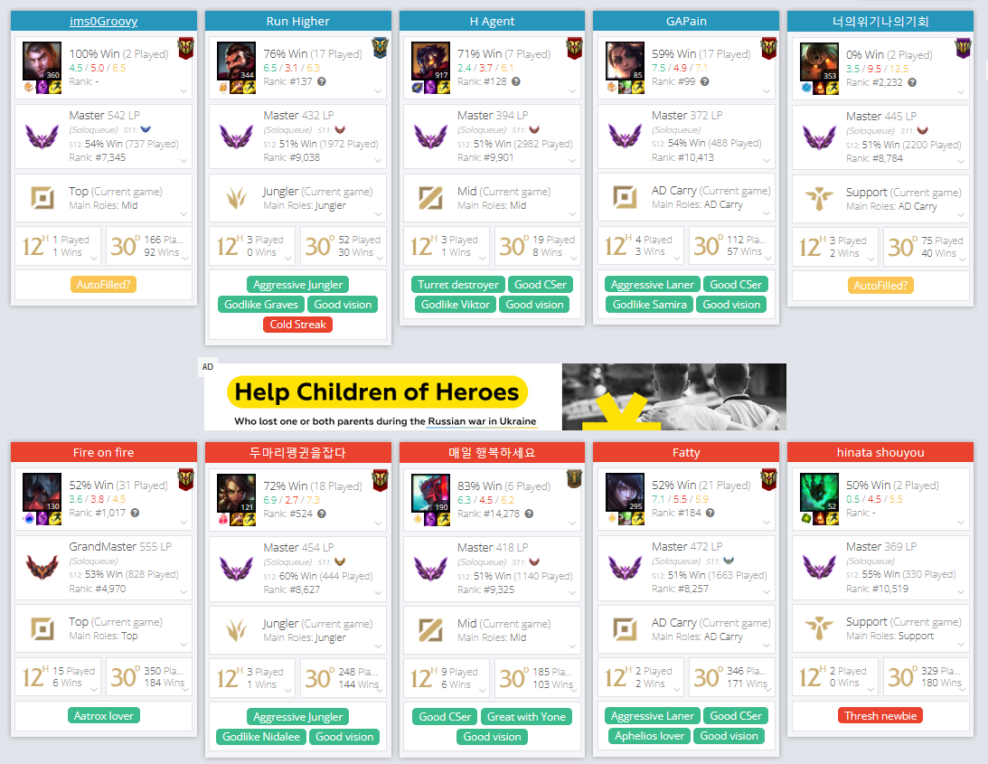
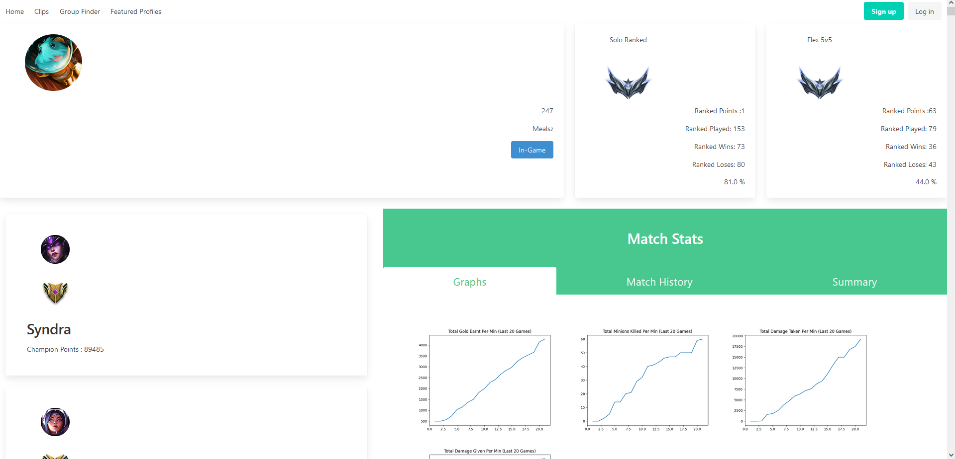
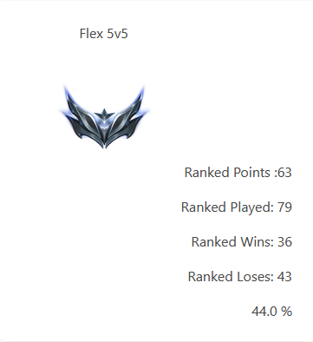
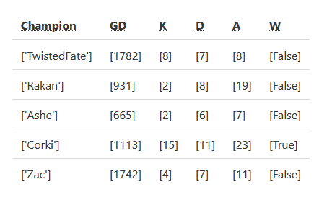
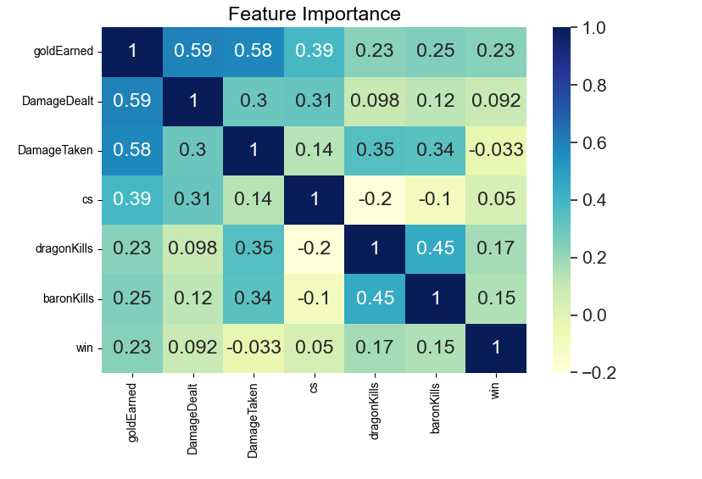
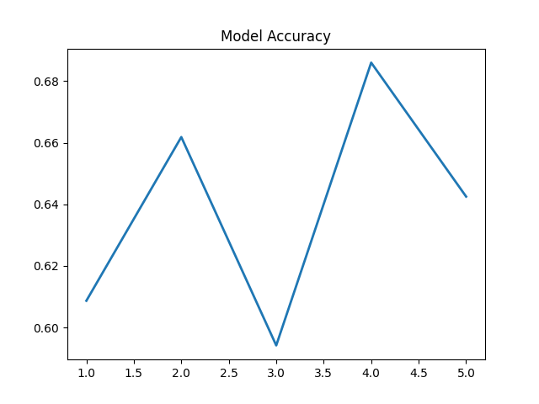
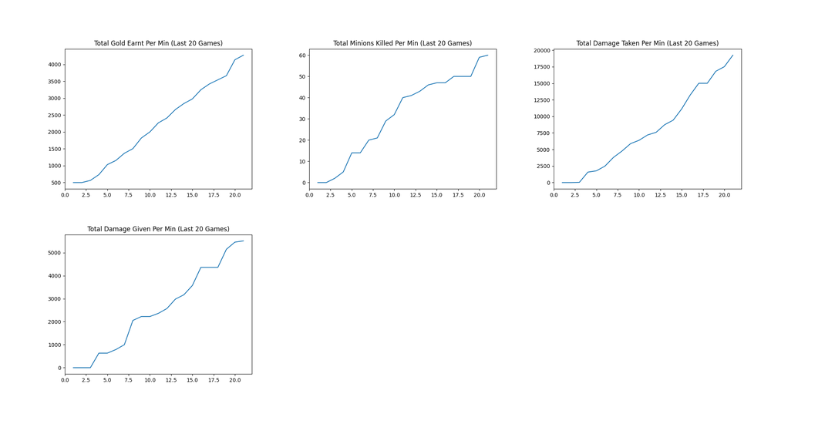
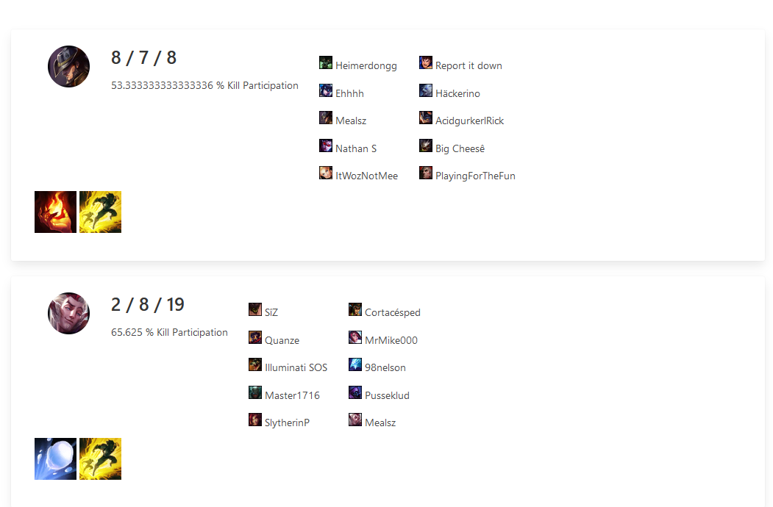
Analysis and Prediction of Player and eSport Data
Introduction
Approach and Methodology
In 2015 the esports audience was around 135 million people, and in 2019 the number tripled, growing to 454 million viewers (Wooyoung Jang and Kevin K. Byon, 2021).
Due to the rapid increase in interest in eSports, data has become more widely available and seen a rise in prediction and statistic-based applications.
This work will use a machine-learning algorithm to enhance these applications.
Statistics are being gathered from the Riot Games API, into a local database that stores statistics on a variety of matches, which is fed into a machine learning engine.
This work will assess a variety of machine learning algorithms to assess the best one for the application.
Currently, the SVC algorithm has an accuracy of 63%.
Similar Applications
Applications like op.gg and LeagueOfGraphs offer similar services but lack the prediction of matches using ML, rather they get each player’s win rate and provide the mean value to show who is more likely to win the game.
Project by Allan Bruno (2020) saw a 74.004% prediction rate using features like Gold and Experience in the early game to predict the winner.
Newzoo (2022). eSports Audience Size.
Objectives
Progress Made
The main aim is to identify and define patterns and behaviours of the players; through the use of a machine learning algorithm.
The secondary aim is to include this into an application that enhances player decision-making to enhance their performance, based on:
Analysing and Locating a player's weakest attributes to highlight areas of improvement.
Simulating a match based on user inputs.
Collate and Process League of Legends Match data to predict outcomes.
Used Riot API, to create infographics based on matches.
Query a player based on region and name.
User based-accounts.
Simple Machine Learning Algorithm – SVC .
Design Examples
Further Development
In-Game Feature
In-Depth Match History View
Compare with other players
Simulate a match
Feature Selection and Accuracy
GitHub (NathanSmallcalder):
https://github.com/NathanSmallcalder/Dissertation

