Slide 1
AI Applications in Network Congestion Control
Nathan Pemberton

Slide 2
Problem Statement
Round Trip Time (RTT)
(dependent variable)
Main Objective:
Maximize send rate, minimize Loss and RTT
Flows
(don’t directly coordinate, only infer from loss or RTT)
Bottleneck
Loss
(dependent variable)
Send Rate (c)
(independent variable)

Slide 3
Congestion Control Other Desiderata
Fairness: All flows should converge to the same properties
Heterogeneity: Should work even when other flows use different algorithm (especially TCP) or different goals (e.g. centrally controlled BW caps)
Regret-Free: Adaptive schemes should be strictly better than a fixed policy
Optimality: Each metric should be maximized at steady state (e.g. fair throughput should occur at min RTT)
Random Loss Tolerance: Not all packet loss is due to send rate, algorithms must tolerate random packet loss as well
Dynamics: Algorithms must react quickly to changes in NW, both short term (noise) and long term (new flows, mobile, etc.)

Slide 4
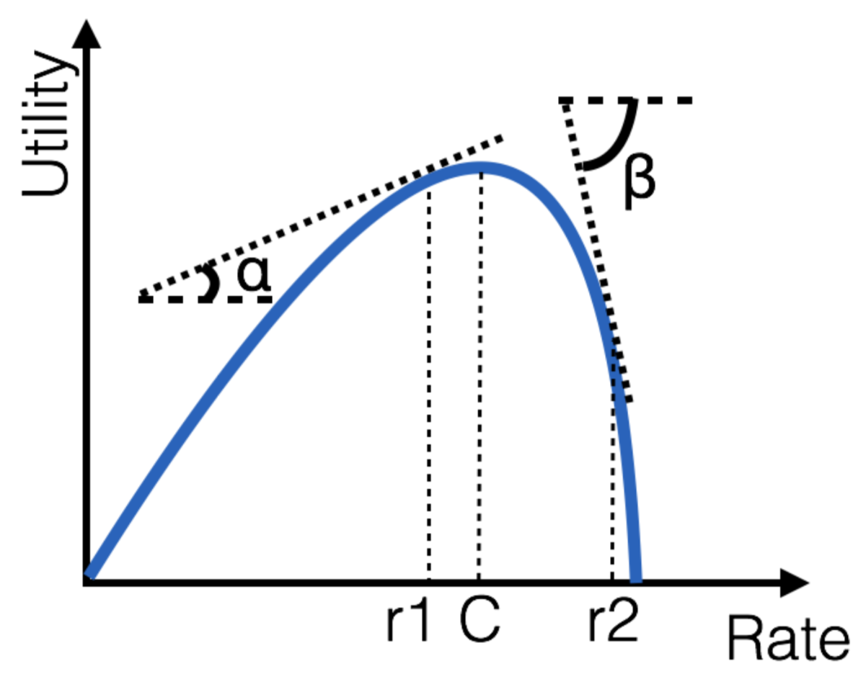
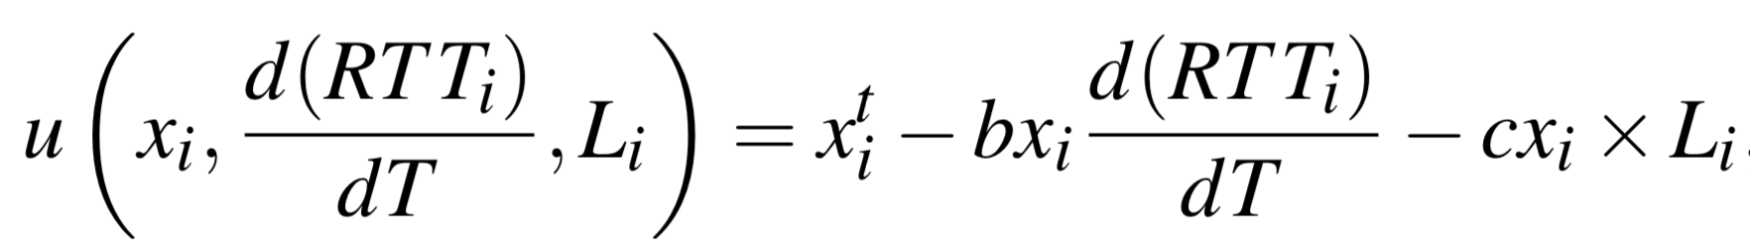
Background PCC Vivace
Online Gradient
Ascent
(adaptive learning rate)
Latency
Gradient
Packet
Loss
Send Rate
Maximize
Minimize

Slide 5
Vivace Strengths and Limitations
Strengths
Provable Properties:
Formal bounds on parameters give proof of all desiderata (not all mutually achievable)
Excellent Performance
Rapidly adapts to many situations
Best-in-class or better in most metrics, but much more stable and less fiddly (especially vs TCP)
Easily tuned (parameters mean something, and have associated proofs)
Limitations
Slow adaptation in extreme environments (e.g. mobile)
Random loss tolerance => higher congestion loss
Paper claims this is fundamental
Conflicts with TCP: fundamental tradeoff between loss-based and latency-based algorithms

Slide 6
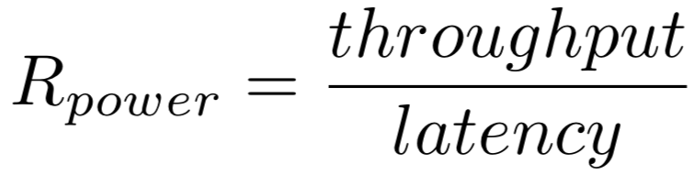
General E2E RL Approach
Actions: Change Sending Rate
State: Past N time windows (rate, latency, loss)
Rewards:
(Didn’t use Allegro or Vivace utility for some reason?)
Model: Deep NN for policy
Training: Simple network simulator with single flow, vary only in latency and capacity

Slide 7
Results - RL Approach
“Our evaluation showed that Custard was fairly robust with respect to link capacity, latency and buffer size”
“Our model may be resilient to changes in link parameters, but it can suffer significantly from even minor changes in the environment”
“our model achieves near-capacity throughput with low self-inflicted latency”
“Improving our agent’s robustness to multiflow competition is an interesting avenue for future work”

Slide 8
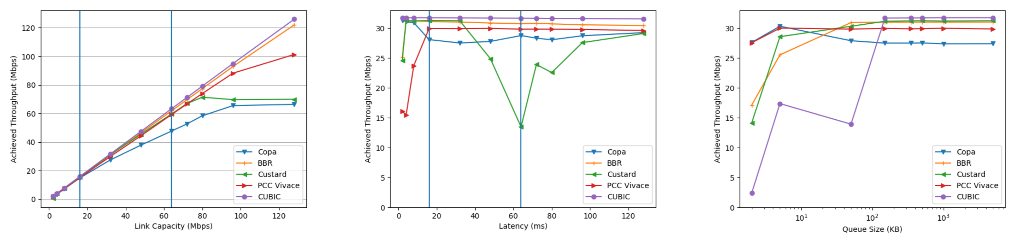


Results - RL Approach
Capacity vs Throughput
Latency vs Throughput
Queue Size vs Throughput
Regularization?
Somebody grab
the champagne!
Bad training data

Slide 9
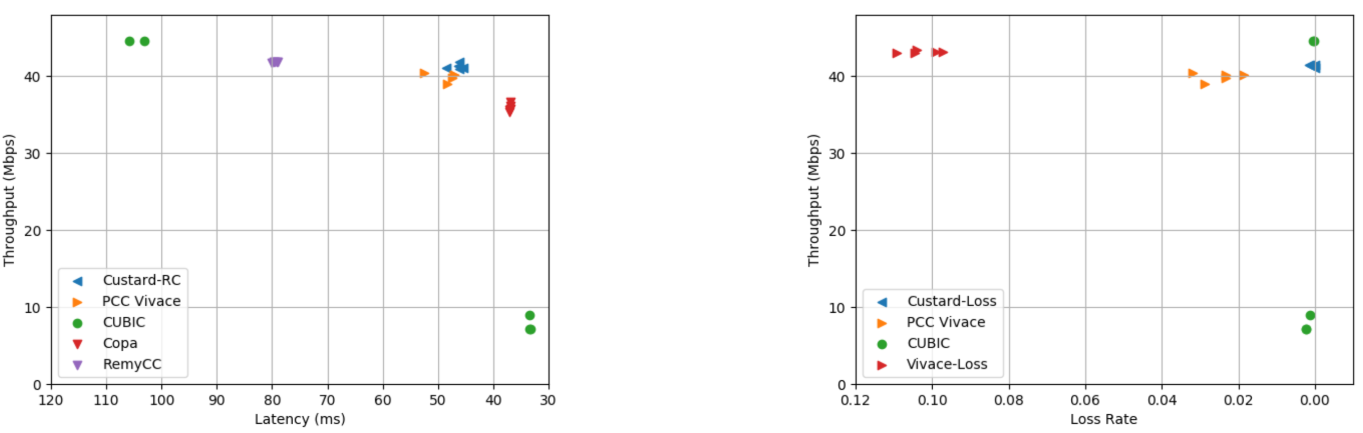
Results - RL Approach on dynamic links
Slightly better, but
could some Vivace tuning fix that?

Slide 10
Discussion
Why were the RL results so mediocre?
Better uses for ML techniques here?
Vivace is very good, has lots of parameters. Can we try to learn these parameters, maybe online?
How significant are the different metrics (throughput, latency, loss)? What is the impact of these numbers?

