Slide 1
CS294: Solving system problems with RL
Joey Gonzalez and Ion Stoica
April 1, 2019

Slide 2
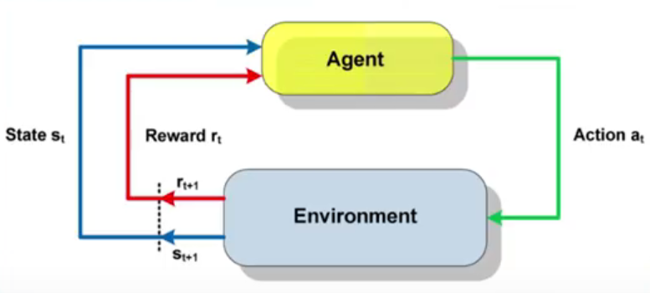
Reinforcement Learning
*https://sergioskar.github.io/Reinforcement_learning/

Slide 3
Many systems problems fit this pattern
 | TCP | Video bitrate adaptation | Job scheduling
Objective (reward) | Max throughput | Quality of Experience (QoE) | Max throughput / Min response time
Control | Window size | Bitrate | Next job to schedule
Environment | Losses, etc | throughput, buf size, file size | System utilization, job characteristics, etc

Slide 4
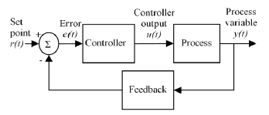
Classic control systems

Slide 5
Optimal control vs Deep RL
 | Optimal Control* | RL
Objective | Cost function | Reward
Control | Set of differential eqs. | Neural Network
Environment | Known model (often expressed as constraints) | Possible unknown model
RL is a form of stochastic optimal controls
*Largely founded by Lev Pontryagin and Richard Bellman

Slide 6
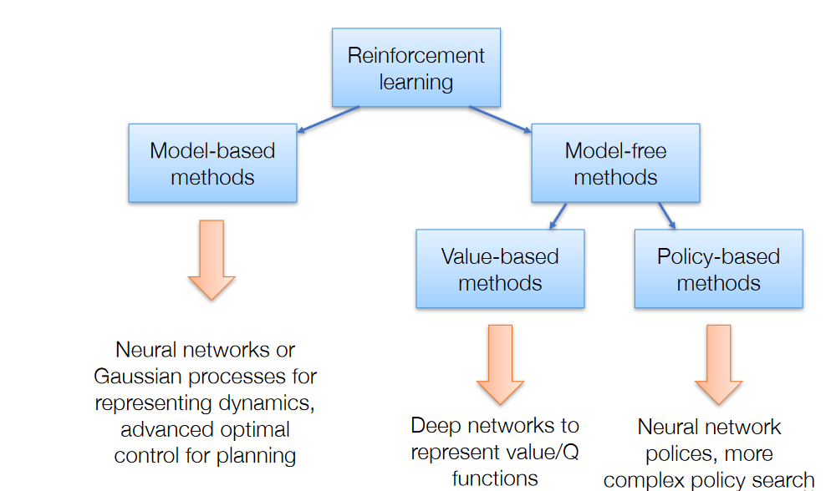
1950s-1960s
Application
(Assembly Language)

