Slide 1
What Brought International Students to Truman?
By Nathan Ryan, Kelly Hoskins, and Nathan Bresette
Notes:
-Hello, introduce ourselves (name, year, major)
-Introduce project *International Students*

Slide 2
Table of Contents
Methods
Demographics
Research Questions
Initial heard about Truman
Impact on decision
Current Outlook
Key Takeaways
Notes:
-Throughout this presentation, …
-Briefly explain each one

Slide 3
Methods
Meeting with Client
Creation of Survey
Focus Group
Finalization of Survey and Data Collection
Data Cleaning and Analysis
Notes:
-Assigned client Tim Urbonya (idk how to say his last name)
-talk about meeting with Tim and Stephanie to learn the CIS process
-focus group: kelly led, both nathans took notes, 10 students, mix of international and regular students
-finalize survey, send to Tim, revise, send to students (October 24-Nov 4)
-clean by cleaning output of weird numbers, combining majors into one column for demographics, recode type sensitive for country/city

Slide 4
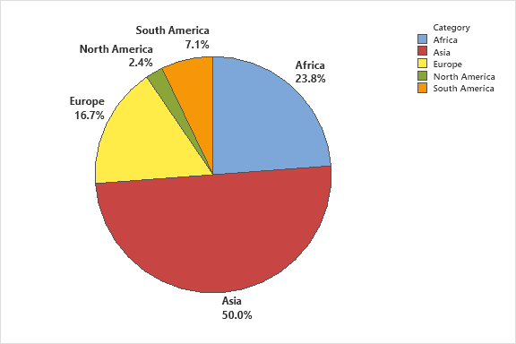
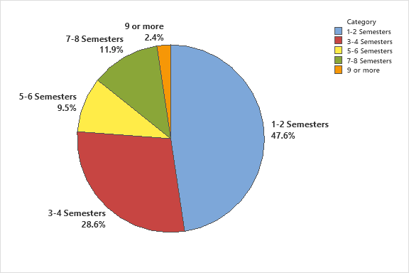
Demographics
Continent
Semesters at Truman
Notes:
After cleaning the data, now look at the demographics…
-Asia 50%, Africa 23%, Europe 16, SA 3 responses, NA 1
-47% 1-2 sem (freshman), 28.6% 3-4 (sophomores)

Slide 5
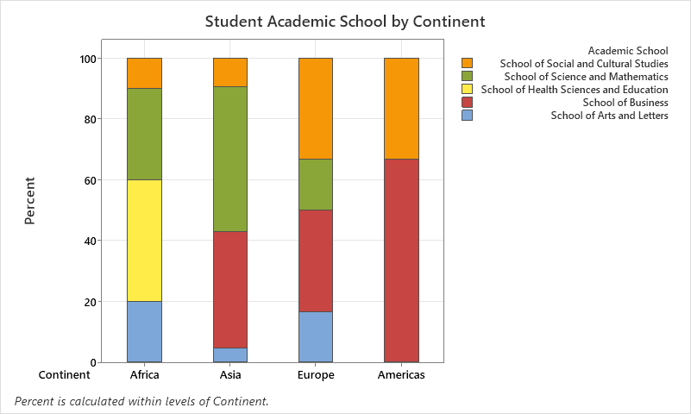
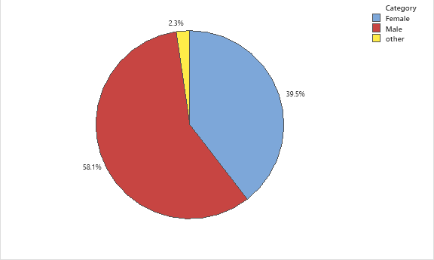
Demographics
21 Different Majors
Into Academic Schools
Gender
Notes:
-combined majors into academic schools
Gender: 58% male, 39% female, 1 person other

Slide 6
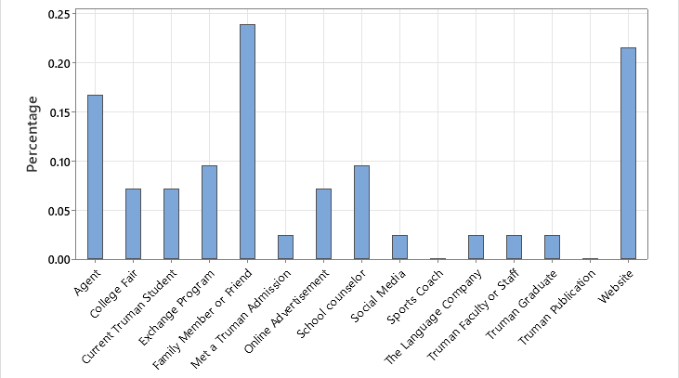
Initially Heard About Truman
“I just liked the website pictures. The students looked really happy so I thought I would be too”
Notes:
An important question we wanted to answer was what are the most common ways that international students initially hear about Truman. This graph shows the percent of students who chose each option. Over 60% answered agent, fam, website. We thought agent and fam would be high but website was a little unexpected. Read quote, students can be attracted by a clean and organized website

Slide 7
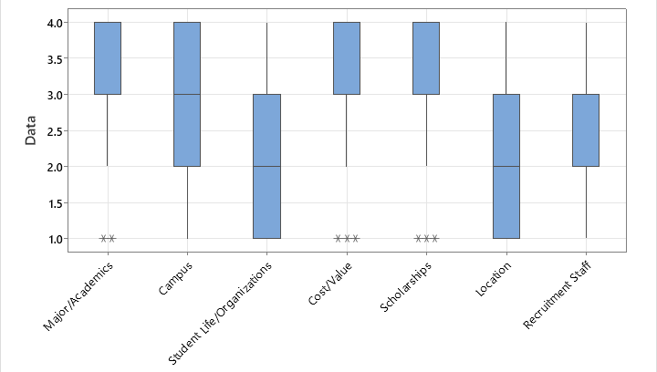
Impact on Decision
“Truman is very affordable compared to other universities. The classes are also small”
Notes:
Next, we looked at what had the most impact on students decision to attend Truman. the data ranges from 1–4, with 1 being No Impact, 2 being small Impact, 3 being Moderate Impact, and 4 being large Impact. 4 bars are high, ranging from Moderate to Large Impact, while 3 range from No impact to moderate impact. These results agree with what we believed prior to the survey, because Truman is known for its strong academics and low costs, and also there are a lot of scholarships for International students. Address quote

Slide 8
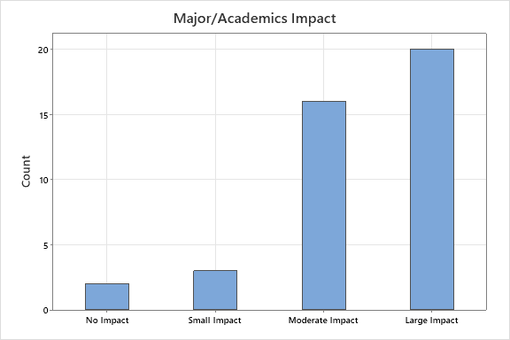
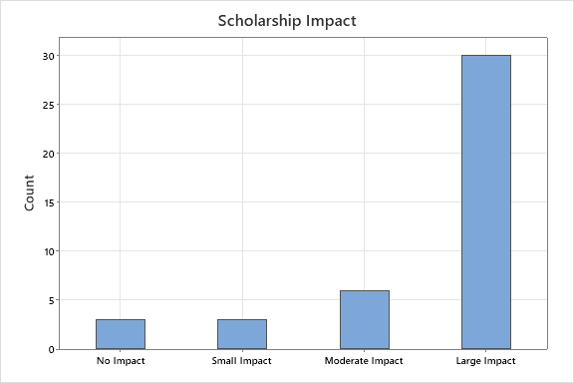
Notes:
These graphs look closer at 2 of the highest impacts on international students, Academics and Scholarships. It is easy to see that for both variables, the large impact was the most common response, especially with scholarships, as very few people answered that they had less than a large impact on their decision

Slide 9
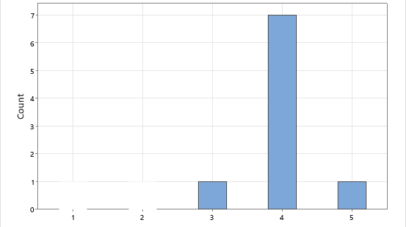
Friend/Relative Who Attended Truman Impact
Notes:
Out of all the students surveyed, 9 of them said they had a friend or relative attending Truman before they attended. We wanted to look at the impact that a friend or relative had on the student in their decision to attend Truman. The most common response was that they agree that this person had an impact on their decision, which makes sense, especially since if a friend or relative had a negative impact on them, they most likely didn’t choose to come to Truman. It was a little surprising that the responses for strongly agree weren’t as high as the agree responses, but this shows that international students aren’t just going to attend a University because they have someone they know there, the university will still have to have other attractive features for them to attend.

Slide 10
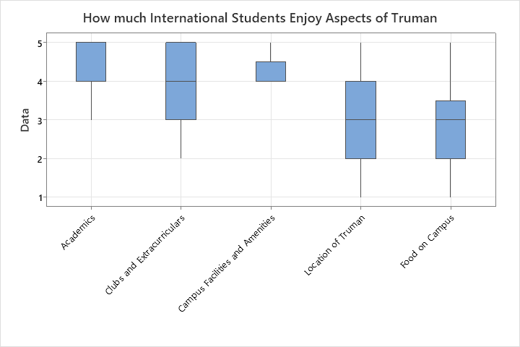
Current Outlook
Notes:
Next, we looked at how international students at Truman enjoy certain aspects of Truman. They were asked if they agree with the statement, “I enjoy this aspect of Truman” for each aspect and rated it on a scale of Strongly Disagree to Strongly Agree. Overall students agreed and strongly agreed that they enjoyed the academics and the campus facilities and amenities, while they either agreed or were neutral about clubs and extracurriculars. However, the results for the location of Truman and food on campus were more split, with some students agreeing, some disagreeing, and some being neutral.

Slide 11
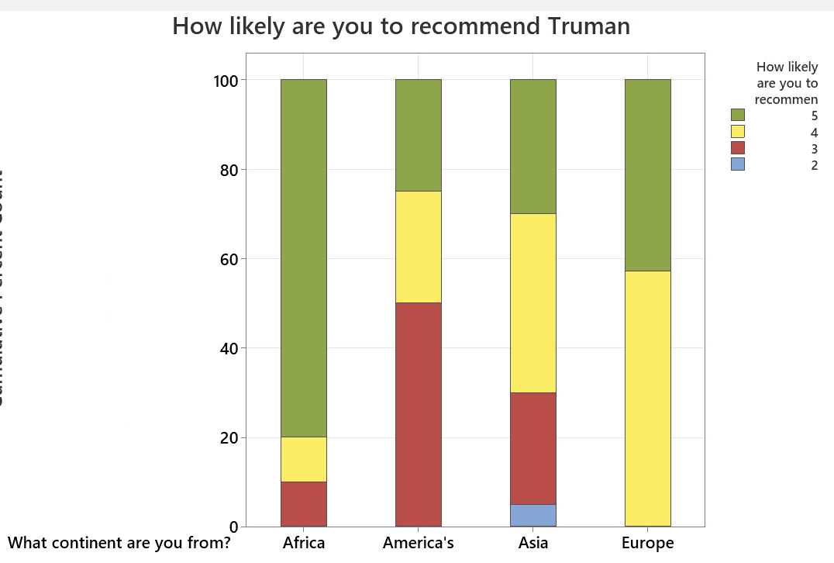
Notes:
Lastly, we analyzed the results of the question, “how likely are you to recommend Truman with the continent that the students were from. Students answered on a scale from very Unlikely to very likely. The Americas didn’t have many responses, so the data isn’t as useful, but there is clearly a difference in the other continents. 80% of students from Africa said they were very likely to recommend Truman to a student thinking about a university, with a small amount either somewhat likely or neutral to the idea. Europe had a lower percentage of students very likely to recommend Truman, but every person said they were either very likely or somewhat likely to recommend. Even less students from Asia were very likely to recommend Truman, and about 30% were either neutral or were somewhat unlikely to recommend.
Explain question, Explain scale, Explain findings, Explain our thoughts on findings

Slide 12
Respondent’s Additional Comments
80% positive responses and 20% neutral responses
“I like the international community and my Japanese minor program, they all provide me with warmth and purpose on campus. The high course load and grading structures of classes are less enjoyable. “
“I like how truman takes cares of you. They are always there to help you.”
“The people are very genuine and nice. It's been a delight to be here.”

Slide 13
Key Takeaways
Different Continents have unique academic interests
60% initially hear about Truman through agent, family/friend, and website
Major/academics and scholarships have biggest impact
Mostly enjoy everything and are neutral on food and location

Slide 14
Thank You!
Questions?

