Slide 1

Credit Risk Analysis
Final Project
Nathan Teakle

Slide 2
Table of Contents
Introduction | Introduces the Project and provides a Background story / Projet scenario
Data Set | Overview of the Data Set and how it was sourced
Data Cleaning | Preparing the Data for use in Analysis / Visualisations and Machine Learning
Analysis and Visualisations | Basic Analysis and Visualisations that helped me understand my Data Set
Machine Learning Models | Comparison between 3 different Machine Learning Models
Closing Remarks | My closing thoughts and findings about the best performing Machine Learning Model

Slide 3
Introduction
You are a Data Scientist employed at E-Corp and your newest client Piggy Bank, has come to you with a problem, they are trying to bring their banking system into the 21st century by implementing a Machine Learning Model, but they cannot decide on which model to implement.
To help you, Piggy Bank has supplied you with a sample data set.
With this data set, Piggy Bank, would like you advise them on what Machine Learning models they should consider implementing to help speed up the process of classifying the creditworthiness of individuals who are applying for a financial service.

Slide 4
The Data Set
This data set comprises of 1,225 rows and 15 columns, providing us with a comprehensive collection of client attributes. These attributes serve as crucial inputs for predictive modelling in the context of credit risk analysis.
The data set was sourced from Kaggle, sadly, Piggy Bank isn’t real.

Slide 5
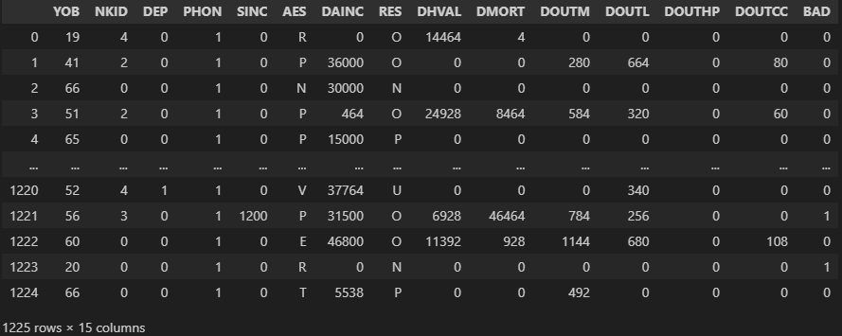
Snippet of the Data Set

Slide 6
A few of the Attributes
YOB | Year of Birth, represented as a numeric value, if unknown, it is assigned ‘99’
NKID | Number of Children, represented as a numeric value
DEP | Number of Dependents, represented as a numeric value
PHON | Indicates whether there is a mobile phone, represented by a binary value
SINC | Spouse’s income, represented as a numeric value
AES | Applicant’s employment status, represented as a categorical values. The possible values are:
V = _government
W = _housewife
M = _military
P = _private sector
B = _public sector
R = _retired
E = _self employed
T = _student
U = _unemployed
N = _others
Z = _no response

Slide 7
Data Cleaning
NULL Values
Duplicates
Outliers
Inconsistent Data
There were Zero NULL Values in the Dataset, which was a nice suprise
There were duplicates, after removing them we are left with 1,202 rows instead of the original 1,225 rows
There are outliers, but these outliers represent unique and significant characteristics of indivudials that impact their credit risk, removing these outliers might lead to losing valuable information later on
After checking negative values, it appears that there are no negative values in the data set

Slide 8
Analysis and Visualisations

Slide 9
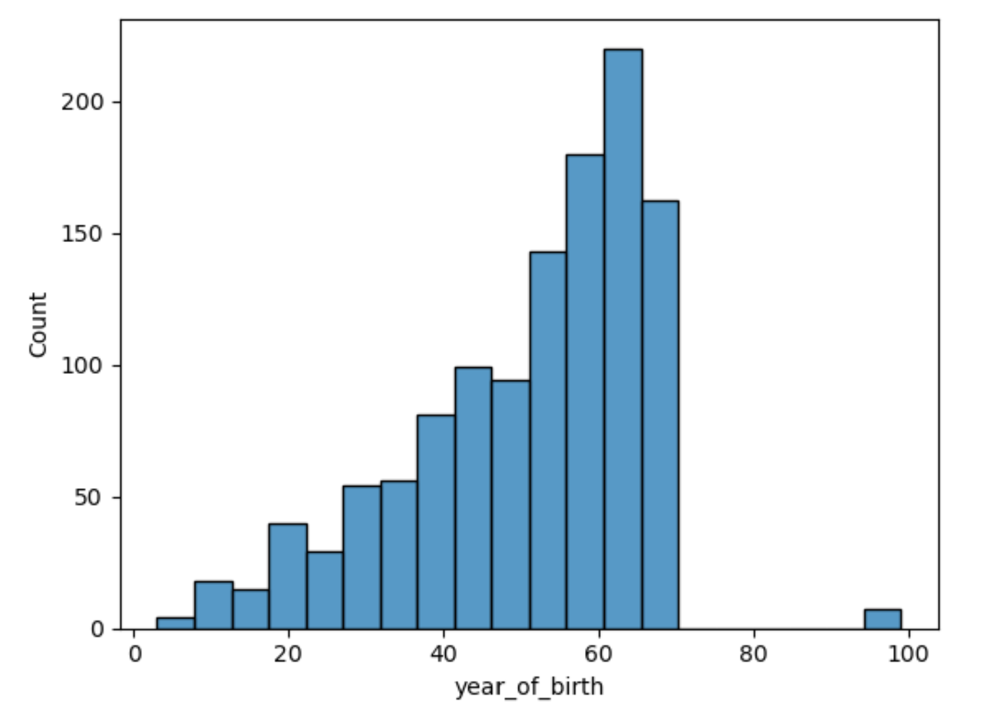
Histogram of Age Column
Shows that most of Piggy Bank’s clients are of higher age.
200 or more clients are over 60 years of age.
Important to recognize and accommodate the diverse age groups within the client base.

Slide 10
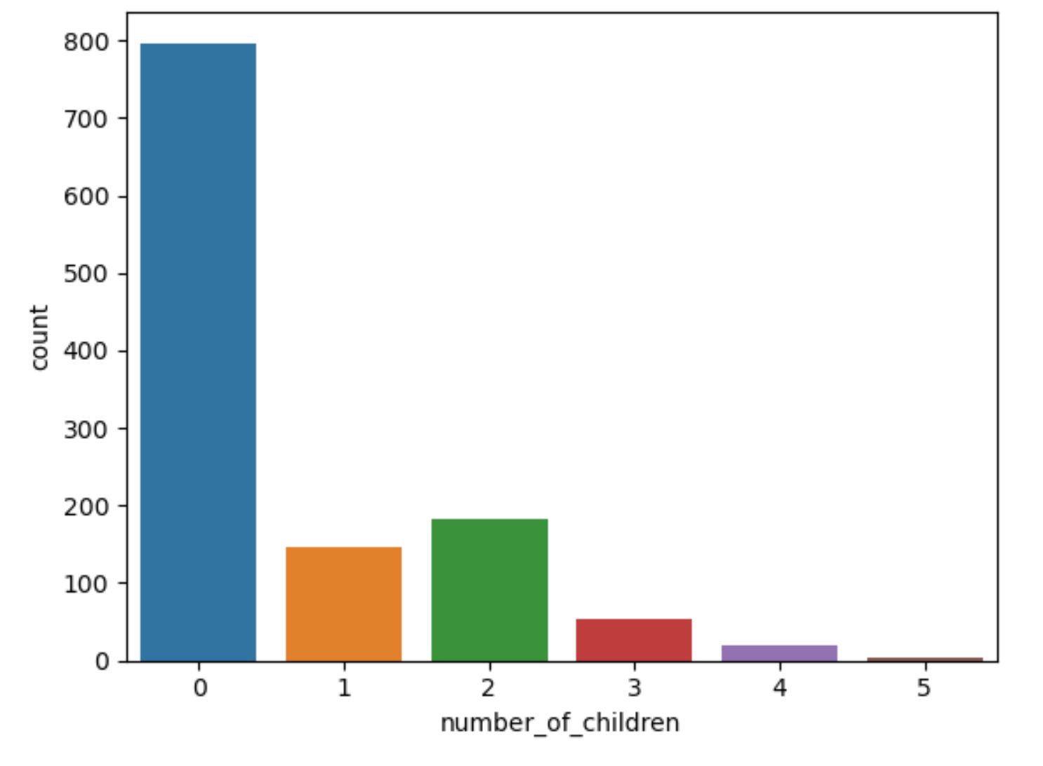
Bar Chart of the Number of Children
Concise snapshot of clients and their number of children.
790 clients without children.
140 with one child, 180 (roughly) have two children.
50 clients with three children.
Valuable insight into the client’s family composition

Slide 11
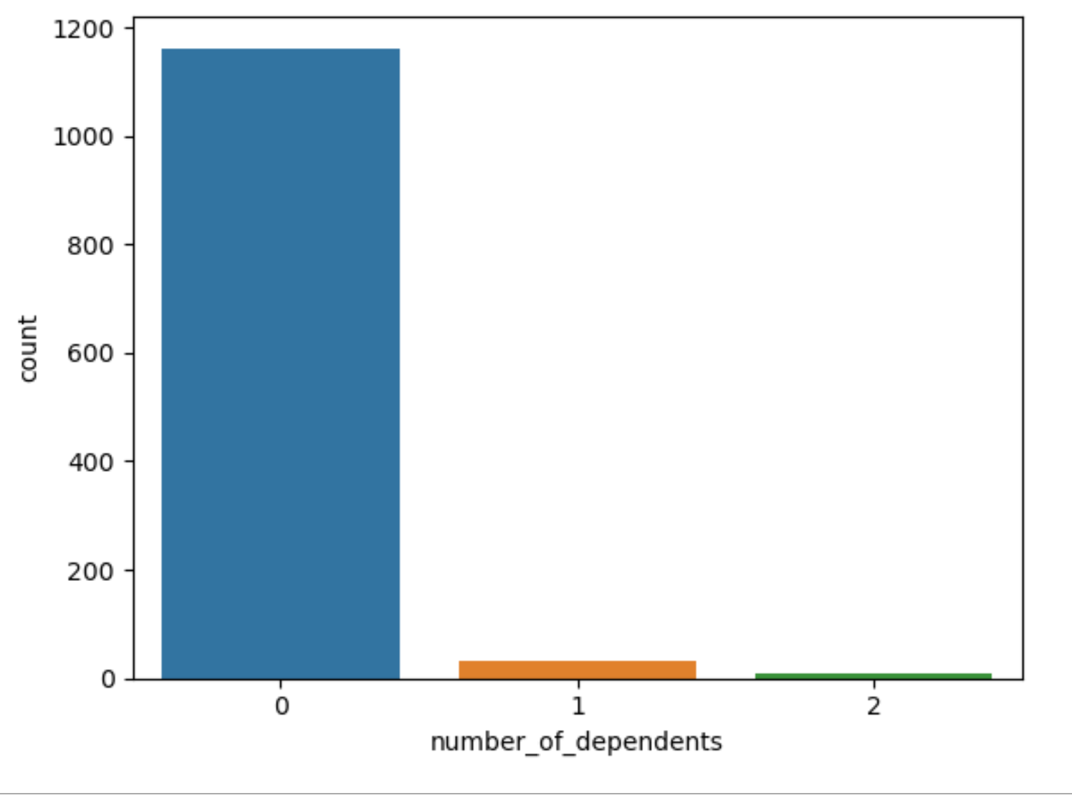
Number of Dependents
Shows how many people rely on others financially.
Most client’s, around 1,150 of them don’t depend on anyone else.
A handful have one person they support financially.
This means most of the client’s are financially independent, and only a small number have someone they need to take care of.
It is important to understand these differences to provide the right kind of financial services and support everyone.

Slide 12
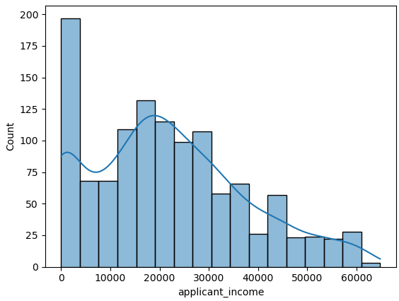
Applicant Income
Approximately 200 clients report having no income.
125 clients indicate an income of $20,000.
100 clients report earnings of $21,000.
80 clients have an income of $22,000.
78 clients earn $30,000.
55 clients earn about $10,000.
Insight into the diverse financial situations of Piggy Bank’s clients.

Slide 13
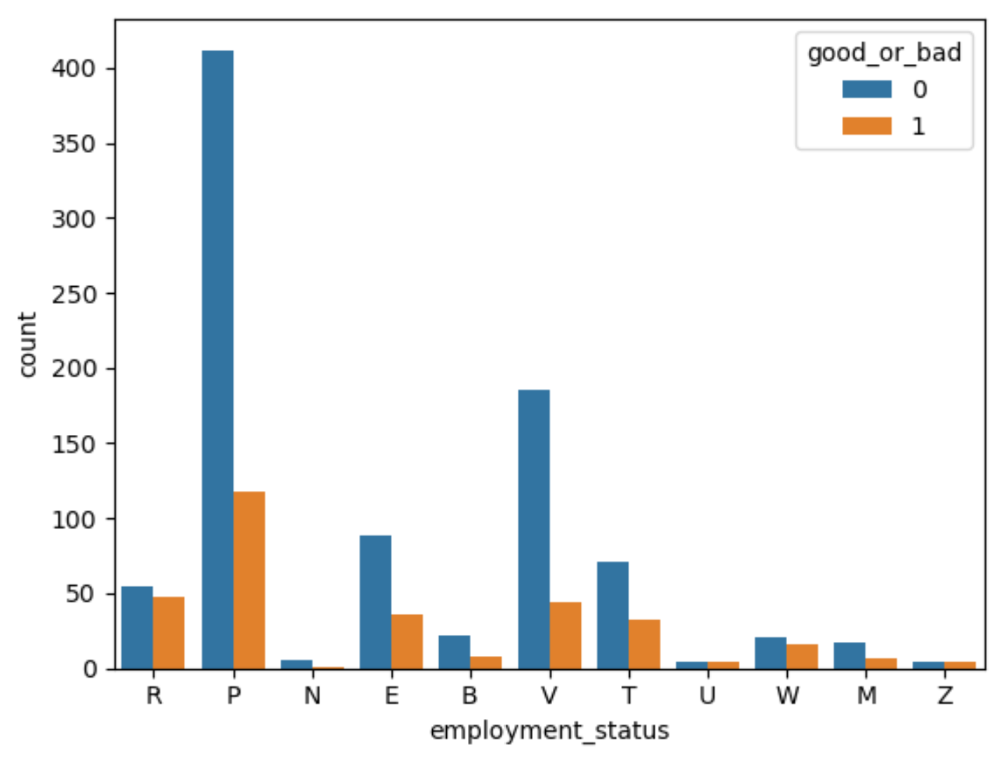
Employment Status
Clients working in the private sector (P), 400 have bad existing credit, 120 have good credit.
Government employees (V), 180 have bad existing credit, while 50 have good credit.
Brief insight into the connection between job types and credit quality.

Slide 14
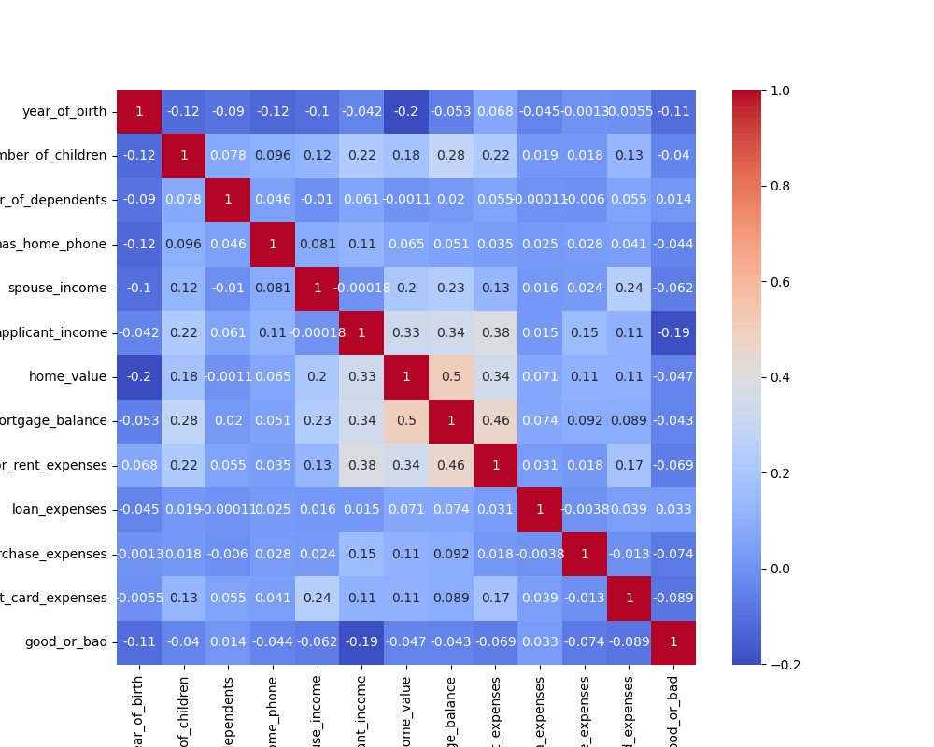
Correlation Matrix
These values help us understand how different factors relate to each other in our data set.
Positive correlation of 0.5 between mortgage balance and home value, meaning that as the value of a client home goes up, the amount of money they owe on their mortgages also tends to increase.
Positive correlation of 0.46 between mortgage or rent expenses and mortgage balance. Meaning that clients who spend more on their mortgage or rent tend to have higher mortgage balances. This is a logical connection, as larger expenses typically result in larger outstanding balances.
Moderate positive correlation of 0.38 between mortgage or rent expenses and applicant income. Suggesting that clients with higher incomes tend to spend more on their mortgage or rent.
Small negative correlation of 0.2 between the year of birth and home value, indicating that as age decreases, home values also slightly decrease.

Slide 15
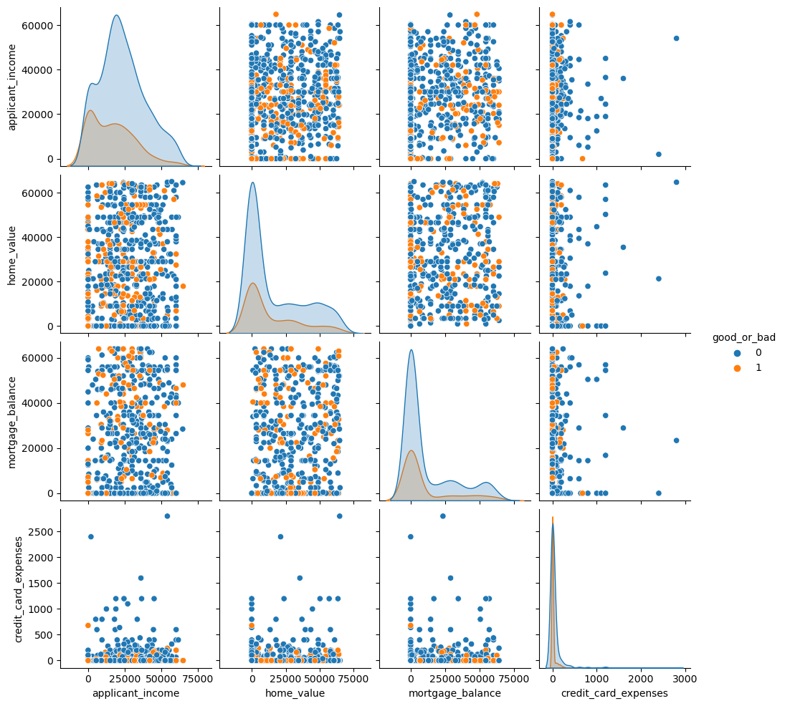
Scatter Plot Matrix of Multiple Variables
PowerPoint does make this hard to read, a more in-depth analysis of this is available for you to view in my written report.
Will be included on my Final-Project GitHub repository.

Slide 16
Machine Learning Models
Decision Tree, Logistic Regression, and Naïve bayes

Slide 17
Perfomance Metrics
Accuracy
Precision and Recall
F1-Score
AUC Curve
ROC Curve
ML Models
Area Under the Curve
Reciever Operating Characteristics
Decision Tree, Logistic Regression, Naïve Bayes

Slide 18
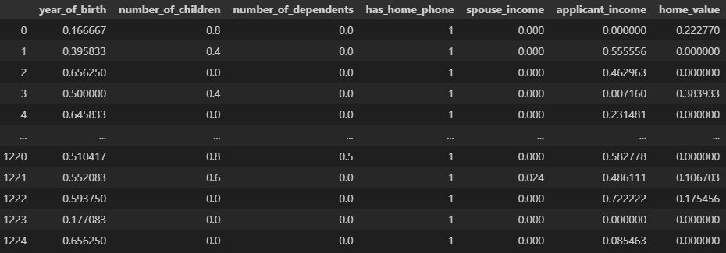
Data Normalization
Before starting with a Machine Learning model, I performed some data normalization.
Converted the numerical values into a range, which helps a machine learning model avoid deviation.
Prior to data normalization the age column had values between 0-100 and the number of kids column from 0-9, so to maintain consistency I converted the numerical data of the age and number of kid’s columns to be between 0 and 1, which helps create consistency in a machine learning model.

Slide 19
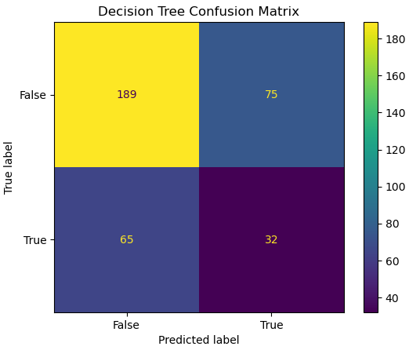
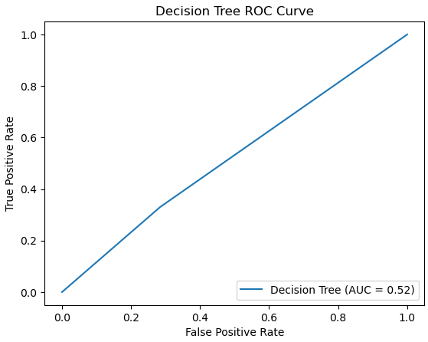
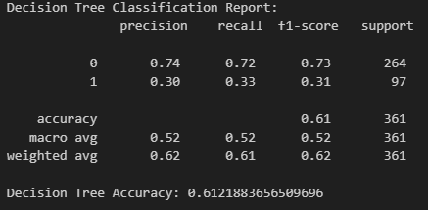
Decision Tree

Slide 20
Performance and Evaluation Decision Tree
Decision Tree Model Performance:
Conducted cross-validation for predictive accuracy
Scores ranged between 59.5% to 70.2%
Average cross-validation score of 63.5%, indicating reasonable predictive ability
Key Take-Aways:
For clients with good credit, the Decision Tree model exhibited a precision and recall of 75%, while for clients with bad credit, these metrics were down at 31%.
This suggest that the Decision Tree performs better at identifying clients with good credit, but it is less effective at recognizing clients with bad credit.
Summary:
Overall accuracy stands at 62.9%
Reasonable predictive capabilities for credit risk analysis
Needs improvement

Slide 21
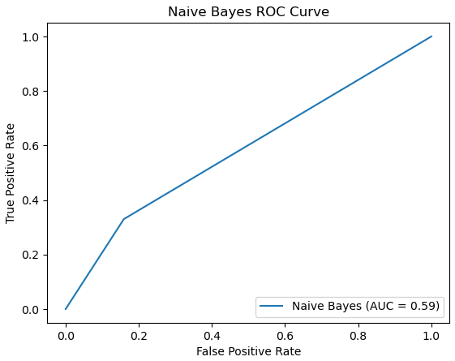
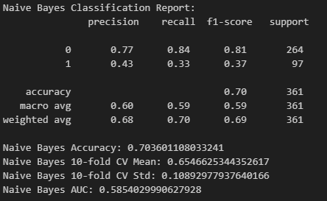
Naïve Bayes

Slide 22
Performance and Evaluation Naïve Bayes
Naïve Bayes Model Performance:
Overall Accuracy: 70%
Precision for good credit: 77%
Precision for bad credit: 43%
Recall for bad credit: 33%
F1-Score for bad credit: 0.37
Cross Validation Results:
Average Accuracy: Approximately 65.5%
Standard Deviation: About 10.9%
Area under the ROC curve (AUC):
0.585
Summary:
Naïve Bayes model shows moderate performance in credit risk analysis
Higher accuracy in identifying clients with good credit
Requires improvement in identifying clients with bad credit

Slide 23
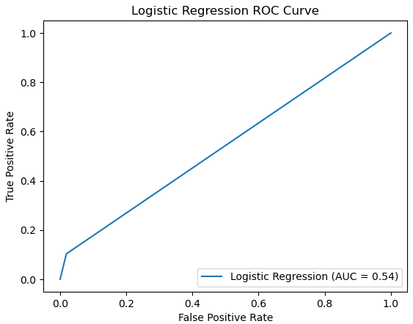
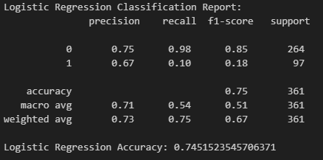
Logistic Regression

Slide 24
Performance and Evaluation Logistic Regression
Logistic Regression model’s performance:
Overall Accuracy: Approximately 74.52%
Precision for good credit: 75%
Precision for bad credit: 67%
Recall for bad credit: 10%
F1-Score for bad credit: 0.18
Cross Validation Results:
Consistent mean scores: Approximately 73.01%
Summary:
Effective identification of clients with good credit.
Needs improvement in identifying clients with bad credit due to low recall and F1-Score.

Slide 25
Model Comparison
Naïve Bayes
Decision Tree
Logistic Regression
Achieved accuracy of 70.36%, however, its performance for bad credit clients was lower
Achieved accuracy of 62.88%, performed reasonably well in identifying both good and bad credit clients
Emerged as the top performer with an accuracy of 74.52%, best recall for good and bad credit classes

Slide 26
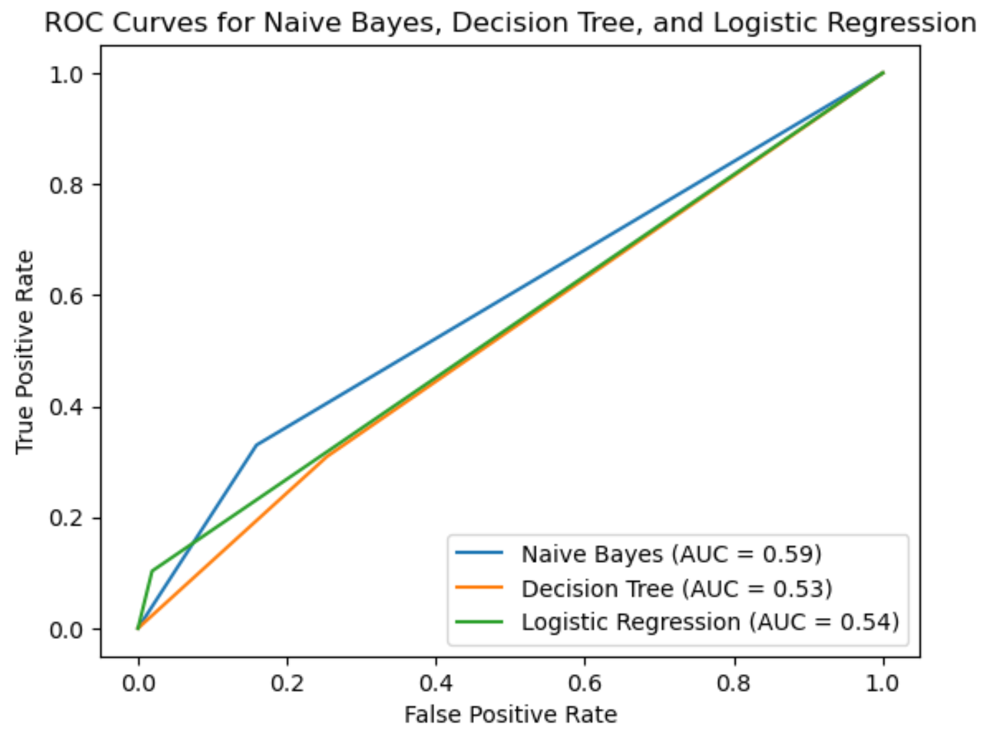
Model Comparison ROC Curve
Naïve Bayes:
AUC = 0.59
Better than random chance
Decision Tree:
AUC = 0.53
Not as strong as Naïve Bayes
Logistic Regression:
AUC = 0.54
Similar too Decision Tree, better than random guessing/

Slide 27
Best Machine Learning Model Logistic Regression
When selecting the best model, it's essential to consider a holistic view of all relevant metrics, including accuracy, precision, recall, and F-measure, as mentioned.
While Naive Bayes had the highest AUC, other factors like precision and recall also played a crucial role. In my case, I found that Logistic Regression performed best when considering all these metrics.
This suggests that it strikes a good balance between correctly identifying good and bad credit clients, making it a more suitable choice for credit risk analysis.

Slide 28
Thank you for your time

