Slide 1


Research Project Presentation Improving Navigation through code-based landscapes
Objective: Misdetection Error Model

Slide 2
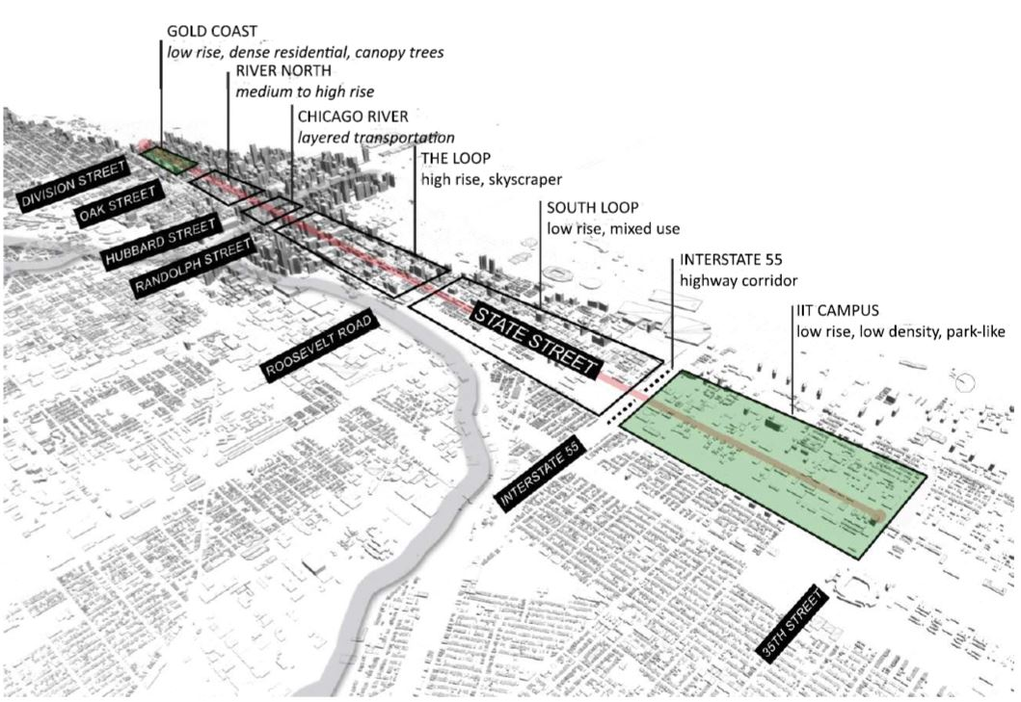
Project Context
Understanding the relationship between landscape and navigation safety
Shaping architecture around robotics
Ensuring localization integrity in regions where GNSS is unavailable
Lidar Localization for periodic reset on IMU
Diagram of State Street Transect
Project Proposal - NRI: FND: The Urban Design and Policy implications of Ubiquitous Robots and Navigation Safety

Slide 3
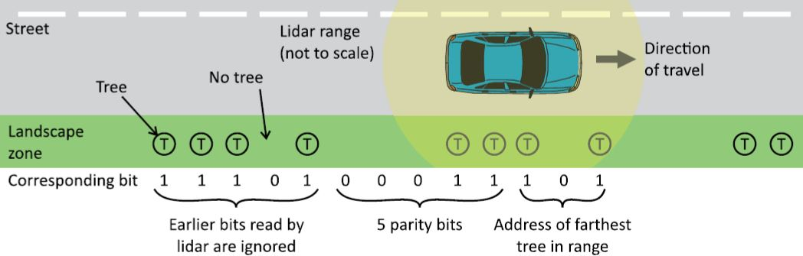
Code-based landscape
Basis concept of Code based landmark identification
Project Proposal - NRI: FND: The Urban Design and Policy implications of Ubiquitous Robots and Navigation Safety
Association problem
The right measurement to the right mapped object
Maximum likelihood and nearest neighbor process create uncertainty
Providing a landmark signature though code-based landscape
Retrieving the localization of the landmark
ID 107 → Landmark (42° N, 88° W)
ID: 1 0 1 1 1 0 1
93
ID: 1 0 1 0 1 1 1
87
ID: 1 1 0 1 0 1 1
107
T
T
T
T
T
T
T
T
T
T
T
T
T
T
T
1
1
0
1
0
1
1
1
0
1
0
1
1
1
0
1
1
0
1
1
0
1
Creating IDs from a set of measurements

Slide 4
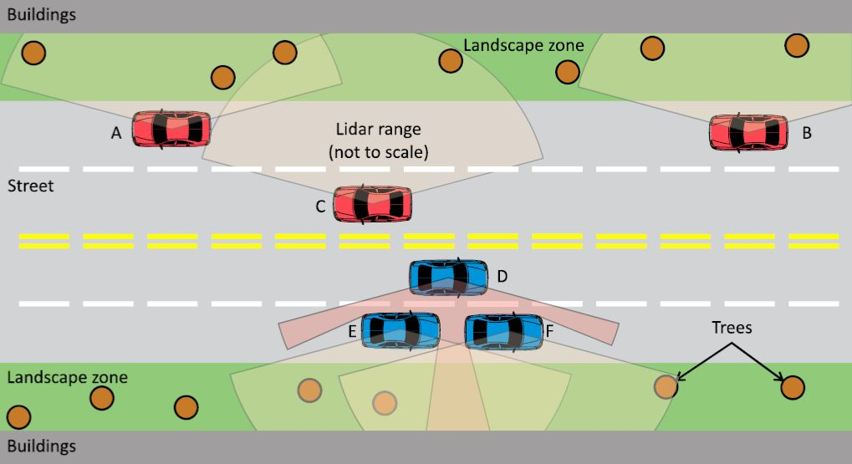
This can get complicated
Numerous sources of Noise
GNSS
Lidar
IMU
Irregularity of landmark placement – spatial and temporal
Misdetection possibilities
0 to 1: Measuring an inexistant landmark
1 to 0: Not measuring an existing landmark
A more realistic view of Code based landmark identification
Project Proposal - NRI: FND: The Urban Design and Policy implications of Ubiquitous Robots and Navigation Safety

Slide 5
Error Correcting Codes A brief Overview
Hamming (7, 4) Codes:
Message : a b c d - 1 1 0 1
Redundancy bits: x y z - 1 0 0
x = a ⊕ b ⊕ d
y = a ⊕ c ⊕ d
z = b ⊕ c ⊕ d
Codeword = a b c d x y z – 1 1 0 1 1 0 0
Parity check: Adding a 1 if uneven number of bits, else 0
Correction of one bit error by checking redundancy bits
Procedures:
Detect if and how many errors have occurred
Pinpoint the location of the error(s)
Correct the error(s)
Retrieve the initial message

Slide 6


Bose-Chaudhuri-Hocquenghem Codes
Code vector v:
Polynomial representation of a code vector:
BCH [n, k, d] code
Subclass of cyclic code with multiple errors capability
Cyclic code for handling sequences of landmarks
At each step, a single bit changes in the sequence
Choosing the number of errors to correct generates the code
ID: 1 0 1 1 1 0 1
93
ID: 1 0 1 0 1 1 1
87
ID: 1 1 0 1 0 1 1
107
T
T
T
T
T
T
T
T
T
T
T
T
T
T
T
1
1
0
1
0
1
1
1
0
1
0
1
1
1
0
1
1
0
1
1
0
1
Cyclic nature of the IDs

Slide 7
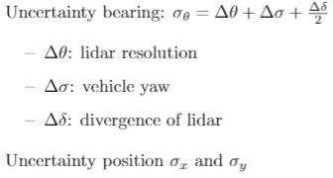
Error Model Probability of misdetection
Parameters | Values
σx | 1 cm
σy | 2 cm
Δθ | 0.2 deg
Δσ | 6.6 cm
Δδ | 0.1 deg
d | 6.35 to 10.2 cm
Focusing on the misdetection
1 → 0: not detecting an existing landmark
Referred as the transitional probability
p(1 → 0): probability of not detecting our landmark from the ratio between dimensions of landmark and section of detection
W2
2r
W1
Representation Landmark and Lidar detection

Slide 8
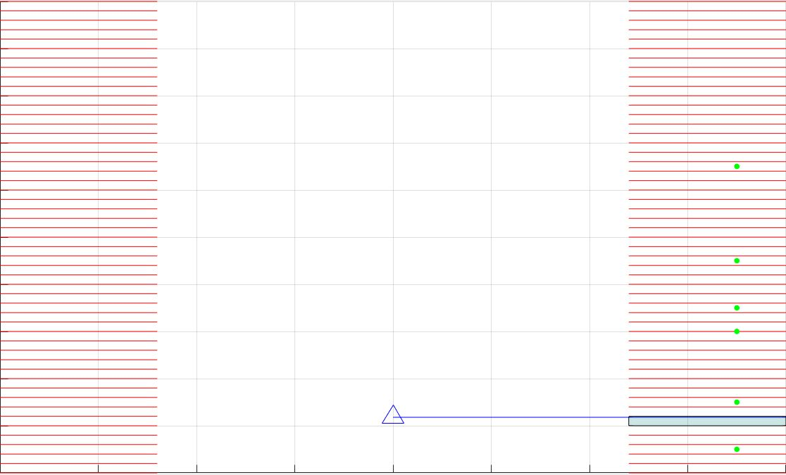
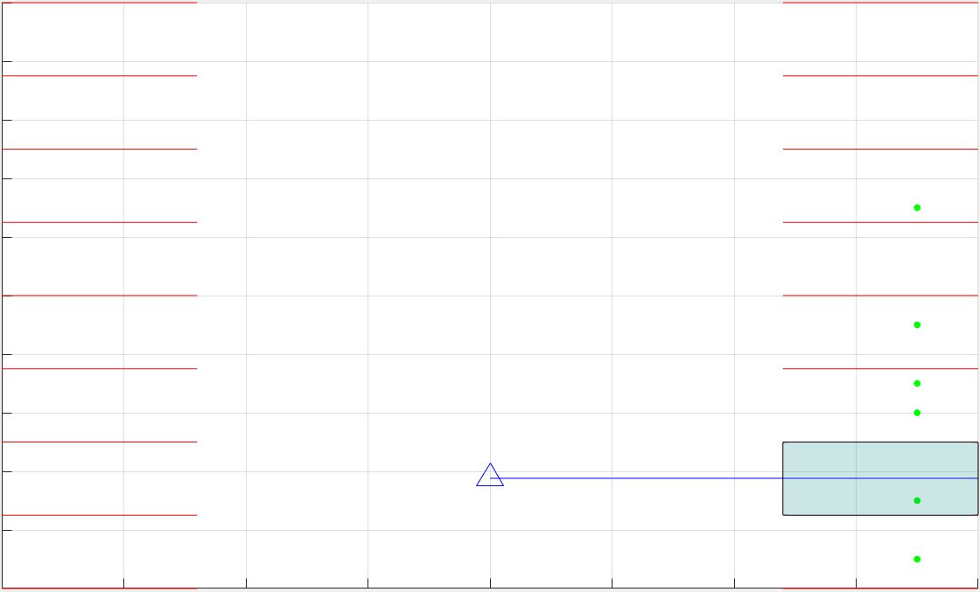
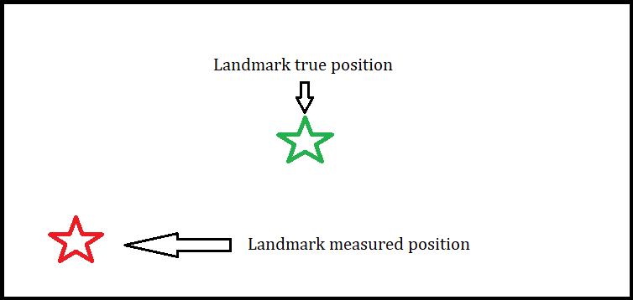
Sections of bit assignments
Imposing sections of measurements and bit assignement
Unambiguously Identifying and replacing landmarks
To many sections creates lots of zeros
Measurement Ld vs Truth Ld
Not enough sections potentially looses information

Slide 9
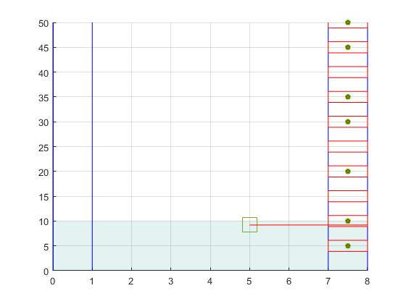
Selected Sections of detection
Imposing step between or sections of measurements
Practical for constructing a code
Placing a 1 in the section if a landmark is detected
Placing a 0 if not
Selected sections with a nominal range

Slide 10

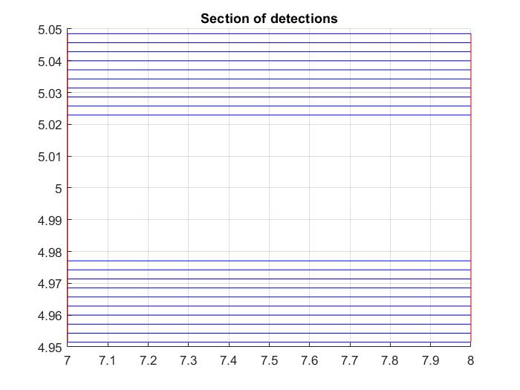
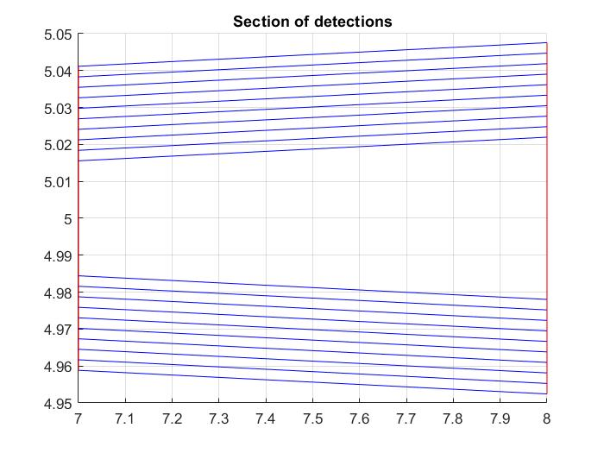
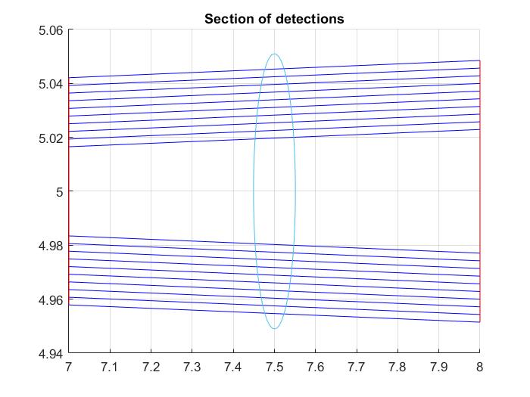
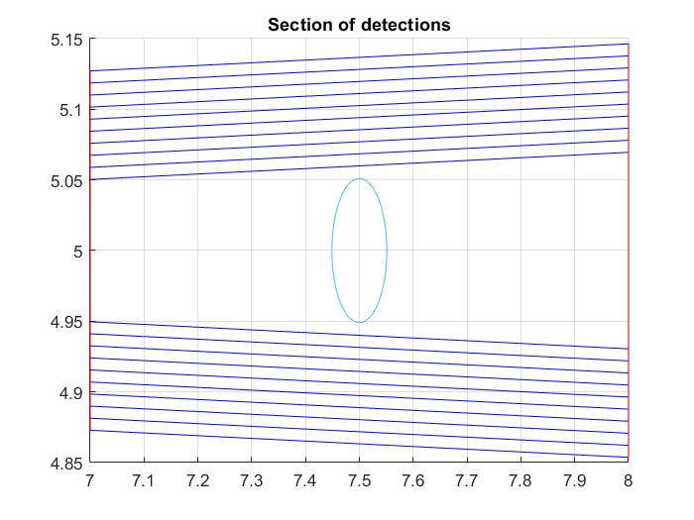
Shape of sections of detections
Proposed Shape:
Rectangular
Trapezoid
Construction by edge cases of
Incertitude of position
GNSS sigmas
IMU drift
Incertitude of lidar
Rectangular and Trapezoid: 1 to 5 meters from sidewalk
Trapezoid Section – 10 cm tree – σ and 3σ

Slide 11
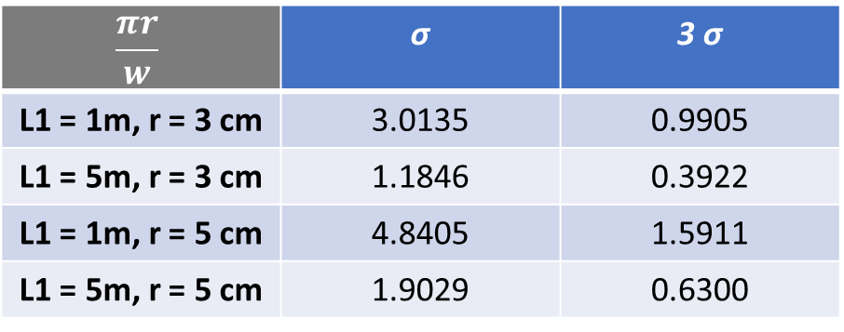
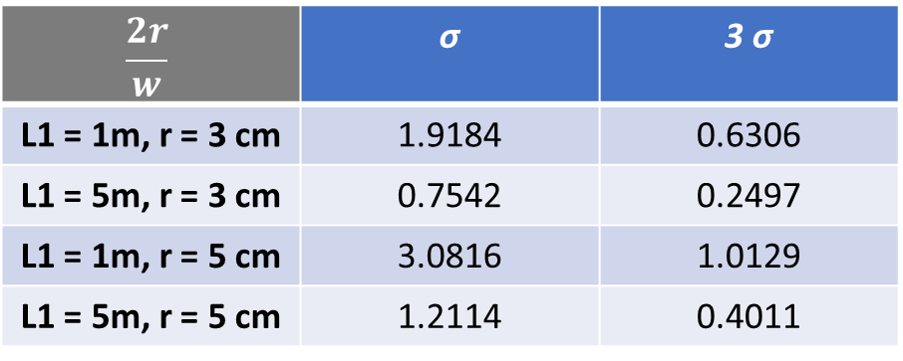
Ratio and probabilities
 | σ | 3 σ
w1 for L1 = 1m | 0.0331 m | 0.1007
w1 for L1 = 5m | 0.0842 m | 0.2543
Widths of sections vs distance from sidewalk
$$\frac{2r}{w}$$ | σ | 3 σ
L1 = 1m, r = 3 cm | 1.9184 | 0.6306
L1 = 5m, r = 3 cm | 0.7542 | 0.2497
L1 = 1m, r = 5 cm | 3.0816 | 1.0129
L1 = 5m, r = 5 cm | 1.2114 | 0.4011
σ values for probabilities:
σ for 67%
3 σ for 99%
Ratio for projected curve
$$\frac{πr}{w}$$ | σ | 3 σ
L1 = 1m, r = 3 cm | 3.0135 | 0.9905
L1 = 5m, r = 3 cm | 1.1846 | 0.3922
L1 = 1m, r = 5 cm | 4.8405 | 1.5911
L1 = 5m, r = 5 cm | 1.9029 | 0.6300
Ratio for circular curve

Slide 12
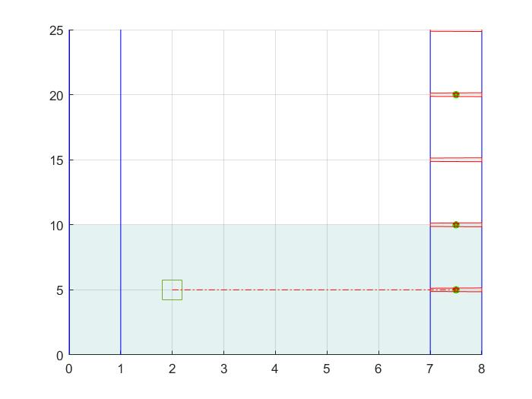
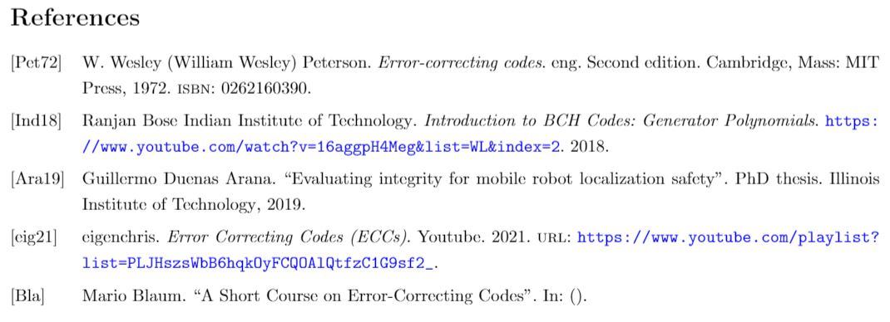
Conclusion and Perspective
Defining the error model to take incertitude of IMU drift into account
Adding noisy landmark and test the process with BCH encoding –decoding

