Slide 1
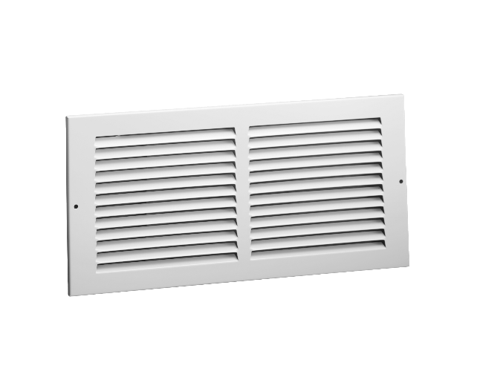

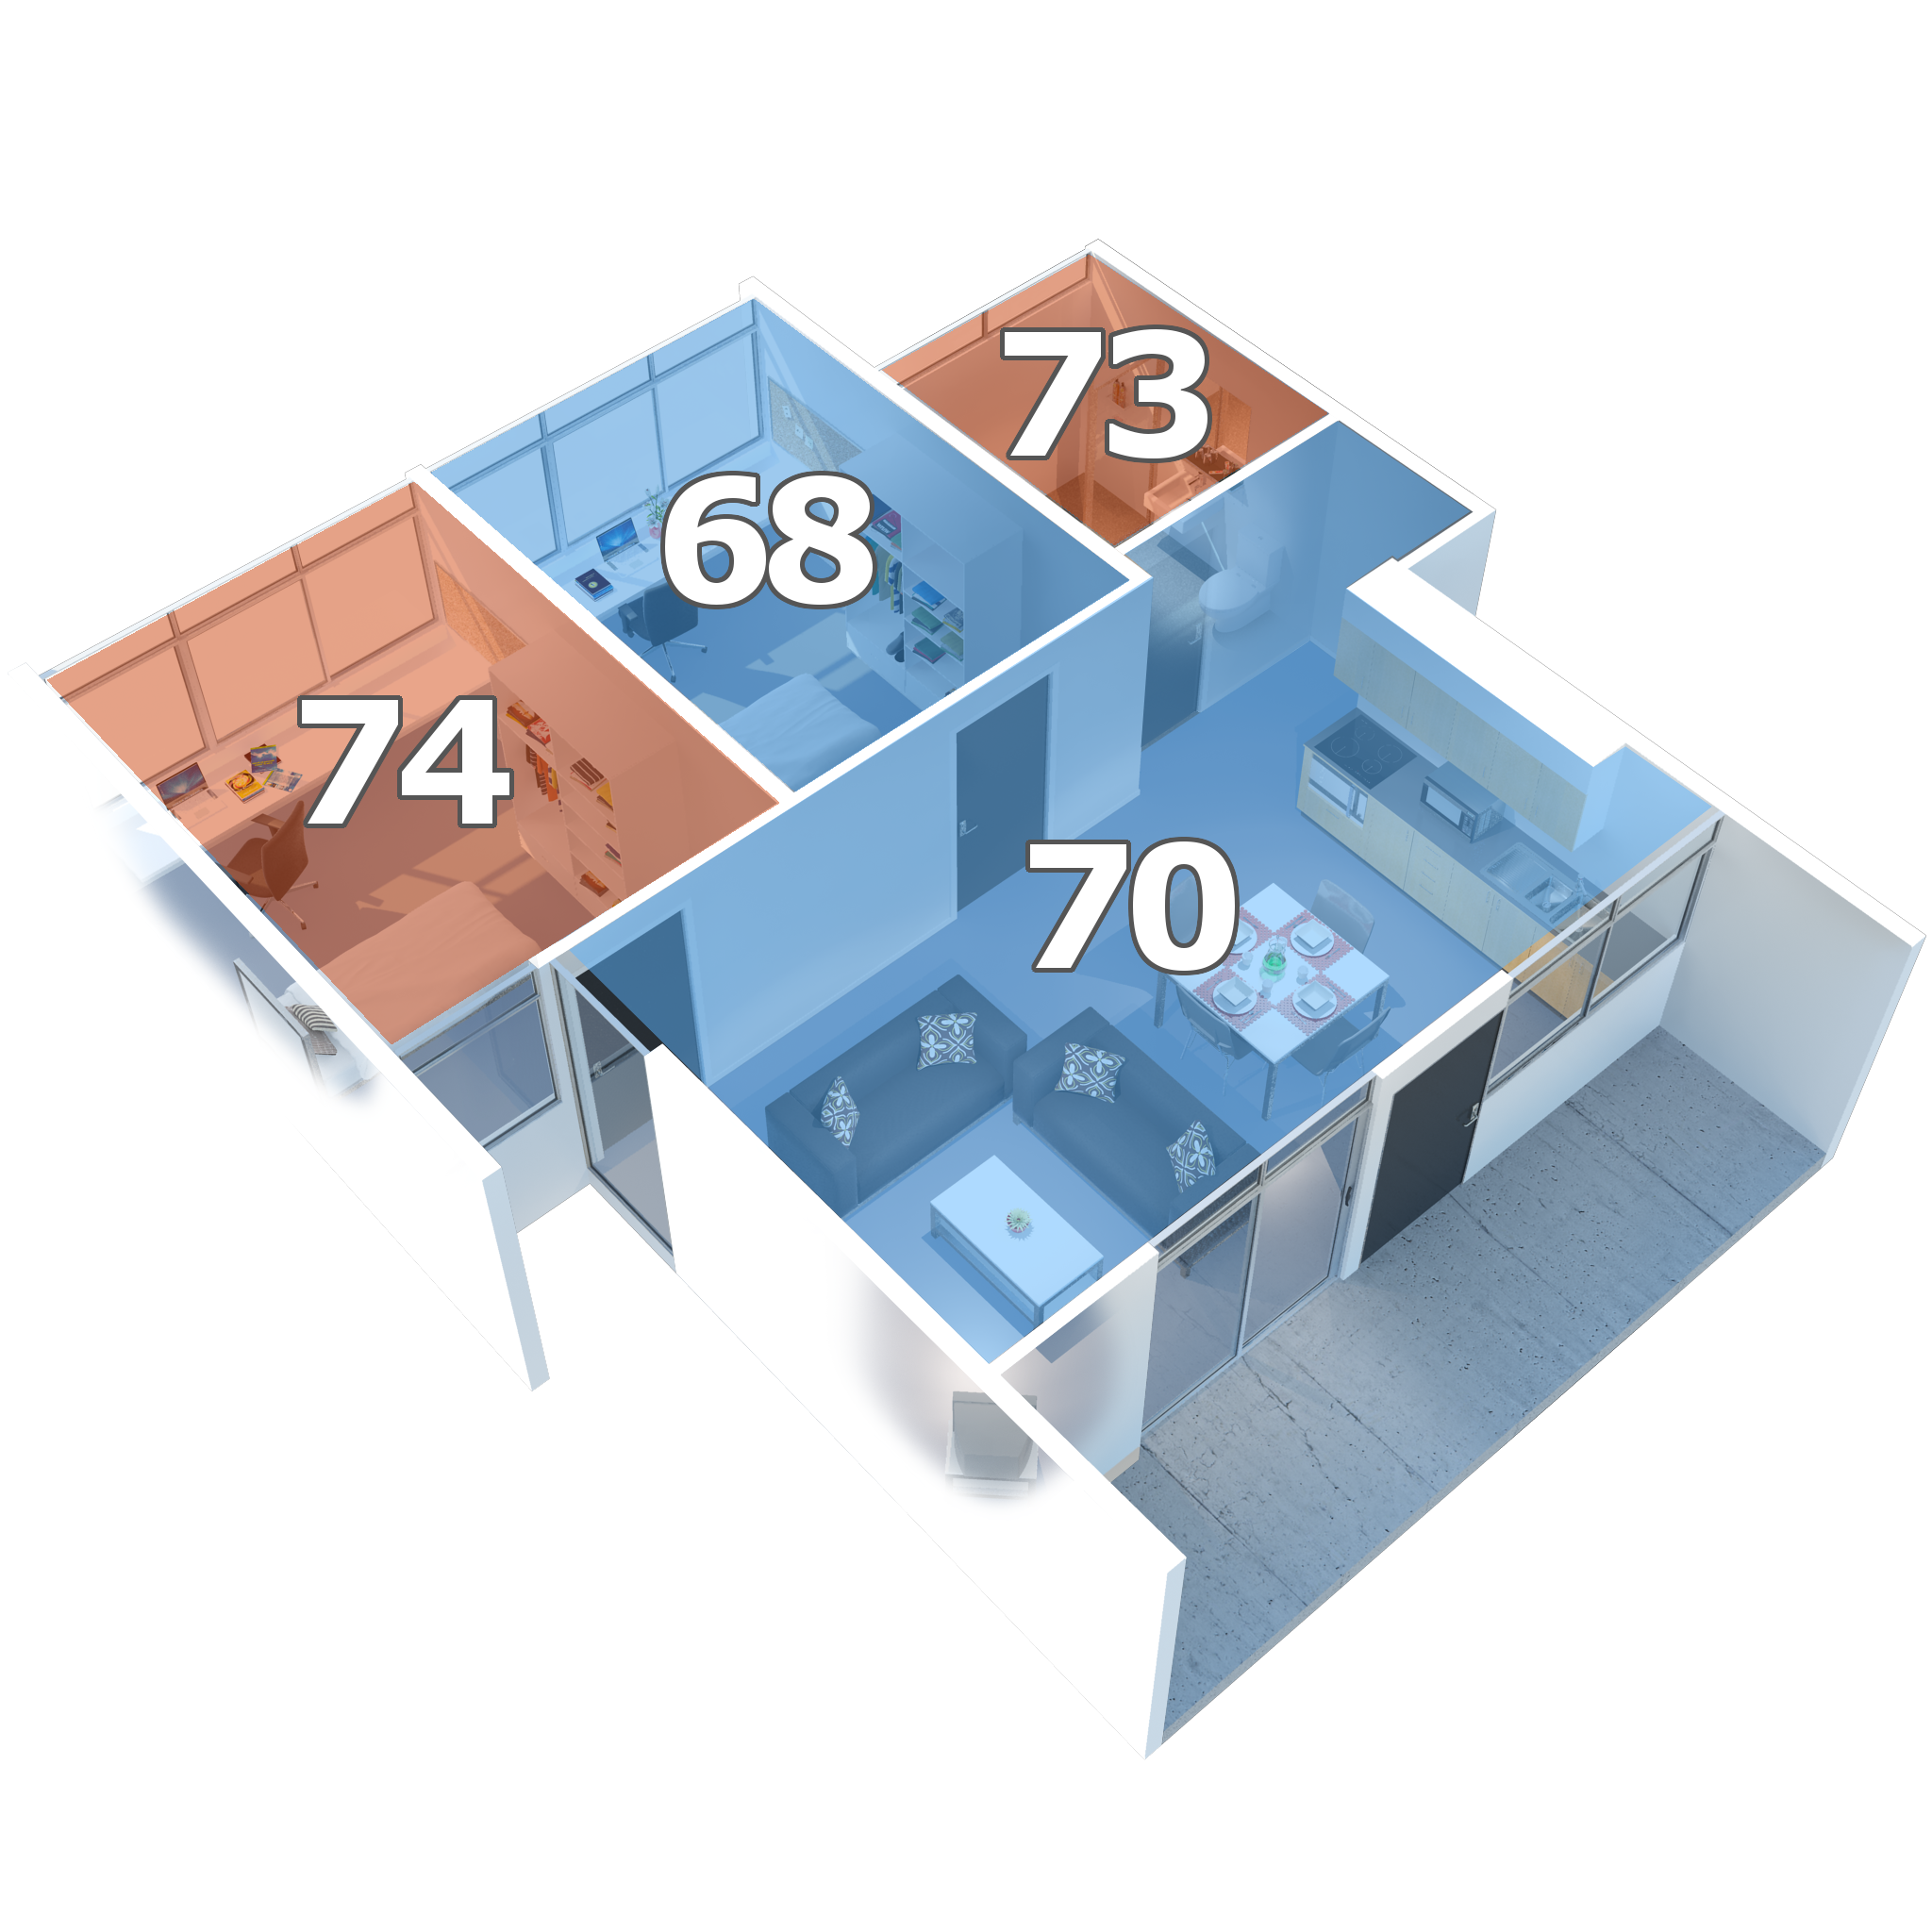
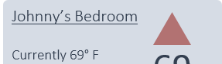
Comfort Control
Application
Allows users to set the climate of each room separately
70
Master Bedroom
74
Specifications
Wi-Fi enabled hub
Smartphone application
Automated vents
Wireless temperature sensors
Expandable with more rooms
Schedules
Change Room
Comfort Control
Master Bedroom
Currently 72° F
No schedules set.
72
Living Room
Currently 68° F
Schedules: - 1:00pm – 5:00pm: 73
- 5:00pm – 9:30pm: 68
- 9:30pm – 3:00am: 70
68
Features
Can be controlled and monitored via the app
Designed to be energy-efficient
Integrates with existing HVAC systems

