Slide 1
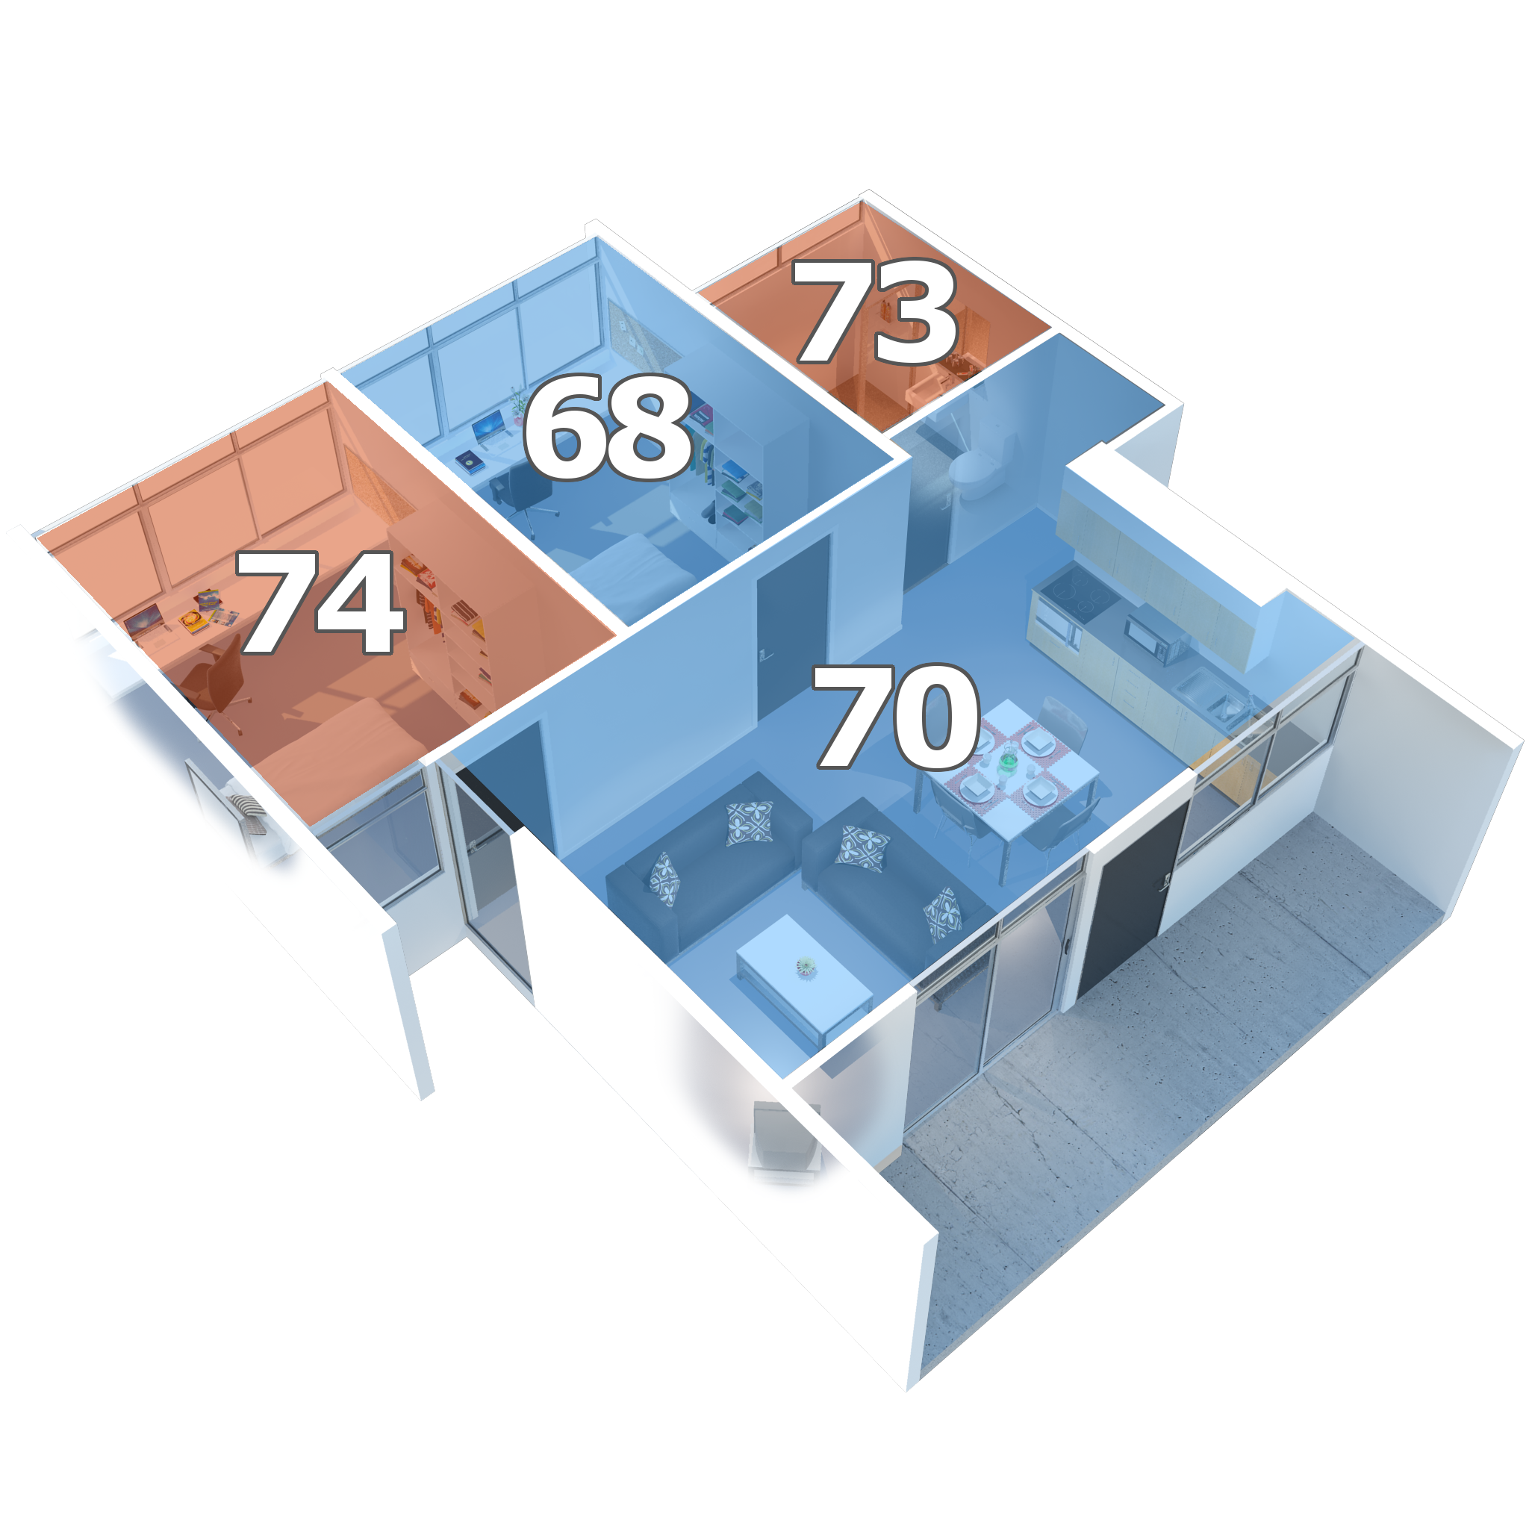

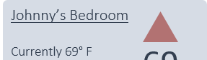
Comfort Control
Application
Personalized comfort in every room
70
Master Bedroom
74
Schedules
Change Room
Specification
Local temperature sensors
Main thermostat hub
Motorized vents
Smartphone application
Wireless compatibility
Comfort Control
Master Bedroom
Currently 72° F
No schedules set.
Master Bedroom
Currently 72° F
No schedules set.
72
72
Living Room
Currently 68° F
Schedules: - 1:00pm – 5:00pm: 73
- 5:00pm – 9:30pm: 68
- 9:30pm – 3:00am: 70
68
Features
Remotely control and monitor temperatures
Energy efficient design
Can be integrated with existing HVAC systems

