Slide 1
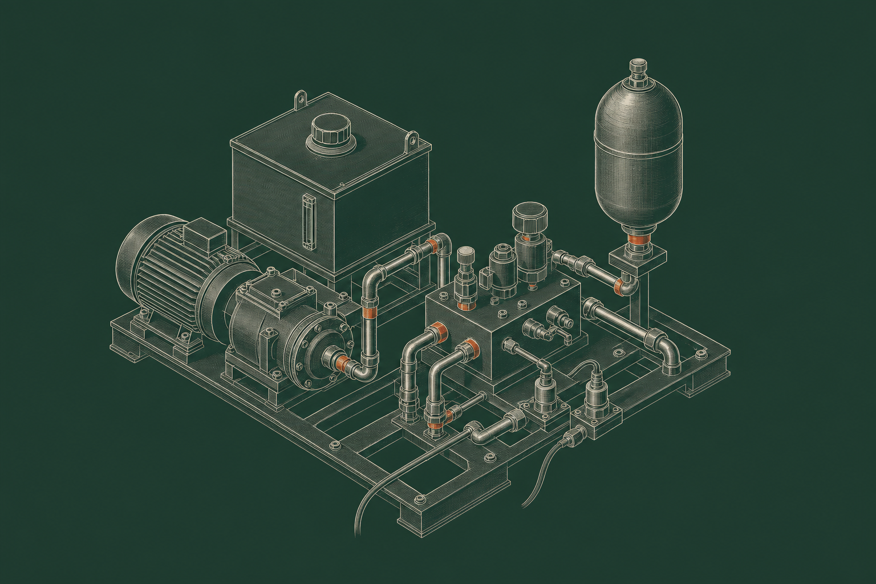
DATA SCIENCE PORTFOLIO | SIGNAL PROCESSING | 2026
Detecting Hydraulic Pump
Leakage from Sensor Signals
Comparing RAW, FIR, and IIR signals
with feature-based machine learning
Nathanael Komang Bagus P
Data Science Program
Universitas Brawijaya
Concept illustration, not a photograph or model of the actual test rig.
Dataset: UCI Condition Monitoring of Hydraulic Systems [1]
01 / 18
Notes:
This case study tests whether filtering pressure and flow measurements helps classify hydraulic pump leakage. The UCI dataset comes from one laboratory test rig. I analyzed existing digital recordings rather than collecting data from a physical pump.
The workflow covers sensor-data checks, RAW/FIR/IIR signal representations, feature extraction, Random Forest classification, and group-based validation. The key question is whether filtering improves diagnostic performance, particularly for severe leakage, rather than whether it produces a smoother-looking waveform.

Slide 2
I | PROJECT QUESTION
Pressure and flow measurements need context
Sensors record how the rig operates. Fault labels come from the dataset and guide model training.
DE / DATA INTEGRITY
DSP / REPRESENTATION
DSA / VALIDATION
Keep sensor values
and timing consistent
Compare features from
raw and filtered signals
Measure predictions
and error types
60 seconds
14 features
3 classes
PS1 and FS1 use different
sampling rates and units.
Filters change fluctuations
and transients. We test
whether those changes help.
Normal, mild, severe.
Error types matter.
A smoother trace may hide a useful fault signal.
We test filtering against the original recordings.
Source: UCI data [1]; preprocessing and evaluation notebooks for this study.
02 / 18
Notes:
PS1 measures pressure and FS1 measures flow. Neither sensor directly reports the pump's leakage class. Those labels are provided at the cycle level and are used to train and evaluate the classifier.
Data engineering keeps the two sampling rates and cycle IDs consistent. Digital signal processing creates alternative versions of each waveform. Analytics turns those versions into features, predicts three leakage classes, and examines mistakes. Visual smoothness alone cannot tell us whether information relevant to diagnosis has been retained.

Slide 3
I | RESEARCH QUESTION
Does filtering help classify pump leakage?
Can FIR or IIR produce more useful classification features than the unfiltered signals?
Smoothing can reduce fluctuations, but it can also blur rapid changes that matter.
RAW
FIR
IIR
Unfiltered baseline
Causal moving average
Exponential smoothing
Same 14 features, same Random Forest settings,
and the same grouped validation splits.
Measures: mean Macro F1, fold variation, and missed severe-leakage cases
Source: experiment design and evaluation notebooks for this study.
03 / 18
Notes:
I compare three signal representations. RAW is the recorded signal without smoothing. FIR uses a causal moving average. IIR uses first-order exponential smoothing. All three go through the same feature definitions, classifier type, and grouped cross-validation splits.
Filtering could reduce variations that distract the classifier. It could also suppress brief changes that distinguish one leakage condition from another. This comparison tests which outcome matters more in the available dataset. It does not assume either filter is better in advance.

Slide 4
II | DATA PREPARATION
How the sensor recordings become model inputs
Each observation keeps its sensor, sampling rate, cycle ID, and leakage label.
Stage | What I used or checked | Why it matters | Evidence in this study
Recorded signals | Digital pressure and flow measurements | Two sensors run at different sample rates | PS1: 100 Hz FS1: 10 Hz
Quality checks | Check NaN, infinity, and zero readings | Avoid treating valid zeros as missing data | No NaN or infinity in PS1 or FS1
Cycle matching | Keep each sensor tied to its 60-second cycle | Sample index is not the same as time | Join by cycle ID, not raw sample index
Feature table | Calculate seven features per sensor and cycle | Each cycle becomes one model observation | 1,449 cycles with 14 input features
All processing uses existing digital recordings.
Live sensing and deployment were not tested.
Sources: UCI hydraulic dataset [1]; preprocessing notebooks for this study.
04 / 18
Notes:
The analysis starts with two digital sensor recordings from the UCI dataset. Each recording has a distinct sampling rate. I check for invalid values and retain the cycle identity so pressure and flow features belong to the same 60-second observation.
I found no NaN or infinite values in PS1 or FS1. Some zero readings in flow are kept because zero can be a valid operating state. After processing the signals separately, I calculate seven features for each sensor and join them by cycle. The resulting table has 1,449 labeled observations and 14 predictors. This project does not test physical ADC hardware or real-time performance.

Slide 5
II | SAMPLING AND ALIGNMENT
Two sensors observe the same cycle at different rates
PS1 and FS1 cover the same 60 seconds but take readings at different intervals.
PROBLEM / DIFFERENT RATES
METHOD / KEEP TIME
OUTPUT / JOIN BY CYCLE
PS1: 6,000 readings
FS1: 600 readings
Use each sensor's
own time axis
Combine seven PS1 and
seven FS1 features
60 seconds
1 cycle
1 row
The same sample index
does not mean the same time.
Check data → filter by cycle
→ calculate sensor features.
One feature row for
each 60-second cycle.
At index 100, PS1 is at 1 second while FS1 is at 10 seconds.
Matching raw array indices would mix different times.
Source: sampling rates in UCI [1]; data preparation notebooks for this study.
05 / 18
Notes:
PS1 records at 100 Hz, yielding 6,000 pressure values in one minute. FS1 records at 10 Hz, yielding 600 flow values in the same minute. If we look at index 100 using a zero-based time axis, it represents 1 second for PS1 and 10 seconds for FS1.
I therefore do not pair individual pressure and flow readings by their array index. I compute features on each sensor's own time axis and combine the seven pressure features with seven flow features from the same cycle. Each cycle becomes one row for the classifier.

Slide 6
II | FEATURE ENGINEERING
What the 14 features capture
For each sensor, five features describe time behavior and two describe frequency content.
Signal property | Features used | What it describes
Typical level | Mean, RMS | Average and effective signal magnitude
Variability | Standard deviation, peak-to-peak | How widely the values change within a cycle
Fast changes | Difference RMS | Size of changes between adjacent samples
Frequency content | Spectral centroid, relative spectral energy | How energy is distributed over frequency
Seven PS1 features plus seven FS1 features give 14 inputs.
Random Forest stays fixed across RAW, FIR, and IIR.
Sources: feature extraction notebooks; SciPy FFT and signal processing [3].
06 / 18
Notes:
A single 60-second cycle contains 6,600 values across PS1 and FS1. To compare cycles, I calculate seven features for each sensor. Mean and RMS describe signal level; standard deviation and peak-to-peak measure variation; difference RMS captures changes between adjacent readings. Spectral centroid and relative spectral energy describe two aspects of frequency content.
That gives 14 inputs for each cycle. The same feature definitions are used with RAW, FIR, and IIR data. Random Forest is a controlled analysis tool here, not a claim that this is the best classifier for all hydraulic fault data.

Slide 7
II | EVALUATION DESIGN
An overall score can hide missed severe faults
A high Macro F1 score can coexist with severe leakage being classified as mild.
Features
Prediction
Error review
Reporting
Decision support
14 values
per cycle
Normal, mild,
or severe
Which classes
get confused?
Explain error
counts and limits
Inspect findings
before acting
Check: class recall, class precision, and the out-of-fold confusion matrix
Missed severe leakage and incorrect severe predictions create different concerns.
For engineers
For managers
Check sensor integrity,
filter response, and errors.
Use results to plan further
validation, not automatic action.
Source: evaluation notebooks; precision, recall, and grouped validation [4].
07 / 18
Notes:
Macro F1 gives all three leakage classes equal weight, but it does not tell us which errors occurred. In this study, a severe case classified as mild deserves separate attention. Severe-class recall measures how many severe cases are detected, while severe precision describes how often a severe prediction is correct.
I also inspect the out-of-fold confusion matrix, which combines held-out predictions from the five group splits. This gives a more concrete view of error counts. The same numbers can be explained differently to an engineer and an operations manager, but they must keep the same limitations. This is decision support, not an operational alarm system.

Slide 8
III | DATASET
One 60-second cycle is one observation
UCI Hydraulic Systems contains recordings from one laboratory test rig.
2,205
Sensor | Measurement and rate | Samples per cycle
PS1 | Pressure (bar) 100 Hz | 6,000 samples 60 seconds
FS1 | Flow (L/min) 10 Hz | 600 samples 60 seconds
cycles in the full dataset
not individual time samples
1,449
0 · Normal | 1 · Mild | 2 · Severe
489 | 480 | 480
stable cycles in this analysis
with nearly balanced classes
Target: pump leakage class 0 / 1 / 2.
UCI supplies digital data. We did not run an ADC.
Source: UCI Hydraulic Systems [1]; Helwig et al. (2015) [2].
08 / 18
Notes:
The UCI Condition Monitoring of Hydraulic Systems dataset contains 2,205 operating cycles recorded on one laboratory test rig. Each cycle lasts 60 seconds. This study uses the 1,449 cycles labeled stable, including 489 normal, 480 mild-leakage, and 480 severe-leakage cycles.
PS1 supplies 6,000 pressure samples per cycle at 100 Hz. FS1 supplies 600 flow samples at 10 Hz. The target leakage label applies to the entire cycle, not each sample. The data are already digital. The 756 excluded cycles are outside the present analysis, which limits the population to which the results directly apply.

Slide 9
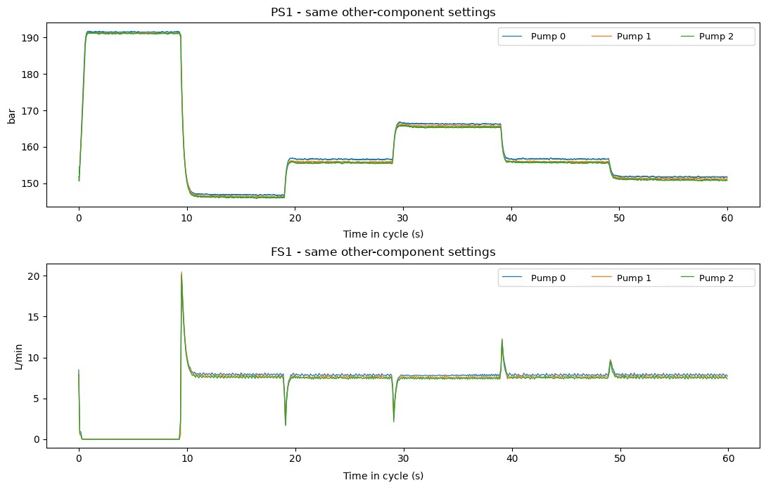
III | SENSOR DATA AUDIT
Checking the recorded pressure and flow traces
Recorded PS1 and FS1 signals across three leakage classes, with other component settings matched.
01. Check data quality
No NaN or infinity in PS1 or FS1.
Zero flow is not automatically missing.
02. Respect sampling rates
PS1: Δt = 10 ms; Nyquist 50 Hz.
FS1: Δt = 100 ms; Nyquist 5 Hz.
Align by time and cycle,
not by sample index.
03. Build the feature table
Filter each cycle → summarize both sensors → one feature row.
Sources: waveform plots and audit notebooks; UCI sampling rates [1].
09 / 18
Notes:
The data audit found no NaN or infinite values for PS1 and FS1. Zero flow readings remain in the dataset because they can represent part of the operating cycle. I retain both sensors' own time axes, based on sampling intervals of 10 milliseconds for PS1 and 100 milliseconds for FS1.
The plots show three leakage classes under otherwise matched component settings. They help reveal how signals change during one operating cycle, but do not establish that every visible difference is caused by leakage alone. The next step is to measure what changes when the traces are filtered.

Slide 10
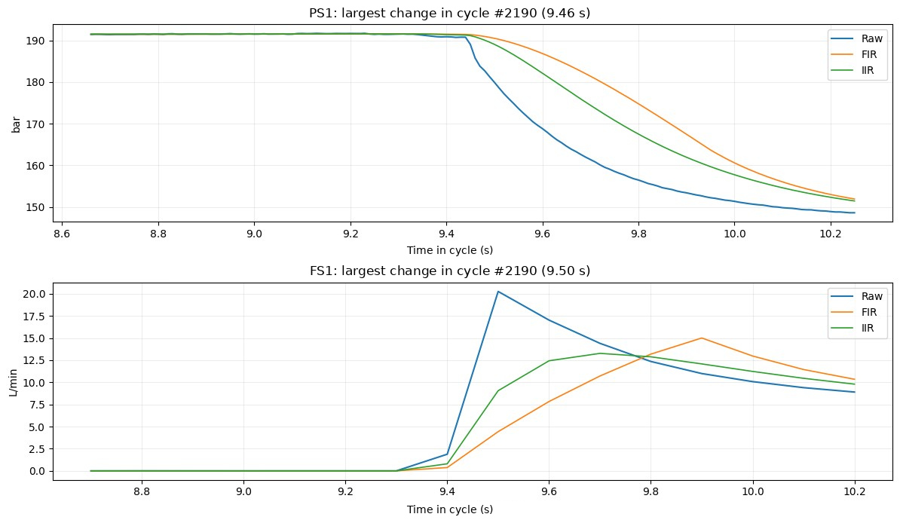
III | SIGNAL FILTERS
FIR and IIR change the shape of rapid transitions
Recorded PS1 and FS1 responses near a large change in cycle #2190.
RAW: baseline
Keeps the measured fluctuations and transients without smoothing.
FIR: no feedback
y[n] = (1/L) Σ x[n−k]
k = 0, …, L−1
Average of the current and previous L−1 samples.
IIR: feedback
y[n] = (1−a)x[n]
+ a·y[n−1]
Uses the previous output. Changes decay gradually.
Sources: filter-comparison notebook; SciPy signal filtering [3].
10 / 18
Notes:
This plot zooms in on a large change in cycle 2190. RAW preserves the recorded transition. The FIR moving average uses a fixed number of current and past samples. With the 0.5-second setting, that means 50 values for PS1 and five for FS1. The first-order IIR uses the previous output, producing a different smoothing response.
Both filters can delay or reshape brief events. The plot shows how the representation changes, but cannot tell us whether the changes improve diagnosis. We have not independently identified all fluctuations as sensor noise. The classification experiment addresses whether the filtered features are useful.

Slide 11
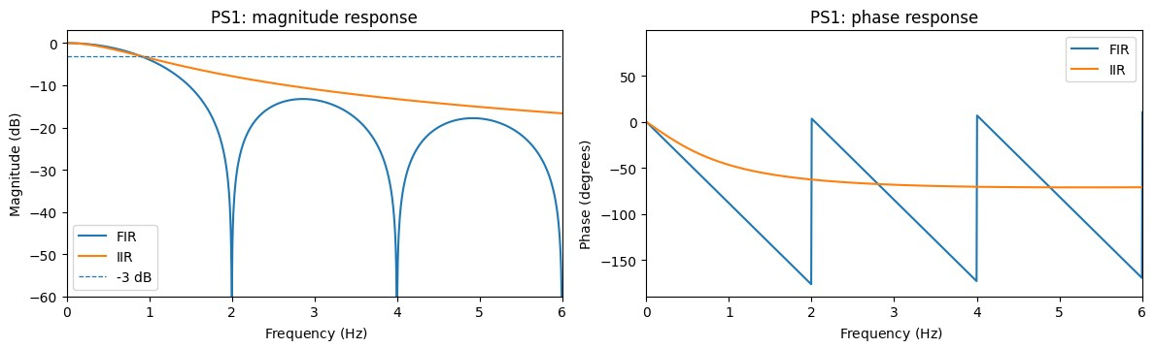
III | FILTER RESPONSE IN THE Z-DOMAIN
H(z) describes the digital filter response
LTI: y[n] = x[n] ∗ h[n] | H(z) = Y(z)/X(z) | z⁻¹ delays by one sample.
FIR: finite impulse response
IIR: decaying impulse response
H(z) = (1/L) Σ[k=0…L−1] z⁻ᵏ
Poles at 0; zeros where zᴸ=1, except z=1.
Finite coefficients give a stable filter.
H(z) = (1−a) / (1−az⁻¹)
Pole at z=a; zero at z=0.
0 < a < 1 places the pole inside the unit circle.
Sources: filter frequency-response notebook; SciPy freqz [3].
11 / 18
Notes:
For a linear time-invariant discrete-time filter, the output is the convolution of input and impulse response. With zero initial conditions, H(z) is Y(z)/X(z), and z to the minus one represents a one-sample delay.
The moving-average FIR has a finite impulse response and is BIBO stable. For the moving-average design with L greater than one, its zeros lie at the non-unit L-th roots of unity and its rational representation has poles at zero. The first-order IIR has a pole at a; with 0<a<1, that pole lies inside the unit circle and the causal filter is stable. The magnitude and phase plots describe the designed filters, not the physical hydraulic pump.

Slide 12
III | MODEL AND VALIDATION
Group-aware validation keeps configurations separate
One cycle gives 14 features. Each signal version uses the same Random Forest classifier.
Feature engineering
5-fold GroupKFold
Domain | Features per sensor
Time (5) | mean, SD, RMS, peak-to-peak, diff RMS
Frequency (2) | spectral centroid, relative spectral energy
 | G1 | G2 | G3 | G4 | G5
Fold 1 | Test | Train | Train | Train | Train
Fold 2 | Train | Test | Train | Train | Train
Fold 3 | Train | Train | Test | Train | Train
Fold 4 | Train | Train | Train | Test | Train
Fold 5 | Train | Train | Train | Train | Test
RAW / FIR / IIR → 14 features
→ Random Forest → held-out predictions
Groups are defined by cooler, valve, and accumulator states.
G1-G5 show the split idea, not the actual number of groups.
This does not test generalization to other machines.
Metrics: Macro F1 / severe recall / OOF confusion matrix / fold-to-fold variation
Source: experiment notebooks; scikit-learn GroupKFold [4].
12 / 18
Notes:
Every cycle is represented by 14 features. I evaluate RAW, FIR, and IIR representations with the same Random Forest setup and five-fold GroupKFold. Groups are defined by the combination of cooler, valve, and accumulator settings. The grid is a simple illustration; it does not show the true group counts or fold composition.
A group does not appear in both training and test data within a fold. This reduces the risk of measuring performance on an operating configuration the model has already seen during training. I report the average fold-level Macro F1 separately from pooled out-of-fold error counts. Neither result establishes performance on other physical machines.

Slide 13
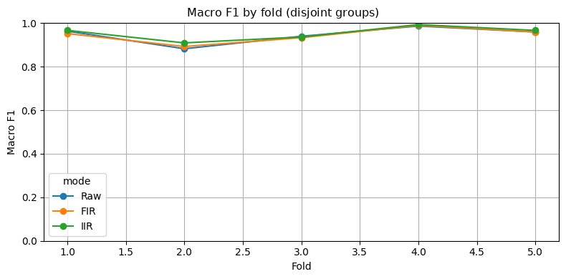
IV | CLASSIFICATION PERFORMANCE
IIR has the highest mean Macro F1, by 0.83 points
Five grouped folds. SD measures variation across folds, not uncertainty in the population.
Macro F1 by fold
Method | Mean F1 | SD
RAW | 94.62% | 3.94 pp
FIR | 94.54% | 3.60 pp
IIR | 95.45% | 3.23 pp
+0.83 pp
IIR does not lead in every fold.
The mean difference has not been tested for statistical significance.
IIR vs. RAW. FIR is 0.08 percentage points below RAW.
Source: five-fold evaluation outputs and original notebook chart.
13 / 18
Notes:
Mean Macro F1 is 94.62% for RAW, 94.54% for FIR, and 95.45% for IIR across the same five grouped folds. The corresponding standard deviations are 3.94, 3.60, and 3.23 percentage points. IIR leads RAW by 0.83 percentage points, not by a 0.83 percent relative gain.
The plotted folds vary, and IIR does not win on every split. These are descriptive cross-validation summaries. The experiment does not provide a significance test or independent evidence that IIR is better on other hydraulic systems.

Slide 14
IV | SEVERE-LEAKAGE ERRORS
IIR reduces missed severe cases from 48 to 35
Among 480 severe cycles, every missed case was classified as mild rather than normal.
Severe cases not recognized as severe
−13
fewer severe cases missed
with IIR than RAW
27.1%
relative reduction in misses
(48 − 35) / 48
Method | Missed | Detected | Severe recall
RAW | 48 | 432 / 480 | 90.00%
FIR | 42 | 438 / 480 | 91.25%
IIR | 35 | 445 / 480 | 92.71%
Severe precision: 94.74% → 94.68%.
Incorrect severe predictions: 24 → 25.
Severe recall improves, but precision does not.
All counts are held-out predictions.
Source: out-of-fold error counts and class-metrics notebooks.
14 / 18
Notes:
The evaluation contains 480 truly severe-leakage cycles. RAW identifies 432 and misses 48. FIR identifies 438 and misses 42. IIR identifies 445 and misses 35. All 35 severe cases missed by IIR are labeled mild, not normal.
Compared with RAW, IIR misses 13 fewer severe cases, a 27.1% reduction relative to the 48 RAW misses. That is not a 27.1-point increase in accuracy. Severe recall rises from 90.00% to 92.71%, while precision edges down from 94.74% to 94.68%. Incorrect severe predictions rise from 24 to 25. Those are model errors on held-out data, not real factory alarm counts.

Slide 15
IV | FEATURE ABLATION
Time-only features reach 94.92% in the RAW test
Ablation uses unfiltered data and reports mean Macro F1 across five grouped folds.
What the comparison shows
Both sensors help.
PS1 and FS1 together outperform
either sensor on its own.
Time features work well.
94.92% time-only vs. 94.62%
with all 14 RAW features.
More features do not always help.
The observed gap needs
further validation.
The two selected spectral features perform poorly alone.
This does not rule out other frequency-domain approaches.
Source: RAW feature-ablation notebook and grouped validation outputs.
15 / 18
Notes:
This ablation uses RAW signals only. Mean Macro F1 is 94.92% with time features, 94.62% with all 14 features, 88.54% with FS1 alone, 85.57% with PS1 alone, and 44.67% with the two selected spectral features alone.
The two sensors provide complementary information under this setup. Time features are competitive, but the 0.30-point difference between time-only and all-feature results was not tested for statistical significance. The poor frequency-only score applies to the specific spectral centroid and relative-energy features chosen here. Other spectral representations could behave differently. The results do not establish that frequency features should always be removed.

Slide 16
V | LIMITATIONS AND NEXT TESTS
The results are promising, but come from one test rig
Separate measured results from possible explanations and follow-up tests.
Status | Evidence | What remains open
Measured | IIR: mean F1 95.45%; 35 of 480 severe cases missed | Best mean under this test, not in every fold
Hypothesis | Filter attenuation may shape more useful features | Noise was not isolated; mechanism not causal proof
Limitations | One rig; five grouped folds; 0.3, 0.5, 1.0 s explored | Choosing filter settings on these folds may inflate scores
Next experiments | Tune inside training folds; set aside final evaluation | Test other rigs and conditions; measure real-time behavior
No deployment, sensor-noise isolation, or cross-machine validation was performed.
Source: evaluation notebooks and documented study constraints.
16 / 18
Notes:
The measured evidence favors IIR on average, but there are several limitations. All data come from one laboratory rig. GroupKFold separates component settings, not physical machines. Filters with 0.3, 0.5, and 1.0-second settings were explored under the same evaluation setup, which can make the selected result optimistic.
The idea that a particular filter response creates better diagnostic features is a possible explanation, not an established causal mechanism. A stronger follow-up study would tune filter settings within training folds, reserve a separate final test, use data from other rigs and operating conditions, and measure latency if real-time monitoring is the goal.

Slide 17
V | INTERPRETING THE RESULTS
What engineers and operations teams need to know
The numbers stay the same. The follow-up questions differ by audience.
Topic | Maintenance / Reliability Engineer | Operations Manager
Sensor data | Check quality, sampling rates, and PS1/FS1 cycle IDs. | Reliable diagnosis depends on reliable sensor data.
DSP | Inspect transients, H(z), and FIR/IIR stability. | Filtering is tested, not assumed to help.
Model results | IIR: mean F1 95.45%; SD 3.23 pp. Keep fold means and OOF apart. | Highest average in this test; field performance is unknown.
Severe cases | 35 missed vs. 48 with RAW; all misclassified as mild. | 13 fewer severe cases missed in the evaluation.
Trade-offs and limits | Severe precision: 94.74% → 94.68%. One rig; no real-time test. | Better recall, but some false severe predictions remain.
Next tests | Tune on train data; external tests and error reviews. | Run a controlled pilot with engineers before use.
Cost-sensitive analysis would compare error consequences; no financial costs were measured.
Source: held-out predictions, experiment notebooks, and suggested follow-up tests.
17 / 18
Notes:
For engineers, the useful detail is how the signals were sampled, how the filters changed transients, how grouped validation was set up, and which labels the classifier confused. For an operations manager, the same results need to be framed around inspection priorities and uncertainty.
IIR missed 13 fewer severe cases than RAW in the available test, but it also produced one additional incorrect severe prediction. Neither result is a measured savings or a field reliability estimate. The practical next step would be a monitored pilot with engineers after external validation, not an automated maintenance decision based on this model alone.

Slide 18
V | FINDINGS AND SOURCES
IIR helped in this evaluation; field performance is unknown
Data integrity
Filter behavior
Measured performance
Check readings, sampling rates,
and cycle IDs before building
the feature table.
FIR and IIR reshape transients.
H(z) explains the filters,
not the hydraulic machine.
IIR: 95.45% mean Macro F1
and 13 fewer severe misses
than RAW in held-out testing.
Next steps: separate model selection from final evaluation,
then test additional machines before considering deployment.
DATA, METHODS, AND REFERENCES
[1] UCI Hydraulic Systems. DOI 10.24432/C5CW21.
[2] Helwig et al. (2015). I2MTC.
DOI 10.1109/I2MTC.2015.7151267.
[3] SciPy. Signal processing and FFT documentation.
[4] scikit-learn. GroupKFold and Random Forest.
Dataset: UCI Hydraulic Systems [1].
Methods: RAW, FIR, IIR, Random Forest [3,4].
Evaluation: five GroupKFold splits.
Outputs: fold metrics, OOF errors, and ablation.
Scope: one laboratory test rig.
Results describe the selected stable cycles and the evaluation setup used in this study.
18 / 18
Notes:
This project compares raw and filtered sensor representations for three leakage classes on the UCI hydraulic dataset. The pipeline checks data integrity, preserves the two sampling rates, summarizes each cycle as 14 features, and evaluates the same Random Forest classifier using GroupKFold.
IIR has the highest mean Macro F1, 95.45%, and misses 13 fewer severe cases than RAW in pooled out-of-fold predictions. Severe precision does not improve, and performance varies by split. The evaluation comes from one laboratory rig and exploratory filter settings. Before deployment, the next steps are separate model selection, external machine validation, and operational testing.
Primary references: UCI Hydraulic Systems, DOI 10.24432/C5CW21; Helwig et al. (2015), DOI 10.1109/I2MTC.2015.7151267; SciPy signal and FFT documentation; scikit-learn GroupKFold and RandomForestClassifier documentation. Results were calculated in the project notebooks.

