Slide 1
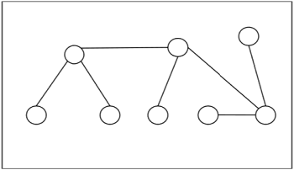
Trees
By: Jennifer Ortiz
CS 131 Discrete Structures
Spring 2022

Slide 2
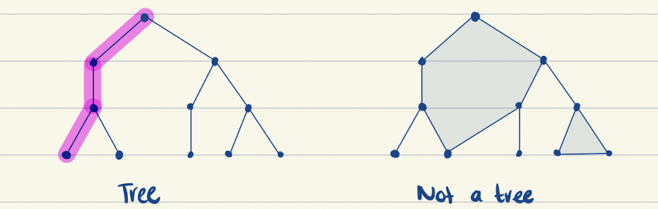
What are Trees?
They are a simple, connected, undirected graph with no simple circuits.
This means that there is a unique simple path between any two of its vertices.

Slide 3
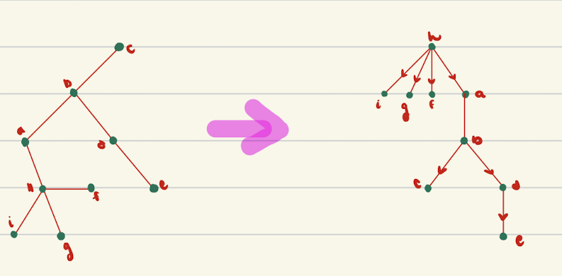
Rooted Trees
A tree in which one vertex has been designed as the root and every edge is directed away from the root.
We typically place the root at the top of the tree.

Slide 4
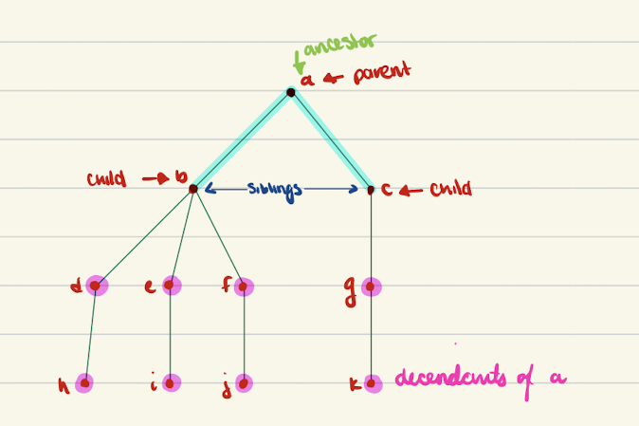
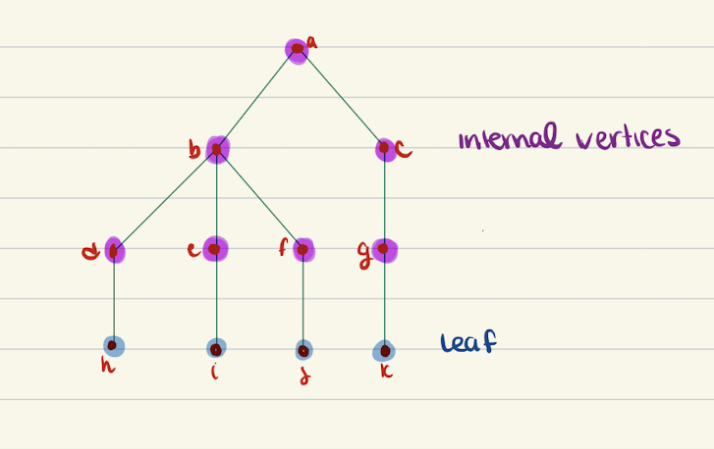
More Terminology for Rooted Trees.
Binary Tree
Parent
Child
Sibling
Ancestor
Descendants
Leaf
Internal Vertices

Slide 5
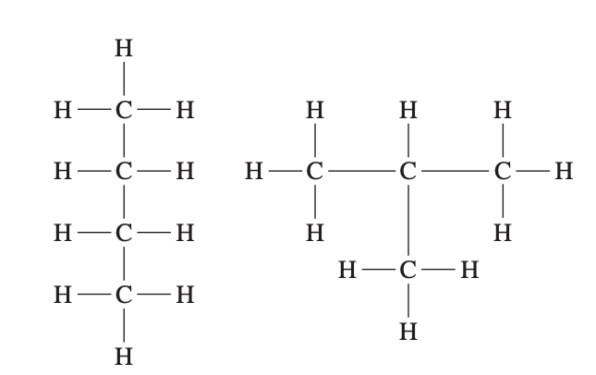
Saturated Hydrocarbons and Trees
Graphs can be used to represent molecules, where atoms are represented by vertices and bonds between them by edges.
The English mathematician Arthur Cayley discovered trees in 1857.
In graph models of saturated hydrocarbons, each carbon atom is represented by a vertex of degree 4, and each hydrogen atom is represented by a vertex of degree 1.
Because the graph is connected and the number of edges is one less than the number of vertices, it must be a tree

Slide 6
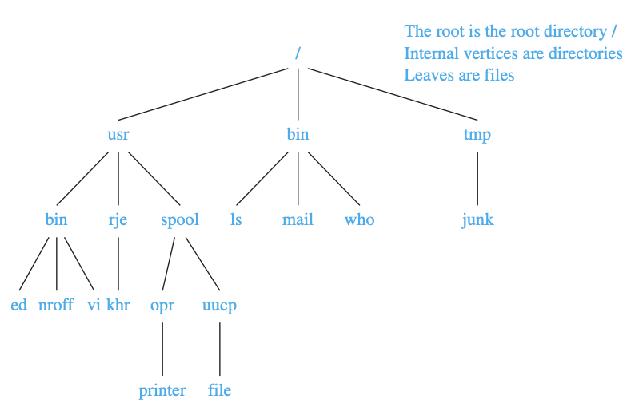
Computer File Systems
Files in computer memory can be organized into directories. A directory can contain both files and subdirectories.
The root directory contains the entire file system.
Thus, a file system may be represented by a rooted tree, where the root represents the root directory, internal vertices represent subdirectories, and leaves represent ordinary files or empty directories.

Slide 7
Properties of Trees
A Tree with n vertices has n-1 edges.
A full m-ary tree with I internal vertices contains n=mi = 1 vertices.
A full m-ary tree with:
(i) n vertices has i=n-1/m internal vertices and l=(m-1)n+1/m leaves.
(ii) I internal vertices has n=mi +1 vertices and l=(m-1)i+1 leaves.
- (iii) l leaves has n= (ml-1)/m-1 vertices and i=l-1/m-1 internal vertices.

Slide 8
The importance of Treses
They represent hierarchal relationships between individual elements or nodes.

