Slide 1


Looter-Shooter
Looter-Shooter
Logan Tan
Nate Adams
Ramsay Fencl
Logan Tan
Nate Adams
Ramsay Fencl
Logan Tan
Nate Adams
Ramsay Fencl

Slide 2
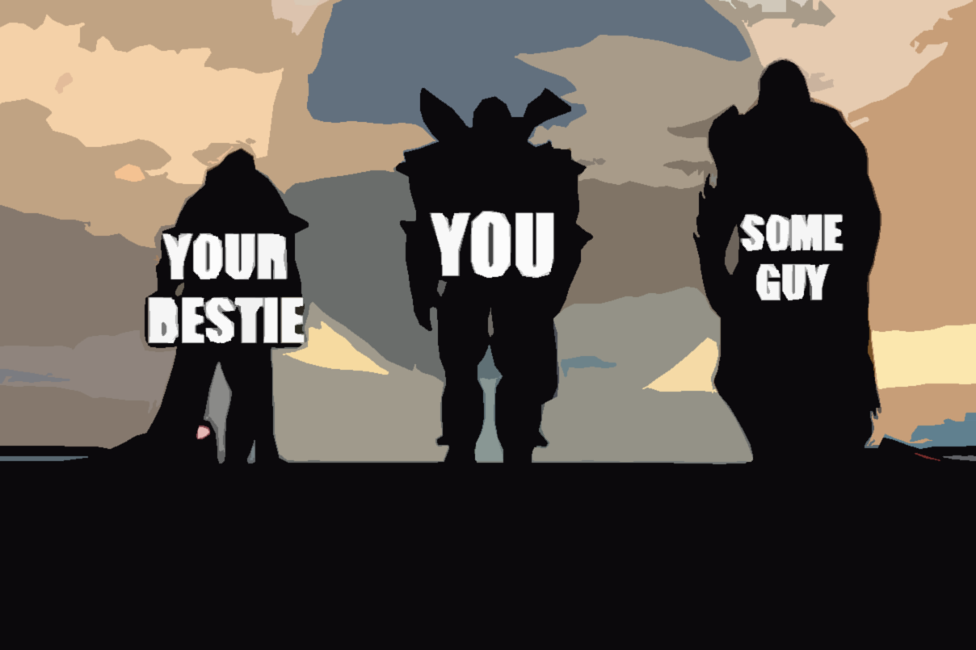
Gameplay
Form a squad of 1-4 players
Enter a randomized dungeon
Proceed through encounters
Fight a Boss
Get Paid

Slide 3
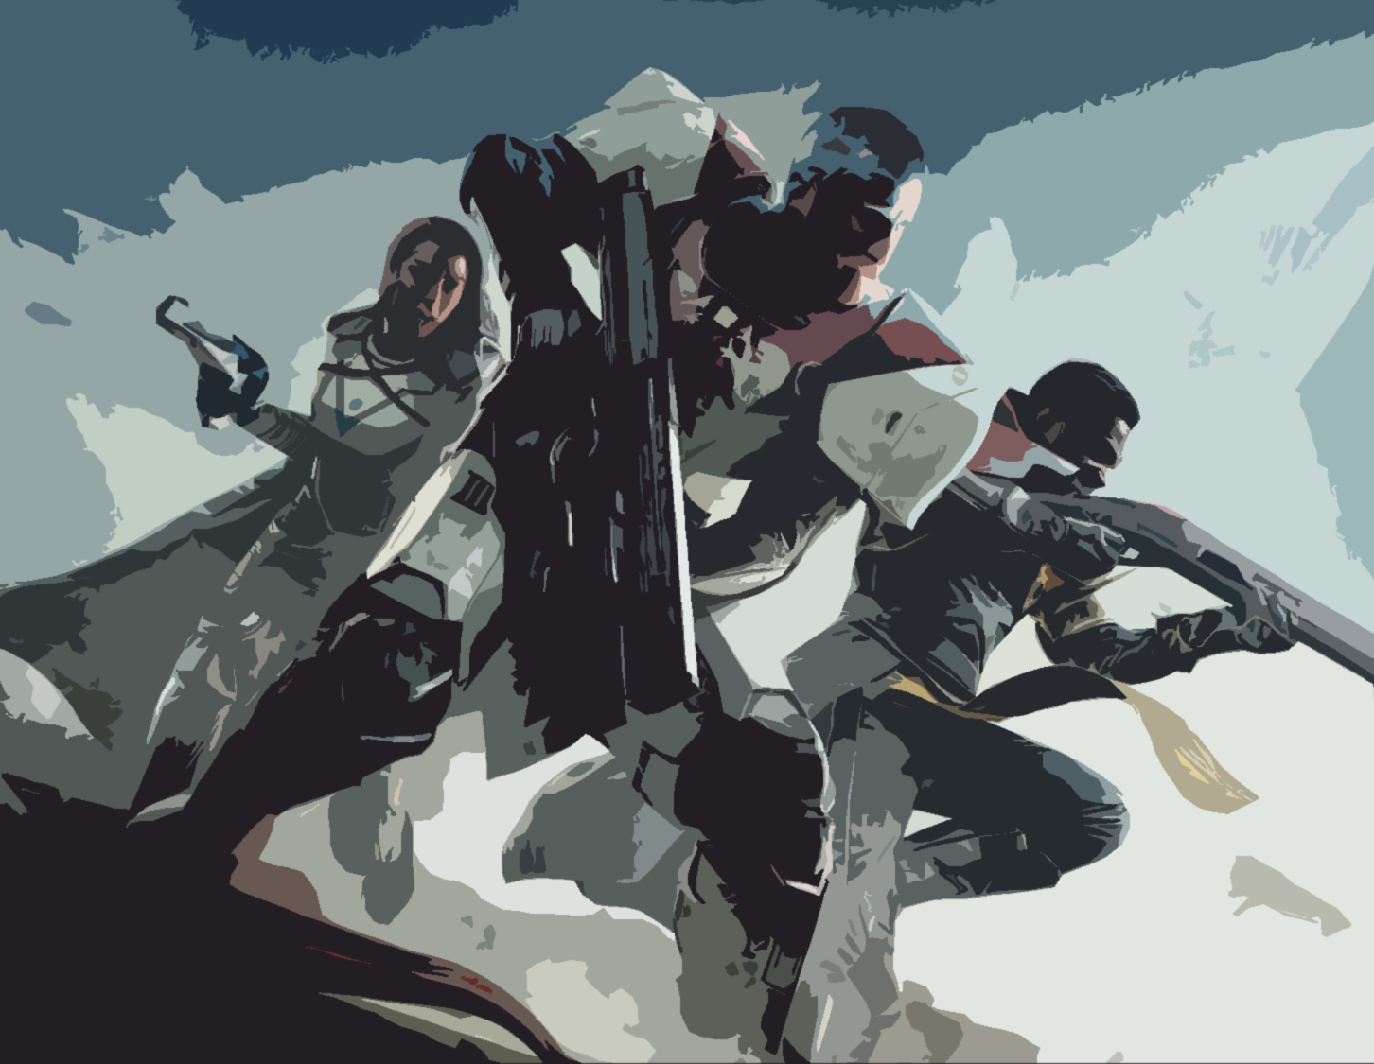
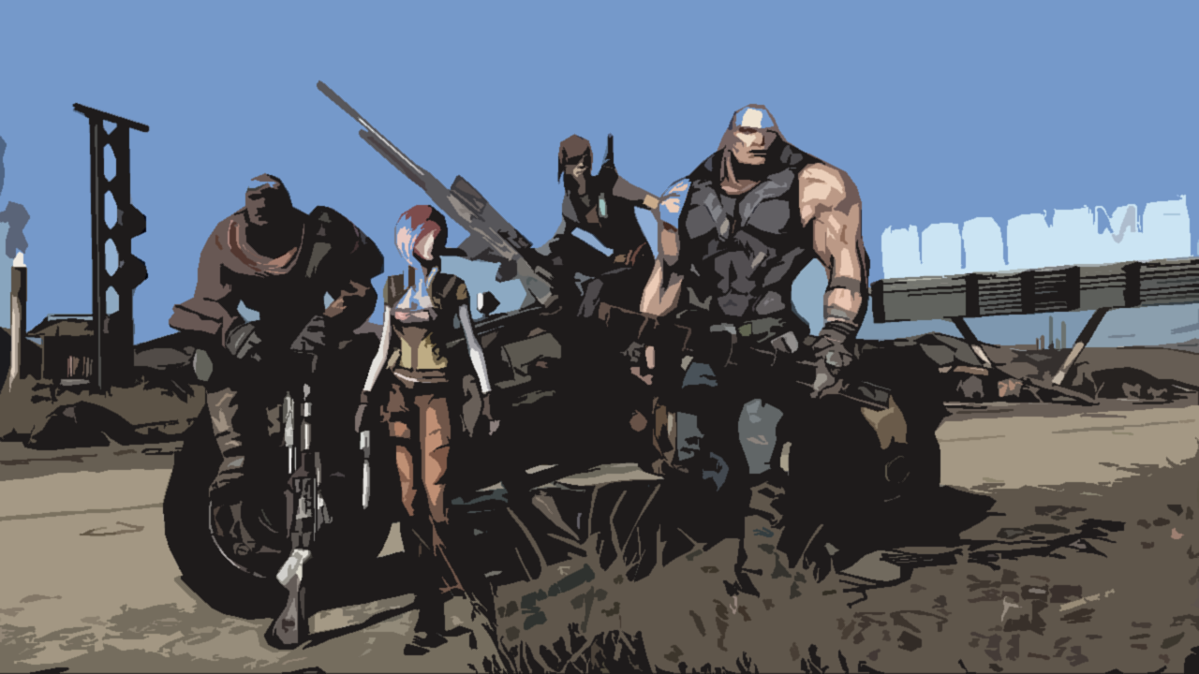
Inspirations
Destiny 2 | Borderlands (The First One)
Mechanic-Driven Boss Fights | Randomized loot
Dungeons | 4 player co-op

Slide 4
Approach
Players connect to Host’s game and receive/send serialized data to maintain consistent world.
Random Boss is chosen when dungeon is entered, determines encounters used
Dungeon is made up of a “Start Room”, “Hallways/Junctions”, “Encounter’s”, and a “Boss Room”.
Gun part randomization and serialization, weapon can be stored as a String.

Slide 5
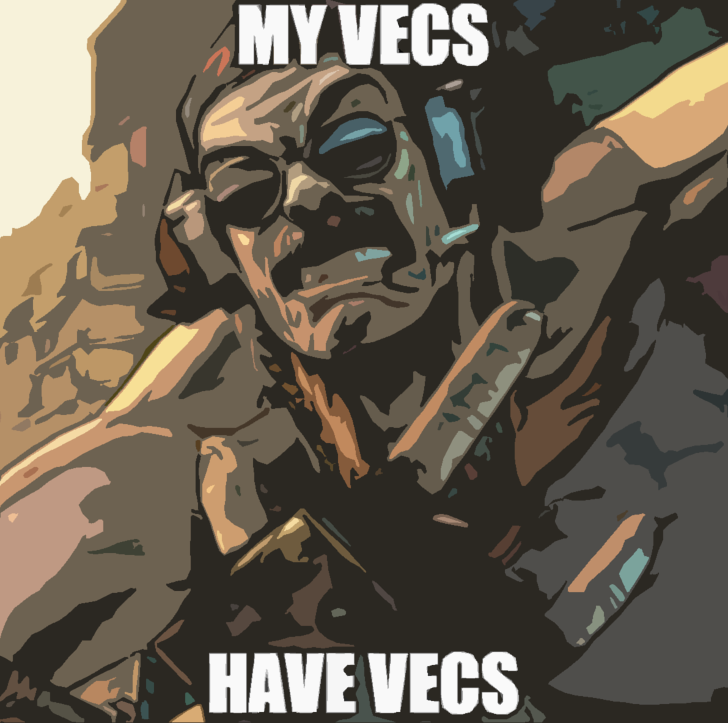
Complexity Requirement?
Overall Complexity: Stupid Hard -
3D Math and Rendering
Randomization/Serialization
Boss fights with unique mechanics
Networking
Continuous Player Progression

Slide 6
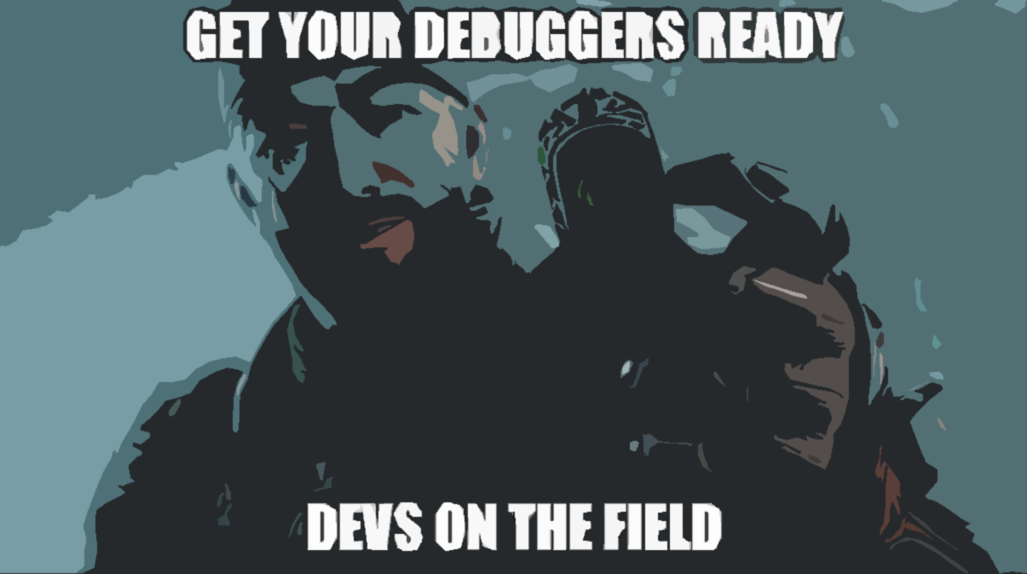
Workloads
Ramsay – Engine/DevTools
Nate – Networking/Serialization
Logan – Mechanic/Gameplay Design
Shared – Art, Level Design, Sound Design, Balancing

