Slide 1
A Tutorial on Bayesian Data Analysis
Presented by Nathaniel Haines
Department of Psychology, The Ohio State University, Columbus, OH

Slide 2

Outline
Conceptual barriers to Bayesian thinking
“Generative thinking” as the core of Bayesian analysis
Workflow and example

Slide 3
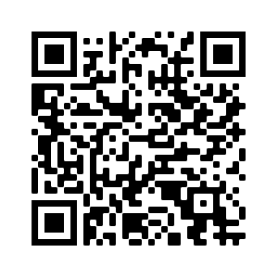
To Follow Along

Slide 4
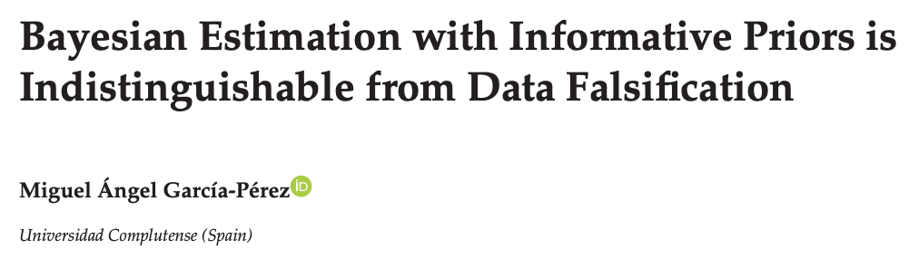
Conceptual barriers
“Bayesian analysis is just adding priors to traditional frequentist models”
“Bayesian probability (and prior information) is subjective and inherently biases our statistical inference”

Slide 5
What Bayesian Modeling is
Developing a generative model that spans across all variables being used to make a given inference
Generative model → a single, or joint, probability distribution that can simulate forward all quantities of interest
Includes:
Distribution of observed data
Distribution of parameters
All theoretically relevant relationships between observed data and parameters

Slide 6
What Bayesian Modeling is
Developing a generative model that spans across all variables being used to make a given inference
Generative model → a single, or joint, probability distribution that can simulate forward all quantities of interest
Importantly…
Our generative model should represent and encode our theoretical knowledge of how quantities of interest are generated

Slide 7
The Bayesian Workflow
General steps:
Specify generative model (i.e. one that can simulate data you plan to analyze)
Distribution of data (likelihood)
Distribution of parameters (prior)
Prior predictive simulations
Determine if model produces data consistent with what you expect
If not, back to step 1
Condition on data to obtain posteriors (Bayes rule!)
Posterior predictive simulations
Determine if model predictions can capture observed data
If not, back to step 1

Slide 8

Example: Design
The inference problem
Difference in impulsivity between people with versus without a history of chronic substance use
The task
Iowa Gambling Task
The participants
Ahn et al. (2014)
48 healthy controls
38 with past stimulant use disorder (amphetamine)
Net gain per selection
1 +100
2 +100
3 -50
4 +100
5 -200
6 +100
7 -100
8 +100
9 -150
10 -250
EV -250
+100
+100
+100
+100
+100
+100
+100
+100
-1150
+100
-250
+50
+50
-50
+50
-50
+50
-50
+50
-50
-50
+250
+50
+50
+50
+50
+50
+50
+50
+50
+50
-200
+250
A
B
C
D

Slide 9
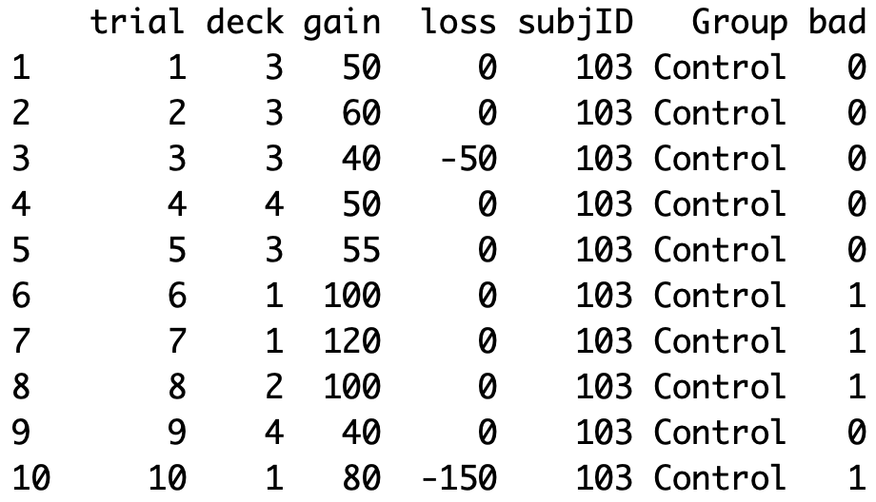
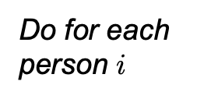

Example: Traditional approach
Proportion of “bad” decks selections for each person
$${prop}_{i}=.43$$
…
…
…
…
…
…
…
…
Do for each person $i$

Slide 10
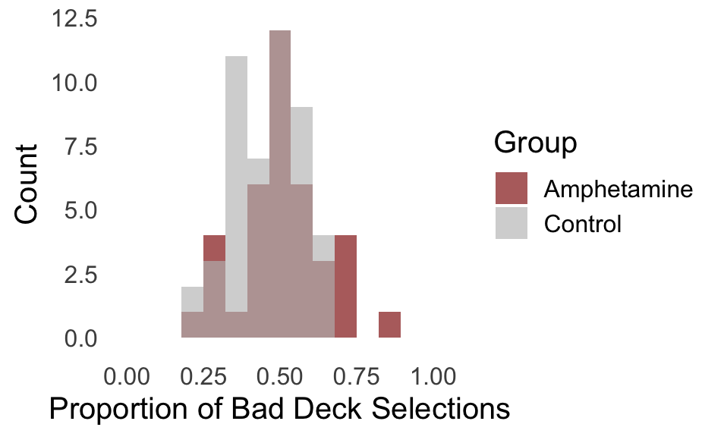
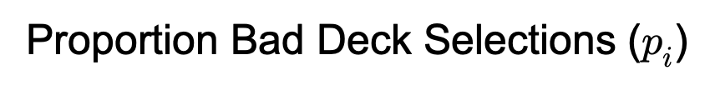

Example: Traditional Approach
Two-sample t-test p = .08
$$({prop}_{i})$$
Proportion Bad Deck Selections ($p_{i}$)

Slide 11
Example: The data-generating process
Theoretical knowledge
About data collection
100 total trials/elections made by each person
Observed outcomes are binary—each trial is coded “good” (0) or “bad” (1)
About impulsivity and behavior
Each person has a latent “impulsivity” trait, which probabilistically gives rise to impulsive behavior
Higher trait impulsivity should produce more “bad” selections across trials in the current context
Trait impulsivity is normally distributed at the population level

Slide 12
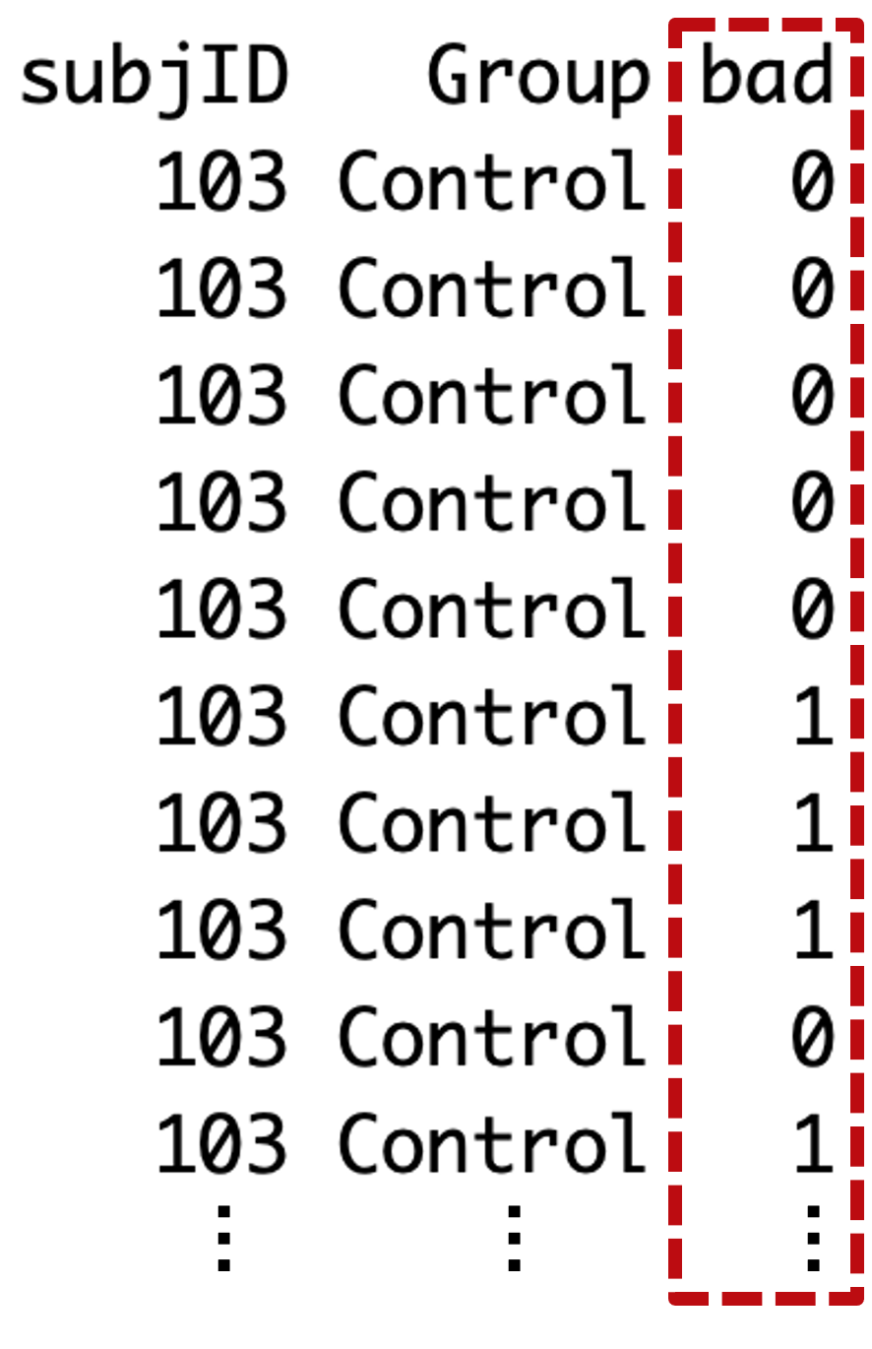
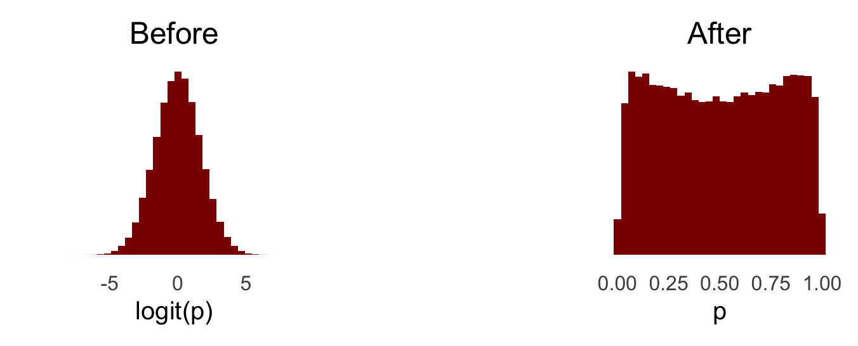
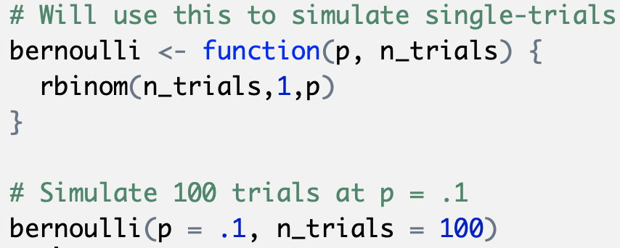
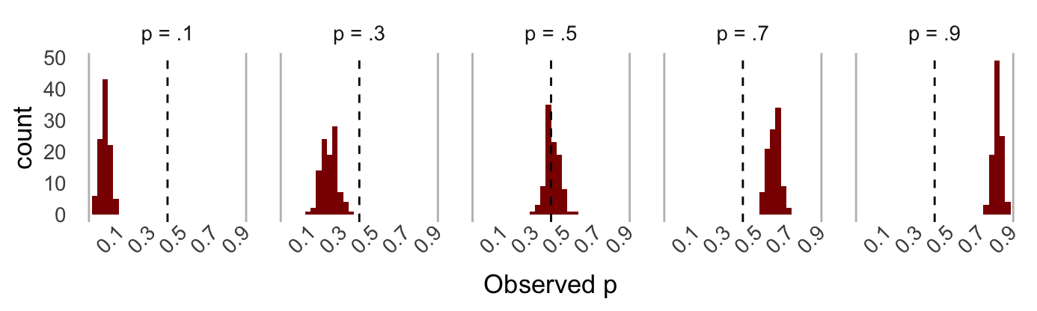



Example: Simulating binary outcomes
Bad/good selection is a biased coin flip on each trial
Likelihood
Sim 2
Sim 1
Prior
Approximately Uniform
$$.05$$
$$.08$$
$$…………$$

Slide 13
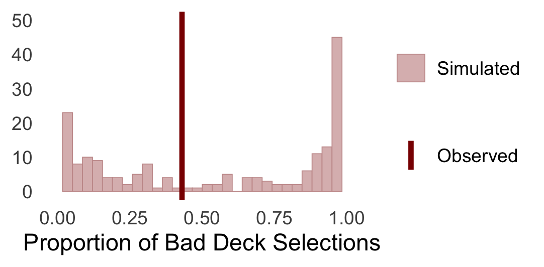
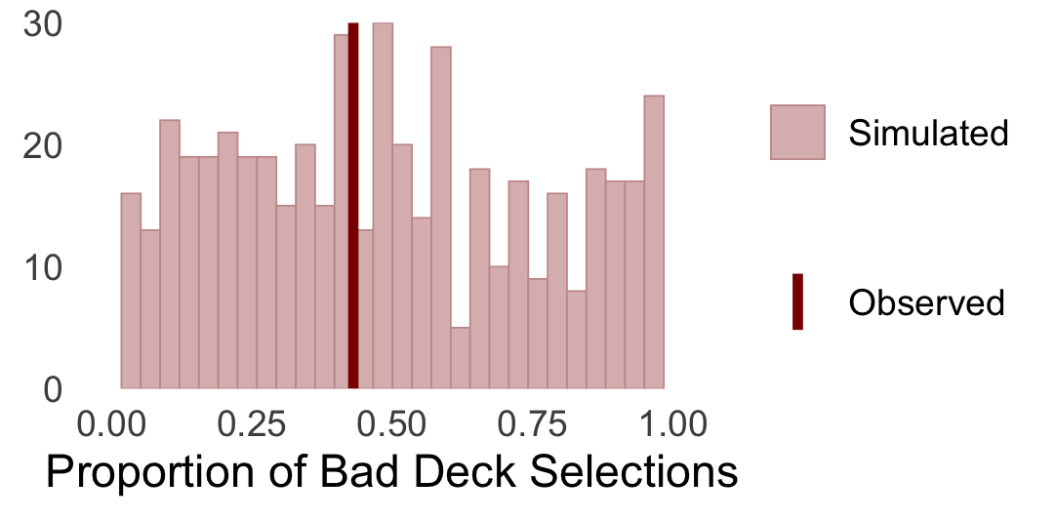
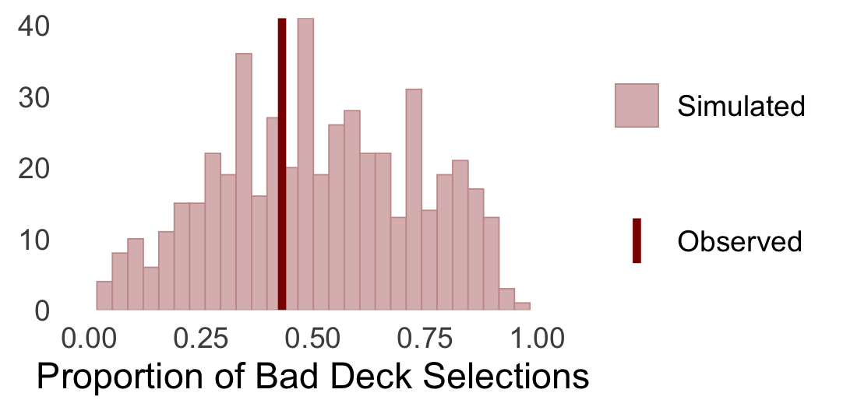
Example: Prior predictive simulations
“Non-informative” priors can sometimes be quite informative…
Sample prior
Sample likelihood
Summarize
Repeat

Slide 14
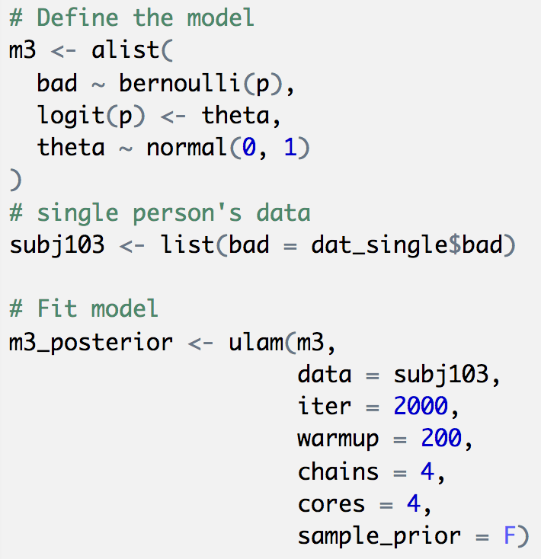
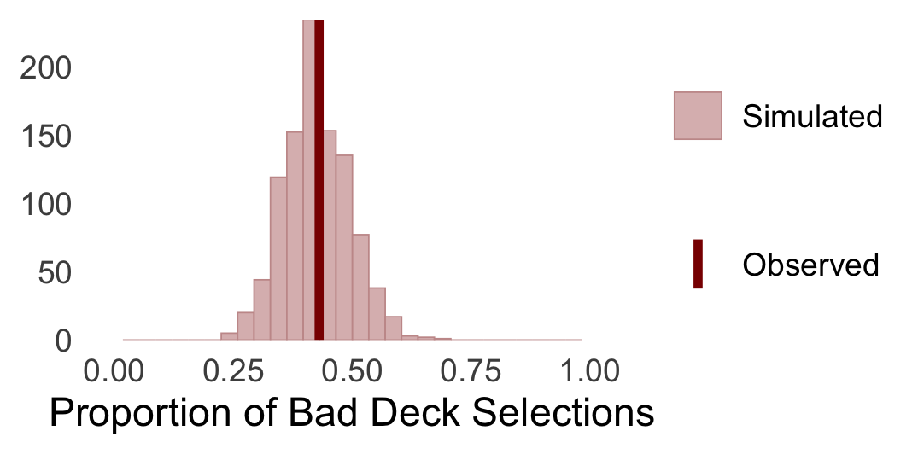
Example: Bayesian updating
Posterior Predictions
Prior Predictions

Slide 15
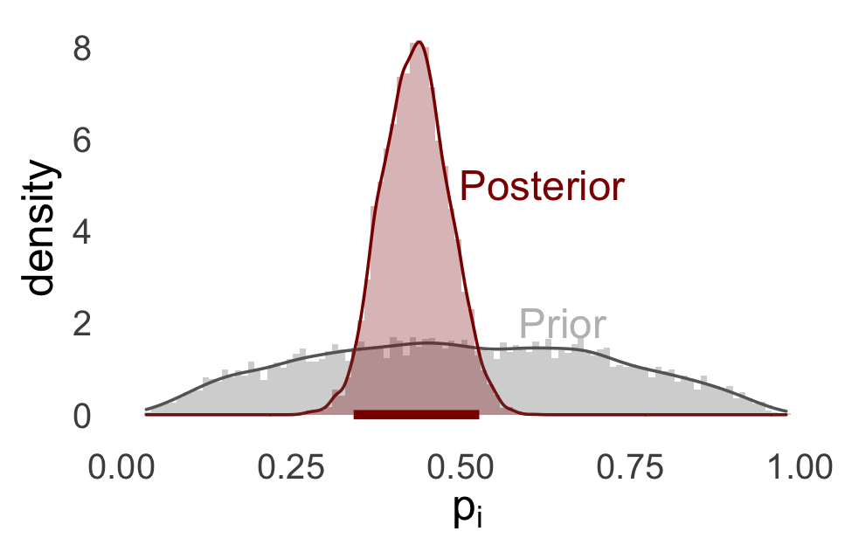
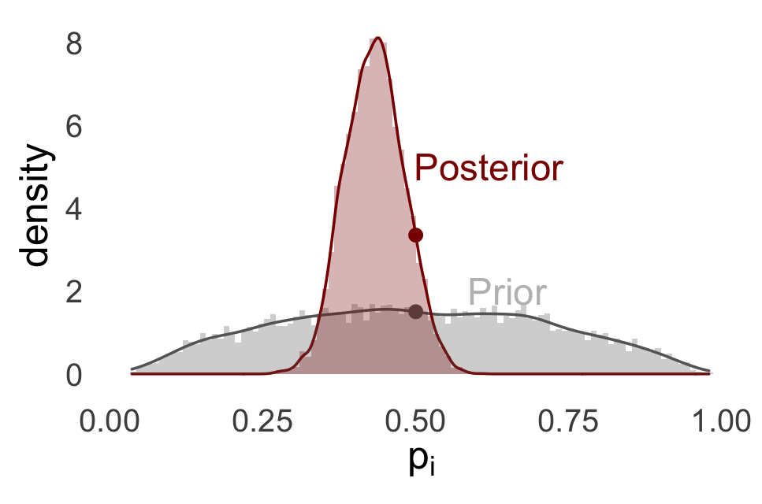
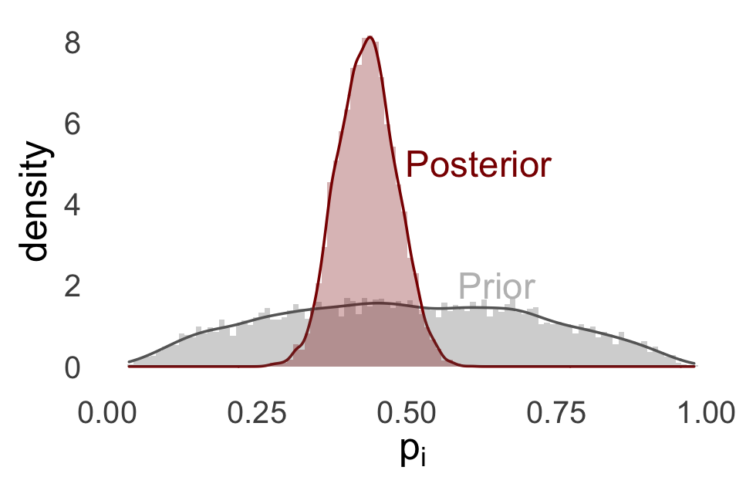
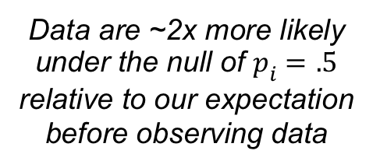
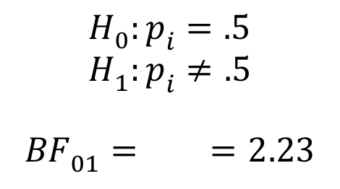
Example: Interpreting parameters
Savage-Dickey Density Ratio for computing Bayes Factor
$$H_{0}:p_{i}=.5 \\ H_{1}:p_{i}≠.5$$
$BF_{01}= =2.23$
Highest density interval
An X% HDI contains X% of the mass of the distribution, where every point inside is more probable than any point outside
Data are ~2x more likely under the null of $p_{i}=.5$ relative to our expectation before observing data

Slide 16
Example: Multiple participants
Posterior Predictions
Prior Predictions
Observed
Simulated

Slide 17
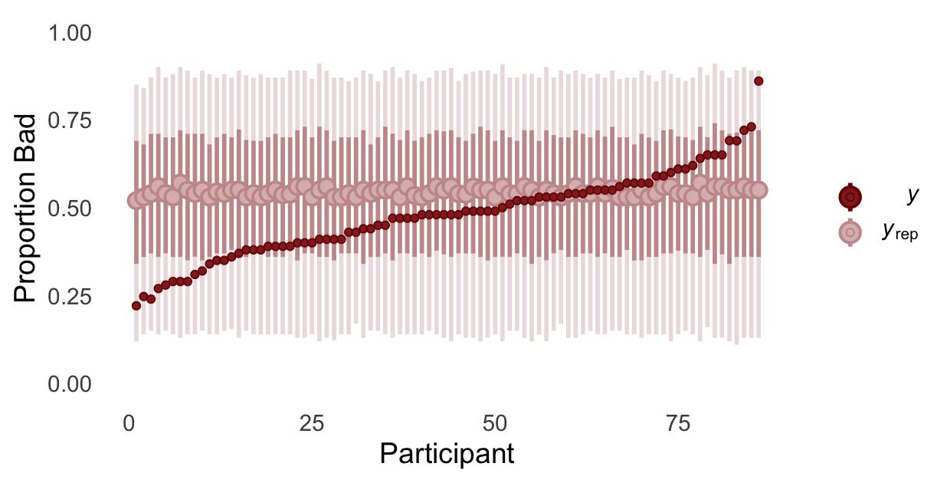
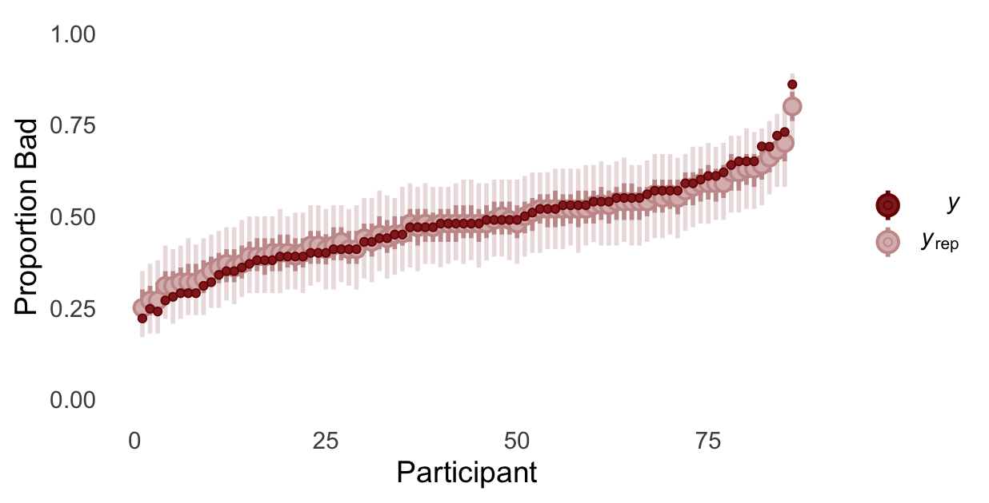
Example: Estimating group differences
The prior now functions as a group-level model
Posterior Predictions
Prior Predictions
0 = control
1 = substance use
95% HDI
[-.32, -.02]
beta weights!
95% HDI
[-.02, .41]
Observed
Simulated
This is hierarchical Bayesian analysis!

Slide 18
Example: What have we learned
No convincing evidence of group-level mean difference between controls and those with substance use disorders
Controls showed evidence for choosing the “good” decks more frequently than “bad” decks
Substance use group appeared to choose both about equally
Lot’s of heterogeneity within groups!
p_{i} varied a lot from person-to-person

Slide 19
Example: Possible extensions
Different group-level SDs
Learning effects
e.g., estimating change in p_{i} across trials within persons
Going back to theory
If we believe impulsivity is normally distributed at the population level, perhaps individual differences analyses would be more fruitful than binary group comparisons
Estimate correlations between p_{i} and impulsivity-related covariates (e.g., self-reports)
Self-report measure of impulsivity

Slide 20
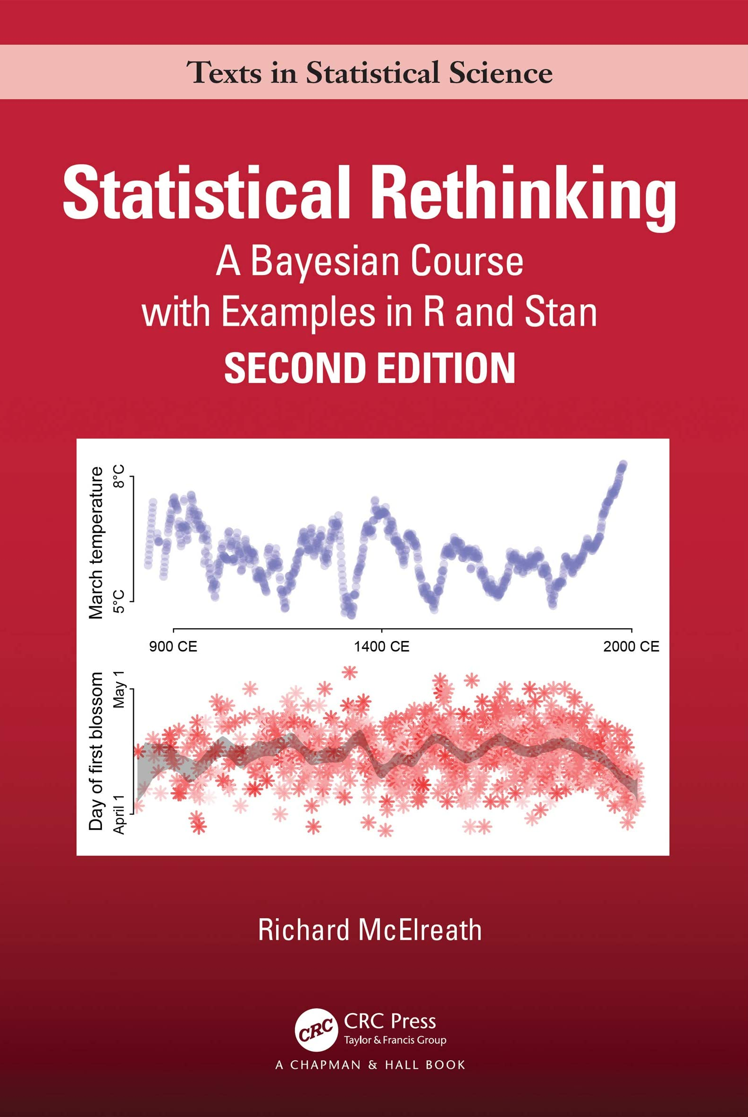
Wrap up
Bayesian data analysis forces us to think about the data-generating process
We can construct models that better align with our theories
We can use our models to simulate data to better understand both:
Our statistical models
Implications of models for substantive theory

