Slide 1


Learning from the reliability paradox: How theoretically informed generative models can improve person-level inference
Nathaniel Haines, Peter Kvam, Louis Irving, Colin Smith, Theodore Beauchaine, Mark Pitt, Woo-Young Ahn, & Brandon Turner

Slide 2
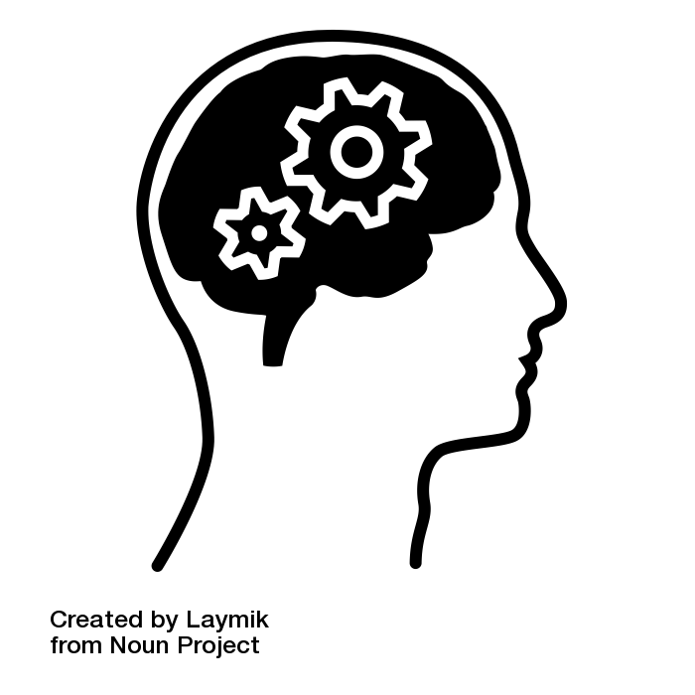
Outline
The Reliability Paradox
Breaking down inference
Parameter recovery study
Empirical test-retest applications
General implications

Slide 3
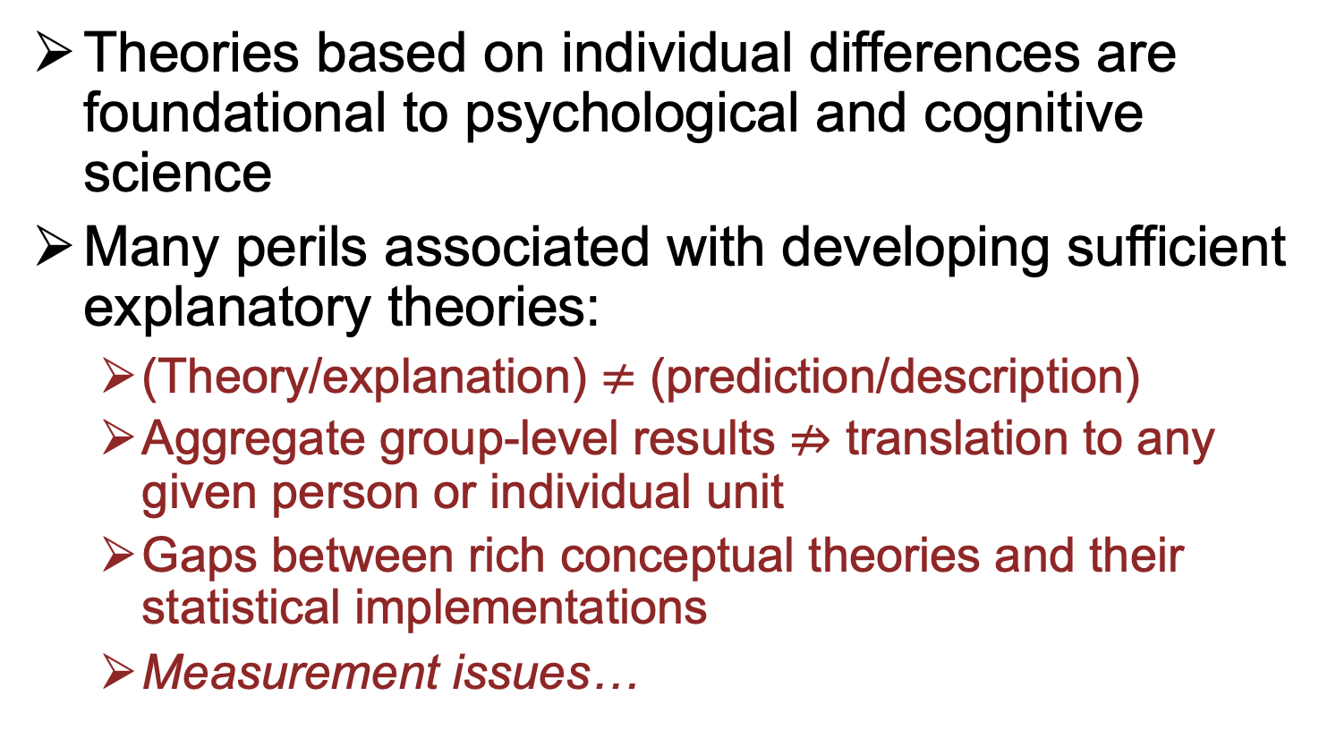
Prologue
#psynom21
Theories based on individual differences are foundational to psychological and cognitive science
Many perils associated with developing sufficient explanatory theories:
(Theory/explanation) $≠$(prediction/description)
Aggregate group-level results ⇏ translation to any given person or individual unit
Gaps between rich conceptual theories and their statistical implementations
Measurement issues…
Guest & Martin, 2020; Kellen, 2019; Navarro, 2018; Suppes, 1966; van Rooij & Baggio, 2020

Slide 4
Prologue
#psynom21
Measurement issues galore:
Self-report measures
Often Likert scales
Scoring → sum item responses
Behavioral measures
Often accuracy or response time tasks
Scoring → percent correct or average response time (either within a condition or contrasted across conditions)
(1) and (2) often show low correspondence (e.g., impulsivity literature) → Why?
Cyders & Coskunpinar, 2011; Duckworth & Kern, 2011

Slide 5
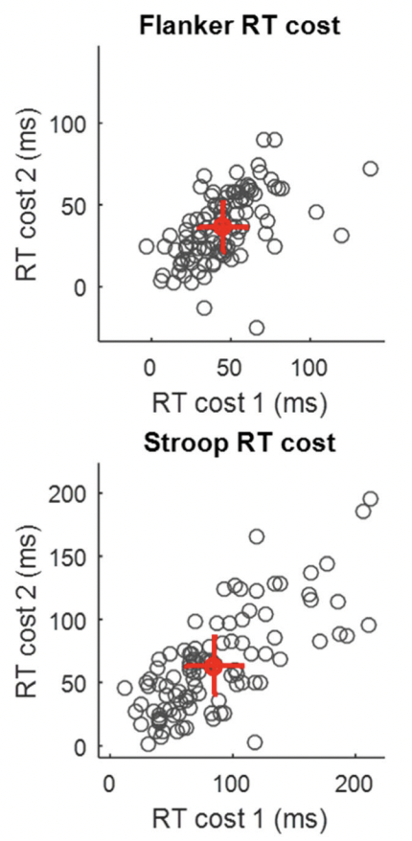
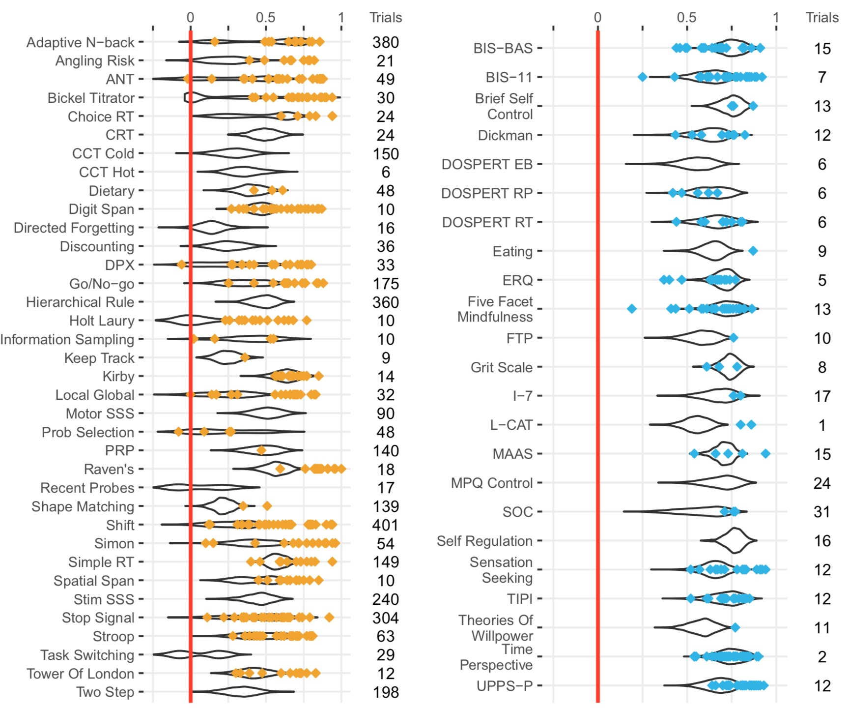
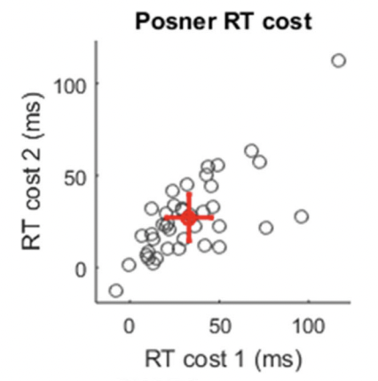
The Reliability Paradox
#psynom21
Partly because many behavioral summary measures have low test-retest reliability
Hedge et al. (2017)
Enkavi et al. (2019)

Slide 6
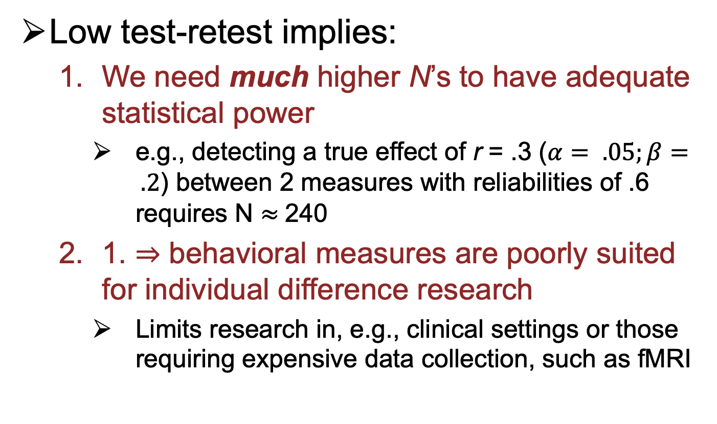
The Reliability Paradox
#psynom21
Low test-retest implies:
We need much higher N’s to have adequate statistical power
e.g., detecting a true effect of r = .3 ($α= .05;β= .2$) between 2 measures with reliabilities of .6 requires N $≈$240
1. ⇒ behavioral measures are poorly suited for individual difference research
Limits research in, e.g., clinical settings or those requiring expensive data collection, such as fMRI
Dang et al., 2020; Hedge et al., 2017; Wennerhold & Friese, 2020

Slide 7
If behavioral and neural measures perform poorly, should we not use them for individual difference research?
It’s complicated…

Slide 8
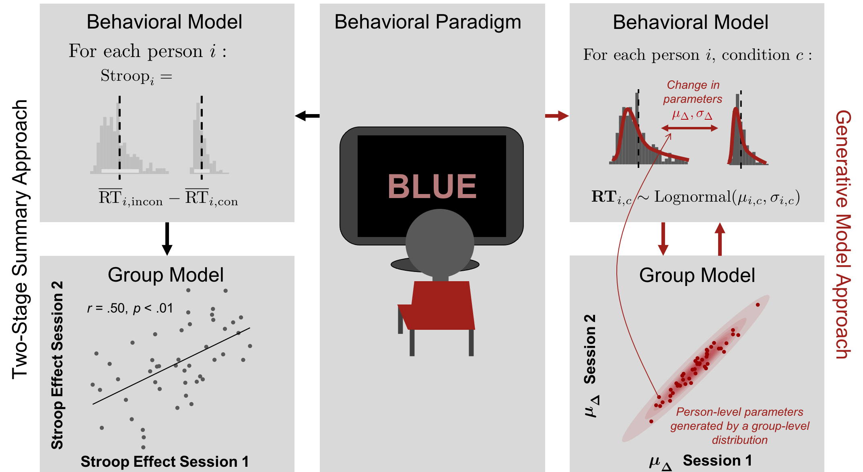
Breaking Down Inference
#psynom21
Two-stage approaches ignore measurement uncertainty, attenuating individual difference correlations
Simple summary statistics fail to connect conceptual theories of behavior to data in meaningful ways
Devezer et al., 2019; 2020; Estes, 1956; Regenwetter & Robinson, 2017; Rouder & Haaf, 2019; Turner et al., 2018; Vandekerckhove, 2014
Haines et al. 2021; Turner et al., 2016; 2019

Slide 9
How does generative modeling resolve issues associated with the two-stage approach?
Let’s talk about the data generating process!

Slide 10
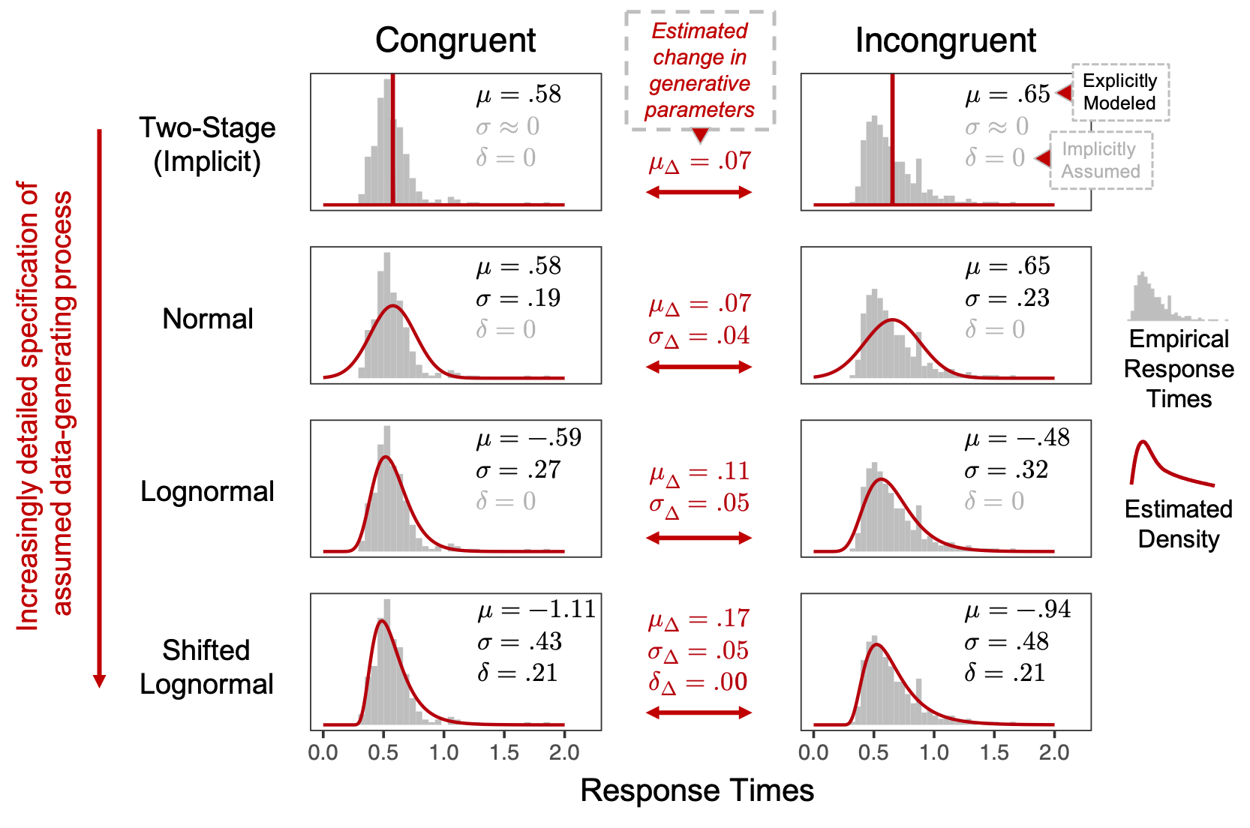
Breaking Down Inference
#psynom21

Slide 11
How big of a difference should it actually make?
Time to simulate!

Slide 12
Parameter Recovery
#psynom21
Procedure:
Draw person-level parameters (e.g., mean RT) from a multivariate normal with a “test-retest” correlation ranging from -1 and +1
Draw response times from lognormal distribution with parameters from (1) for each simulated person, within both task conditions and sessions
Compare the two-stage summary statistic approach versus generative model estimates

Slide 13
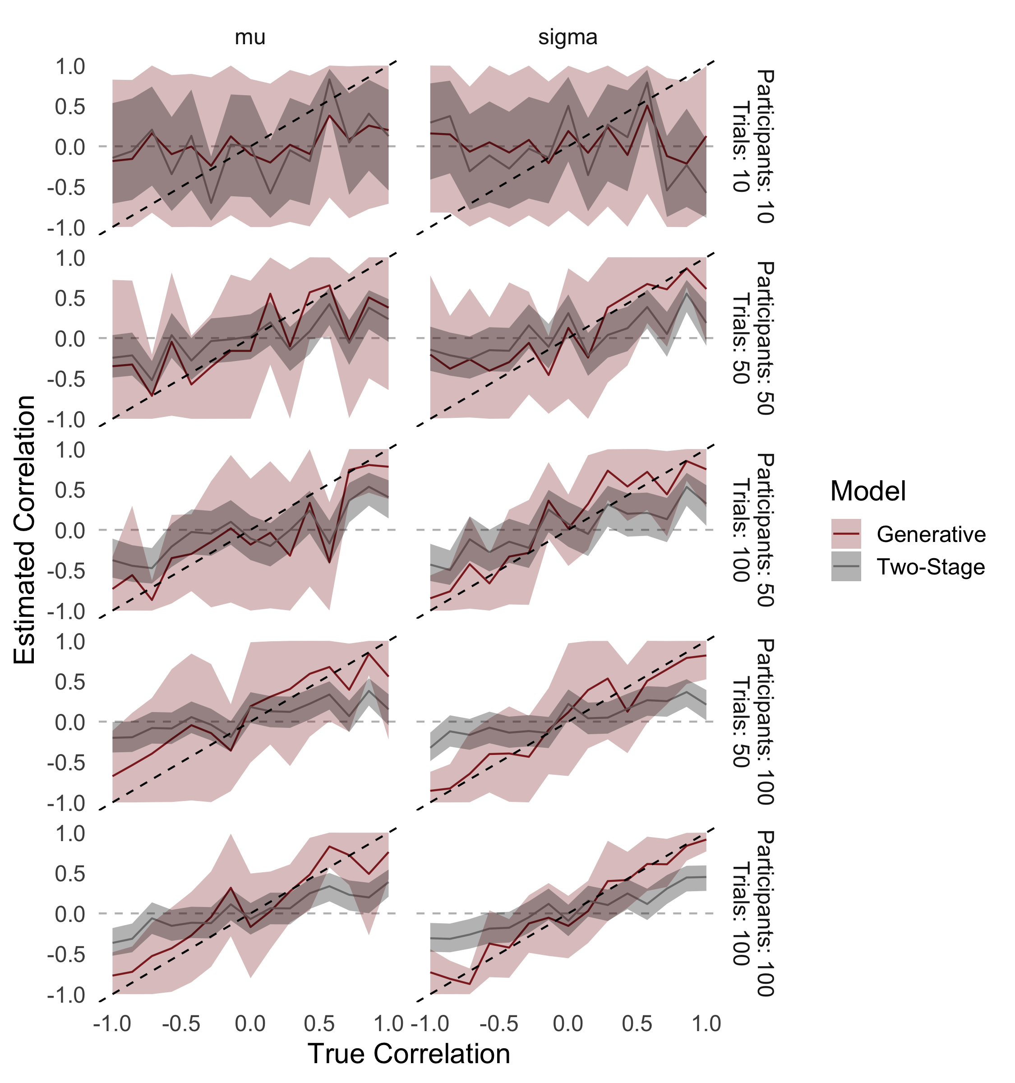

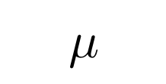
Parameter Recovery
#psynom21
$$μ$$
$$σ$$

Slide 14
Parameter Recovery
#psynom21
Implications:
We should expect the two-stage approach to infer low correlations in typical low-data settings, even when the underlying correlation is perfect
Generative modeling resolves issues with correlation attenuation resulting from measurement error/low reliability by accounting for uncertainty

Slide 15
Does it really matter for real-world data?
Let’s find out ☺

Slide 16
Empirical Applications
#psynom21
Included tasks:
Stroop and Flanker task
3 weeks; N = (47, 60); T = (240, 240)/condition
Posner Cueing task
3 weeks; N = 40; T = 640 total (80% congruent)
Implicit Association Test (Self-Concept and Black/White race versions)
8 weeks; N = (152, 116); T = (80, 60)/condition
Delay Discounting task (choice preference as opposed to RTs)
4 weeks; N = 58; T = 42 total
Ahn et al., 2020; Hedge et al., 2017; Gawronski et al., 2016

Slide 17
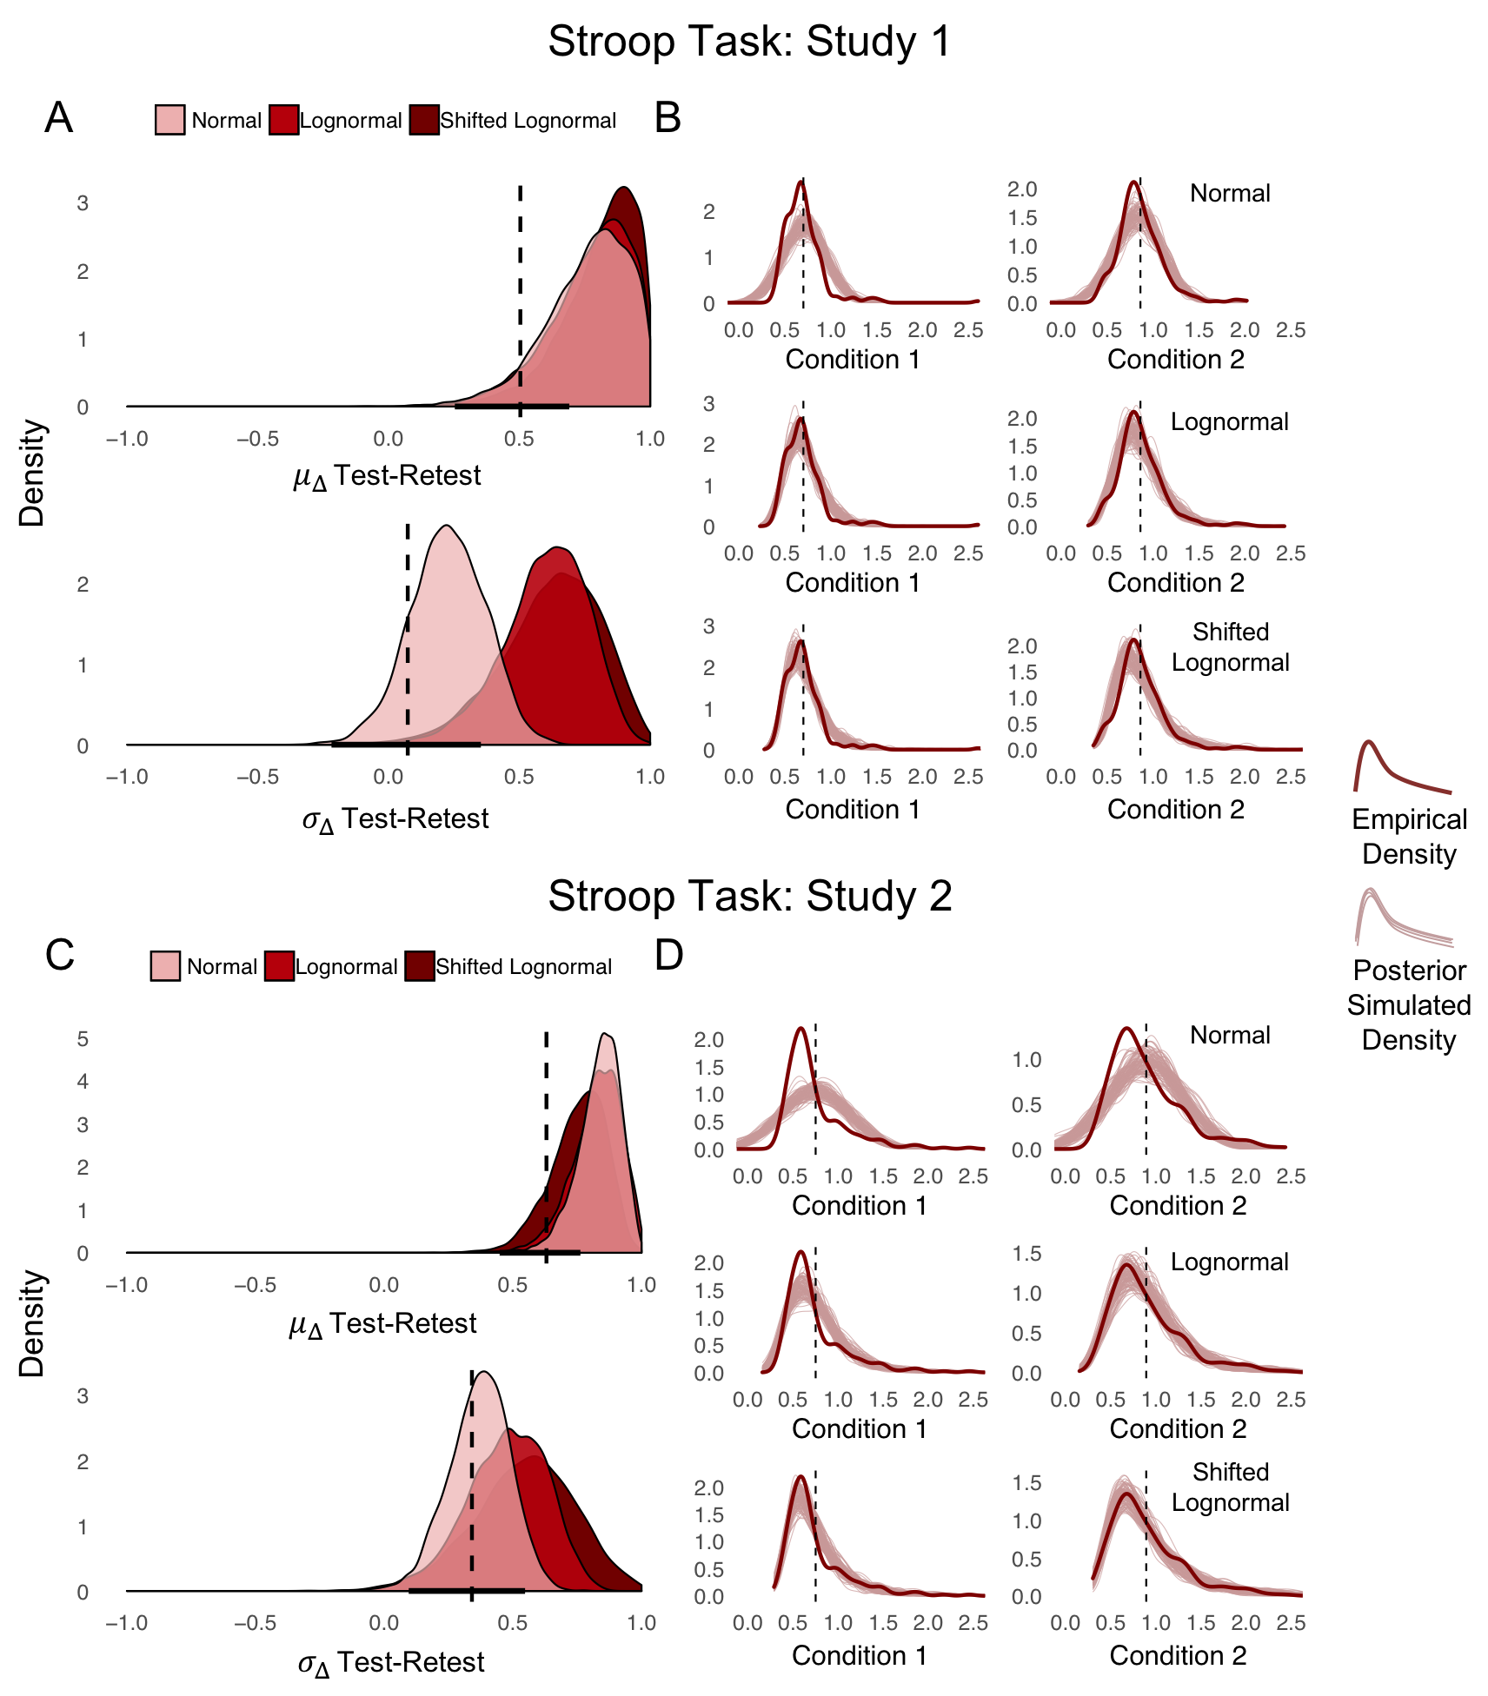


Empirical Applications
#psynom21
$$μ_{Δ }$$
Dataset
$${ σ}_{Δ }$$

Slide 18
General Implications
#psynom21
Generative modeling requires more effort up front, but it pays off!
Requires attention to both scientific and statistical details of model specification
Explication of all data-generating assumptions in the form of a formal, probabilistic model
Steps anyone can take to facilitate:
Make raw data (trial-level) openly available
Exercise caution when making inference using summary statistics or two-stage approaches
Ahn et al, 2017; Farrell & Lewandowsky, 2018; Guest & Martin, 2020; Lee & Wagenmakers, 2013; Mathys et al., 2014; Palestro et al., 2018; Turner et al., 2019; van Rooij & Baggio, 2020; van Rooij & Blokpoel, 2020; Wiecki et al., 2013; Wilson & Collins, 2019;

Slide 19
Turner Lab
Beauchaine Lab
Thanks to mentors
and co-authors!
Colin Smith
Mark Pitt
Jay Myung
Trisha Van Zandt
Woo-Young Ahn
Peter Kvam
Louis Irving

Slide 20
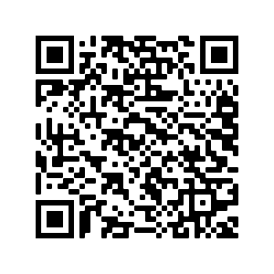
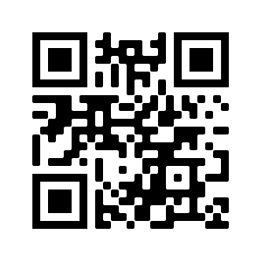
Blog
Paper

Slide 21
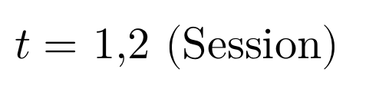
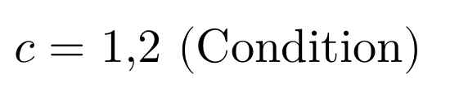
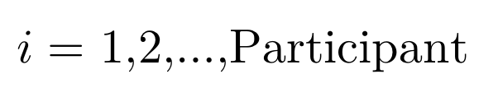
Breaking Down Inference
Normal
Lognormal
Shifted Lognormal
$i=$1,2,…,Participant
$c=$1,2 (Condition)
$t=$1,2 (Session)

Slide 22
Breaking Down Inference

Slide 23
Breaking Down Inference
Is atheoretical use of summary statistics really that bad?
Detecting process-level differences underlying observed behavior
Comparing accuracy of eye-witness detection between sequential versus simultaneous line-ups
Benchmarking methods used to estimate racial biases in police shootings
Haines et al., 2018; 2020; Heathcote et al., 1991; Kellen, 2019; Romeu-Kelly et al., 2019; Ross et al., 2020; Rotello et al., 2014

Slide 24
Breaking Down Inference
“Baseline” condition
“Change” condition
Putting everything together
$i=$1,2,…,Participant
$c=$1,2 (Condition)
$t=$1,2 (Session)

Slide 25
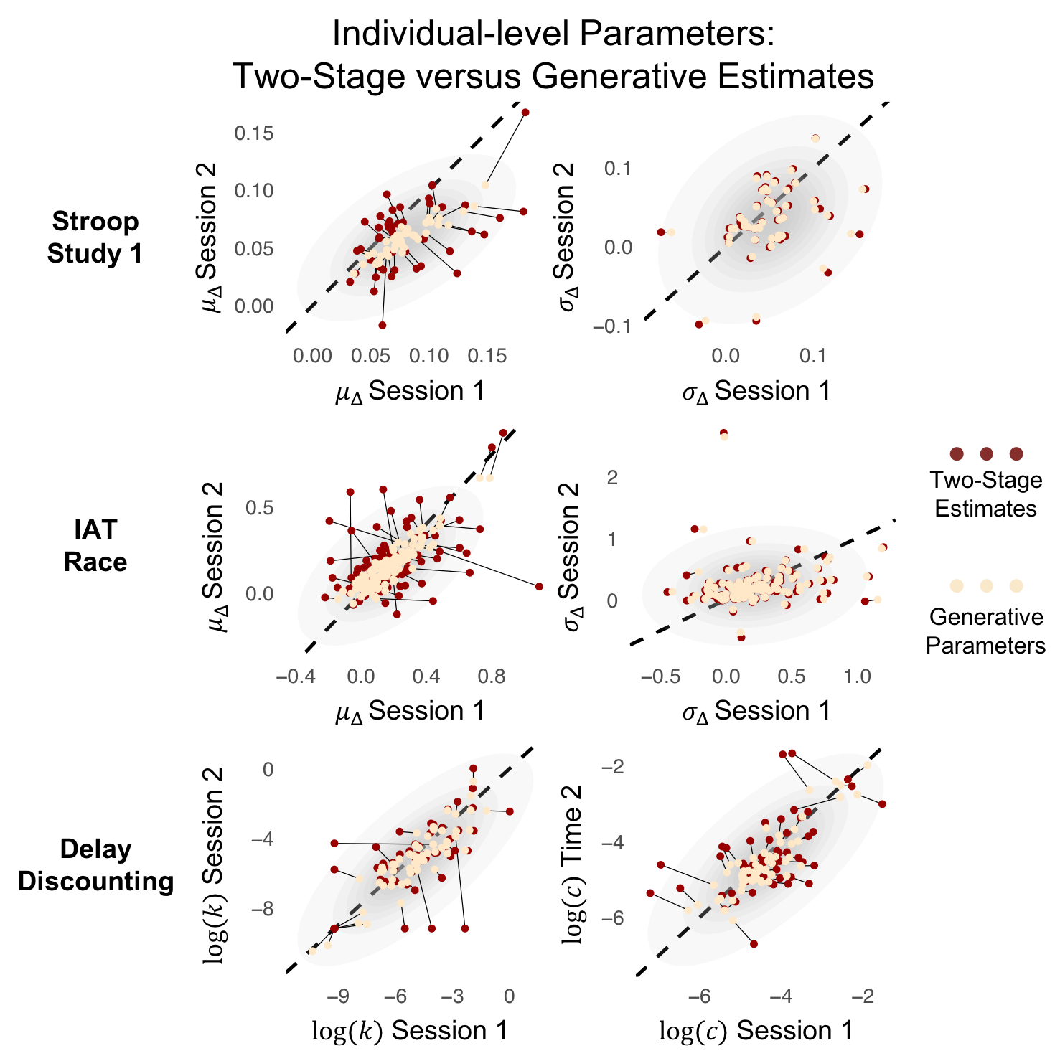
Empirical Applications
Hierarchical pooling (aka regularization, shrinkage, regression to the mean) in action:
Stroop Study 1

