Slide 1
Motivation for blockchain-based storage for satellite observation data
Nathaniel Nemenzo – Intern (GSFC)

Slide 2

Agenda
- Introduction
- Challenges of traditional storage solutions
- Overview of blockchain technology
- Benefits of blockchain-based storage solutions
- Use cases for blockchain-based storage of satellite data
- Challenges of implementing blockchain-based storage solutions
- Future directions
- Conclusion

Slide 3
Introduction
Growth of Satellite Data
Blockchain-based alternative
The number of satellites orbiting our planet has nearly doubled in the last two years.
The amount of satellite data available for consumption is increasing dramatically.
Traditional storage solutions having glaring downsides in security, tampering, and inefficient data sharing.
Blockchain-based storage offers an alternative solution that can address some of the challenges posed by the increasing volume of satellite observation data.
In this presentation, we will explore the benefits of using blockchain-based storage for satellite observation data and examine how it can improve data management, security, and accessibility.

Slide 4
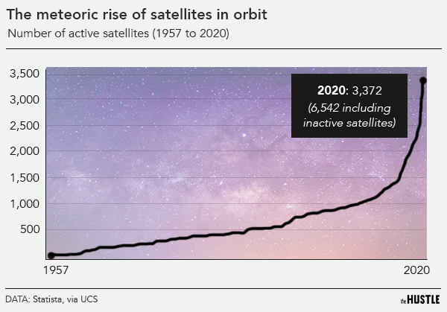

Slide 5
Challenges of traditional storage solutions
Centralized storage solutions
Blockchain-based storage
Centralized storage solutions for satellite observation data can be slow, insecure, and difficult to access and share.
Large volumes of data can strain centralized systems, leading to delays and inefficiencies.
Centralized storage solutions have a single point of failure and are vulnerable to cyber attacks.
Improved data availability and accessibility.
Enabling of more efficient data retrieval and sharing.
Can enable faster data processing and decision making.

Slide 6
Overview of blockchain technology
Overview
Benefits
Blockchain is a decentralized, distributed ledger records transactions in a secure and transparent way.
The technology is based on cryptographic algorithms and a network of nodes that verify and validate transactions.
Each block in the blockchain contains a timestamp, a unique identifier, and a cryptographic hash of the previous block.
Once a block is added to the chain, it cannot be altered or deleted without the consensus of the network.
This immutability and transparency make blockchain technology ideal for applications where trust and security are essential.
Blockchain technology is being explored for a variety of use cases, including supply chain management, financial services, and healthcare, among others.

Slide 7
Benefits of blockchain-based storage solutions
Decentralized Storage Solutions
Efficient Data Retrieval and Sharing
Satellite observation data can be stored in a decentralized and distributed network of nodes, rather than being held in a single central location.
Decentralized storage can improve data availability and accessibility, as the data is replicated across multiple nodes, making it less vulnerable to a single point of failure.
Decentralized storage can also provide enhanced security by utilizing cryptographic techniques to ensure that data is securely stored and transmitted.
Blockchain-based storage can enable more efficient data retrieval and sharing by utilizing a P2P network architecture.
Smart contracts can be used to automate the sharing of data between different stakeholders, eliminating the need for intermediaries and streamlining the process.
By utilizing blockchain-based storage, satellite observation data can be shared and accessed more easily and quickly, leading to improved collaboration and decision-making.

Slide 8
Uses cases of blockchain-based storage solutions
Disaster Response
Climate Change Research
In the event of a natural disaster, timely access to satellite observation data can help first responders and aid organizations to assess the damage and coordinate relief efforts. Blockchain-based storage can ensure that the data is available to all stakeholders in real-time and securely.
Satellite observation data is critical for climate change research and policy-making. By using blockchain-based storage, researchers can ensure the integrity and transparency of the data, allowing for more accurate and reliable analysis and removing the possibility of data poisoning from a threat actor.

Slide 9
Challenges of implementing blockchain-based storage solutions
Technical Challenges
Regulatory Challenges
Scalability: The large amount of satellite data may pose issues for the blockchain at scale.
Latency: Bloating (too much data stored on the chain) may slow down the blockchain.
Infrastructure: Integration with existing data management systems may require changes to existing infrastructure.
The use of blockchain-based storage for satellite observation data may raise regulatory issues related to data privacy and security.
There are currently no established standards for blockchain-based storage in the context of satellite observation data, which may make it difficult to ensure interoperability between different systems.

Slide 10
Future directions for blockchain-based storage of satellite data
Integration with emerging technologies
Scalability and Cost-Effectiveness
The integration of blockchain-based storage with emerging technologies such as AI, machine learning, and big data analytics can enhance the value and utility of satellite observation data.
By leveraging the security and immutability of blockchain, these technologies can make sure that the data going through their systems are accurate and valid.
Addressing scalability and cost-effectiveness issues can further promote the adoption and use of blockchain-based storage solutions for satellite observation data.
The development of more efficient consensus algorithms can reduce the computational and energy costs of blockchain-based storage, making it a more viable option for large-scale satellite observation data applications.

Slide 11
Conclusion
Blockchain-based storage has the potential to address many of the challenges of traditional centralized storage solutions for satellite observation data.
By leveraging the benefits of decentralization, transparency, and security, blockchain-based storage can improve data availability, accessibility, and sharing, while enabling more efficient and cost-effective data management and processing.
However, implementing blockchain-based storage for satellite observation data also involves several challenges and requires careful consideration of technical, regulatory, and governance issues.
The future of blockchain-based storage for satellite observation data looks promising, with many ongoing initiatives and collaborations aiming to explore and develop new solutions and applications in this space.

