Slide 1
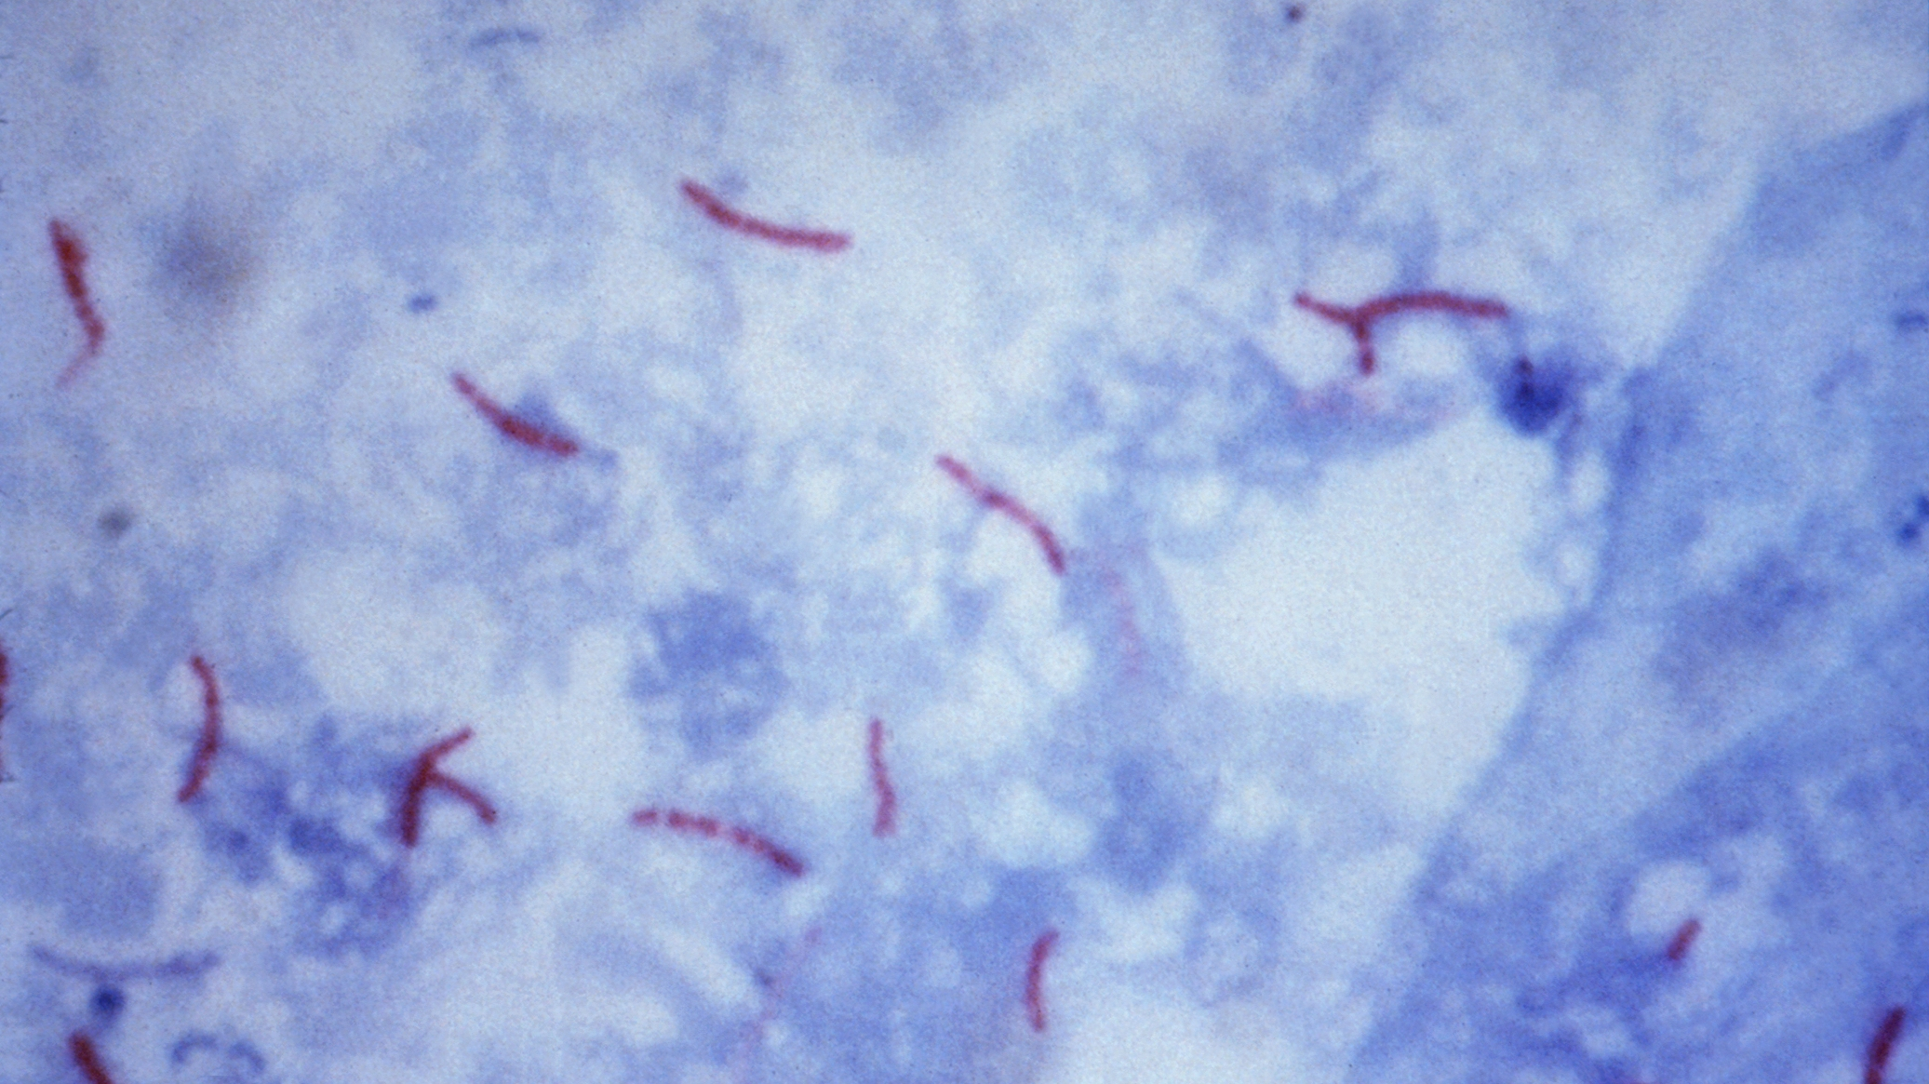
Mycobacterium tuberculosis Nathaniel Davies

Slide 2
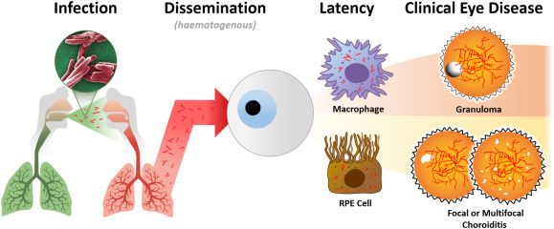
Importance
Intraocular tuberculosis
<1% prevalence in the US
Can be caused by macrophages carrying Mycobacterium tuberculosis
Very difficult to diagnose
Needle aspiration
PCR
1.
Neuhouser AJ, Sallam A. 2024. Ocular TuberculosisStatPearls. StatPearls Publishing, Treasure Island (FL).

Slide 3
Methods
Genome Assembly
Abyss vs SPAdes
Quality Assessment
QUAST with a reference genome
Genome Annotation
RAST

Slide 4
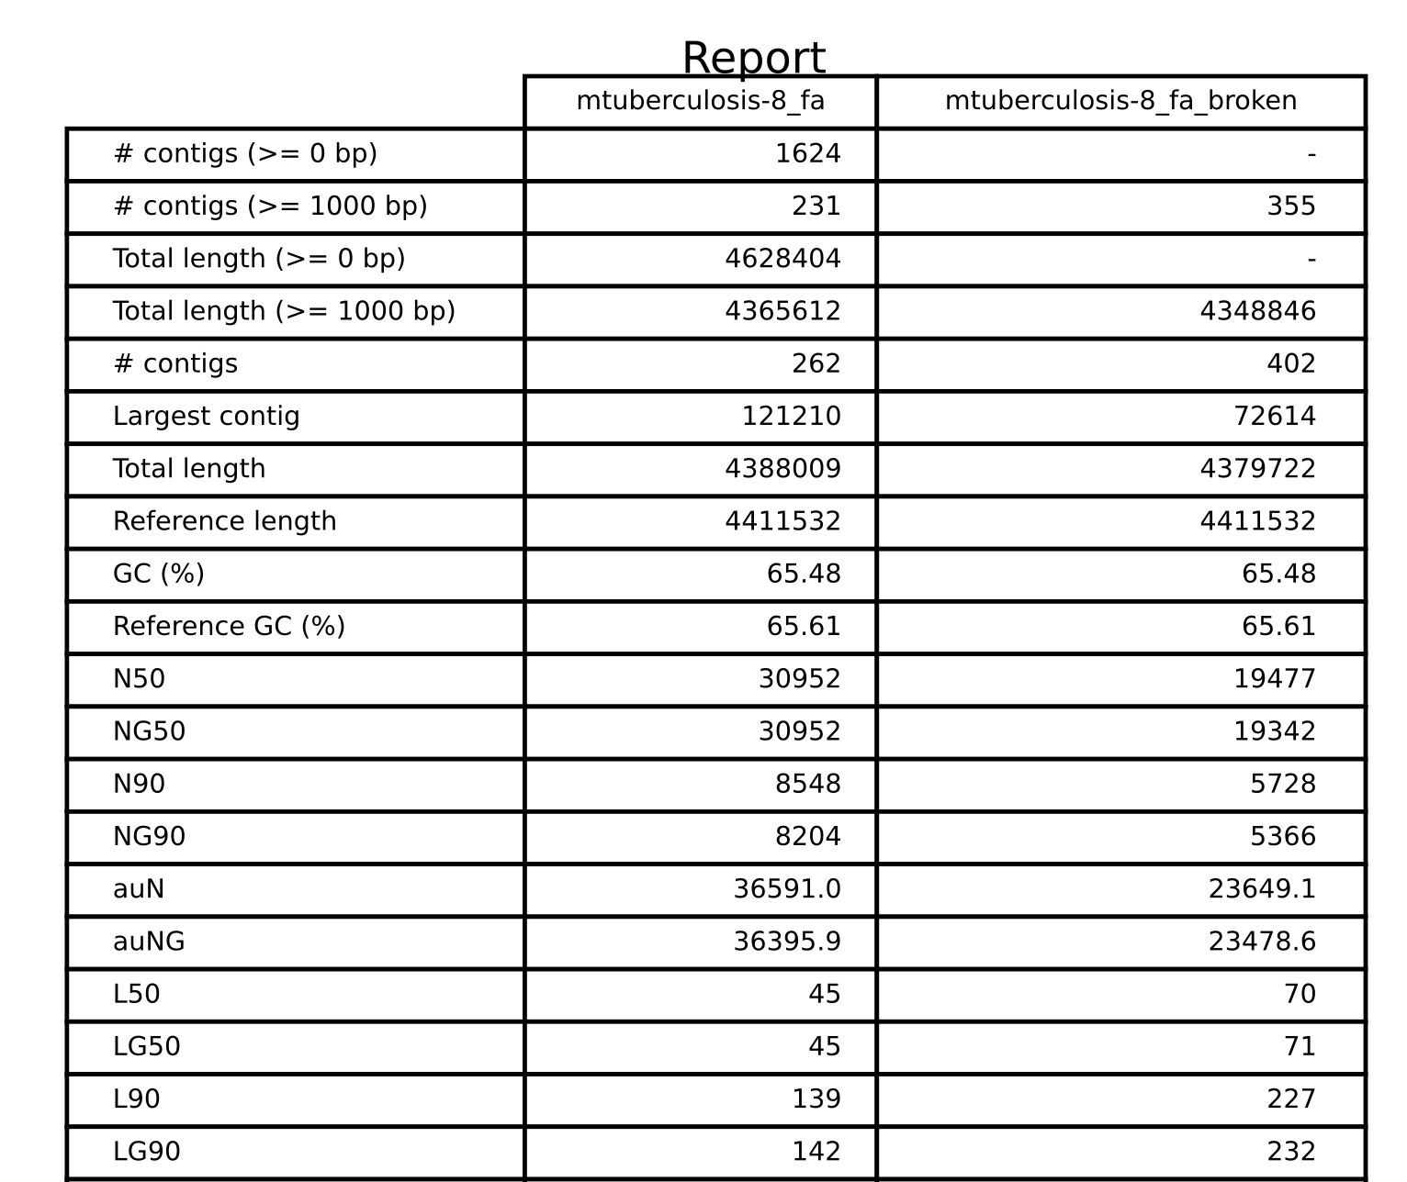
Abyss

Slide 5
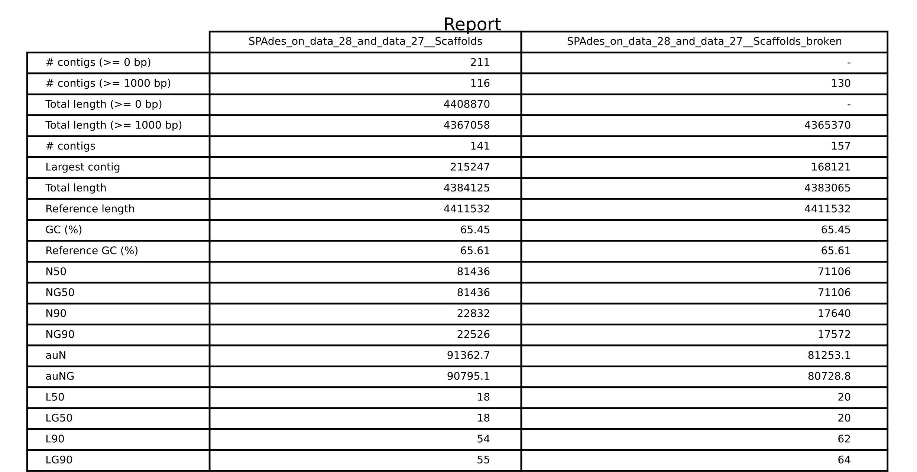
SPAdes
121210
30952
45

Slide 6
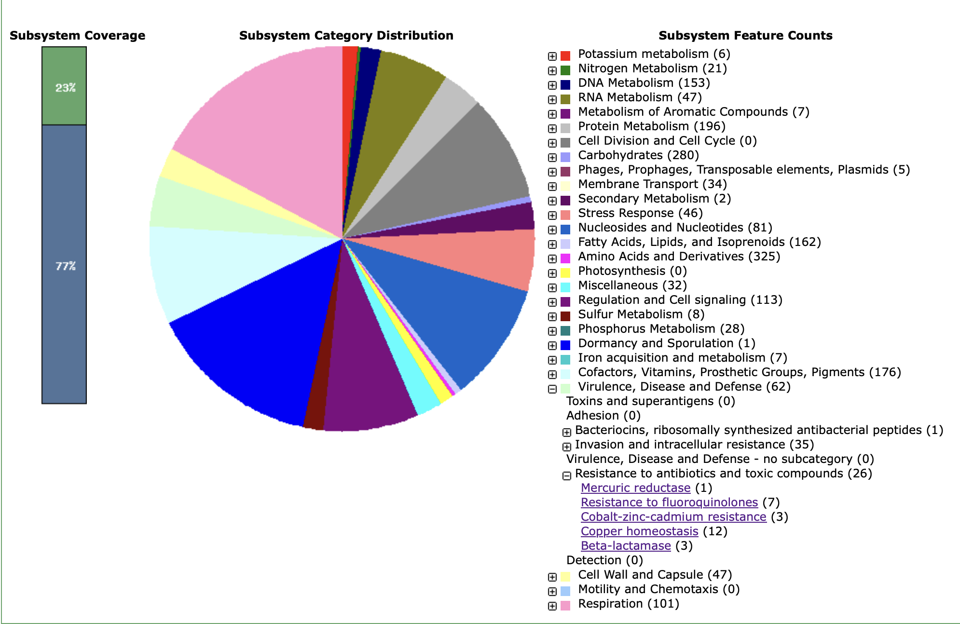
RAST

Slide 7
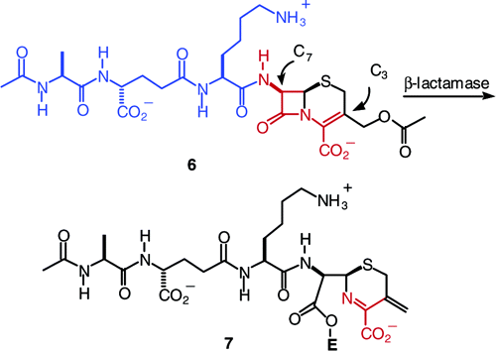
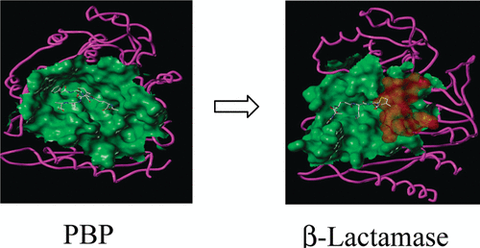
RAST
Cephalosporin
1.
Meroueh SO, Minasov G, Lee W, Shoichet BK, Mobashery S. 2003. Structural Aspects for Evolution of β-Lactamases from Penicillin-Binding Proteins. J Am Chem Soc 125:9612–9618.

Slide 8
References
Meroueh SO, Minasov G, Lee W, Shoichet BK, Mobashery S. 2003. Structural Aspects for Evolution of β-Lactamases from Penicillin-Binding Proteins. J Am Chem Soc 125:9612–9618.
2. Neuhouser AJ, Sallam A. 2024. Ocular TuberculosisStatPearls. StatPearls Publishing, Treasure Island (FL).
3. Mycobacterium tuberculosis strain:SNMICRO 2047-20 (ID 742522) - BioProject - NCBI. https://www.ncbi.nlm.nih.gov/bioproject/PRJNA742522. Retrieved 18 May 2024.

