Slide 1
Certifications vs. Bachelor Degrees: Which is more beneficial?
Micah neal
Ibrahima Balde
Nathaniel Nelson

Slide 2
Our Topic/ Research Question
Does a certification take you farther than a bachelor's degree in the Technology field?

Slide 3
Project Objectives/Goals
Which field of technology is the focus?
What location will be used to intake the data?
Is race and/or sex a factor that helps determine which path someone decides to take?
What is the relationship between bachelor's degree holders and full time-workers in technology?
What's the criteria for who is further?

Slide 4
Why our topic?
We chose this topic because as CTEC majors, we thought it would be interesting to embark on figuring out if the degree we are all going for is more beneficial than another ulterior route we all could have decided to take. Overall, did we make the right decision by coming to college?

Slide 5
Data Science Pipeline
Data Questions -> Ingestion -> Wrangling -> EDA -> Visualizations

Slide 6


Data Ingestion
Name of data source and who collects it- American Community Survey(ACS) and Bureau of Labor Statistics (BLS).
Overview- The American Community Survey’s main purpose is to inform local administrators, leaders, and businesses of the changes in our community. The Bureau of Labor Statistics (BLS) is responsible for collecting, processing, analyzing, statistical data pertaining to labor, economics, and measures the income level families need to maintain a successful quality of life.
Years of Data Available- 1939/83 years (BLS) and 1996/26 years (ACS)
What is the instance?- ACS instance is to discover people with specific tech jobs in MD and race of people in tech jobs. BLS is to discover the employment status/ qualification, whether it’s a degree or certification needed for a tech job.
Specific year of data being used?- 2018-2021(BLS) and 2021 (ACS)

Slide 7

Data Wrangling
Final features selected for the project?- The features selected from ACS for the most precise data collection in our project was educational attainment (SCHL), SEX, race (RAC1P), and standard occupational classification (SOCP). From BLS, the features we selected that fit best to gauge an accurate finding were Occupation, Total individuals, and those with a certification or license. We also included from BLS which jobs require certification/license.
If the decision was made to only use a portion of the data, describe it?-When figuring out which portion of data to be finally selected, we decided to use ACS for people with a degree and are employed at a tech job. Then, we used BLS for people who were employed with tech jobs and had no degree with a certificate in the respective field.
For the final analytic data set, what is the number of instances and features?-For the final analytic data set, the number of instances from ACS was 12,994 and the number of features was 5. The total number of instances for BLS is 37,000.
Discuss any featuring engineering that was done- The feature engineering that was performed was mostly from ACS. We had to manipulate the standard occupational classification (SOCP) field to only occupations that involved tech jobs. This helped us distinguish the accurate number of persons employed with a technology field related job.
Discuss all data errors and issues. How were they resolved?- The data error we encountered was finding out how many people had a tech job with no degree and certification. This was a hard task because ACS only had people with no degree at all and didn’t show if they had certs or not in the tech field.

Slide 8

EDA
SO! Does a certification take you farther than a bachelor's degree in Technology?
Which field of technology is the focus?
- Specified fields of technology were not relayed with the data, but rather all categories put under one umbrella term "STEM' (Science, Tech, Engineering, Math) or "Computer Science".
What location will be used to intake the data?
- Maryland
Is race and/or sex a factor that helps determine which path someone decides to take?
- Race and sex are factors that might determine what path one will decide to take because we saw that it's not popular for women to go into tech versus men.
What is the relationship between bachelor's degree holders and full time-workers in technology?
- Although not as much of a requirement as years ago, a lot of full-time work in the technology field still requires the completion of a bachelor's degree. It's fair to say most seek a degree for full-time work.
What's the criteria for who is further?
- With the data that we were granted with, we decided to use the overall employment rates in both educational attainment levels (Certification holders vs Bachelor Degree holders) and we found that a bachelor's degree takes you farther in Technology due to the difference in employment rates and job requirements.

Slide 9
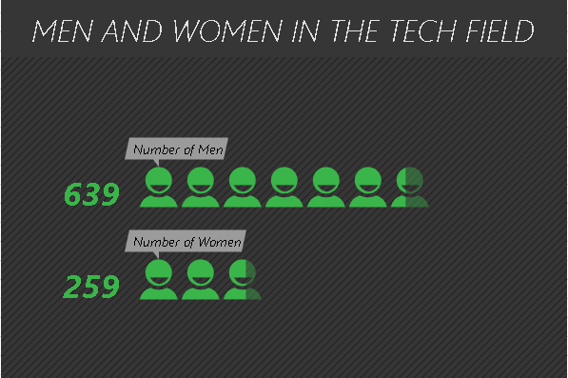
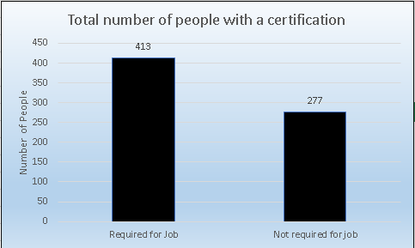
VISUALIZATIONS

Slide 10
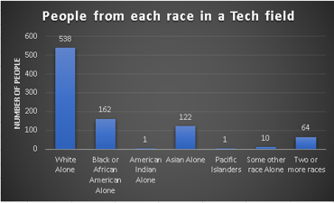
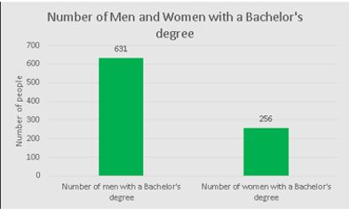
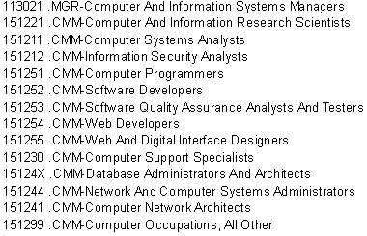
VISUALIZATIONS (Cont.)

Slide 11
Data Insights
What did you learn from the data?
- The main takeaways from our data/data analysis was that a certification does not necessarily take you further in the Technology field. Based on our data intake, we came to agree that those who have a certification are not necessarily at an advantage when it comes to attaining full-time employment versus those who have a degree. In the data that we used from BLS, we found that only 690 had a tech-related certification, and only 413 of those were required for the job. We also learned through this data that the technology field is still heavily dominated by men, while women make up a small portion.
What are some actionable insights based on what you have learned from the data? From the data collected actionable insights we learned was, it being better to attain a degree versus just a certification based on the monetary difference.
-Some actionable insights that we developed from the data is helping with decision-making as to what route one may want to take to enter the Tech world. This project would likely help someone choose the field that they would want to enter in Technology. We have found in our data that those who are White make up a majority of those who have a job in the Tech field with 538, followed by Black or African Americans with 162, and Asians Alone with 122.

Slide 12

PROPOSED DATA PRODUCT
THE HANDY TECHNOLOGY HANDY GUIDE : WHICH ROAD TO TAKE?
- This handbook would be a guide (specifically for high schoolers and under) that will allow those who are interested in going into the technology field to assess the different approaches they can take to enter the field, depending on which is most beneficial for them. It would include data from the ACS and BLS to showcase the data we took from this project with formulated passages to help readers weigh the pros and cons of each decisional route.

Slide 13
Project Challenges & "FOR THE FUTURE"
Well, the first challenge we had was finalizing a topic that spoke to us, but overall, we were pleased after choosing this one. Another challenge we faced while doing this project was having to explore databases outside of the ACS to find what we needed to answer our question. BLS had a different way of intaking their data and showcasing their statistics, but we maneuvered through that obstacle.
For the future, we would be more likely to meet up in person versus via video chat. We believe that our research and wrangling process could have been a lot smoother if we were all doing it under one roof, and could have spent more time on visualizations. We would also use our time more efficiently although we felt like we did, but there is always room for improvement. We also wish our data permitted us to have gotten into more specified categories such as wages, job ranks, etc. Also, we would go more in depth with more states to really see if a degree or certificate would be better in a larger perspective.

Slide 14
References
Bureau, U. S. C. (2022, February 24). Educational attainment in the United States: 2021. Census.gov. Retrieved December 12, 2022, from https://www.census.gov/data/tables/2021/demo/educational-attainment/cps-detailed-tables.html
U.S. Bureau of Labor Statistics. (n.d.). Professional Certifications and occupational licenses: Evidence from the Current Population Survey : Monthly labor review. U.S. Bureau of Labor Statistics. Retrieved December 12, 2022, from https://www.bls.gov/opub/mlr/2019/article/professional-certifications-and-occupational-licenses.htm
U.S. Bureau of Labor Statistics. (2022, September 8). Computer and Information Research Scientists : Occupational outlook handbook. U.S. Bureau of Labor Statistics. Retrieved December 12, 2022, from https://www.bls.gov/ooh/computer-and-information-technology/computer-and-information-research-scientists.htm
U.S. Bureau of Labor Statistics. (n.d.). Education pays, 2020 : Career outlook. U.S. Bureau of Labor Statistics. Retrieved December 12, 2022, from https://www.bls.gov/careeroutlook/2021/data-on-display/education-pays.htm

