Slide 1
How many rows and columns are there in your file?
Print row 3-8 ( using iloc/loc).
Find the mean number of all-inclusive hotels across all destinations.
Find the lowest scoring destination.
Find the highest scoring destination.
Find all the destinations where there are more than 9 all-inclusive hotels.
Filter the data by score above 8.
Filter the data score below 2 ( I need to know if these destinations should be removed or there is a problem)
Is there a correlation between number of all-inclusive hotels and score?
Create a data visualisation diagram to show destination and highest scores?

Slide 2
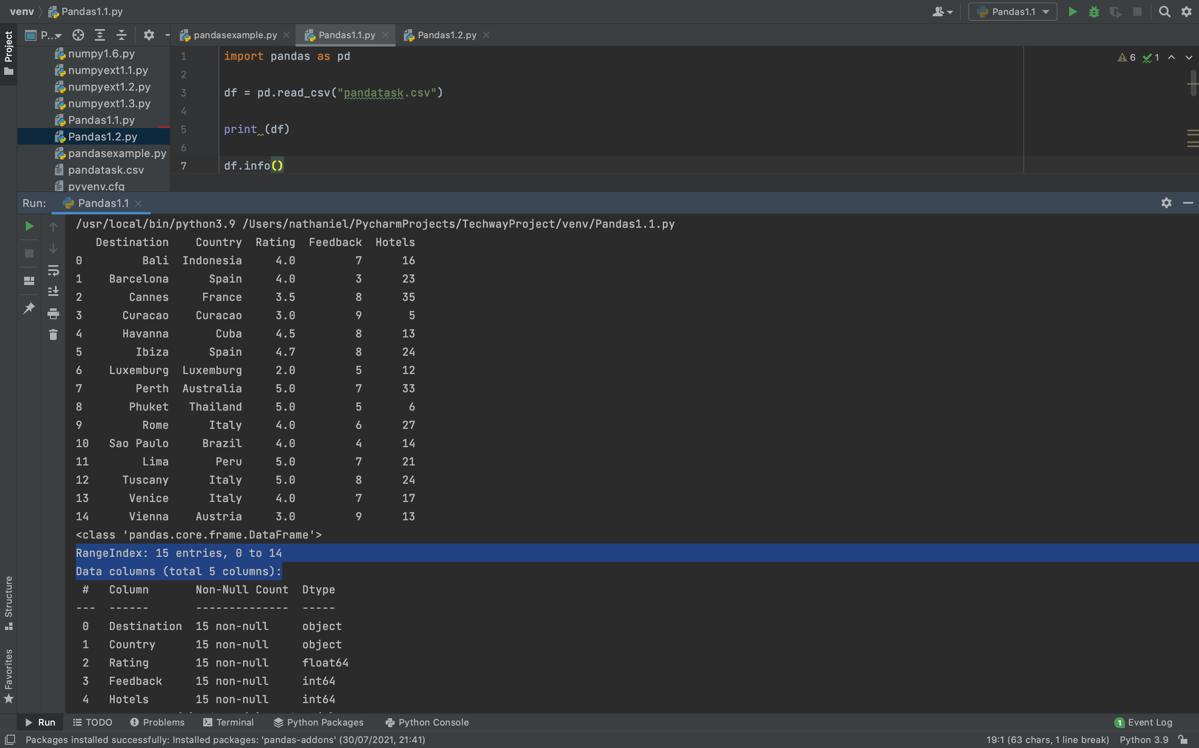
How many rows and columns are there in your file?

Slide 3
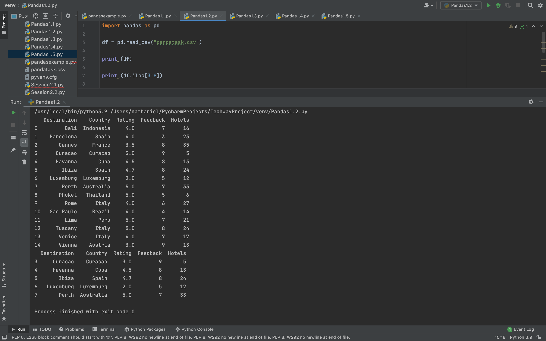
2. Print row 3-8 ( using iloc/loc).

Slide 4
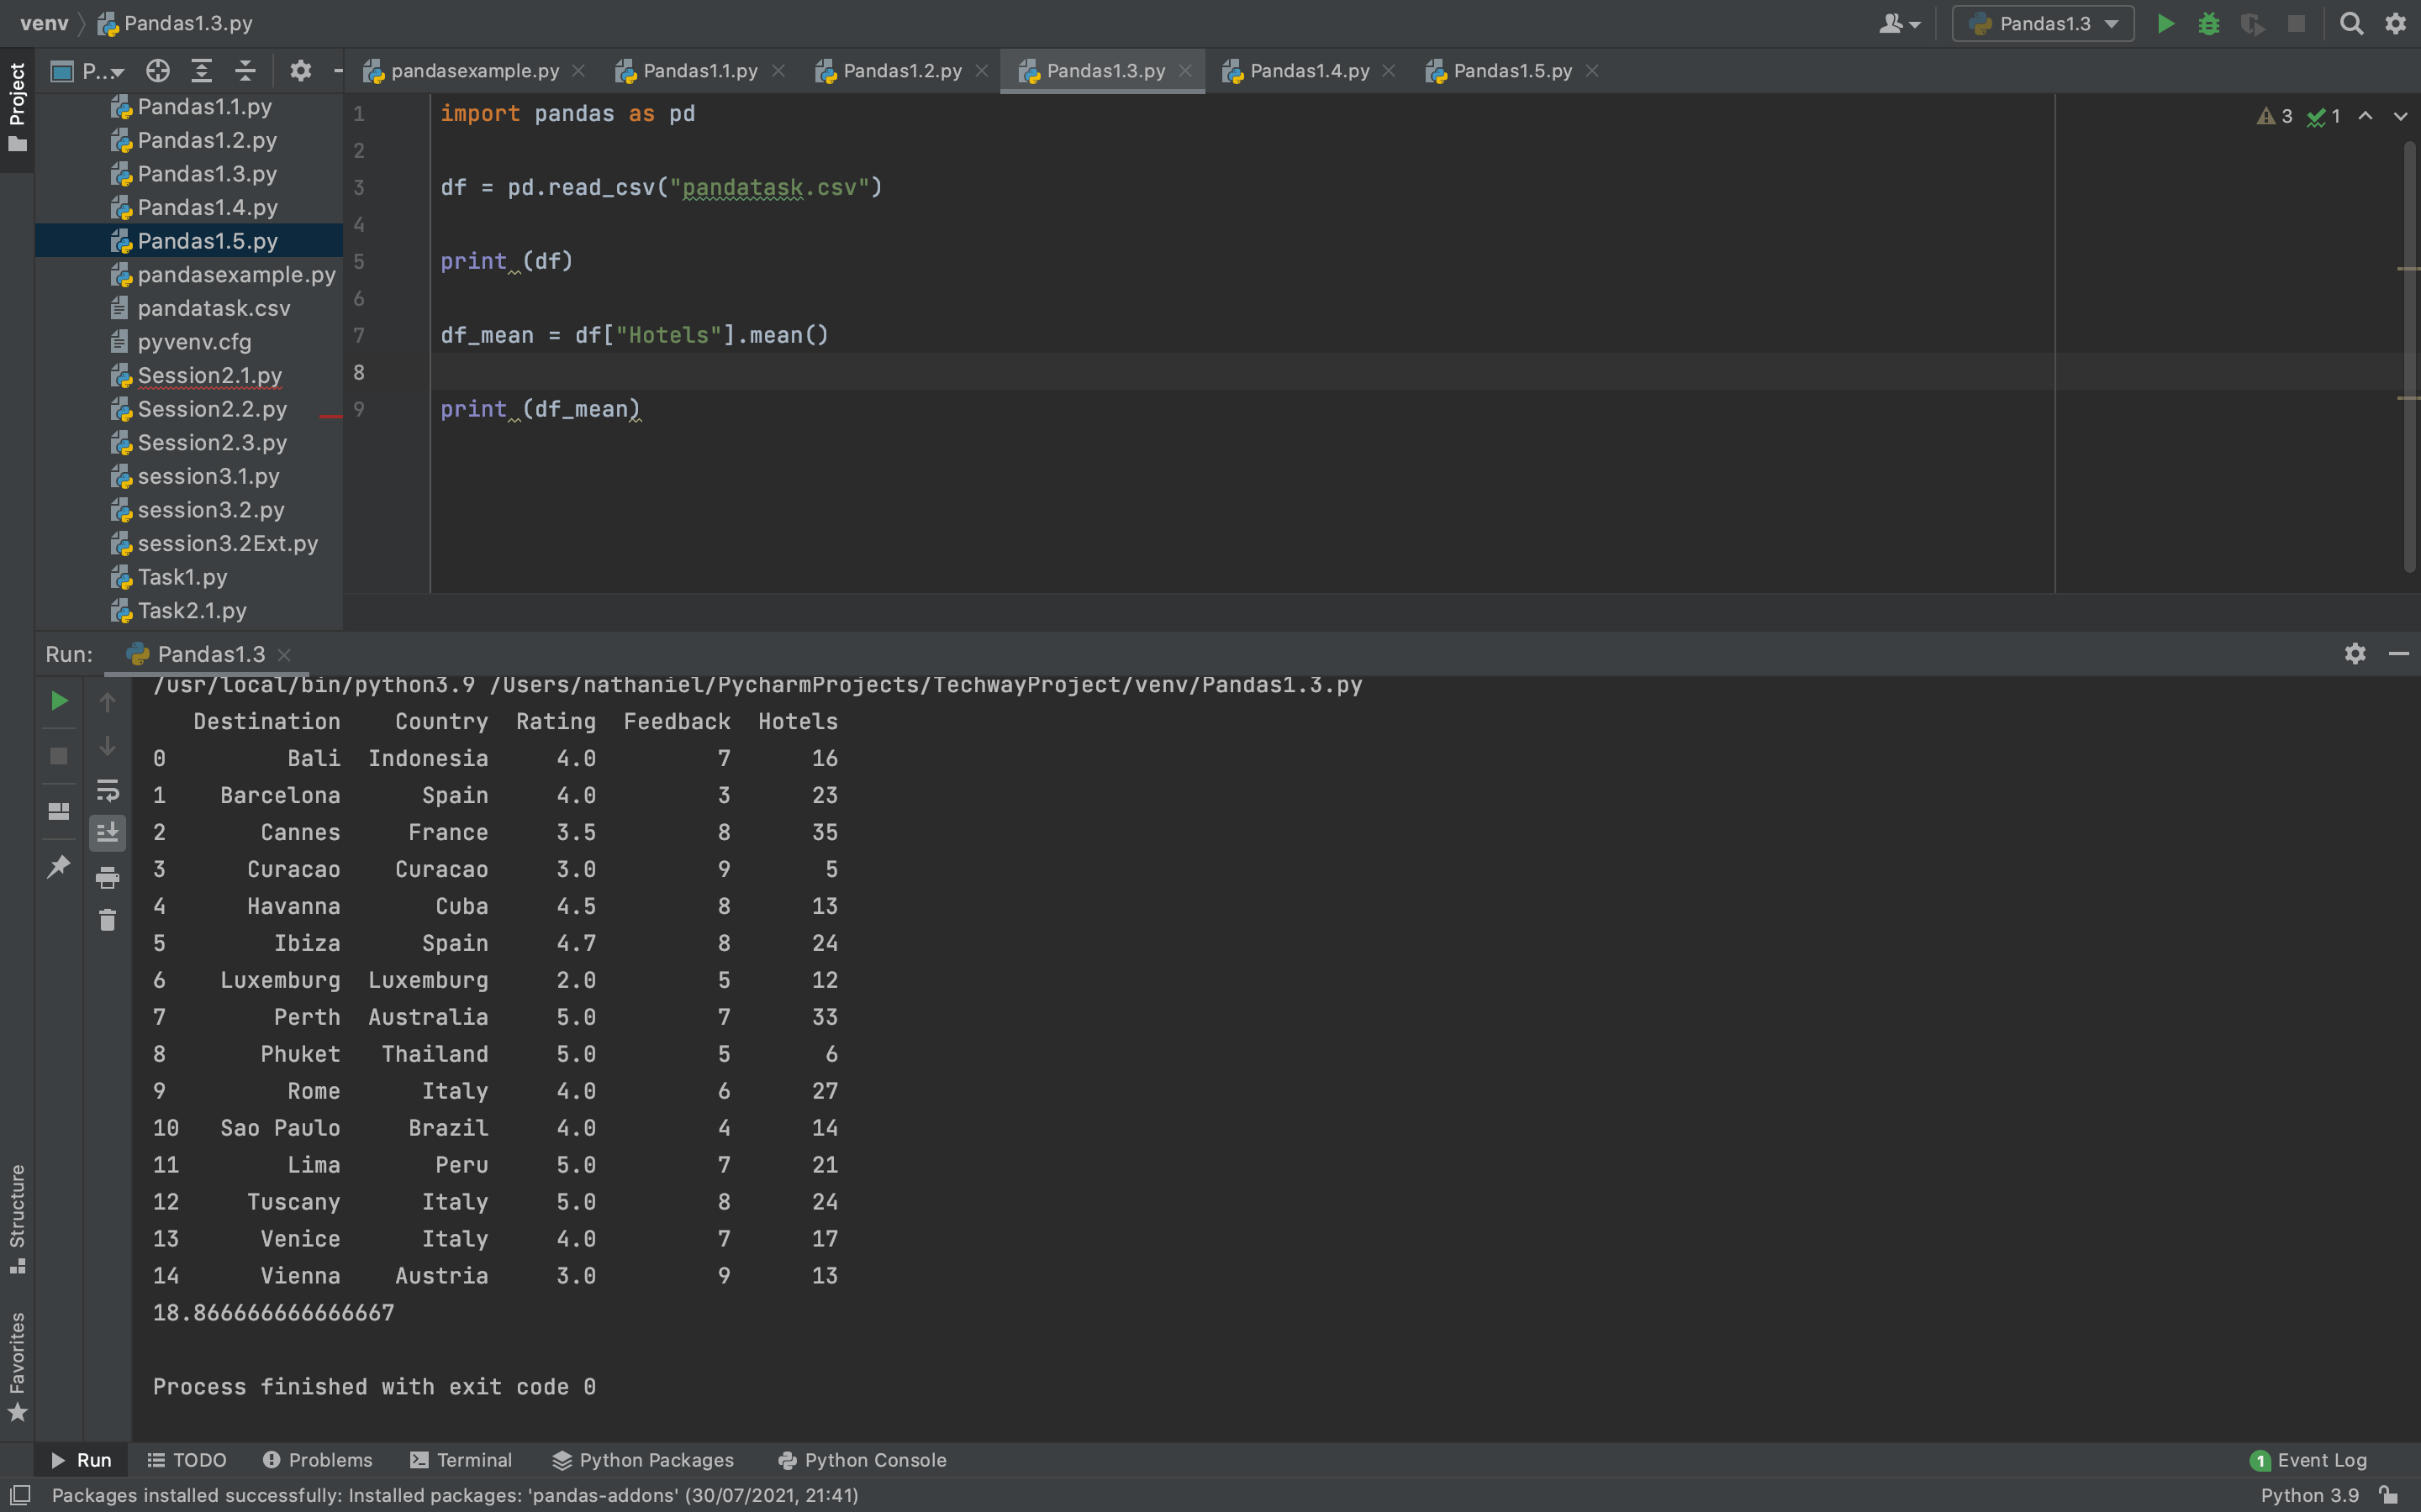
3. Find the mean number of all-inclusive hotels across all destinations.

Slide 5
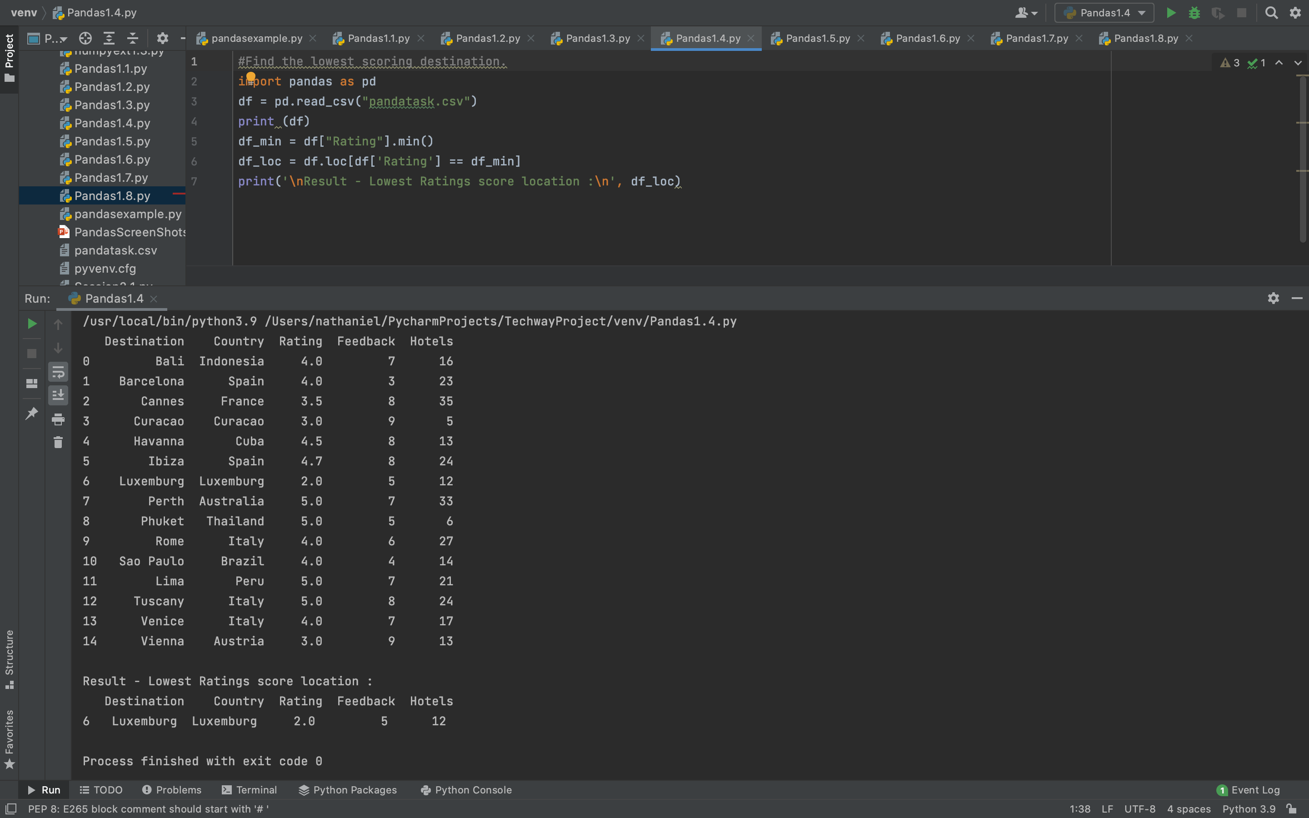
4. the lowest ratings score destination.

Slide 6
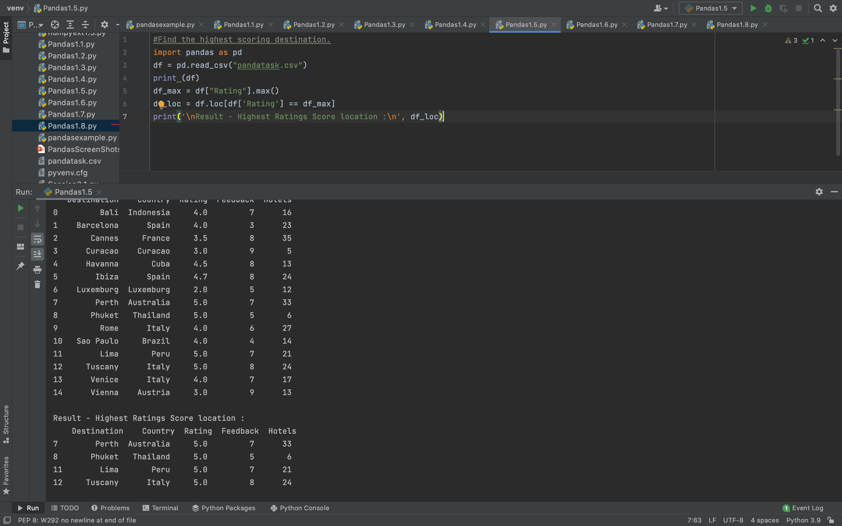
5. Find the highest Ratings score destination.

Slide 7
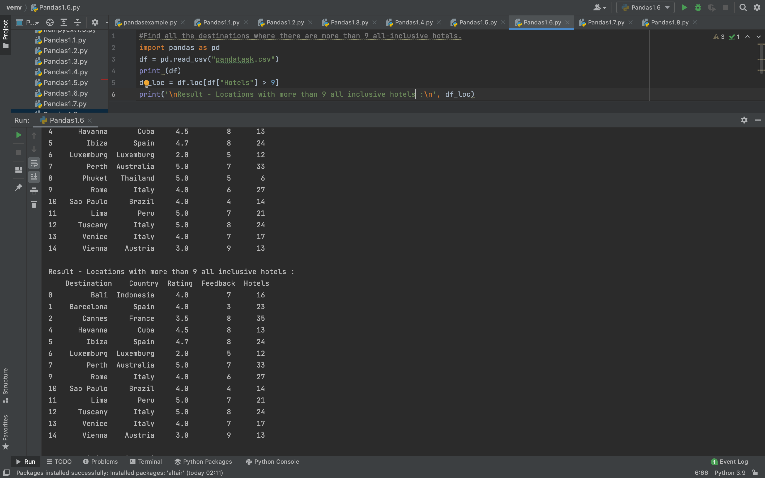
6. Find all the destinations where there are more than 9 all-inclusive hotels.

Slide 8
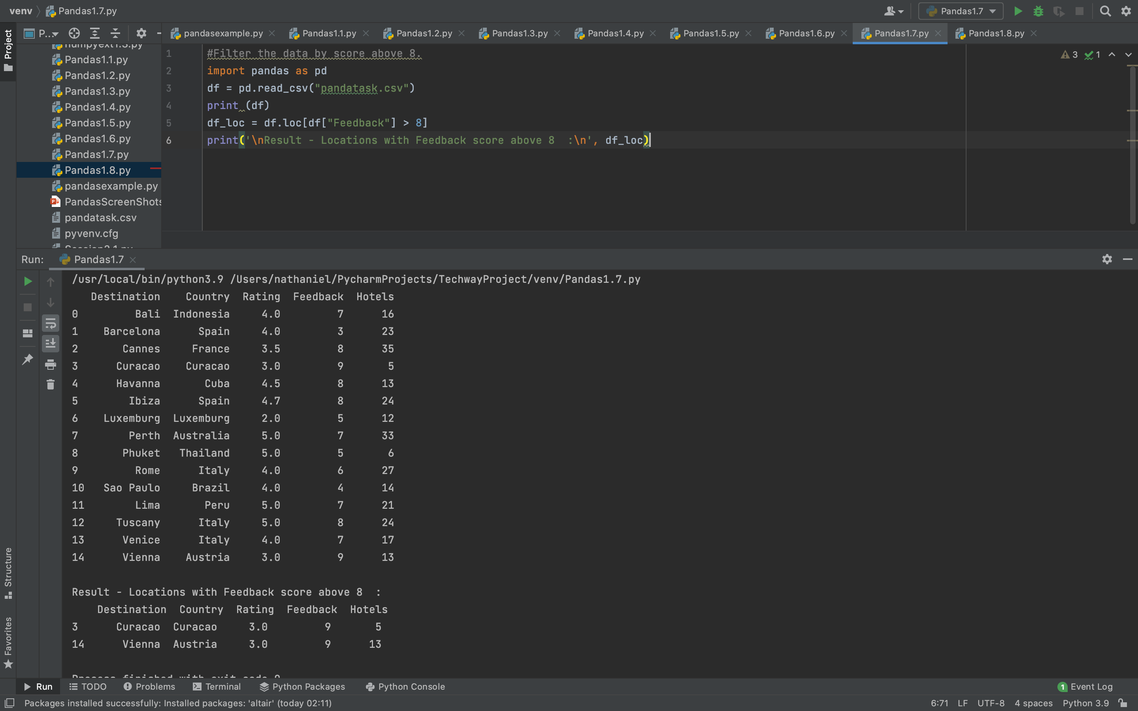
7. Filter the data by score above 8.

Slide 9
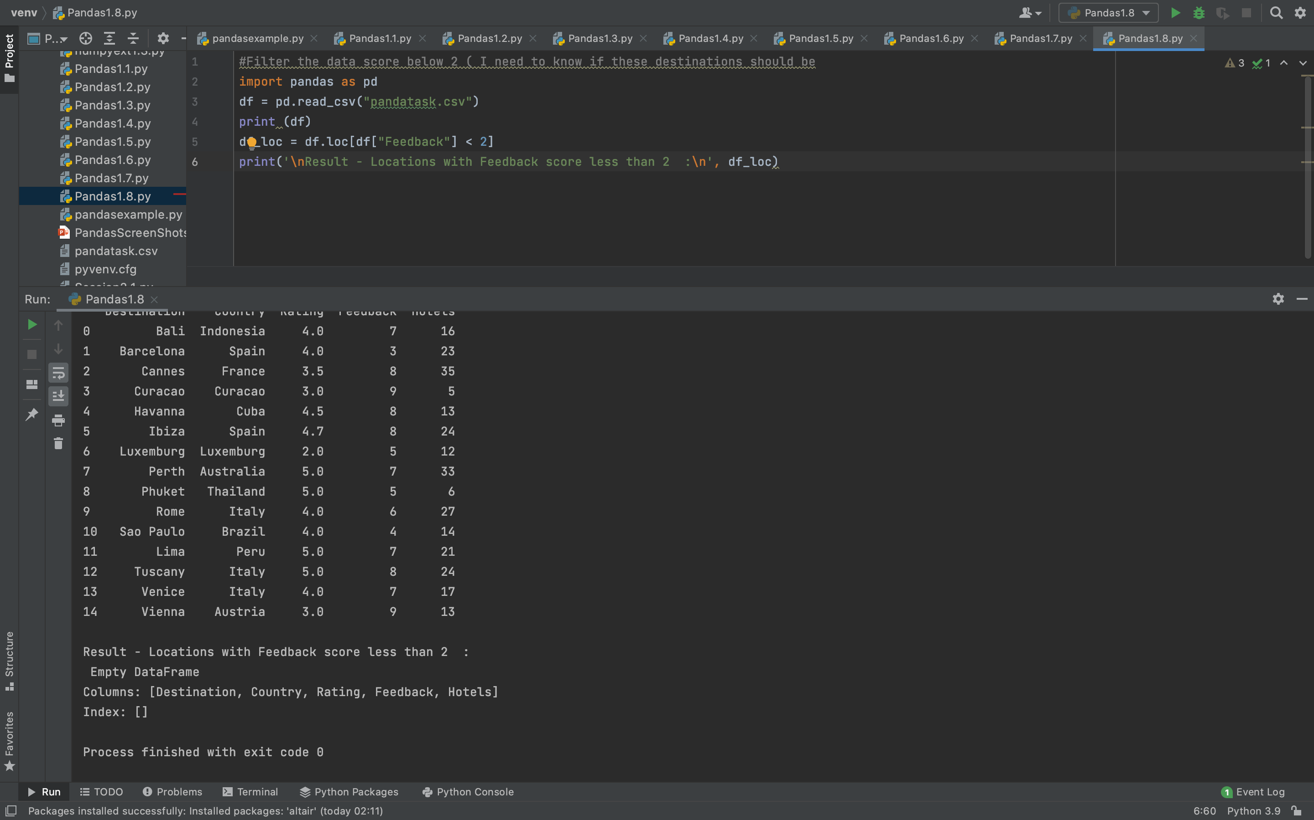
8. Filter the data score below 2 ( I need to know if these destinations should be removed or there is a problem)

Slide 10
9. Is there a correlation between number of all-inclusive hotels and score?

Slide 11
10. Create a data visualisation diagram to show destination and highest scores?

