Slide 1
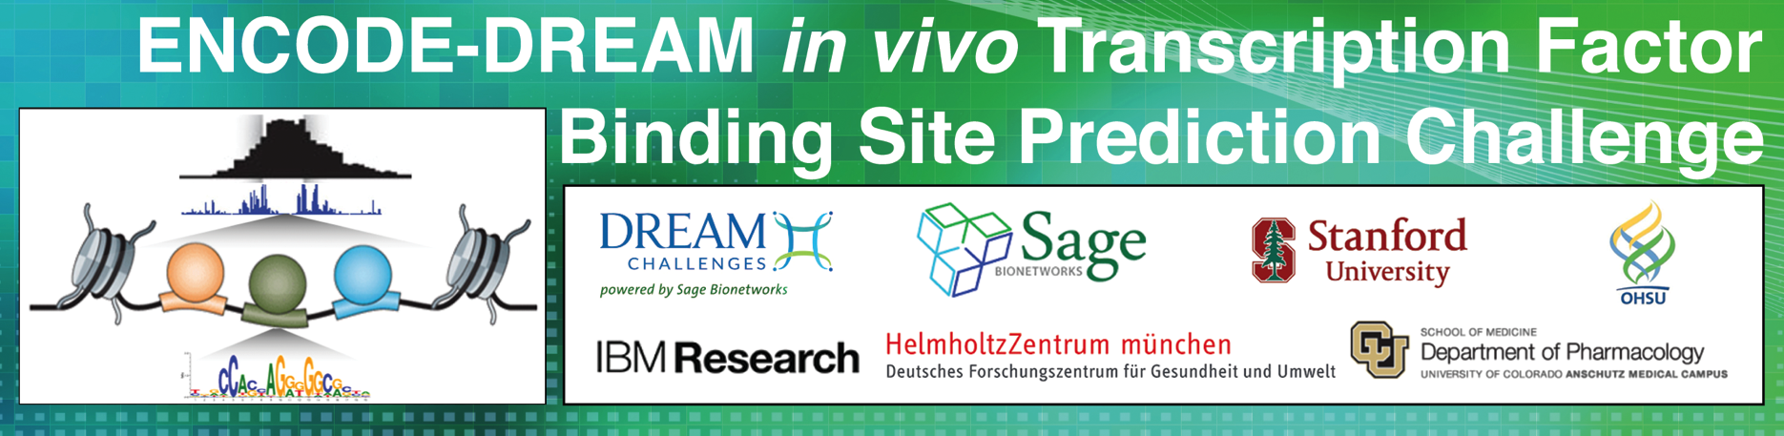
Everything you need to know to participate
July 22, 2016

Slide 2
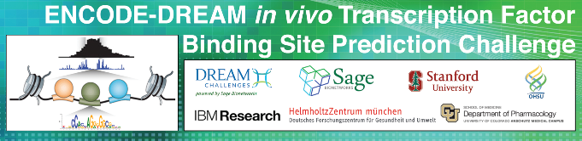
Webinar Outline
For details please visit the ENCODE-DREAM Challenge Wiki: https://www.synapse.org/ENCODE
DREAM Introduction
ENCODE-DREAM organizing team
Challenge Introduction (Objectives, Motivation)
Description of the Challenge Data (data types, how data was compiled, TFs, cell lines/cell types)
Challenge Question
Challenge Scoring Metrics
Challenge Timelines, Scoring Rounds and Leaderboards
Challenge Incentives
Live Demo (registration, teams, downloading data, submitting predictions and leaderboard)
Questions & Answers Session
1

Slide 3



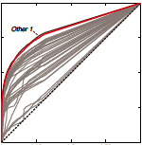
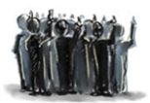
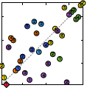
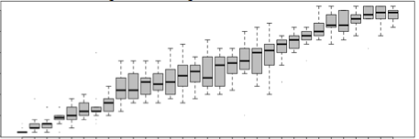
Dialogue for Reverse Engineering Assessments and Methods
DREAM Challenges pose fundamental questions about systems biology and translational medicine. Designed and run by a community of researchers from a variety of organizations, our challenges invite participants to propose solutions — fostering collaboration and building communities in the process. Expertise and institutional support are provided by Sage Bionetworks, along with the infrastructure to host challenges via their Synapse platform. Together, we share a vision allowing individuals and groups to collaborate openly so that the “wisdom of the crowd” provides the greatest impact on science and human health.
Design
Open Challenge
Scoring
Pose
Challenge
to the
Community
Challenge
Train
Test
http://dreamchallenges.org/
2

Slide 4
ENCODE-DREAM organizing team
DREAM
ENCODE
Rani Powers, University of Colorado
Elise Blaese, IBM
Gustavo Stolovitzky (gustavo@us.ibm.com)
Robert Kueffner (robert.kueffner@bio.ifi.lmu.de)
Laura Heiser (heiserl@ohsu.edu)
James Costello (james.costello@ucdenver.edu)
Mike Pazin, NIH
Nathan Boley (npboley@gmail.com)
Jin-wook Lee
Anshul Kundaje (akundaje@stanford.edu)
Sage Bionetworks
Elias Chabub Neto
Thea Norman
Amy Truong
Chris Bare
Thomas Yu
Stephen Friend
Lara Mangravite
Bruce Hoff (bruce.hoff@sagebase.org)
3

Slide 5
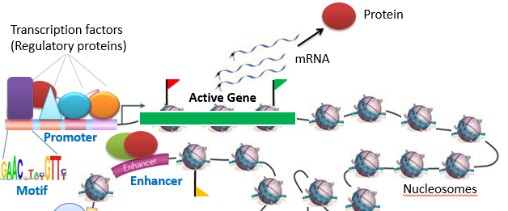
ENCODE-DREAM Challenge Objective
Experimental measurement of in vivo binding profiles of every transcription factor (TF) in every condition and cell type is infeasible!
Objective: Can we computationally predict in vivo TF binding?
We provide in vivo binding data for diverse TFs in reference cell types
Participants predict in vivo binding in new cell types
Participants develop predictive models that integrate key input data types: (1) DNA sequence, (2) in vitro DNA shape parameters (3) in vivo chromatin accessibility (4) gene expression
We perform systematic comparisons to benchmark and identify methods with best predictive performance
4

Slide 6
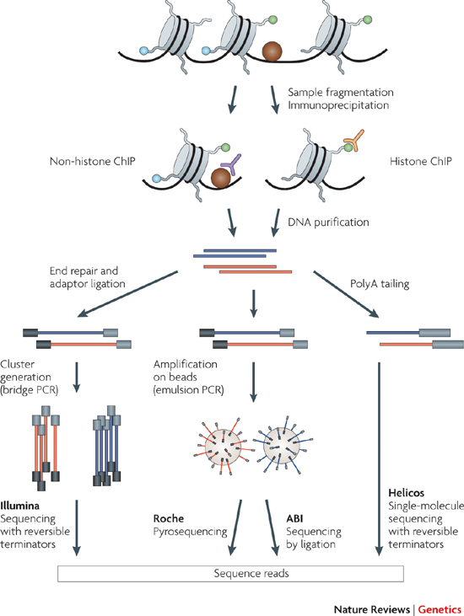
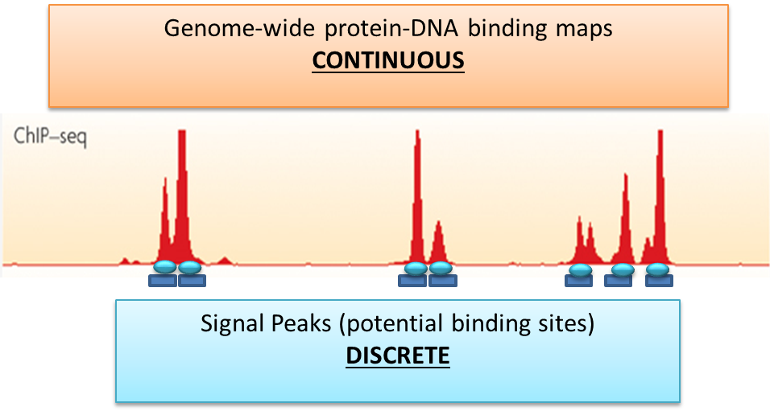
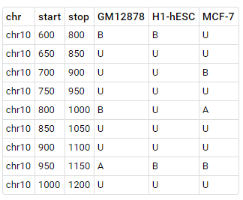
Description of Challenge Data Overview
Genome-wide in-vivo TF binding data
Chromatin immunoprecipitation followed by sequencing (ChIP-seq) targeting specific TF in specific cell type
Continuous, genome-wide, smoothed fold-enrichment track of ChIP-seq signal relative to control
Peak calling: Regions of enrichment => likely binding events
Peaks ranked by enrichment and reproducibility across replicates
Two types of peaks
Conservative: High-confidence, reproducible peaks labeled as bound (B)
Relaxed: Lower confidence, reproducible peaks labeled as ambiguous (A) – not used in evaluation
Rest of the genome is labeled unbound (U)
Training label resolution: 200 bp bins every 50 bp
Genomic bins
Cell types
5

Slide 7
Description of Challenge Data Overview
Held-out cell types
For each TF
ChIP-seq data is provided for some training cell types for participants to train models on
Binding to be predicted in new held-out cell types (ChIP-seq data not provided to participants throughout challenge)
Two types of held-out cell types
Leaderboard cell types: During leaderboard round, participants can query performance in these held-out cell types. Multiple submissions allowed.
Final round cell types: Multiple submissions allowed. No feedback provided. Final submission used for evaluation
TFs have different training and held-out cell types
Held-out chromosomes
Binding data in chr1, 21 and 8 is never provided (even in training cell types)
chr1 and 21 can be queried in Leaderboard round
Performance will be evaluated on these 3 held-out chromosomes
chrY and chrM are never used in the challenge
6

Slide 8
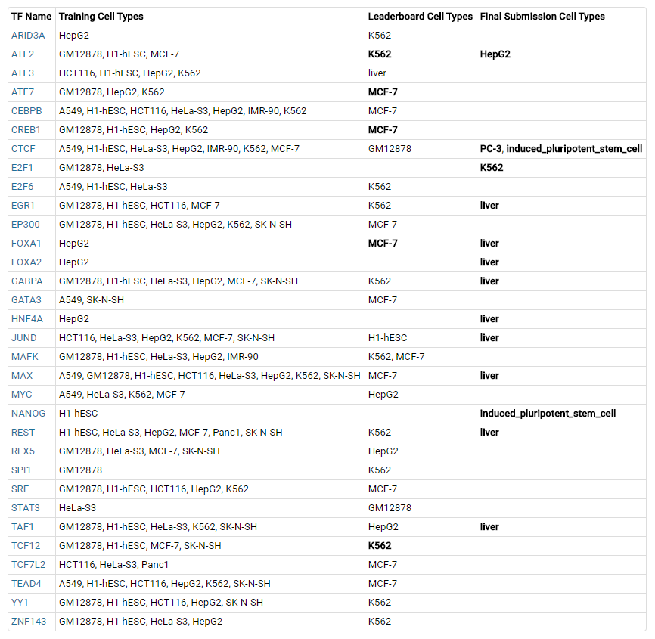
Description of Challenge Data Overview
32 TFs in total
14 cell types in total
NOTE: training and held-out cell types are different for each TF
7

Slide 9
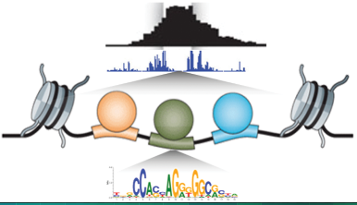
Description of Challenge Data Overview
Input Data Types to be used as predictors
DNA sequence: TFs bind specific sequence motifs
Can be featurized in any way e.g. k-mer counts, known motifs, motifs learned from training data
Features can be obtained from any external source (ONLY EXCEPTION)
Several resources listed in Resource section
Chromatin accessibility data (DNase-seq) in each cell type: TFs prefer binding nucleosome depleted accessible chromatin that is sensitive to the DNase enzyme
Raw alignments
Genome-wide, smoothed fold-enrichment track of DNase-seq signal
Conservative peaks (similar definition to ChIP-seq)
Relaxed peaks (similar definition to ChIP-seq)
Gene expression (RNA-seq) in each cell type: TF expression level in cell type? Is peak near expressed target gene? etc ..
Gene-level expression values (recommended to use TPM units)
Gene annotations (gene names, coordinates)
in vitro DNA shape parameters: TFs recognize specific DNA shape properties e.g. minor groove width, helix and propeller twist, Roll
8

Slide 10
Description of Challenge Data Hosting in Synapse
Participants can ONLY use data hosted or pointed to from Synapse.
Participants need not use all the input data types (can use any combination or all of them) BUT cannot use any additional data types
Only exception to this rule is sequence-affinity features derived from DNA sequence. Can use any motif database. Several listed in resource section
Please read all challenge rules carefully
If in doubt ask organizers in Discussion forum!
9

Slide 11
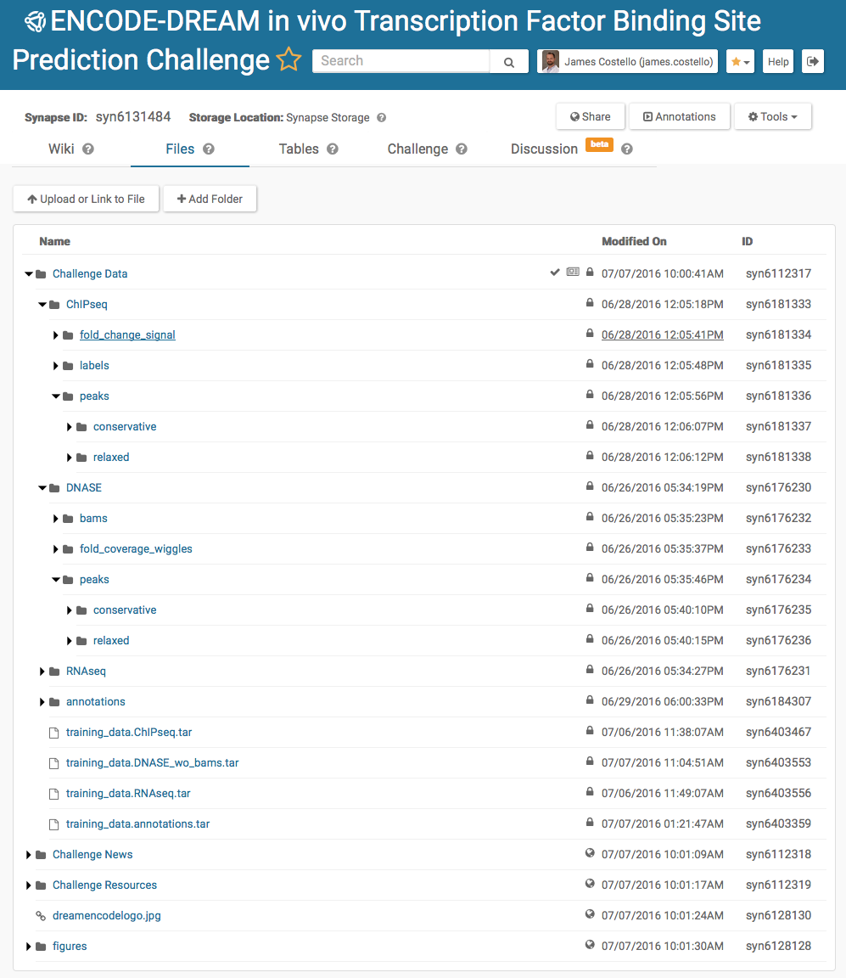
10

Slide 12
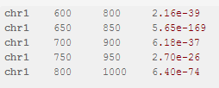
Challenge Questions
Binary prediction task: Predictions must be predict probability (between 0 and 1) of being bound by TF for each 200 bp bin every 50 bp in test cell type
Across cell-type prediction challenge
How well can we predict binding in new cell types?
LeaderBoard Round
For each TF, train models using provided binding data in training cell types
Predict and submit binding probabilities in held-out leaderboard cell types in held-out chromosomes (chr1, chr21, chr8)
Multiple submissions with feedback on performance on chr1 and chr21
Participants can submit each TF-cell type combination separately to receive feedback
Teams will be limited to 10 submissions per TF-cell type combination
Final submission round
For each TF, train models using provided binding data in training cell types
Predict and submit binding probabilities in held-out final round cell types in all chromosomes
Multiple submissions allowed. Only final submission used for evaluation. No feedback on performance.
Evaluation for ranking only on chr1, chr21 and chr8.
Participants must submit all TF-cell type combinations to get into final ranking
Please use exact submission template and file naming convention (“Submitting models section”)
11

Slide 13
Challenge Questions
Within cell-type prediction challenge
After across cell-type rounds, binding data will be released in held-out cell types EXCEPT in chr1, chr21 and chr8
For each TF and held-out cell type, train models using provided binding data in this cell type (training chromosomes)
Predict binding probabilities in held-out chromosomes (chr1, chr21 and chr8) in same cell type that was used for training
This round is mainly for benchmarking cross-cell type performance vs. same cell type performance
Collaborative community challenge
Not used for ranking teams
Participants and organizers can collaborate to find best solution
Open to use other types of data
Participants must provide (final submission round)
Code (any data preprocessing + training + testing code), clear running instructions. Organizers must be able to recreate results.
Detailed Description of methods
12

Slide 14
Challenge Scoring
Predictions
Provide binding probabilities. DO NOT provide thresholded binary predictions
Use exact provided templates for each round (“Submitting models section”)
Performance measures
Area under ROC: The area under the curve that results from plotting recall as a function of the false positive rate.
Area under Precision-Recall Curve: The area under the curve that results from plotting precision as a function of the recall.
recall at X% FDR (10%, 50%): The fraction of positives labeled as positives when controlling the false discovery rate to be under X%.
These measures will be calculated for every TF/cell type combination in the test sets.
13

Slide 15

Challenge Scoring
auPRC is used as ranking measure in leaderboard round
Combined score in final round:
score_{i,j}: score for measure i in TF-cell type combination j ran(score_{i,j}): rank among all submissions for score_{i,j} N_{j}: the total number of sumbissions for TF-cell type j
where:
i is taken over all four measures
auROC, auPRC, recall 10% FDR, relcall 50% FDR
j is taken over all TF-cell type combination in the final set
14

Slide 16
Baseline Model
Stage 1: Bins that don't overlap conservative DNASE peak are labeled as negatives
Stage 2: Bins that do overlap DNASE peaks are scored using a linear classifier with a log loss function
- SGDClassifier in scikit learn
Linear Classifier Input features:
Known motifs: -log2(motif score) region summary statistics
Max, 0.99%, 0.95%, 0.75%, 0.50%, mean
max DNASE fold change across each bin
Training Set:
Binary binding data from all training cell types
Genomic regions from different cell types are treated like independent observations
15

Slide 17
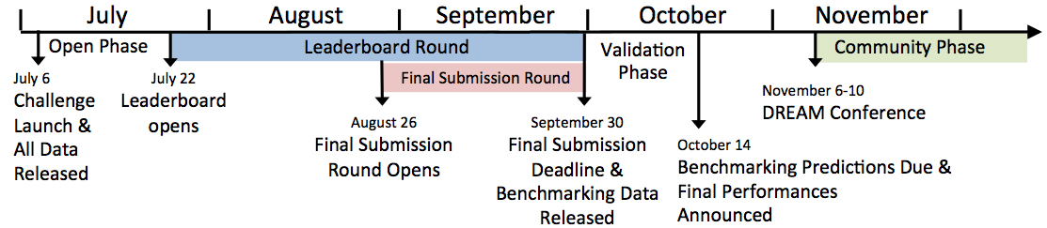
Challenge Timeline, Rounds and Leaderboard
16

Slide 18
Challenge Incentives
Authorship. The winning team(s) will be invited to be byline coauthors on a manuscript submitted to Cell. All participants* will be invited to the “ENCODE-DREAM Community” and included as a coauthor. * participation requires submission of predictions, scoring code, and a write-up of the methodology to be included in the publication. These are specified in the Challenge Rules
DREAM Conference. Winning teams will be invited to present at the RECOMB/ISCB Conference on Regulatory & Systems Genomics with DREAM Challenges & Cytoscape Workshop. Nov 6-10, 2016. Phoenix, AZ.
17

Slide 19


Using Synapse
a platform for collaborative data analysis and data sharing
developed by Sage Bionetworks and used to host the DREAM challenges
used to distribute data and coordinate scoring
18

Slide 20

Q & A
19

