Slide 1

VAVE
BY
Nathapon Sripornprasert
December’2020

Slide 2



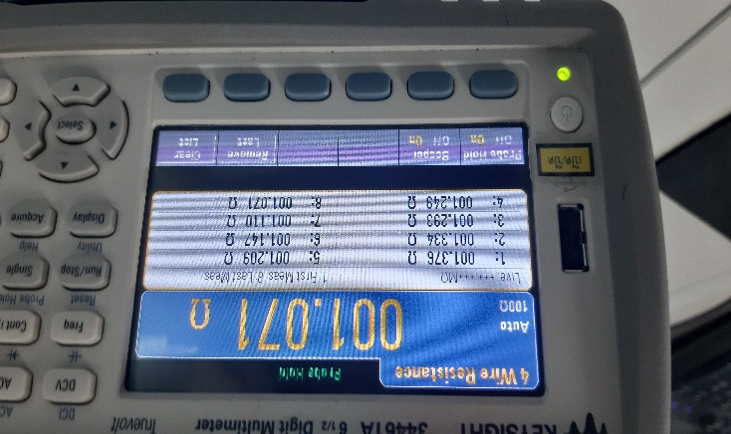
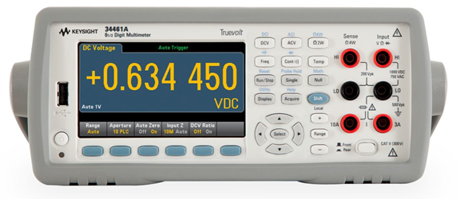
Action
Project Name : Keysight Improvement Model 34461A
 | Before | After
Condition | Hold the Resistance data in 8 times The current program need to get foot switch (Not Convenient to User) | Use VBA and Keysight Connection to get data and import to Excel file auto
Picture Or Figure | Remember Prob Hole mode and key to Excel
Current apply | - | Current State: Start to use program in QA => 4 Machine Future: Apply to PTH Process 2 Machine
Manual key
Connect
Send value to report

Slide 3
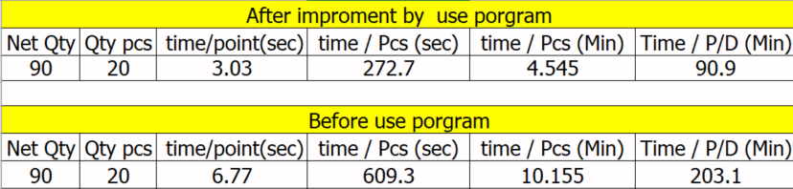
Cost Improve
Conclusion only QA Process
Hours Reduce = 203.1 – 90.9 ≈ 120 Min = 2 Hrs.
Cost / Month = 32000 Baht / Product / Month / Keysight 4 Machine

