Slide 1

VAVE
BY
Nathapon Sripornprasert
February’2021

Slide 2
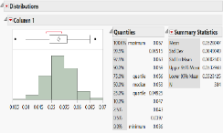
Action
Project Name : Data Visualization (PRINT: Solder Thickness)
 | Before | After
Condition | Take over time to summary report by each products | - Use VB.net to take result from machine - Summary by SSRS Program
Picture Or Figure | Take data from excel to JMP Program
Product Apply | - | Apply 4 Product RGO-530S, RGPZ-030MW, RGPZ-114ML, RGPZ-161ML, RGPZ-183ML, and RGPZ-199ML
machine
Get Excel to Database
VB.net Code
SE Server
Send Excel file every 2 Hrs.
Send data from excel to DB
Database
Transform data to visualization
SSRS

Slide 3
Cost Improve
Conclusion (0.5 Hrs/Product = (Move file from machine + Upload to Database)
Save Cost= 4 products/day * 0.5 Hrs/product * 130 Bath /Labor * 3 Labor * 30 Days * 5 graphs = 117,000 Bath / Month

