Slide 1

VAVE
BY
Nathapon Sripornprasert
December’2020

Slide 2



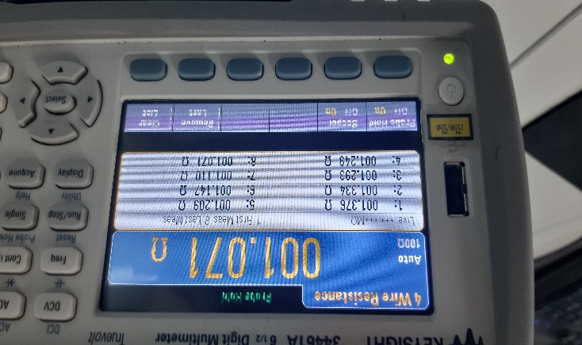
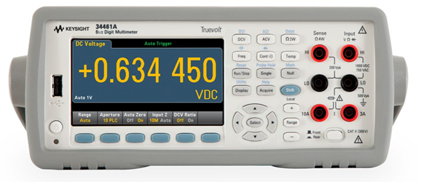
Action
Project Name : Keysight Improvement Model 34461A
 | Before | After
Condition | Hold the Resistance data in 8 times The current program need to get foot switch (Not Convenient to User) | Use VBA and Keysight Connection to get data and import to Excel file auto
Picture Or Figure | Remember Prob Hole mode and key to Excel
Current apply | - | Current State: Apply to PTH Process 2 Machine
Manual key
Connect
Send value to report

Slide 3
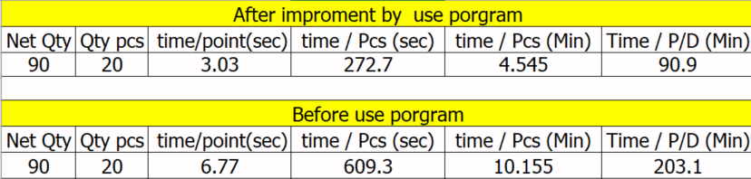
Cost Improve
Conclusion
For QA (Apply on Dec2020)
Save Cost= 4 products/day * 2 Hrs/product * 130 Bath /Labor * 4 Labor * 30 Days = 124,800 Bath / Month
For PTH (Apply on Jan2021)
Save Cost = 4 products/day * 2 Hrs/product * 130 Bath /Labor * 2 Labor * 30 Days = 62,400 Bath / Month
Total Save = 124,800 + 62,400 = 187,200 Bath / Month

