Slide 1
Calibration du leaf area density LAD
Etude menée par Nathéo BEAUCHAMP
et supervisée par Gauthier LIGOT (absent aujourd’hui)
(Université de Liège, AgroBio Tech Gembloux, Belgique)
Avec la collaboration de :
Philippe BALANDIER (INRAe UMR PIAF, Clermont-Ferrand, France)
Benoit COURBAUD (INRAe UR LESSEM, Grenoble, France)
Mathieu JONARD (UCLouvain, Louvain-la-Neuve, Belgique)
13 Octobre 2025, de 14h à 15h:
  Présentation de l’étude et des premiers résultats (15mn)
  Discussion entre nous (30mn)
  Modalités de la collaboration (5mn)

Slide 2
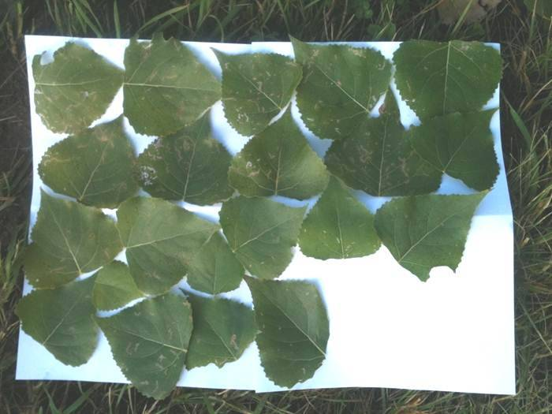
Motivation of the study
Leaf area density (LAD) :
area of leaves per unit of tree crown volume (in m2/m3)
Important parameter for forest models
Direct estimation through samples of leaves (Stadt & Lieffers, 2000)
➔ Laborious and destructive
Indirect methods using model inversion (Courbaud et al. 2003) or LiDAR (Wei et al. 2020)
➔ Difficulties in obtaining consensual results for several species (Ligot et al., 2014)

Slide 3
Objective of the study
Estimation of the leaf area density LAD for 9 species/groups:
Fagus sylvatica, Picea abies, Quercus sp., Carpinus betulus, Pseudotsuga menziesii, Pinus sylvestris, Abies alba, Larix decidua and ‘other species’
  Hypotesis: LAD is greater for late successional species (or high shade tolerant species)
Effect of tree diameter
Hypothesis: decreasing LAD with increasing tree age (Nock et al., 2008).
Does it depend on the species autecology ?
Effect of local competition
Hypothesis: suppressed trees may harbour more leaves to intercept more energies from low-energy light rays ?
Does it depend on the species autecology ?

Slide 4
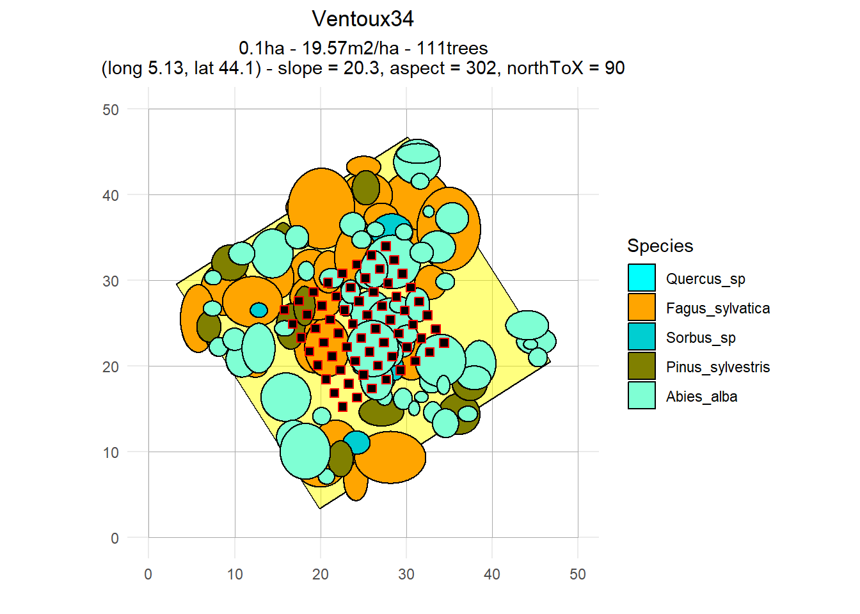
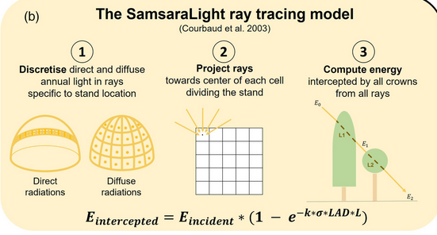
Global methodology
Calibration of a species-specific tree-level LAD model through model inversion using the SamsaraLight ray-tracing model (Courbaud et al. 2003)
Bayesian approach: minimize the residuals between PACLobs and PACLest at each sensor
4 origins (UCLouvain, INRAe, Cloture, IRRES), 45 sites and 1,121 sensors

Slide 5
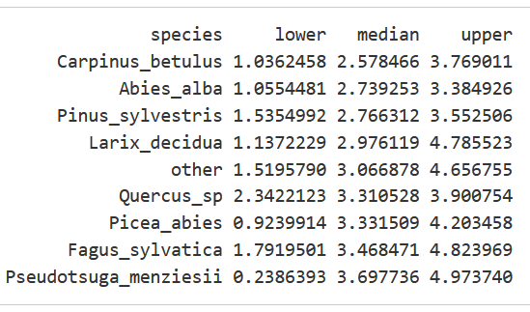
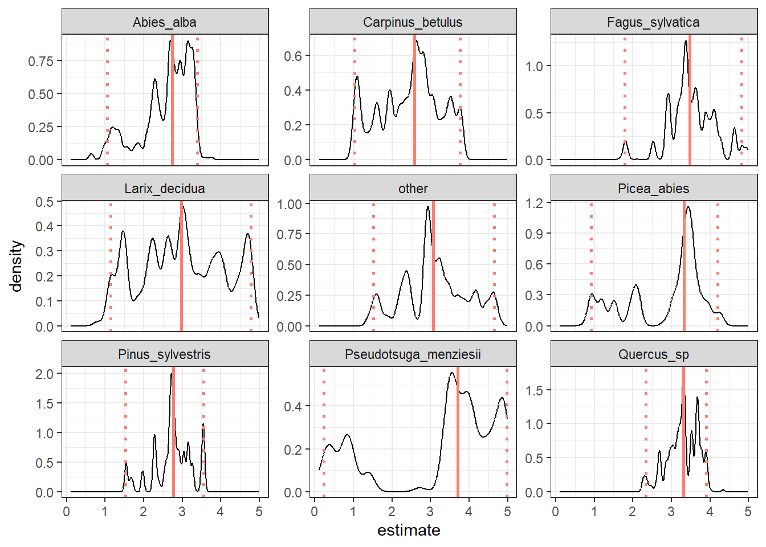
First results
Species-specific intercept
2 key points:
Convergence difficulties
High values of LAD, but the same magnitude between species (around LAD of 3)

Slide 6
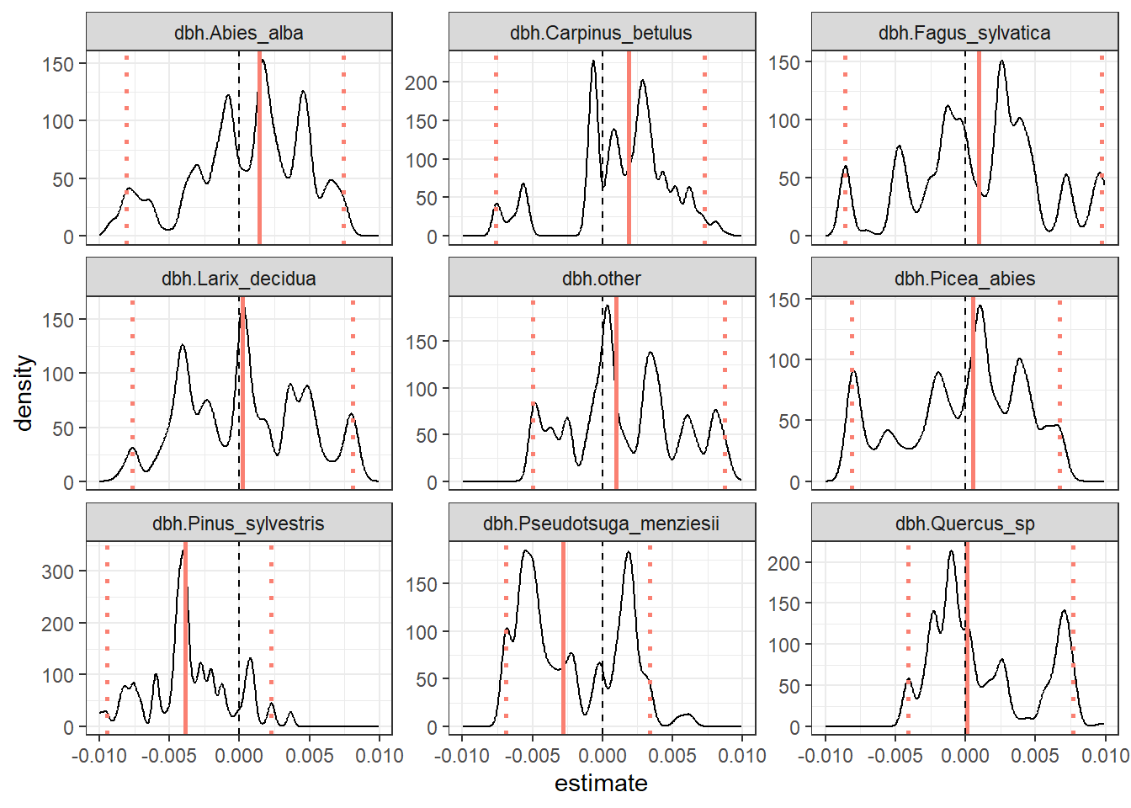
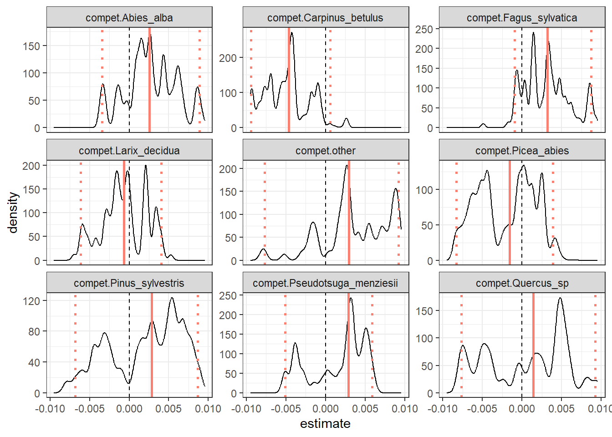
First results
Effect of diameter
Effect of competition

Slide 7
A methodology to improve
There is still problem of convergence
  Standardize predictors ? Covariance between intercept and slope ? More informative priors ?
  Asking a statistician to participate to the study
We could imagine another index of competition
  BAH is an absolute index of competition, is it ecologically relevant ? Apply a transformation effect, such as a plateau function ?
  DBH/DG, as a social status index, which is a stand-relative index of competition
The model may be highly sensitive to the trees we consider in the likelihood
  Consider only trees in a given radius around the sensor for the computation of the likelihood (e.g. 15m) ?
  May question the relevance of a preliminary study concerning the shading radius of trees

Slide 8
Limits
We may miss some important environmental factors
  Effect of climate: leaf area density may decrease with increasing hydraulic constraints (site-specific aridity or high local competition)
    Too small intra-origins variability in climatic conditions, climate is considered in the origins and site random effects
  Effect of sanitary health: for exemple, bark beetles or drought consequences may greatly influence the LAD
  ➔ But we do not have such information

Slide 9
Perspectives
Ecological mechanisms that could underlie the differences between species: Do species with different shade tolerance have different leaf area densities? Do they react differently to competition?
Model comparison: Species-specific models ? Effect of dbh and competition ? Different index of competition ?

Slide 10
Modalités de la collaboration
2 next weeks (13 and 20 October): valorisation of the SamsaRaLight R package
Reprendre l’étude en Novembre/Décembre 2025:
  Fin Novembre/Début décembre = organiser une deuxième réunion avec vous pour vous presenter les résultats et l’orientation du papier
  Fin décembre, avant les vacances de fin d’année = envoyer un draft V1 du papier
  En vous laissant un gros mois pour faire des retours deadline en début Février = organiser une troisième reunion pour discuter de vos retours

