Slide 1


High level Language To Assembly Language
Members | ID
Nathnael yimer | UGR/6855/13
Kaleab Tibebu | UGR/2979/13
Enyew Anberber | UGR/9324/13
Deribew Shimels | UGR/5307/13
Etsubdink Awoke | UGR/1185/13
Betelhem yimam | UGR/8483/13
HLL to MIPs assembly

Slide 2
Features…..
Where to where ?
Features of Java Compiler
Syntax-Checking
Type Checking
Optimization
Code Generation
Debugging Support
Linking
Java Programming Language
Input
Compiler
Other features we add…
Flexible source language support
Increased performance
Reduce time loss
Improve integration
Minimal data loss:
Support for multiple platforms
Comprehensive debugging tools
Output
MIPs Assembly
Language

Slide 3
High level design
Java programming Language
Input
Lexical Analysis
Stream of tokens
Compiler
Syntax analysis
Parse tree
Semantic analysis
Parse tree semantically verified
Intermediate code representation
Three Address code
Code optimization
Optimized Three Address code
Target code generation
Assembly Language (MIPS)
Output

Slide 4
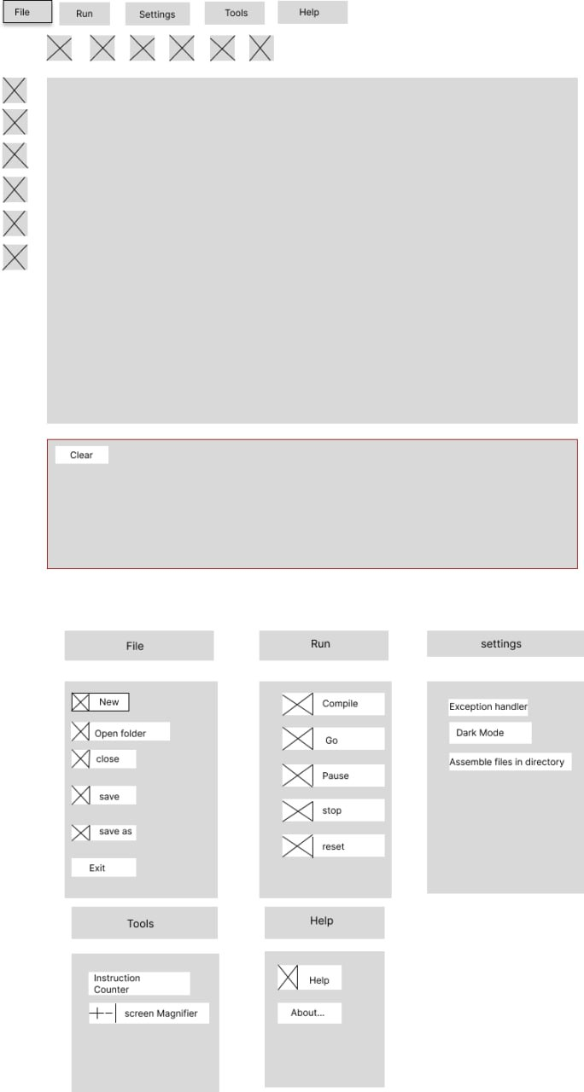
UI Design

