Slide 1

Peak Demand Risk Forecasting and Generation Planning Support for CEB
Decision Analytics Case Study
Ceylon Electricity Board, Sri Lanka
Nathumini Pramuditha Jayathilake
Notes:
My presentation is titled “Peak Demand Risk Forecasting and Generation Planning Support for CEB.”
This is a Decision Analytics case study based on the Ceylon Electricity Board in Sri Lanka. The focus of this
presentation is not only on building a machine learning model, but on understanding how analytics can
support an important planning decision.
The selected problem is short-term peak-demand risk forecasting and generation planning support. In
simple terms, the question is: how can CEB identify days where electricity demand may become risky, early
enough for planners to prepare?
The presentation will move through the problem in a structured way. First, I will explain the CEB planning
environment. Then I will show the evidence behind the selected problem. After that, I will explain the
planning problem, the proposed decision-support flow, the dataset used, the model and evaluation, and
finally the recommended next step.
The main idea I want to communicate is that decision analytics should support CEB planners with earlier
and clearer signals, but it should not replace engineering judgement.

Slide 2
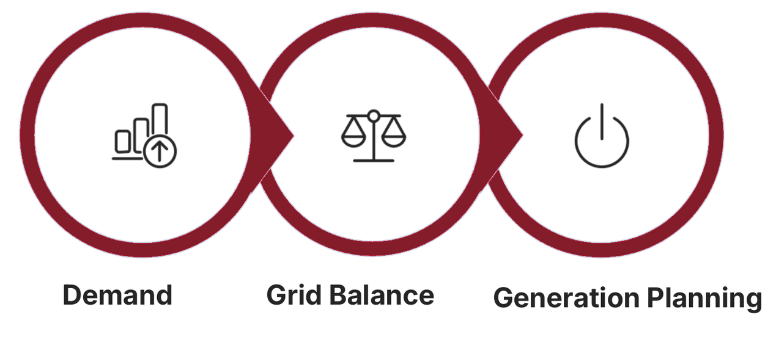
CEB's Planning Environment
CEB has to balance electricity demand and generation continuously.
Continuous Balance
Early Preparation
Demand and generation must be balanced continuously.
Generation must be prepared before demand occurs.
Operational Impact
Decision Problem
Planning errors can affect reliability, cost and public confidence.
Peak-demand forecasting supports generation planning decisions.
Notes:
2 CEB operates in a planning environment where electricity demand and generation must be balanced
continuously.
This is different from many ordinary business problems. For example, in a retail business, if demand
increases, the company may respond after seeing sales. But electricity planning is more time-sensitive.
Generation must be prepared before demand occurs, because demand and supply need to remain
balanced across the grid.
This creates a strong planning challenge. If demand is underestimated, there can be reliability pressure. If
demand is overestimated, generation preparation may become inefficient and costly. Therefore, peakdemand forecasting is not just a technical forecasting task. It directly supports generation planning
decisions.
The slide shows the basic relationship: demand, grid balance, and generation planning. These are
connected. Demand creates pressure on the grid, grid balance must be maintained, and generation
planning is the process that prepares the system before the pressure happens.
There are four key ideas here.
First, continuous balance. Demand and generation must be balanced continuously.
Second, early preparation. Generation has to be prepared before the actual demand occurs.
Third, operational impact. Planning errors can affect reliability, cost and public confidence.
Fourth, decision problem. Peak-demand forecasting supports generation planning decisions.
So this case study is not only about predicting electricity demand. It is about helping CEB make better
planning decisions before peak pressure occurs.

Slide 3

Evidence Behind the Selected Problem
The selected problem is grounded in CEB public evidence.
16,802
GWh Total Generation
Total generation in 2024
45.91
GWh/day Average
Average daily generation in 2024
2,673
MW Peak Pressure
Night maximum demand in 2024
867
GWh Solar Exports
Rooftop solar exports in 2024
Notes:
3 This slide shows the public evidence used to define the selected problem.
There are four key figures.
The first is 16,802 GWh, which is the total generation in 2024.
The second is 45.91 GWh per day, which is the average daily generation in 2024.
The third is 2,673 MW, which is the night maximum demand in 2024. I have highlighted this as peak
pressure because it directly connects to the planning problem.
The fourth is 867 GWh, which is rooftop solar exports in 2024.
These values show that the issue is not based on an assumption. The case is grounded in CEB public
evidence.
When these values are viewed together, they show a more complex planning environment. Total generation
and average daily generation show that electricity requirement is significant. Night maximum demand
shows that the timing of demand matters. Rooftop solar exports show that renewable contribution is also
becoming part of the planning environment.
The important point is that the planning issue is not just “electricity demand is high.” The issue is that CEB
must plan around demand pressure, peak timing, and changing generation conditions. That is why this
problem is suitable for decision analytics.

Slide 4

What the Evidence Means
The issue is not only how much electricity is generated, but when demand pressure occurs.
Demand Pressure
Time Pressure
Renewable Planning Pressure
Higher generation requirement
Night maximum demand is important
Rooftop solar changes daytime supply contribution
Bottom takeaway: CEB needs earlier warning of high-risk peak-demand conditions.
Notes:
4 The evidence from the previous slide can be interpreted in three main ways.
The first is demand pressure. Higher generation requirement means that CEB must plan carefully to meet
electricity needs. A higher electricity requirement increases the importance of accurate planning.
The second is time pressure. The night maximum demand value is important because peak demand is not
only about total energy. It is also about when the pressure occurs. A day may seem manageable at an
average level, but the system can still face pressure during the night peak period.
The third is renewable planning pressure. Rooftop solar changes daytime supply contribution. This is useful,
but it also means that planning has to consider time-of-day patterns. Solar contribution is mainly connected
to daylight hours, while the highlighted peak pressure is at night.
Therefore, CEB needs earlier warning of high-risk peak-demand conditions. It is not enough to only look at
historical annual figures. Planners need signals that can help them understand which days may become
risky and what conditions are contributing to that risk.
This is where decision analytics becomes useful. It can combine demand, weather, generation and calendar related information to support a more structured risk view.

Slide 5
The Planning Problem
CEB needs to identify high-risk peak-demand days early enough to support generation planning.
Core Questions
5W1H Summary
What — Peak-demand risk
Why — Reliability and generation planning
Who — CEB planners and dispatch teams
Where — National grid
When — Daily, seasonal and night peak periods
How — Demand, weather, generation and calendar data
When will demand pressure become high?
What conditions are driving the risk?
What planning actions should be reviewed?
Notes:
5 Based on the planning environment and the evidence, the selected problem is this:
CEB needs to identify high-risk peak-demand days early enough to support generation planning.
This can be broken into three core questions.
The first question is: when will demand pressure become high? This is about identifying the timing of risk
before it occurs.
The second question is: what conditions are driving the risk? This is important because a prediction alone is
not enough. Planners also need to understand whether the risk is connected to demand, weather,
generation mix, previous demand patterns, or calendar effects.
The third question is: what planning actions should be reviewed? This connects the model output to
decision-making. The result should help planners think about generation readiness, peak alerts and
renewable balancing.
The 5W1H summary helps to narrow the scope.
What is the problem? Peak-demand risk.
Why does it matter? Reliability and generation planning.
Who is involved? CEB planners and dispatch teams.
Where does it occur? Across the national grid.
When does it occur? Daily, seasonally and during night peak periods.
How can it be supported? By using demand, weather, generation and calendar data.
This breakdown is important because it prevents the project from becoming just a model-building exercise.
It keeps the focus on the actual decision that needs support.

Slide 6

Proposed Decision-Support Flow
Analytics should connect data inputs to planning action.
Inputs
Data
Warehouse
Pre-
Processing
ML Risk
Model
Decision
Dashboard
Outputs
Weather
Demand
Generation
Calendar
Fuel / Policy
Shows risk
and drivers
Peak alerts
Generation scheduling
Renewable Balancing
Stores
Planniig data
Clean and
Structure data
Classifies
Low / Medium / High
The model only becomes useful when its output is connected to planning decisions
Notes:
6 This slide shows the proposed decision-support flow.
The process starts with inputs. These include weather data, historical demand, generation mix, calendar
and holiday data, and fuel or policy signals.
These inputs then move into a data warehouse. The purpose of the data warehouse is to store the planning
data in a structured way.
After that, the data goes through pre-processing. This stage is important because raw data usually needs to
be cleaned, structured and prepared before modelling.
Then the processed data goes into the machine learning risk model. In this case, the model is used to
classify daily peak-demand risk as low, medium or high.
The model output then goes to a decision dashboard. This is a key part of the solution, because the value is
not only in the model. The value comes when the result is presented in a way that planners can use.
Finally, the dashboard supports outputs such as generation scheduling, peak alerts and renewable
balancing.
The important point here is that analytics should connect data inputs to planning action. A model that only
gives a label is not enough. For decision analytics, the output must support a real decision process.
So the proposed flow is: inputs, data warehouse, pre-processing, machine learning risk model, decision
dashboard, and planning outputs.

Slide 7
Dataset Used for the Prototype
This is an academic prototype, not a live CEB forecasting system.
Used
Not Used
Synthetic daily dataset
Calibrated to CEB 2024 anchor values
Internal CEB SCADA data
Dispatch data
Smart-meter data
The dataset supports the modelling demonstration but does not represent live CEB operational performance.
Notes:
7 This slide is very important because it explains the limitation of the practical implementation.
The dataset used for the prototype is a synthetic daily dataset. It was calibrated to CEB 2024 anchor values.
This means the dataset was created for academic modelling demonstration and connected to the official
2024 values used in the case study.
However, internal CEB SCADA data, dispatch data, and smart-meter data were not used.
The dataset supports the modelling demonstration, but it does not represent live CEB operational
performance.
That means the model result should be interpreted carefully.
In real electricity planning, a deployable system would need real operational data, such as hourly or half-hourly demand, generator availability, dispatch information, weather station data and renewable output.
So the correct interpretation is: this prototype demonstrates how the workflow could operate, but any real
deployment would need validation using actual operational data.

Slide 8
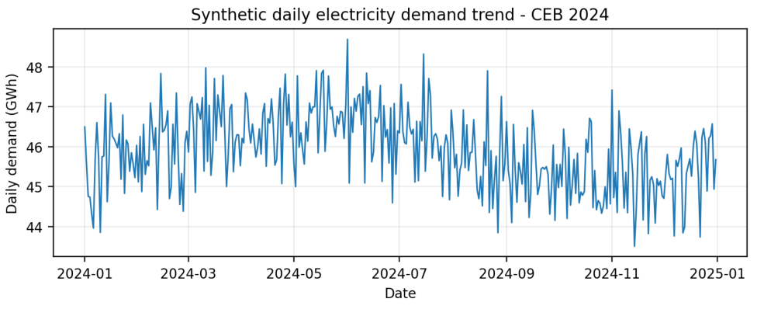
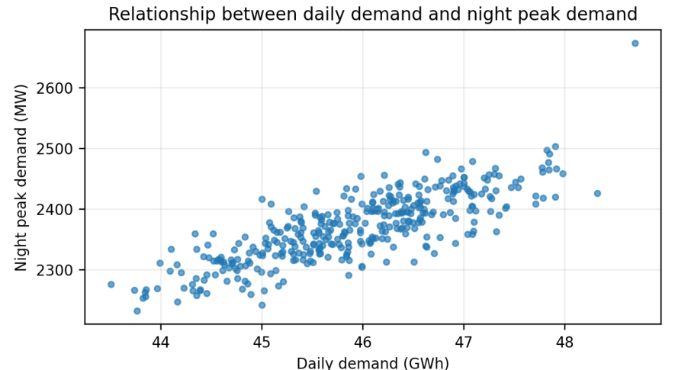
EDA and Model Selection
EDA checked the data structure before modelling, then Random Forest was used for risk classification.
EDA Checked
Demand variation
Risk-label balance
Daily demand vs night peak relationship
Random Forest Selected Because
It classifies Low / Medium / High risk
It handles non-linear relationships
It provides feature importance
Notes:
8 Before modelling, exploratory data analysis was used to check the data structure.
The EDA focused on three main areas.
First, demand variation. The daily demand trend helps to check whether the synthetic data has reasonable
daily movement around the 2024 anchor value.
Second, risk-label balance. This is important because if the risk classes are badly imbalanced, the model
may appear accurate while not properly identifying high-risk days.
Third, the relationship between daily demand and night peak demand. The scatter plot shows a visible
positive relationship, which supports the idea that daily demand is relevant to peak-demand risk.
After EDA, the Random Forest model was selected for risk classification.
Random Forest was selected because it can classify low, medium and high risk levels. It can also handle
non-linear relationships between demand, weather, generation and calendar variables. Another reason is
that it provides feature importance, which is useful for explanation.
However, I am not claiming that Random Forest is the final best model for CEB. It is suitable for this
prototype. In a real implementation, it should be compared with other models using real operational data
and cost-sensitive evaluation.
So this slide has two purposes. First, it shows that EDA was used to understand the data before modelling.
Second, it explains why Random Forest was a suitable model choice for the prototype.

Slide 9
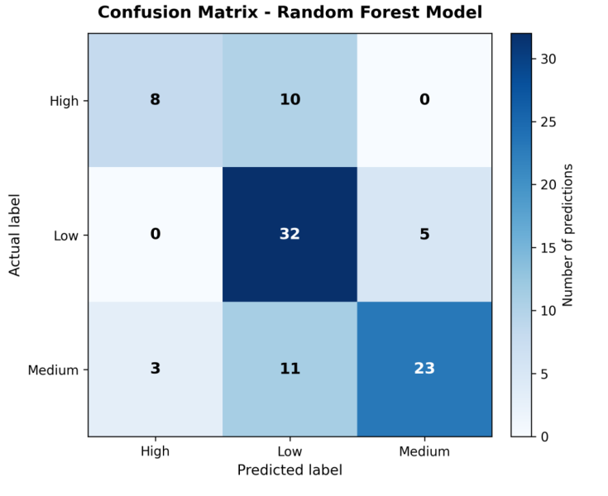
Model Performance and Critical Evaluation
The result shows useful signal, but accuracy alone is not enough.
Test Accuracy
68.48%
Useful proof-of-concept signal, but not deployment-ready without real CEB operational data.
Missing a high-risk day is more serious than a false alert, so high-risk recall should be improved first.
Notes:
9 The Random Forest model achieved 68.48% test accuracy.
This result shows a useful proof-of-concept signal. It suggests that the selected variables contain some
predictive information for classifying peak-demand risk.
However, accuracy alone is not enough for this type of problem.
In electricity planning, different errors have different consequences. A false alert may lead to extra review or
preparation. But missing a high-risk day is more serious because planners may lose preparation time.
That is why high-risk recall is important. If the model fails to identify actual high-risk days, the model may
not be useful enough for planning support, even if the overall accuracy looks acceptable.
The confusion matrix helps to show this issue. It gives more detail than a single accuracy score. For this
case, the key learning is that future improvement should prioritise high-risk recall.
The result should therefore be interpreted carefully. It is useful as a prototype, but it is not without real CEB operational data.
The critical point is this: the model should be improved not only to increase accuracy, but to reduce missed
high-risk days. This could involve better real data, threshold tuning, class weighting, or testing alternative
algorithms.

Slide 10
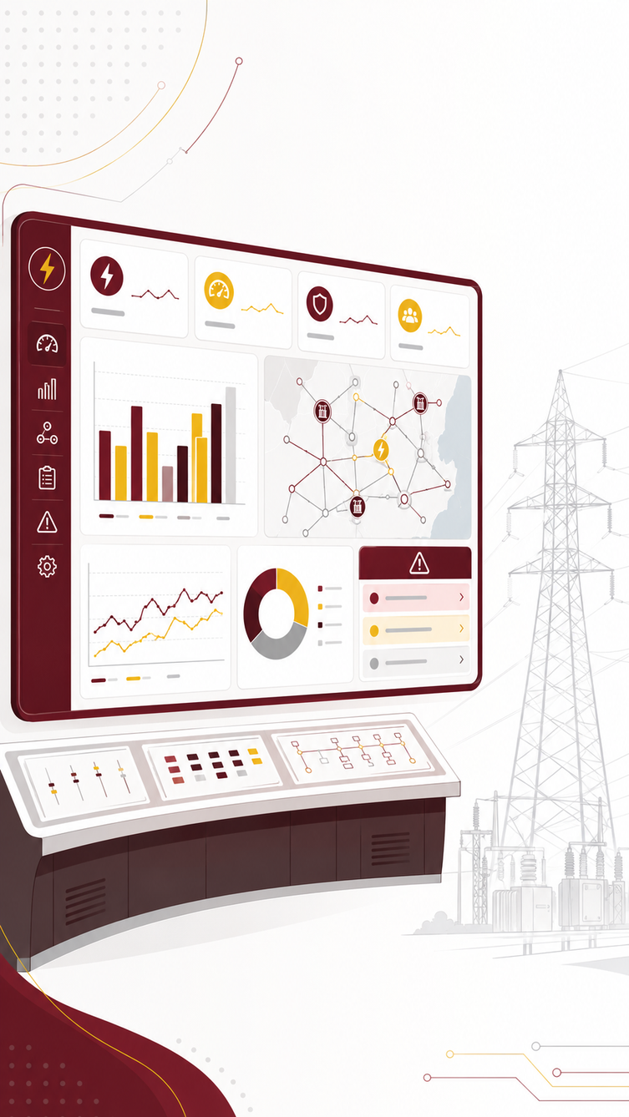
Recommended Next Step
Start with a controlled decision-support pilot dashboard.
Feasibility Score
Dashboard Should Show
4.00 / 5.00
Peak-risk level
Confidence
Top drivers
Suggested planning actions
Suggested Actions
Review generation readiness
Check renewable balancing
Prepare demand-response options
Final takeaway: Decision analytics should support CEB planners, not replace engineering judgement.
Notes:
10 The recommended next step is to start with a controlled decision-support pilot dashboard.
The feasibility score is 4.00 out of 5.00. This suggests that the idea is feasible as a controlled pilot, but not as
a fully automated national system.
The dashboard should show four key things.
First, the peak-risk level. This tells planners whether the day is low, medium or high risk.
Second, confidence. This helps planners understand how strongly the model supports the prediction.
Third, top drivers. This is important because planners need to know what factors are contributing to the
risk.
Fourth, suggested planning actions. These actions should support planner review, not automatically control
dispatch.
Suggested actions may include reviewing generation readiness, checking renewable balancing, and
preparing demand-response options.
The final takeaway is that decision analytics should support CEB planners, not replace engineering
judgement.
This is important because electricity planning is a high-impact environment. A model can provide earlier
warning and clearer evidence, but human expertise, operational constraints and engineering judgement
remain essential.

Slide 11
Peak Demand Risk Forecasting and Generation Planning Support for CEB
Decision Analytics Case Study
Ceylon Electricity Board, Sri Lanka
Nathumini Pramuditha Jayathilake
CB012526
Notes:
11 To conclude, this case study shows how decision analytics can support peak-demand risk forecasting and
generation planning for CEB.
The analysis starts from CEB public evidence, identifies the planning problem, proposes a decision-support
flow, demonstrates a prototype model, and critically evaluates the result.
The model achieved 68.48% test accuracy, but the more important lesson is that accuracy alone is not
enough. High-risk recall should be improved because missing high-risk days matters more in planning.
The best recommendation is not full automation. The best next step is a controlled pilot dashboard using
real operational data, planner oversight and clear governance.
Thank you.

Slide 12
Notes:
“The business problem was CEB’s need for earlier peak-demand planning support. The analytical problem became classifying each day as Low, Medium or High peak-demand risk using demand, weather, generation and calendar data.”
Big Data 4Vs Volume, Velocity, Variety and Veracity. Sometimes Value is added.
Volume The amount of data.
Velocity How fast data is generated or updated.
Variety Different types of data.
Veracity Data quality and trustworthiness.
Value The usefulness of data for decision-making.
Simple one-line Q&A answers
1. Why did you choose CEB? Because CEB has a real planning challenge where demand and generation must be balanced continuously.
2. What is the main problem? The main problem is identifying high-risk peak-demand days early enough to support generation planning.
3. Why is this Decision Analytics? Because the model output is connected to planning decisions, not just prediction.
4. Why not just forecast demand? Because planners need an understandable risk level: Low, Medium or High.
5. Why did you use synthetic data? Because internal CEB SCADA, dispatch and smart-meter data are not publicly available.
6. Is this real CEB operational data? No, it is a synthetic dataset calibrated to CEB 2024 anchor values.
7. Is the model ready for CEB use? No, it is only a decision-support prototype and must be validated with real operational data.
8. Why Random Forest? Because it handles non-linear relationships and gives feature importance for explanation.
9. Is Random Forest the best model? I am not claiming it is the best; it was suitable for this prototype.
10. Why not use time-series forecasting? Time-series forecasting is useful, but this prototype focuses on risk classification for planning action.
11. What does 68.48% mean? It shows proof-of-concept performance, not production-level performance.
12. Is 68.48% good enough? Not for deployment; it only shows that the selected variables contain useful signal.
13. Why is accuracy alone not enough? Because missing a high-risk day is more serious than a false alert.
14. What is high-risk recall? It is how many actual high-risk days the model correctly identifies.
15. What is the main weakness? The main weakness is the use of synthetic data and weaker high-risk recall.
16. What data would improve this? Real hourly demand, SCADA data, dispatch records, generator availability, weather and rooftop solar data.
17. What did feature importance show? It showed that both demand-side and generation-side variables influenced the prediction.
18. Why is Thermal_GWh important? In the prototype, the model found Thermal_GWh strongly connected with risk classification.
19. Does Thermal_GWh cause peak risk? Not directly; it influenced the model prediction and must be validated with real data.
20. What should the dashboard show? Risk level, confidence, top drivers and suggested planning actions.
21. Will the dashboard make decisions? No, it should support planners, not replace engineering judgement.
22. What is your recommendation? Start with a controlled decision-support pilot dashboard.
23. Why not build a full national system? Because real deployment needs data access, validation, governance and security controls.
24. What does 4.00 / 5.00 feasibility mean? It means the idea is feasible as a controlled pilot, not as full automation.
25. What would you improve next? Use real CEB data, improve high-risk recall, test other models and validate with planners.
26. What is your final conclusion? Decision analytics can support earlier peak-risk planning, but it should not replace CEB planners.
Emergency answer: “This is a decision-support prototype, not a live CEB forecasting system.”
“The 4.00 score came from a weighted feasibility assessment, where different areas like technical, data, operational, economic and governance feasibility were scored out of 5 and multiplied by their importance weight.”
How dataset was created Synthetic daily dataset calibrated to CEB 2024 anchor values.
What features were used Demand, previous-day demand, weather, generation mix, calendar variables.
What target was predicted Peak Risk Level: Low, Medium, High.
Why Random Forest Handles non-linear relationships and gives feature importance.
How model was evaluated Train-test split, classification report, confusion matrix, accuracy.
Main result 68.48% test accuracy, but high-risk recall needs improvement.
If he asks, “Can you show the code?”, say:
“Yes sir, I followed the Colab workflow for data generation, EDA, train-test split, Random Forest training, and evaluation. I can show the notebook/code if required.”
But don’t open code unless he asks.
What he may ask instead:
“Did you really implement the model?” Say: “Yes sir, the prototype workflow was implemented in Google Colab using the synthetic CEB-calibrated dataset.”
“What library did you use?” Say: “Python with pandas, scikit-learn, matplotlib/seaborn for analysis and visualisation.”
“What did the code do?” Say: “It generated/loaded the dataset, checked EDA, created the train-test split, trained Random Forest, then evaluated using accuracy, classification report and confusion matrix.”
generated 366 daily rows in Python, added calendar, demand, weather and generation variables, controlled the values around CEB 2024 anchor figures, calculated a peak-risk score, converted it into Low/Medium/High labels using percentiles, and excluded the risk score from training to avoid leakage.”
Accuracy = Correct predictions / Total predictions
“I got the accuracy and evaluation metrics by comparing the Random Forest predictions on the test set against the actual Low, Medium and High risk labels using scikit-learn metrics such as accuracy score, classification report and confusion matrix.”

