Slide 1
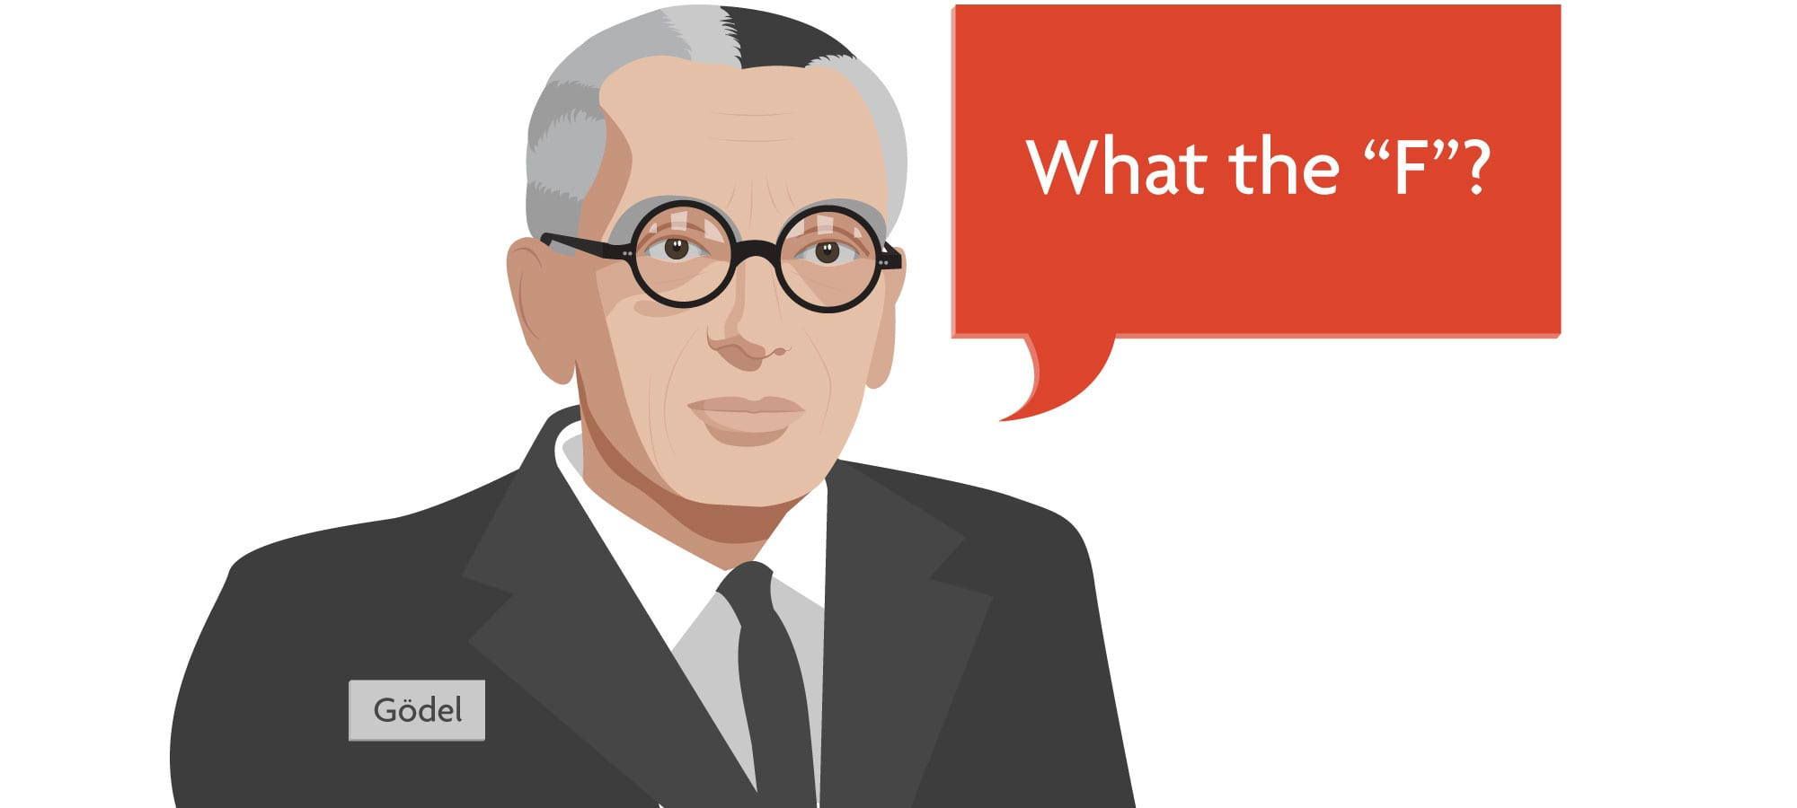
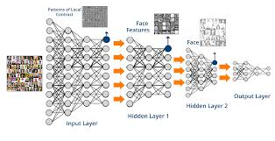
On the Relation between Software 2.0 and Gödel’s Incompleteness Theorems

