Slide 1
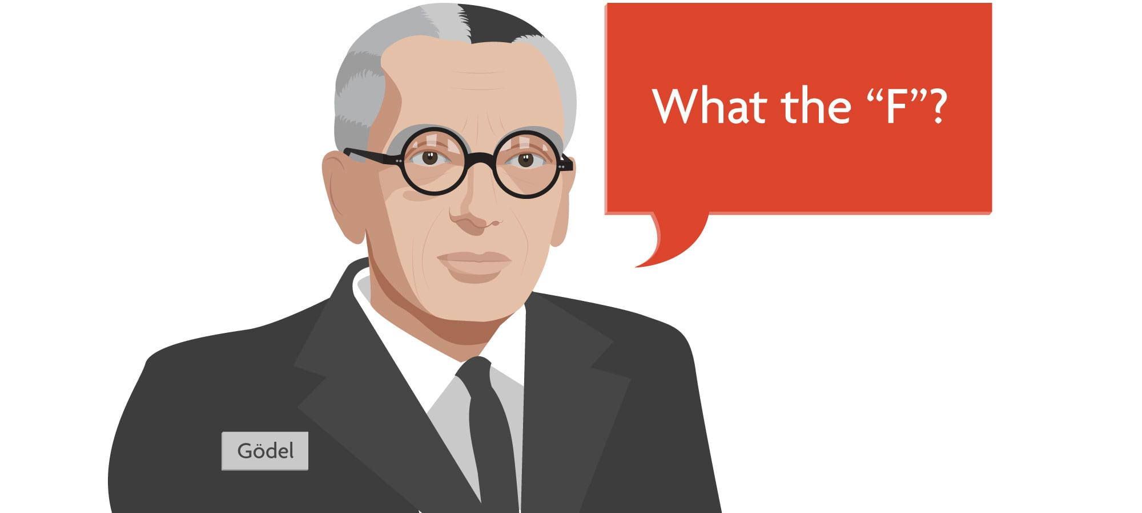
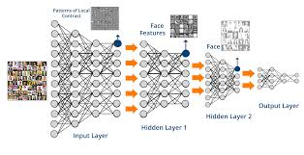
On the Relation between Software 2.0 and Gödel’s Incompleteness Theorems

Slide 2
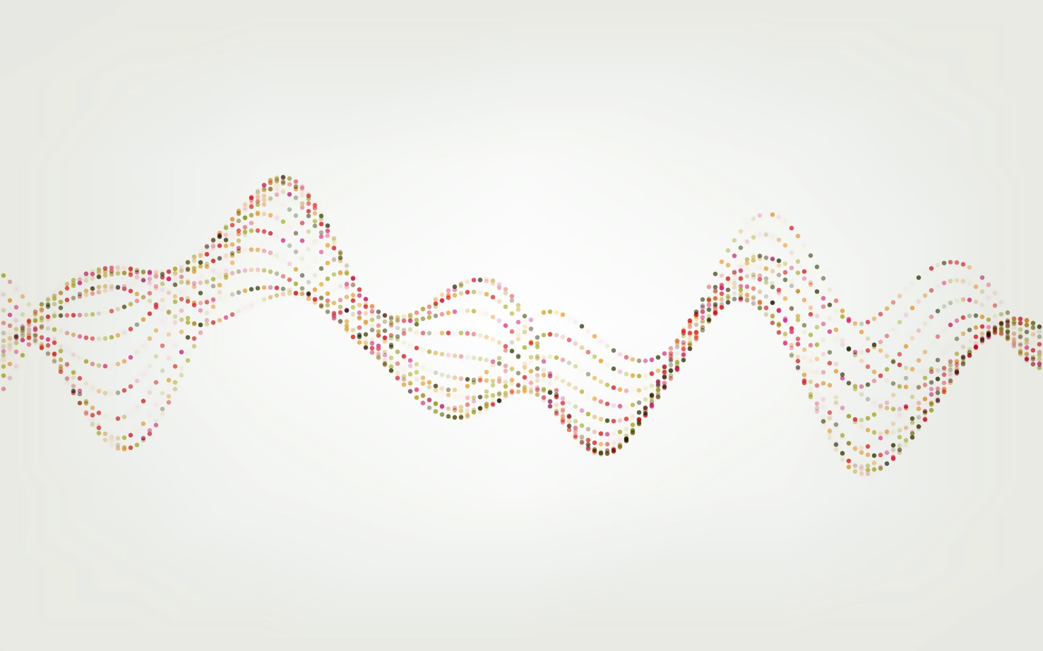
How do we encode information into a computer?

Slide 3
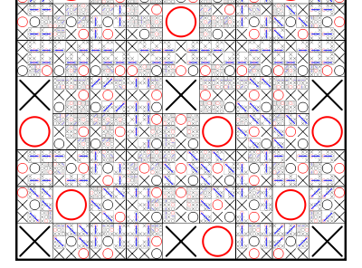
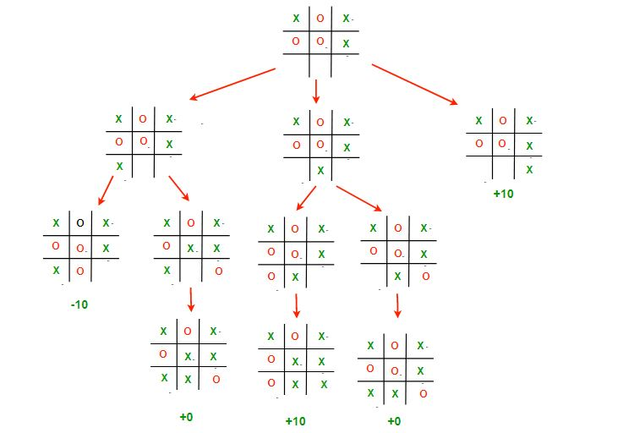
Software 1.0
Tic-Tac Toe

Slide 4
Enter Software 2.0

Slide 5
Incompleteness

