Slide 1

On the Relation between Software 2.0 and Gödel’s Incompleteness Theorems
Nate
natitaw.com

Slide 2
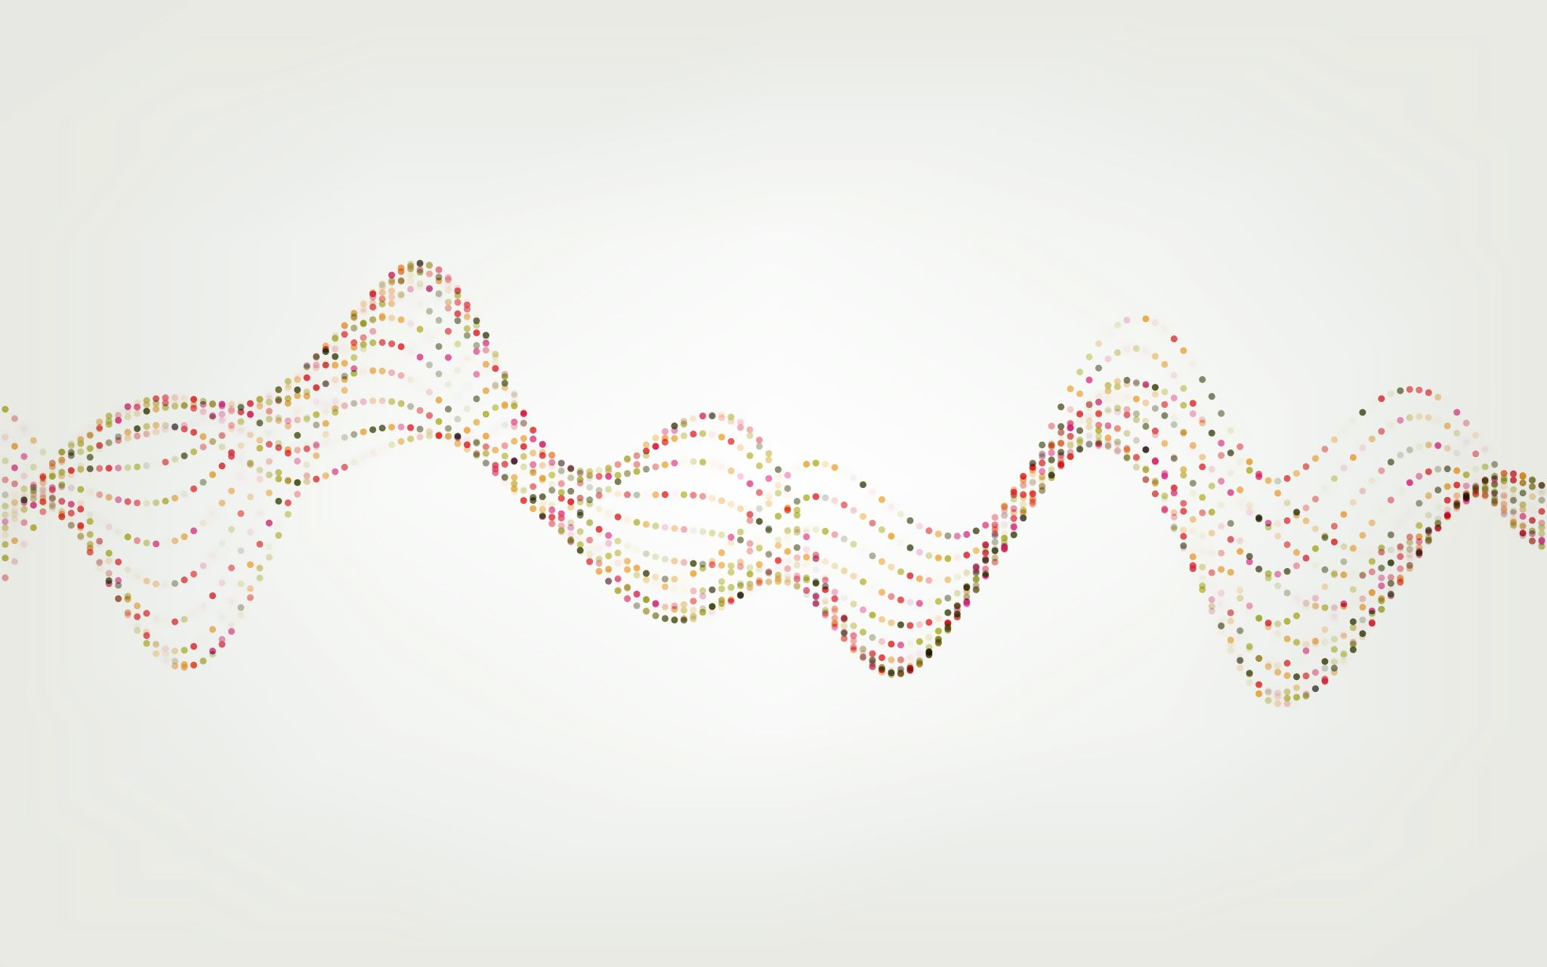
How do we encode information into a computer?

Slide 3
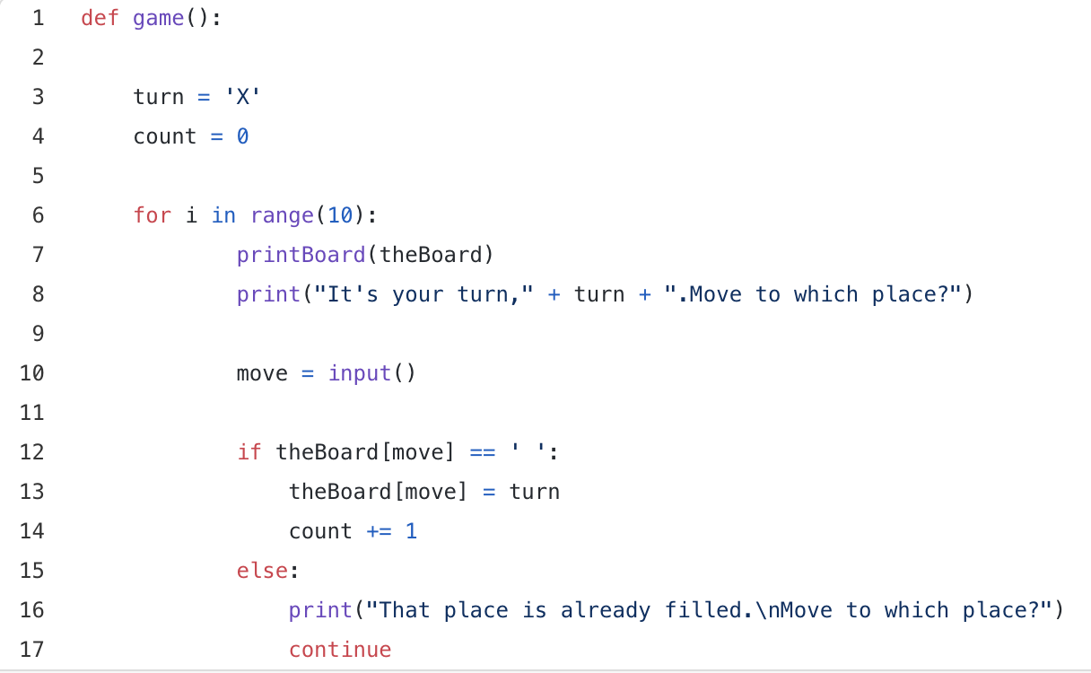
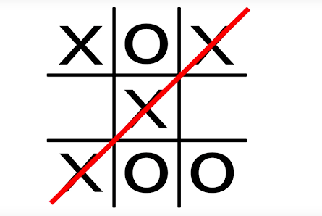
A Simple Case – Tic-Tac Toe
Define Rules
Execute a Search Algorithm

Slide 4
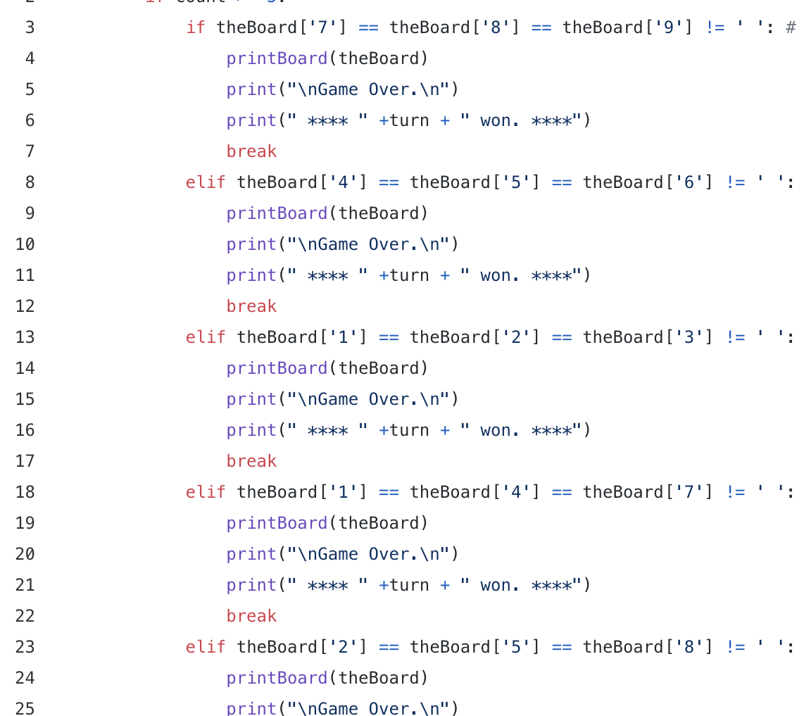
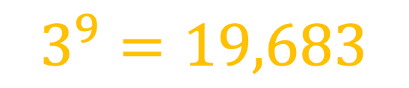
A Simple Case – Tic-Tac Toe
Force Compute
$$3^{9}=19,683$$

Slide 5
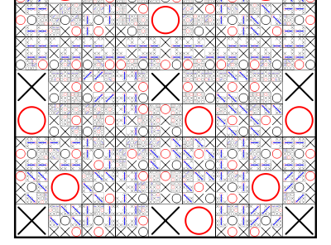
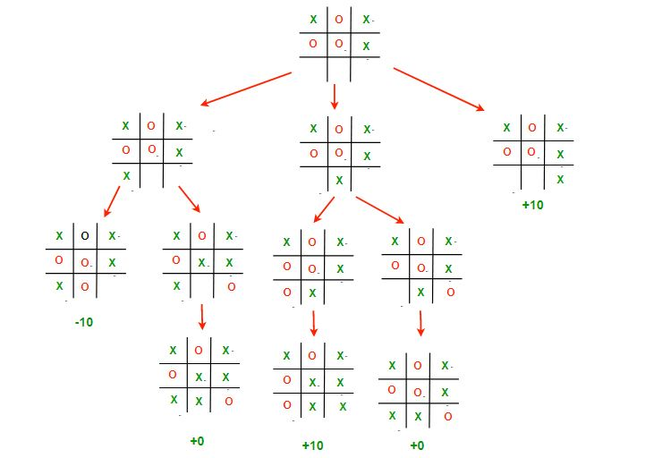
Software 1.0 ✅
Tic-Tac Toe

Slide 6
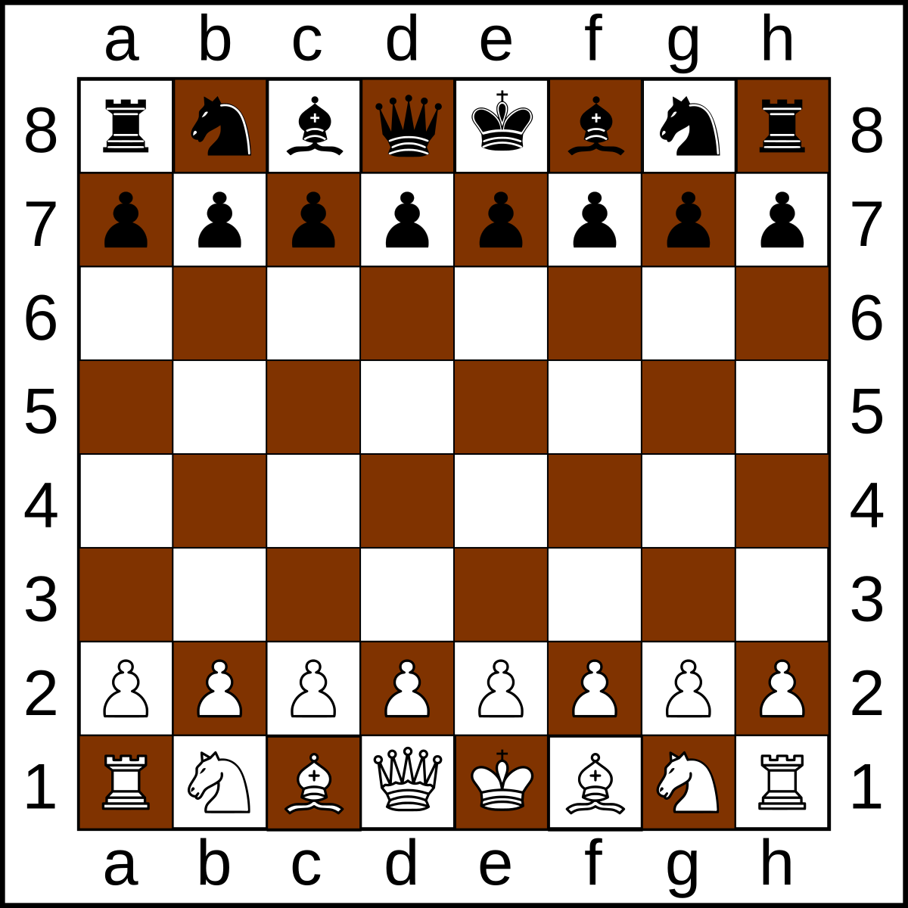
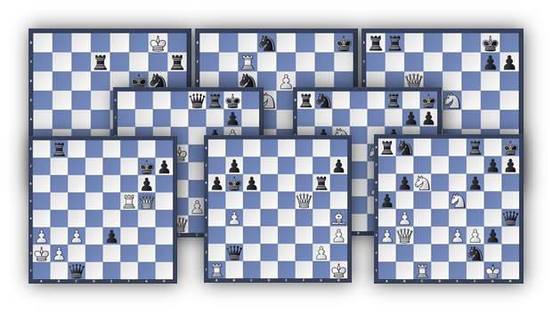
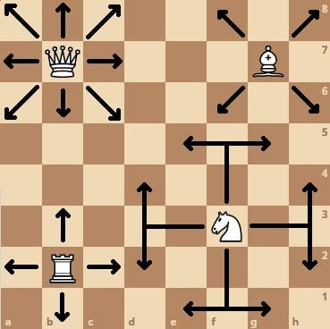
Slight Complication -- Chess
Define Rules
Execute a Search Algorithm

Slide 7
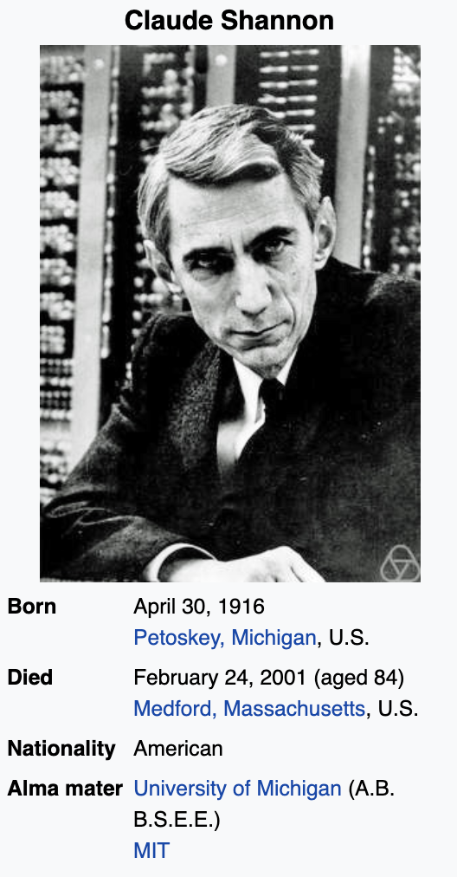
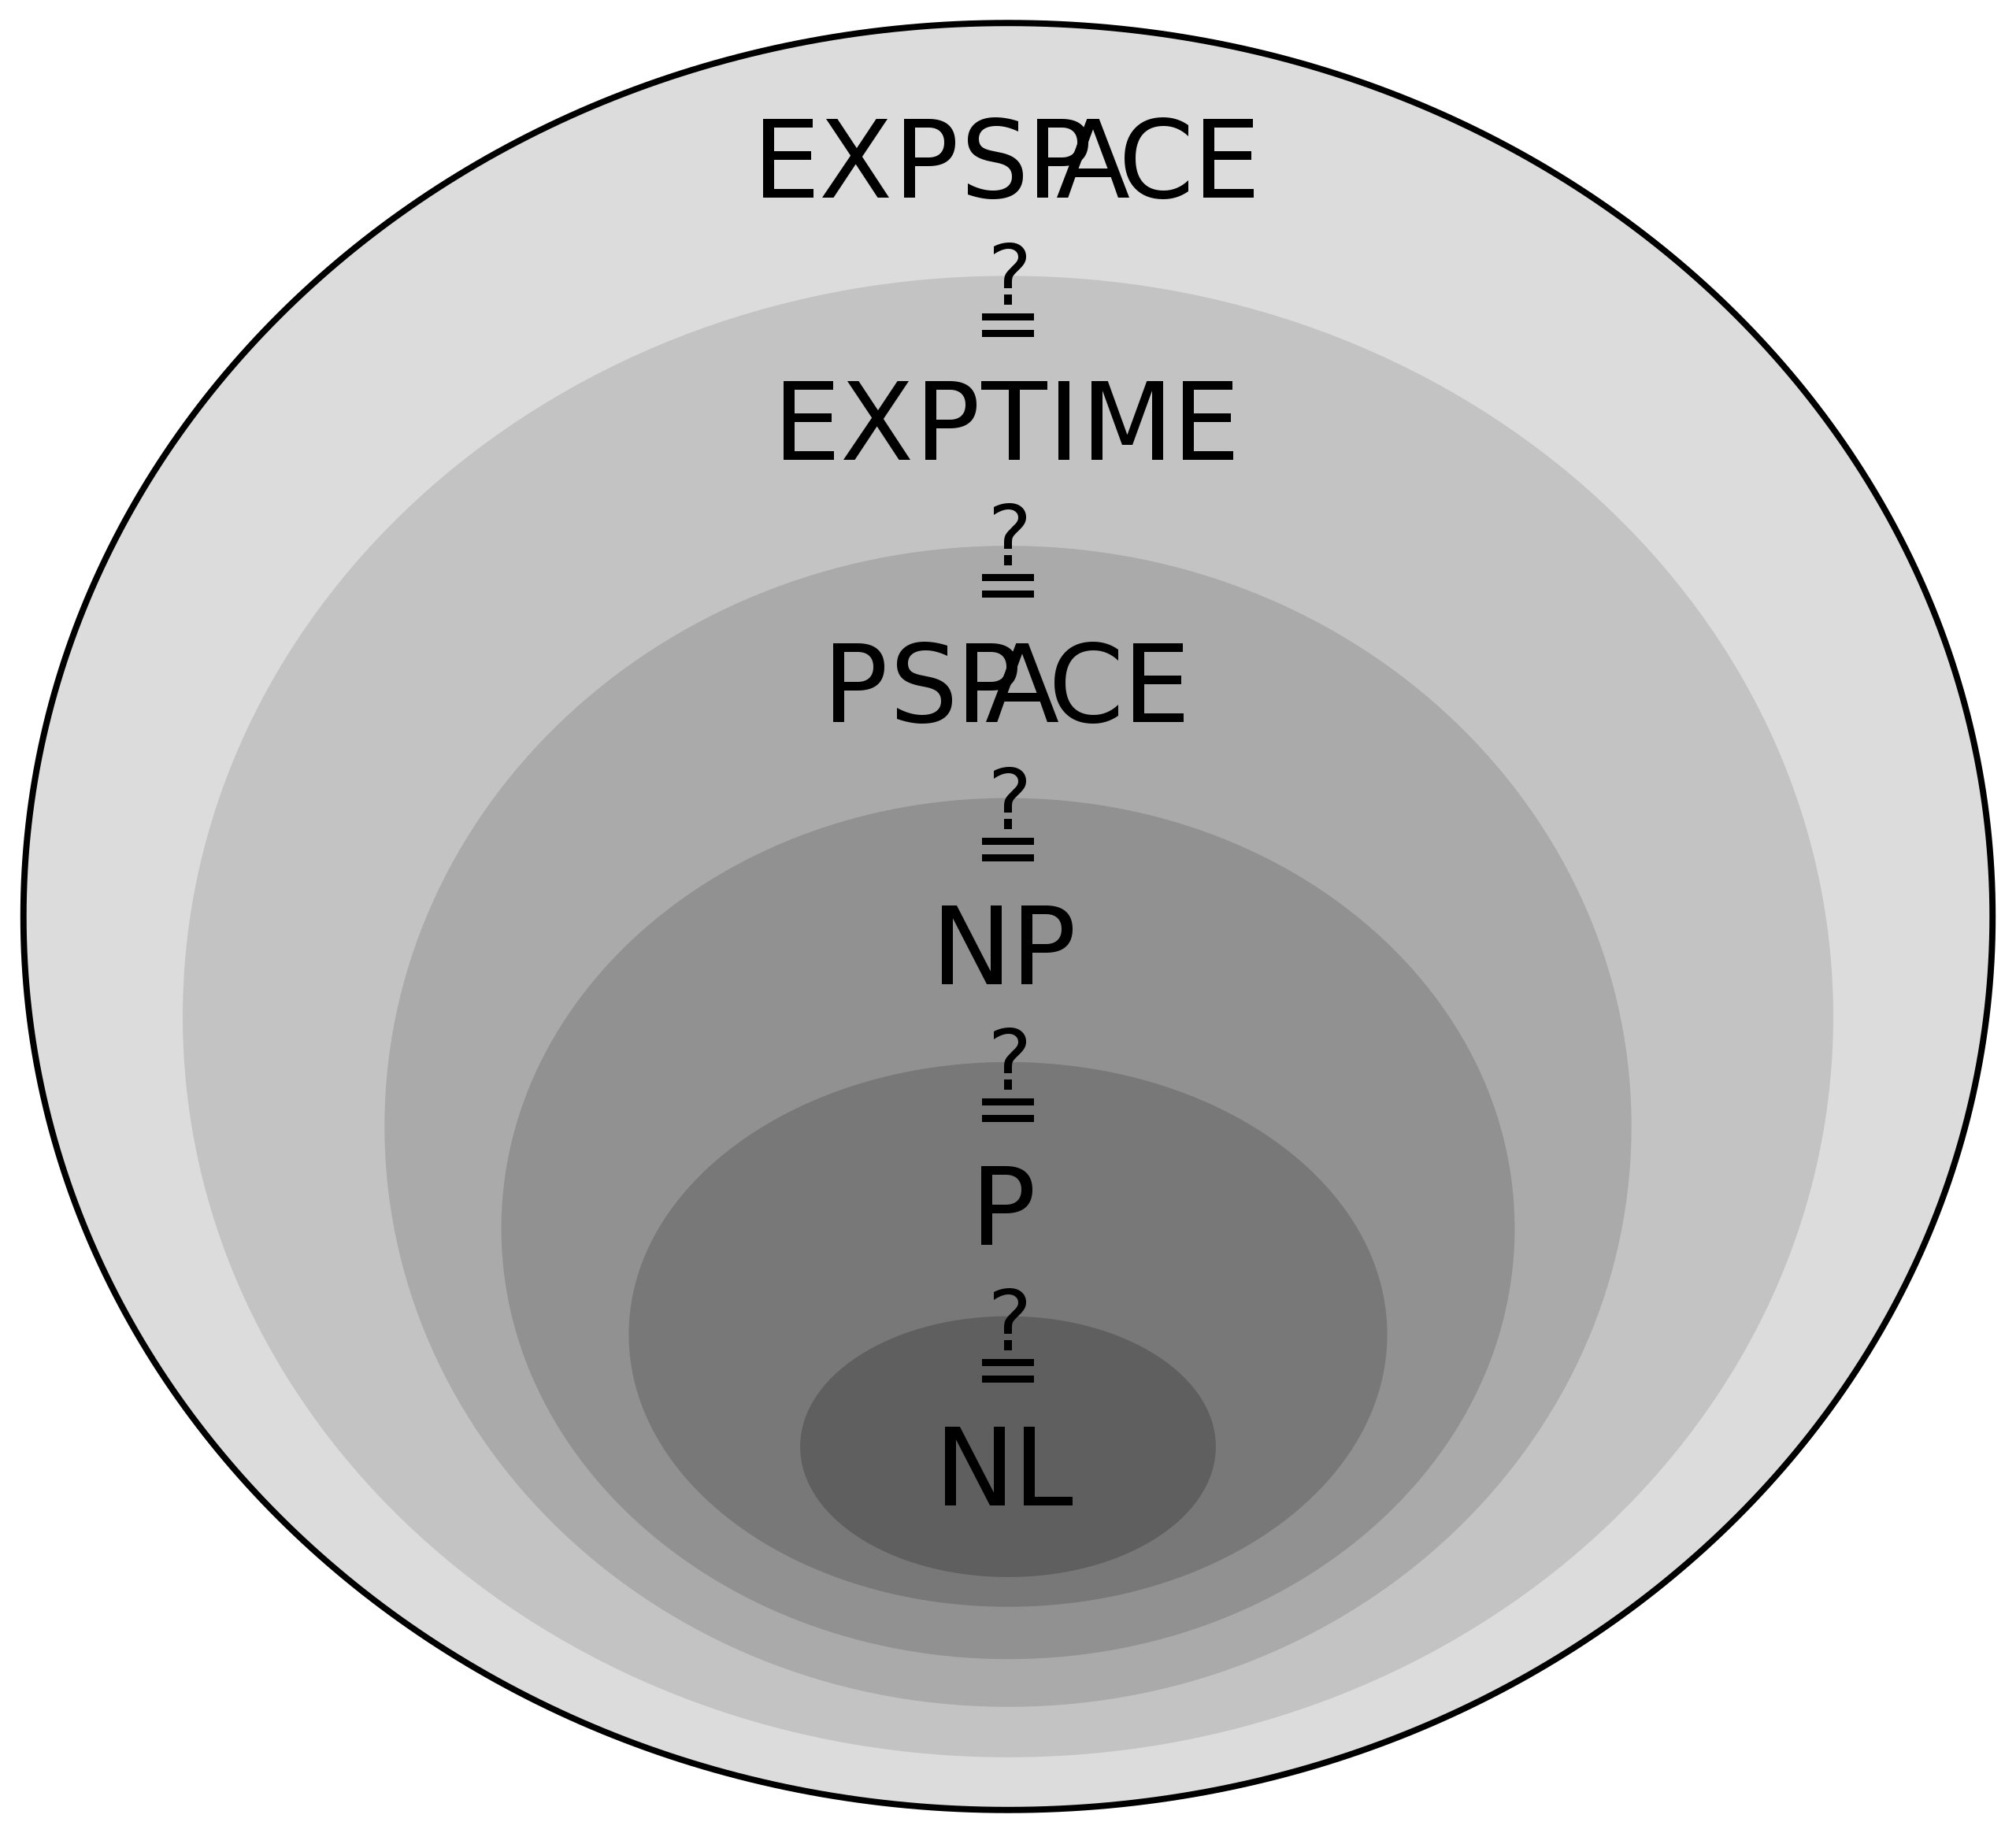
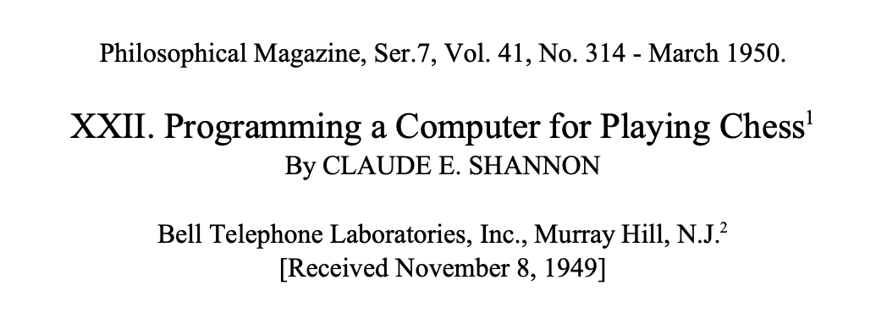
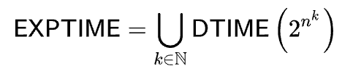

Slight Complication -- Chess
Define Rules
Execute a Search Algorithm
$${10}^{120}$$

Slide 8
Enter Software 2.0

Slide 9
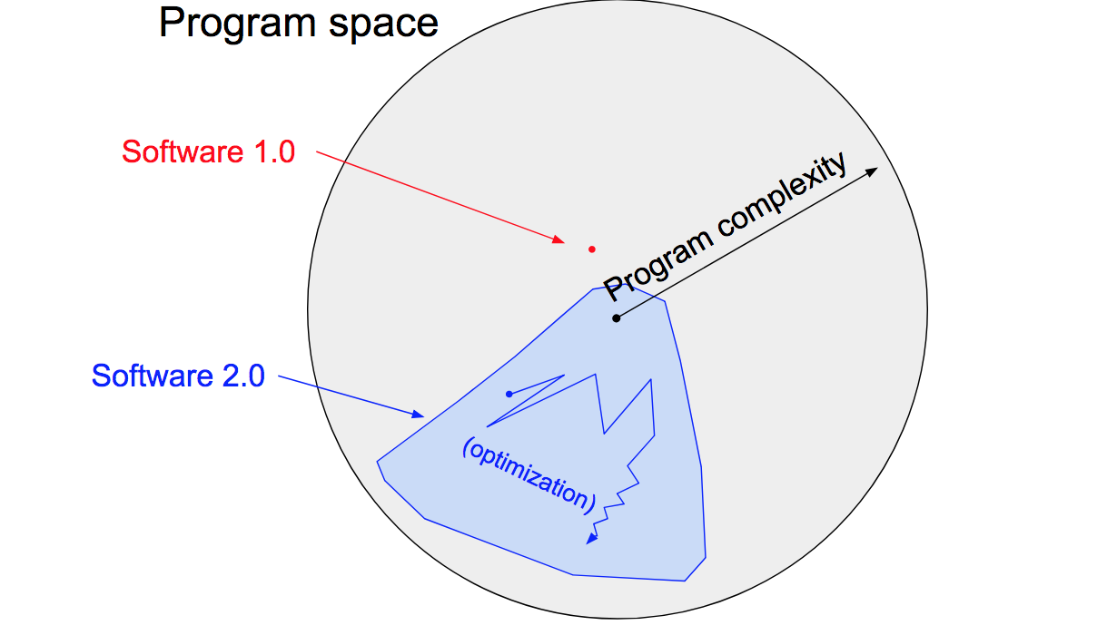
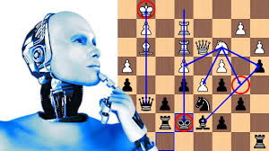
What is Software 2.0?

Slide 10
Modern Artificial Intelligence
Execute Training Cycles
Extract Rules from Data

Slide 11
What is Meaning?

Slide 12
In the past, your source code is your code. In the future, your source code is your data.

Slide 14
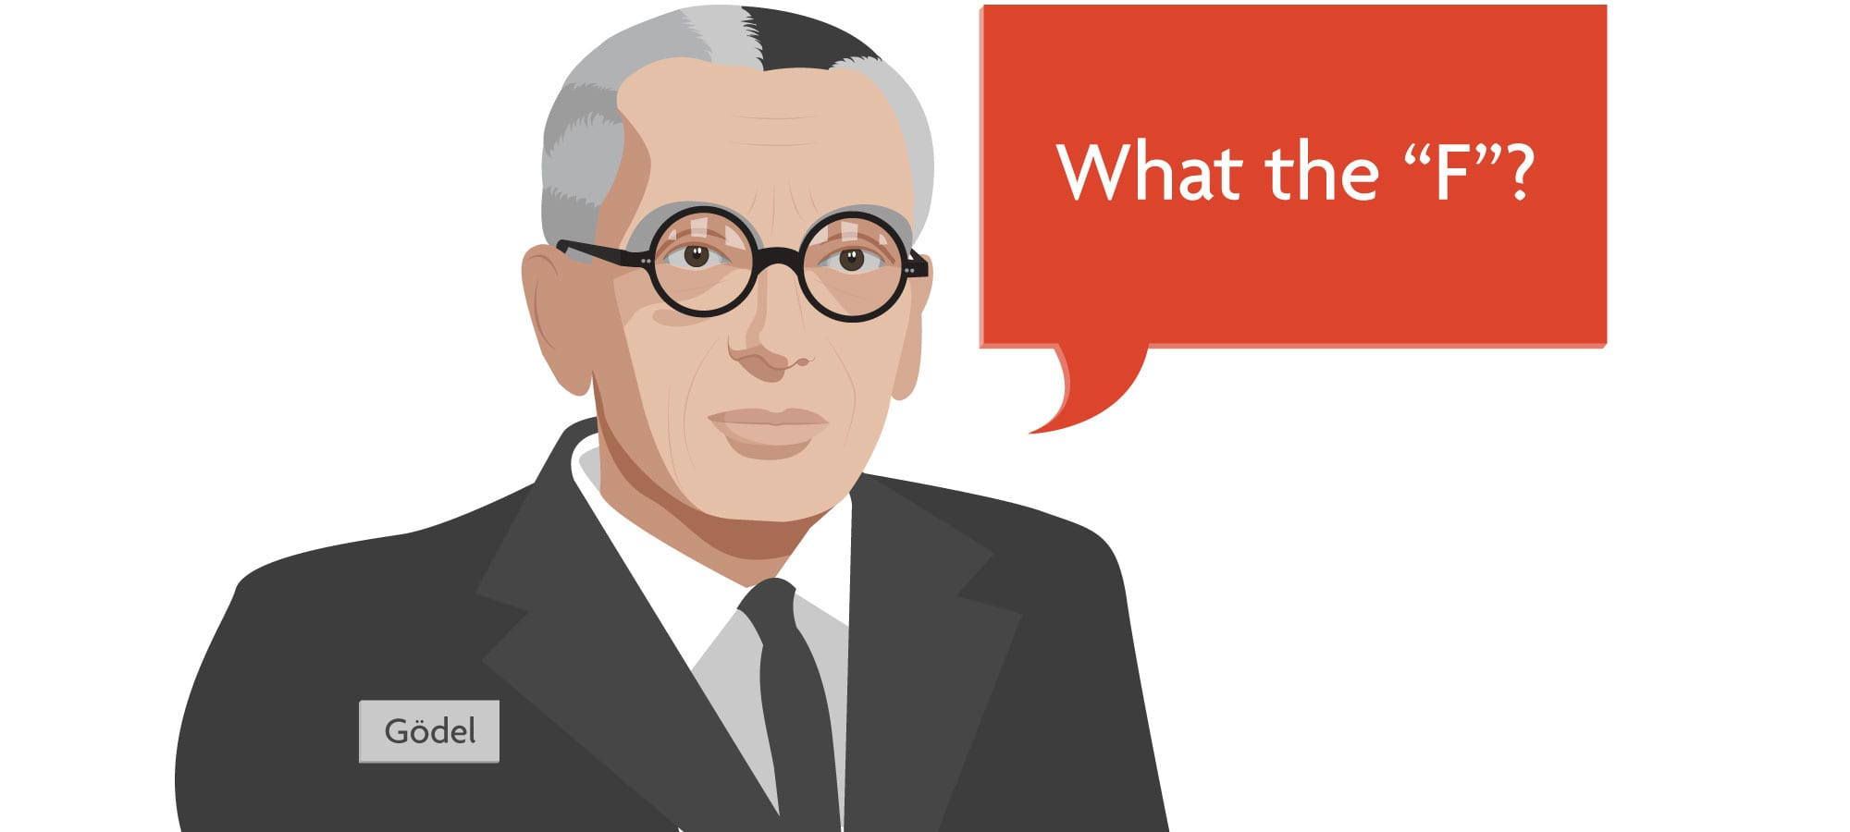
Incompleteness

