Slide 1
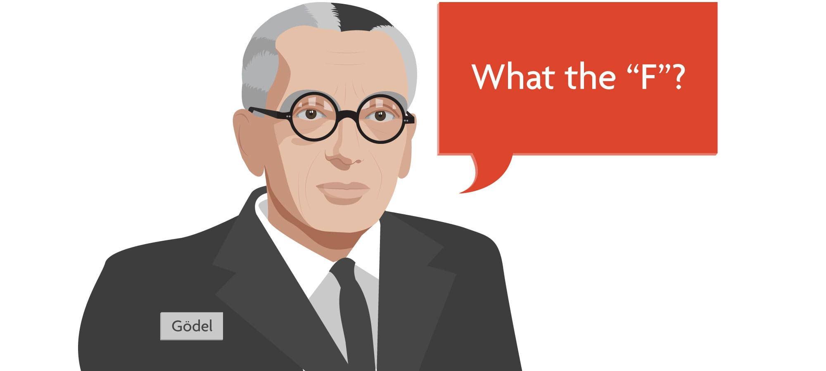
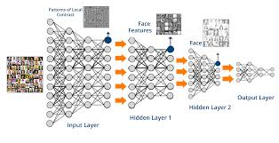
On the Relation between Software 2.0 and Gödel’s Incompleteness Theorems

Slide 2
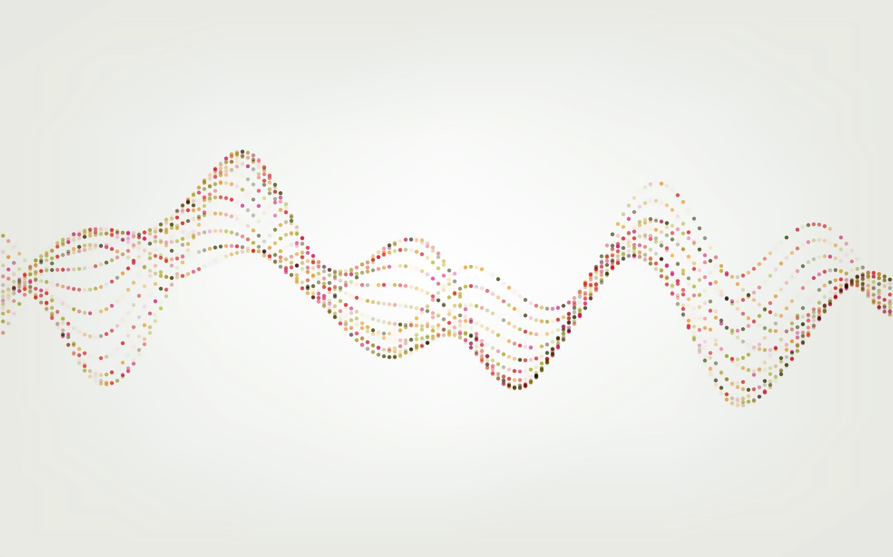
How do we encode information into a computer?

Slide 3
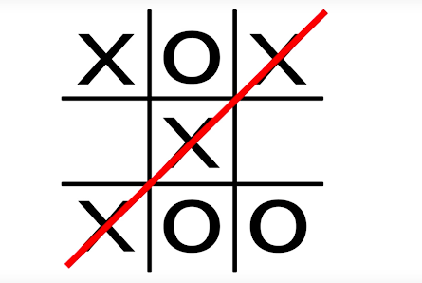
A Simple Case -- Tic-Tac Toe
Define Rules
Execute a Search Algorithm

Slide 4
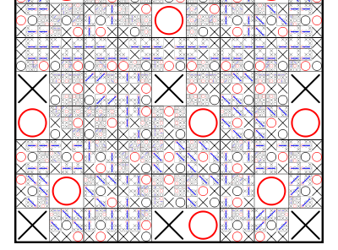
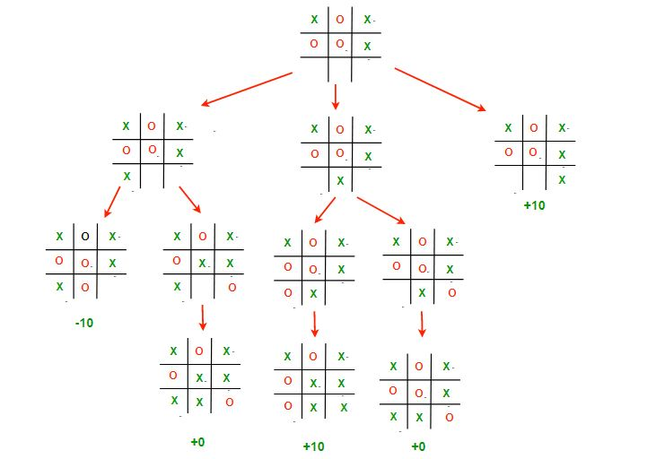
Software 1.0
Tic-Tac Toe

Slide 5
Enter Software 2.0

Slide 6
Incompleteness

