Slide 1
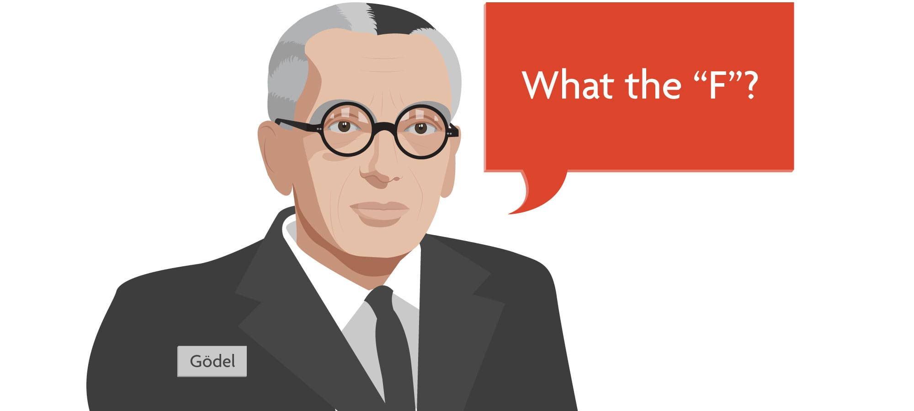
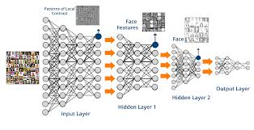
On the Relation between Software 2.0 and Gödel’s Incompleteness Theorems

Slide 2
Software 0 -> 1.X -> 2.0

Slide 3
Incompleteness

