Slide 1
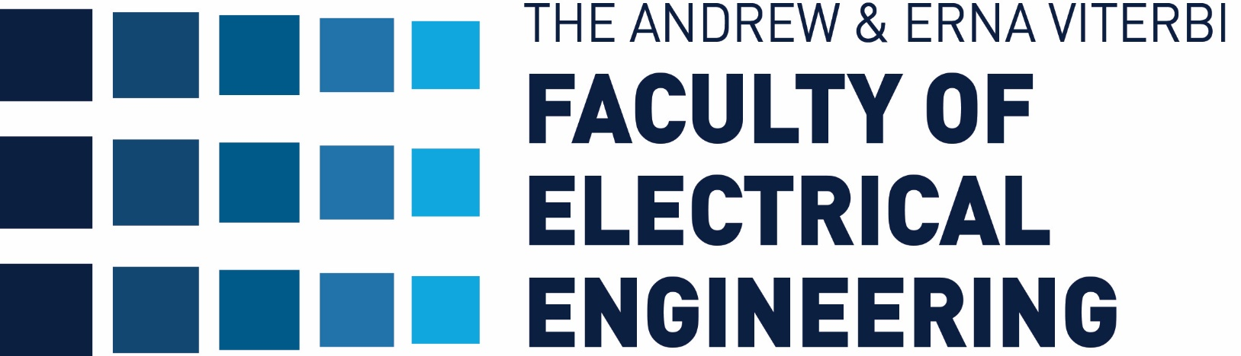



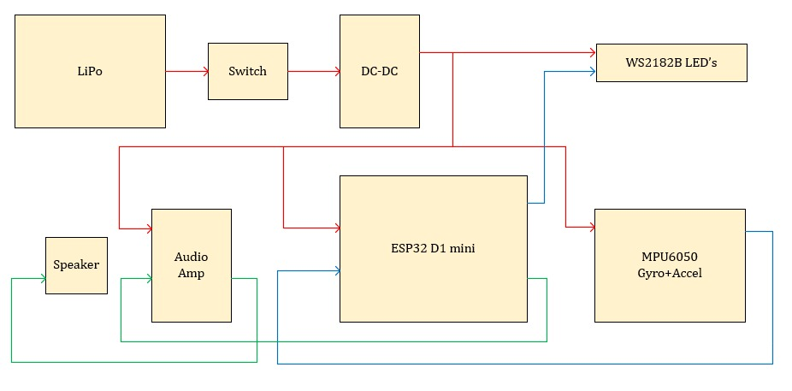
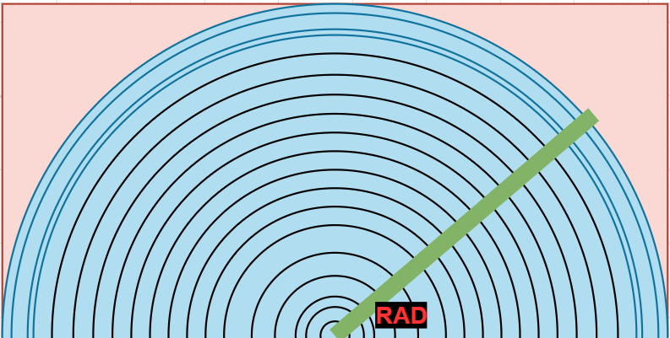
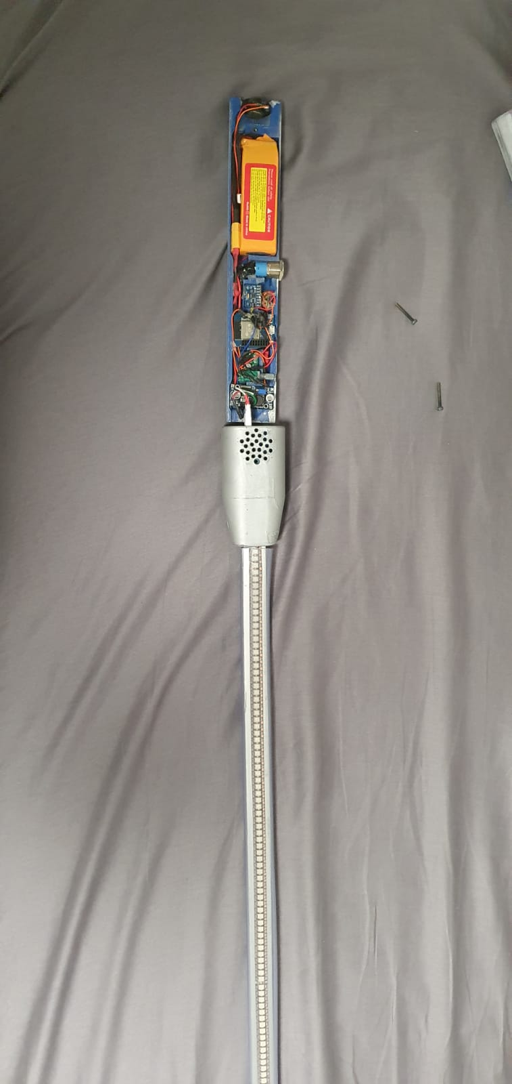
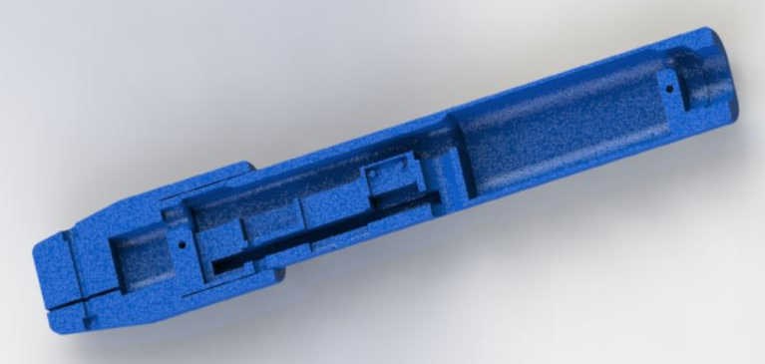
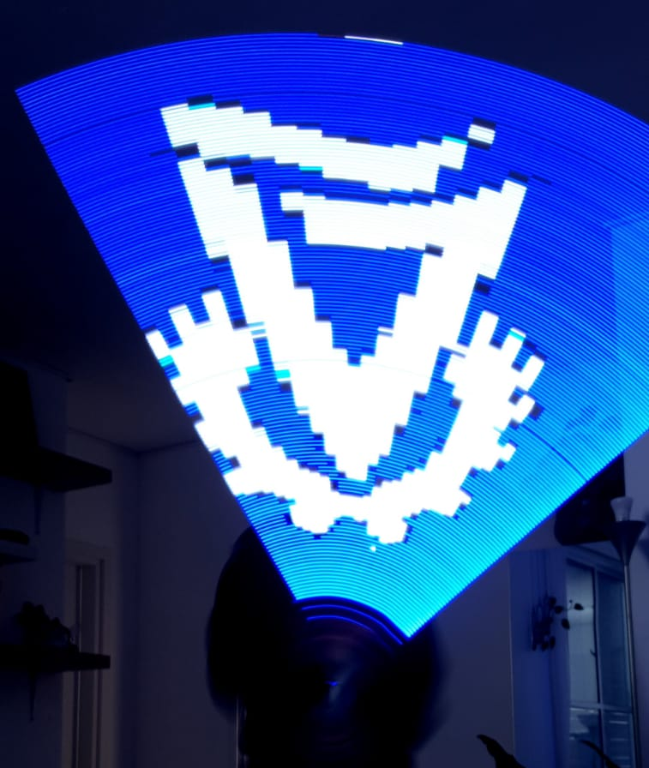
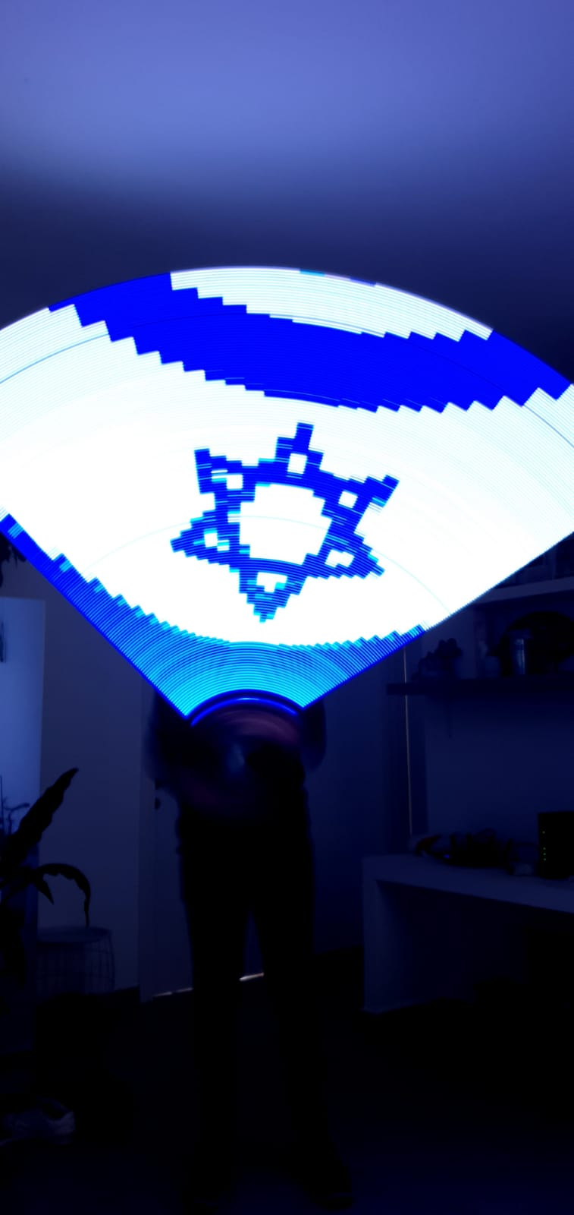
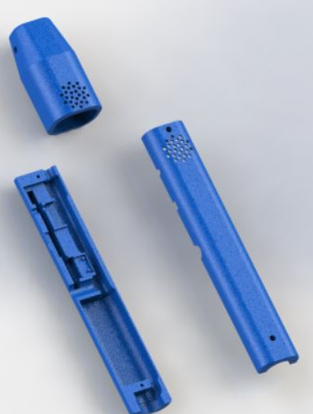
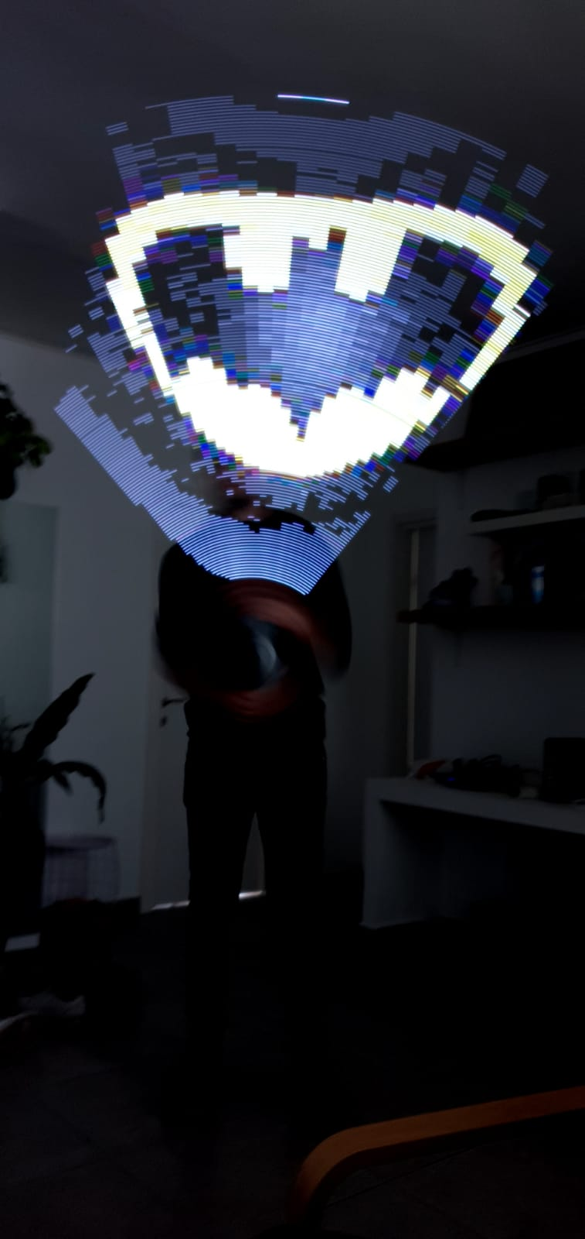
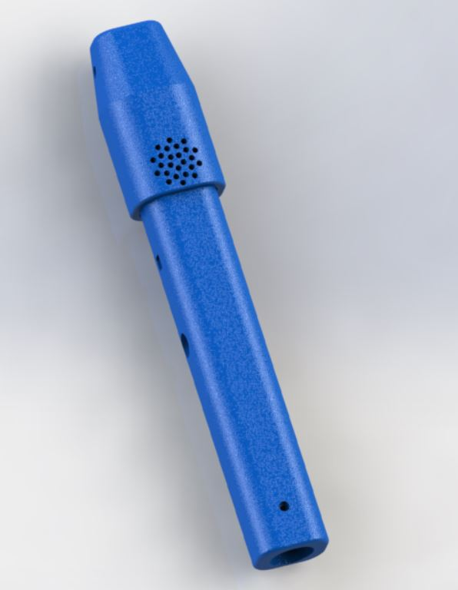
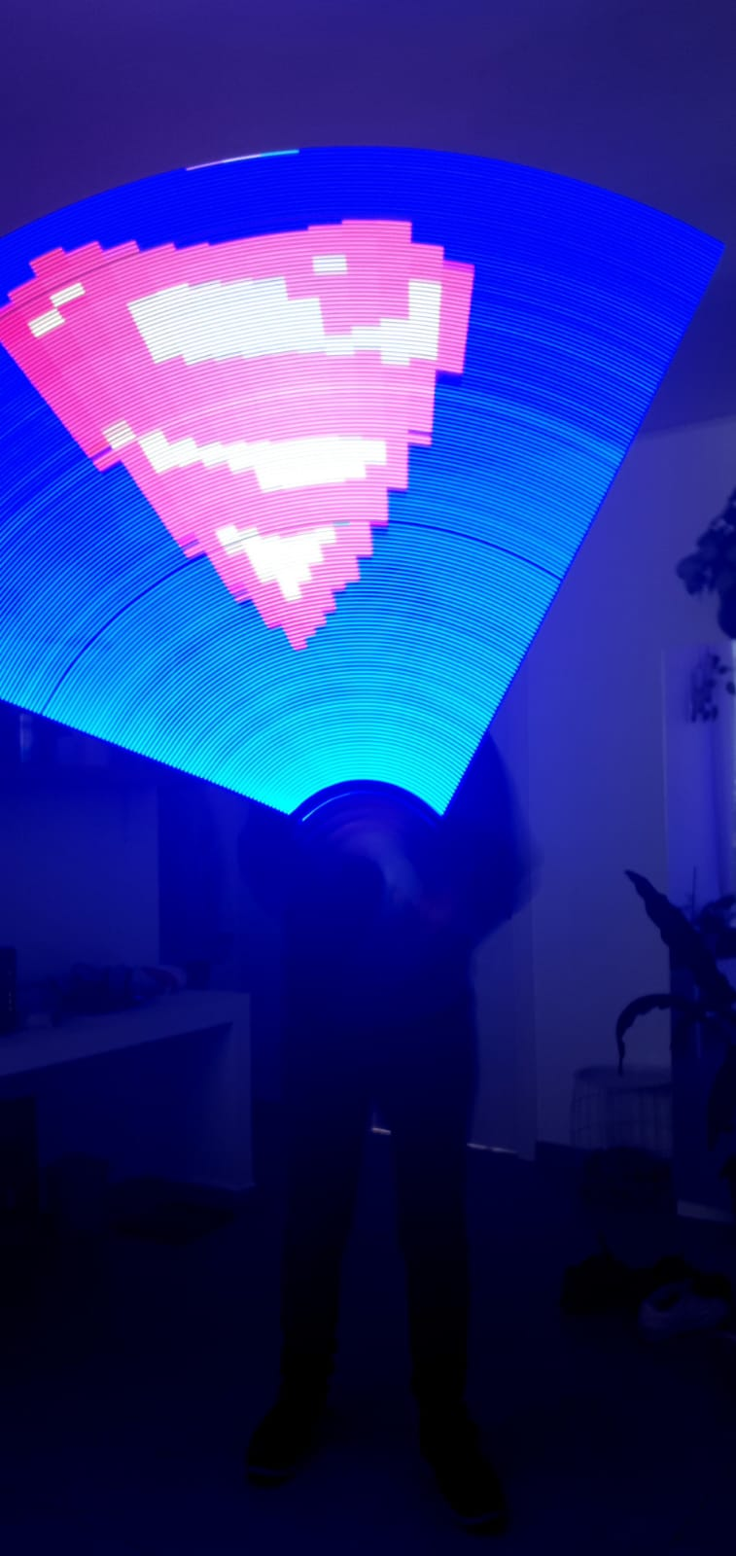

^{Image} ^{Displaying} ^{Sword}
Nathaniel Joseph and Daniel Gutman, Supervised by Koby Kohai
Introduction
Software
Hardware
Persistence of Vision (POV) refers to the optical illusion that occurs when visual perception of an object does not cease for some time after the rays of light proceeding from it have ceased to enter the eye.
The entire film industry is based on POV – this is how a few pictures of a house displayed one after each other can produce a film of a running horse.
Fast execution and easy to operate.
Reading values calculated by the MPU6050 gyroscope and accelerometer in order to estimate the location and angle of the device in 3-axis.
Converting sensor output to radians using the formula $rad=angle∗\frac{π}{180}$ .
Calculating the proper pixels to display from the picture matrix via $\left(pixel_{x}, pixel_{y}\right)=(r∗\cos\left(angle_{rad}\right)+$ $3∗NUMPIXELS, r∗\sin\left(angle_{rad}\right))$
Displaying the corresponding RGB pixels for each LED.
Low cost.
Low power .
Small footprints.
High quality.
Single ESP32 D1 mini controller used to control:
MPU6050 sensor for gyroscope and accelerometer data.
WS2182B LED strip in order to produce the image.
Audio Amplifier for sound.
Custom design with SolidWorks of exterior shell for the device:
Special design for ventilation of battery and DC-DC convertor.
Easy connection to ESP32 controller.
Audio holes for better sound quality.
Easy assembling.
Goals
Produce a picture from a single line of LED’s by moving it swiftly.
Gyroscope and Accelerometer provides input
Computing device angle and pixels to display.
Fast LED display.
Results
Implementation of a LED sword that is based on the Persistence of Vision theory.
Light weight, easy to use product.
Added sound for better user experience.
Easy Image loading, without the need to disassemble the sword.
Able to display any image.
Challenges
No prior experience in IoT.
Coronavirus pandemic.
No suitable solutions in the literature
The Loaded Picture
Conclusions and Future Suggestions
Successful presentation of different complexity and quality of pictures:
Accurate device position detection
High quality display.
Future improvement’s:
App for better picture customization.
Produce audio based on swing direction and speed.
Buttons that enable the user to change sounds and pictures on-demand.
Loaded picture dimension 320*160.
Picture will be in BMP format, 8-bit RGB.
The displayed picture will be a semicircle produced by swinging the sword from side to side.
April 2021

