Slide 1
GoalWise — Critical Design Review
v0.2.0 Integrated Staging Release · Core MVP planning loop
Team: Nati, Vishal, Ashutosh, Thanh
Goal: tell a user whether they are on pace for one near-term savings goal
Design stance: deterministic financial core, AI-free calculations, auditable snapshots
CDR focus: refined design, implementation progress, test strategy, risks, and final plan
CORE STACK
React + Vite
FastAPI
PostgreSQL
Railway
Preparation note: OpenAI Codex assisted with slide drafting, layout generation, and formatting; the team reviewed and owns the content.
GoalWise — Critical Design Review · MSCS 2101 · Aug 22, 2026
1

Slide 2
Since the PDR
Visible changes from preliminary design to detailed design
Requirements
SRS v2.0 review + phased build path made explicit
Frontend
React/Vite workflow integrated with auth, goal, financial inputs, dashboard
Backend
Goal lifecycle, dashboard reads, snapshots, weekly plans, API conventions
Deployment
Railway staging + Caddy same-origin /api proxy for hosted browser behavior
Review
Quality gates + historical findings fed back into implementation work
CDR answer to PDR feedback
The project now has a buildable layered design, multiple accepted ADRs, a real integrated core, and a clear next path for CSV import and AI explain-only work.
GoalWise — Critical Design Review · MSCS 2101 · Aug 22, 2026
2

Slide 3
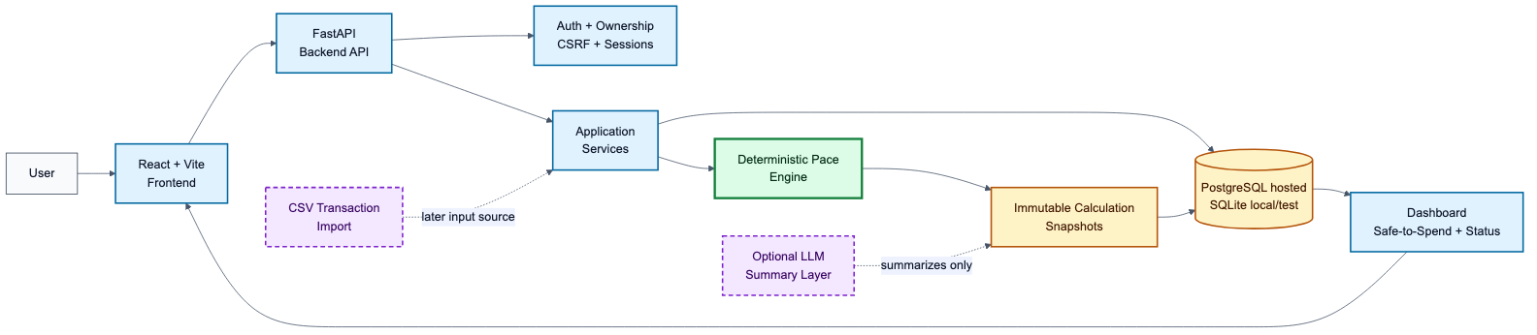
Architecture & Key Decisions
Layered modular monolith with a deterministic financial core
KEY ADRS
ADR-0001
Layered modular monolith
ADR-0002
Deterministic engine; no runtime AI
ADR-0003
Immutable calculation snapshots
ADR-0005
Server sessions + ownership checks
ADR-0008/9
React/Vite + Railway deployment
Defensible trade-off
Build CSV import and AI explanations next, but keep money guidance deterministic, testable, and backend-owned.
GoalWise — Critical Design Review · MSCS 2101 · Aug 22, 2026
3

Slide 4
Detailed Design — Class / Module View
Buildable backend boundaries and core domain objects
FastAPI routers
auth.py
goals.py
financial_inputs.py
dashboard.py
Pydantic schemas
request models
response models
field errors
Services
business rules
ownership checks
recalculation
Repositories
parameterized
SQLAlchemy queries
Database
PostgreSQL
SQLite tests
CORE PERSISTED ENTITIES
User
identity, session owner, time zone
Goal
target, saved amount, dates, status
Financial Profile
starting cash, reserve buffer
Income Source
amount, recurrence, confirmation
Planned Expense
amount, recurrence, category
CALCULATION TRAIL
Calculation Snapshot
append-only pace-v1 inputs and result
Weekly Plan
frozen current-week allowance
Pace Engine
pure deterministic module
GoalWise — Critical Design Review · MSCS 2101 · Aug 22, 2026
4

Slide 5
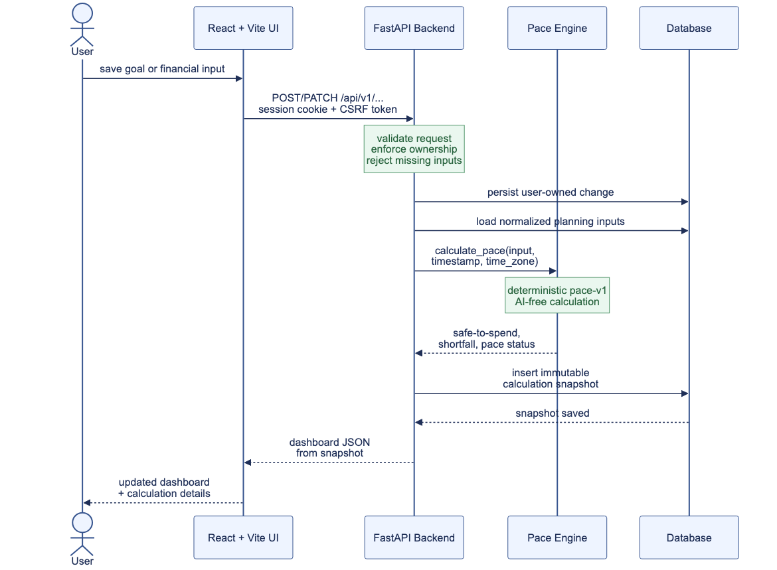
Detailed Design — Sequence
Save input → recalculate → snapshot → dashboard refresh
Key validation
Authenticated session
CSRF on unsafe methods
Server-side ownership checks
Key invariant
The frontend triggers changes, but the backend owns official calculations.
Traceability
Every valid change can create an immutable pace-v1 snapshot.
GoalWise — Critical Design Review · MSCS 2101 · Aug 22, 2026
5

Slide 6
Detailed Design — Data Model
User-owned planning inputs produce immutable calculation history
OWNERSHIP
PLANNING INPUT RECORDS
CALCULATION OUTPUTS
USER
owns every private record
GOAL
target, saved, dates, status
FINANCIAL_PROFILE
cash, date, reserve
PACE-V1
pure deterministic
engine
CALCULATION_SNAPSHOT
immutable input/result record
INCOME_SOURCE
amount, recurrence, confirmation
PLANNED_EXPENSE
amount, recurrence, class
WEEKLY_PLAN
frozen opening allowance
DATA RULES
Money stored as integer cents, never floats
UTC timestamps; local-calendar semantics for date-only values
Every protected row belongs to user_id
Cross-user private resource access returns 404
Snapshot rows are inserted, not mutated
Next demo increments
CSV import adds transaction inputs. AI summaries explain committed snapshot results. Neither replaces pace-v1 as the source of truth.
GoalWise — Critical Design Review · MSCS 2101 · Aug 22, 2026
6

Slide 7
Implementation Progress + Code Review
v0.2.0 integrated staging release
Built now
Auth/session/CSRF, goal lifecycle, manual inputs, pace engine, snapshots, dashboard API, React workflow
Integrated
v0.2.0 hosted staging core; frontend uses same-origin /api proxy
Next
CSV import and AI explain-only layer for the upcoming demo increment
Reviewed
AI-assisted code review + manual SRS workflow checks + CI gates
REVIEW FINDINGS
High: hosted CSRF/cookie behavior
Resolved by Caddy same-origin /api proxy and Railway staging verification.
Medium: API existed before full workflow
Goal archive gap was treated as a spec-conformance issue, not merely a backend task.
GoalWise — Critical Design Review · MSCS 2101 · Aug 22, 2026
7

Slide 8
Test & Verification Strategy
Guarding against the spec-conformance trap
Unit
pace-engine golden tests
format/label utilities
service rules
Integration
API routes
CSRF/session behavior
repository/database tests
CI gates
backend check
frontend check
migration smoke
Docker build
Acceptance
manual staging flow
SRS traceability
review findings
Spec-conformance trap
We verify user-visible workflows, not just code existence. Backend support is not counted complete until the frontend workflow, validation, permissions, and staging behavior are exercised.
AI verification rule
AI can draft code, reviews, diagrams, and checklists. The team owns final decisions, tests, SRS mapping, and security review.
GoalWise — Critical Design Review · MSCS 2101 · Aug 22, 2026
8

Slide 9
Risks, Schedule, and Plan to Final
Active risk management for the final push
Scope creep
Add CSV and AI as bounded next increments without moving calculation out of pace-v1
Deployment drift
Use Railway staging, Caddy /api proxy, health checks, and env-var review
Calculation trust
Protect deterministic engine with golden tests, integer cents, snapshots, formula version
UX completeness
Streamline the UI, reduce friction, improve intuitive flow, and preserve demo path stability
REMAINING WORK
Finalize CDR feedback → streamline UI → security pass → broaden acceptance testing → prepare final demo and release notes.
Team status: on track, with CSV import and AI summaries positioned as demo increments on top of the verified core.
GoalWise — Critical Design Review · MSCS 2101 · Aug 22, 2026
9

