Slide 1
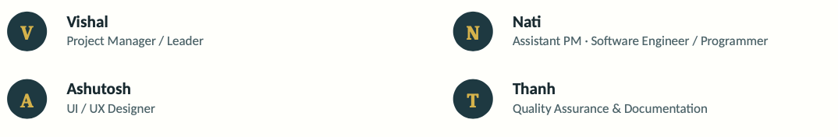
GoalWise
Goal-oriented budgeting that tells you what's safe to spend — this week.
MSCS 2101 Software Engineering • Group 3
TEAM 3

Slide 2
THE PROBLEM AND OUR SOLUTION

Slide 3
Weekly guesswork vs. one honest number
THE PROBLEM
Budgeting apps organize around spending categories and last
month's report card.
Someone saving for one near-term goal is left doing manual
math: “What can I actually spend this week without missing
my goal?”
Worse, uncertain or unconfirmed income is often counted at
face value — producing false confidence.
OUR SOLUTION
GoalWise turns cash, confirmed income, planned expenses, a
reserve buffer, and time-to-goal into one conservative weekly
Safe-to-Spend amount.
It recalculates automatically whenever the inputs change,
and it always explains why the number moved.
Deterministic, versioned, and testable — never a black box.
+ Confirmed Income
− Planned Expenses
− Reserve Buffer
Current Cash
Weekly Safe-to-Spend

Slide 4
VISION & COMPETITIVE analysis

Slide 5
VISION
Empower users to achieve financial goals through goal-driven budgeting.
Success looks like:
• Meet savings goals consistently
• Automatic weekly safe-to-spend updates
• Real-time goal progress
• Less manual budgeting
Feature | GoalWise | YNAB | Monarch
Goal-based budgeting | ✓ | ✓ | ✓
Weekly recalculation | ✓ Auto | Manual | Limited
Forward-looking | ✓ | Partial | Partial
Recurring expenses | ✓ | ✓ | ✓
Goal progress | Real-time | ✓ | ✓

Slide 6
USER FLOW
Start
↓
Enter Income & Recurring Expenses
↓
Create Savings Goal
↓
Calculate Safe-to-Spend
↓
Record/Upload Spending
↓
Recalculate Weekly Pace
↓
Display Updated Progress
↓
End

Slide 7
Technical Approach

Slide 8
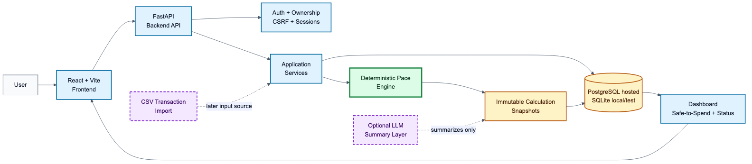
System ARCHITECTURE

Slide 9
Decisions
AI Boundary​
​
AI may summarize deterministic results later​
AI may assist transaction classification later​
AI never calculates or overrides safe-to-spend​
Pace engine remains deterministic and testable​
Technical Stack
React + Vite frontend
FastAPI backend with REST /api/v1
SQLAlchemy + Alembic persistence
PostgreSQL on Railway
Argon2id auth, HTTP-only sessions, CSRF
Mermaid ADR/spec documentation

Slide 10
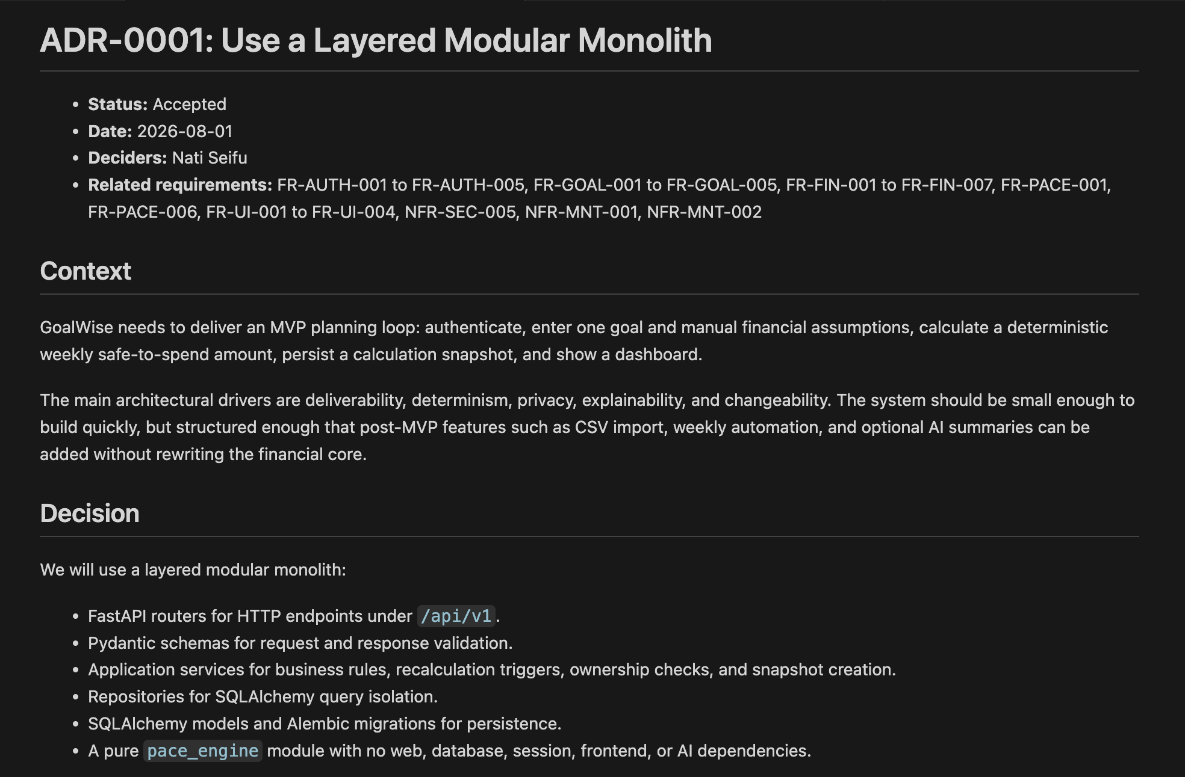
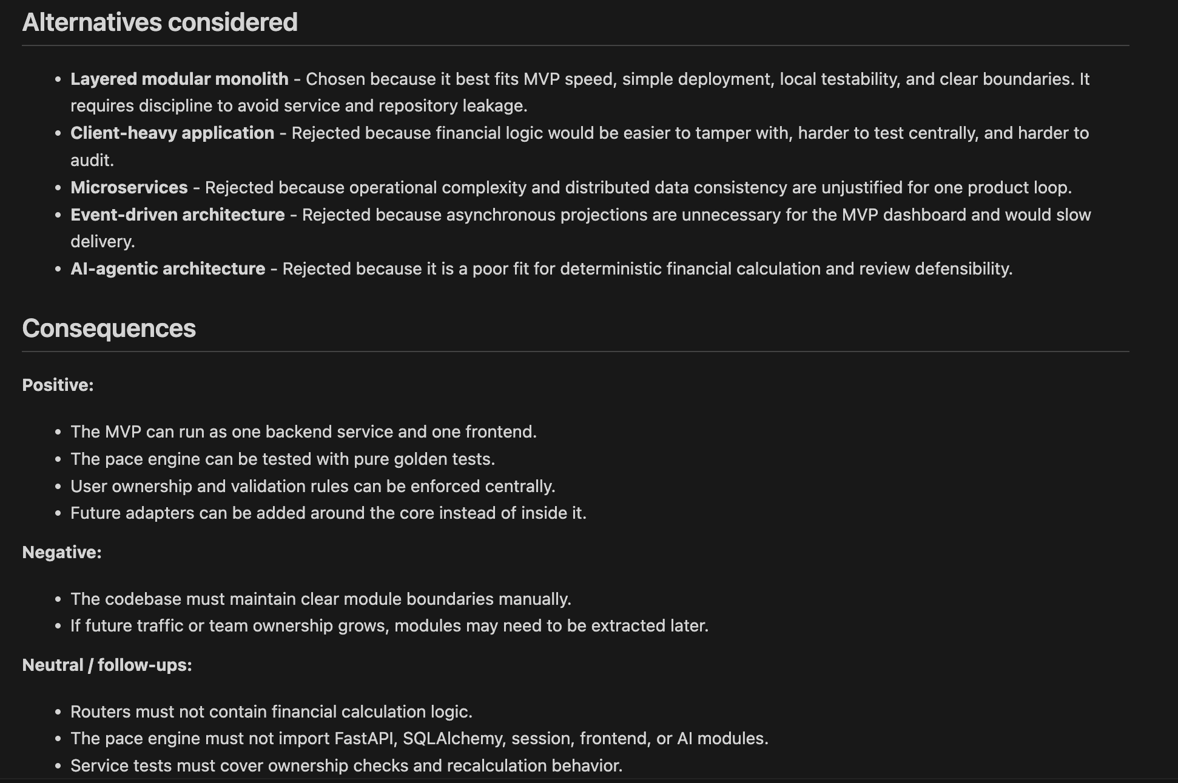
ADR-0001

Slide 11
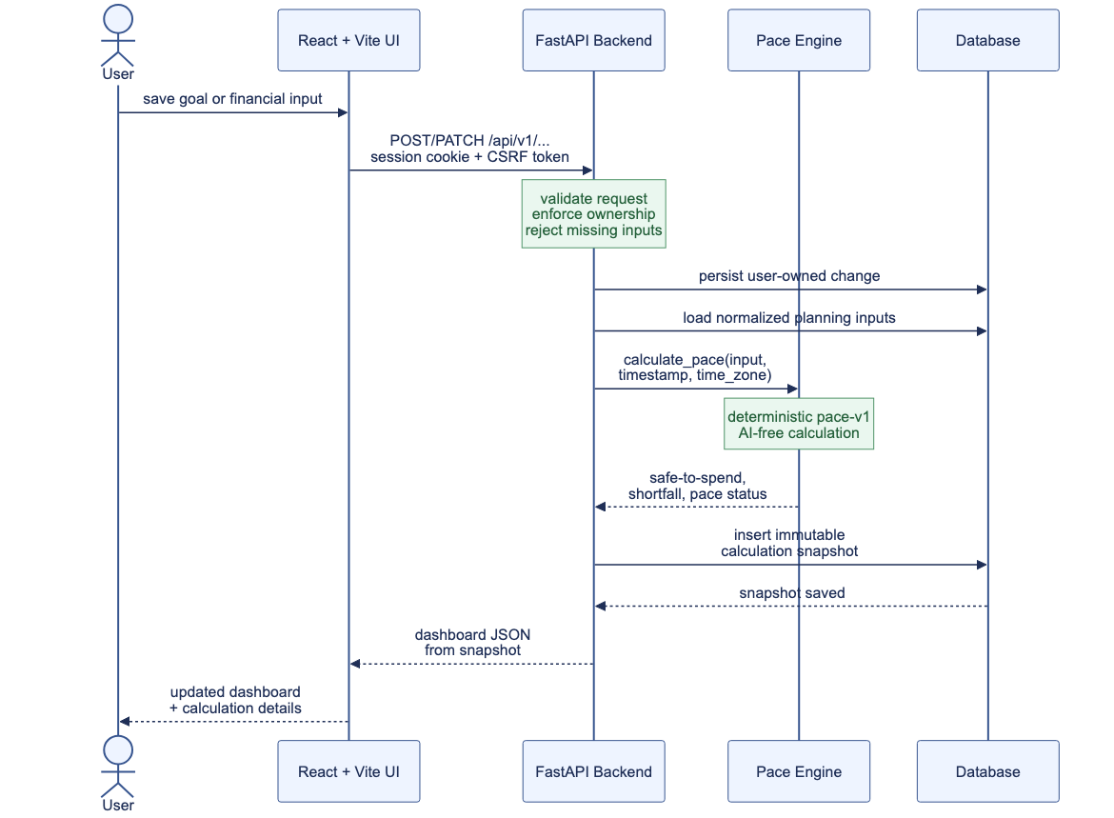
Sequence DIAGRAM
"Set a financial goal"

Slide 12
Challenges, Risks and NEXT STEPS

Slide 13
PRACTICAL CHALLENGES
UNREALISTIC EXPECTATION: Overly Optimistic Safe-to-Spend Calculation
Income:
  Overestimates income
  Relies on uncertain income in the total income calculation (freelance projects)
Expense:
  Underestimate expenses
  Lack of understanding about unpredictable expenses (medical bills, urgent household equipment repairs, car tune-up, etc)
USER INPUT INCORRECT DATA & LOW ENGAGEMENT
Missing incomes/expenses, incorrect amounts & not entering enough data
PRIVACY AND SECURITY BREACHES
Personal finance data (volume and category)
Financial behavior exposure (habit of spending, invest/withdraw routine,…)
SOFTWARE CALCULATION BUGS

Slide 14
Mitigation strategy (1)
UNREALISTIC EXPECTATION: Overly Optimistic Safe-to-Spend Calculation
Rely heavily on predictable income and underestimate uncertain income (commission, bonuses, freelance,…)
Use % conservative reserve buffer (set safety margin)
Display how recommendations are made (saving analysis)
Real-time update (or weekly update) per new entries
NEXT STEPS:
Test against predefined financial scenarios
User sets the safety margin according to average %
Reduce the use of AI in recommendation; focus on if-then rules
Weekly goals notice feature

Slide 15
Mitigation strategy (2)
USER INPUT INCORRECT DATA & LOW ENGAGEMENT
Verify steps after data entry (review)
Reuse past data for auto-fill (during entry) & verification (after entry)
NEXT STEPS:
Validation feature from the user (feedback) for important requirements

Slide 16
Mitigation strategy (3)
PRIVACY AND SECURITY BREACHES
User authentication is required for entry/edit, view, and extract data/report/recommendation from software
User confirmation for any suggestion/recommendation from software
No AI/automation besides suggestion/financial plan assumption
NEXT STEPS:
User information allowance policy
Two-step authentication sign-in
Password rules

Slide 17
Mitigation strategy (4)
SOFTWARE CALCULATION BUGS
Code review & automated cross-test (using multiple AI)
Adjust predefined financial scenario testing
NEXT STEPS:
AI agent selection criteria
Build predefined financial scenario testing

Slide 18

Q&A
Panel discussion session

