Slide 1

207
COFFEE QUALITY INTELLIGENCE
Cupping Records
Machine Learning
for Coffee Grading
5
ML Models
99.5%
Roast Accuracy
Predicting quality · Classifying roast levels · Detecting defects · Segmenting flavors
87%
Defect Accuracy
2025 | Ethiopian Coffee Analysis
Notes:
Welcome. This presentation covers the full suite of ML models built to automate and standardize coffee quality assessment. We have 5 models spanning regression, computer vision, and clustering.

Slide 2






What We'll Cover Today
1
2
Project Overview
Model 1 — Quality Scorer
Dataset, motivation & exploratory analysis
Linear Regression & XGBoost on sensory scores
3
4
Model 2 — Roast Classifier
Model 3 — Defect Detector
MobileNetV2 CNN · 4 roast levels · 99.5% accuracy
MobileNetV2 CNN · 9 defect classes · 87% accuracy
5
6
Flavor Clustering
Ethiopian Focus
K-Means unsupervised segmentation into 4 profiles
Regional quality benchmarking for top Ethiopian origins
Notes:
Quick agenda overview. Six sections. We'll move through each model's purpose, architecture, training, and results.

Slide 3
Project Overview — Dataset & Motivation
Three datasets power our five models:
207
1,600
1,260
CQI Cupping Records
Roast Level Images
Defect Images
13 sensory features · Ethiopian & global origins
Target: Total Cup Points (78–89.3, mean 83.71)
224×224 px · 4 classes: Dark, Green, Light, Medium
1,200 train · 400 validation/test
224×224 px · 9 defect categories
1,005 train · 123 val · 132 test
Why ML? Manual cupping is subjective, time-consuming, and hard to scale. These models bring consistency and speed to specialty coffee grading.
Notes:
Quick dataset context. CQI = Coffee Quality Institute. Images sourced from Kaggle. The regression model uses the 207-row CQI dataset; both CNNs use image datasets.

Slide 4
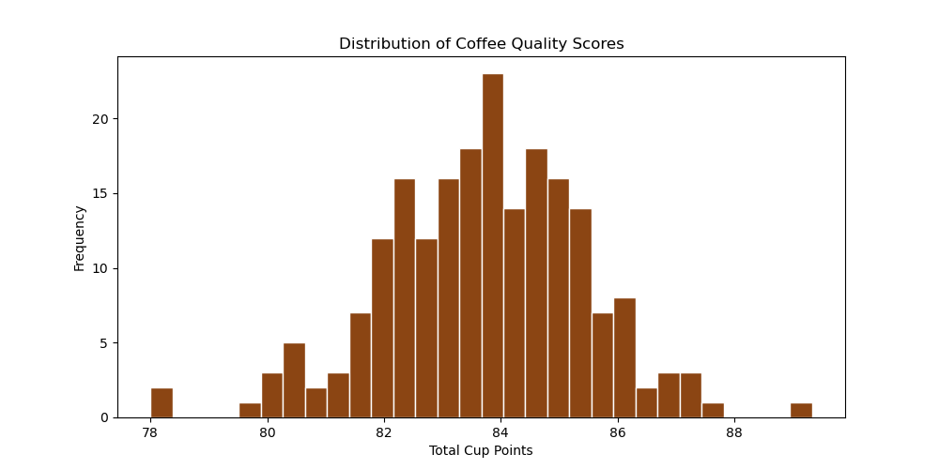
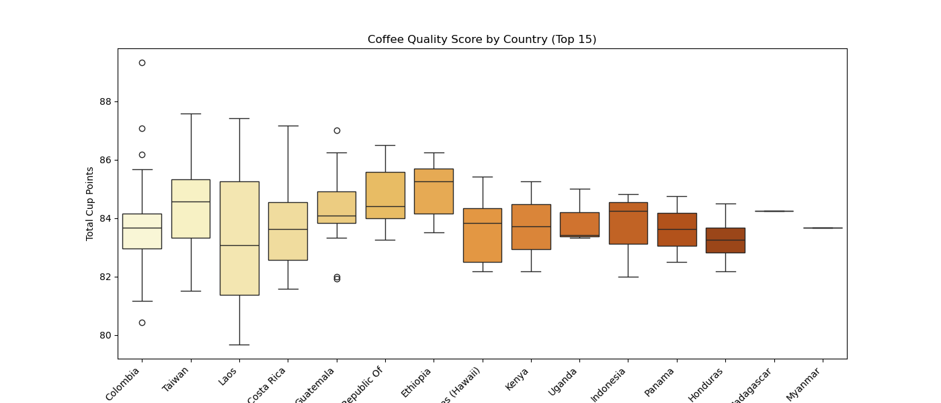
Exploratory Analysis — Score Distribution
Total Cup Points range 78–89.3, mean 83.71
Score Distribution
Quality by Country (Top 15)
Key Insights
Bell-shaped distribution centered at 83–84 pts — typical specialty range
Taiwan and Ethiopia lead on median score; Colombia shows widest variance
All samples exceed the 80-point SCA Specialty Grade threshold
Notes:
The score distribution is fairly normal. Important to note — every sample scores above specialty grade (80+). Ethiopia is in the top tier globally.

Slide 5
MODEL 1
Coffee Quality
Scorer
Linear Regression & XGBoost on 13 sensory features
Predicting Total Cup Points (R² = 0.994)
Notes:
Model 1 is about predicting the numeric quality score from cupping sub-scores. This is a regression task. We tested two models.

Slide 6
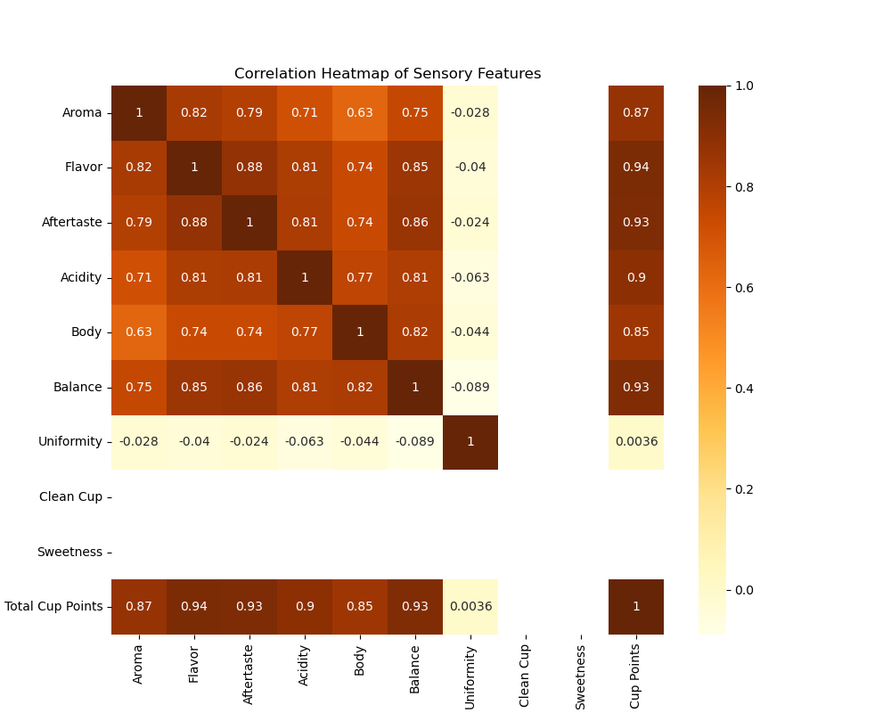
Model 1 — Feature Correlation Analysis
Strongest Predictors of Total Cup Points
Flavor
r = 0.94
Aftertaste
r = 0.93
Balance
r = 0.93
Aroma
r = 0.87
Acidity
r = 0.90
Body
r = 0.85
Note: Uniformity, Clean Cup & Sweetness show near-zero variance — minimal predictive value.
Notes:
The heatmap clearly shows the sensory sub-scores are highly inter-correlated and strongly correlated with TCP. This near-linear structure is why Linear Regression ends up outperforming XGBoost.

Slide 7
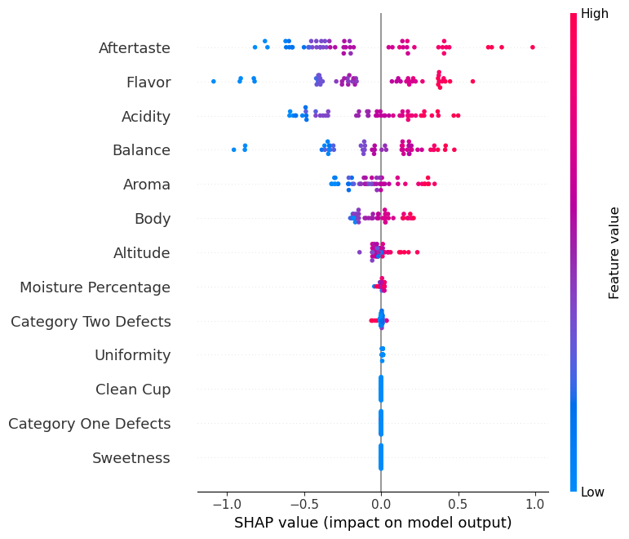

Model 1 — Results: Linear Regression vs XGBoost
Metric | Linear Regression | XGBoost (Tuned)
Test RMSE | 0.128 ✓ | 0.341
Test R² | 0.994 ✓ | 0.960
Train R² | 0.996 | 0.999
CV R² Mean | 0.992 ± 0.007 ✓ | 0.958 ± 0.015
Recommended Model: Linear Regression
Best generalization (Test R² 0.994), near-zero error (RMSE 0.128), and full interpretability. XGBoost overfits on this small dataset.
SHAP Feature Importance
Notes:
Linear Regression wins here because the cupping score structure is inherently additive. XGBoost can't find non-linearities that help more than the linear signal, and overfits with only 207 rows. SHAP on the right shows Aftertaste and Flavor dominate.

Slide 8
MODEL 2
Roast Level
Classifier
MobileNetV2 Transfer Learning · 4 Classes · 1,600 Images
Test Accuracy: 99.5%
Notes:
Model 2 switches to computer vision — classifying roast level from a bean photo. Four classes: Dark, Green (unroasted), Light, Medium.

Slide 9
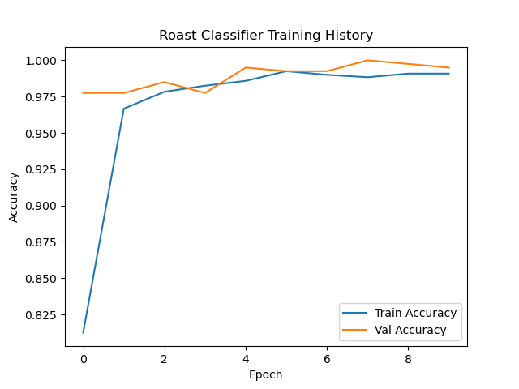
Model 2 — Architecture & Training History
MobileNetV2 + custom head · Adam · Categorical Cross-Entropy
MobileNetV2
(ImageNet frozen)
Global Avg
Pooling2D
Dense(128)
ReLU
Dense(4)
Softmax
→
→
→
Training Specs
Training images:
1,200
Val / Test images:
400
Epochs:
10
Batch size:
32
Best Val Accuracy:
100% (Epoch 8)
Final Val Accuracy:
99.50%
Final Val Loss:
0.0174
Training Accuracy over 10 Epochs
Notes:
The model converges incredibly fast — 97.75% val accuracy by Epoch 1 — because ImageNet features transfer very well to coffee bean images. Peak of 100% at Epoch 8.

Slide 10
Model 2 — Classification Results
Class | Precision | Recall | F1-Score | Support
Dark | 1.00 | 0.99 | 0.99 | 100
Green | 1.00 | 1.00 | 1.00 | 100
Light | 1.00 | 0.99 | 0.99 | 100
Medium | 0.98 | 1.00 | 0.99 | 100
OVERALL | 1.00 | 0.99 | 0.99 | 400
99.5%
100%
Test Accuracy
Best Val Acc
400 images
Epoch 8
Only 2
0.0174
Confusion Matrix Summary
Misclassified
Final Val Loss
1 Dark→Medium | 1 Light→Medium | 398 / 400 perfectly classified
out of 400
The model is production-ready for automated visual roast grading.
Notes:
Near-perfect. Only 2 misclassifications out of 400. Both were boundary cases between adjacent roast levels (Dark and Light confused with Medium). Completely production-ready.

Slide 11
MODEL 3
Defect
Detector
MobileNetV2 Transfer Learning · 9 Defect Classes · 1,260 Images
Test Accuracy: 87% · Deployed with EarlyStopping
Notes:
The hardest model — 9 classes with significant class imbalance. This maps directly to SCA primary and secondary defect grading.

Slide 12
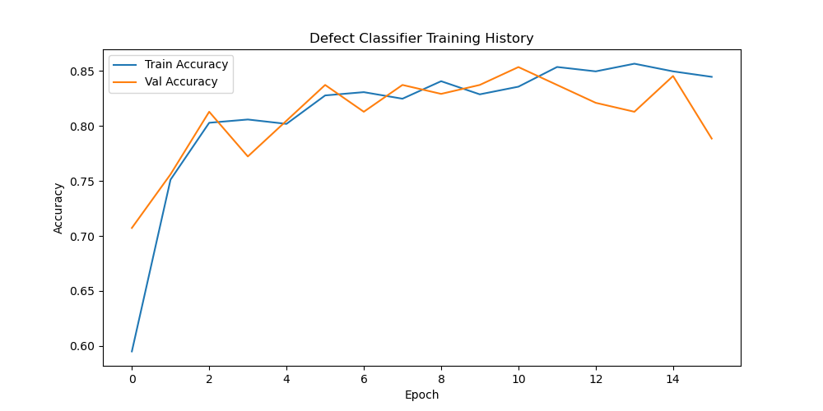
Model 3 — Defect Classes & Training
9-class CNN · MobileNetV2 + Dropout(0.3) · EarlyStopping (patience=5)
black
broken
foreign
Fermentation/drying
Fractured beans
Non-coffee matter
fraghusk
green
husk
Husk fragments
Unripe/underdeveloped
Dried fruit skin
immature
infested
sour
Pale underdeveloped
Insect damage (CBB)
Fermented/discolored
Training History (16 epochs)
Best Val Accuracy
85.37% at Epoch 11
Final Test Accuracy: 87%
Notes:
9 classes is significantly harder. Class imbalance is the key challenge — sour has only 3 test samples. The model uses Dropout to regularize and EarlyStopping to prevent overfitting.

Slide 13

Model 3 — Classification Report
Class | Precision | Recall | F1 | Support
black | 0.81 | 0.90 | 0.85 | 29
broken | 0.91 | 1.00 | 0.95 | 21
foreign | 0.97 | 0.94 | 0.95 | 31
fraghusk | 0.92 | 1.00 | 0.96 | 12
green | 0.38 | 0.43 | 0.40 | 7 ⚠
husk | 1.00 | 0.80 | 0.89 | 5 ⚠
immature | 1.00 | 0.25 | 0.40 | 4 ⚠
infested | 0.90 | 0.95 | 0.93 | 20
sour | 0.00 | 0.00 | 0.00 | 3 ⚠
ACCURACY | — | — | 0.87 | 132
Strong classes (F1 ≥ 0.85)
broken, foreign, fraghusk, infested
All high-support classes perform well
Low-support classes (⚠)
green, husk, immature, sour
Need more training samples
Overall Accuracy
87% weighted F1: 0.86
Notes:
The story here is class imbalance. Classes with 20–31 samples perform great. Classes with 3–7 samples struggle — sour gets 0% because we only have 3 test samples. More data collection is the top priority.

Slide 14
SUPPLEMENTARY
K-Means Flavor
Clustering
Unsupervised segmentation into 4 distinct flavor profiles
Aroma · Flavor · Acidity · Body · Balance
Notes:
Unsupervised clustering reveals natural groupings in the sensory space — useful for market segmentation and blending.

Slide 15
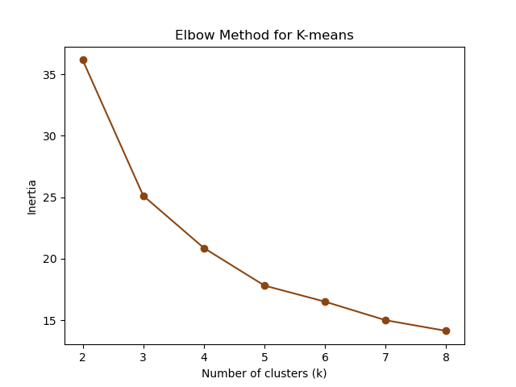
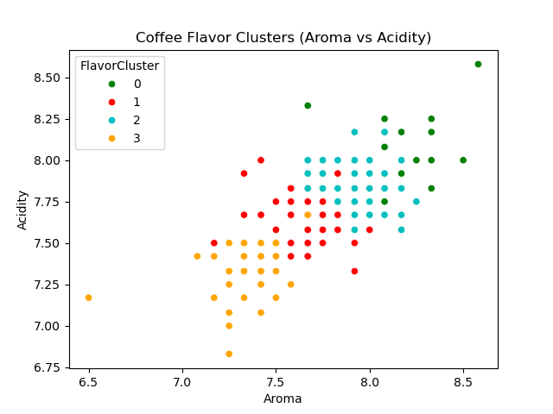
K-Means — 4 Flavor Clusters
Elbow method confirmed k=4 · Final inertia: 20.88
Elbow Method → k=4
Aroma vs Acidity (colored by cluster)
Cluster 0 — Bright & Floral
Cluster 1 — Earthy & Full-bodied
Aroma 8.17 · Flavor 8.19 · Highest quality tier
Aroma 7.64 · Flavor 7.67 · Rich bold profiles
Cluster 2 — Balanced & Sweet
Cluster 3 — Mild & Neutral
Aroma 7.89 · Flavor 7.92 · Mid-range balanced
Aroma 7.35 · Flavor 7.35 · Entry-level specialty
Notes:
4 clusters give a clean separation. Cluster 0 is the premium tier — high on all dimensions. Cluster 3 is still specialty grade but on the lower end. Useful for pricing strategy and blending decisions.

Slide 16
ETHIOPIAN FOCUS
Regional Quality
Analysis
Applying the quality scorer to Ethiopian origins
Guji · OROMIA · Sidama · and more
Notes:
Ethiopia-specific deep-dive. We apply the trained regression model to score and compare Ethiopian regional coffees.

Slide 17
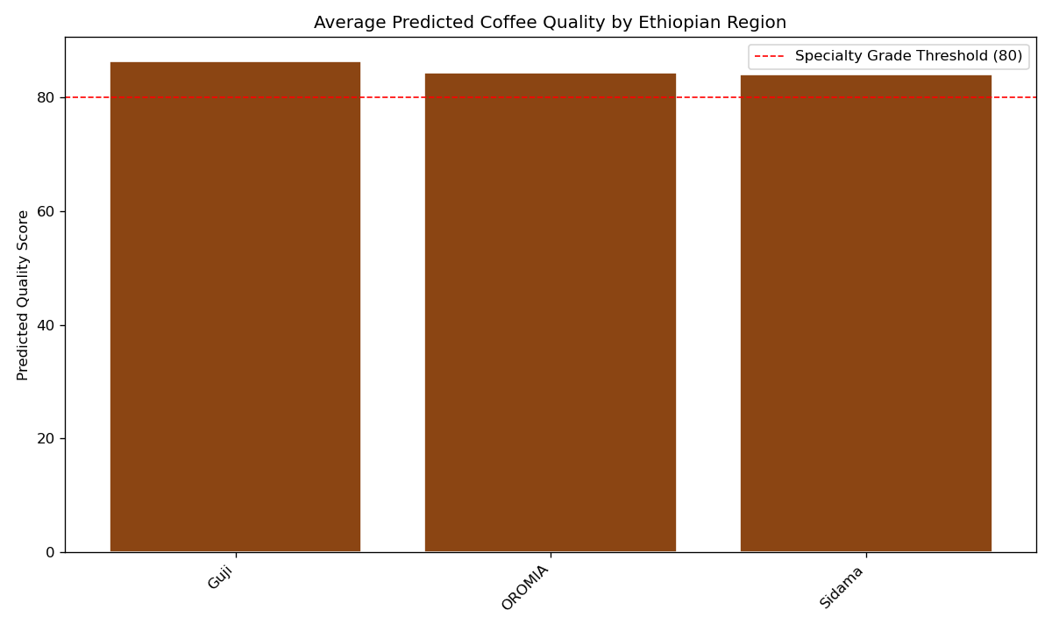
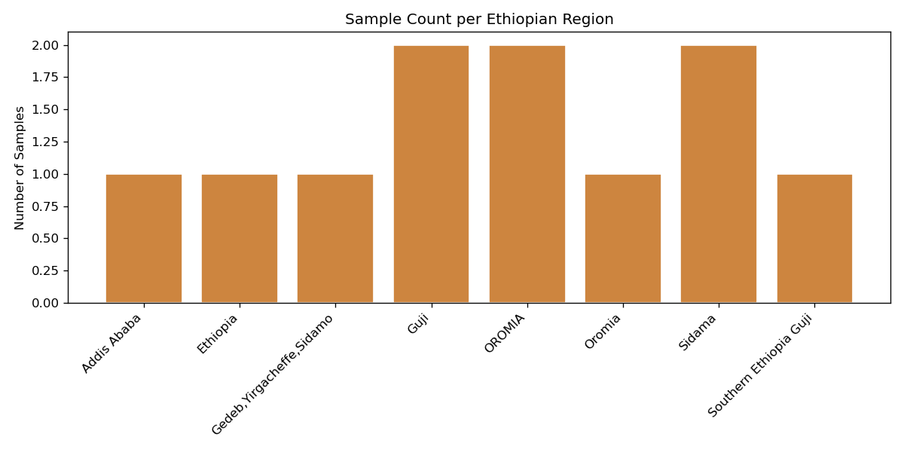
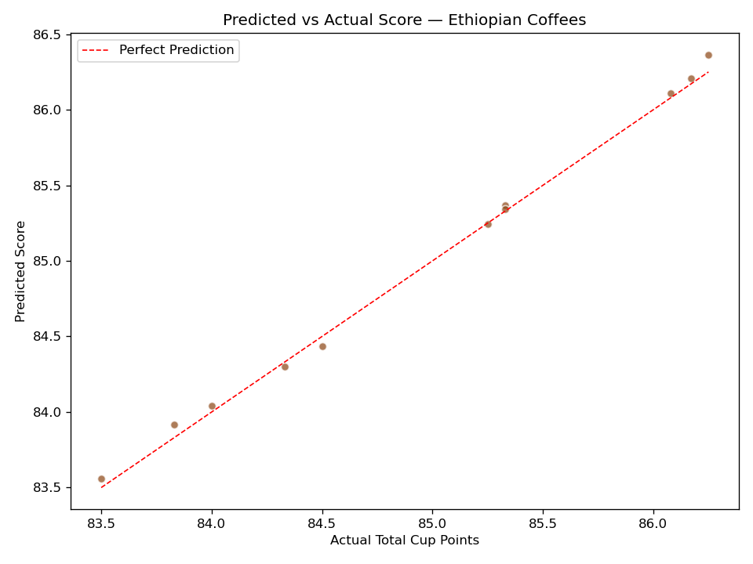
Ethiopian Coffee — Regional Quality Analysis
All regions exceed SCA Specialty Grade threshold (80 pts)
Samples per Region
Avg Predicted Score by Region
Regional Findings
Guji leads with highest avg predicted score (~86 pts)
All 3 major regions comfortably above 80-pt specialty threshold
Predicted vs. Actual shows excellent model alignment for Ethiopian lots
Predicted vs Actual Score
Notes:
Guji comes out on top, consistent with its market reputation for floral, fruit-forward profiles. The tight predicted-vs-actual scatter confirms the model generalizes well to Ethiopian coffees specifically.

Slide 18
Summary — All Models at a Glance
Model | Type | Task | Key Result | Status
Quality Scorer (LR) | Regression | Predict Cup Score | R² = 0.994, RMSE 0.128 | ✓ Production Ready
Quality Scorer (XGB) | Regression | Predict Cup Score | R² = 0.960, RMSE 0.341 | Needs more data
Roast Classifier | CNN (4-class) | Identify Roast Level | 99.5% accuracy | ✓ Production Ready
Defect Detector | CNN (9-class) | Classify Bean Defect | 87% accuracy | Improve minority classes
Flavor Clustering | Unsupervised | Market Segmentation | 4 clean clusters | ✓ Deployed
2 of 5
99.5%
0.994
Production-Ready Models
Best Classification Accuracy
Best Regression R²
Roast Classifier
Linear Regression
Notes:
Quick summary. Three models are production-ready now. The XGBoost scorer would benefit from more data, and the defect detector needs more samples for low-support classes.

Slide 19
Limitations & Recommended Next Steps
⚠ Current Limitations
🔜 Short-Term
Only 207 cupping samples — XGBoost overfits
Defect minority classes (sour, immature) have <5 test samples
Ethiopian regional analysis: 1–2 samples per region only
MobileNetV2 backbone is frozen — fine-tuning could help
Collect 100+ images per low-support defect class
Fine-tune MobileNetV2 top layers for both image models
Ensemble LR + XGBoost via stacking
Add processing method as a regression feature
📈 Medium-Term
🚀 Long-Term
Expand Ethiopian dataset: 20+ samples per region
Build interactive SHAP dashboard for quality explanation
Add altitude and harvest year as model features
Multi-modal pipeline: images + sensory scores combined
Deploy REST API for cupping lab software integration
Continuous learning as new cupping data accumulates
Notes:
Honest about limitations. The core constraint is data — more samples will unlock better performance for XGBoost and the defect detector. The architecture choices are solid.

Slide 20
Thank You
Coffee Quality Intelligence — ML Project
0.994
99.5%
87%
4
Quality R²
Roast Acc.
Defect Acc.
Flavor Clusters
Questions?
Notes:
Closing slide. Summarize: 5 models, 3 production-ready, clear roadmap. Open for questions.

