Slide 1
Chapter 1: Introduction

Slide 2
Chapter 1: Introduction
What Operating Systems Do
Computer-System Organization
Computer-System Architecture
Operating-System Structure
Operating-System Operations
Process Management
Memory Management
Storage Management
Protection and Security
Kernel Data Structures
Computing Environments
Open-Source Operating Systems

Slide 3
Objectives
To describe the basic organization of computer systems
To provide a grand tour of the major components of operating systems
To give an overview of the many types of computing environments

Slide 4
What is an Operating System?
A program that acts as an intermediary between a user of a computer and the computer hardware
Operating system goals:
Execute user programs and make solving user problems easier.
Convenience vs efficiency as goals distinguish OS types:
Make the computer system convenient to use (UI) (Mobiles)
Use the computer hardware in an efficient manner across multiple simultaneous users (Mainframes)
Easy to use (UI) and efficient hardware usage to achieve quick response times (PCs)

Slide 5
What is an Operating System?
A program that acts as an intermediary between a user of a computer and the computer hardware

Slide 6
What Operating Systems Do
Depends on the point of view
PC Users want convenience, ease of use and good performance
Don’t care about resource utilization
Shared computers such as mainframes or minicomputers must keep all users happy
Users of dedicated systems such as workstations have dedicated resources but frequently use shared resources from servers
Handheld computers are resource poor, optimized for usability and battery life
Some computers have little or no user interface, such as embedded computers in devices and automobiles (this is changing rapidly with IoT+)

Slide 7
Operating System Task List
Provide the environment in which programs are executed
Optimize computer resources by supporting multiprogramming and multitasking
Limit the ability of concurrently running jobs to affect one another
Ensure reasonable response time.
Protect computer resources from inappropriate use.
Provide mechanisms for job synchronization and communication
Prevent job deadlock

Slide 8
Computer System Structure
Computer system can be divided into four components:
Hardware – provides basic computing resources
CPU, memory, I/O devices
Operating system
Controls and coordinates use of hardware among various applications and users
Application programs – define the ways in which the system resources are used to solve the computing problems of the users
Word processors, compilers, web browsers, database systems, video games
Users
People, machines, other computers

Slide 9
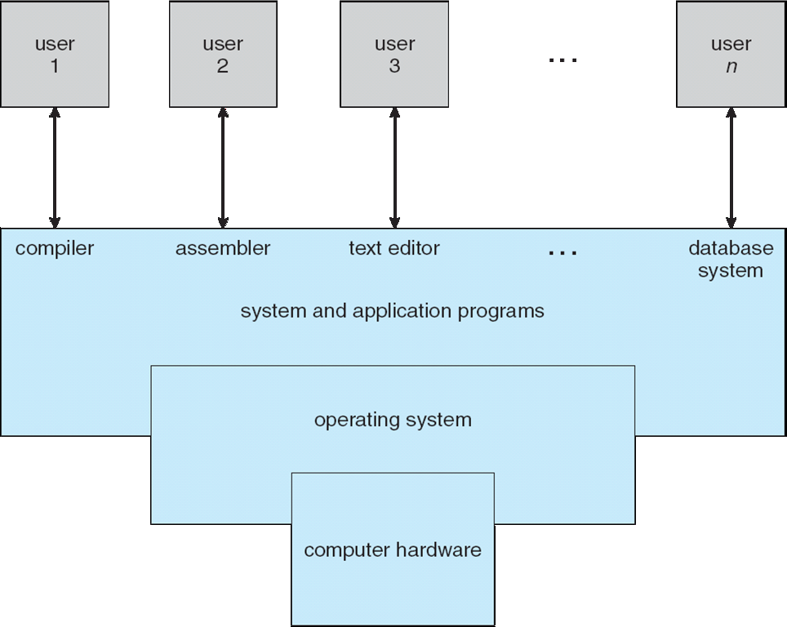
Four Components of a Computer System

Slide 10
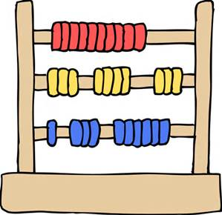

Four Components of a Computer System
User 1
User 2
User 3
…
User n
Web Browser!!
Text Editor
Photo Editor
Database
System and Application Programs
OPERATING SYSTEM
COMPUTER HARDWARE

Slide 11
An Operating System as a Market Barrier?
User 1
User 2
User 3
…
User n
System & Application Programs
Text Editor
Photo Editor
Database
OPERATING SYSTEM
Web Browser!!
COMPUTER HARDWARE
Notes:
In 1998 Microsoft was challenged when it included its web browser as part of its Operating System.
It was viewed as an inhibitor to competition.
Today, both Android and IoS provide robust middleware frameworks that provide access to complex functionality (multimedia, database, graphics, etc.) to application developers.

Slide 12
Operating System Definition
OS is a resource allocator
Manages all resources
CPU time
Memory Space
File Storage Space
I/O Devices
Decides between conflicting requests for efficient and fair resource use
OS is a control program
Controls execution of programs to prevent errors and improper use of the computer’s I/O devices.

Slide 13
Operating System Definition (Cont.)
No universally accepted definition
“Everything a vendor ships when you order an operating system” is a good approximation
But varies widely
“The one program running at all times on the computer” is the kernel.
Everything else is either
a system program (ships with the operating system) , or
an application program.

Slide 14
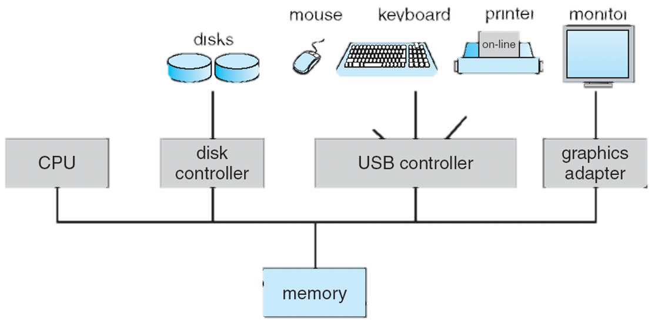

Computer System Organization
One or more CPUs, device controllers connect through common bus providing access to shared memory
Concurrent execution of CPUs and devices competing for memory cycles
Kernel
ROM
Bootstrap Program

Slide 15
Computer Startup
Bootstrap program is loaded at power-up or reboot
Typically stored in ROM or EPROM, generally known as firmware
Initializes all aspects of system
Loads operating system kernel and starts execution

Slide 16
Storage Definitions and Notation Review
The basic unit of computer storage is the bit. A bit can contain one of two values, 0 and 1. All other storage in a computer is based on collections of bits. Given enough bits, it is amazing how many things a computer can represent: numbers, letters, images, movies, sounds, documents, and programs, to name a few. A byte is 8 bits, and on most computers it is the smallest convenient chunk of storage. For example, most computers don’t have an instruction to move a bit but do have one to move a byte. A less common term is word, which is a given computer architecture’s native unit of data. A word is made up of one or more bytes. For example, a computer that has 64-bit registers and 64-bit memory addressing typically has 64-bit (8-byte) words. A computer executes many operations in its native word size rather than a byte at a time.
Computer storage, along with most computer throughput, is generally measured and manipulated in bytes and collections of bytes.
A kilobyte, or KB, is 1,024 bytes
a megabyte, or MB, is 1,024² bytes
a gigabyte, or GB, is 1,024³ bytes
a terabyte, or TB, is 1,024⁴ bytes
a petabyte, or PB, is 1,024⁵ bytes
Computer manufacturers often round off these numbers and say that a megabyte is 1 million bytes and a gigabyte is 1 billion bytes. Networking measurements are an exception to this general rule; they are given in bits (because networks move data a bit at a time).

Slide 17
Storage Structure
Main memory – only large storage media that the CPU can access directly
Random access
Typically volatile
Secondary storage – extension of main memory that provides large nonvolatile storage capacity
Hard disks – rigid metal or glass platters covered with magnetic recording material
Disk surface is logically divided into tracks, which are subdivided into sectors
The disk controller determines the logical interaction between the device and the computer
Solid-state disks – faster than hard disks, nonvolatile
Various technologies
Becoming ubiquitous

Slide 18
Storage Hierarchy
Storage systems organized in hierarchy
Speed
Cost
Volatility
Caching – copying information into faster storage system; main memory can be viewed as a cache for secondary storage
Device Driver for each device controller to manage I/O
Provides uniform interface between controller and kernel (OS)

Slide 19
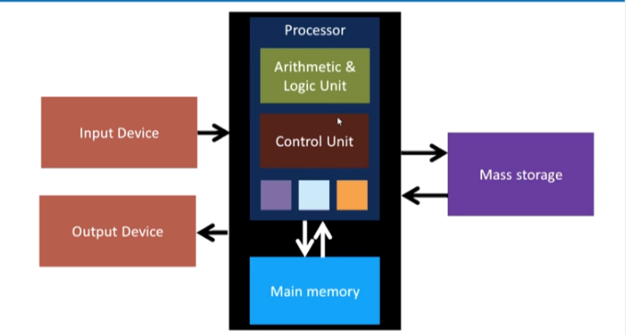
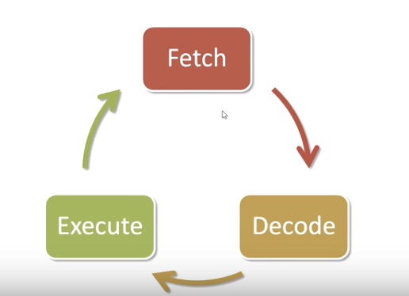
Von Neumann Architecture

Slide 20
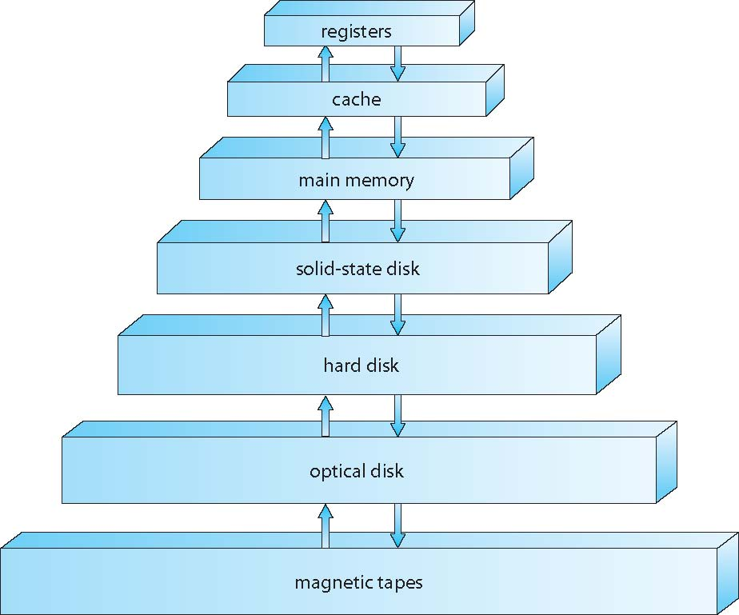
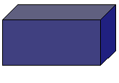
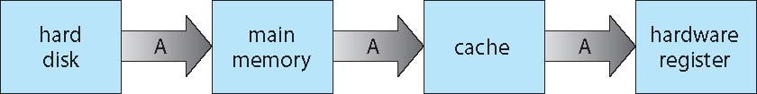
Storage-Device Hierarchy
P
R
I
M
A
R
Y
CPU
SRAM
DRAM
Flash
SECONDARY
Notes:
A memory cache, sometimes called a cache store or RAM cache, is a portion of memory made of high-speed static RAM (SRAM) instead of the slower and cheaper dynamic RAM (DRAM) used for main memory. Memory caching is effective because most programs access the same data or instructions over and over.
Cache memory, also called CPU memory, is random access memory (RAM) that a computer microprocessor can access more quickly than it can access regular RAM. This memory is typically integrated directly with the CPU chip or placed on a separate chip that has a separate bus interconnect with the CPU.

Slide 21
Storage-Device Hierarchy
Notes:
A memory cache, sometimes called a cache store or RAM cache, is a portion of memory made of high-speed static RAM (SRAM) instead of the slower and cheaper dynamic RAM (DRAM) used for main memory. Memory caching is effective because most programs access the same data or instructions over and over.
Cache memory, also called CPU memory, is random access memory (RAM) that a computer microprocessor can access more quickly than it can access regular RAM. This memory is typically integrated directly with the CPU chip or placed on a separate chip that has a separate bus interconnect with the CPU.

Slide 22
Caching
Important principle, performed at many levels in a computer (in hardware, operating system, software)
Information in use copied from slower to faster storage temporarily
Faster storage (cache) checked first to determine if information is there
If it is, information used directly from the cache (fast)
If not, data copied to cache and used there
Cache smaller than storage being cached
Cache management important design problem
Cache size and replacement policy

Slide 23
Software/Hardware/OS Interaction
The Operating System is notified of a need for its services by an interrupt from either the hardware or a software program.
Hardware triggers an interrupt by sending a signal to the CPU on the system bus
Software triggers an interrupt by executing a system or monitor call.
The Operating System
Stops what is it doing
Takes a snapshot of the current state of the CPU
Executes defined actions based on the interrupt type and originator.
Restores the CPU to its original state
Resumes processing

Slide 24
Computer System Operation
I/O devices and the CPU can execute concurrently
Each device controller is in charge of a particular device type
Each device controller has a local buffer
CPU moves data from/to main memory to/from local buffers
I/O is from the device to local buffer of controller
Device controller informs CPU that it has finished its operation by causing an interrupt

Slide 25
Storage Definitions and Notation Review
The basic unit of computer storage is the bit. A bit can contain one of two values, 0 and 1. All other storage in a computer is based on collections of bits. Given enough bits, it is amazing how many things a computer can represent: numbers, letters, images, movies, sounds, documents, and programs, to name a few. A byte is 8 bits, and on most computers it is the smallest convenient chunk of storage. For example, most computers don’t have an instruction to move a bit but do have one to move a byte. A less common term is word, which is a given computer architecture’s native unit of data. A word is made up of one or more bytes. For example, a computer that has 64-bit registers and 64-bit memory addressing typically has 64-bit (8-byte) words. A computer executes many operations in its native word size rather than a byte at a time.
Computer storage, along with most computer throughput, is generally measured and manipulated in bytes and collections of bytes.
A kilobyte, or KB, is 1,024 bytes
a megabyte, or MB, is 1,024² bytes
a gigabyte, or GB, is 1,024³ bytes
a terabyte, or TB, is 1,024⁴ bytes
a petabyte, or PB, is 1,024⁵ bytes
Computer manufacturers often round off these numbers and say that a megabyte is 1 million bytes and a gigabyte is 1 billion bytes. Networking measurements are an exception to this general rule; they are given in bits (because networks move data a bit at a time).

Slide 26
Direct Memory Access Structure
Used for high-speed I/O devices able to transmit information at close to memory speeds
Device controller transfers blocks of data from buffer storage directly to main memory without CPU intervention
Only one interrupt is generated per block, rather than the one interrupt per byte

Slide 27
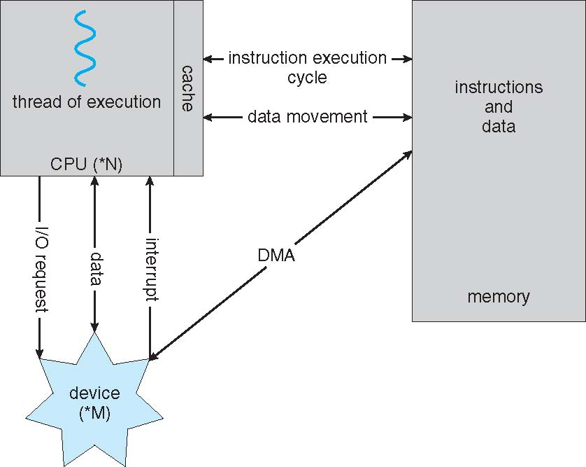
Direct Memory Access Structure
A von Neumann architecture
one interrupt per block, rather than the one interrupt per byte
Notes:
Used for high-speed I/O devices able to transmit information at close to memory speeds
Device controller transfers blocks of data from buffer storage directly to main memory without CPU intervention
Only one interrupt is generated per block, rather than the one interrupt per byte

Slide 28
Computer System Architecture
Older systems use a single general-purpose processor
And have special-purpose processors as well (e.g., disk, keyboard, graphics controllers, I/O processors)
Multiprocessors systems in use today
Advantages include:
Increased throughput
Economy of scale
Increased reliability – graceful degradation or fault tolerance
Two types of Multiprocessor Systems:
Asymmetric Multiprocessing – each processor is assigned a specific task. (Boss processor controls the system – schedules and allocates work to the worker processors)
Symmetric Multiprocessing (SMP)– More common. Each processor performs all tasks. (e.g., IBM AIX)
Notes:
Multiple processors share the computer bus, clock, memory, and peripherals.
Graceful degradation- the ability to continue providing service proportional to the level of surviving hardware.
Fault tolerance requires a mechanism tro allow the failure to be detected, diagnosed, and, if possible, corrected.
The HP NonStop (formerly Tandem) system uses both hardware and software duplication to ensure continued operation despite faults. The system consists of multiple pairs of CPUs, working in lockstep. Both processors in the pair execute each instruction and compare the results. If the results differ, then one CPU of the pair is at fault, and both are halted. The process that was being executed is then moved to another pair of CPUs, and the instruction that failed is restarted. This solution is expensive, since it involves special hardware and considerable hardware duplication.

Slide 29
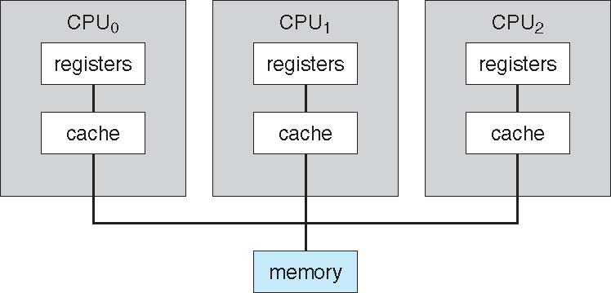
Symmetric Multiprocessing Architecture
Advantages? Disadvantages?
Software or Hardware can determine symmetric vs asymmetric: SunOS Version 4 provided asymmetric processing.
Version 5 (Solaris) provides symmetric processing on the same hardware.

Slide 30
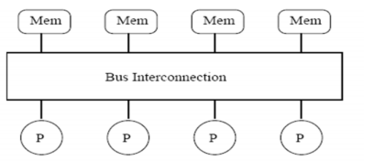
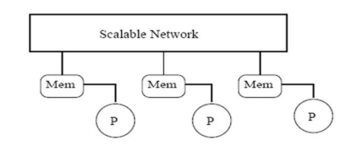
Symmetric Multiprocessing Architecture
Memory Access Models
UMA – Uniform Memory Access – access to any RAM takes the same amount of time.
NUMA –Non-Uniform Memory Access – some parts of memory make take longer to access than others (local vs. remote)
NUMA
UMA

Slide 31
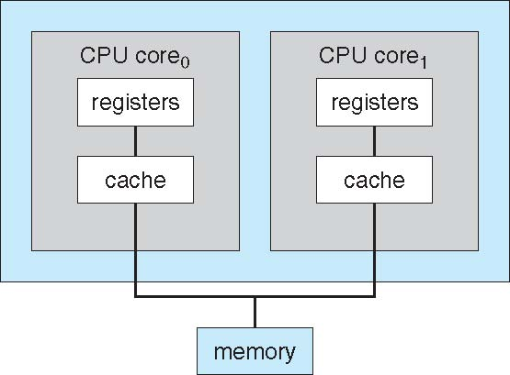
Multiprocessor Types
Not Every Multiprocessor System is Multicore
Every Multicore is a Multiprocessor system
Multi-chip vs. Multicore
SPEED… POWER CONSUMPTION
Chip
One computing core per chip. Multiple chips.
Multiple computing cores per chip. One chip

Slide 32
Blade Servers
A blade server is a server chassis housing multiple thin, modular electronic circuit boards, known as server blades. Each blade is a server in its own right, often dedicated to a single application, running its own operating system.
The blades are literally servers on a card containing processors, memory, integrated network controllers, and input/output (IO) ports.

Slide 33
Clustered Systems
AKA Loosely-Coupled Multiprocessor Systems
Usually, a Local Area Network

Slide 34
Clustered Systems
AKA Loosely-Coupled Multiprocessor Systems
Like multiprocessor systems, but multiple systems working together
Usually sharing storage via a storage-area network (SAN)
Provides a high-availability service which survives failures
Asymmetric clustering has one machine in hot-standby mode and the other running applications. Hot-standby constantly monitors the active server.
Symmetric clustering has multiple nodes running applications, AND monitoring each other.

Slide 35
Clustered Systems
AKA Loosely-Coupled Multiprocessor Systems
Some clusters are for high-performance computing (HPC)
Applications must be written to use parallelization – program divided into components that run in parallel on individual computers in the cluster. Results are then combined.
Some have distributed lock manager (DLM) to avoid conflicting operations

Slide 36
Operating System Structure
Multiprogramming (Batch system) needed for efficiency
Single user cannot keep CPU and I/O devices busy at all times
Multiprogramming organizes jobs (code and data) so CPU always has one to execute
A subset of total jobs in system is kept in memory
One job selected and to load into memory using job scheduling
When it has to wait (for I/O for example), OS switches to another job
Timesharing (multitasking) is logical extension in which CPU switches jobs so frequently that users can interact with each job while it is running, creating interactive computing
Response time should be < 1 second
Each user has at least one program executing in memory process
If several jobs ready to run at the same time  CPU scheduling
If processes don’t fit in memory, swapping moves them in and out to run
Virtual memory allows execution of processes not completely in memory

Slide 37
Operating System Task List
Provide the environment in which programs are executed
Optimize computer resources by supporting multiprogramming and multitasking
Limit the ability of concurrently running jobs to affect one another
Ensure reasonable response time.
Protect computer resource from inappropriate use.
Provide mechanisms for job synchronization and communication
Prevent job deadlock

Slide 38
Operating-System Operations
Interrupt driven (hardware and software)
Hardware interrupt by one of the devices
Software interrupt (exception or trap):
Software error (e.g., division by zero)
Request for operating system service
Infinite loop – protect other programs from slowing down
Processes modifying each other or the operating system
An interrupt service routine is provided to deal with each type of interrupt

Slide 39
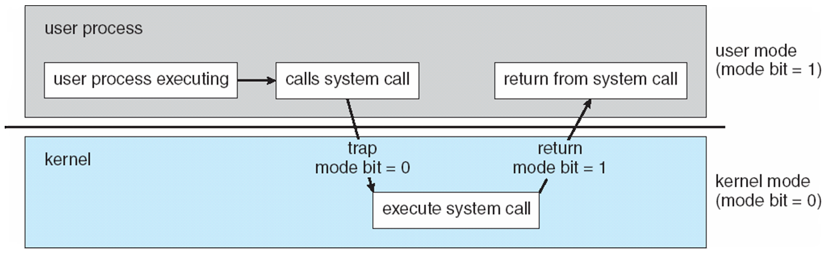
Operating-System Operations (cont.)
Dual-mode operation allows OS to protect itself and other system components
User mode and kernel mode
Mode bit provided by hardware
Provides ability to distinguish when system is running user code or kernel code
Some instructions designated as privileged, only executable in kernel mode (e.g., I/O Control, Timer Mgt., Interrupt Mgt.)
System call changes mode to kernel, return from call resets it to user

Slide 40
Process Management
A process is a program in execution. It is a unit of work within the system. Program is a passive entity, process is an active entity.
Multiple processes may be associated with the same program.
Process needs resources to accomplish its task
CPU, memory, I/O, files
Initialization data
Process termination requires reclaim of any reusable resources
Single-threaded process has one program counter specifying location of next instruction to execute (more in Chapter 4)
Process executes instructions sequentially, one at a time, until completion
Multi-threaded process has one program counter per thread (more in Chapter 4)

Slide 41
Process Management Activities
The operating system is responsible for the following activities in connection with process management:
Creating and deleting both user and system processes
Suspending and resuming processes
Providing mechanisms for process synchronization
Providing mechanisms for process communication
Providing mechanisms for deadlock handling

Slide 42
Memory Management
To execute a program all (or part) of the instructions must be in memory
All (or part) of the data that is needed by the program must be in memory.
Memory management determines what is in memory and when
Optimizing CPU utilization and computer response to users
Memory management activities
Keeping track of which parts of memory are currently being used and by whom
Deciding which processes (or parts thereof) and data to move into and out of memory
Allocating and deallocating memory space as needed

Slide 43
Storage Management
OS provides uniform, logical view of information storage
Abstracts physical properties to logical storage unit - file
Each medium is controlled by device (i.e., disk drive, tape drive)
Varying properties include access speed, capacity, data-transfer rate, access method (sequential or random)
File-System management
Files usually organized into directories
Access control on most systems to determine who may access what and how they may access it (CRUD)
OS activities include
Creating and deleting files and directories
Primitives to manipulate files and directories
Mapping files onto secondary storage
Backup files onto stable (non-volatile) storage media

Slide 44
Mass-Storage Management
Disks used to store data that does not fit in main memory or data that must be kept for a “long” period of time
Proper management is of central importance
Entire speed of computer operation hinges on disk subsystem and its algorithms
OS activities
Free-space management
Storage allocation
Disk scheduling
Some storage need not be fast
Tertiary storage includes optical storage, magnetic tape
Still must be managed – by OS or applications
Varies between WORM (write-once, read-many-times) and RW (read-write)

Slide 45
Performance of Various Levels of Storage
Movement between levels of storage hierarchy can be explicit or implicit

Slide 46
Caching
Important principle, performed at many levels in a computer (in hardware, operating system, software)
Information in use copied from slower to faster storage temporarily
Faster storage (cache) checked first to determine if information is there
If it is, information used directly from the cache (fast)
If not, used from the source and data copied to cache for subsequent use
Cache smaller than storage being cached
Cache management important design problem
Cache size and replacement policy discussed in Chapter 9

Slide 47
Migration of data “A” from Disk to Register
Multitasking environments must be careful to use most recent value, no matter where it is stored in the storage hierarchy
Multiprocessor environment must provide cache coherency in hardware such that all CPUs have the most recent value in their cache
Distributed environment situation even more complex
Several copies of a datum can exist
Various solutions covered in Chapter 17

Slide 48
I/O Subsystem
One purpose of OS is to hide peculiarities of hardware devices from the user
I/O subsystem responsible for
Memory management of I/O including buffering (storing data temporarily while it is being transferred), caching (storing parts of data in faster storage for performance), spooling (the overlapping of output of one job with input of other jobs)
General device-driver interface
Drivers for specific hardware devices
More about this in Chapter 13

Slide 49
Protection and Security
Protection – any mechanism for controlling access of processes or users to resources defined by the OS
Security – defense of the system against internal and external attacks
Huge range, including denial-of-service, worms, viruses, identity theft, theft of service
Systems generally first distinguish among users, to determine who can do what
User identities (user IDs, security IDs) include name and associated number, one per user
User ID then associated with all files, processes of that user to determine access control
Group identifier (group ID) allows set of users to be defined and controls managed, then also associated with each process, file
Privilege escalation allows user to change to effective ID with more rights (e.g., UNIC setuid)

Slide 50
Kernel Data Structures
Many similar to standard programming data structures
Singly linked list
Doubly linked list
Circular linked list

Slide 51
Kernel Data Structures
Binary search tree left <= right
Search performance is O(n)
Balanced binary search tree is O(lg n)

Slide 52
Kernel Data Structures
Hash function can create a hash map
Bitmap – string of n binary digits representing the status of n items
Linux data structures defined in
include files <linux/list.h>, <linux/kfifo.h>, <linux/rbtree.h>

Slide 53
Computing Environments - Traditional
Stand-alone general purpose machines
But blurred as most systems interconnect with others (i.e., the Internet)
Portals provide web access to internal systems
Network computers (thin clients) are like Web terminals
Mobile computers interconnect via wireless networks
Networking is ubiquitous – even home systems use firewalls to protect home computers from Internet attacks

Slide 54
Computing Environments - Mobile
Handheld smartphones, tablets, etc
What is the functional difference between them and a “traditional” laptop?
Extra features – more OS features (GPS, gyroscope)
Allows new types of apps like augmented reality
Use IEEE 802.11 wireless, or cellular data networks for connectivity
Leaders are Apple iOS and Google Android

Slide 55
Computing Environments – Distributed
Distributed computing
Collection of separate, possibly heterogeneous, systems networked together
Network is a communications path, TCP/IP most common
Local Area Network (LAN)
Wide Area Network (WAN)
Metropolitan Area Network (MAN)
Personal Area Network (PAN) via Bluetooth/802.11
Network Operating System provides features between systems across network
Communication scheme allows systems to exchange messages
Illusion of a single system (More in Chapter 17)

Slide 56
Computing Environments – Client-Server
Client-Server Computing
Dumb terminals supplanted by smart PCs
Many systems now servers, responding to requests generated by clients
Compute-server system provides an interface to client to request services (i.e., database)
File-server system provides interface for clients to store and retrieve files

Slide 57
Computing Environments - Peer-to-Peer
Another model of distributed system
P2P does not distinguish clients and servers
Instead all nodes are considered peers
May each act as client, server or both
Node must join P2P network
Registers its service with central lookup service on network, or
Broadcast request for service and respond to requests for service via discovery protocol
Examples include Napster and Gnutella, Voice over IP (VoIP) such as Skype

Slide 58
Computing Environments - Virtualization
Allows operating systems to run applications within other OSes
Vast and growing industry
Emulation used when source CPU type different from target type (i.e. PowerPC to Intel x86)
Generally slowest method
When computer language not compiled to native code – Interpretation
Virtualization – OS natively compiled for CPU, running guest OSes also natively compiled
Consider VMware running WinXP guests, each running applications, all on native WinXP host OS
VMM (Virtual Machine Manager) provides virtualization services

Slide 59
Computing Environments - Virtualization
Use cases involve laptops and desktops running multiple OSes for exploration or compatibility
Apple laptop running Mac OS X host, Windows as a guest
Developing apps for multiple OSes without having multiple systems
QA testing applications without having multiple systems
Executing and managing compute environments within data centers
More on virtualization in Chapter 16

Slide 60
Computing Environments - Virtualization

Slide 61
Computing Environments – Cloud Computing
Delivers computing, storage, even apps as a service across a network
Logical extension of virtualization because it uses virtualization as the base for its functionality.
Amazon EC2 has thousands of servers, millions of virtual machines, petabytes of storage available across the Internet, pay based on usage
Many types
Public cloud – available via Internet to anyone willing to pay
Private cloud – run by a company for the company’s own use
Hybrid cloud – includes both public and private cloud components
Software as a Service (SaaS) – one or more applications available via the Internet (i.e., word processor)
Platform as a Service (PaaS) – software stack ready for application use via the Internet (i.e., a database server)
Infrastructure as a Service (IaaS) – servers or storage available over Internet (i.e., storage available for backup use)

Slide 62
Computing Environments – Cloud Computing
Cloud computing environments composed of traditional OSes, plus VMMs, plus cloud management tools
Internet connectivity requires security like firewalls
Load balancers spread traffic across multiple applications

Slide 63
Computing Environments – Real-Time Embedded Systems
Real-time embedded systems most prevalent form of computers
Vary considerably, special purpose, limited purpose OS, real-time OS
Use expanding
Many other special computing environments as well
Some have OSes, some perform tasks without an OS (e.g., ASICs)
Real-time OS has well-defined fixed time constraints
Processing must be done within constraint
Consider: variable cruise control, collision avoidance
Application Specific Integrated Circuits

Slide 64
Open-Source Operating Systems
Operating systems made available in source-code format rather than just binary closed-source
Counter to the copy protection and Digital Rights Management (DRM) movement
Started by Free Software Foundation (FSF), which has “copyleft” GNU Public License (GPL)
Examples include GNU/Linux and BSD UNIX (including core of Mac OS X), and many more
Can use VMM like VMware Player (Free on Windows), Virtualbox (open source and free on many platforms - http://www.virtualbox.com)
Use to run guest operating systems for exploration

Slide 65
End of Chapter 1

