Slide 1
Chapter 3: Processes

Slide 2
Chapter 3: Processes
Process Concept
Process Scheduling
Operations on Processes
Interprocess Communication
Examples of IPC Systems
Communication in Client-Server Systems

Slide 3
Objectives
To introduce the notion of a process -- a program in execution, which forms the basis of all computation
To describe the various features of processes, including scheduling, creation and termination, and communication
To explore interprocess communication using shared memory and message passing
To describe communication in client-server systems

Slide 4
Process Concept
An operating system executes a variety of programs:
Batch system – jobs
Time-shared systems – user programs or tasks
Textbook uses the terms job and process almost interchangeably
Process – a program in execution; process execution must progress in sequential fashion
Process > Program Multiple parts
The program code, also called text section
Current activity including program counter, processor registers
Stack containing temporary data
Function parameters, return addresses, local variables
Data section containing global variables
Heap containing memory dynamically allocated during run time

Slide 5
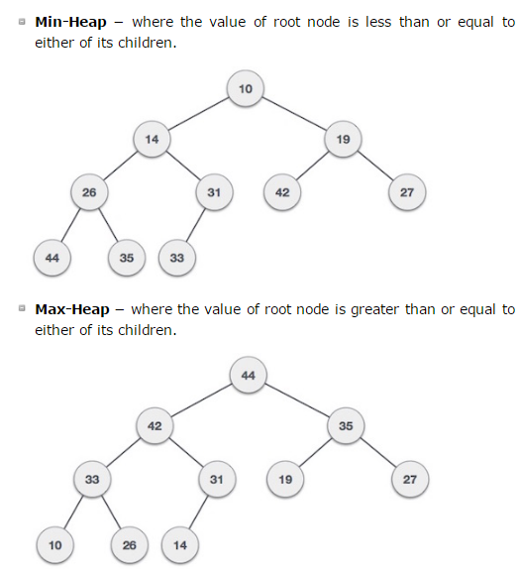
What is a Heap?

Slide 6
Process Concept (Cont.)
Program is passive entity stored on disk (executable file), process is active
Program becomes process when executable file loaded into memory
Execution of program started via GUI mouse clicks, command line entry of its name, etc
One program can become several processes
Consider multiple users executing the same program (e.g. email program, web browser)
A process can also be an execution environment for other code
Java programming environment is a good example.
An executable Java program is executed within the JVM.
JVM executes as a process that interprets the loaded Java code and takes actions via native machine instructions on behalf of that code.

Slide 7
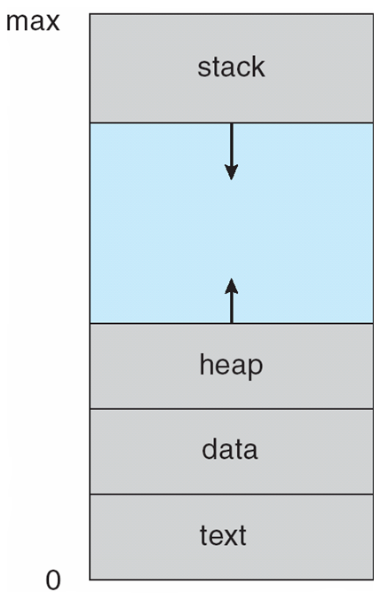
Process in Memory

Slide 8
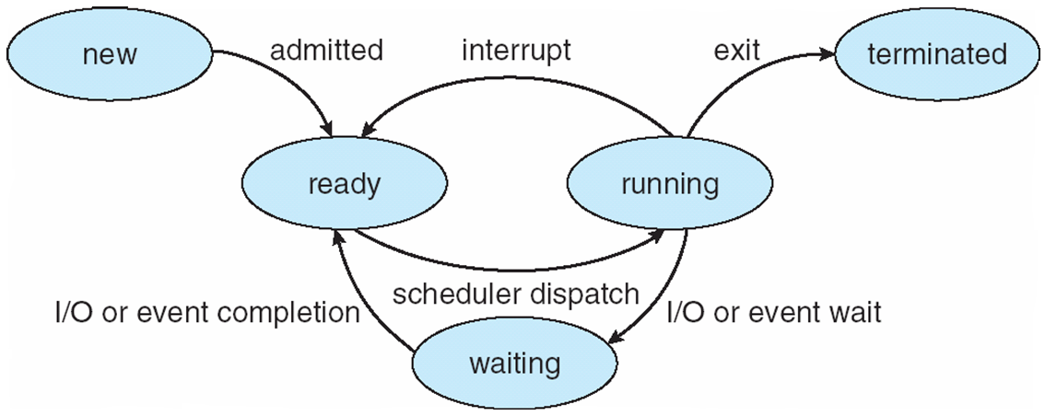
Process State
As a process executes, it changes state
new: The process is being created
ready: The process is waiting to be assigned to a processor
running: Instructions are being executed
waiting: The process is waiting for some event to occur
terminated: The process has finished execution

Slide 9
Diagram of Process State

Slide 10
Context Switch
When CPU switches to another process, the system must save the state of the old process and load the saved state for the new process via a context switch
Context of a process represented in the PCB
Context-switch time is overhead; the system does no useful work while switching
The more complex the OS and the PCB ➔ the longer the context switch
Context-switch time dependent on hardware support
Some hardware provides multiple sets of registers per CPU ➔ multiple contexts loaded at once and a pointer is used to indicate the active context

Slide 11
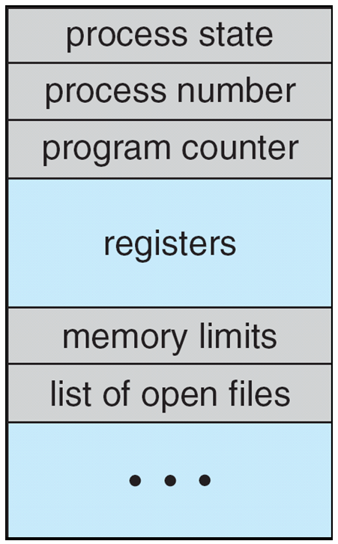
Process Control Block (PCB)
Information associated with each process
(also called task control block)
Process state – running, waiting, etc
Program counter – location of instruction to next execute
CPU registers – contents of all process-centric registers
CPU scheduling information- priorities, scheduling queue pointers
Memory-management information – memory allocated to the process
Accounting information – CPU used, clock time elapsed since start, time limits
I/O status information – I/O devices allocated to process, list of open files

Slide 12
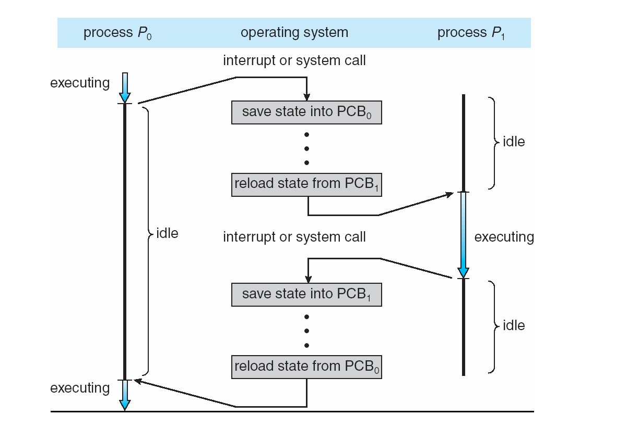
CPU Switch From Process to Process

Slide 13
Threads
So far, process has a single thread of execution
Consider having multiple program counters per process
Multiple locations can execute at once
Multiple threads of control -> threads
PCB expanded to include thread details, multiple program counters.
LOTS more about threads in Chapter 4.

Slide 14
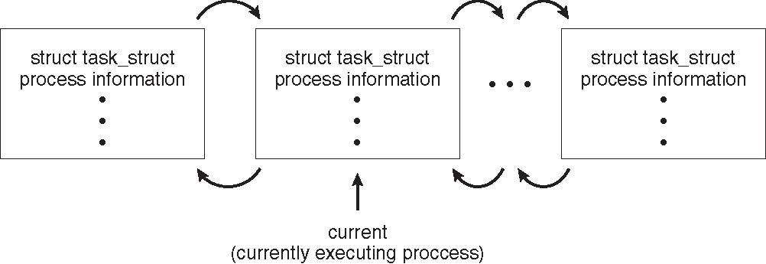
Process Representation in Linux
Represented by the C structure task_struct
pid t_pid; /* process identifier */ long state; /* state of the process */ unsigned int time_slice /* scheduling information */ struct task_struct *parent; /* this process’s parent */ struct list_head children; /* this process’s children */ struct files_struct *files; /* list of open files */ struct mm_struct *mm; /* address space of this process */

Slide 15
Process Scheduling
Multiprogramming goal: Maximize CPU use
Time sharing goal: quickly switch CPU between processes for time sharing
Process scheduler
Selects among available processes for next execution on CPU
In a single processor system, there will never be more than one running process.
Maintains scheduling queues of processes
Job queue – entry point of all processes in the system
Ready queue – set of all processes residing in main memory, ready and waiting to execute (linked list)
Device queues – set of processes waiting for an I/O device
Processes migrate among the various queues

Slide 16
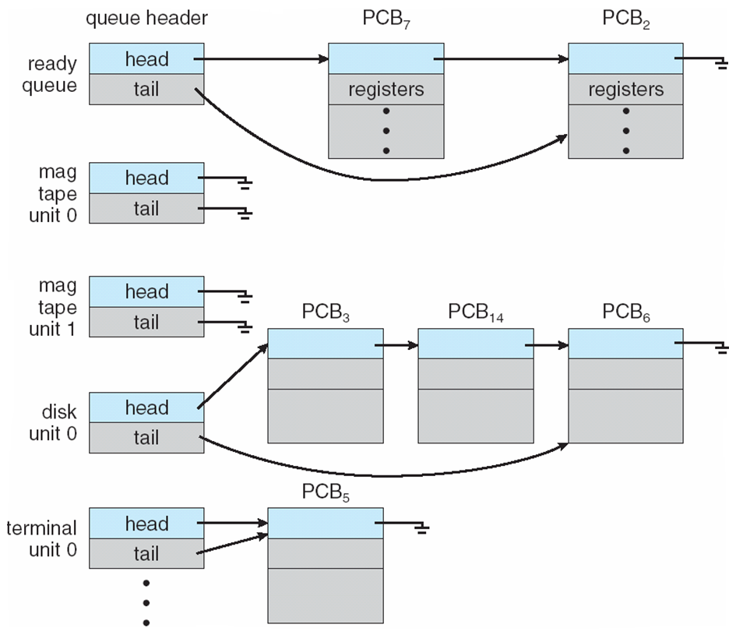
Ready Queue And Various I/O Device Queues
In what state are these processes?

Slide 17
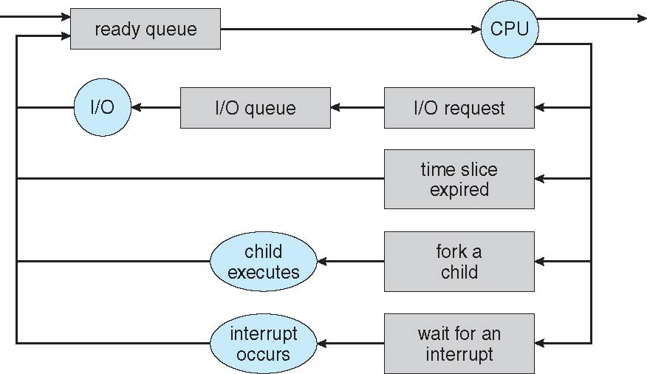
Representation of Process Scheduling
Queueing diagram represents queues, resources, flows

Slide 18
Schedulers
Long-term scheduler (or job scheduler) – selects which processes spooled on a mass storage device should be brought into the ready queue in memory (usually found in batch environments only)
Long-term scheduler is invoked infrequently (seconds, minutes) ⇒ (may be slow)
The long-term scheduler controls the degree of multiprogramming
Short-term scheduler (or CPU scheduler) – selects which process on the ready queue should be executed next and allocates CPU
Sometimes the only scheduler in a system
Short-term scheduler is invoked frequently (milliseconds) ⇒ (must be fast) it had better be efficient!!
Processes can be described as either:
I/O-bound process – spends more time doing I/O than computations, many short CPU bursts
CPU-bound process – spends more time doing computations; few very long CPU bursts
Long-term scheduler strives for good process mix to ensure utilization of all resources

Slide 19
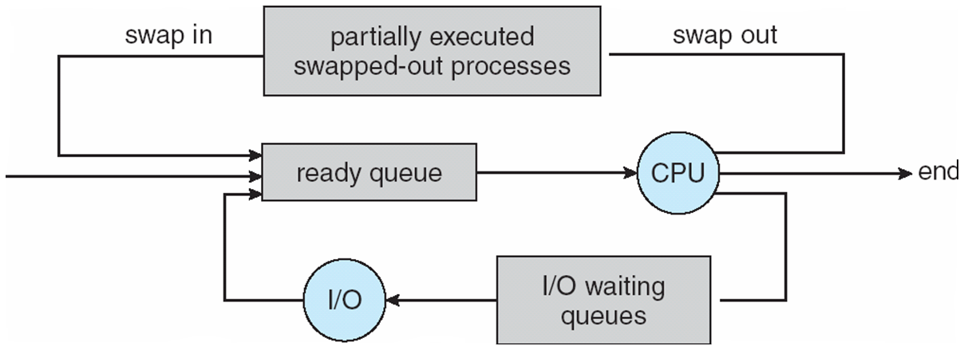
Addition of Medium Term Scheduling
Medium-term scheduler can be added if degree of multiprogramming needs to decrease due to unforeseen rise in memory requirements. (this is usually found in time-sharing systems)
Removes process from memory, store on disk, bring back in from disk to continue execution: swapping (more in Chapter 8)

Slide 20
Multitasking in Mobile Systems
Some mobile systems (e.g., early version of iOS) allow only one process to run, others suspended
Due to screen real estate, user interface limits iOS provides for a
Single foreground process- controlled via user interface
Multiple background processes– in memory, running, but not on the display, and with limits
Limits include single, short task, receiving notification of events, specific long-running tasks like audio playback
Android runs foreground and background, with fewer limits
Background process uses a service to perform tasks
Service can keep running even if background process is suspended
Service has no user interface, small memory use

Slide 21
Operations on Processes
The processes in most systems can execute concurrently, and they may be created and deleted dynamically.
Operating Systems must provide a mechanism for process creation and termination.

Slide 22
Process Creation
Parent process create children processes, which may, in turn, create other processes, forming a tree of processes
Generally, a process is identified and managed via a process identifier (pid)

Slide 23
A Tree of Processes in Linux
sshd is the daemon program for ssh
Bash is a type of
Linux shell
(replaces Bourne shell)
Kernel-related processes
tcsh is a type of
Linux shell
SSH stands for Secure SHell. It is a program designed to allow users to log into another computer over a network, to execute commands on that computer and to move files to and from that computer. It effectively replaces telnet, ftp and the rcp/rsh/remsh programs.

Slide 24
Process Creation
Resource sharing options
Parent and children share all available OS-managed resources
Children share subset of parent’s resources
When a process creates a new process… .Either the….
Parent and children execute concurrently
Parent waits until some or all children terminate
Address space options
The child process is a duplicate of the parent process (it has the same program and data as the parent)
The child program has a new program loaded into it

Slide 25
Process Creation (Cont.)
UNIX examples
fork() system call creates new process
Returns PID to parent process
Returns 0 (zero) to child process
If the fork system call is successful, a child process is produced that continues execution at the point where it was called by the parent process.
After the fork system call, both the parent and child processes are running and continue their execution at the next statement in the parent process.

Slide 26
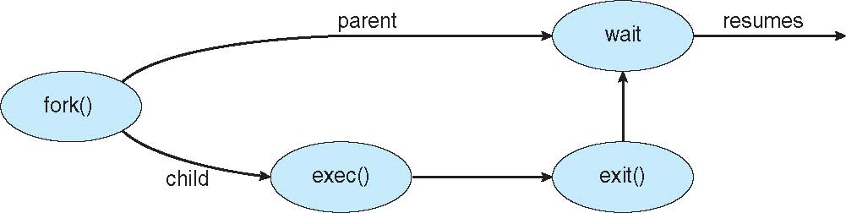
Process Creation (Cont.)
UNIX examples
fork() system call creates new process
Returns PID to parent process
Returns 0 (zero) to child process
exec() system call used after a fork() to replace the process’ memory space with a new program
optional
Identical address spaces
Loads a new program
And new address space

Slide 27
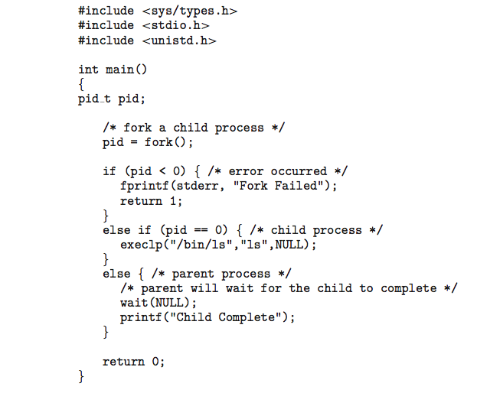
C Program Forking Separate Process
this system call is used when the number of arguments to be passed to the program to be executed is known in advance
Wait(NULL) waits for all child processes to complete
Notes:
int execlp(const char *path, const char *arg0, ..., NULL); DESCRIPTION
Like all of the exec functions, execlp replaces the calling process image with a new process image. This has the effect of running a new program with the process ID of the calling process. Note that a new process is not started; the new process image simply overlays the original process image. The execlp function is most commonly used to overlay a process image that has been created by a call to the fork function.
pathidentifies the location of the new process image within the hierarchical file system (HFS). If the path argument contains a slash (/), it is assumed that either an absolute or a relative pathname has been specified. If the path argument does not contain a slash, the directories specified by the PATH environment variable are searched in an attempt to locate the file.
arg0, ..., NULLis a variable length list of arguments that are passed to the new process image. Each argument is specified as a null-terminated string, and the list must end with a NULL pointer. The first argument, arg0, is required and must contain the name of the executable file for the new process image. If the new process image is a normal SAS/C main program, the list of arguments will be passed to argv as a pointer to an array of strings. The number of strings in the array is passed to themain() function as argc.

Slide 28
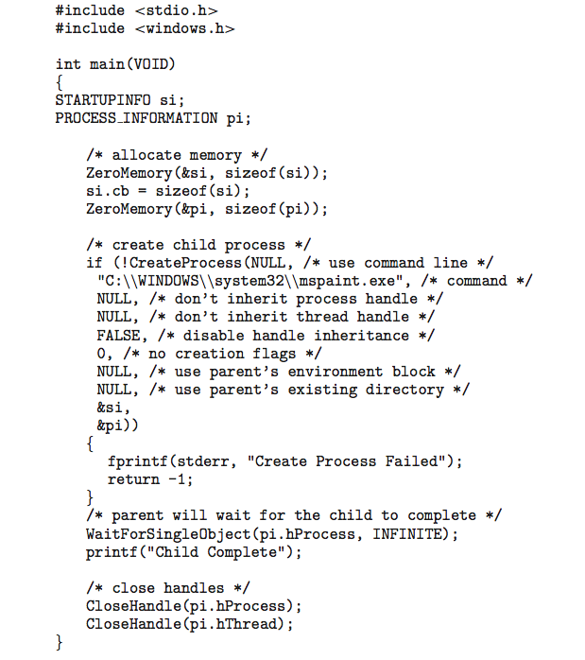
Creating a Separate Process via Windows API

Slide 29
Process Termination
Process executes last statement and then asks the operating system to delete it using the exit() system call.
Returns status data from child to parent (via wait())
Process’ resources are deallocated by operating system
Parent may terminate the execution of children processes using the abort()(UNIX) or TerminateProcess (Windows) system call. Some reasons for doing so:
Child has exceeded allocated resources
Task assigned to child is no longer required
The parent is exiting and the operating systems does not allow a child to continue if its parent terminates

Slide 30
Process Termination
Some operating systems do not allow child to exists if its parent has terminated. If a process terminates, then all its children must also be terminated.
cascading termination - initiated by the operating system
All children, grandchildren, etc. are terminated when parent process terminates
The parent process may wait for termination of a child process by using the wait()system call. The call returns status information and the pid of the terminated process
pid = wait(&status);
If process has terminated and parent did not yet invoke wait() process is a zombie
If parent terminated without invoking wait , process is an orphan
Linux and Unix will assign the orphan process as a child of init that issues wait periodically to allow for graceful exit.
init is root of process hierarchy in UNIX/LINUX

Slide 31

Multiprocess Architecture – Chrome Browser
Many web browsers ran as single process (some still do)
If one web site causes trouble, entire browser can hang or crash
Google Chrome Browser is multiprocess with 3 different types of processes:
Browser process manages user interface, disk and network I/O
Only one Browser process will exist
Renderer process renders web pages, deals with HTML, Javascript. A new renderer created for each website opened
Runs in sandbox restricting disk and network I/O, minimizing effect of security exploits
Plug-in process for each type of plug-in (e.g., Flash, QuickTime)

Slide 32
Interprocess Communication (3.4)
Processes within a system may be independent or cooperating
Cooperating process can affect or be affected by other processes, including sharing data
Reasons for cooperating processes:
Information sharing
Computation speedup (requires multiple processing cores)
Modularity
Convenience
Cooperating processes need interprocess communication (IPC)
Two models of IPC
Shared memory
Message passing
Multicore systems make message passing more efficient due to cache coherency issues with shared memory

Slide 33
Communications Models
(a) Message passing. (b) shared memory.

Slide 34
Interprocess Communication – Shared Memory
An area of memory shared among the processes that wish to communicate
The communication is under the control of the users processes not the operating system.
Goal is to provide mechanism that will allow the user processes to synchronize their actions when they access shared memory.
Synchronization is discussed in great detail in Chapter 5.

Slide 35
Producer-Consumer Problem
Paradigm for cooperating processes, producer process produces information that is consumed by a consumer process
So, what’s the problem?
Allowing both processes to run concurrently and not requiring the consumer to wait until the producer has terminated.
One Solution: Shared Memory
A buffer that is filled by the producer and emptied by the consumer.
Producer and consumer must be synchronized so that the consumer doesn’t try to consume an item that has not yet been produced.
If you think the answer is trivial.. You may be right… stay tuned.

Slide 36
Producer-Consumer Problem
Two buffer choices:
unbounded-buffer places no practical limit on the size of the buffer
Consumer may have to wait for new items
Producer can always produce new items
bounded-buffer assumes that there is a fixed buffer size
Consumer may have to wait for new items
Producer may have to wait if buffer is full

Slide 37
Bounded-Buffer – Shared-Memory Solution
Shared data
#define BUFFER_SIZE 10
typedef struct {
. . .
} item;
item buffer[BUFFER_SIZE];
int in = 0;
int out = 0;
Solution is correct, but can only use BUFFER_SIZE-1 elements
Treated as a circular array
in points to next free position
out points to first full position
Buffer is empty when in == out
Buffer has unread contents when out < (in%BUFFERSIZE)
Buffer is full when (in+1) % BUFFERSIZE == out

Slide 38
Bounded-Buffer – Producer
item next_produced;
while (true) {
/* produce an item in next produced */
while (((in + 1) % BUFFER_SIZE) == out)
; /* do nothing */
buffer[in] = next_produced;
in = (in + 1) % BUFFER_SIZE;
}

Slide 39
Bounded Buffer – Consumer
item next_consumed;
while (true) { while (in == out)
; /* do nothing */ next_consumed = buffer[out];
out = (out + 1) % BUFFER_SIZE;
/* consume the item in next consumed */
}

Slide 40
Interprocess Communication – Message Passing
Mechanism for processes to communicate and to synchronize their actions
Particularly useful in distributed systems where processes may reside on different computers connected by a network
Message system – processes communicate with each other without resorting to shared variables
IPC facility provides two operations:
send(message)
receive(message)
The message size is either fixed or variable
Variable messages are harder for the OS programmer to implement and make the life of the application programmer easier.
Fixed messages are easier for the OS programmer to implement and make the life of the application programmer harder.

Slide 41
Message Passing (Cont.)
If processes P and Q wish to communicate, they need to:
Establish a communication link between them
Exchange messages via send/receive
Implementation issues:
How are links established?
Can a link be associated with more than two processes?
How many links can there be between every pair of communicating processes?
What is the capacity of a link?
Is the size of a message that the link can accommodate fixed or variable?
Is a link unidirectional or bi-directional?

Slide 42
Message Passing (Cont.)
Implementation of communication link
Physical: (Covered in Chapter 17)
Shared memory
Hardware bus
Network
Logical:
Direct or indirect
Synchronous or asynchronous
Automatic or explicit buffering

Slide 43
Direct Communication
Processes must name each other explicitly:
send (P, message) – send a message to process P
receive(Q, message) – receive a message from process Q
Properties of communication link
Links are established automatically
A link is associated with exactly one pair of communicating processes
Between each pair there exists exactly one link
The link may be unidirectional, but is usually bi-directional

Slide 44
Direct Communication
Symmetric Addressing: sender and receiver name their partner
send (P, message) – send a message to process P
receive(Q, message) – receive a message from process Q
Asymmetric Addressing: only sender names partner
send (P, message) – send a message to process P
receive(id, message) – receive a message from any process. Id is set to the id of the sender process.
Significant Disadvantage: If process names change or PID values change, all referring processes must be modified.

Slide 45
Indirect Communication
Messages are directed and received from mailboxes (also referred to as ports)
Each mailbox has a unique id
Processes can communicate only if they share a mailbox
Properties of communication link
Link established between two processes IFF only if processes share a common mailbox
A link may be associated with many processes
Each pair of processes may share several communication links with each link corresponding to one mailbox
Link may be unidirectional or bi-directional
Primitives are defined as:
send(A, message) – send a message to mailbox A
receive(A, message) – receive a message from mailbox A

Slide 46
Indirect Communication
Mailbox sharing
P₁, P₂, and P₃ share mailbox A
P₁, sends; P₂ and P₃ receive
Who gets the message?
Assumption (message is consumed when received)
Solutions
Allow a link to be associated with at most two processes
Allow only one process at a time to execute a receive operation
Allow the system to select arbitrarily the receiver (or use an algorithm –e.g., round-robin). Sender is notified who the receiver was.

Slide 47
Indirect Communication
Mailboxes can be owned by a process or the operating system
Process-owned mailboxes are part of the address space of the process
Mailbox owner (can only receive messages from the mailbox)
Mailbox user (can only send messages to the mailbox)
Since each mailbox has a unique owner (receiver), then there can be no confusion about which process should receive a message sent to this mailbox.
When the process terminates, the mailbox disappears. Senders to the mailbox are informed that the mailbox no longer exists.

Slide 48
Indirect Communication
OS-owned mailboxes are independent and not attached to any process
Required Operations
Create a new mailbox (become the owner, and have exclusive rights to receive)
Send and receive messages through mailbox
Pass ownership and receiving privileges
And run the risk of ambiguity of receiving process
Destroy a mailbox

Slide 49
Synchronization
Message passing may be either blocking or non-blocking
Blocking is considered synchronous
Blocking send -- the sender is blocked until the message is received by the receiving process or mailbox
Blocking receive -- the receiver is blocked until a message is available
Non-blocking is considered asynchronous
Non-blocking send -- the sender sends the message and resumes operation
Non-blocking receive -- the receiver receives:
A valid message, or
Null message
Different combinations possible
If both send and receive are blocking, we have a rendezvous

Slide 50
Synchronization (Cont.)
Producer-consumer problem becomes trivial
Producer invokes a non blocking send() call.
Consumer invokes a blocking receive() and waits until a message is available.

Slide 51
Synchronization (Cont.)
Producer-consumer problem becomes trivial
message next_produced;
while (true) { /* produce an item in next produced */
send(next_produced);
}
message next_consumed;
while (true) {
receive(next_consumed);
/* consume the item in next consumed */
}

Slide 52
Buffering
Messages exchanged between communicating processes reside in a temporary queue.
implemented in one of three ways
No Buffering System:
Zero capacity – no messages are queued on a link. Sender must wait for receiver (rendezvous)
Automatic Buffering:
Bounded capacity – finite length of n messages Sender must wait if link full
Unbounded capacity – infinite length Sender never waits

Slide 53
Examples of IPC Systems - POSIX
POSIX Shared Memory
Process first creates shared memory segment shm_fd = shm_open(name, O CREAT | O RDWR, 0666);
Name – name of shared memory object
O CREAT – create if it does not exist
O RDWR – open for reading and writing
0666 – directory permissions
Also used to open an existing segment to share it
Set the size of the object
ftruncate(shm fd, 4096);
mmap() establishes a memory-mapped file containing the shared-memory object – returning a pointer to the file
Now the process could write to the shared memory
sprintf(shared memory, "Writing to shared memory");

Slide 54
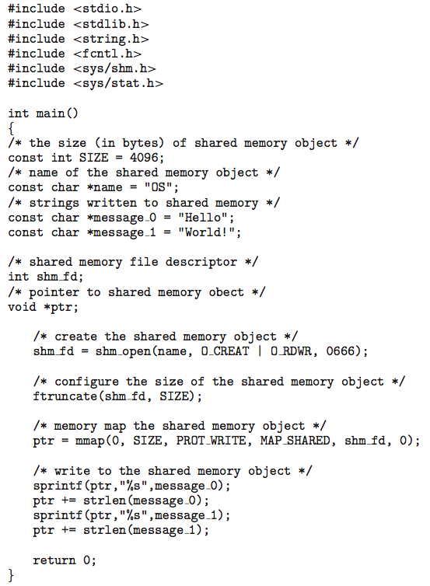
IPC POSIX Producer
Visible to all processes sharing the object.

Slide 55
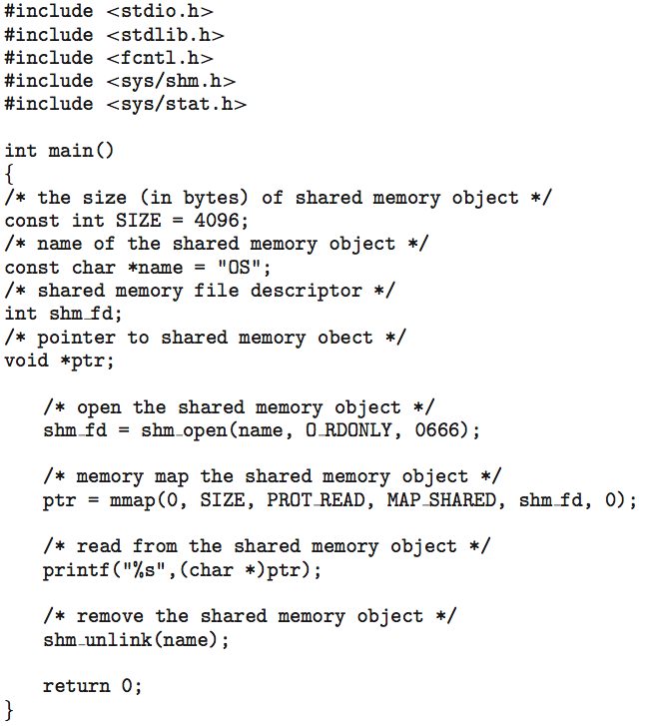
IPC POSIX Consumer

Slide 56
Examples of IPC Systems - Mach
Mach communication is message based
Even system calls are messages
Each task gets two mailboxes (called ports) at creation- Kernel and Notify
Only three system calls needed for message transfer
msg_send(), msg_receive(), msg_rpc()
Mailboxes needed for communication, created via
port_allocate()
Send and receive are flexible, for example four options if mailbox full:
Wait indefinitely
Wait at most n milliseconds
Return immediately
Temporarily cache a message

Slide 57
Examples of IPC Systems – Windows
Message-passing centric via advanced local procedure call (ALPC) facility
Only works between processes on the same machine
Uses ports (like mailboxes) to establish and maintain communication between two processes
Communication works as follows:
Servers publish connection-port objects visible to all processes.
The client opens a handle to the subsystem’s connection port object and sends a connection request.
The server creates two private communication ports (one for client -> server messages and one for server -> client messages) and returns the handle to one of them to the client.
The client and server use the corresponding port handles to send messages or callbacks and to listen for replies.
Callback is supported (allows client and server to accept a request when they would normally be expecting a reply

Slide 58
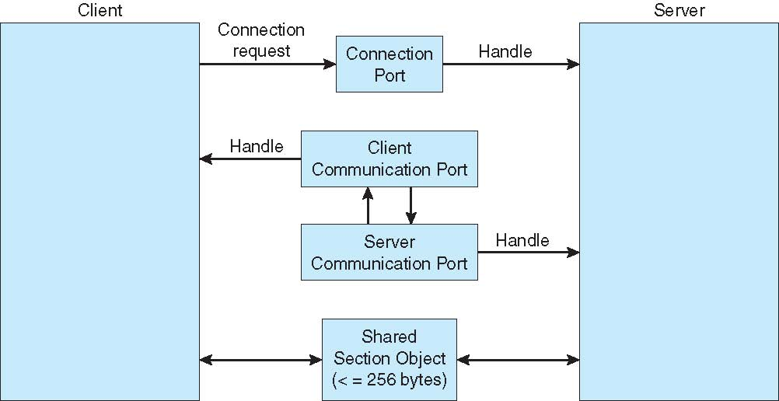
Local Procedure Calls in Windows
Server creates two ports in response to connection request
>
Small messages (<256 bytes) use the port’s message queue as intermediate storage.
Section objects are used for messages > 256 bytes and are created by the process requiring larger message size.
Larger messages are written directly into client address space by server.

Slide 59
Communications in Client-Server Systems
Sockets
Remote Procedure Calls
Pipes
Remote Method Invocation (Java)

Slide 60
Sockets
A socket is defined as an endpoint for communication
Concatenation of IP address and port – a number included at start of message packet to differentiate network services on a host
The socket 161.25.19.8:1625 refers to port 1625 on host 161.25.19.8
Communication consists between a pair of sockets
All ports below 1024 are well known, used for standard services
Special IP address 127.0.0.1 (loopback) to refer to system on which process is running

Slide 61
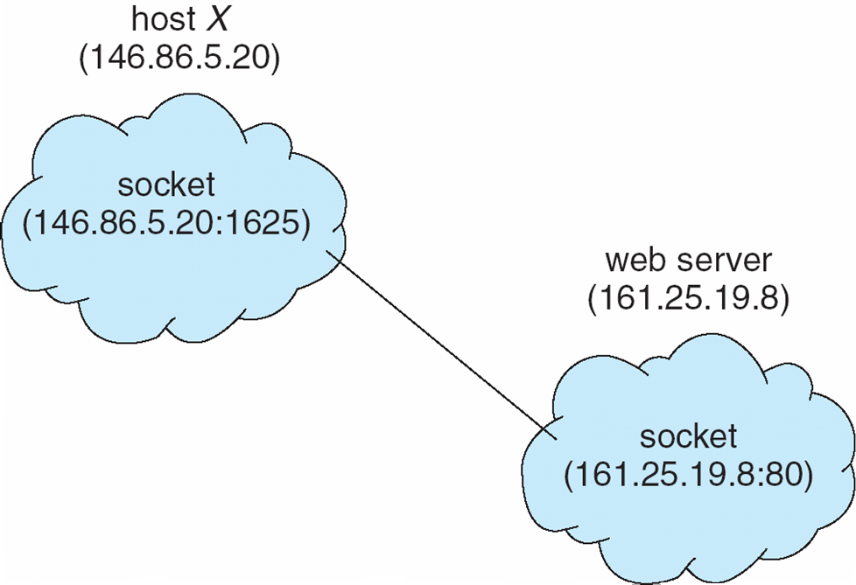
Socket Communication

Slide 62
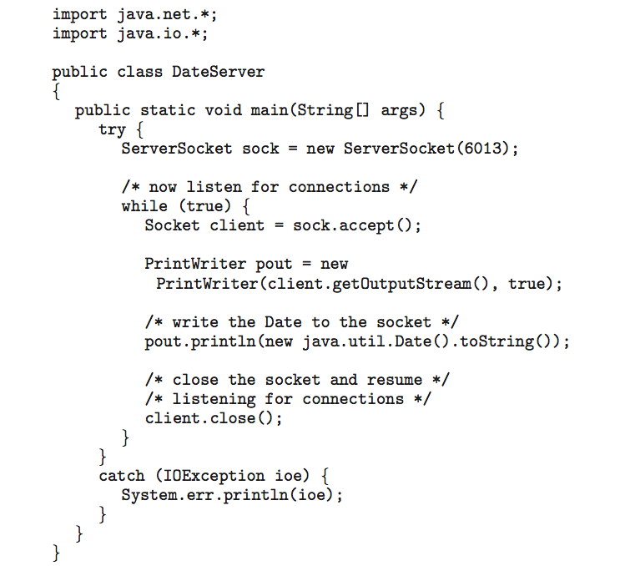
Sockets in Java
Three types of sockets
Connection-oriented (TCP)
Connectionless (UDP)
MulticastSocket class– data can be sent to multiple recipients
Consider this “Date” server:

Slide 63
Remote Procedure Calls
Remote procedure call (RPC) abstracts procedure calls between processes on networked systems
Again uses ports for service differentiation
Stubs – client-side proxy for the actual procedure on the server
The client-side stub locates the server and marshalls the parameters
The server-side stub receives this message, unpacks the marshalled parameters, and performs the procedure on the server
On Windows, stub code compile from specification written in Microsoft Interface Definition Language (MIDL)

Slide 64
Remote Procedure Calls (Cont.)
Data representation handled via External Data Representation (XDL) format to account for different architectures
Big-endian and little-endian
Remote communication has more failure scenarios than local
Messages can be delivered exactly once rather than at most once
OS typically provides a rendezvous (or matchmaker) service to connect client and server

Slide 65
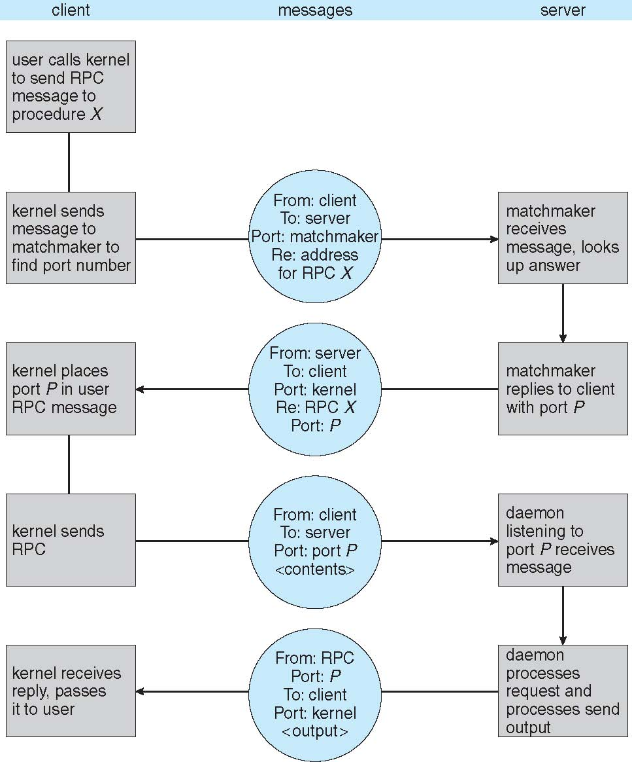
Execution of RPC

Slide 66
Pipes
Acts as a conduit allowing two processes to communicate
Issues:
Is communication unidirectional or bidirectional?
In the case of two-way communication, is it half or full-duplex?
Must there exist a relationship (i.e., parent-child) between the communicating processes?
Can the pipes be used over a network?
Ordinary pipes – cannot be accessed from outside the process that created it. Typically, a parent process creates a pipe and uses it to communicate with a child process that it created.
Named pipes – can be accessed without a parent-child relationship.

Slide 67
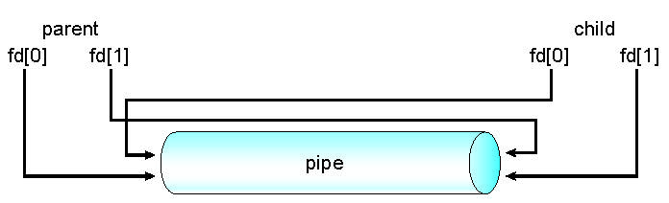
Ordinary Pipes
Ordinary Pipes allow communication in standard producer-consumer style
Producer writes to one end (the write-end of the pipe)
Consumer reads from the other end (the read-end of the pipe)
Ordinary pipes are therefore unidirectional
Require parent-child relationship between communicating processes
Windows calls these anonymous pipes
See Unix and Windows code samples in textbook

Slide 68
Named Pipes
Named Pipes are more powerful than ordinary pipes
Communication is bidirectional
No parent-child relationship is necessary between the communicating processes
Several processes can use the named pipe for communication
Provided on both UNIX and Windows systems

Slide 69
End of Chapter 3

