Slide 1
Chapter 4: Threads

Slide 2
Chapter 4: Threads
Overview
Multicore Programming
Multithreading Models
Thread Libraries
Implicit Threading
Threading Issues
Operating System Examples

Slide 3
Objectives
To introduce the notion of a thread—a fundamental unit of CPU utilization that forms the basis of multithreaded computer systems
To discuss the APIs for the Pthreads, Windows, and Java thread libraries
To explore several strategies that provide implicit threading
To examine issues related to multithreaded programming
To cover operating system support for threads in Windows and Linux

Slide 4
Motivation
Thread: Basic unit of CPU utilization. Comprises
Thread ID
Program Counter
Register Set
Stack
Threads of a process share
Code section
Data section
Other OS resources (e.g., open files and signals)
Most modern applications are multithreaded. Threads run within application.

Slide 5
Single and Multithreaded Processes

Slide 6
Motivation
Multiple simultaneous tasks within the application can be implemented by separate threads
Update display
Fetch data
Spell checking
Answer a network request
Can simplify code, increase efficiency
Kernels are generally multithreaded
Consider implications of a single threaded web server with 9,000 requests!!....
We can create a new process for each received request
And.. Process creation is time consuming and resource intensive

Slide 7
Multithreaded Server Architecture
ASYNCHRONOUS THREADING (threads run simultaneously)
In Solaris process creation is ~30 times slower than thread creation.
Context switching is ~5 times slower.
SYNCHRONOUS THREADING (threads run sequentially)

Slide 8
Benefits
Responsiveness – may allow continued execution if part of process is blocked, especially important for user interfaces
Resource Sharing – threads share (impromptu) resources of process, easier than shared memory or message passing
Economy – cheaper than process creation, thread switching lower overhead than context switching
In Solaris process creation is ~30 times slower than thread creation.
Context switching is ~5 times slower.
Scalability – process can take advantage of multiprocessor architectures

Slide 9
Multicore Programming
Concurrency supports more than one task making progress via rapid switching, and only one executes at any given time.
In a single processor/core environment, scheduler provides concurrency
Concurrency simulates parallelism
Why can there be no true parallelism in a single core environment?

Slide 10
Concurrency vs. Parallelism
Parallelism implies a system can perform more than one task simultaneously (requires multicore or multiprocessor)
Multithreaded programming takes advantage of Multicore or multiprocessor systems and achieves parallelism…. If….

Slide 11
Multicore Programming
Multicore or multiprocessor systems put pressure on both OS and application programmers.
Challenges include:
Dividing activities
Balance – ensuring that separate execution is worth the cost
Data splitting
Data dependency
Testing and debugging – more challenging to debug concurrent programs than single-threaded applications.
Should software development be taught with increased emphasis on parallel programming?

Slide 12
Multicore Programming (Cont.)
Types of parallelism
Data parallelism – distributes subsets of the same data across multiple cores, same operation on each
Add up the elements in an array A. Use two threads on two cores- subsets of the same data. Same operation
Task parallelism – distributing threads across cores, each thread performing unique operation
Perform two distinct statistical operations on array A. Use two threads on two cores. Two distinct operations. (Data may or may not be the same)
As # of threads grows, so does architectural support for threading
CPUs have cores as well as hardware threads
Consider Oracle SPARC T4 with 8 cores, and 8 hardware threads per core

Slide 13
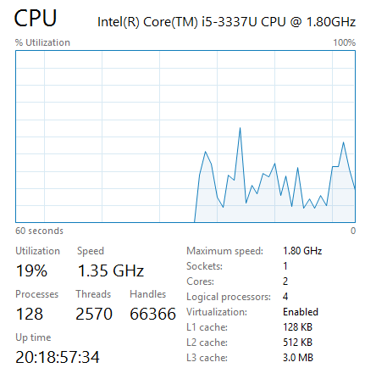
Threads. Cores. Logical Processors.
Logical cores enable a single core to do 2 or more things simultaneously. This grew out of the early Pentium 4 CPUs ability to do what was termed Hyper Threading

Slide 14
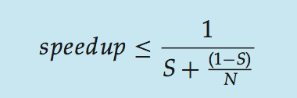
Amdahl’s Law
Identifies performance gains from adding additional cores to an application that has both serial and parallel components
S is serial portion
N processing cores
That is, if application is 75% parallel / 25% serial, moving from 1 to 2 cores results in speedup of 1.6 times
As N approaches infinity, speedup approaches 1 / S. i.e., at some point, adding more cores doesn’t improve speedup.
But does the law take into account contemporary multicore systems?

Slide 15
User Threads and Kernel Threads
User threads - management done by user-level threads library
Three primary thread libraries:
POSIX Pthreads (either user-level or kernel level)
Windows threads (kernel level)
Java threads (implemented using host system API)
Kernel threads - Supported by the Kernel
Examples – virtually all general purpose operating systems, including:
Windows
Solaris
Linux
Tru64 UNIX
Mac OS X

Slide 16
Multithreading Models
Why?
A relationship must exist between user threads and kernel threads.
Many-to-One
One-to-One
Many-to-Many
By itself a user thread is just a bunch of data in a user program.
Kernel threads are the real threads in the system, so for a user thread to make progress the user program has to have its scheduler take a user thread and then run it on a kernel thread.

Slide 17
Many-to-One
Many user-level threads mapped to single kernel thread
Thread management is done efficiently in the user space by the thread library
One thread blocking causes all to block
Multiple threads may not run in parallel on multicore system because only one user thread may access the kernel at a time
Few systems currently use this model
Example:
Solaris Green Threads

Slide 18
One-to-One
Each user-level thread maps to a kernel thread
Creating a user-level thread creates a kernel thread (cost issue)
More concurrency than many-to-one – another thread can run when a thread makes a blocking system call
More parallelism in multiprocessor environment
Number of threads per process sometimes restricted due to overhead
Examples
Windows
Linux
Solaris 9 and later

Slide 19
Many-to-Many Model
Allows many user level threads to be mapped to many kernel threads
Allows the operating system to create the appropriate number of kernel threads based on application or hardware requirements
Solaris prior to version 9
Windows with the ThreadFiber package

Slide 20
User to Kernel Thread Mapping Models
Impact on Concurrency
Many-to-one allows ‘unlimited’ user kernels
Not true concurrency since only one kernel thread executes at a time
One-to-one allows greater concurrency but sets limits on the number of threads
Many-to-many allows ‘unlimited’ user kernels and the kernel threads can run in parallel on a multiprocessor.

Slide 21
Two-level Model
Similar to M:M, except that it allows a user thread to be bound to kernel thread
Examples
IRIX
HP-UX
Tru64 UNIX
Solaris 8 and earlier

Slide 22
Asynchronous/Synchronous Threading
Asynchronous Threading:
Once the parent creates a child thread, the parent resumes its execution.
Parent and child execute concurrently.
Each thread runs independently of every other thread
Parent thread agnostic to child terminations.
Synchronous Threading: (fork-join strategy)
Once the parent creates a child thread it must wait for all child threads to terminate
Child threads work concurrently, but parent must wait.
Typically involved significant data sharing amongst threads.

Slide 23
Thread Libraries
Thread library provides programmer with API for creating and managing threads
Two primary ways of implementing
Library entirely in user space
less overhead to create a thread
Kernel-level library supported by the OS
requires system call to kernel each time a thread is created.

Slide 24
Pthreads
May be provided either as user-level or kernel-level
A POSIX standard (IEEE 1003.1c) API for thread creation and synchronization
Specification, not implementation What’s the difference?
API specifies behavior of the thread library, implementation is up to development of the library
Common in UNIX operating systems (Solaris, Linux, Mac OS X)

Slide 25
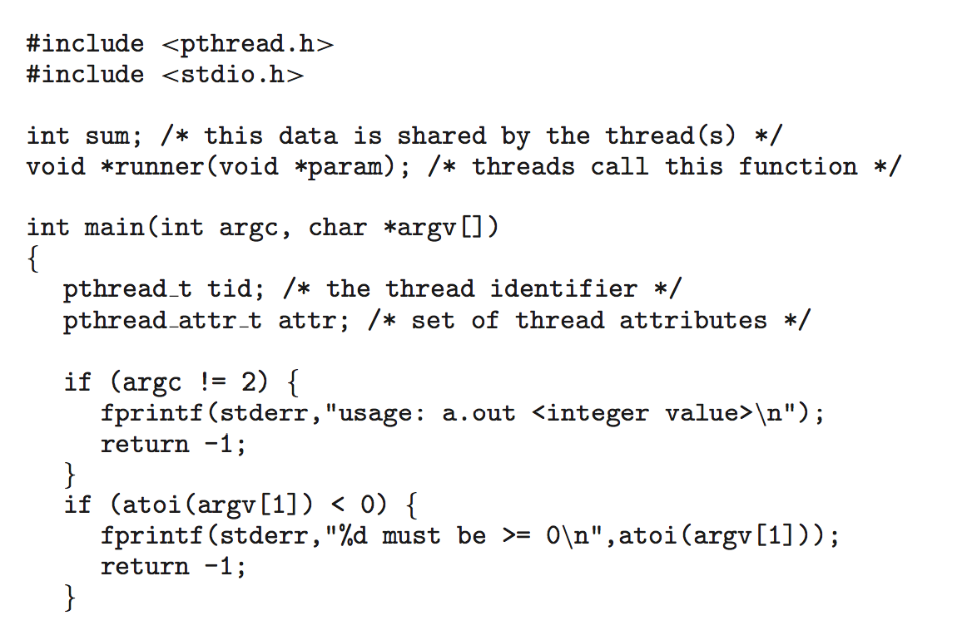
Pthreads Example

Slide 26
Pthreads Example (Cont.)

Slide 27
Pthreads Code for Joining 10 Threads

Slide 28
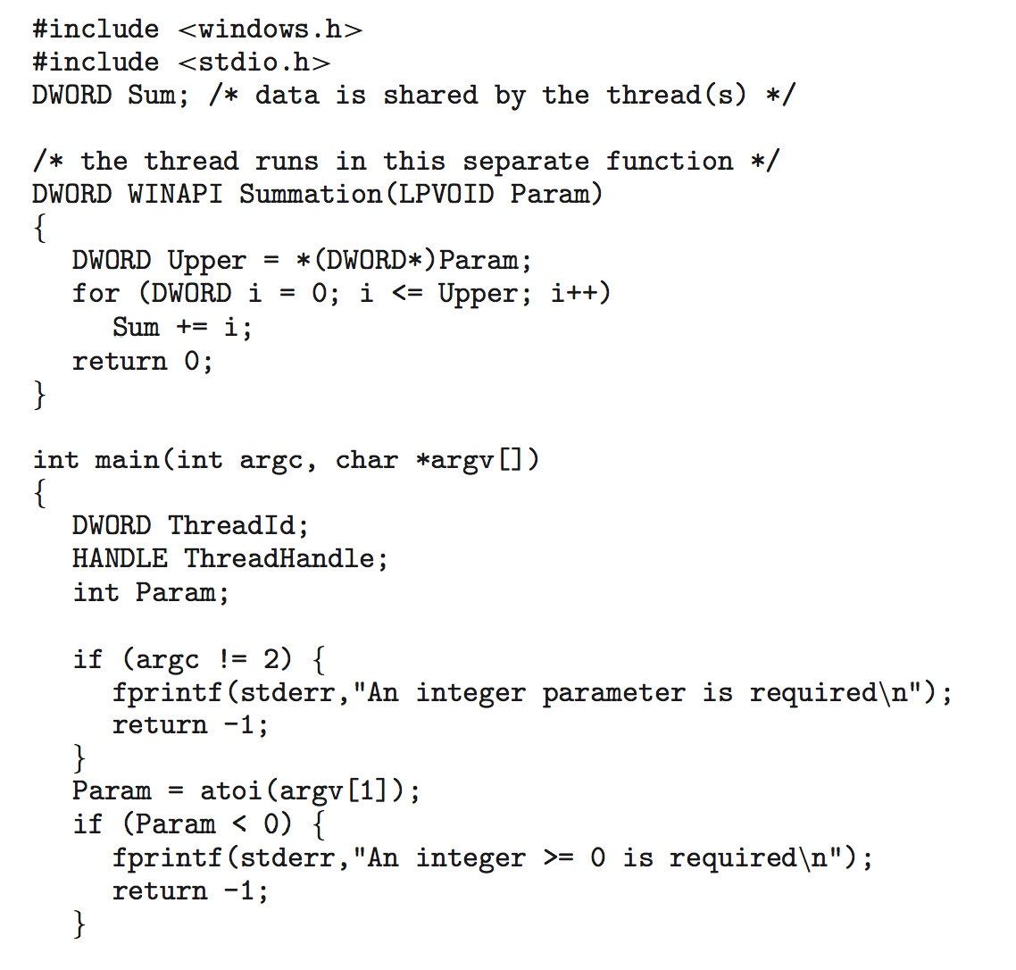
Windows Multithreaded C Program

Slide 29
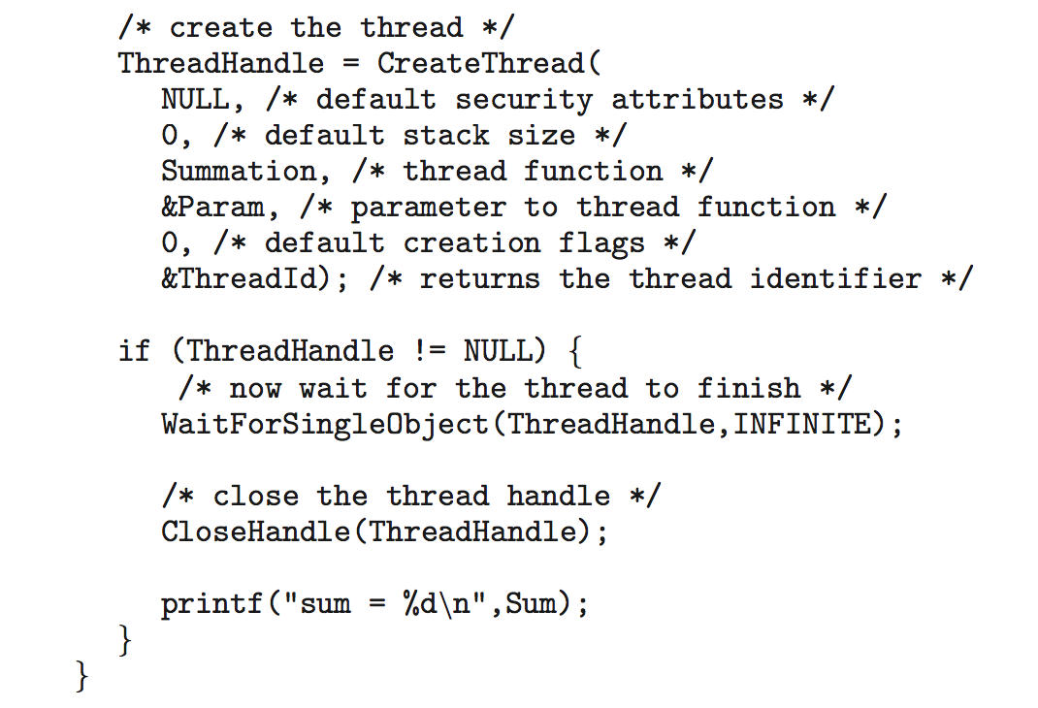
Windows Multithreaded C Program (Cont.)

Slide 30
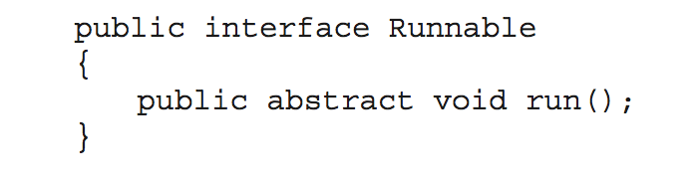
Java Threads
Java threads are managed by the JVM
Typically implemented using the threads model provided by underlying OS
Java threads may be created by:
Extending Thread class
Implementing the Runnable interface

Slide 31
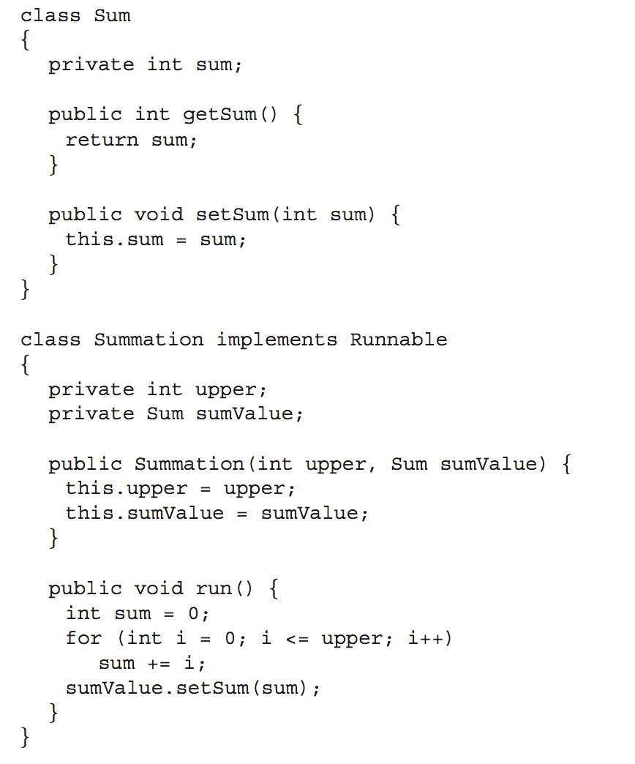
Java Multithreaded Program

Slide 32
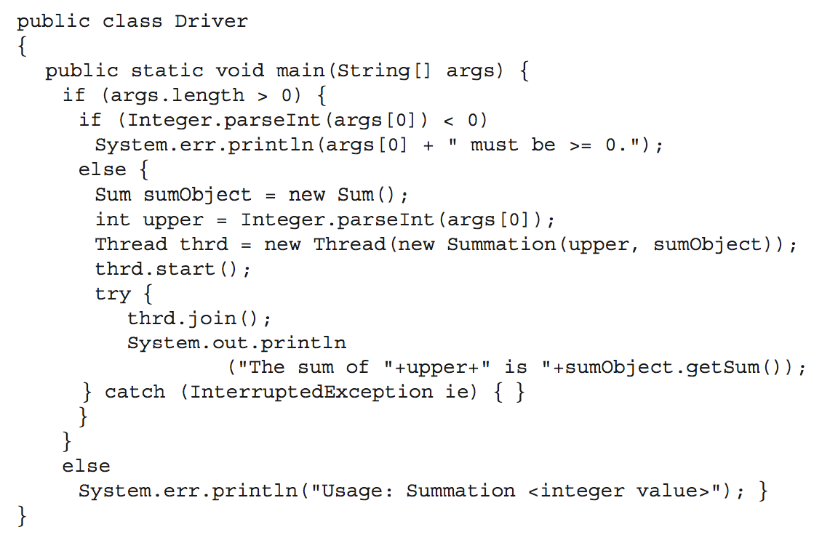
Java Multithreaded Program (Cont.)

Slide 33
Implicit Threading
Growing in popularity as numbers of threads increase, program correctness more difficult with explicit threads
Creation and management of threads done by compilers and run-time libraries rather than programmers
Three methods for designing multithreaded programs that can take advantage of multicore processing through implicit threading:
Thread Pools
OpenMP
Grand Central Dispatch
Other methods include Microsoft Threading Building Blocks (TBB), java.util.concurrent package

Slide 34
Thread Pools – Why?
Earlier web server example:
Issues with This Solution:
Thread creation still takes time (albeit less than process creation)
Threads are discarded after they complete their tasks
‘Unlimited’ threads could exhaust CPU or memory.

Slide 35
Thread Pools
Create a number of threads at process startup in a pool where they await work
Advantages:
Usually slightly faster to service a request with an existing thread than create a new thread
Allows the number of threads in the application(s) to be bound to the size of the pool
Separating task to be performed from mechanics of creating task allows different strategies for running task
i.e. Tasks could be scheduled to run periodically or after a delay
Thread pool size can be
Set heuristically based on system resources and expected concurrent client requests
Dynamically adjusted (e.g., Apple’s Grand Central Dispatch)

Slide 36
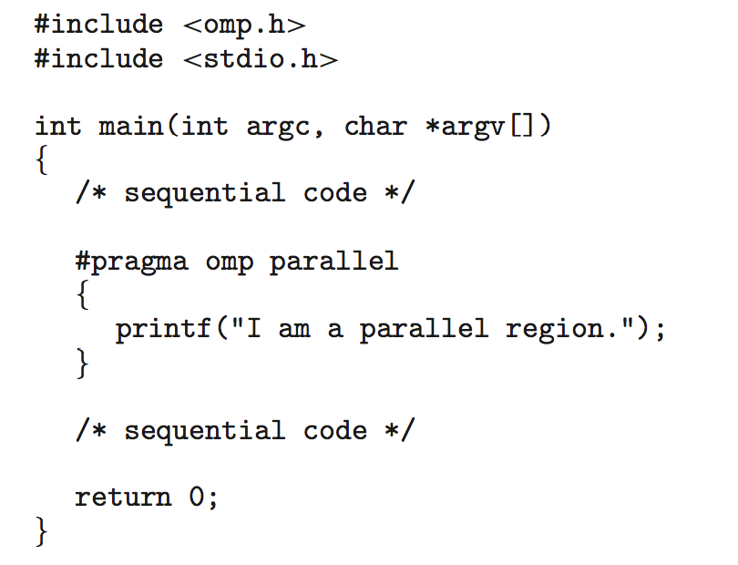
OpenMP
Set of compiler directives and an API for C, C++, FORTRAN
Provides support for parallel programming in shared-memory environments
Identifies parallel regions – blocks of code that can run in parallel
#pragma omp parallel
Create as many threads as there are cores

Slide 37
OpenMP
OpenMP supports parallelizing loops.
To sum the contents of Arrays A and B into C we would use the following syntax:
The work of summing the arrays is divided among the created threads
#pragma omp parallel for for(i=0;i<N;i++) {
c[i] = a[i] + b[i];
}

Slide 38
Grand Central Dispatch
Apple technology for Mac OS X and iOS operating systems
Extensions to C, C++ languages, API, and run-time library
Allows identification of parallel sections
Manages most of the details of threading
Block is in “^{ }” - ˆ{ printf("I am a block"); }
Blocks placed in dispatch queue
Assigned to available thread in thread pool when removed from queue

Slide 39
Grand Central Dispatch
Two types of dispatch queues:
serial – blocks removed in FIFO order, queue is per process, called main queue
Programmers can create additional serial queues within program
concurrent – removed in FIFO order but several may be removed at a time
Three system wide queues with priorities low, default, high

Slide 40
Threading Issues
Semantics of fork() and exec() system calls in multithreaded program
Should fork() duplicate all threads or is new process single-threaded?
what if one thread is deducting money from your checking account?
Some UNIX systems (e.g., Solaris) have two versions fork() and forkall()
Use fork() when exec() will be called immediately after forking since exec() will replace the process
Use forkall() when the new process does not call exec() so the new process should duplicate all threads.

Slide 41
Threading Issues
Signal: notification of an event occurring
Synchronous and asynchronous
Thread cancellation of target thread
Asynchronous or deferred
Thread-local storage
Scheduler Activations

Slide 42
Threading Issues: fork()/exec()
Does fork()duplicate only the calling thread or all threads?
what if one thread is deducting money from your checking account? Do you want that duplicated?
Some UNIXes have two versions of fork (Solaris’ forkall())
exec() usually works as normal – replace the running process including all threads

Slide 43
Signal Handling
Signals are used in UNIX systems to notify a process that a particular event has occurred.
A signal handler is used to process signals
A Signal is
generated by particular event
delivered to a process
handled by one of two signal handlers:
default
user-defined
Every signal has default handler that kernel runs when handling signal
User-defined signal handler can override default
For single-threaded process, signal delivered to process

Slide 44
Signal Handling (Cont.)
Where should a signal be delivered for multi-threaded process?
Deliver the signal to the thread to which the signal applies
Deliver the signal to every thread in the process
Deliver the signal to certain threads in the process
Assign a specific thread to receive all signals for the process
Synchronous signals need to be delivered to the thread causing the signal (e.g., divide by 0 error)
Some Asynchronous signals should go to all threads (e.g., <control> <C>)
OSs vary in their support
to specify threads as destination (Windows APC),
the ability of threads to selectively block signals (some multithread UNIX systems)

Slide 45
Thread Cancellation
Terminating a thread before it has finished
Multiple threads searching a database. When the data item is found by one thread, the others can be cancelled.
Pressing the X button on a browser window will cause multiple threads loading content (each image is loaded by a separate thread) to be cancelled.
Thread to be canceled is target thread
Two general approaches:
Asynchronous cancellation terminates the target thread usually immediately but not guaranteed to be so
Problems occur when resources have been allocated to the target thread or it is updating data shared by other threads
OSs may only reclaim system resources but not all resources
Deferred cancellation allows the target thread to periodically check if it should be cancelled

Slide 46
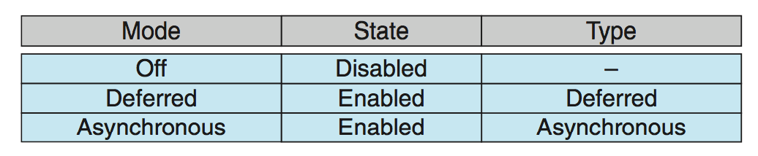
Thread Cancellation (Cont.)
Pthreads Implementation: Invoking thread cancellation requests cancellation, but actual cancellation depends on thread state
If thread has cancellation disabled, cancellation remains pending until thread enables it
Default type is deferred
Cancellation only occurs when thread reaches cancellation point
I.e. pthread_testcancel()
Then cleanup handler is invoked
On Linux systems, thread cancellation is handled through signals

Slide 47
Thread-Local Storage
Threads share the data of the process and reduces overhead in data sharing.
Sometimes threads need their own copy of the data.
Transactions might store their Transaction IDs in TLS
Thread-local storage (TLS) allows each thread to have its own copy of data
e.g., use of errno to specify system error code. If not protected can get overwritten by another thread
Useful when you do not have control over the thread creation process (i.e., when using a thread pool)
Different from local variables
Local variables visible only during single function invocation
TLS visible across function invocations (useful to save state)
Similar to static data
Except that TLS is unique to each thread

Slide 48
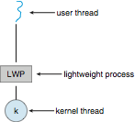
Scheduler Activations
Both M:M and Two-level models require communication to maintain the appropriate number of kernel threads allocated to the application
Typically use an intermediate data structure between user and kernel threads – lightweight process (LWP)
Appears to be a virtual processor on which process can schedule user thread to run
Each LWP attached to kernel thread
Kernel threads are scheduled to run on physical processors.
When a kernel thread blocks (e.g., waiting for I/O), the LWP blocks, and so does the thread.
Applications may have limited allocations of LWP and may be forced to wait when they exhaust their LWP quota.

Slide 49
Scheduler Activation
Communication between Kernel and User-thread library
Kernel provides application with a set of virtual processors (LWPs)
Application can schedule user threads on any available virtual processors
Kernel informs application about events via an upcall.
Upcalls are handled by upcall handlers that run on virtual processors.

Slide 50
Scheduler Activation
Blocking event upcall sequence:
Kernel makes an upcall to the application identifying the thread that is about to block
Kernel allocates a new virtual processor to the application.
Application runs an upcall handler on this new virtual processor which saves the state of the blocking thread, and releases the old virtual processor on which the blocking thread is running.
Upcall handler schedules another thread to run on the new virtual processor
When blocking is cleared, Kernel issues another upcall to the thread library, issues a new virtual processor.
Application marks thread as eligible to run and schedules it on an available virtual processor

Slide 51
Operating System Examples
Windows Threads
Linux Threads
Notes:
51

Slide 52
Windows Threads
Windows implements the Windows API – primary API for Win 98, Win NT, Win 2000, Win XP, and Win 7
Implements the one-to-one mapping, kernel-level
Each thread contains
A thread id
Register set representing state of processor
Separate user and kernel stacks for when thread runs in user mode or kernel mode
Private data storage area used by run-time libraries and dynamic link libraries (DLLs)
The register set, stacks, and private storage area are known as the context of the thread

Slide 53
Windows Threads (Cont.)
The primary data structures of a thread include:
ETHREAD (executive thread block) – includes pointer to process to which thread belongs and to KTHREAD, in kernel space
KTHREAD (kernel thread block) – scheduling and synchronization info, kernel-mode stack, pointer to TEB, in kernel space
TEB (thread environment block) – thread id, user-mode stack, thread-local storage, in user space

Slide 54
Windows Threads Data Structures

Slide 55
Linux Threads
fork()creates processes (shares all parent data structures)
clone()creates threads
Linux refers to processes and threads as tasks
clone()controls what a child shares of the address space of the parent task (process)
Flags control behavior

Slide 56
Threads Revisited
3 "Types" Of Threads
User level threads
threads which you create in a multi-threaded application
Kernel threads
each acts as a unit to be scheduled by the OS scheduler
Hardware threads (or CPU threads)
A single CPU core is represented to the Operating System as two cores
OS schedules two tasks on the two "logical" cores as it would on two physical cores in a multi-processor system
The single physical CPU core will switch between the tasks on the two logical cores as it sees fit
when one task is stalled waiting for data to be loaded, it switches to the other one

Slide 57
Threads Revisited - Hardware threads
Program issues a LOAD instruction
if the content of the requested address isn’t in cache, it needs be fetched from RAM and there’s a delay
Without hardware CPU threading, the CPU is idle during this fetch time.
With hardware threading multiple threads of computation are saved in an internal CPU memory.
Instead of waiting, the computer swaps out the current state, swaps in one ready to go, and keeps executing
That swap can start the new thread on the very next CPU cycle

Slide 58
End of Chapter 4

