Slide 1

Digital Marketing Simternship
Presented by Natibundit Suntraranusorn (Pete)

Slide 2
Agenda
1. Overview
3. Conclusion & Reflection
2. Digital Marketing Tactics & Performance Analysis
Objectives
Product Selection
Target Market
Overall Performance
Lessons Learned
Digital Marketing Tactics
Key Decisions
Outcomes
Performance Analysis

Slide 3
1.Overview

Slide 4

Objectives
Design backpack products that align with the customer’s preferences
Increase online visibility by developing SEO to improve the company's online presence through digital marketing strategies
Utilizing data-driven approaches to continually enhance the decision making
Consistently improve the exposure effectiveness and maximizing Return on Investment (ROI) through optimization strategies

Slide 5
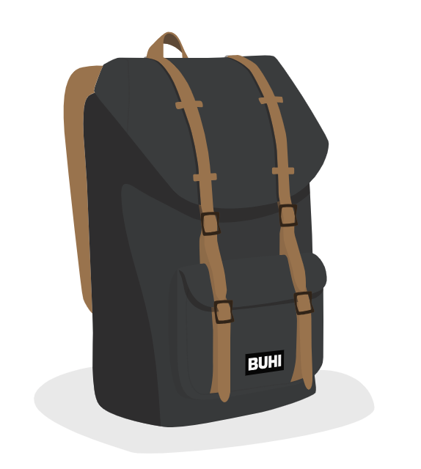
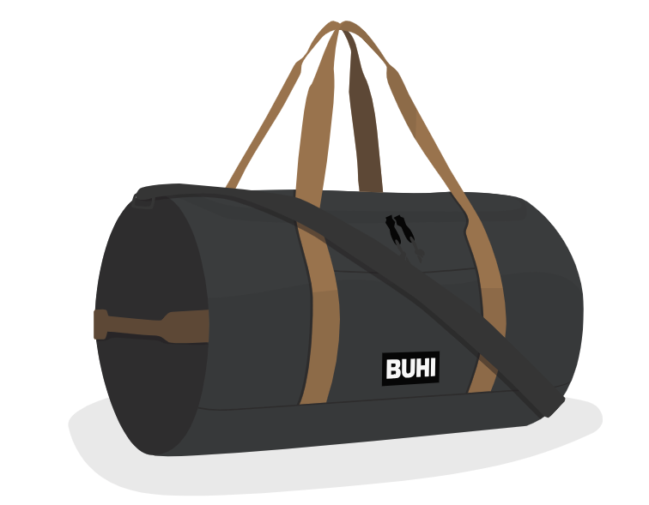

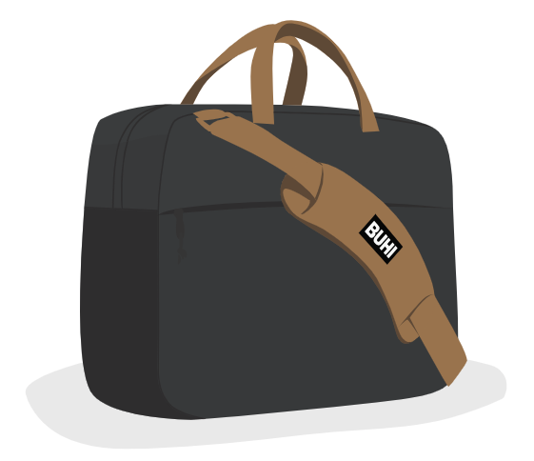
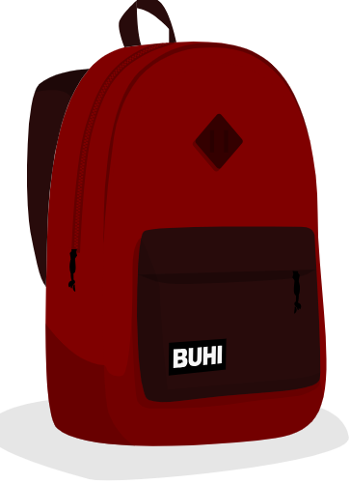
Product Selection
American Dream Backpack
American Dream Duffel Bag
American Dream Messenger Bag

Slide 6
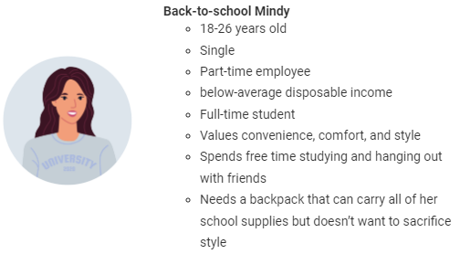
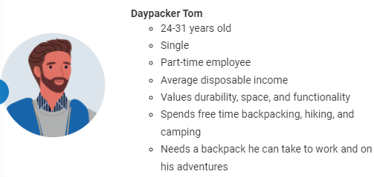
Target Market for Backpack
American Dream School Backpack Campaign
American Dream Traveling Backpack Campaign

Slide 7
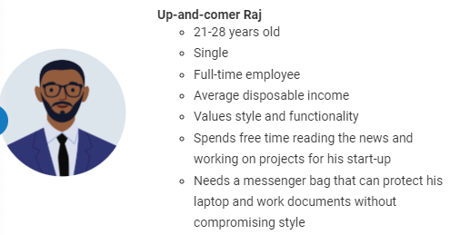
Target Market for Messenger Bag
American Dream Messenger Bag campaign

Slide 8
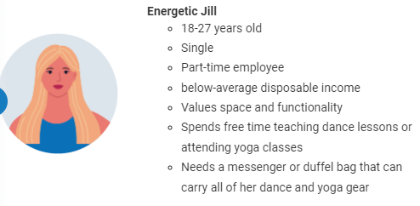
Target Market for Duffel Bag
American Dream Duffel Bag

Slide 9
2.Digital Marketing Tactics & Performance Analysis

Slide 10
Digital Marketing Strategy
Awareness
Interest
Desire
Action
Turn 1 - 3
Turn 4 - 7
Turn 8 - 10
Generating Traffic
Driving Conversions
Maximize Revenue

Slide 11
Digital Marketing Tactic for Search Ads
Turns 1 - 3
Generating Traffic with Search Ads
In this phase, my focus is on creating awareness and attracting user attention. Using broad keyword rather than specific keyword.
The keyword list per campaign is in between 12 and 20.
Search Ad is the primary revenue that generate profit to the organization. Therefore, the budget was approximately allocated 50% for search Ads.
The bid strategy is driven by incremental impressions and CPC (cost-per-click). Aiming to maximize visibility and control costs. The Maximum CPC will not exceed than $2 per keyword.
To evaluate compelling keywords, Ad relevance, Page relevance, and bid Quality from the three critical criteria of star rating are a key success.

Slide 12
Digital Marketing Tactic for Display Ads
Turns 4 – 7
Driving Conversions with
Display Ads
During this stage, Visually appealing and persuasive display ads guide users through the interest and desire stages of AIDA, leading to conversions.
Creating one display ad for each campaign by allocating budget on American dream backpack and American dream messenger rather than American dream duffel because of higher profit margin.
The purpose of Display Ad is to dramatically increase the impressions. Therefore, the budget was approximately allocated 20% because Display Ad generate less conversion rate.
Maintaining conversion rate of display ads to be greater than 1% for all of campaigns and 4% for Search ads.

Slide 13
Digital Marketing Tactic for Shopping Ads
Turns 8 - 10
Maximizing Revenue with Shopping Ads
At this point, users are in the decision stage, ready to make a purchase.
Shopping ads provide detailed product information and pricing.
The Shopping Ad goal is to capitalize on user intent and facilitate conversions. Therefore, the budget was approximately allocated 30%.
excluding irrelevant search terms (Negative keywords) to efficiently improve performance by continually monitoring for better targeting.
Implement remarketing campaigns to target users who have previously engaged with the products to encourage conversions.
Maintaining conversion rate of display ads to be greater than 1% , 4% for Search ads, and 4% for Shopping ads.

Slide 14
Round1 – Introduction to Search ads Key decisions
Budget and Objective Round 1
Key decisions#3
- Budget: $1,200
- Reach: 1,500 Clicks
- Select over 20 keywords
Keyword Selection Criteria:
- Keywords with a high search volume and relevance are prioritized
- Selecting Keywords with medium to low competition.
Key decisions#1
Key decisions#4
Creating American Dream backpack campaign and Duffel bag campaign.
- Bids under $2 are preferred.
- Maximum CPC bid conform the system suggestion.
Key decisions#2
Key decisions#5
Creating a Landing page for American dream backpack that include the functionality of product message and relevant information keywords.
Designing a Search Ad for American dream backpack and Duffel bag campaign.

Slide 15
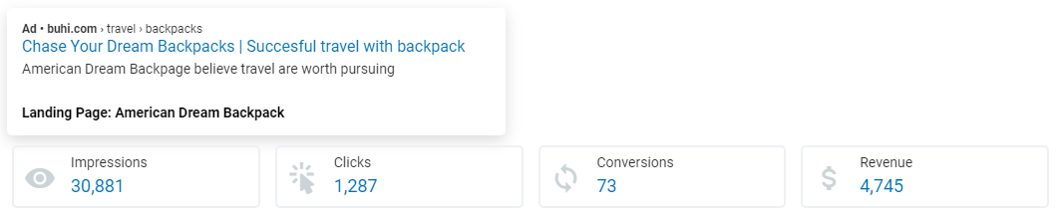
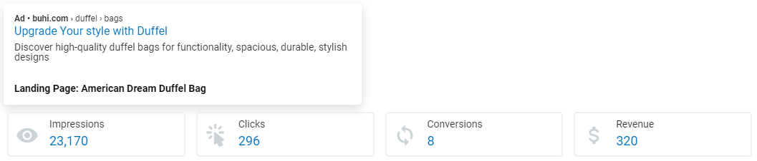
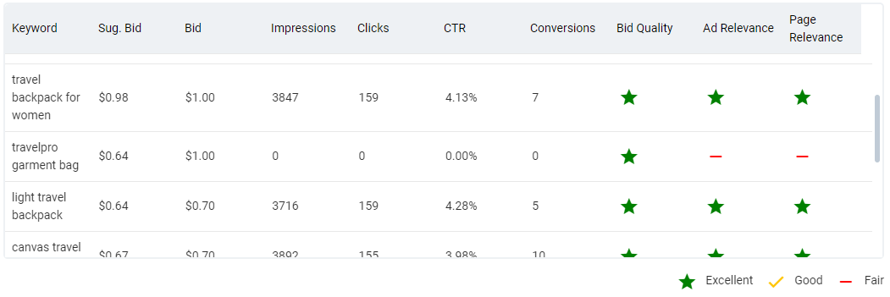
Round1 – Introduction to Search ads Performance
Analyze the result
In the first round, the primary objective was to familiarize with the simulation environment and test the impact of running two different campaigns: one related to the product (Backpack) and another unrelated campaign (Duffel). The goal was to understand how these decisions influenced key performance indicators and learn about the simulation's interface. After finished this round, all keyword list have been analyzed.
15

Slide 16
Round2 – Search Ad Practice Key decisions
Key decisions#3
Optimizing keyword lists in enhancing digital marketing performance:
- Remove ineffective keywords by analyzing the quality scores of keywords in three important elements
- Add New potential keywords
Budget and Objective Round 2
- Budget: $2,400
- Backpack: Maintain over 1,500 clicks
- Messenger Bag: Reach 800 clicks,
- Messenger Bag: Select over 20 keywords
Key decisions#4
- Optimizing a Landing page for American dream backpack
- Creating a Landing page for American dream messenger bag
Key decisions#1
Remove the duffel bag campaign and replacing school backpack campaign instead.
Key decisions#5
Key decisions#2
- Adjusting a Search Ad for American dream backpack of traveling campaign
- Designing a Search Ad for American dream backpack of school campaign and American dream messenger bag.
- Optimizing American Dream backpack campaign
- Creating American Dream messenger bag campaign.

Slide 17

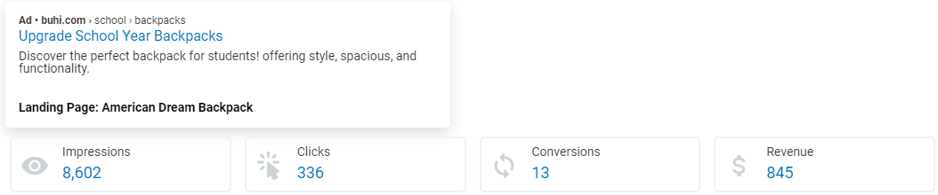
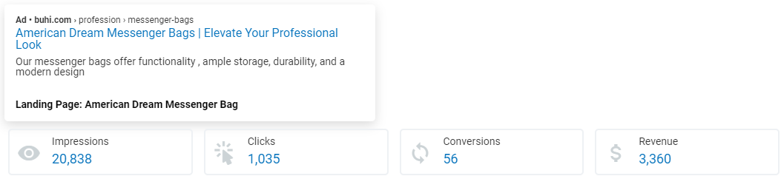
Round2 – Search Ad Practice
Analyze the result
In the second round, three campaigns have been continuously deployed. The Traveling Backpack campaign maintained a moderate performance level similar to the first round even though some potential keywords were replaced. Unfortunately, the School Backpack campaign displayed poor performance with limited impression and clicks. While the Messenger Bag campaign performed well, showing high impression and clicks.
17

Slide 18
Round3 – Search Ad Optimization Key decisions
Key decisions#3
Budget and Objective Round 3
- Optimizing a Landing page for American dream backpack
- Creating a Landing page for American dream duffel bag
- Budget: $4,800
- Backpack: Maintain over 1,500 clicks
- Messenger Bag: Reach 1,000 clicks
- Duffel Bag: Reach 1,000 clicks
- Duffel Bag: Select over 20 keywords
Key decisions#4
- Adjusting a Search Ad for American dream backpack of traveling campaign, school campaign and American dream messenger bag.
- Designing a Search Ad for American dream duffle bag
Key decisions#1
- Optimizing American Dream backpack campaign for traveling campaign and school campaign.
- Creating American Dream duffel bag campaign.
Key decisions#5
Key decisions#2
Allocating a budget in equality for four campaigns
Optimizing keyword lists in enhancing impression and clicks performance.

Slide 19


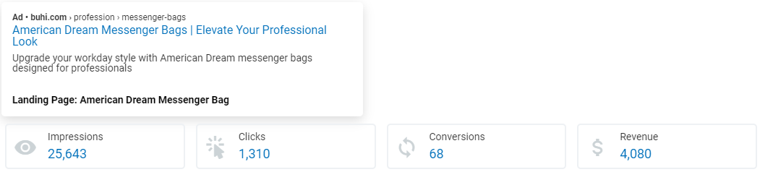
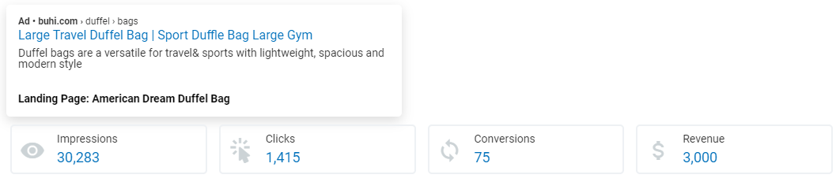
Round3 – Search Ad Optimization
Analyze the result
After optimization of Search Ad, The Traveling Backpack campaign and the Messenger Bag campaign remained a performance level similar to the second rounds while, the School Backpack campaign dramatically improve the performance due to adjust the keyword group. The Duffel Bag campaign well performed with the highest impression and clicks when the product campaign was first released.
19

Slide 20
Round4 – Introduction to Display Ads Key decisions
Key decisions#3
Budget and Objective Round 4
Creating Display Ads for four campaigns.
- Budget: $7,500
- Reach $10,000 in total revenue across your campaigns
Key decisions#4
Search ads are revenue-focused, targeting users with high purchase intent, while display ads prioritize impressions and brand exposure. Therefore, 70% of budget was allocated to Search Ads and 30% of budget was distributed to Display Ads because of emphasizing on ROI.
Key decisions#1
Optimizing all landing pages to convert impression into conversion by applying CTA button and encouraging message to attract target audiences.
Key decisions#2
Optimizing keyword lists of all campaign to convert impression into conversion.

Slide 21
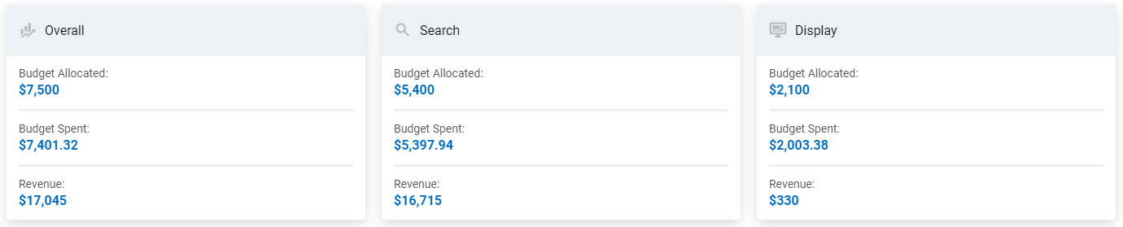
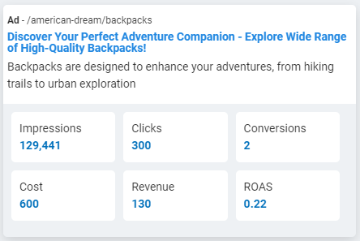
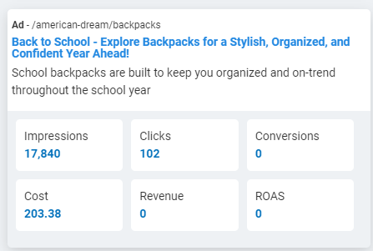
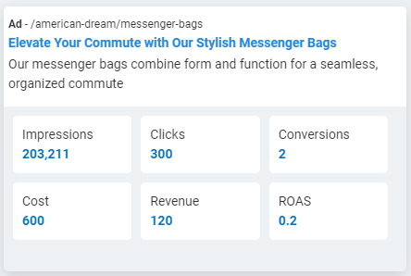
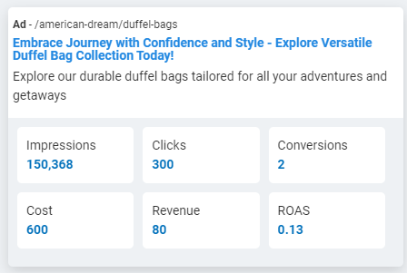
Round4 – Introduction to Display Ads
Overall budget allocation and Revenue
Display Ad results
Analyze the result
For Search Ad, all campaigns had been consistently improved especially the Messenger Bag campaign. For Display Ad, display ads have a remarkable advantage in terms of their wide reach to visually appeal a large number of potential customers. However, display ads have lower direct conversion rates compared to search ads and requiring a significant investment with low return on advertising spend(ROAS).
21

Slide 22
Round5 – Display Ads and Remarketing Key decisions
Budget and Objective Round 5
Key decisions#2
- Budget: $10,500
- Reach $15,000 in total revenue across your campaigns
Optimizing Display Ads for three campaigns.
Key decisions#3
Optimizing keyword lists of all campaign by selecting keyword that have CTR exceed than 4.5% and 20 keywords was the maximum per each campaign to maximize ROI.
Key decisions#1
After an analysis of the display Ad performance, it has been determined that the school campaign are not aligning with ROI goals. The impressions generated are considerably low and do not justify the associated costs. As a result, I decided to discontinue the school campaign of display ads in order to reallocate resources more efficiently.
Key decisions#4
75% of budget was allocated to Search Ads and 25% of budget was distributed to Display Ads.

Slide 23
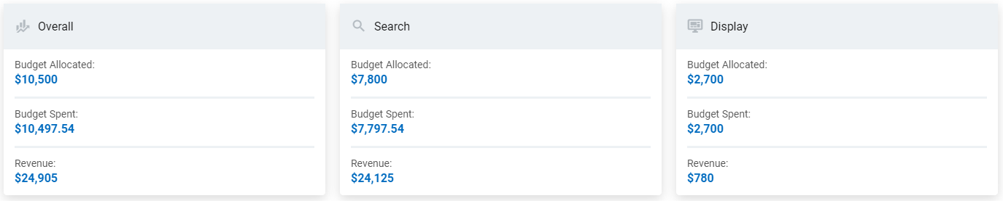
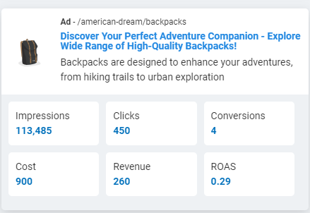
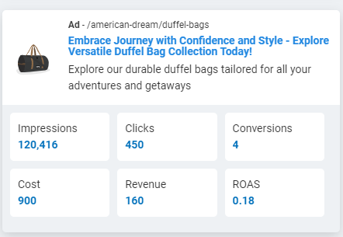
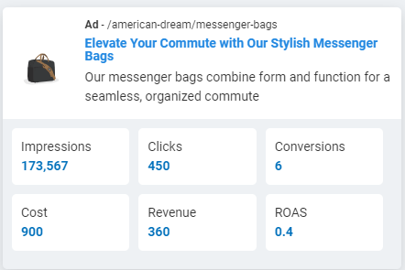
Round5 – Display Ads and Remarketing
Overall budget allocation and Revenue
Display Ad results
Analyze the result
For Search Ad, all four campaigns had been consistently improved.
For Display Ad, Despite observing a marginal decline in impressions across three display ad campaigns. As one can see a favorable improvement in the conversion rates. This highlight the importance of quality over quantity that emphasize the engaging with a responsive audience.
23

Slide 24
Round6 – Optimize Display Ad Campaigns Key decisions
Budget and Objective Round 6
Key decisions#3
- Budget: $10,500
- Reach $17,500 in total revenue across your campaigns
Adjusting CPC by following these tactics:
- For Broad keywords, bids will set slightly below the suggestion.
- For Specific keywords, bids will set at the suggestion or slightly above for potential specific keywords for ROI purpose.
- For Low Competition keywords, bids will set slightly below the suggestion.
- For Medium Competition keywords, bids will set at the suggestion.
- For High Competition keywords, bids will set slightly above the suggestion.
Key decisions#1
- 70% of budget was allocated to Search Ads and - - 30% of budget was distributed to Display Ads.
Key decisions#2
Allocating the budget for all three campaigns of Display Ads in equality to test the result with the round 5.

Slide 25
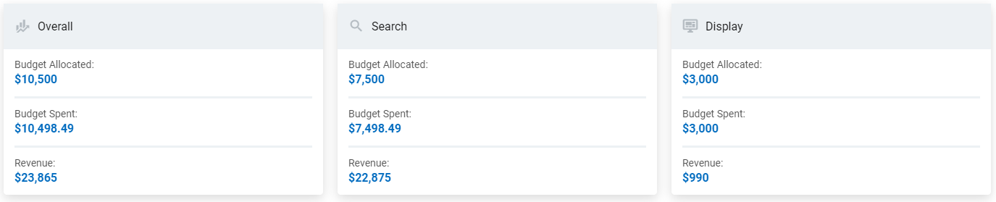
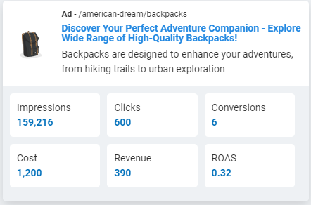
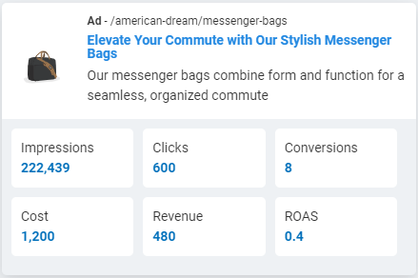
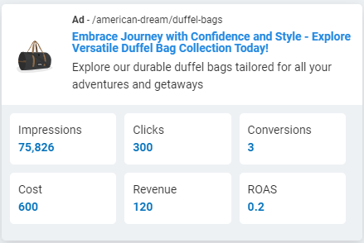
Round6 – Optimize Display Ad Campaigns
Overall budget allocation and Revenue
Display Ad results
Analyze the result
For Search Ad, a slight reduction in revenue across all four campaigns due to marginally decrease the budget.
For Display Ad, a significant increase in impressions for the Messenger Bag campaign, while the Duffle Bag campaign experienced a decline in impressions. However, the overall Display Ad campaigns show a slight improvement in terms of conversion rates.
25

Slide 26
Round7 – Introduction to Shopping Ads Key decisions
Budget and Objective Round 7
Key decisions#3
- Budget: $14,850
- Reach $20,000 in total revenue across your campaigns
Adjusting the keywords and choose negative keywords that are a wider range of related terms such as backpack and excluding terms that are not relevant to specific products such as duffel bag with wheels.
Key decisions#1
- 50% of budget was allocated to Search Ads
- 30% of budget was distributed to Display Ads.
- 20% of budget was distributed to Shopping Ads.
Key decisions#4
Analyzing the ad totals of report keyword that has high conversion and add specific key words into the keyword list. The specific keywords of selection include the number of clicks above 50 and conversion is greater than 2.
Key decisions#2
Creating a shopping Ads

Slide 27
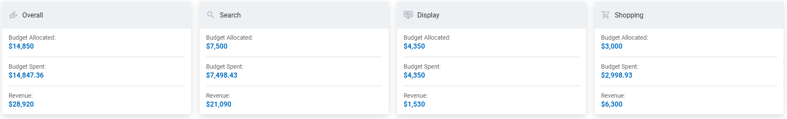
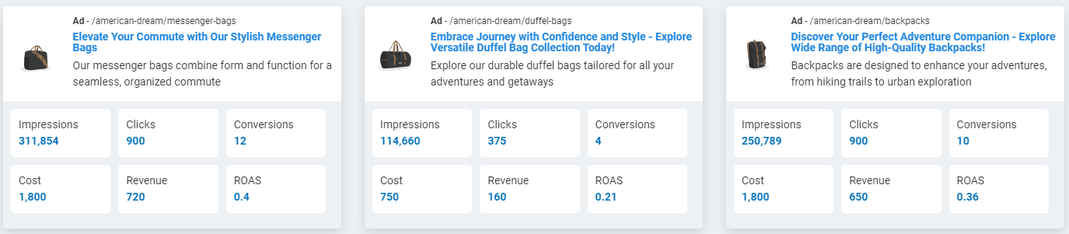
Round7 – Introduction to Shopping Ads
Overall budget allocation and Revenue
Analyze the result
For Search Ad, the revenue remains consistent with the results from round 6 across all four campaigns.
For Display Ad, there has been a substantial increase in impressions across all three campaigns and slightly expand in conversion rates.
For Shopping Ad, it generated a profit margin to $3,300
Display Ad results
27

Slide 28
Round8 – Shopping Ads Practice Key decisions
Budget and Objective Round 8
Key decisions#2
- Budget: $14,850
- Reach $25,000 in total revenue across your campaigns
Adjusting the keywords and choose negative keywords
Key decisions#1
Allocating the budget at the same proportion of round 7. However, emphasizing on American dream backpack campaign and American dream messenger bag because of higher profit margin.

Slide 29
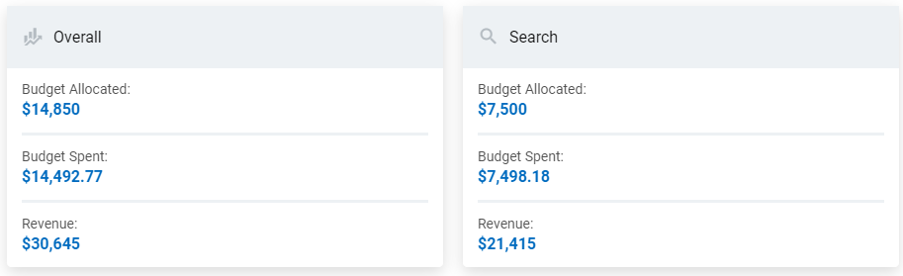
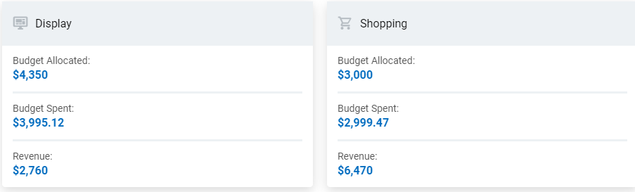
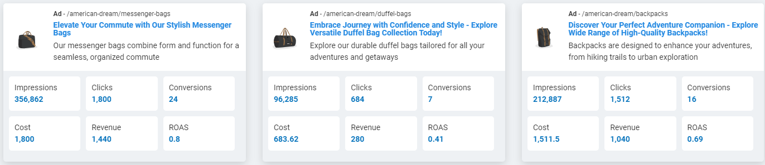
Round8 – Shopping Ads Practice
Overall budget allocation and Revenue
Analyze the result
The overall result for search ad, display ad, and shopping ads closely mirror those of round 7 with a subtle improvement in revenue performance.
29
Display Ad results

Slide 30
Round9 – Shopping Ad Optimization Key decisions
Budget and Objective Round 9
Key decisions#2
- Budget: $24,000
- Reach $35,000 in total revenue across your campaigns
Reviewing CPC on each product group to determine the appropriate bids.
Key decisions#3
Key decisions#1
Changing default CPC campaign from 1$ to 2$ for Search Ad and shopping Ad to cover all interesting keywords.
Adjusting the specific keywords and choose negative keywords that has generic terms but low conversion rates.

Slide 31
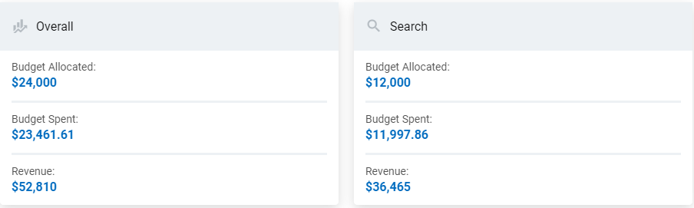
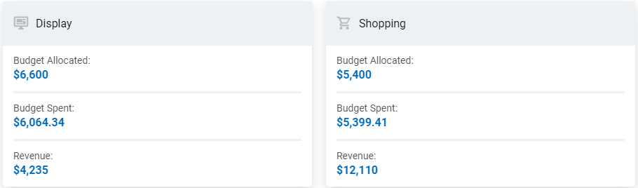
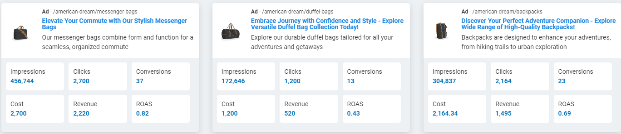
Round9 – Shopping Ad Optimization
Overall budget allocation and Revenue
Analyze the result
The collective performance of Search Ad, Display Ad, and Shopping Ad experienced a substantial boost of approximately 60%, despite a 40% increase in the advertising budget. Furthermore, conversion rate for Display Ad has been improved.
Display Ad results
31

Slide 32
Round10 – Campaign Optimization Key decisions
Budget and Objective Round 8
- Budget: $36,000
- Reach $50,000 in total revenue across your campaigns
Key decisions#1
Optimizing the specific keywords

Slide 33
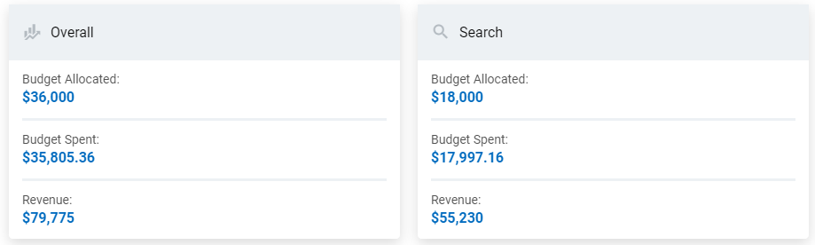
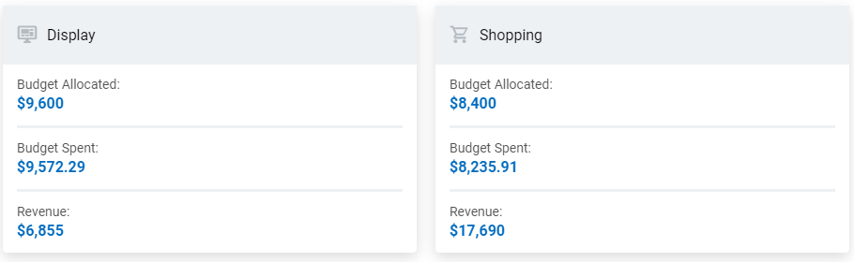
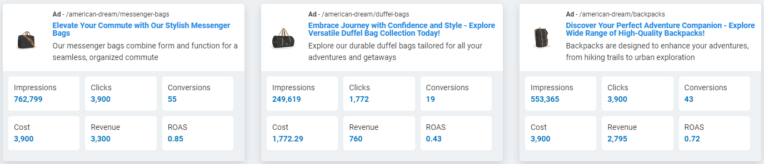
Round10 – Campaign Optimization
Overall budget allocation and Revenue
Analyze the result
The revenue from Search Ad and Shopping Ad displays a consistent upward trend in direct correlation with the allocated budget. Similarly, Display Ad was a continual growth in both impressions and conversions.
Display Ad results
33

Slide 34
3.Conclusion & Reflection

Slide 35
Overall Trend Performance

Slide 36
Overall Performances
Turn | Impressions | Clicks | Conversions | Cost | Revenue | Profit | Return on Ad spend
1 | 54,051 | 1,583 | 81 | 1,200 | 5,065 | 3,865 | 4.22
2 | 58,119 | 2,570 | 130 | 2,399 | 8,170 | 5,771 | 3.41
3 | 97,450 | 4,569 | 234 | 4,797 | 12,995 | 8,198 | 2.71
4 | 612,454 | 6,336 | 299 | 7,401 | 17,045 | 9,644 | 2.30
5 | 572,875 | 9,174 | 424 | 10,498 | 24,905 | 14,407 | 2.37
6 | 617,796 | 9,119 | 407 | 10,498 | 23,865 | 13,367 | 2.27
7 | 901,070 | 11,490 | 488 | 14,847 | 28,920 | 14,073 | 1.95
8 | 894,201 | 13,352 | 513 | 14,493 | 30,645 | 16,152 | 2.11
9 | 1,340,002 | 21,554 | 871 | 23,462 | 52,810 | 29,348 | 2.25
10 | 2,134,162 | 32,840 | 1,342 | 35,805 | 79,775 | 43,970 | 2.23

Slide 37
Lesson learn
Hands-on Experience
Practical of Budget Management
The digital marketing simulation provided a valuable hands-on experience, allowing us to apply theoretical knowledge in a real-world scenario.
We need to adept the budget allocation to achieve the ROI objective by finding the right balance between cost-effective strategies and desired outcomes.
Improved Decision-Making Skills
Practical of Keyword Research
Through the simulation, we have practiced a decision-making skills by making critical choices on budget allocation and digital marketing strategies.
Gaining hands-on experience in the importance of keyword research to optimize our product listings and advertising campaigns, helping us connect with our target audience effectively.
The importance of Data-Driven
The simulation emphasized the importance of data-driven by providing necessary information to use analytics and optimize campaigns for better results.

Slide 38

Thank you

