Slide 1

AI Based
TRAFFIC VIOLATION DETECTION AND REPORTING SYSTEM
EYUEL GASHAYE - BDU1201637
FIRAOL TOLESSA - BDU1201719
NATNAEL ADAMU - BDU1202627
NATNAEL BIRHANU - BDU1202631

Slide 2





Outline
INTRODUCTION
PROBLEM STATEMENT
METHODOLOGY AND SYSTEM COMPONENT
SYSTEM DESIGN
RESULT AND DEMO
RECOMMENDATION FOR FUTURE WORK

Slide 3
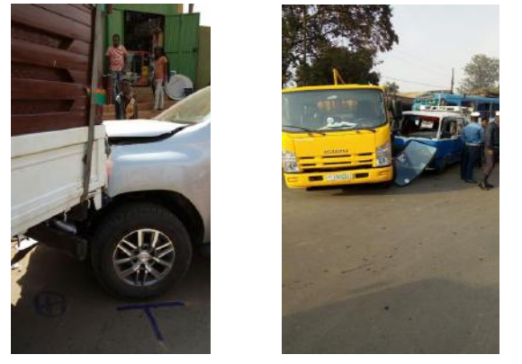
Traffic Violation
Traffic safety is critical concern worldwide
Cause disruption in traffic flow and in some cases fatalities

Slide 4
Contd.
WHAT ARE TRAFFIC VIOLATIONS TYPES
Red light violation
Red traffic light detection
Speeding
Over speeding condition check
Lane violation
Lane violation
Notes:
Outline some of the traffic violation types like speeding , redlight violations ….

Slide 5
Problem statement
Large volume of vehicle traffic
Inefficiency in mass vehicle handling and corruption
Lack of proper evidence of violation committed and human error
Difficulty tracking criminal vehicles

Slide 6
Objective
General Objective
Specific Objective
Implement a comprehensive traffic violation detection and reporting system to improve traffic efficiency and safety
Violation Detection
Police Watch List Hit
Real-Time Monitoring
Evidence Capture
Automated Reporting and Alerting
Secure Communication

Slide 7
Scope
Object type
car
Violations
Red light ,Speeding , Lane violation, flagged
Region of operation
Focus area is limited to streets that have traffic light
Detect and notify

Slide 8
Methodology
Literature Review
Requirement Gathering
System Design
Data Collection, pre processing and training
System Implementation
Algorithm Selection and Development

Slide 9
Literature review
Strengths:
Integration of AI models with algorithm such as data flow models, edge detection, and real-time tracking for traffic violation detections.
Weaknesses:
They don’t act on the data/violation record.
Challenges in managing real-time data
Focus on only single violation detection procedure
What we accomplished:
Implemented data management procedure, flagged car detection , integrated various violations.

Slide 10
Requirement Specification
Functional Requirements | Non-Functional Requirements
Plate Detection | Accuracy
License Plate Recognition | Security
Violation Detection | User Friendly Interface
Violation Reporting
Flagged Plate Detection
Real-time Alerting

Slide 11
System Component and Operation
System components are
1.Processing unit
2.Central Server and
3.Inter Connection communication
Processing
Unit
Violation data
Central Server
Alerting data
Traffic Personnel
flagged data

Slide 12
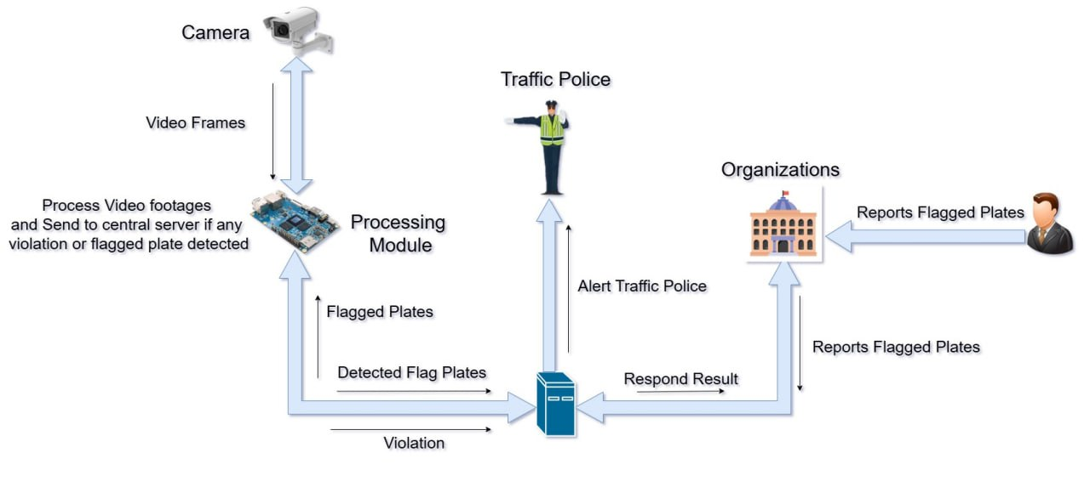
Contd.

Slide 13
System design

Slide 14
WHY YOLO ?
Real-time
Faster Response
Simpler to implement

Slide 15
Training of YOLO
Data Set Collection
Preprocessing
Annotation Process
Training Process
Google
Augmentation
Google collab
RoboFlow
Kaggle
Filtration
Roboflow

Slide 16
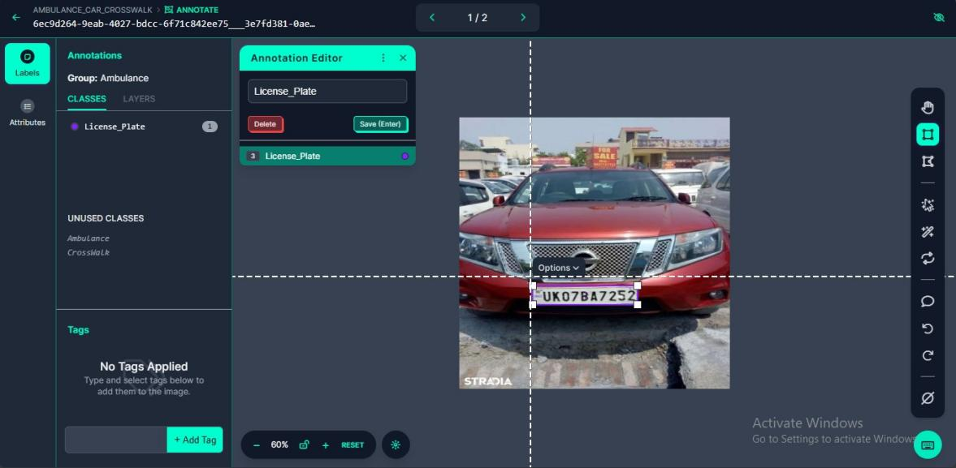
Annotation procedure

Slide 17
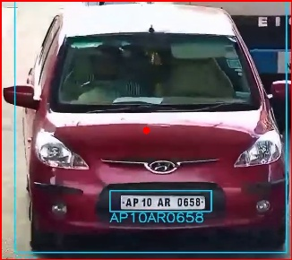


License Plate Detection and Recognition
Image Preprocessing
Cropping and gray scaling License plate ROI
Resizing and Threshold filtering
Cropping Vehicle and license plate ROI
Character segmentation and bitwise filter

Slide 18
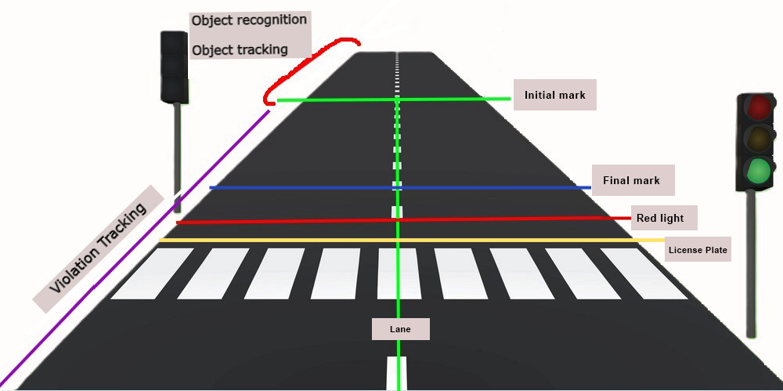
Traffic violation detection

Slide 19
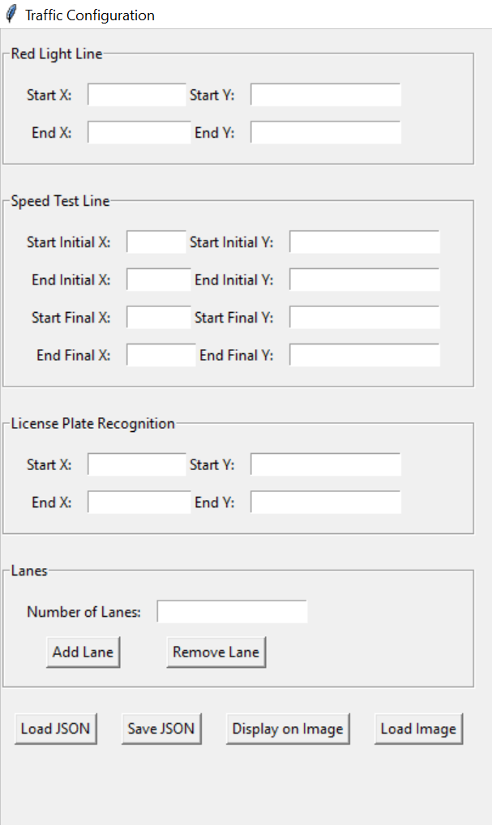
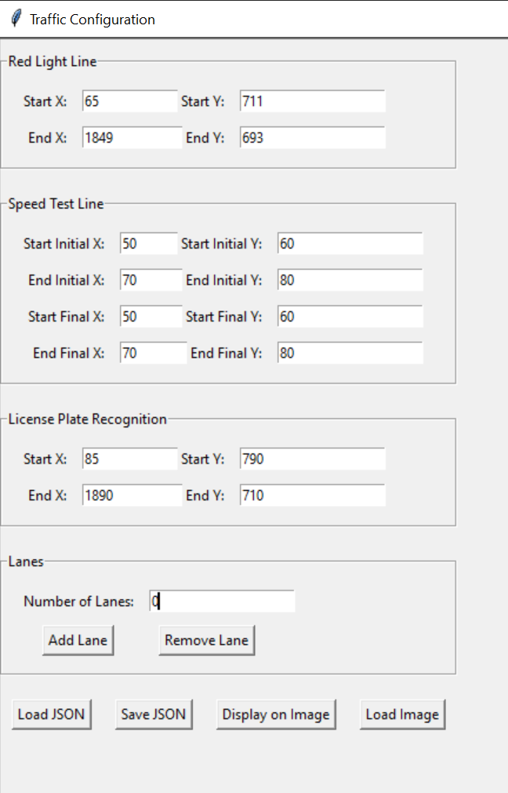
Line Editor utility software component
Config.json
Load

Slide 20
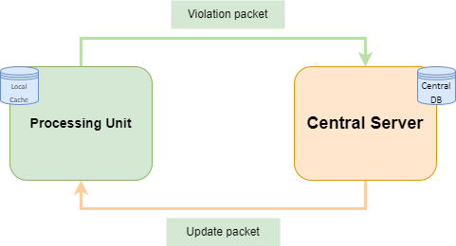
System Interconnection
Violation data
JWT
communication
Update data

Slide 21
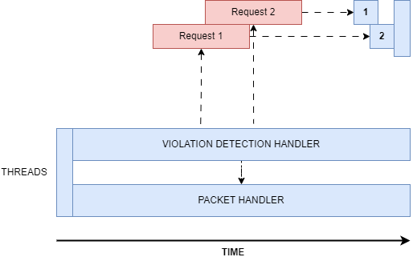
Processing unit Thread handling

Slide 22
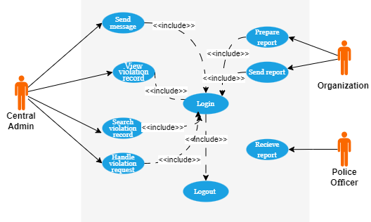
Use Case

Slide 23
Result and demo

Slide 24
Violation detection
RESULT AND DEMO

Slide 25
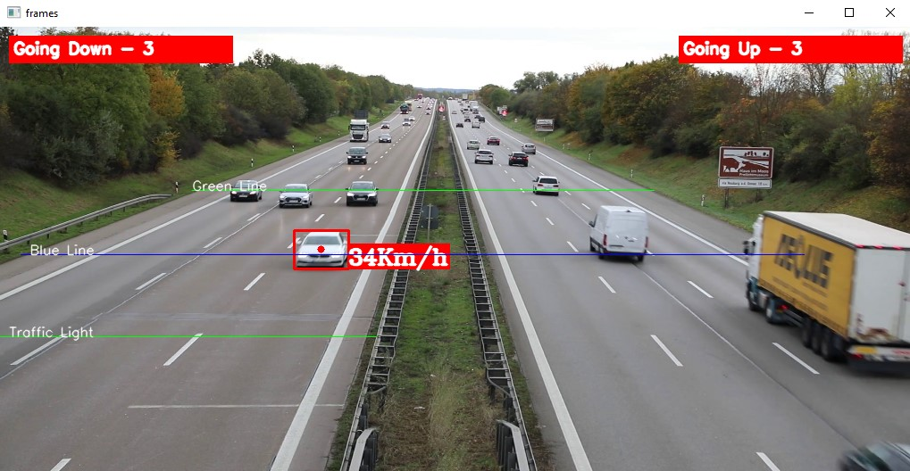
Speed violation
Over speeding

Slide 26
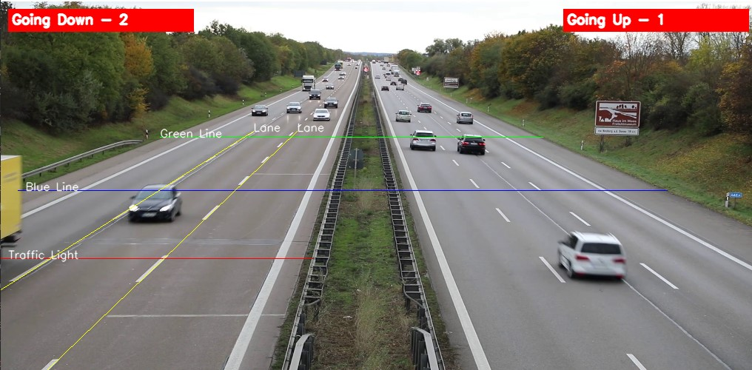
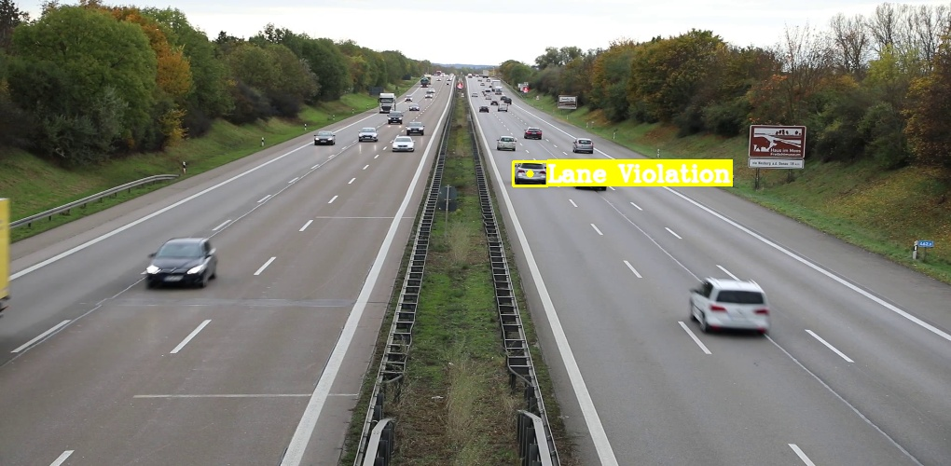
Lane violation

Slide 27
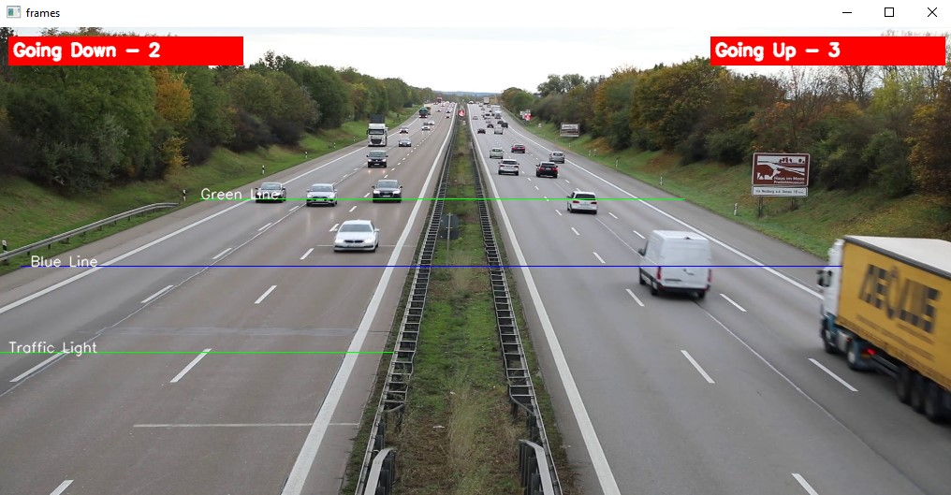
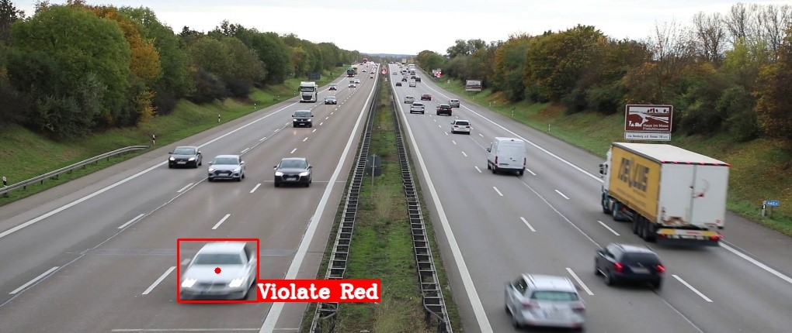
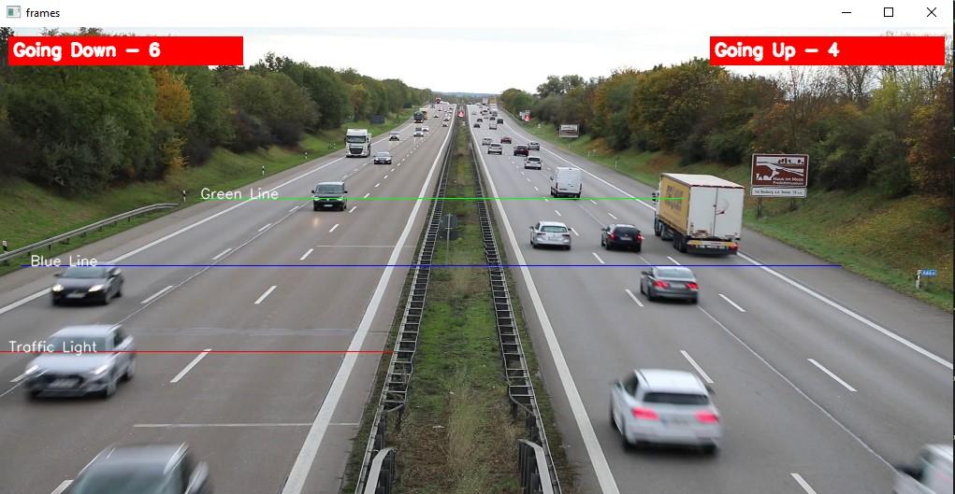
Red Light violation
Green Light
Red Light
Red Light violation

Slide 28
User interface
RESULT AND DEMO

Slide 29
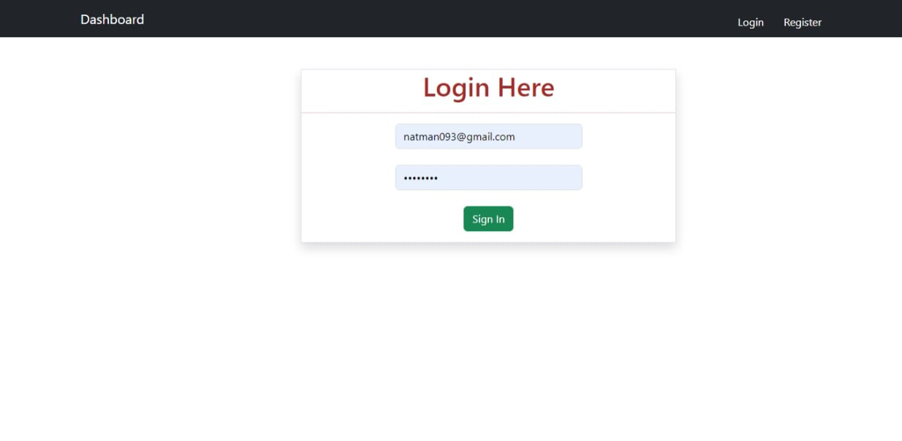
Contd.
Login with JWT Token authentication

Slide 30
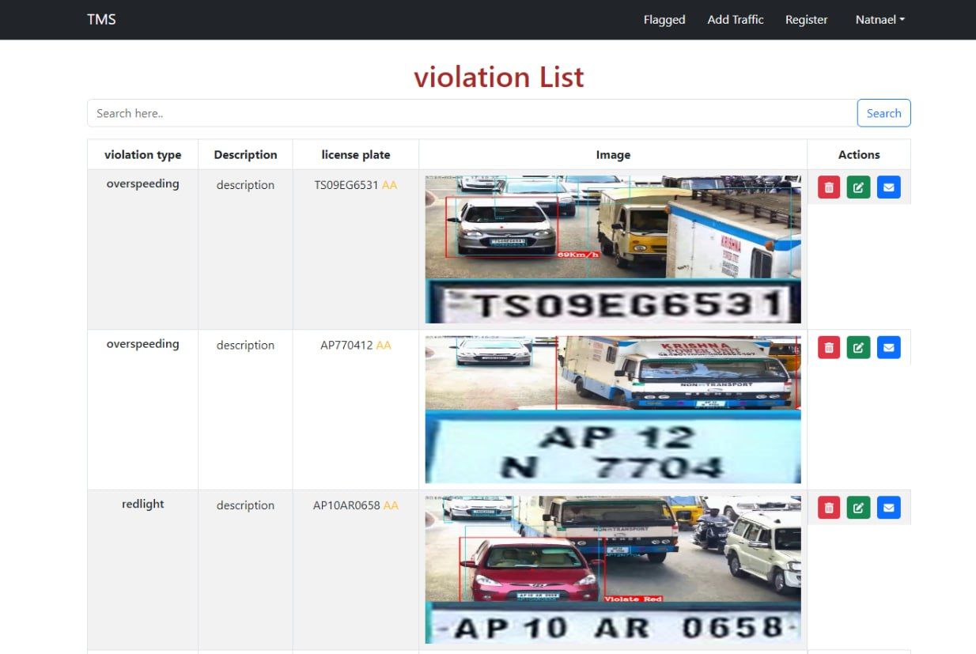
Contd.
Violation handler page

Slide 31
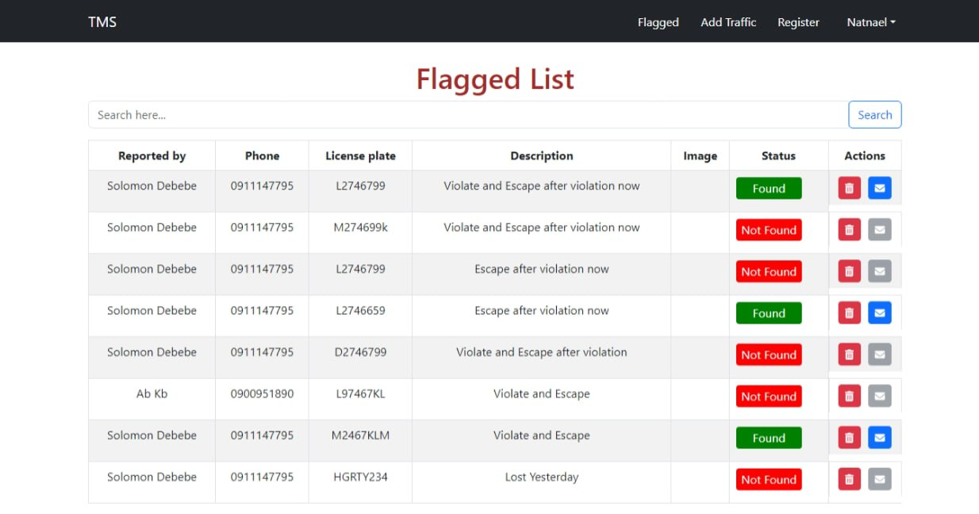
Contd.
Violation handler page

Slide 32
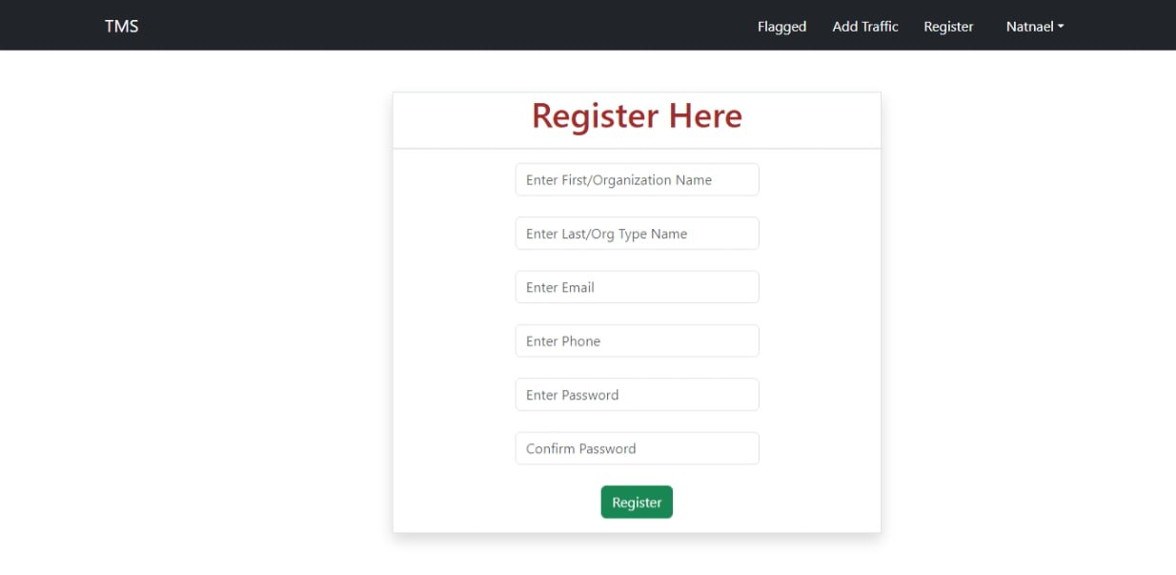
Contd.
Register User / Organization

Slide 33
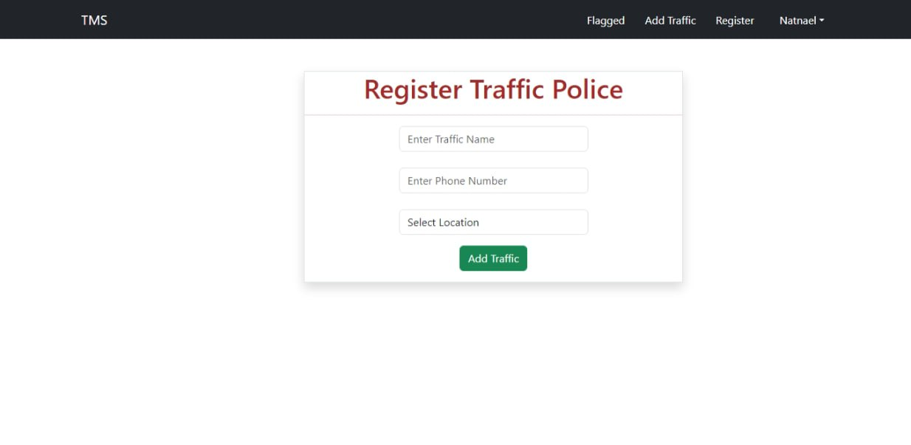
Contd.
Register traffic

Slide 34
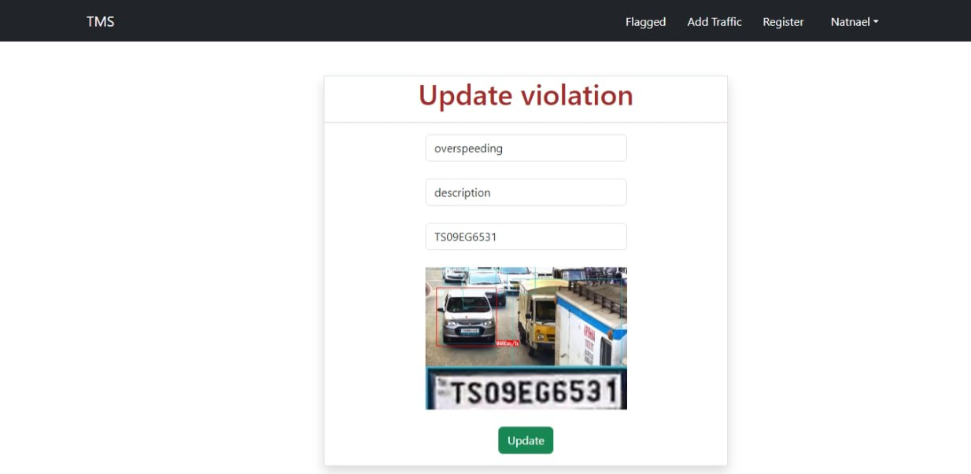
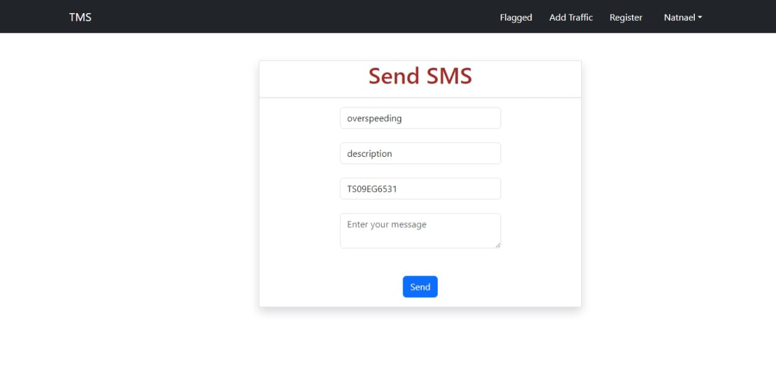
Contd.
Violation update handler page
SMS alerting handler page

Slide 35
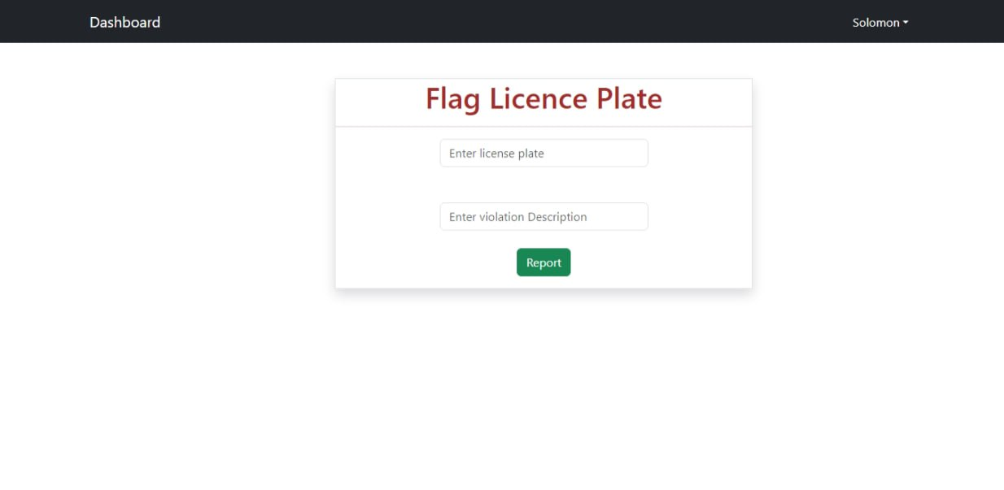
Contd.
License plate handler page

Slide 36
Recommendation for future work

Slide 37
Contd.
Emergency Vehicle Detection
Integration with Broader Traffic Violations
Localized License plate detection

Slide 38





Software component

Slide 39
Demo
RESULT AND DEMO

