Slide 1
META-ANALYSIS WORKSHOP Robert J. Tempelman Department of Animal Science Michigan State University
National Animal Nutrition Program (NANP) Workshop
2023 American Dairy Science Association Meetings
June 25, 2023
https://github.com/Tempelman/Meta_analysis

Slide 2
Introduction to Meta Analysis
Growing in popularity in animal science at apparently 15% per year (Sauvant et al. 2020; Animal).
Likely to keep being important, especially if supplemental electronic submissions of raw data/summary statistics increases in the future.
“The statistical analysis of a large collection of analysis results from individual studies for the purpose of integrating the findings” - Glass (1976)
There are many important issues (publication bias, GIGO, etc.) that will go beyond the scope of a 2 hour workshop.

Slide 3
Strategy used in today’s workshop
Simulated Data (including some from St. Pierre, 2001)
Why?
Truth is “known” -> so meta-analysis methods could be assessed relative to not only the truth but also to analyses based on raw data (versus using summary statistics from individual studies).
Raw data typically not available for meta-analysis (but that will change!)
Avoids problems with workshop participants trying to read in data.
For the vast majority of cases, meta-analysis of original raw data should closely agree with meta-analysis of summary statistics!

Slide 4
Case #1: A good starting point

Slide 5
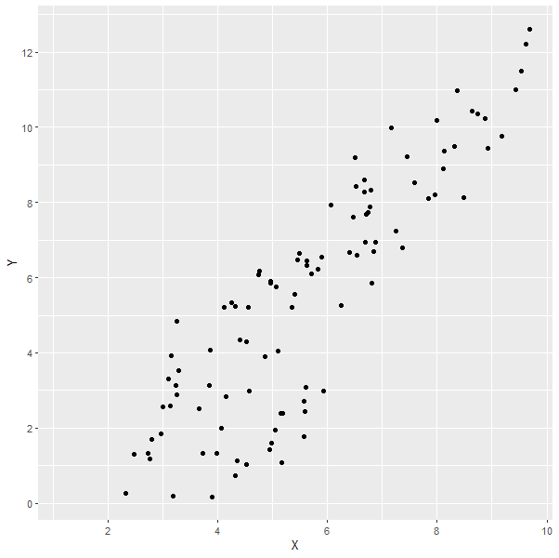
Y vs X
Graph created from data provided at Appendix St-Pierre (2001) (see lab)
Wrong data was seemingly provided
Figure 2a in St-Pierre (2001)

Slide 6

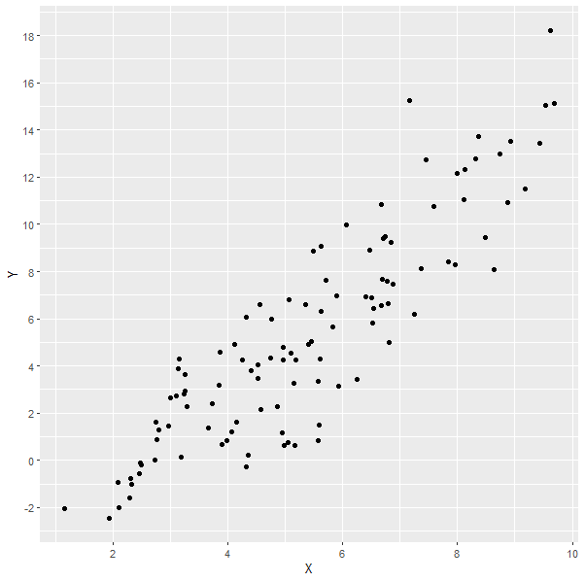
Corrected data provided by Dr. White (forwarded by Dr. St-Pierre)
Corrected data (see lab)
Figure 2a in St-Pierre (2001)

Slide 7
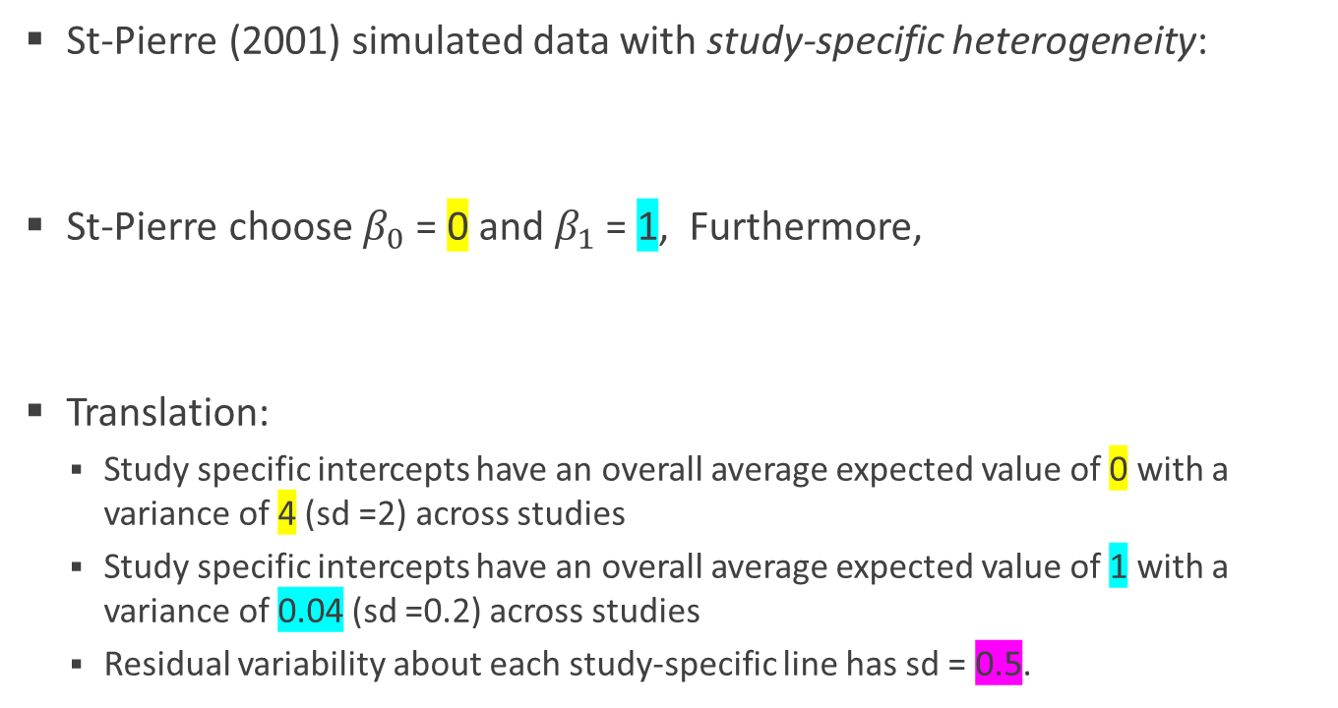
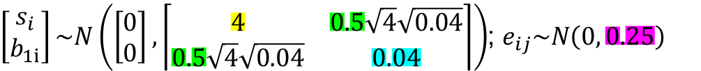
Data generation
St-Pierre (2001) simulated data with study-specific heterogeneity:
St-Pierre choose $β_{0}$ = 0 and $β_{1}$ = 1, Furthermore,
Translation:
Study specific intercepts have an overall average expected value of 0 with a variance of 4 (sd =2) across studies
Study specific intercepts have an overall average expected value of 1 with a variance of 0.04 (sd =0.2) across studies
Residual variability about each study-specific line has sd = 0.5.
$y_{ij}=β_{0}+s_{i}+\left(β_{1}+b_{1i}\right)$ $x_{ij}$+ $e_{ij}$; i=1,2,… $n_{study}=20$, j = 1,2…, $n_{i}$
Study-specific intercept
Study-specific slope
$\left[\begin{matrix}s_{i} \\ b_{1i}\end{matrix}\right]\sim N\left(\left[\begin{matrix}0 \\ 0\end{matrix}\right], \left\lceil \begin{matrix}4 & 0.5\sqrt{4}\sqrt{0.04} \\ 0.5\sqrt{4}\sqrt{0.04} & 0.04\end{matrix}\right\rceil \right)$; $e_{ij}\sim N\left(0, 0.25\right)$
Correlation = 0.5 across studies

Slide 8
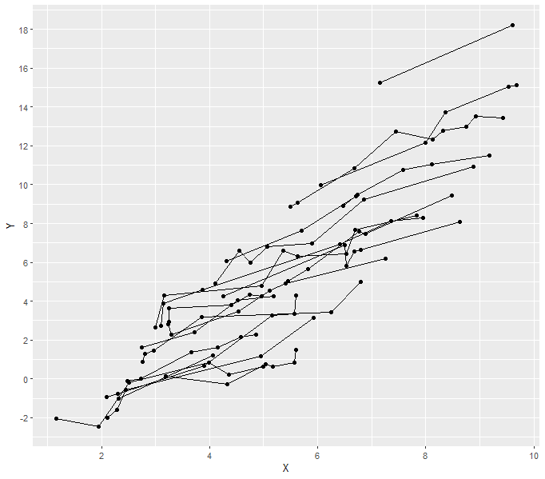
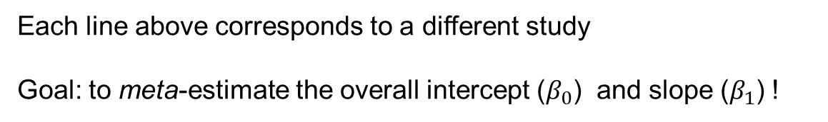
Figure 2b
Generated in R lab
Each line above corresponds to a different study
Goal: to meta-estimate the overall intercept ($β_{0}$) and slope ($β_{1}$) !

Slide 9
Meta-analysis
EFFECT SIZE (z_{i})
Suppose we only had the study-specific slopes and estimates alongside with the standard errors (St-Pierre did not pursue this)
Each meta-analysis “data point” would be a duplet of (1) estimate and (2) std.error
Let’s focus entirely on the slope estimates
## Study term estimate std.error t.statistic p.value nrec
## 1 A Intercept -3.07734838 0.76656078 -4.01448711 1.593713e-02 6
## 2 A X 0.81671421 0.22252478 3.67021698 2.138706e-02 6
## 3 B Intercept -4.15298434 0.63281610 -6.56270335 7.195518e-03 5
## 4 B X 1.17586084 0.16301208 7.21333571 5.492902e-03 5
## 5 C Intercept -4.07597045 0.61009504 -6.68087785 2.609649e-03 6
## 6 C X 1.39429265 0.13995723 9.96227671 5.702866e-04 6
## 7 D Intercept -1.80848842 1.09619111 -1.64979300 1.743302e-01 6
## 8 D X 0.50088152 0.22415810 2.23450111 8.916425e-02 6
## 9 E Intercept -3.97906524 NaN NaN NaN 2
## 10 E X 1.27253453 NaN NaN NaN 2
Can’t include Study E…only 2 datapoints!! No se!

Slide 10
Sampling variances and weights
Instead of std.error, these are more commonly used in meta-analysis software
Sampling variance = std.err^2 (s_{i}²)
Weight = (1/std.err^2) (w_{i})
So a duplet data point might be either one of the following:
estimate,sampling variance (z_{i},s_{i}²) popular in meta-analysis software (metafor)
estimate, weight (z_{i},w_{i}) useful in mixed model analysis
s_{i}² :Not to be confused with variance of data or residuals!
w_{i} : “precision”

Slide 11
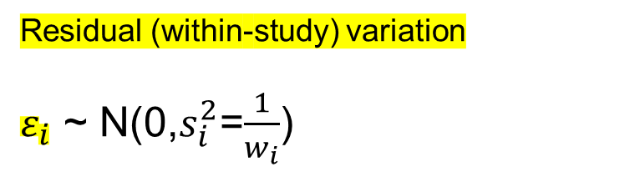
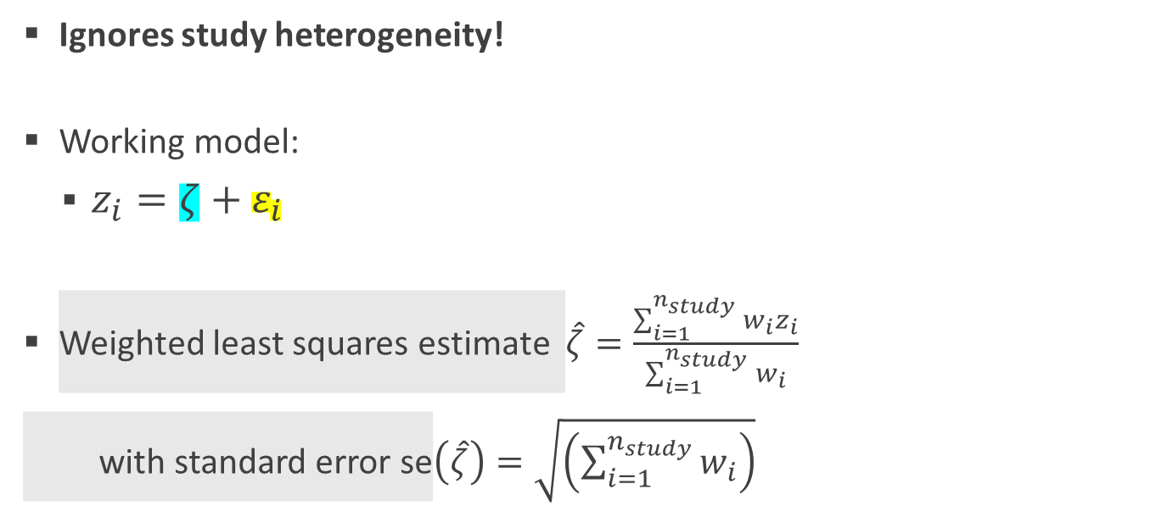
Common effects (CE) analysis
Assumes that variability between studies is simply due to sampling error!
Ignores study heterogeneity!
Working model:
$z_{i}=ζ+ε_{i}$
Weighted least squares estimate $\hat{ζ}=\frac{\sum_{i=1}^{n_{study}}{w_{i}z_{i}}}{\sum_{i=1}^{n_{study}}{w_{i}}}$
with standard error se$\left(\hat{ζ}\right)=\sqrt{\left(\sum_{i=1}^{n_{study}}{w_{i}}\right)}$
Residual (within-study) variation
$ε_{i}$ ~ N(0,$s_{i}^{2}$=$\frac{1}{w_{i}}$)
Unknown true effect size

Slide 12
Common effects (CE) analysis
Three different sets of R codes provided to compute
1. WLS estimate on previous slide.
2. Using linear (mixed) models software
3. Using metafor (popular R meta-analysis software package)
Option method = EE
THIS SHOULD NOT BE YOUR FIRST OPTION!

Slide 13


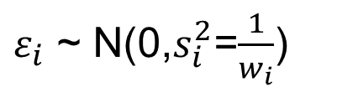
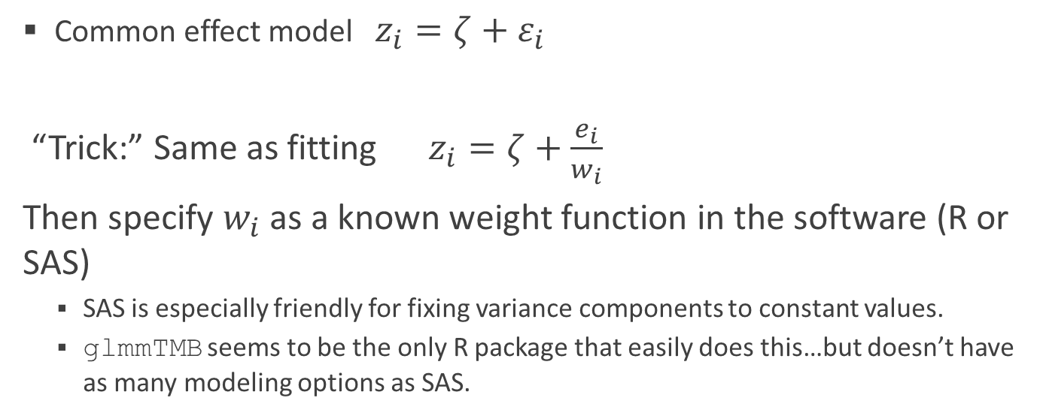

Using linear models software to do CE analysis (see Madden, LV, H-P Piepho and P.A. Paul. 2016. Statistical models and methods for network meta-analysis. Phytopathology 106:792-806)
$ε_{i}$ ~ N(0,$s_{i}^{2}$=$\frac{1}{w_{i}}$)
Common effect model $z_{i}=ζ+ε_{i}$
“Trick:” Same as fitting $z_{i}=ζ+\frac{e_{i}}{w_{i}}$
Then specify $w_{i}$as a known weight function in the software (R or SAS)
SAS is especially friendly for fixing variance components to constant values.
glmmTMB seems to be the only R package that easily does this…but doesn’t have as many modeling options as SAS.
$e_{i}$~ N(0,$1$)
Hold constant to 1 in software

Slide 14
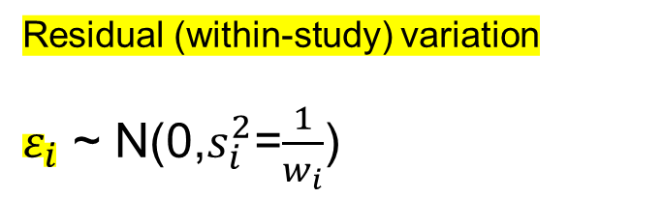
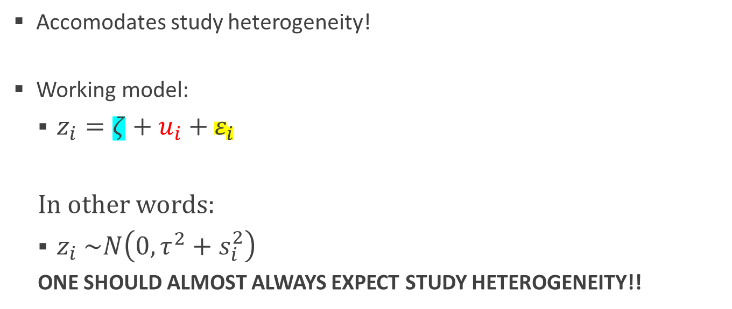
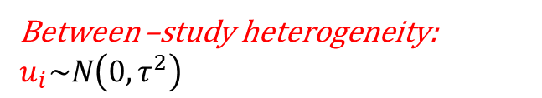
Mixed effects univariate meta-analysis
Meta-analysis statisticians bicker whether study is fixed or random
Accomodates study heterogeneity!
Working model:
$z_{i}=ζ+u_{i}+ε_{i}$
In other words:
$z_{i}$ $\sim N\left(0, τ^{2}+s_{i}^{2}\right)$
ONE SHOULD ALMOST ALWAYS EXPECT STUDY HETEROGENEITY!!
Residual (within-study) variation
$ε_{i}$ ~ N(0,$s_{i}^{2}$=$\frac{1}{w_{i}}$)
Unknown true effect size
Between –study heterogeneity: $u_{i}\sim N\left(0, τ^{2}\right)$

Slide 15
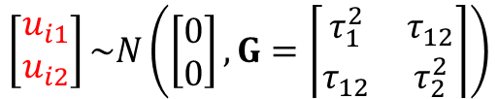
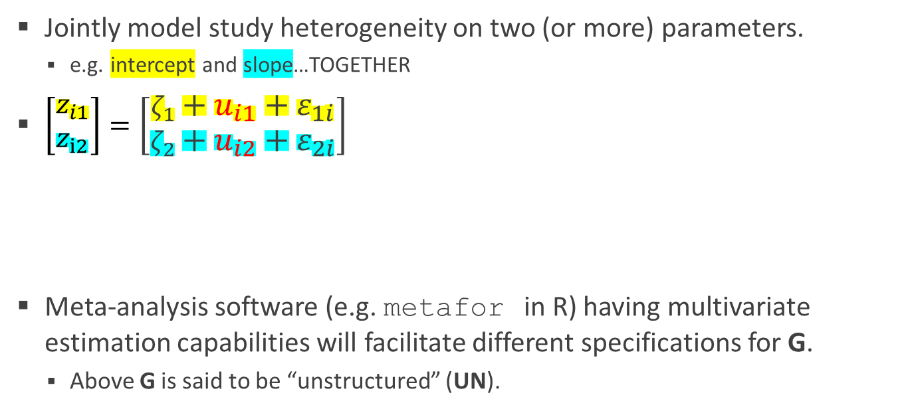
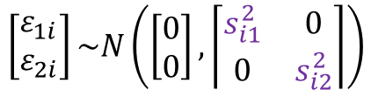
Mixed effects multivariate meta-analysis
Jointly model study heterogeneity on two (or more) parameters.
e.g. intercept and slope…TOGETHER
$\left[\begin{matrix}z_{i1} \\ z_{i2}\end{matrix}\right]=\left[\begin{matrix}ζ_{1}+u_{i1}+ε_{1i} \\ ζ_{2}+u_{i2}+ε_{2i}\end{matrix}\right]$
Meta-analysis software (e.g. metafor in R) having multivariate estimation capabilities will facilitate different specifications for G.
Above G is said to be “unstructured” (UN).
Study specific squared standard errors
$$\left[\begin{matrix}u_{i1} \\ u_{i2}\end{matrix}\right]\sim N\left(\left[\begin{matrix}0 \\ 0\end{matrix}\right], G=\left\lceil \begin{matrix}τ_{1}^{2} & τ_{12} \\ τ_{12} & τ_{2}^{2}\end{matrix}\right\rceil \right)$$
$$\left[\begin{matrix}ε_{1i} \\ ε_{2i}\end{matrix}\right]\sim N\left(\left[\begin{matrix}0 \\ 0\end{matrix}\right], \left\lceil \begin{matrix}s_{i1}^{2} & 0 \\ 0 & s_{i2}^{2}\end{matrix}\right\rceil \right)$$

Slide 16
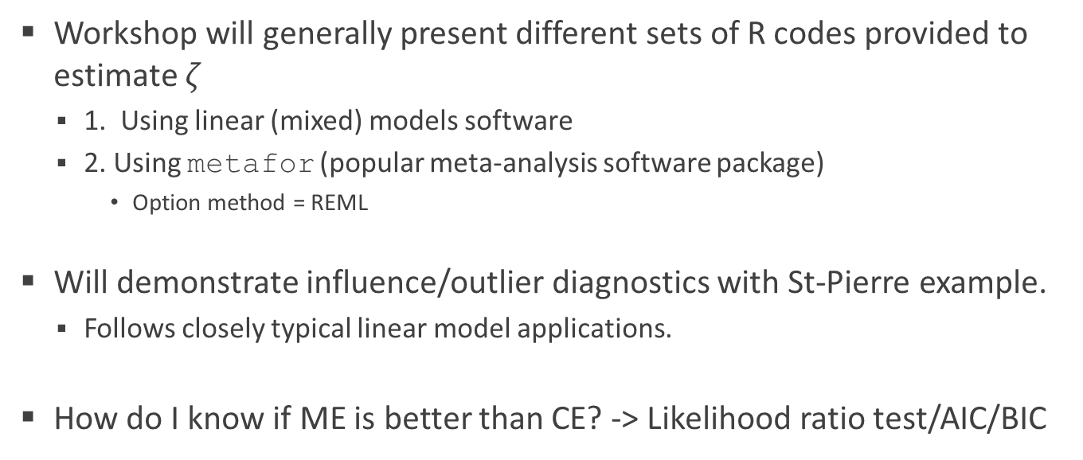
Mixed effects (ME) analysis
Workshop will generally present different sets of R codes provided to estimate $ζ$
1. Using linear (mixed) models software
2. Using metafor (popular meta-analysis software package)
Option method = REML
Will demonstrate influence/outlier diagnostics with St-Pierre example.
Follows closely typical linear model applications.
How do I know if ME is better than CE? -> Likelihood ratio test/AIC/BIC

Slide 17
Recap on estimates of $ζ$ ($β_{1}$ in St-Pierre)
Using mixed model (random coefficients) analysis of raw data (deleting two studies with 2 datapoints each)
## Estimate Std. Error t value
## (Intercept) -0.78266 0.50278 -1.557
## X 1.08502 0.05775 18.787
Using CE analysis (metafor) on summary stats
## estimate se zval pval ci.lb ci.ub
## 1.0864 0.0317 34.3165 <.0001 1.0244 1.1485 ***
Using mixed model analysis (metafor univariate) on summary stats
## estimate se zval pval ci.lb ci.ub
## 1.0810 0.0586 18.4410 <.0001 0.9661 1.1959 ***
Using mixed model analysis (metafor multivariate) on summary stats
## estimate se zval pval ci.lb ci.ub
## termIntercept -0.7954 0.4894 -1.6252 0.1041 -1.7546 0.1638
## termX 1.0820 0.0582 18.5847 <.0001 0.9679 1.1961 ***
Random coefficient (“random regression”) model

Slide 18
Validating meta-analytic models
A good meta-analysis should lead to nearly the same estimates and standard errors as one would get using the correct model on the raw data.
Being able to simulate various experimental designs might be pedagogically helpful in that regard (we do that today!)
Various R packages (metafor,netmeta) also provide example datasets that are useful to work through as well.
Linear mixed models allow diagnostic checks as well.
Should be based on studentized residuals. Regular estimated residuals are not comparable between different studies.

Slide 19
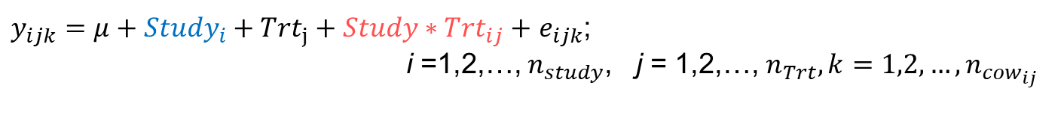
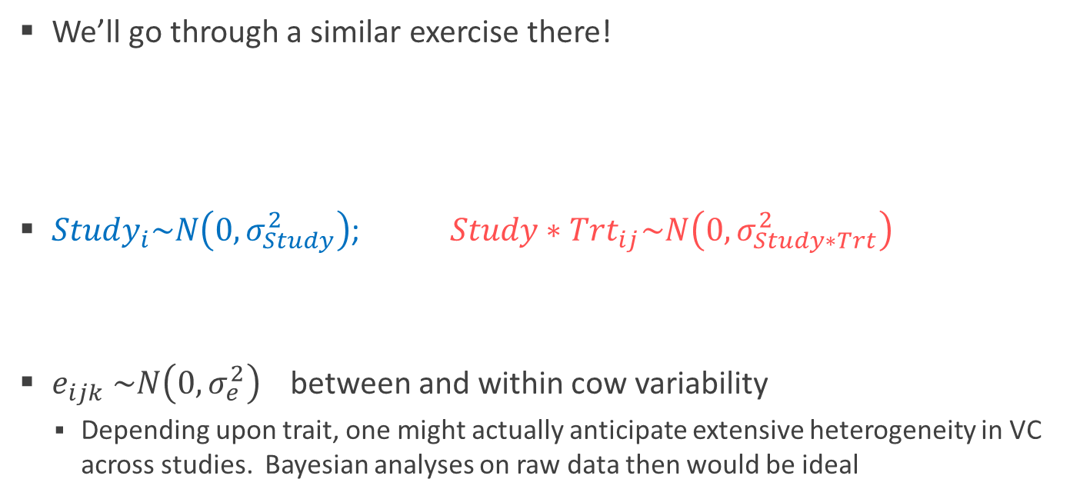
The completely randomized design
We’ll go through a similar exercise there!
${Study}_{i}\sim N\left(0,σ_{Study}^{2}\right)$;${ Study∗Trt}_{ij}\sim N\left(0,σ_{Study∗Trt}^{2}\right)$
$e_{ijk}$ $\sim N\left(0,σ_{e}^{2}\right)$ between and within cow variability
Depending upon trait, one might actually anticipate extensive heterogeneity in VC across studies. Bayesian analyses on raw data then would be ideal
$y_{ijk}=μ+{{Study}_{i}+Trt}_{j}+{Study∗Trt}_{ij}+$ $e_{ijk}$;
i =1,2,…, $n_{study}$, j = 1,2,…, $n_{Trt},k=1,2,…,n_{{cow}_{ij}}$
Study heterogeneity Treatment effect heterogeneity

Slide 20
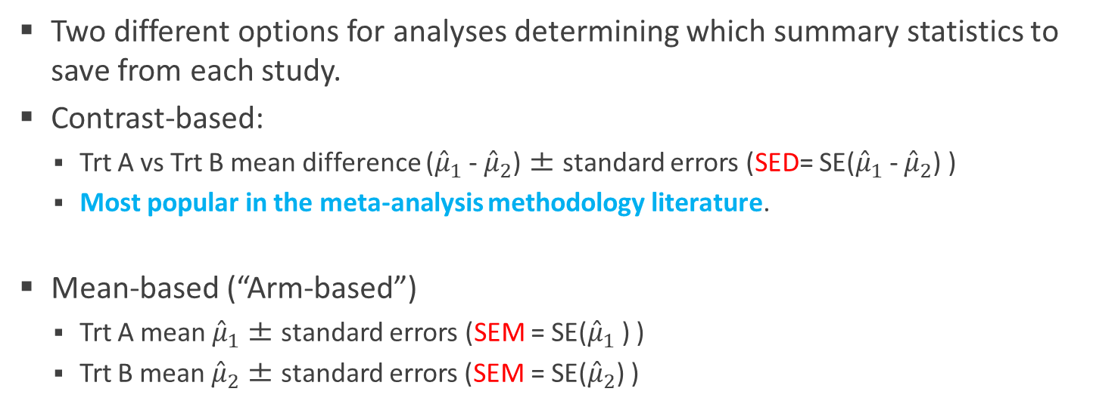
Fit simple CRD for each study
Two different options for analyses determining which summary statistics to save from each study.
Contrast-based:
Trt A vs Trt B mean difference (${\hat{μ}}_{1}$- ${\hat{μ}}_{2}$) ± standard errors (SED= SE(${\hat{μ}}_{1}$- ${\hat{μ}}_{2}$) )
Most popular in the meta-analysis methodology literature.
Mean-based (“Arm-based”)
Trt A mean ${\hat{μ}}_{1}$± standard errors (SEM = SE(${\hat{μ}}_{1}$) )
Trt B mean ${\hat{μ}}_{2}$± standard errors (SEM = SE(${\hat{μ}}_{2}$) )
Commonly pursued in animal/dairy science

Slide 21
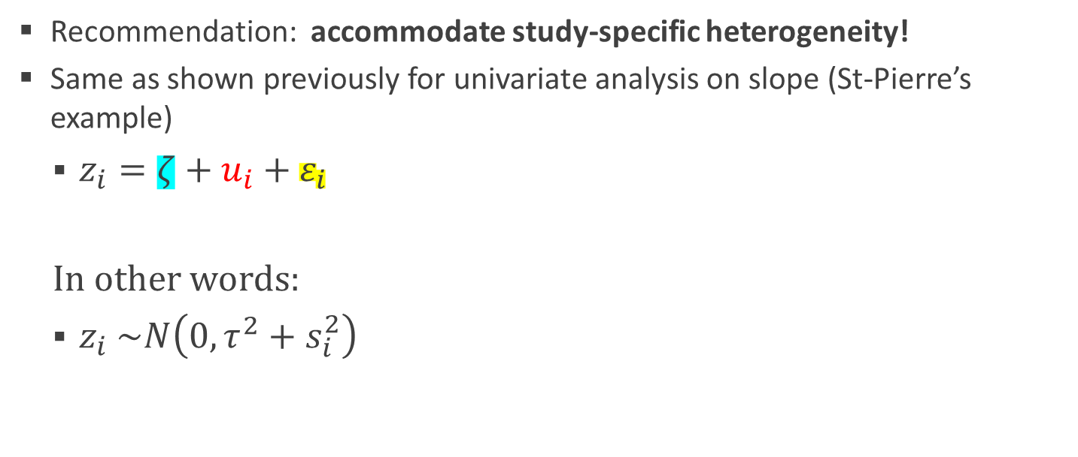

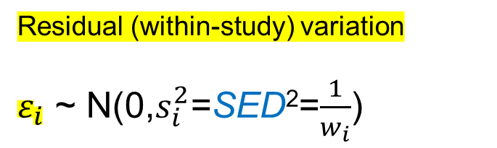
Contrast-based analyses (i.e., on ${\hat{μ}}_{1}$- ${\hat{μ}}_{2}$)
Recommendation: accommodate study-specific heterogeneity!
Same as shown previously for univariate analysis on slope (St-Pierre’s example)
$z_{i}=ζ+u_{i}+ε_{i}$
In other words:
$z_{i}$ $\sim N\left(0, τ^{2}+s_{i}^{2}\right)$
Residual (within-study) variation
$ε_{i}$ ~ N(0,$s_{i}^{2}$=SED²=$\frac{1}{w_{i}}$)
Between –study heterogeneity: $u_{i}\sim N\left(0, τ^{2}\right)$

Slide 22

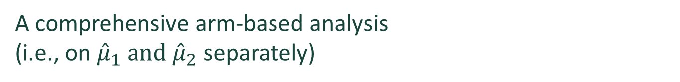


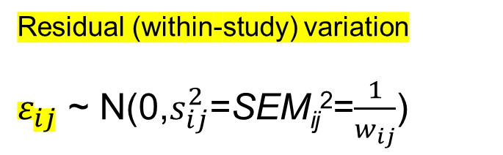
A comprehensive arm-based analysis (i.e., on ${\hat{μ}}_{1} and$ ${\hat{μ}}_{2}$ separately)
Popular R software (netmeta, metafor) converts arm-based to contrast based information before analyses
Modeling extension needed relative to contrast-based analysis.
$z_{ij}=ζ_{j}+u_{i}+{uζ}_{ij}+ε_{ij}$
Between –study heterogeneity: $u_{i}\sim N\left(0, τ^{2}\right)$ (or fixed?)
Between –study inconsistency:${ uζ}_{ij}\sim N\left(0, ω^{2}\right)$
Residual (within-study) variation
$ε_{ij}$ ~ N(0,$s_{ij}^{2}$=SEM_{ij}²=$\frac{1}{w_{ij}}$)
Recall the “trick”
Specify $e_{ij}$~ N(0,$1$) and weight by $w_{ij}$
Unfortunately, many scientists don’t consider this but most statisticians agree this is required

Slide 23
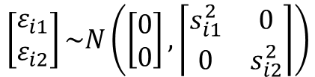
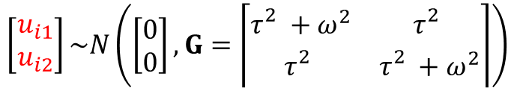

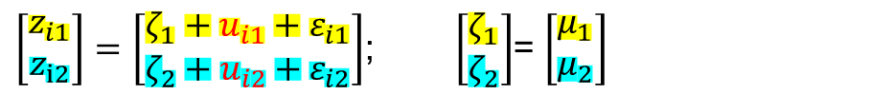
An equivalent model to that on previous slide
${Combine u}_{i}+{uζ}_{ij}$ as $u_{ij}$
Multivariate specification…typically used in software packages
$\left[\begin{matrix}z_{i1} \\ z_{i2}\end{matrix}\right]=\left[\begin{matrix}ζ_{1}+u_{i1}+ε_{i1} \\ ζ_{2}+u_{i2}+ε_{i2}\end{matrix}\right]$; $\left[\begin{matrix}ζ_{1} \\ ζ_{2}\end{matrix}\right]$= $\left[\begin{matrix}μ_{1} \\ μ_{2}\end{matrix}\right]$
CS
$$\left[\begin{matrix}u_{i1} \\ u_{i2}\end{matrix}\right]\sim N\left(\left[\begin{matrix}0 \\ 0\end{matrix}\right], G=\left\lceil \begin{matrix}τ_{}^{2}+ω^{2} & τ_{}^{2} \\ τ_{}^{2} & τ_{}^{2}+ω^{2}\end{matrix}\right\rceil \right)$$
$$\left[\begin{matrix}ε_{i1} \\ ε_{i2}\end{matrix}\right]\sim N\left(\left[\begin{matrix}0 \\ 0\end{matrix}\right], \left\lceil \begin{matrix}s_{i1}^{2} & 0 \\ 0 & s_{i2}^{2}\end{matrix}\right\rceil \right)$$
CS (compound symmetry) “reasonable” but several others available using either mixed model analyses (SAS or R) or R meta-analysis packages (metafor).
A multivariate parameterization allows us to explore alternative specifications to CS (see Madden et al., 2016; Phytopathology)

Slide 24
Meta-analytic contrast versus arms-based analysis vs analysis of raw data
25 simulated CRD studies
Should all give you (nearly) the same answers!!
Using Raw Data:
## contrast estimate SE df t.ratio p.value
## A - B -1.92 0.475 24 -4.048 0.0005
Contrast-based meta-analytic
## Estimate Std. Error z value Pr(>|z|)
## (Intercept) -1.9266 0.4752 -4.054 5.03e-05 ***
Arms-based meta-analytic
## contrast estimate SE df t.ratio p.value
## A - B -1.93 0.475 48 -4.054 0.0002
metafor leads to same test statistic but uses z-test (infinite df). This is typical of meta-analysis software. See code. SAS is more flexible

Slide 25
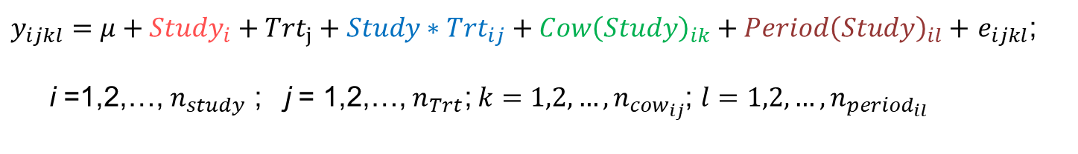

Analyzing Latin square designs across studies
${Study}_{i}\sim N\left(0,σ_{Study}^{2}\right)$;${ Study∗Trt}_{ij}\sim N\left(0,σ_{Study∗Trt}^{2}\right)$
${Cow\left(Study\right)}_{ik}\sim N\left(0,σ_{Cow\left(Study\right)}^{2}\right)$;${ Period\left(Study\right)}_{il} \sim N\left(0,σ_{Period\left(Study\right)}^{2}\right)$
$e_{ijk}$ $\sim N\left(0,σ_{e}^{2}\right)$ within cow variability
$y_{ijkl}=μ+{{Study}_{i}+Trt}_{j}+{Study∗Trt}_{ij}+{Cow\left(Study\right)}_{ik}+{Period\left(Study\right)}_{il}+$ $e_{ijkl}$;
i =1,2,…, $n_{study}$ ; j = 1,2,…, $n_{Trt}\text{;} k=1,2,…,n_{{cow}_{ij}}$; $l=1,2,…,n_{{period}_{il}}$

Slide 26
Contrast vs Arm based analysis
Contrast-based analysis
With 3 or more treatments, more than one contrast then!
Suppose focus was on A vs B contrast!
Two potential contrast-based strategies.
Only consider univariate A vs B contrast analysis.
Multivariate analysis considering ALL contrasts (or just “base contrasts” Piepho et al. (2012))

Slide 27

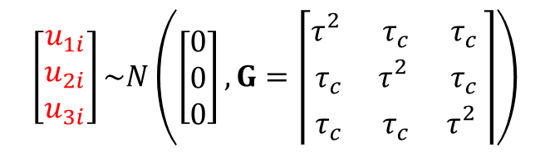



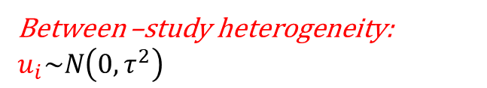
Contrast-based analysis.
Residual (within-study) variation
$ε_{i}$ ~ N(0,$s_{i}^{2}$=SED²=$\frac{1}{w_{i}}$)
Univariate: same as before: $z_{i}=ζ+u_{i}+ε_{i}$
Multivariate: Include other contrasts.
Suppose a three-treatment replicated Latin square
Basic versus functional contrasts (Piepho et al. 2012)
Between –study heterogeneity: $u_{i}\sim N\left(0, τ^{2}\right)$
CS
$$\left[\begin{matrix}z_{1i} \\ z_{2i} \\ z_{3i}\end{matrix}\right]=\left[\begin{matrix}ζ_{1}+u_{1i}+ε_{1i} \\ ζ_{2}+u_{2i}+ε_{2i} \\ ζ_{3}+u_{3i}+ε_{3i}\end{matrix}\right]$$
$\left[\begin{matrix}ζ_{1} \\ ζ_{2} \\ ζ_{3}\end{matrix}\right]$= $\left[\begin{matrix}μ_{1}−μ_{2} \\ μ_{1}−μ_{3} \\ μ_{2}−μ_{3}\end{matrix}\right]$
$$\left[\begin{matrix}u_{1i} \\ u_{2i} \\ u_{3i}\end{matrix}\right]\sim N\left(\left[\begin{matrix}0 \\ 0 \\ 0\end{matrix}\right], G=\left\lceil \begin{matrix}τ_{}^{2} & τ_{c} & τ_{c} \\ τ_{c} & τ_{}^{2} & τ_{c} \\ τ_{c} & τ_{c} & τ_{}^{2}\end{matrix}\right\rceil \right)$$
CS (compound symmetry) “reasonable” but several others available using either mixed model analyses (SAS or R) or R meta-analysis packages (metafor)

Slide 28


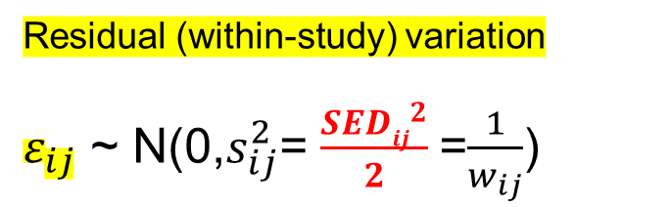

Arm-based analysis.
Multivariate: Suppose a three treatment replicated Latin square
$$\left[\begin{matrix}z_{1i} \\ z_{2i} \\ z_{3i}\end{matrix}\right]=\left[\begin{matrix}ζ_{1}+u_{1i}+ε_{1i} \\ ζ_{2}+u_{2i}+ε_{2i} \\ ζ_{3}+u_{3i}+ε_{3i}\end{matrix}\right]$$
$\left[\begin{matrix}ζ_{1} \\ ζ_{2} \\ ζ_{3}\end{matrix}\right]$= $\left[\begin{matrix}μ_{1} \\ μ_{2} \\ μ_{3}\end{matrix}\right]$
$$\left[\begin{matrix}u_{1i} \\ u_{2i} \\ u_{3i}\end{matrix}\right]\sim N\left(\left[\begin{matrix}0 \\ 0 \\ 0\end{matrix}\right], G=\left\lceil \begin{matrix}τ_{}^{2} & τ_{c} & τ_{c} \\ τ_{c} & τ_{}^{2} & τ_{c} \\ τ_{c} & τ_{c} & τ_{}^{2}\end{matrix}\right\rceil \right)$$
Residual (within-study) variation
$ε_{ij}$ ~ N(0,$s_{ij}^{2}$= $\frac{{SEDij}^{2}}{2}$=$\frac{1}{w_{ij}}$)
Between –study heterogeneity: CS but many other options are available
Don’t use SEM if cow treated as random because between-cow variation is “cancelled out” in treatment comparisons (see Piepho et al., 2012)

Slide 29
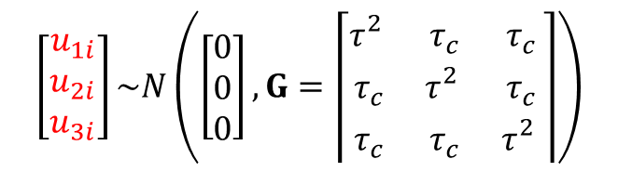
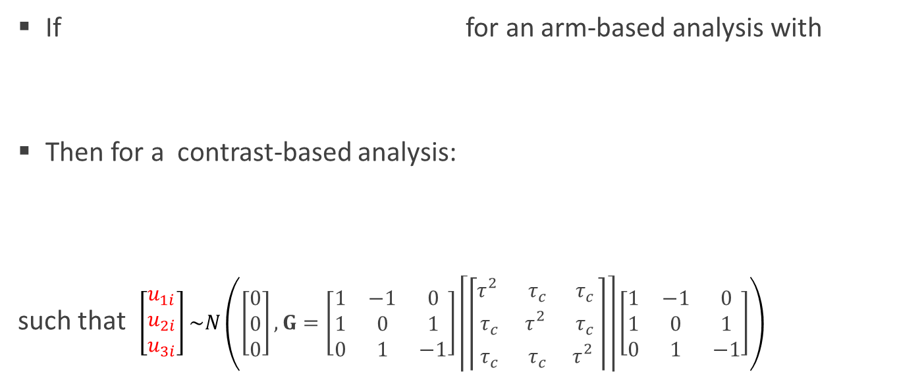

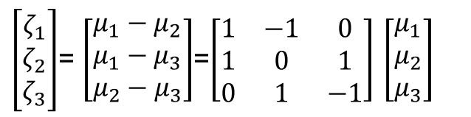
The arm-based analysis is “more correct” than the contrast based analyses given model on Slide 25 ((Piepho et al., 2012, Biometrics)).
$$\left[\begin{matrix}u_{1i} \\ u_{2i} \\ u_{3i}\end{matrix}\right]\sim N\left(\left[\begin{matrix}0 \\ 0 \\ 0\end{matrix}\right], G=\left\lceil \begin{matrix}τ_{}^{2} & τ_{c} & τ_{c} \\ τ_{c} & τ_{}^{2} & τ_{c} \\ τ_{c} & τ_{c} & τ_{}^{2}\end{matrix}\right\rceil \right)$$
$\left[\begin{matrix}ζ_{1} \\ ζ_{2} \\ ζ_{3}\end{matrix}\right]$= $\left[\begin{matrix}μ_{1} \\ μ_{2} \\ μ_{3}\end{matrix}\right]$
If for an arm-based analysis with
Then for a contrast-based analysis:
such that $\left[\begin{matrix}u_{1i} \\ u_{2i} \\ u_{3i}\end{matrix}\right]\sim N\left(\left[\begin{matrix}0 \\ 0 \\ 0\end{matrix}\right],G=\left[\begin{matrix}1 & −1 & 0 \\ 1 & 0 & 1 \\ 0 & 1 & −1\end{matrix}\right]\left\lceil \left\lceil \begin{matrix}τ_{}^{2} & τ_{c} & τ_{c} \\ τ_{c} & τ_{}^{2} & τ_{c} \\ τ_{c} & τ_{c} & τ_{}^{2}\end{matrix}\right\rceil \right\rceil \left[\begin{matrix}1 & −1 & 0 \\ 1 & 0 & 1 \\ 0 & 1 & −1\end{matrix}\right]\right)$
$\left[\begin{matrix}ζ_{1} \\ ζ_{2} \\ ζ_{3}\end{matrix}\right]$= $\left[\begin{matrix}μ_{1}−μ_{2} \\ μ_{1}−μ_{3} \\ μ_{2}−μ_{3}\end{matrix}\right]$=$\left[\begin{matrix}1 & −1 & 0 \\ 1 & 0 & 1 \\ 0 & 1 & −1\end{matrix}\right]$ $\left[\begin{matrix}μ_{1} \\ μ_{2} \\ μ_{3}\end{matrix}\right]$

Slide 30
Moderator variables
Effects of parity, lactation stage, 2nd treatment factor, etc.
Could add them as additional model factors, including interaction with primary treatment factor
But more care is needed with Latin squares compared to CRD.
e.g. cows are blocks for treatments but experimental units for parity

Slide 31
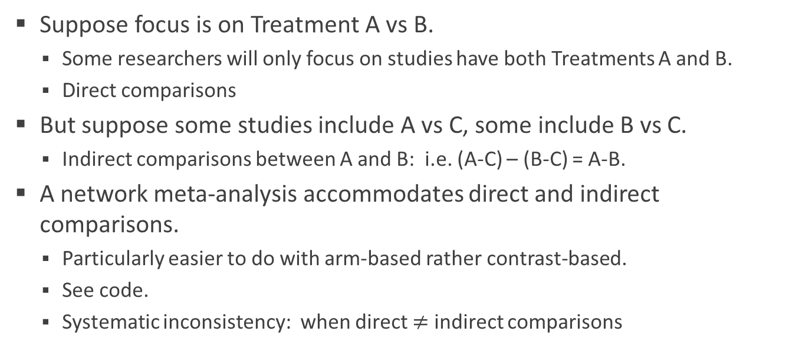
Network meta-analysis
Suppose focus is on Treatment A vs B.
Some researchers will only focus on studies have both Treatments A and B.
Direct comparisons
But suppose some studies include A vs C, some include B vs C.
Indirect comparisons between A and B: i.e. (A-C) – (B-C) = A-B.
A network meta-analysis accommodates direct and indirect comparisons.
Particularly easier to do with arm-based rather contrast-based.
See code.
Systematic inconsistency: when direct $≠$ indirect comparisons

Slide 32
Can I combine CRD and Latin square (and others) studies?
Most certainly!
Network-based arm analysis best suited to capture direct and indirect comparisons.
Caution.
Sampling variances for CRD treatment means = s² = 1/w = SEM²/2
For all other designs, use s² = 1/w = SED²/2
Actually, just use s² = 1/w = SED²/2 FOR ALL DESIGNS!
Infer upon potential systematic inconsistencies!
Effect of design (CRD or Latin Square) on treatment effects

Slide 34
My vision for the future
Mature raw data repositories
Research reproducibility
Allow for Bayesian extensions.
Model distributions on variance components over studies. Better borrowing of information across studies on variance components.
Multivariate analyses involving multiple correlated traits over time.
Code also submitted!!
Acknowledgements: NCCC-170 Research Advances in Agricultural Statistics
https://www.nimss.org/projects/view/mrp/outline/18798 supported by Hatch Multistate Research Fund (MRF) provided by the National Institute for Food and Agriculture (NIFA)

