Slide 1
N3C Short Course Session 3
Jerrod Anzalone
Department of Neurological Sciences

Slide 2
Overview
N3C roles and responsibilities
Computable Phenotype
Analytic Plan
Concept Set Curation
Domain Requirements
Logic Liaison Template
Data Extraction

Slide 3
N3C Role and Responsibilities

Slide 4
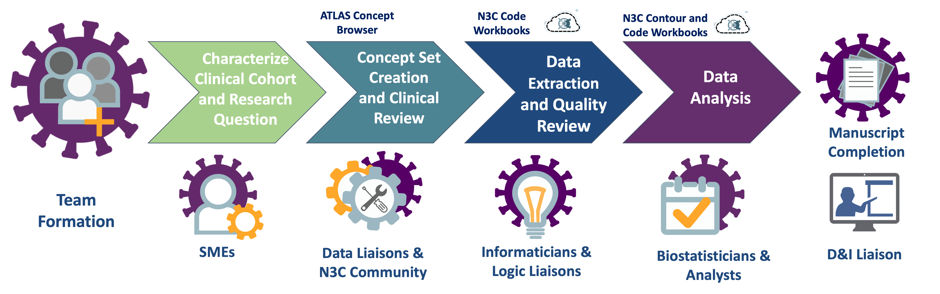
Domain Team Organization

Slide 5
Team Composition
Jana Ponce, PhD, RD
Corrine Hansen, PhD, RD
Kristina Bailey, MD
Megan Timmerman, MPA, RD
Mariah Jackson, MMN, RD
Jerrod Anzalone, MS
James McClay, MD, MS
Greater N3C Community (Davera Gabriel, etc.)
Harlan Sayles, MS

Slide 6
Analytic Plan
Primary Exposure: Malnutrition
COVID and No Hx of Malnutrition
COVID and Hx of Malnutrition
COVID and Hospital-Acquired Malnutrition
Covariates
Age
Gender
Race/Ethnicity
Charlson Comorbidity Index
Smoking Status
Region
Outcomes
Death or Transfer to Hospice (primary)
Invasive Mechanical Ventilation
Oxygen Support
Acute Respiratory Distress Syndrome (ARDS)
ECMO
Hospital-acquired pressure injuries
Inclusion Criteria
Age >18
Positive COVID diagnosis or lab test (PCR, Ag)
Exclusion Criteria
Missing age, gender
Data partners with low death reporting

Slide 7
Computable Phenotyping

Slide 8
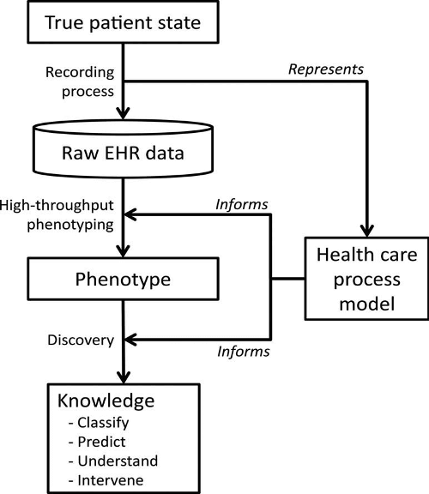
Computable Phenotype
“A computable phenotype refers to a set of clinical conditions and characteristics that can be evaluated via a computerized query to an EHR system or clinical data repository using a defined set of data elements and logical expressions”
Richesson RL, Hammond WE, Nahm M, et al. 2013. Electronic health records based phenotyping in next-generation clinical trials: a perspective from the NIH Health Care Systems Collaboratory. J Am Med Inform Assoc. 20:e226-e231.
Hripcsak G, Albers DJ. 2013. Next-generation phenotyping of electronic health records. J Am Med Inform Assoc. 20:117-121. doi:10.1136/amiajnl-2012-001145.
Notes:
In the context of electronic health records (EHRs), a "computable phenotype," or simply "phenotype," is a clinical condition or characteristic that can be ascertained by means of a computerized query to an EHR system or clinical data repository using a defined set of data elements and logical expressions. These queries can identify patients with particular conditions and can be used to support a variety of purposes, including population management, quality measurement, and observational and interventional research. Standardized computable phenotypes can facilitate large-scale pragmatic clinical trials (PCTs) across multiple healthcare systems while ensuring reliability and reproducibility (Richesson et al 2013).

Slide 9
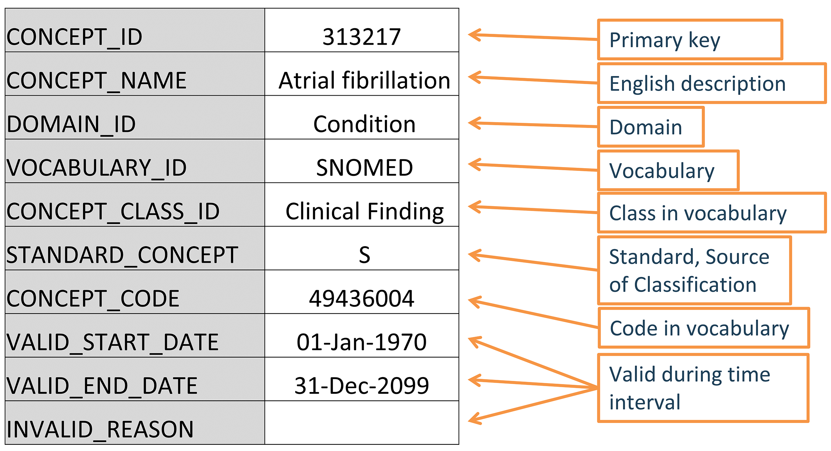
Concept
Source: Book of OHDSI
Notes:
A term (with a code) defined in a medical terminology (e.g., SNOMED CT). Here we see how a concept for atrial fibrillation is stored in OMOP.

Slide 10
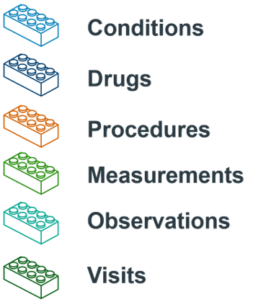
Concept Set
Concept Set: A data-agnostic expression that defines one or more Standard Concepts encompassing the clinical entity of interest.
Concept sets are the building blocks of a cohort definition.
Source: Book of OHDSI
Notes:
A concept set is an expression representing a list of concepts that can be used as a reusable component in various analyses. It can be thought of as a standardized, computer-executable equivalent of the code lists often used in observational studies. A concept set expression consists of a list of concepts with the following attributes:
Exclude: Exclude this concept (and any of its descendants if selected) from the concept set.
Descendants: Consider not only this concept, but also all of its descendants.
Mapped: Allow to search for non-standard concepts.
For the most part, they are comprised of items like conditions, drugs, procedures, measurements, observations, and visits

Slide 11
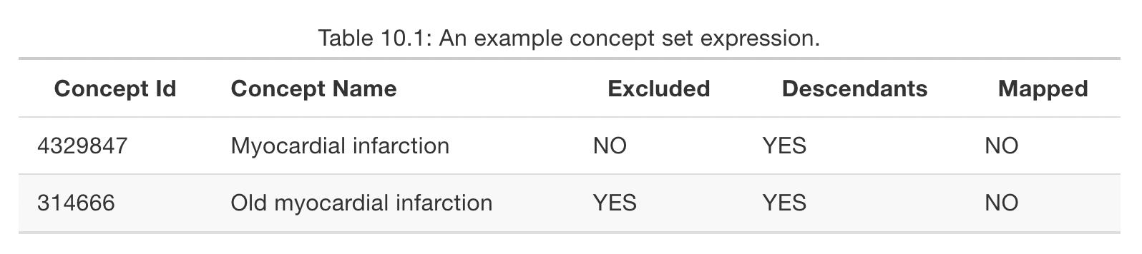
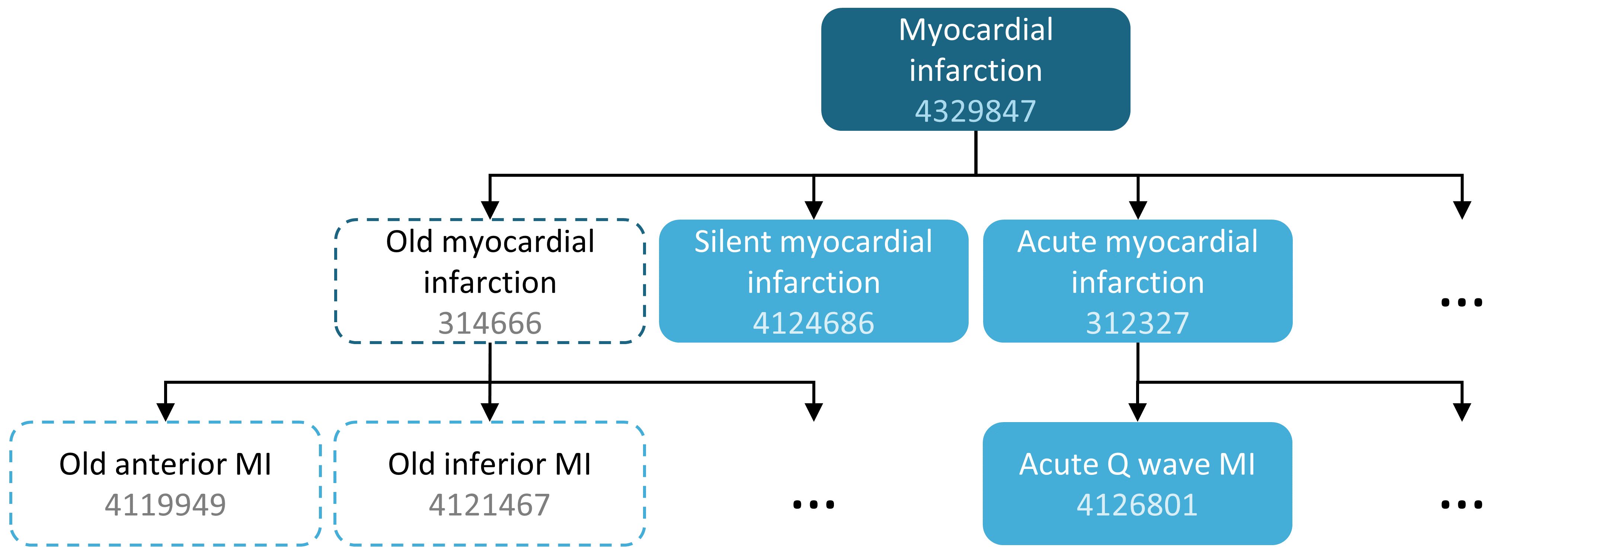
Concept Set Example
Source: Book of OHDSI
Notes:
For example, a concept set expression could contains two concepts as depicted in Table 10.1. Here we include concept 4329847 (“Myocardial infarction”) and all of its descendants, but exclude concept 314666 (“Old myocardial infarction”) and all of its descendants.
As shown in Figure 10.2, this will include “Myocardial infarction” and all of its descendants except “Old myocardial infarction” and its descendants. In total, this concept set expression implies nearly a hundred Standard Concepts. These Standard Concepts in turn reflect hundreds of source codes (e.g. ICD-9 and ICD-10 codes) that may appear in the various databases.

Slide 12
Concept Sets Required
Cohorts:
COVID-19 Positivity
Malnutrition
Outcome Concept Sets:
Hospitalization
Invasive Mechanical Ventilation
ECMO
Death
Pressor exposure
Hospital-acquired events
Comorbid Conditions:
Smoking
Hypertension
CCI Categories, including:
Heart failure, MI, CVD, dementia, diabetes, pulmonary disease, rheumatic disease, peptic ulcer disease, liver disease, renal disease, cancer, HIV
Medication exposure
Remdesivir
Steroids

Slide 13
OMOP Domains
Domain | Standard Vocabulary
Condition | SNOMED, ICDO3
Procedure | SNOMED, CPT4, HCPCS, ICD10PCS, ICD9Proc, OPCS4
Measurement | SNOMED, LOINC
Drug | RxNorm, RxNorm Extension, CVX
Device | SNOMED
Observation | SNOMED
Visit | CMS Place of Service, ABMT, NUCC
Source: Book of OHDSI
Notes:
A Domain defines the set of allowable Concepts for the standardized fields in the CDM tables. For example, the “Condition” Domain contains Concepts that describe a condition of a patient, and these Concepts can only be stored in the condition_concept_id field of the CONDITION_OCCURRENCE and CONDITION_ERA tables.

Slide 14
Conditions
A diagnosis, a sign, or a symptom, which is either observed by a provider or reported by the patient.
Concept set requirements for study:
COVID-19 Diagnosis
Malnutrition
Smoking status
Hypertension
Charlson Comorbidity Index Categories
Hospital-Acquired Pressure Injury
Supplemental Oxygen
Acute Respiratory Distress Syndrome
Invasive Mechanical Ventilation

Slide 15
Drugs
A Drug is a biochemical substance formulated in such a way that when administered to a Person it will exert a certain physiological effect. Drugs include prescription and over-the-counter medicines, vaccines, and large-molecule biologic therapies. Radiological devices ingested or applied locally do not count as Drugs.
Concept set requirements for study:
Pressor support
Remdesivir
Steroids
Supplemental Oxygen

Slide 16
Procedures
Activity or process ordered by, or carried out by, a healthcare provider on the patient to have a diagnostic or therapeutic purpose.
Concept set requirements for study:
Hospital-Acquired Pressure Injury
Supplemental Oxygen
Invasive Mechanical Ventilation
ECMO

Slide 17
Measurements
A structured value (numerical or categorical) obtained through systematic and standardized examination or testing of a person or person’s sample.
Concept set requirements for study:
COVID PCR or Antigen Test
Height
Weight

Slide 18
Observations
A clinical fact about a Person obtained in the context of examination, questioning or a procedure.
Concept set requirements for study:
Smoking status
Hospital-Acquired Pressure Injury
Supplemental Oxygen
Invasive Mechanical Ventilation
ECMO

Slide 19
Visits
The span of time a person continuously receives medical services from one or more providers at a care site in a given setting within the health care system.
Concept set requirements for study:
Hospitalization

Slide 20
Defining Malnutrition
Step 1: do a literature search to see what’s been used elsewhere
Step 2 (may not be applicable): look at local data with more homogenous reporting to build a preliminary set of concepts
Step 3: build preliminary concept set in Atlas; parent code:
Nutritional deficiency disorder (SNOMED 70241007)
Step 4: refine concept set with SME. Refine some more.
Step 5: deploy in N3C Concept Set Browser

Slide 21
Exercise 1 (follow along)
Using Atlas, build a starting concept set for malnutrition.
Go to Atlas: https://atlas-demo.ohdsi.org/
In the Search window, look up Nutritional deficiency disorder (SNOMED CT 70241007)
Include all descendant concepts and click “Add to Concept Set”
View concept set and extract it as a csv using the “Included Concepts” tab

Slide 22
Exercise 2
Using Atlas, refine previous concept set to include only Deficiency of Macronutrients.
Starting with Nutritional deficiency disorder (SNOMED CT 70241007) from the search window, click the concept and navigate to the ”Hierarchy” tab
Go to the descendant concept “Undernutrition” and navigate to the ”Hierarchy” tab
Create a new concept set using Deficiency of macronutrients (SNOMED CT 238107002) and add all descendant concepts
Extract concept set as a csv

Slide 23
Exercise 3 (follow along)
Single-Table Query
Create a new folder in your workspace and call it Session 3. Within this, create a new code workbook called “Malnutrition Conditions.”
Import the concept table from the data catalog:
Click ”Import dataset”
Navigate to the data catalog and find the folder “OMOP Concepts”
Select concept and import into your code workbook
Select the concept table and select “new transform” then select “SQL code.” Name the transform exercise_3
Write a query to return the concept_id for Nutritional deficiency using the vocabulary_id ”SNOMED.” Save the results to a dataset by toggling “Save as dataset” and run the transform.

Slide 24
Exercise 4
Single-Table Query
Import the concept_ancestor table from the data catalog:
Click ”Import dataset”
Navigate to the data catalog and find the folder “OMOP Concepts”
Select concept_ancestor and import into your code workbook
Select the concept_ancestor table and select “new transform” then select “SQL code.” Name the transform exercise_4
Write a query to return every descendant_concept_id for Nutritional deficiency using concept_id returned in exercise 3. Save the results to a dataset by toggling “Save as dataset” and run the transform.

Slide 25
Exercise 5 (follow along)
Multiple-Table Query
Select the resulting transformation from exercise 4 (should be called exercise_4) and select “new transform” then select “SQL code.” Name the transform exercise_5.
On the new exercise_5 transformation, add an additional input for the dataset from for the concept table used in exercise 3.
Write a query to return the resulting set from exercise 4 using a JOIN with the concept table and only include those concepts that are standard concepts using the standard_concept column (standard_concept = ‘S’). Save the results to a dataset by toggling “Save as dataset” and run the transform. (Note: don’t be surprised when this is the same result as exercise 4 since we are sticking within one vocabulary)

Slide 26
Exercise 6
Multiple-Table Query
Import the condition_occurrence table from the data catalog:
Click ”Import dataset”
Navigate to the data catalog and find the folder “De-Identified Data”
Select condition_occurrence and import into your code workbook
Select the condition_occurrence table and select “new transform” then select “SQL code.” Name the transform exercise_6.
Add a second input on the new transformation using the resulting transform from exercise 5 (should be called exercise_5). This can be done by clicking the “+” icon in the SQL transform or going to the “Inputs” tab at the bottom of the transform.

Slide 27
Exercise 6
Select a data partner to be discussed in class and rite a query to return every row in the condition_occurrence table from that data partner with a matching condition_occurrence_concept_id from the resulting set of exercise 4. You will need to filter on data_partner_id (either in the WHERE clause or in the JOIN). Only include malnutrition records prior to the start of the COVID-19 pandemic in the US (hint: condition_occurrence_start_date prior to ‘2020-01-01’). Save the results to a dataset by toggling “Save as dataset” and run the transform.

Slide 28
Bonus Exercise (follow along)
We will do the same thing, but using the concept set browser.

Slide 29
HOMEWORK 1
Follow the steps above, but this time for the micronutrient deficiency SNOMED CT code you identified in exercise 2. SNOMED CT: 70241007. Save the results in a new workbook and name it ”Micronutrient Deficiency.”

Slide 30
HOMEWORK 2
Go through the entire process (exercise 1 through 6) with the parent code for rheumatoid arthritis (69896004): https://snomedbrowser.com/Codes/Details/69896004. Save the results in a new workbook and name it “Rheumatoid Arthritis.”

Slide 31
Logic Liaison Template

Slide 32
Rationale
We just defined one concept, meaning we only 29 to go for this very basic study!
The Logic Liaison Template seeks to streamline this process while enabling best practices in line with the literature (e.g., what constitutes a COVID hospitalization)
Documentation available here: https://unite.nih.gov/workspace/module/view/latest/ri.workshop.main.module.3ab34203-d7f3-482e-adbd-f4113bfd1a2b

Slide 33
LL Templates
[LOGIC LIAISON TEMPLATE] L2 and L3 Fact Tables: COVID-19 Diagnosed or Lab Confirmed Patients
This LOGIC LIAISON template produces a table of commonly used variables for COVID-19 Positive Patients (diagnosed with U07.1 and/or rt-PCR/AG confirmed). Both level 2 and level 3 versions of the template are provided in this object, as well as the final tables they produce.
[LOGIC LIAISON TEMPLATE] L2 and L3 Fact Tables: All Patients
This set of templates (Level 2 and Level 3 data versions) provides sample code and summary datasets including a visit-level and a patient-level table. The visit-level "all facts" table has a single row for each patient and each visit day (where any of the facts searched are found to be present). The patient-level table contains one row for each patient and a number of commonly referenced facts and indicators derived from the N3C datasets
[Logic Liaison Template] Data Density by Site and Domain
This template calculates the Standardized Density, Median Absolute Deviation (MAD), and Directional Median Deviations (DMD) with respect to the number of unique patient/concept/days for each of the major OMOP tables (i.e. condition_occurrence, drug_exposure, etc) and uses them to create a heatmap displaying how many MADs each site is from the median for each OMOP table. The template also scores the site's date shifting practices.
[Logic Liaison Template] Fact Density by Site Visualization
This template calculates the Standardized Density, Median Absolute Deviation (MAD), and Directional Median Deviations (DMD) with respect to the numerical values in each column of the input table (any non-numerical field is converted to a binary value using the isNotNull() function) and creates heatmaps to visualize the metrics.

Slide 34
Exercise 7 (follow along)
Deploy the Logic Liaison Template in your student folder!
Create a new code workbook and name it Logic Liaison COVID Positive
Skip the step to import a dataset

Slide 35
Importing into a Code Workbook
Open a new code workbook and select “Skip this Step” under "Import Dataset".
Make sure you are using the "default" or "high-memory" environment (selected under the environment menu towards the top middle of the window: Customize Spark environment → profile-high-memory on the left panel of pop-up → Update Spark environment).
Click “New Transform”, select “Templates”, search for the “[LOGIC LIAISON TEMPLATE] L2 and L3 Fact Tables: COVID-19 Diagnosed or Lab Confirmed Patients" and import into the workbook. When you press the ‘apply transformation’ button, a box pops up that says that there are resources within the template that are not within the scope of the project. You can agree to add these resources.

Slide 36
Required Modifications for Malnutrition Study
Update concept sets in use
Concepts in Use: https://github.com/National-COVID-Cohort-Collaborative/short-course-2022-june/blob/main/lessons/session-3/malnutrition_concept_sets.csv
Using the “Manual entry” option in a code workbook, paste the list from GitHub and name the transformation ll_input.
Toggle “Save as dataset” and run the transform
Modifications
In the cohort template, change proportion_of_patients_to_use to 0.10.
Point all templates to the newly created ll_input under customize_concept_sets.
In visits_of_interest template, toggle off the covid_associated_ED_or_hosp_requires_lab_AND_diagnosis, change num_days_before_index to 3 and num_days_after_index to 14.
Save all transformation as datasets and click ”Run all saved datasets” from the cog icon at the top of the code workbook

Slide 37
HOMEWORK 3
Create a new code workbook and name it Logic Liaison All Patients
Skip the step to import a dataset
Import the template: [LOGIC LIAISON TEMPLATE] L2 and L3 Fact Tables: All Patients
Keep the template as is, but toggle all datasets to save
Run all transforms

